Slide 1
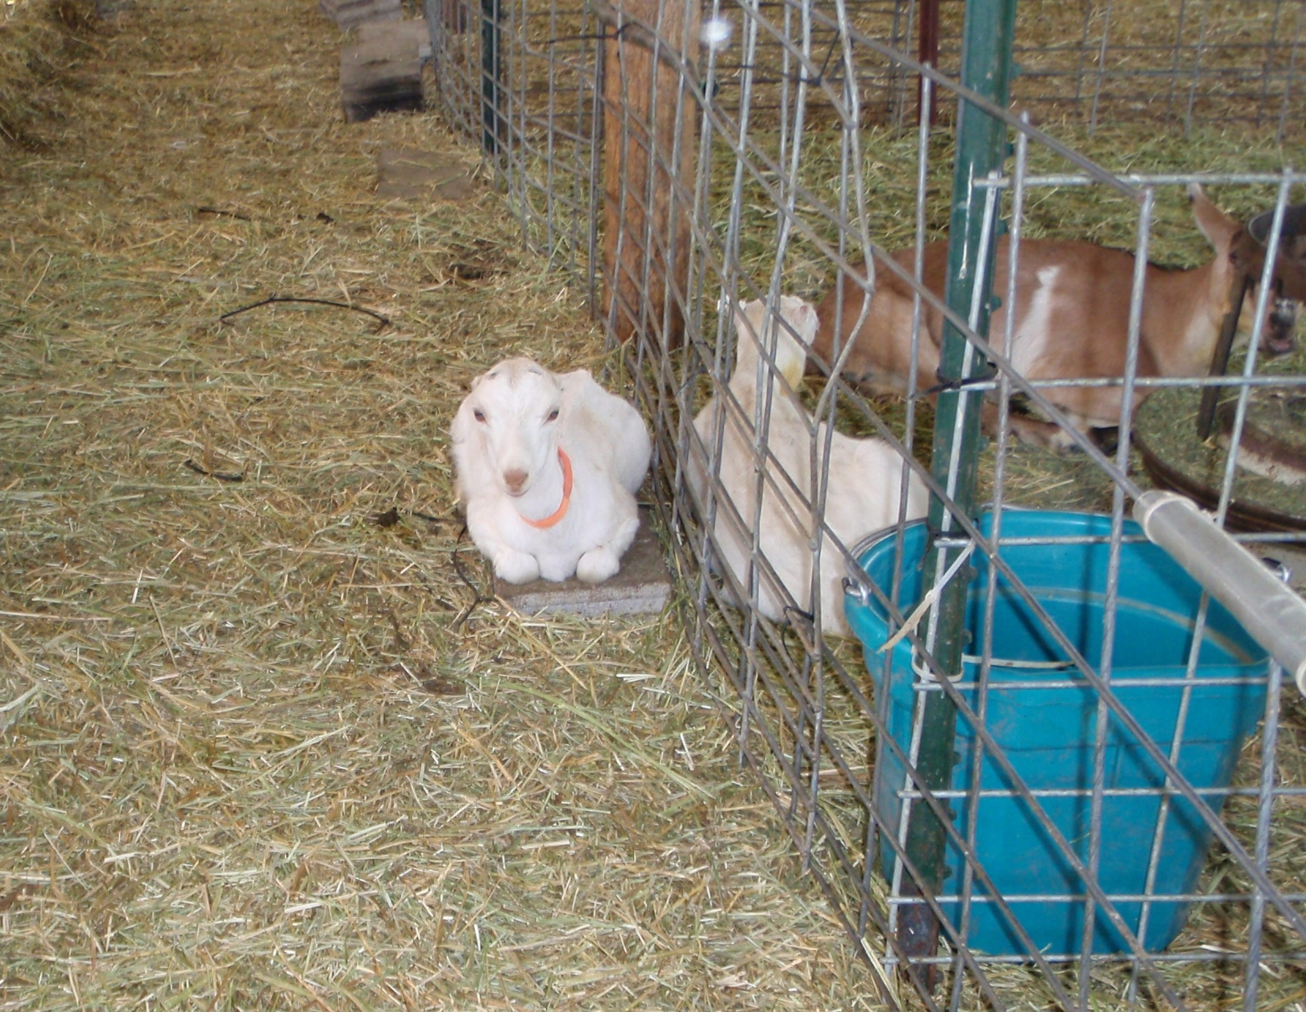
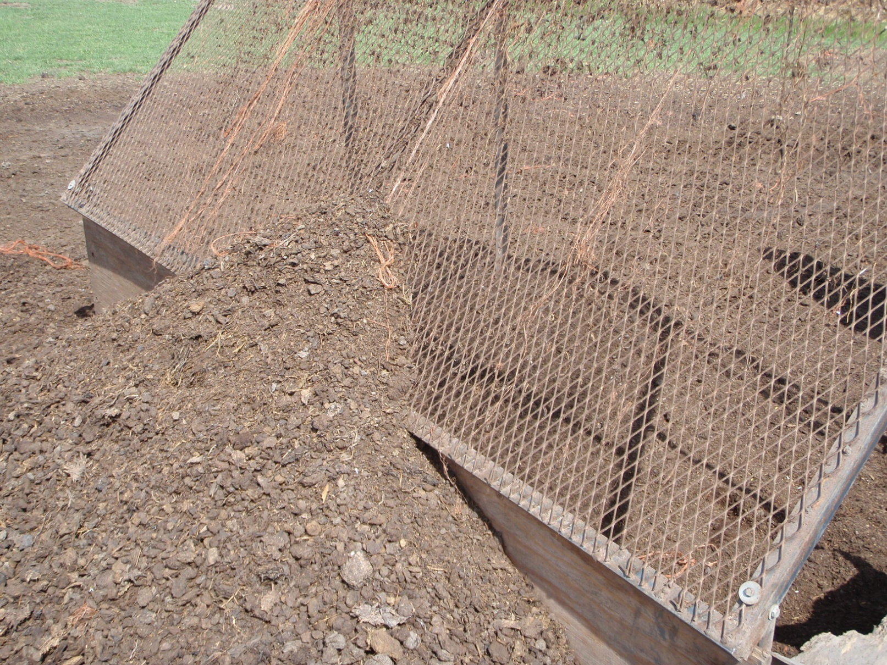
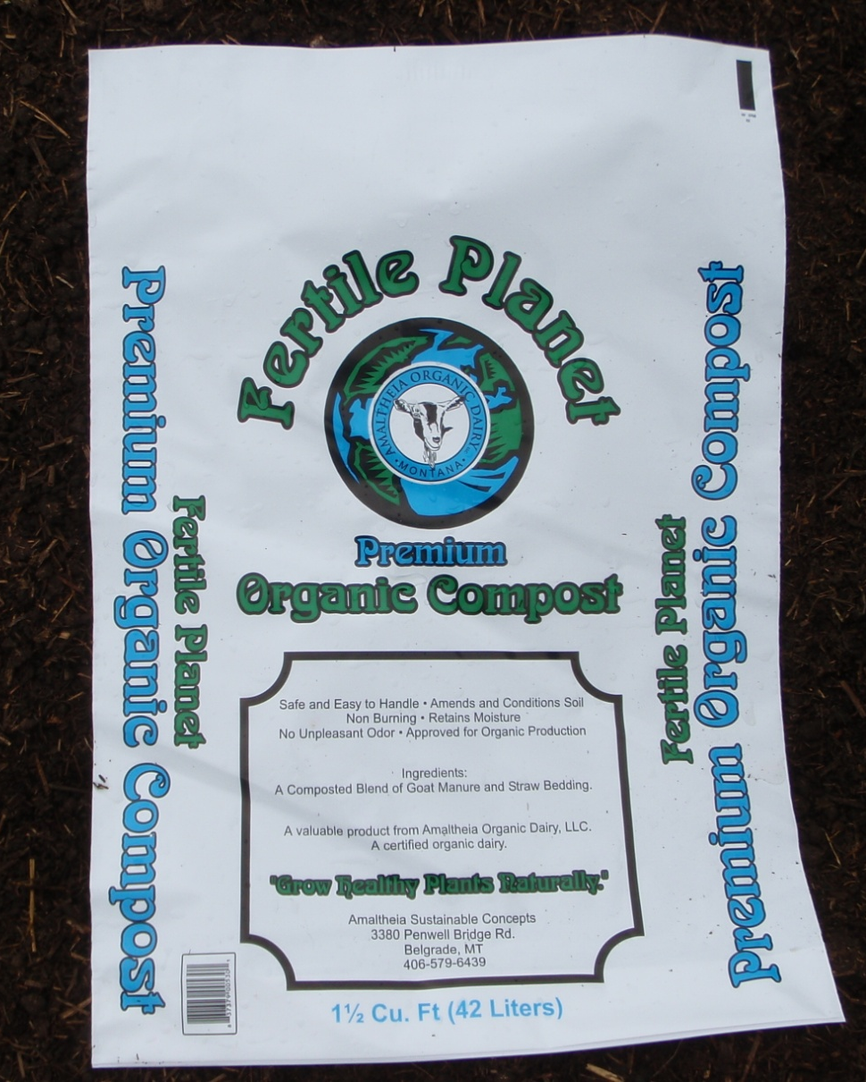
Manure Composting: A Value Added Product for Livestock Producers
G. Nathan Brown, Producer, Amaltheia Organic Dairy LLC, Belgrade, Montana
Thomas M. Bass, Livestock Environment Associate Specialist, Montana State University Extension
Joel Schumacher, Agricultural Economics Associate Specialist, Montana State University Extension
Background: Amaltheia Organic Dairy LLC is a family-run diversified operation that primarily produces artisan goat cheeses, solely from their own milk goat herd (figure 1.). Amaltheia operates its own cheese plant and markets to local grocers, specialty grocers, and restaurants; Amaltheia also produces organic free-range pork. They are able to feed whey, a byproduct of cheese production, as part of the hog diet. As part of their manure management, Amaltheia has been composting manure from the goat lots. This compost is sold locally. Amaltheia also uses some of this material for their own organic farm ground and for organic-transition farm ground in the area.
Amaltheia’s Compost Production: Goat lots, pens and barns are seasonally cleaned in the fall. The material is a mix of manure and carbon based bedding material. Windrows are built with a dump truck and manure spreader and then shaped with a skid-steer loader. The windrows are turned several times in the fall to achieve and maintain desired temperatures before winter. The process is largely dormant and unmanaged during the Montana winter. In late spring, the windrows are worked again, temperatures come back up and the process is completed over the summer.
To prepare a consumer friendly product, the compost is screened (figure 2.) and piled into finished rows. This material will be sold over the coming year, especially in the early summer at the start of gardening season. Compost is marketed in bulk for pick-up or delivery. Additionally, a small amount is bagged (figure 3.) for home garden consumers and sale at local markets. An economic analysis has been conducted to examine time and labor required to produce the compost, and to determine the revenue potential of the different marketing strategies.
Table 1. Compost Production Cost and Profit
Method/Market | On Site Bulk | Delivered Bulk | Delivered Bagged | Spread Raw Manure
Total Production Cost per Cubic Yard | $7.58 | $13.56 | $26.59 | $5.44
Current Wholesale per Cubic Yard | $25.00 | $35.00 | $45.00 | n/a*
Current Profit per Cubic Yard | $17.42 | $21.44 | $18.41 | n/a*
*offset in purchased fertilizer, ie: savings, may represent a value to producer
Composting Basics: Composting is an aerobic microbial process that converts organic matter into a stabilized product. Manure (nitrogen source) and high carbon materials, such as sawdust, straw, or crop residues are mixed and formed into piles or windrows. A carbon to nitrogen ratio (C:N) of 25:1 or 30:1 is ideal, with a moisture content in the range of 45% to 55%. In some climates, especially arid western regions, maintaining proper moisture may require adding water. For an outside windrow or stockpile, direct precipitation can often provide for adequate moisture levels. In humid climates, leaching and run-off can be a problem; this may require covering or other stormwater controls to preserve environmental quality.
Summary: Amaltheia Organic Dairy, LLC, has demonstrated over the last five years that profit can be made on compost exports. The data shown here gives the first detailed analysis of actual cost of production and profit potential. The operation was able to start composting with equipment already owned and in service by the business. Additionally, it is assumed that much of this success is due to the location of Amaltheia Organic Dairy; the dairy is within 10 miles of an urban center with a high population of gardeners and small acreage urban-fringe land owners.
The detailed analysis of production costs will hopefully lead to identifying efficiencies to improve profit margins. It is also recommended that Amaltheia calculate the value of their manure as a fertilizer resource for their own farm ground. Any producer that is considering compost as a money making venture must understand that it is essentially another enterprise within the business. Additionally, markets must be identified and compost purchasing contracts should obtained prior to the start of large scale composting.
Labor and Economics: The cost to produce compost was based on labor and equipment logs kept by the producer for the 2009/2010 composting season. Standard formulas for equipment operation costs were used, as was a hourly labor rate of $12. Labor included production and delivery times when appropriate. Producing compost for: onsite bulk sale cost $7.58/cubic yard , delivered bulk sale cost $13.57/cubic yard , delivered bagged sale cost $26.59/cubic yard . Regardless of the fertilizer value gained for the farm, land applying raw manure cost approximately $5.44/cubic yard (Table 1.). All four options include the fixed cost of $4.07 for pen cleaning, which must be done regardless of the fate of the manure and bedding. Per unit (cubic yard) profits are also shown in Table 1. and range from $17.42/ cubic yard to $21.44/cubic yard.
Temperature and Turning: The best results occur with an internal pile temperature between 105 and 150 degrees F. To destroy most pathogens, 131 degrees F should be reached in the first few days and maintained for 72 hours. Similarly, most weed seeds are destroyed above 145 degrees F. Temperatures greater than 160 degrees F will inhibit the microbial activity and can lead to combustion. Turning piles every few days in the beginning and weekly afterwards will oxygenate the piles, and accelerate and enhance composting. Additionally, all producers who decide to compost will also experience a period of trial and error, in which they work out the nuances of their situation relative to general guidelines.
Figure 1.
Figure 2.
Figure 3.
Department of Animal and Range Sciences
Animal Biosciences Building MSU - Bozeman, Montana 59717
www.animalrangeextension.montana.edu

