Slide 1



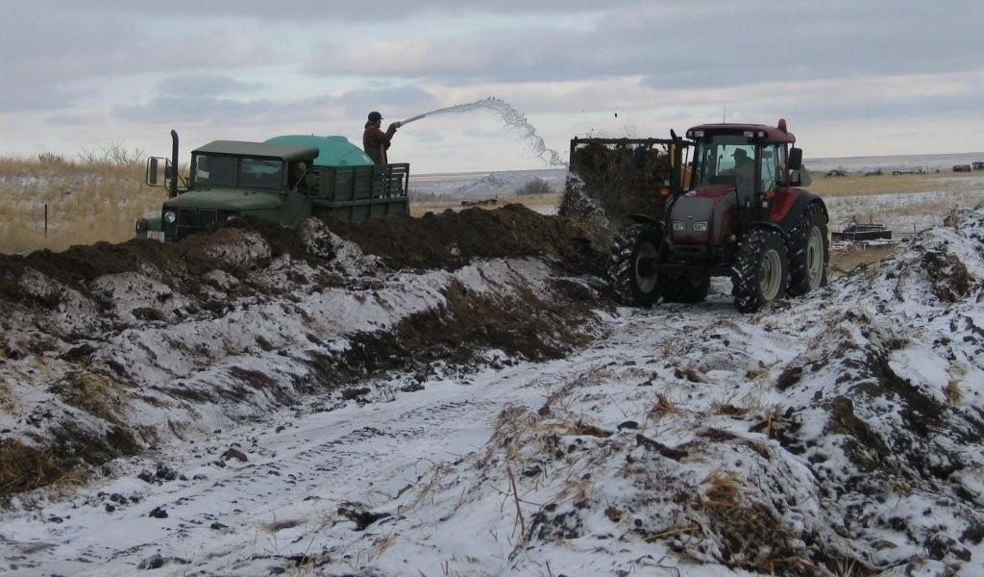
# 47156
Determining the viability of composting on-farm feedstuffs and animal waste in northern Montana
J. M. Dafoe¹, T.M. Bass², J. Schumacher² and D. L. Boss¹
¹Montana State University, Northern Agricultural Research Center, Havre, MT 59501
²Montana State University, Bozeman, MT 59717
Abstract
The objective of this demonstration project was to examine the technical and economic viability of composting in northern Montana during winter months. Composting occurred at Northern Agricultural Research Center in November and December of 2008 and 2009. The compost consisted of cattle manure/bedding material, wheat straw, and spoiled corn silage. Windrows were constructed in 2008 (W1 and W2) and 2009 (W3, W4 and W5) on a flat clay loam soil. Moisture content of the blend was analyzed at the beginning and windrows were irrigated until 50% was achieved to optimize aerobic composting. The compost was turned, with an elevating face Vermeer compost turner, twice weekly. A 90 cm probe with data logger was utilized to record internal temperatures and oxygen levels of the windrows. Ambient temperature readings were recorded daily. Maximum and minimum mean daily ambient temperatures in 2008 were 6.9 and -31.1°C, respectively. In 2008, W1 and W2 reached a high temperature of 60.6±3.97°C 7 d after irrigation and 63.6±4.55°C 9 d after irrigation, respectively. Core temperatures in W1 and W2 exceeded 40°C 120 and 24 h after irrigation, respectively. Core temperatures remained above 40°C for day 26 and 30 d. In 2009, maximum and minimum mean daily ambient temperatures during the study were 10.0 and -33.3°C. High temperatures in W3, W4, and W5 were reached on d 10, 4, and 5 after irrigation (52.9±6.16, 65.7±3.36, 67.6±7.95°C), respectively. Temperatures exceeded 40°C immediately after irrigation in W4 and W5 and 5d after irrigation in W3. Core temperatures remained above 40°C for 14, 25, and 25 d. Even though the minimum ambient temperature reached -31.1°C, there were no lasting negative effects on the composting process. During the coldest periods the core temperatures remained above 35°C. Costs were tracked for cleaning the pens ($2.10/yard), composting ($4.74/yard) and spreading manure or finished compost ($1.14/yard). It was determined that composting is a technically viable option in northern Montana.
Key words: Compost, Animal Waste, Beef
Introduction
The current model of animal feeding relies heavily on imported nutrients in the form of feed, replacement stock, and commercial fertilizer. Nutrient exports are primarily represented by animals, food, fiber or crops sold, and sometimes exported manure. However, animal feeding operations (AFOs) often have a positive nutrient balance; i.e.: more nutrients than they can use. Additionally, long term land application of manure based on nitrogen rates can result in high soil phosphorus, thereby restricting manure use until phosphorus levels can be reduced through crop harvest and export. It may take many years to draw down soil phosphorus levels in this manner.
The nutrient management planning process can identify an operation’s nutrient balance. Many AFOs may be in need of manure management options that not only focus on agronomic use of manure on-site, but also manure export to other enterprises. In 2010 MSU Extension, the Montana Agricultural Experiment Station, and a private custom manure services company identified and tested markets for exporting compost and raw manure within the region. Transportation distances varied; a separate aspect of these case studies will examine economics. The initial work simply identified and worked with introducing regional manure resources to users external to AFOs. The objective of this demonstration project was to examine the technical and economic viability of composting in northern Montana during winter months.
Figure 2. Oxygen levels of two compost windrows (W1 and W2) in November and December Water addition took place on December 3 and 5, 2008.
Figure 4. Oxygen levels of three compost windrows (W3. W4, and W5) in November and December.
Results and Discussion
Maximum and minimum mean daily ambient temperatures for the 47 d trial in 2008 were 6.9⁰C and -31.1⁰C, respectively. From the beginning of the trial to when the windrows were irrigated (d 16 and 14, respectively) no composting or aerobic activity was occurring evidenced by the low temperatures (mean temp W1 and W2; Figure 1) and high oxygen levels (Figure 2). After irrigation, aerobic bacteria immediately began digesting the feedstocks within the windrows, evidenced by the rapid increase in temperature and decrease in oxygen (Figures 1 and 2). Maximum and minimum mean daily ambient temperatures for the 34 day trial in 2009 were 10.0⁰C and -33.3⁰C respectively. In 2009 aerobic composting immediately commenced upon blending and the initiation of regular turnings as evidenced by high temperatures (Figure 3) and decreasing oxygen level (Figure 4). In both 2008 and 2009 oxygen levels consistently returned to 20% immediately after aerating the windrows, however within 24 h of turning, oxygen levels < 2% were observed. The consistent drop in oxygen levels indicates a very rapid aerobic digestion of feedstocks and available oxygen in all windrows across both 2008 and 2009. Windrow 1 and W2 reached a high temperature of 60.6⁰C 7 d and 63.6⁰C 9 d after irrigation, respectively. High temperatures in W3, W4 (65.7°C), and W5 (67.6°C) were reached on d 10, 4, and 5 after irrigation, respectively. Temperatures exceeded 40°C immediately in W4 and W5 and 5 d after irrigation in W3. Core temperatures remained above 40°C for 14 d for W3 and 25d for both W4 and W5. Oxygen levels below 5% result in anaerobic conditions within the windrows, and oxygen becomes the limiting factor (Trautmann et al, 1996), hence the requirement for such frequent turning of the windrows in this trial for both 2008 and 2009.
Composting systems can achieve a significant reduction of pathogens when the compost is maintained at minimum operating conditions of 40°C for 5 d, with temperatures exceeding 55°C for at least four hours of this period (Trautmann et al., 1996). Core temperatures within this trial remained above 40⁰C for 26 d in W1 and 30 d in W2 (Figure 1) and 14 d in W3, 20 d in W4 and 20 d in W5. Even though the minimum ambient temperature reached -31.1⁰C and -15.4⁰C in 2008 and 2009 respectively, there appeared to be no lasting negative effect as the compost was able to maintain and generate appropriate optimum temperatures after each turning. For windrow composting methods, maintaining 55⁰C for 15d is sufficient to destroy weed seeds (Trautmann et al, 1996; Wilen, 1997). Once the temperature of the windrows maintain 55⁰C, the environment in compost windrows have sufficient moisture and temperature to break dormancy of hard seeds followed by thermal kill of seedlings (Egley, G.H., 1990). During the coldest periods of the experiment, ambient temperature was <-17⁰C for 6 d in 2008 and <-12⁰C for 4 d in 2009; core temperatures remained above 35, 47, 36, 47, and 50⁰C in W1, W2, W3, W4, and W5 respectively.
Labor and equipment usage were recorded for each step of the composting project. Costs were based on $12/hour labor and estimates of actual equipment costs, fuel usage and economic depreciation for machinery. Results indicate that cleaning pens cost $2.10/yard (of finished compost produced), composting cost $4.74/yard and applying the finished compost to agricultural land cost $1.14/yard. The value of the compost is determined to be highest value of these possible uses. First, the compost value determined by the price at which it could be sold to an off farm customer (landscaping, land applications, gardeners). Second, the value determined by the reduced amount of commercial fertilizer applied due to the nutrients supplied by the compost. Third, the value determined by the increased productivity of land that would not have otherwise received a fertilizer application. This project estimated the cost of compost production but did not estimate the value of the compost produced due to the wide variation in compost value.
Implications
Composting is a viable option at any time in the semi-arid region of Northern Montana. In this trial the most important factor was to reach appropriate moisture content (>35%) after blending the carbon and nitrogen sources to initiate the composting process and further research is planned.
Materials & Methods
Composting occurred in November and December of 2008 and 2009. In 2008, the compost consisted of 163.3 t of dried cattle manure and bedding material from a permitted feedlot, 38.1 t of wheat straw, and 38.1 t of year-old spoiled corn silage to bring the carbon:nitrogen (C:N) ratio to a calculated value of approximately 30:1. The C:N ratio was within the recommended optimum range for US composting guidelines. In 2009, compost consisted of 180.5 t of dried cattle manure and bedding material from a permitted feedlot and 20.2 tons of wheat straw and corn stalks from NARC.
The compost was turned with an elevating face compost turner (CT-670, Vermeer, Pella, IA) twice weekly, weather permitting. A 90 cm data logger (Windrow Manager, Green Mountain Technologies, Bainbridge Island, WA) was placed into the windrows 3 times weekly to record internal temperature and oxygen levels of each windrow at a depth of 45 and 89 cm. After initial readings, water was added to W1, W2, and W5 as it was being turned bringing the moisture content for each windrow to approximately 50% (5 was already over 50%). Grab samples of each windrow were taken and samples were tested at the beginning and end of the composting period to test for maturity of the compost.
Figure 3. Mean core temperatures of three compost windrows (W3. W4, and W5) in November and December 2009.
Figure 1. Mean core temperatures of two compost windrows (W1 and W2) in November and December 2008. Water addition took place on December 3 and 5, 2008.

