Slide 1
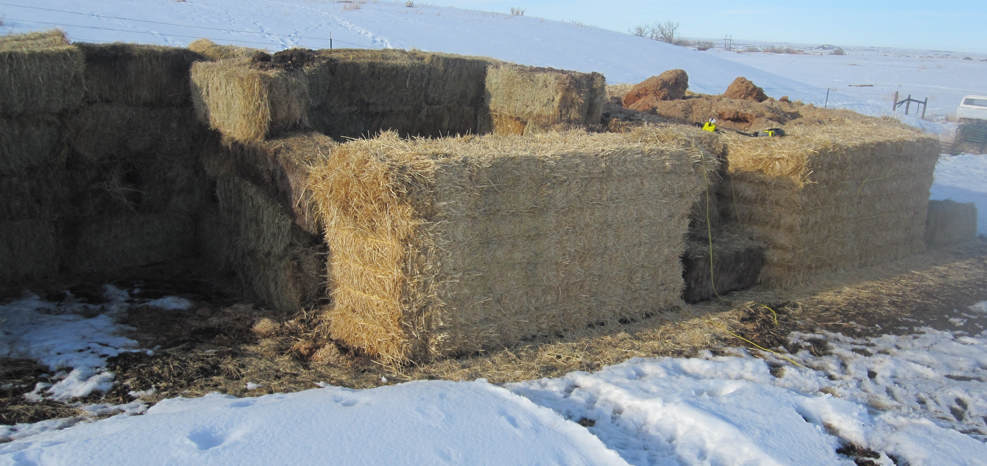
# 47158
Determining the viability of beef cattle mortality composting in northern Montana
J. M. Dafoe¹, T.M. Bass² and D. L. Boss¹
¹Montana State University, Northern Agricultural Research Center, Havre, MT 59501
²Montana State University, Bozeman, MT 59717
Abstract
The object of this demonstration project was to determine the viability of composting mortalities in northern Montana, which is characterized as a cold semi-arid environment. Mature cows (n=3) were composted in individual bins (B1, B2 and B3) and calves (n=11) were composted in two bins (B4 and B5) containing multiple calves. The animals that were composted included calving losses from the 2010 calving season and animals euthanized according to best management practices for animals that were unsalvageable. The bins for the mature cows were constructed with 4 large straw square bales (0.91 x 0.91 x 2.44 m). Bins were constructed in February, 2010 at Northern Agricultural Research Center on flat clay loam soil surface and composting continued through March 2011. Sawdust was used as a base material (approximately 45 cm) for moisture retention and to prevent runoff, the animal was then placed on the base material, covered with year old spoiled corn silage and capped with a layer of sawdust. The bins were recapped with sawdust as needed. The bins for the calves were constructed using small square straw bales (45 x 45 x 91 cm) on three sides and a large square straw bale on one side, base and fill material were the same as used in the cow bins. Calves were placed in the bins as mortalities occurred and then covered with year old spoiled corn silage. Once the bin was full it was capped with sawdust and another bin was constructed. No predator, nuisance or domestic animal disturbance was observed. Very little insect and fly activity was observed. The maximum temperature for B1, B2, B3, B4 and B5 was 65.7±1.72, 63.5±2.84, 64.8±4.00, 70.4±1.10, 68.1±2.33°C occurring 22, 7, 32, 22, and 32 d after mortality was placed in bin, respectively. All bins containing mature cows reached 40°C temp 24 hours after construction. Bins containing calves reached 40°C 9 d after construction. Bins were excavated at 130 d and no soft tissue remained only skeletal structures and hair. Additional work is planned; however it appeared that large domestic animal composting can occur in northern Montana.
Keywords: Mortality Compost, Beef
Introduction
Disposal of agricultural mortalities is becoming of great concern to both the industry and the general public. Appropriate disposal methods may include incineration, burying the carcass (at least six feet deep, yet above seasonal high ground water, and sufficiently far away from water sources to prevent contamination), and transporting the animal to a certified rendering facility or landfill. All these options are expensive and very time consuming in much of Montana and the Northern Great Plains. For permitted confined animal feeding operations (CAFO), management plans must be in place to appropriately dispose of the animals. These plans include appropriate distances from water sources, and plans if a pandemic crisis reaches the feeding operation. Abandonment in a desolate area on the farm or ranch is no longer an appropriate manner of disposing of domestic animals. The objective of the demonstration trial was to investigate the potential to dispose of beef cattle mortalities of various ages and sizes in Northern Montana, and to provide educational opportunity regarding the practice. If Montana’s semi-arid, cold environment can support mortality composting, best management plans for producers in the Northern States can be developed and prepared for mortalities or pandemic events as a viable management option. Although it is not recommended to sell or export compost derived from the mortality composting process this material can be reused in composting future mortalities. Some targeted land application on the site of origin could be considered.
Materials & Methods
Bins were constructed in the winter of 2010 at Northern Agricultural Research Center (NARC), near Havre, Montana on flat clay loam soil surface protected from storm water run-on. The animals that were composted included calving losses from the 2010 calving season and animals euthanized according to best management practices for animals that were unsalvageable (no animals were euthanized solely for the purposes of the demonstrated research). As death losses occurred, mature cows (n = 3, average wt = 904 kg) were composted in individual bins (B1, B2 and B3) and new born calves (n = 11) were composted in two bins (B4 and B5) containing multiple calves. Mature cows consisted of multiple breeds, including one Hereford, one Angus and one Simmental cross bred cow but were from the same herd. The bins for the mature cows were constructed with four large straw square bales (0.91 x 0.91 x 2.44 m). Bins were constructed in February, 2010 and composting continued in the bins relatively undisturbed through March 2011. Sawdust was used as a base material (approximately 45 cm) for moisture retention and to prevent runoff, the animals were then placed on the base material, covered with year old spoiled corn silage and capped with a layer of sawdust. The spoiled silage is used to provide a carbon based substrate and biologically active material. The bins were recapped with sawdust as needed throughout the 12 month period. The bins for the calves were constructed using small square straw bales (45 x 45 x 91 cm) on three sides and a large square straw bale on one side, base and fill material were the same as used in the cow bins. In this project bins were constructed; however, mortality composting has occurred in non-contained windrows. It is believed predator/scavenger disturbance may be more likely in non-contained windrows. Calves were placed in the bins as mortalities occurred and then covered with year old spoiled corn silage. Once the bin was full it was capped with sawdust and another bin was constructed in preparation for future mortalities that could occur. A 90 cm data logger (Windrow Manager, Green Mountain Technologies, Bainbridge Island, WA) was placed into the bins monthly to record internal temperature and oxygen levels of each windrow at a depth of 45 and 89 cm. Mortality composting is static, meaning the bins or windrows are not turned at regular intervals as they are in conventional composting. Aeration occurs passively, and some pockets of anaerobic decomposition occur; over time, the system shifts between aerobic and anaerobic composting. Turning the material after a 3-6 month static period will re-oxygenate the mass and aid in finishing the process.
Results and Discussion
No predator, nuisance or domestic animal disturbance was observed. Very little insect and fly activity was observed. No complaints or personal observations of offensive smell were cited after capping the bins. Daily ambient maximum and minimum temperatures in February, 2010 were 5±5.3°C and -31±6.8°C while March, 2010 was 19.4±6.6°C and 18.9±5.9°C, respectively. All bins containing mature cows reached 40°C 24 hours after bin construction. Bins containing calves reached 40°C 9 d after bin construction and final capping. Indicating the conditions and substrate provided an adequate environment for initiating the composting process. Monthly internal temperatures for each bin are illustrated in Figure 1 to 5. Oxygen was never observed in appreciable levels in any of the bins indicating anaerobic composting was taking place or limited amounts oxygen was passively infiltrating the bins so oxygen measures are not included. The maximum temperature for B1, B2, B3, B4 and B5 was 65.7, 63.5, 64.8, 70.4, 68.1°C occurring 22, 7, 32, 22, and 32 d after the mortality was placed in bin, respectively. Bins were excavated 130 d after beginning the mortality composting process (June 28, 2010) and no soft tissue remained, only skeletal structures and some hair. Looper et al. (2002) reported similar results at 4 m when composting manure and dairy cattle. Bins were re-closed and sealed with sawdust and left undisturbed until March 2011. Upon re-excavating in March 2011, one year from initiating the project all mortality bins contained skeletal bones. All appeared to have reached temperatures to produce a black charred appearance in direct proximity to the skeleton. Calf bones were more brittle and appeared to be more broken down by the process than the mature cow bones. The long bones of the mature cows could not be physically broken by the force of a normal sized human; however some larger long bones of the calves could easily be broken. These results are similar to other mature cow and calf compost projects (Looper et al., 2002; Xu et al, 2010, Stanford et al., 2009). The one year-old mortality compost bin materials were completely excavated and were mixed together. The blend of compost and remaining bones will be the substrate for future compost in 2011. Additional work is planned; however it appeared that large domestic animal composting can occur in northern Montana and similar climates.
Implications
Access to appropriate co-composting materials could be a barrier to implementing the practice. However, if an operation has access to free or affordable carbon material the practice is feasible and can be done with less time and equipment relative to burial on-site. The demonstrated research at NARC in Northern Montana in a semi arid environment provides educational opportunities to regional stakeholders. Additionally, winter weather conditions associated with the region did not appear to hamper the process. With proper site selection, the same area can be used season after season for mortality management in an efficient and safe manner.
Figure 1. Ambient and mean internal core temperatures of Bin 1 for a mature cow placed in a mortality bin.
Figure 3. Ambient and mean internal core temperatures of Bin 3 for a mature cow placed in a mortality bin.
Figure 2. Ambient and mean internal core temperatures of Bin 2 for a mature cow placed in a mortality bin.
Figure 4. Ambient and mean internal core temperatures of Bin 4 for new born calves placed in a mortality bin.
Figure 5. Ambient and mean internal core temperatures of Bin 5 for new born calves placed in a mortality bin.

