Slide 1
Photographic Log of Slot and Traditional Farms
Farm Season 2011

Slide 2
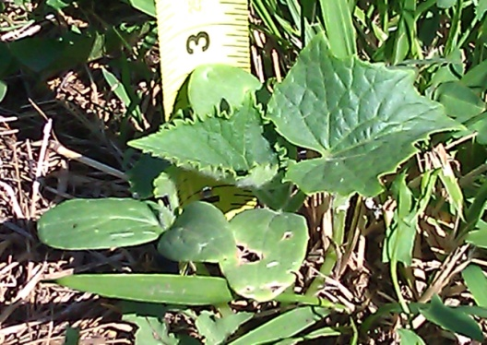
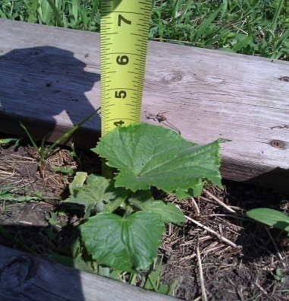
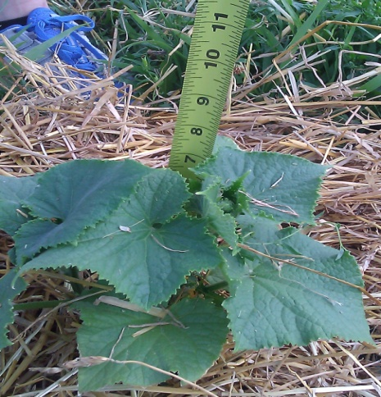
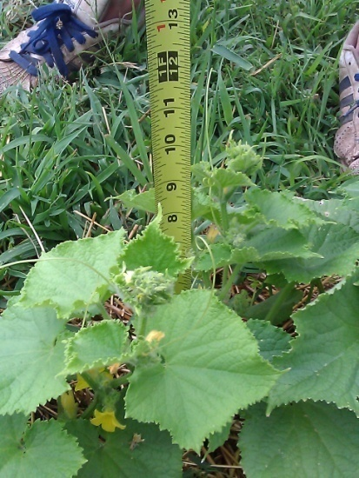
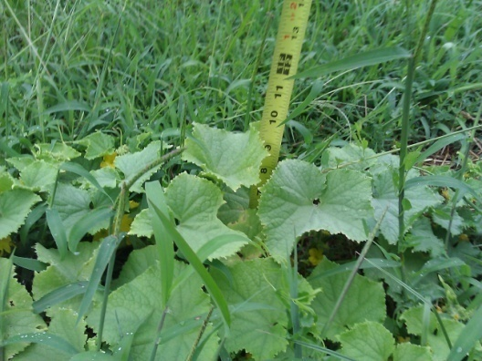
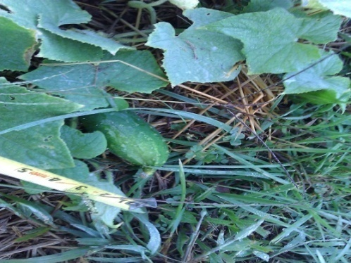
Cucumber
Slot Farm Cucumber
June 24, 2011
Slot Farm Cucumber
June 30, 2011
Slot Farm Cucumber
July 9, 2011
Slot Farm Cucumber
July 23, 2011
Slot Farm Cucumber
August 6, 2011
Slot Farm Cucumber
August 20, 2011
Slot Farm Cucumber
September 10, 2011

Slide 3
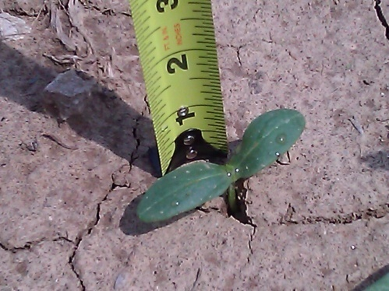
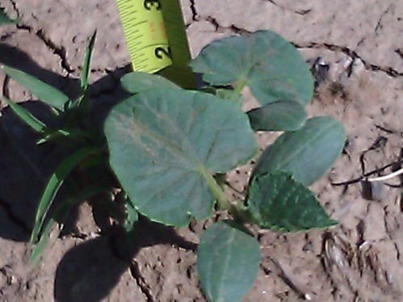
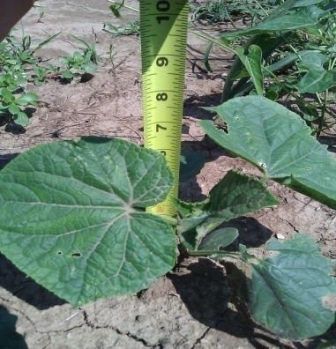
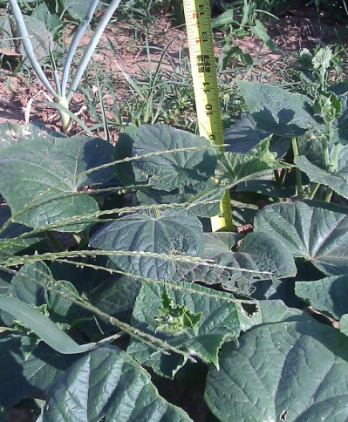
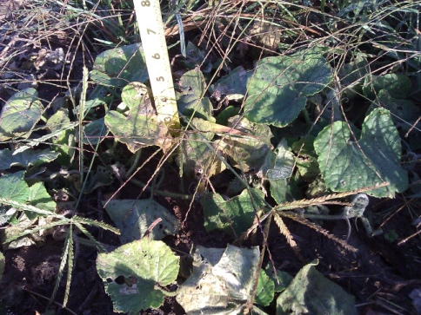
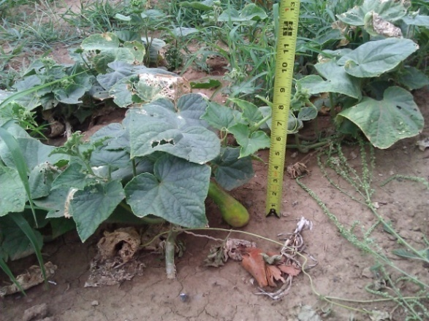
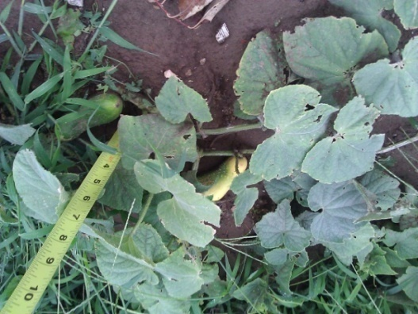
Cucumber
Traditional Farm Cucumber
June 24, 2011
Traditional Farm Cucumber
June 30, 2011
Traditional Farm Cucumber
July 9, 2011
Traditional Farm Cucumber
July 23, 2011
Traditional Farm Cucumber
August 6, 2011
Traditional Farm Cucumber
August 20, 2011
Traditional Farm Cucumber
September 14, 2011

Slide 4
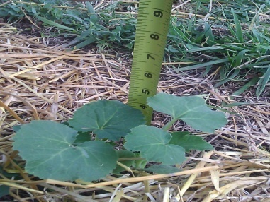
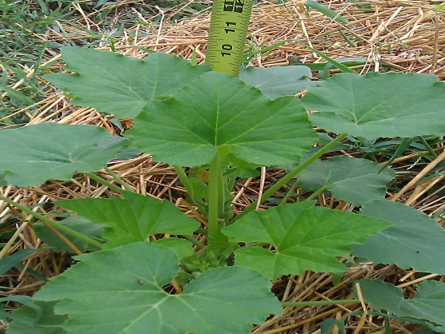
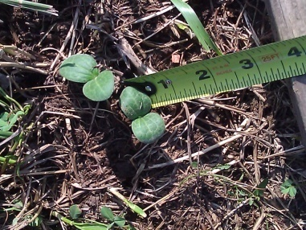
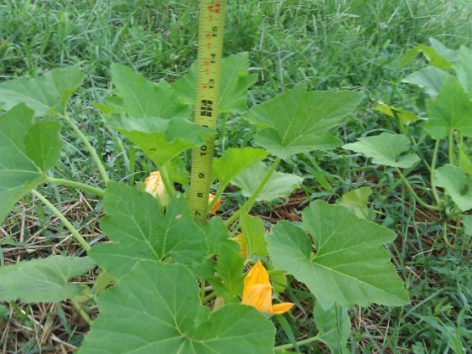
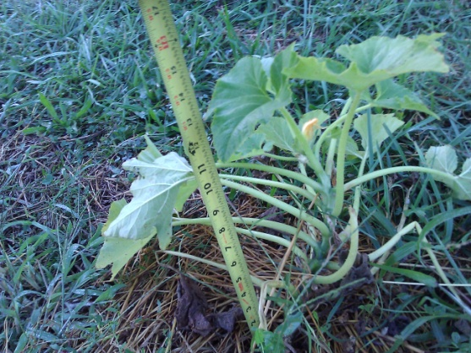
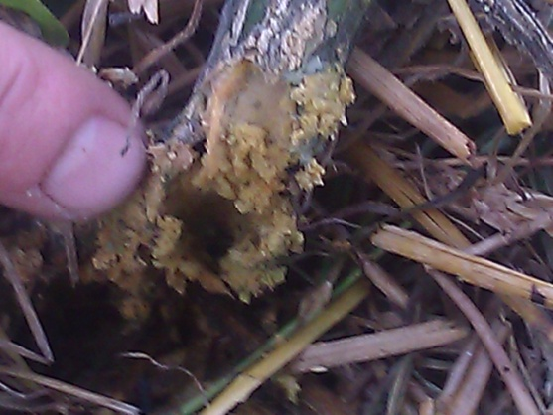
Squash
Slot Farm Squash
July 13, 2011
Slot Farm Squash
July 23, 2011
Slot Farm Squash
August 6, 2011
Slot Farm Squash
August 20, 2011
Slot Farm Squash
September 10, 2011
Slot Farm Squash
Vine Boar Presence

Slide 5
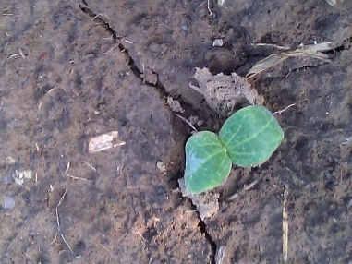
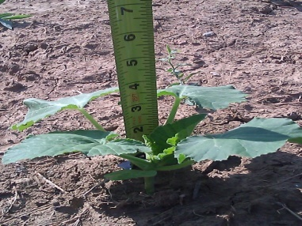
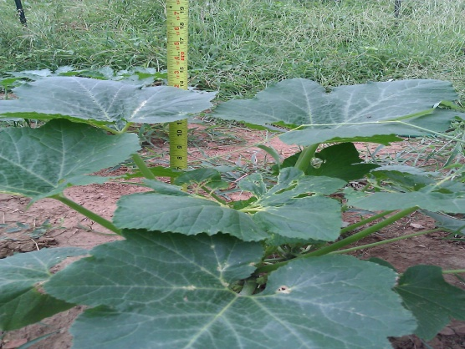
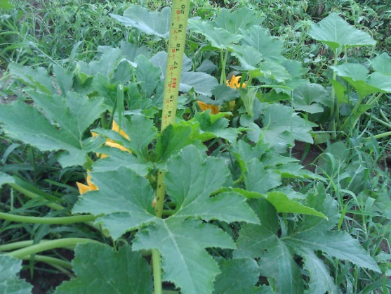
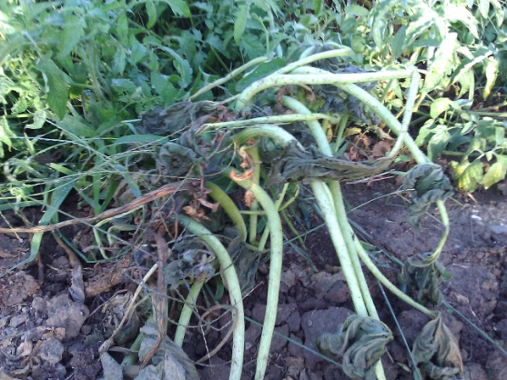
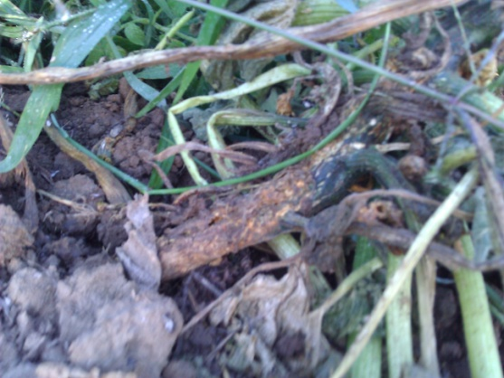
Squash
Traditional Farm Squash
July 13, 2011
Traditional Farm Squash
July 23, 2011
Traditional Farm Squash
August 6, 2011
Traditional Farm Squash
August 20, 2011
Traditional Farm Squash
September 10, 2011
Traditional Farm Squash
Vine Boar Presence

Slide 6
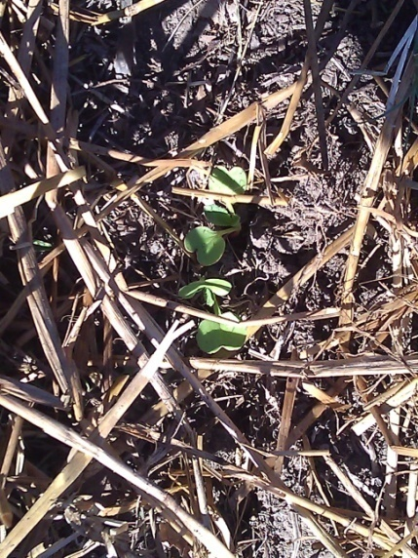
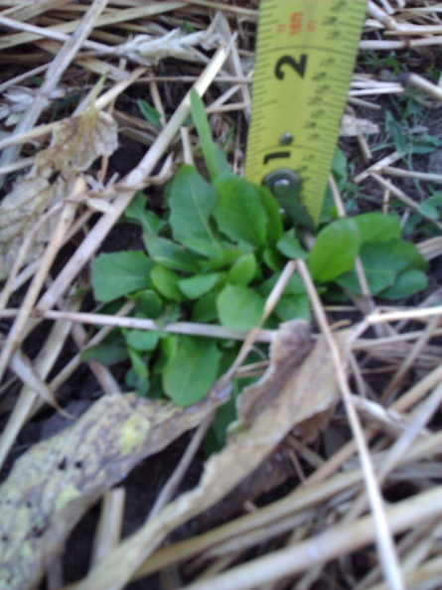
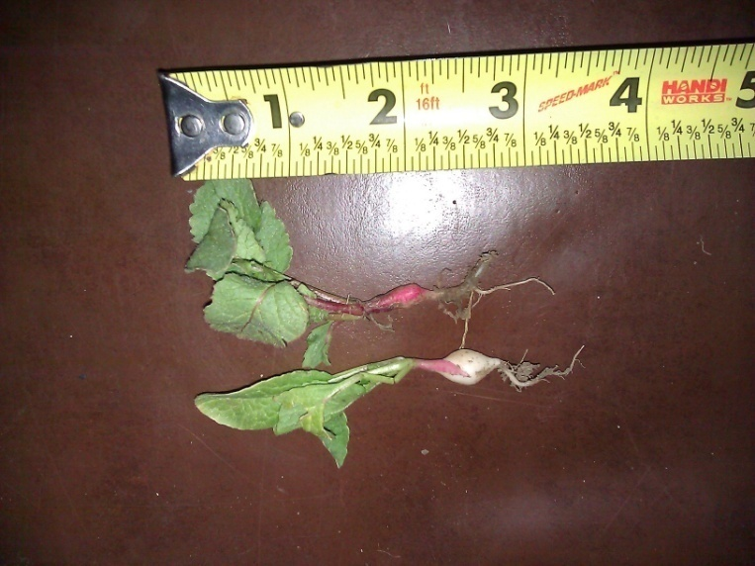
Radish
Slot Farm Radish
September 24, 2011
Slot Farm Radish
October 8, 2011
Slot Farm Radish

Slide 7
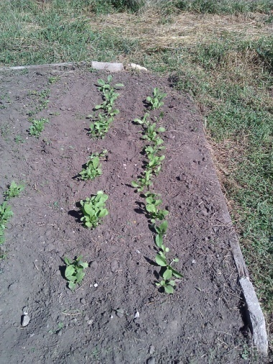
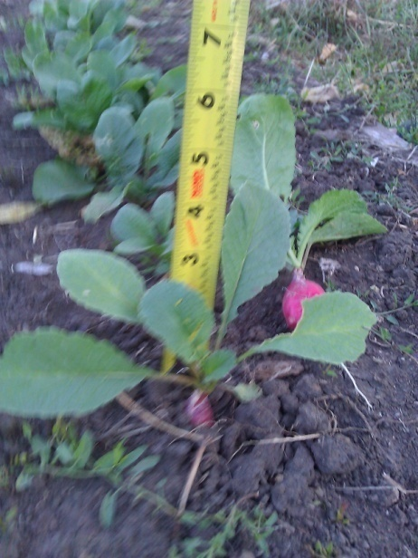
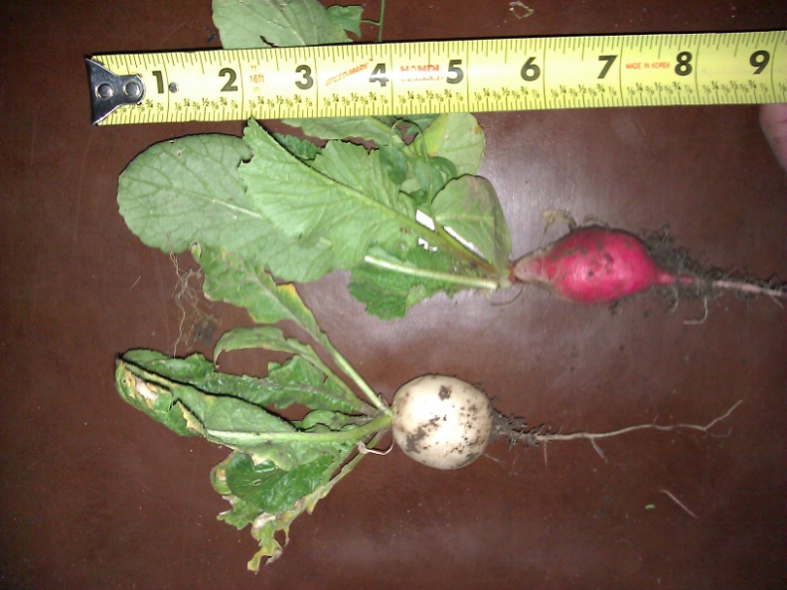
Radish
Traditional Farm Radish
September 24, 2011
Traditional Farm Radish
October 8, 2011
Traditional Farm Radish

Slide 8
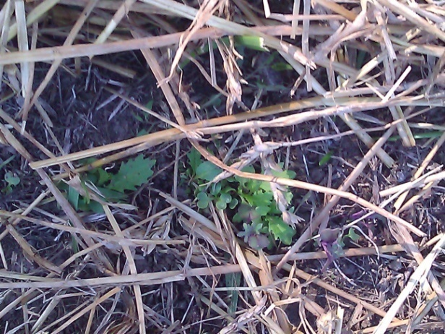
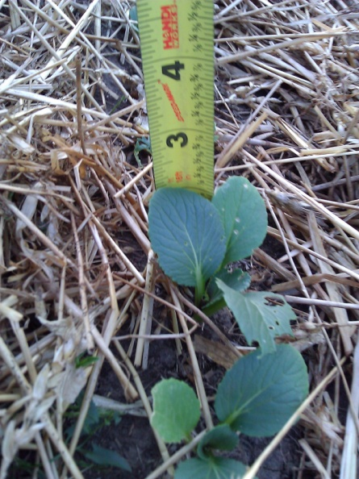
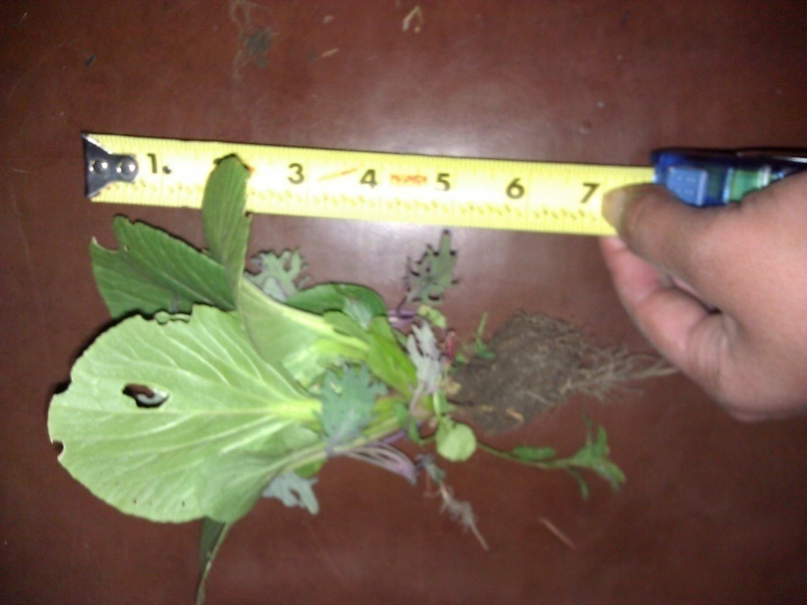
Meslcun Mix
Slot Farm Mesclun Mix
September 24, 2011
Slot Farm Mesclun Mix
October 8, 2011
Slot Farm Mesclun Mix

Slide 9
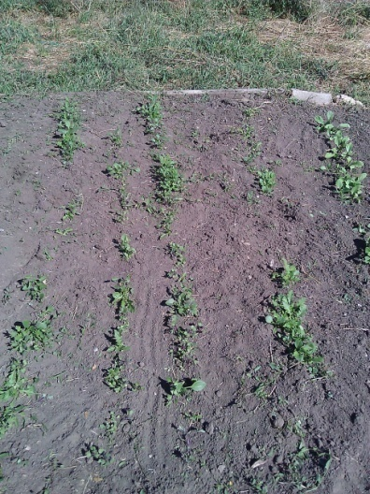
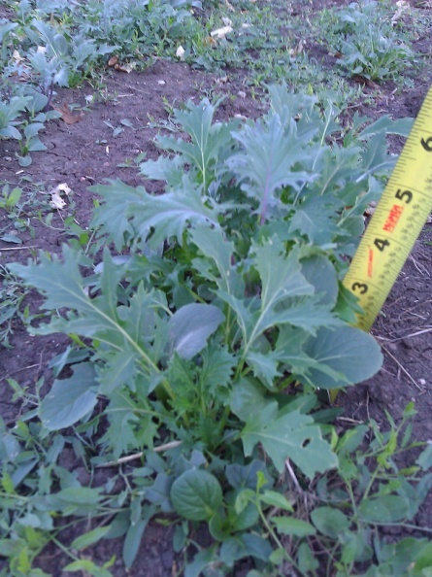
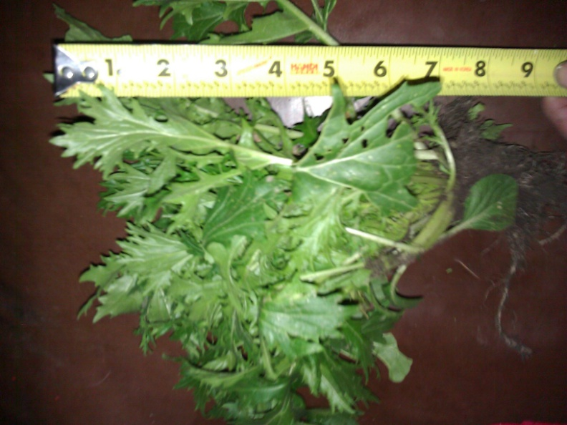
Mesclun Mix
Traditional Farm Mesclun Mix
September 24 2011
Traditional Farm Mesclun Mix
October 8, 2011
Traditional Farm Radish

Slide 10
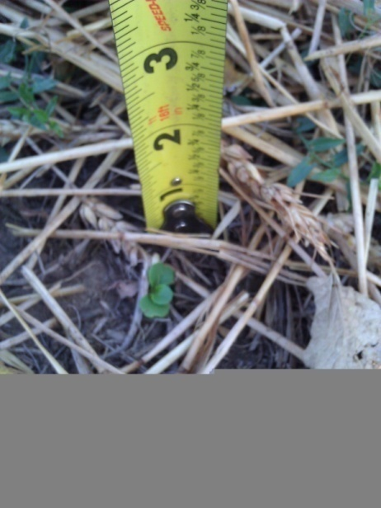
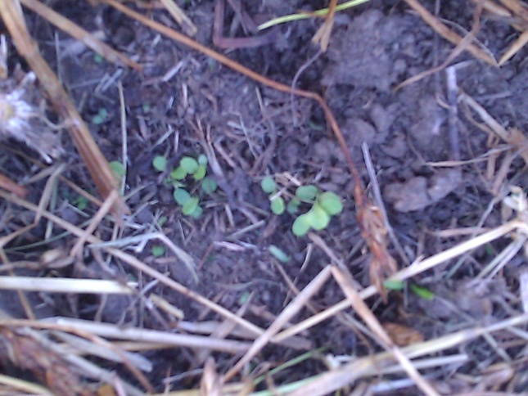
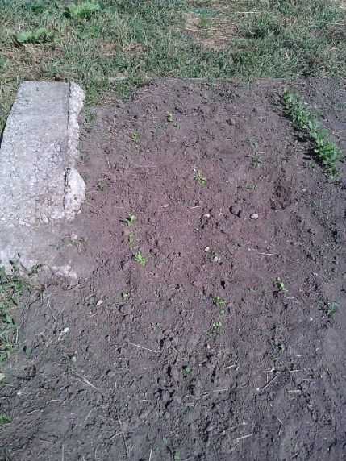
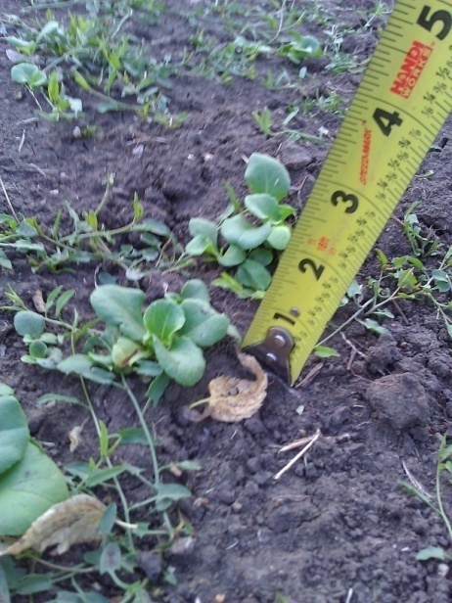
Lettuce
Slot Farm Lettuce
September 24, 2011
Slot Farm Lettuce
October 8, 2011
Traditional Farm Lettuce
September 24, 2011
Traditional Farm Lettuce
October 8, 2011

Slide 11
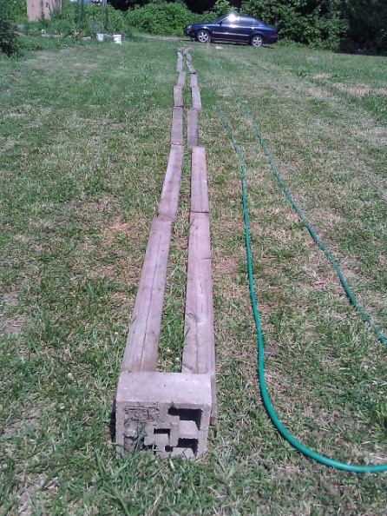
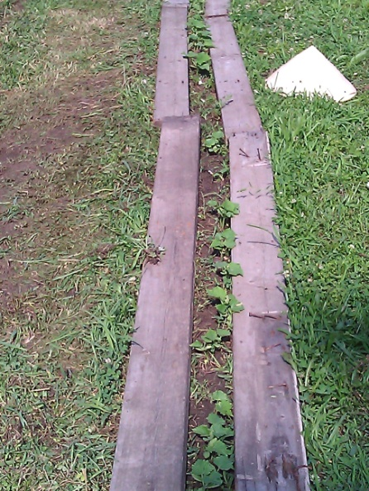
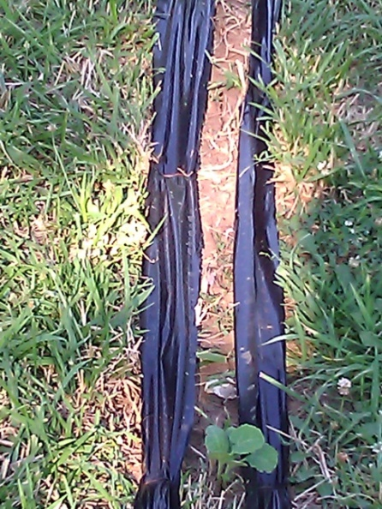
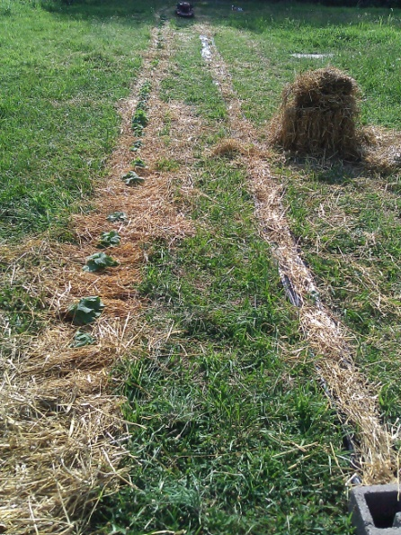
Techniques for Grass Suppression
Edging w/ Wooden Boards
Wooden
Boards
Black Sheeting
Straw

