Slide 1
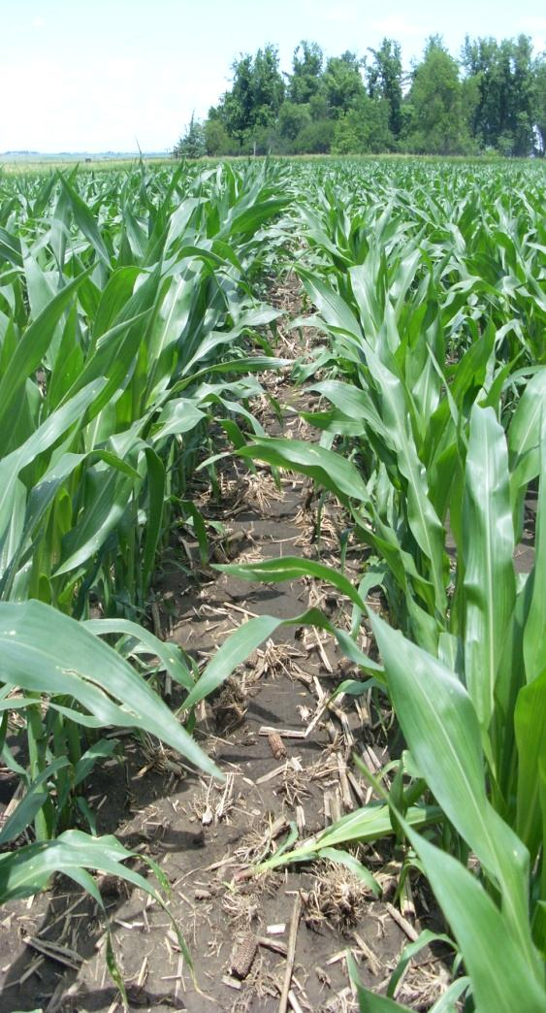
Residue Biomass Removal and Potential Impact on Production and Environmental Quality
Mahdi Al-Kaisi, Associate Professor
Jose Guzman, Research Assistant
Department of Agronomy
Iowa State University

Slide 2
Outline
Background
Project Overview
Preliminary Results
Summary and Conclusions
Background Project Overview GHG results Soil Carbon results Summary & Conclusions

Slide 3
Interest in Corn Residue for Bioethanol
90
*RFA, http://www.ethanolrfa.org/industry/statistics/#C
Gap for cellulosic ethanol to fill
75
October 2007 and 2009 capacity*
(6.9 and 10.7 billion gal)
60
45
Goal (billion gal ethanol)
**NCGA, http://www.ncga.com/ethanol/pdfs/2007/
30
Ethanol from corn grain**
15
0
2005
2015
2025
2035
Replace approximately 30% of gasoline with bioethanol by 2030
Background Project Overview GHG results Soil Carbon results Summary & Conclusions

Slide 4
Interest in Corn Residue for Bioethanol
Currently available biomass from cropland is 194 million dry tons year⁻¹
  – estimated to increase to 425 – 600 million ton*
Approximately 144 million tons from corn
  – estimated to increase to 170 – 256 million ton*
*billion-ton annual supply. 2005
*billion-ton annual supply. 2005
Background Project Overview GHG results Soil Carbon results Summary & Conclusions

Slide 5
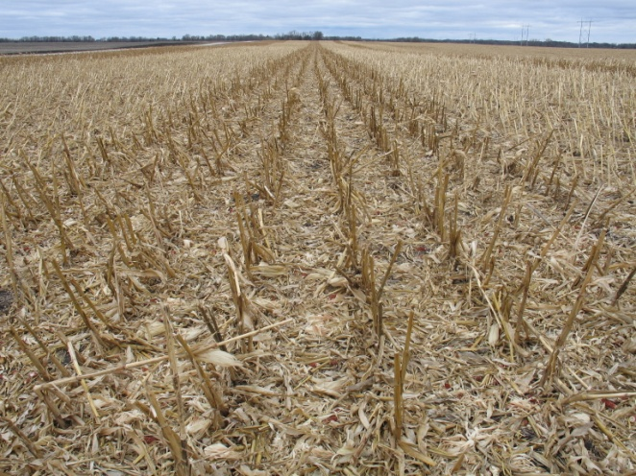
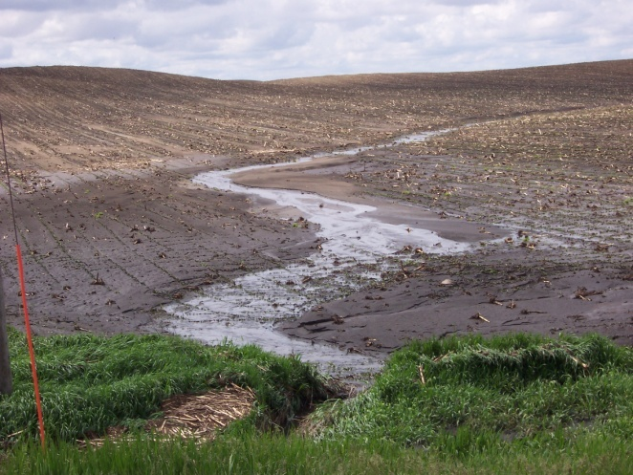
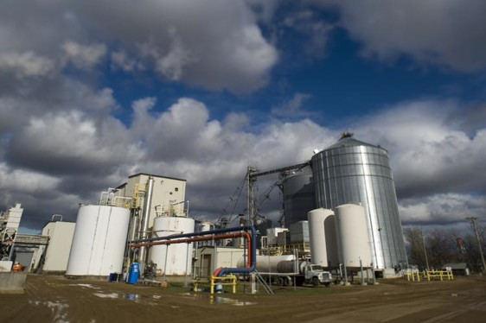
Value of Corn Residue
Environmental services
  Reduce soil erosion
  Enhance soil carbon
  Protect water quality
  Source of Nutrients
  Wild life habitat
Renewable energy feedstock
  428 million ton from crop residues*
Background Project Overview GHG results Soil Carbon results Summary & Conclusions

Slide 6
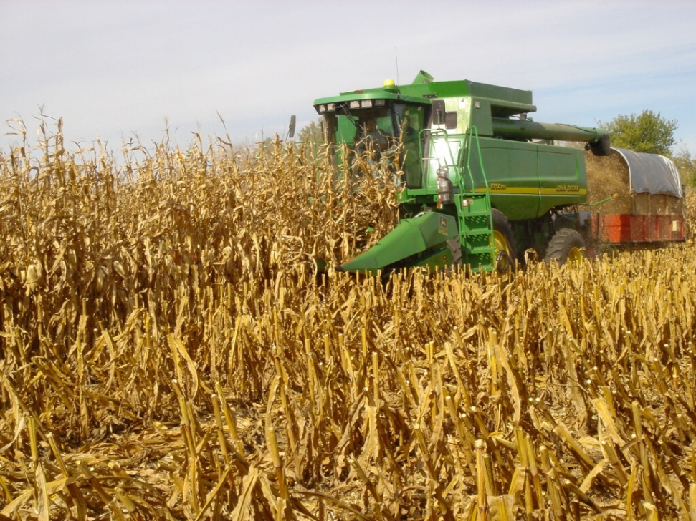
Corn Residue Removal Concerns
Research Findings:
Decline of soil C source
Decline of soil quality
Removal of soil nutrients source
Acceleration of soil erosion risk
Long-term potential reduction of productivity
Background Project Overview GHG results Soil Carbon results Summary & Conclusions

Slide 7
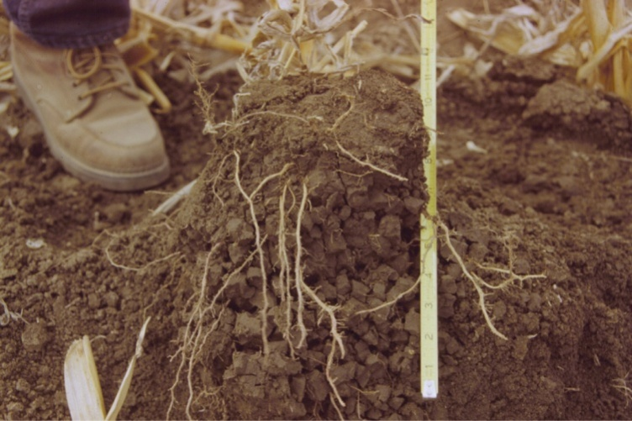
Benefits of Soil Organic Carbon
  Physical Effects: Soil aggregation, bulk density, erosion, drainage
  Chemical Effects: Cation exchange capacity, metal complexing, buffering capacity, supply and availability of N, P, S, and micronutrients
  Biological Effects: promotes bacteria,
  fungi, actinomycetes, earthworms, roots,
  and other microorganisms.
Background Project Overview GHG results Soil Carbon results Summary & Conclusions

Slide 8

Research Question
What are the appropriate level(s) of residue removal and management practices needed to sustain productivity and protect soil quality?
Background Project Overview GHG results Soil Carbon results Summary & Conclusions

Slide 9
Goal & Objectives
Goal of this project is to establish coordinated field studies to determine residue removal effect on the following
Grain Yield
Nutrient cycling, and crop biomass production
Soil C and N sequestration potential with
different residue management practices
3) Estimation of GHG emissions from soil
4) Impacts on soil quality indices
Background Project Overview GHG results Soil Carbon results Summary & Conclusions

Slide 10
Background and Study Description
Sites History:
    Two Research sites: Agronomy and Armstrong Research Farms
    Previous Tillage and Crop Rotation: Chisel Plow and Corn/Soybean
    Fertilizer Program: Approximately 130lb N/acre and removal rate for P&K.
    Baseline O.M. in 2008:

Slide 11
Background and Study Description
Experiment Layout and Treatments:
Split-split plot design:
  Main Treatment: tillage (chisel till, no-till)
  Split Treatment: residue removal level of (0, 50, and 100%)
  Split-Split Treatment: 6 N fertilization rates
    (0, 50, 100, 150, 200, and 250 lb N acre⁻¹)
    Side-dressed UAN in the spring
  Number of Replications: Three

Slide 12
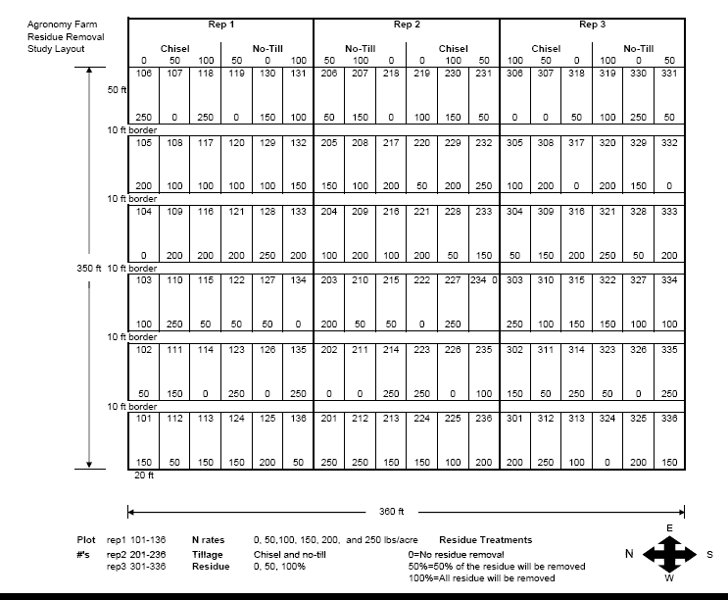
Experiment Layout

Slide 13
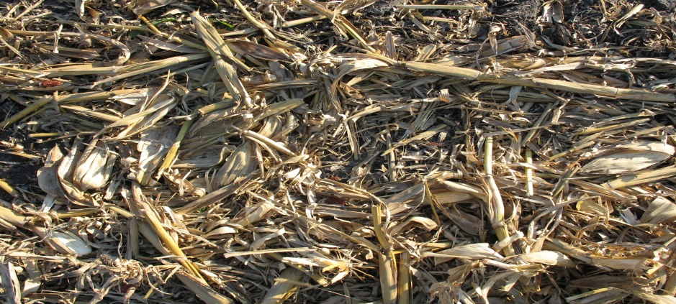
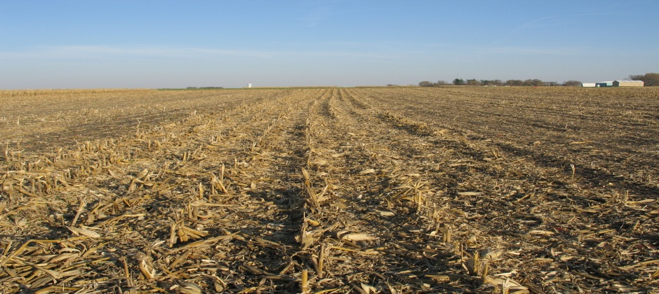
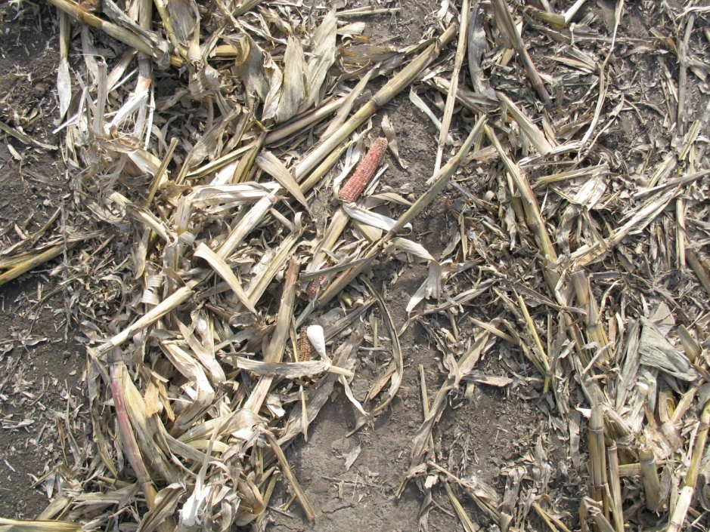
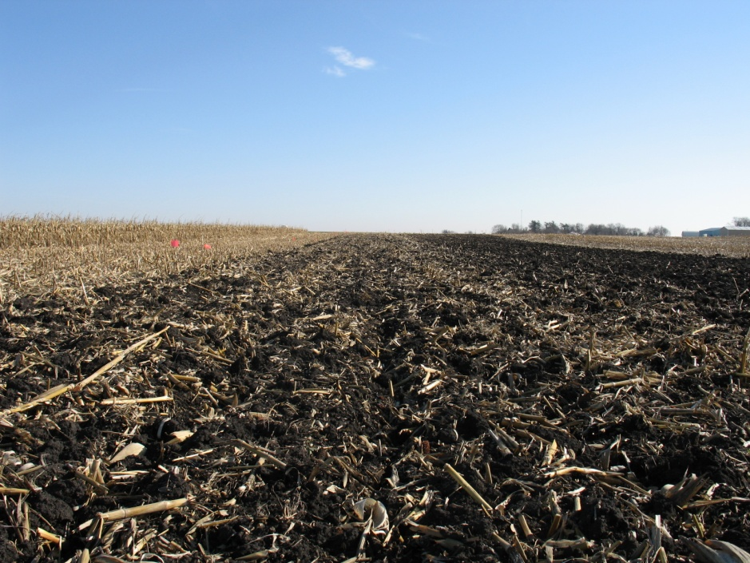
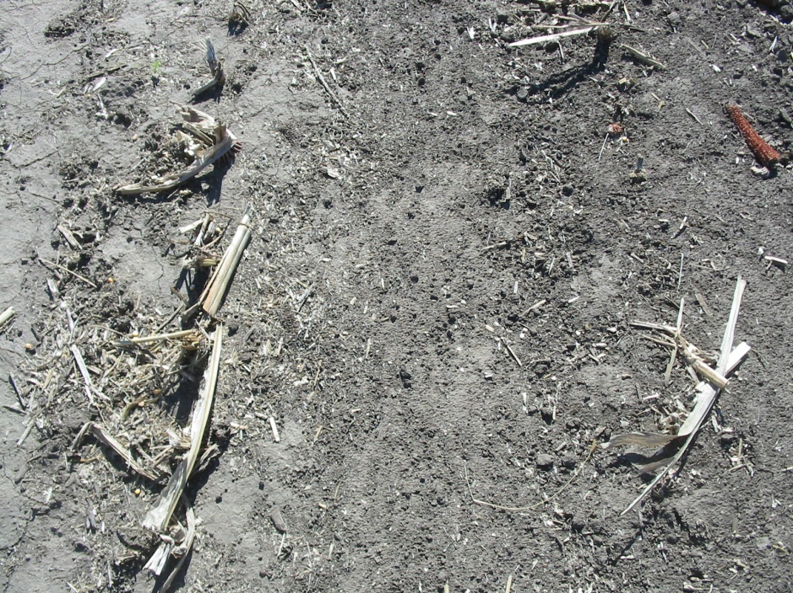
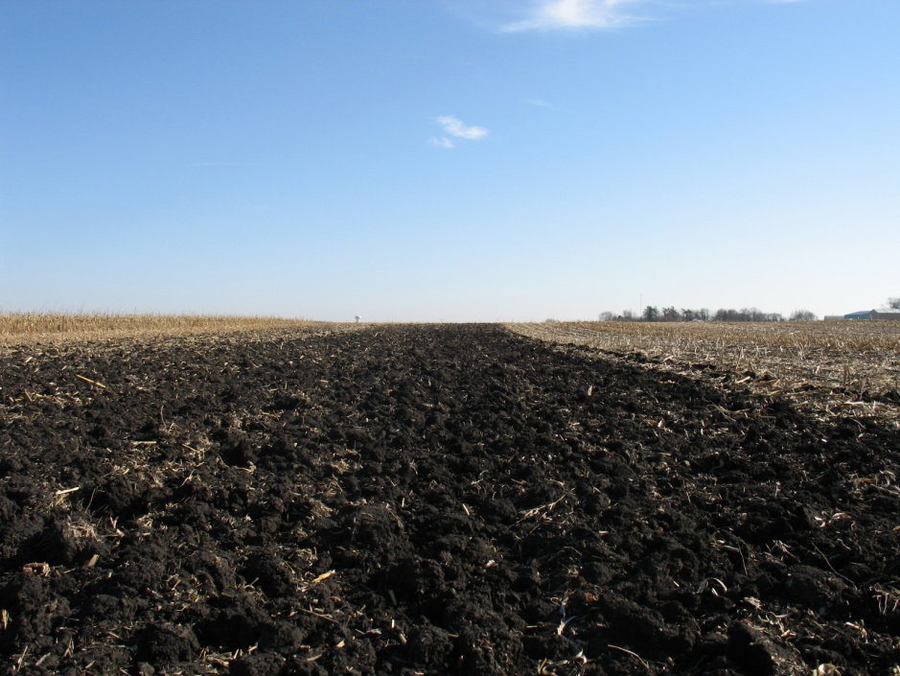
Tillage and Residue Removal
Corn Residue Removal
Tillage and Residue Removal
NT – 0%
0%
CP – 0%
50%
CP – 100%
100%
Background Project Overview GHG results Soil Carbon results Summary & Conclusions

Slide 14
Measurements and Data Collection
Study treatments established on two sites in the fall of 2008
Baseline data in fall 2008 and field monitoring in 2009, 2010, and 2011 included:
  Soil C, GHG emission, soil bulk density,
  Residue decomposition, nutrients cycling, and lab studies
  Crop grain and biomass
  Root biomass and microbial biomass carbon
  Soil compaction and infiltration
  Aggregate Stability and SOC for different size fractions
Notes:
Changed study approach to current progress of study

Slide 15
Grain Yield Response

Slide 16
Grain Production: 2009
Background Project Overview Grain Soil Quality Summary & Conclusions

Slide 17
Grain Production: 2010
Background Project Overview Grain Soil Quality Summary & Conclusions

Slide 18
Corn Yield as affected by tillage and
and N rate in 2009

Slide 19
Corn Yield as affected by tillage and
and N rate in 2010

Slide 20
Grain Production: 2010
Background Project Overview Grain Soil Quality Summary & Conclusions

Slide 21
Tillage and Residue removal Effects on Soil Temperature

Slide 22
Above ground Biomass as Affected by N Rate

Slide 23
Root Biomass as affected by N rate

Slide 24
Root to Shoot Ratio

Slide 25
Effect of N fertilizer Rate on Corn Biomass N and C Content at Plant Maturity Across Sites, 2009-2010 (John Sawyer and Jose Pantoja)
N Rate | Veg. | Cob | Grain | Total |  |  | Veg. |  | Cob | Grain | Total
lb N/acre | - - - - - - - - - -lb N/acre - - - - - - - - - - |  |  |  |  |  | - - - - - - - - - - - -lb C/acre - - - - - - - - - - - - - -
0 | 28 (43%) | 3 (4.6%) | 34 (52%) |  | 65 |  | 1,770 (50%) | 230 (5.5%) |  | 1,555 (44%) | 3,550
150 | 59 (38%) | 6 (4.0%) | 89 (58%) |  | 154 |  | 3,140 (43%) | 510 (7%) |  | 3,670 (50%) | 7,320
250 | 73 (40%) | 7 (3.8%) | 103 (56%) |  | 183 |  | 3,375 (42%) | 555 (7%) |  | 4,080 (51%) | 8,010
Only the main effect of N rate was statistically significant for N and C (p<0.001).
Veg., vegetative material.

Slide 26
Effect of N Fertilizer Rate on Corn Biomass C: N Ratio at Plant Maturity Across Sites, 2009-2010 (John Sawyer and Jose Pantoja)
N Rate | Veg. | Cob | Grain
lb N/acre | - - - - - - - -C:N Ratio - - - - - - - - -
0 | 63:1 | 77:1 | 48:1
150 | 53:1 | 85:1 | 41:1
250 | 46:1 | 79:1 | 40:1
Only the main effect of N rate was statistically significant for N and C (p<0.001).
Veg., vegetative material.

Slide 27
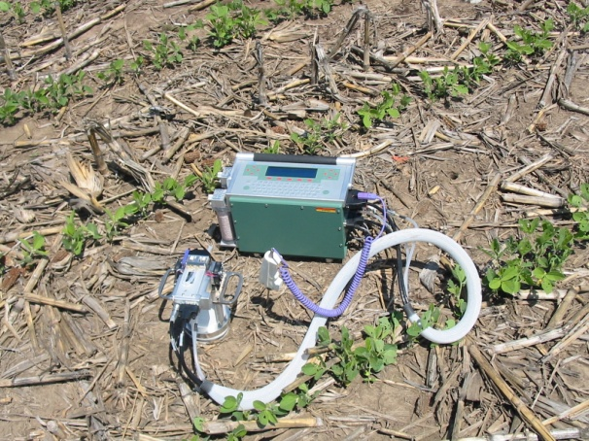
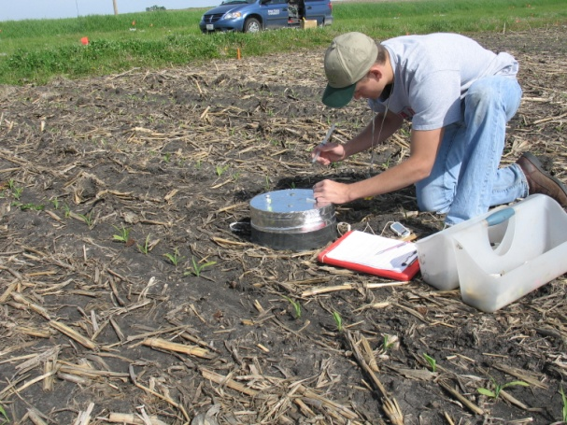
Greenhouse Gas Emissions under
different Residue Managements
CO₂ and N₂O soil surface emissions
  Weekly soil surface CO₂ readings coupled with soil moisture and temperature
CO₂
  LI-COR
N₂O
  GRACEnet Chamber-based Trace Gas Flux Measurement Protocol (GC analyzer)
(LI-COR 6400)
Chamber-based Trace Gas Flux Measurement
Background Project Overview GHG results Soil Carbon results Summary & Conclusions

Slide 28
Seasonal Soil Surface CO₂ Emissions
Background Project Overview GHG results Soil Carbon results Summary & Conclusions
Notes:
Only Ames site
General comments
Two wet years, especially in 2010
NT had lower CO2 than CT early on, until corn canopy completely covered the ground. Resulting in similar soil temperatures thereafter.
Less corn residue removed, greater CO2 emissions

Slide 29
Soil Surface CO₂ Emission: Tillage
Background Project Overview GHG results Soil Carbon results Summary & Conclusions
Notes:
Only Ames site
Averaged across Nrates and residue removal rates
General comments
NT had lower CO2 than CT early on, until corn canopy completely covered the ground. Resulting in similar soil temperatures thereafter.

Slide 30
Potential Sink or Source for Atmospheric CO₂-C
Include above ground biomass, grain, and root biomass for ANPP
(ANPP + BNPP) – Rh
Positive values indicate a sink for atmospheric CO2
Background Project Overview GHG results Soil Carbon results Summary & Conclusions
Notes:
Only 2010 and Ames site
(ANPP + BNPP) – Rh
Included grain for ANPP
Positve values indicate a sink for atmospheric CO2

Slide 31
Seasonal N₂O Emission: Tillage Effect
Two wet years, especially 2010
Background Project Overview GHG results Soil Carbon results Summary & Conclusions
Notes:
Only Ames site
Two wet years, especially 2010

Slide 32
N₂O Emission: Nitrogen Fertilization Effect
N₂O emission increased with increased soil water and fertilizer N rates
Losses of N kg ha⁻¹ range from 4 to 6 % of N applied
Background Project Overview GHG results Soil Carbon results Summary & Conclusions

Slide 33
N₂O Emission: Residue Removal Effect
In general, higher N₂O emissions when no residue was removed
Higher water content when residue is left on the surface
Background Project Overview GHG results Soil Carbon results Summary & Conclusions

Slide 34
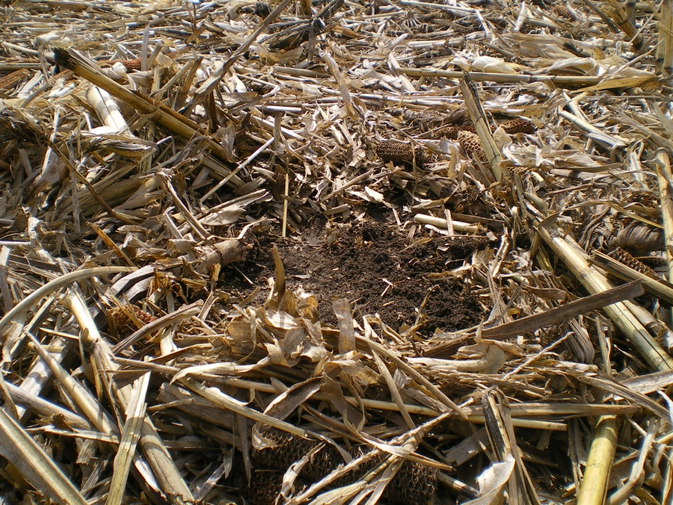
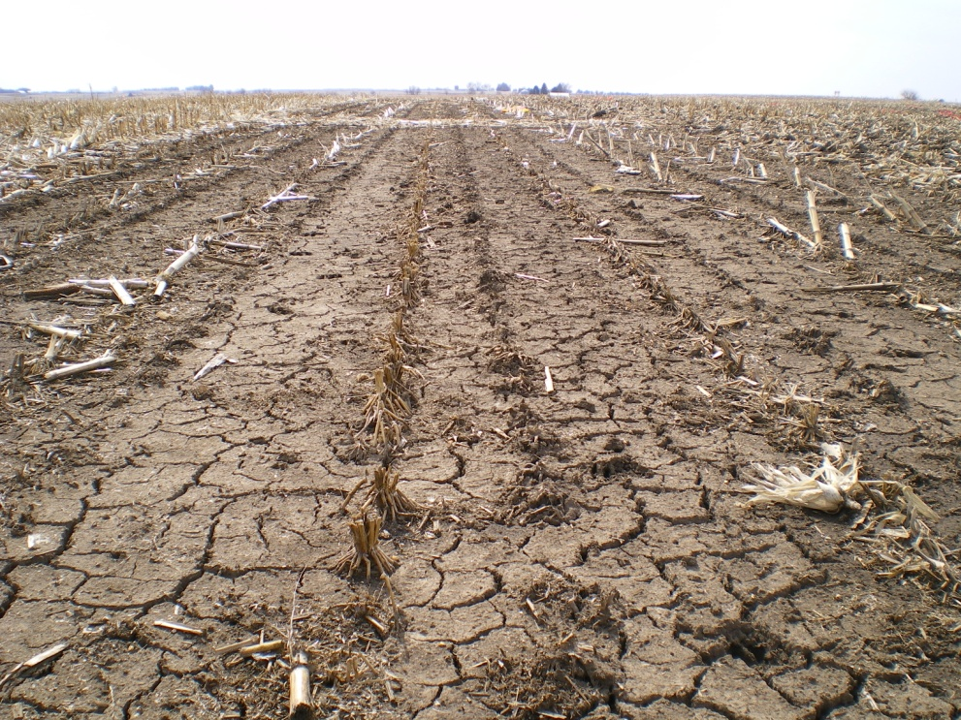
Soil Quality
No-till with 0 % residue removed
No-till with 100 % residue removed
Background Project Overview Grain Soil Quality Summary & Conclusions

Slide 35
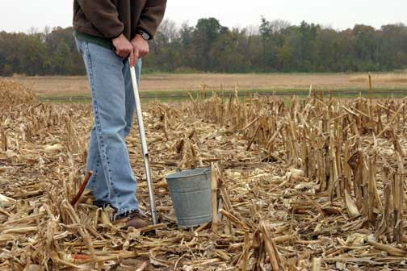
Soil C Sequestration Potential
under different Residue Managements
Soil samples are being collected every August
  TC/TN
  Microbial Biomass-C
  Bulk Density
  pH
5 depths
  0-3, 3-6, 6-12, 12-18, 18-24 in
Carbon Budget
  NEP = (ANPP + BNPP) – R_{h}
  NEP=Net ecosystem productivity, Rh=microbial _{respiration}
Soil sampling in no-till
Background Project Overview GHG results Soil Carbon results Summary & Conclusions

Slide 36
Potential Soil Organic Carbon Sequestration
Include aboveground and root biomass contribution to soil C
Positive values indicate net gain in SOC
Background Project Overview GHG results Soil Carbon results Summary & Conclusions
Notes:
2010 in Ames site only
Measured only changes in top 6 inches for CO2 (pipe study) and root biomass.
Did not include grain, just potential C into the soil
Positive values indicate net gain in SOC

Slide 37
Soil Organic Carbon
Background Project Overview Grain Soil Quality Summary & Conclusions

Slide 38
Annual Soil Carbon Loss
No-till has significantly lower soil C losses compared to chisel plow.

Slide 39
Carbon Budget
C budget approach was used to estimate net ecosystem productivity (NEP)
NEP_{C} = (ANPP_{C} + BNPP_{C}) – R_{h}
where,
ANPP_{C} is potential C content input from above- ground plant biomass,
BNPP_{C} is potential C content input from below- ground root biomass, and
R_{h} is C loss as CO₂ due to organic materials microbial decomposition.
Background Project Overview Grain Soil Quality Summary & Conclusions

Slide 40
Residue Removal and N Rate on Soil C

Slide 41
Bulk Density
Background Project Overview Grain Soil Quality Summary & Conclusions

Slide 42
Bulk Density
Background Project Overview Grain Soil Quality Summary & Conclusions

Slide 43
Wet Aggregate Stability
Background Project Overview Grain Soil Quality Summary & Conclusions

Slide 44
Summary & Conclusions
Grain and biomass yields affected by residue removal, tillage, and N rate.
No significant change in soil organic C in the short-term.
Adoption of no-till and increased N rates did reduce some of the C losses due to residue removal.
Only with adoption of no-till and N rates greater than 150 lb/acre with very little residue removed can increase potential soil C.
Significant amount of C, N, P, and K will be removed with residue removal.
Background Project Overview Grain Soil Quality Summary & Conclusions

Slide 45
Summary & Conclusions
Increase of bulk density was observed with increase residue removal regardless of tillage and it increased with N fertilization rate.
Decreases in aggregate sizes were observed with residue removal, regardless of tillage and it increased with N fertilization rate.
Increase in N₂O and CO₂ emission with increased N application, residue removal, and tillage.
Regardless of tillage system only 10-20% of residue can be removed to maintain soil organic matter and soil quality.
Background Project Overview Grain Soil Quality Summary & Conclusions

