Slide 1
Marketing Analysis of New State Shaped Maple Candies
By Charlie Chase
&
Becky Chase

Slide 2
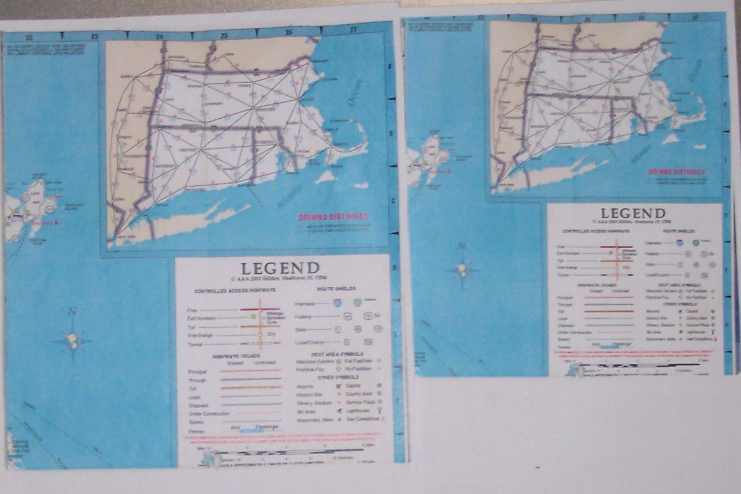
I used state road maps and reduced them in size 10% at a time to get the size that I wanted

Slide 3
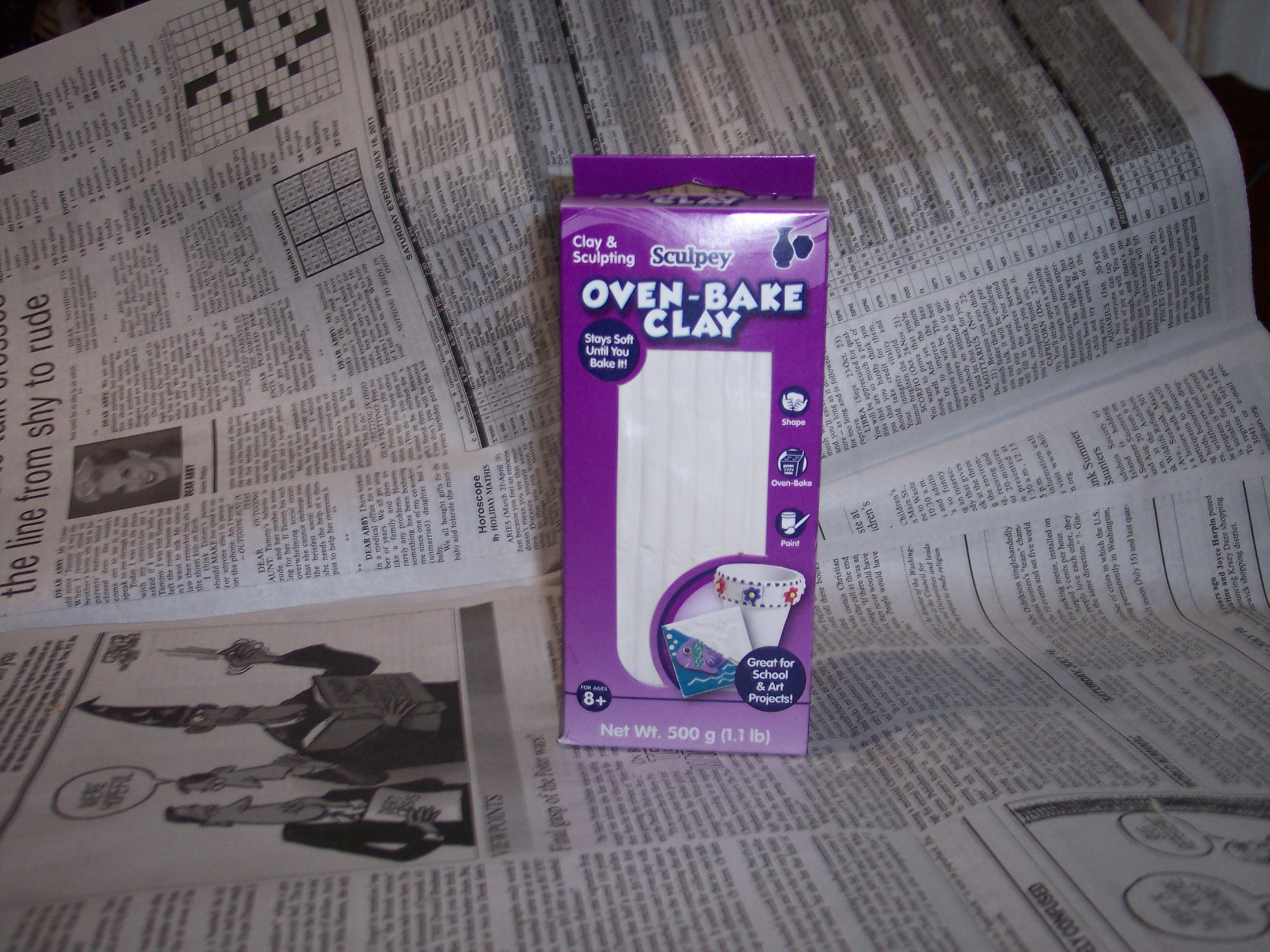
Sculpy clay to form the candy shape

Slide 4
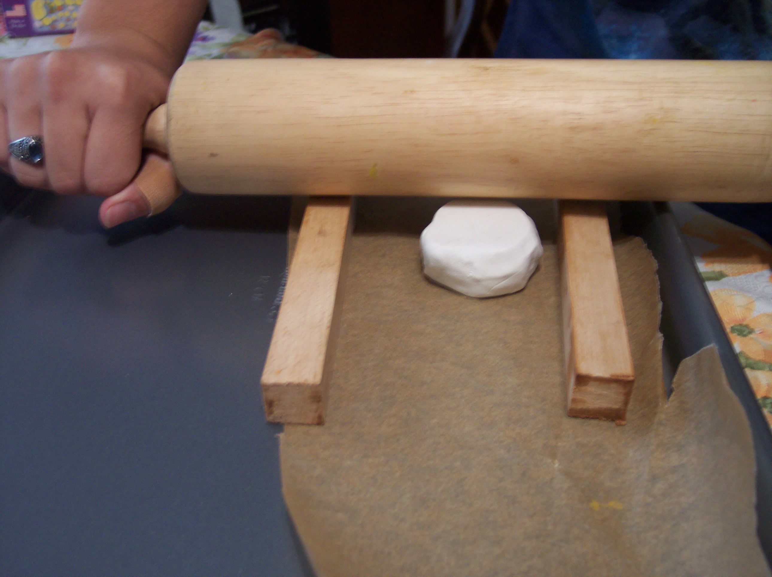
A rolling pin, Sculpy in the middle of two dowels on parchment paper right on a cookie sheet

Slide 5
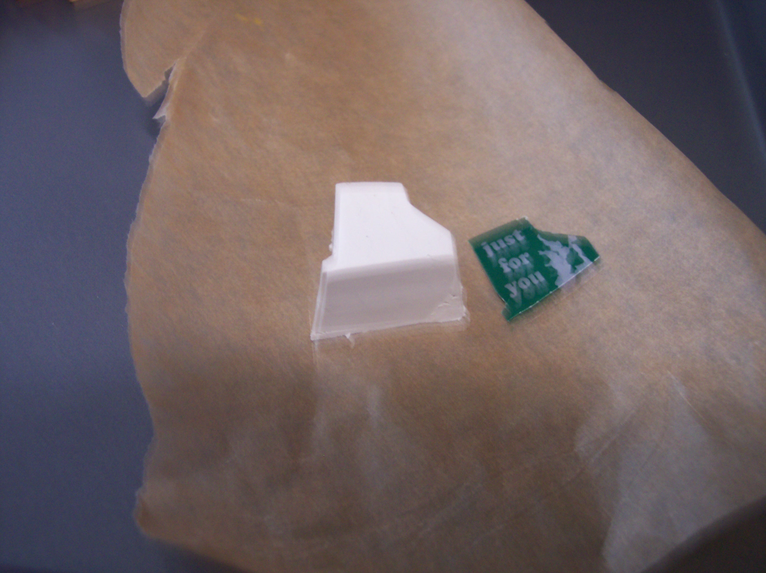
RI shaped clay

Slide 6
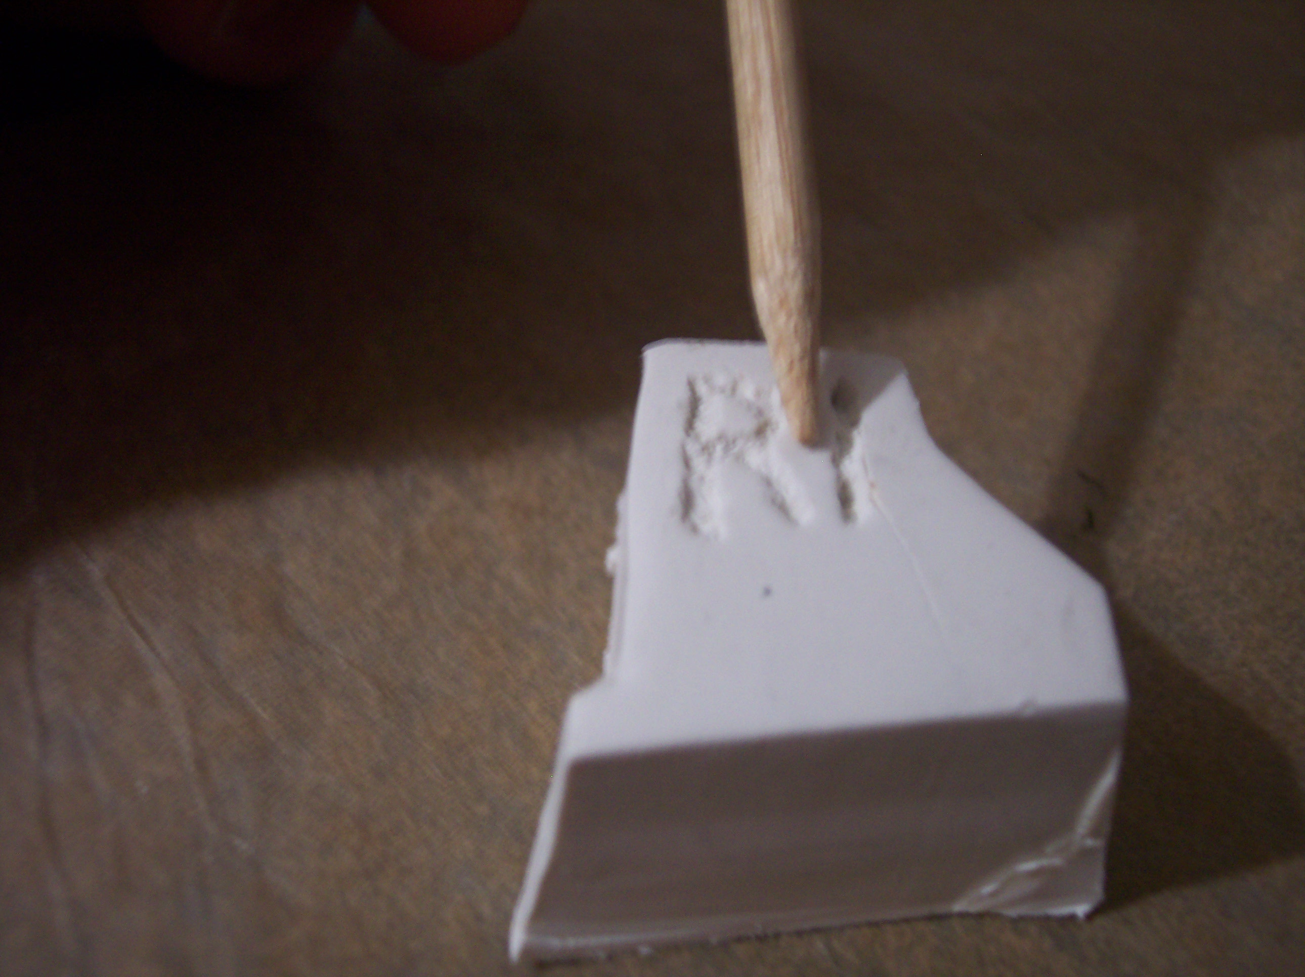
A pointed dowel used to make the letters RI

Slide 7
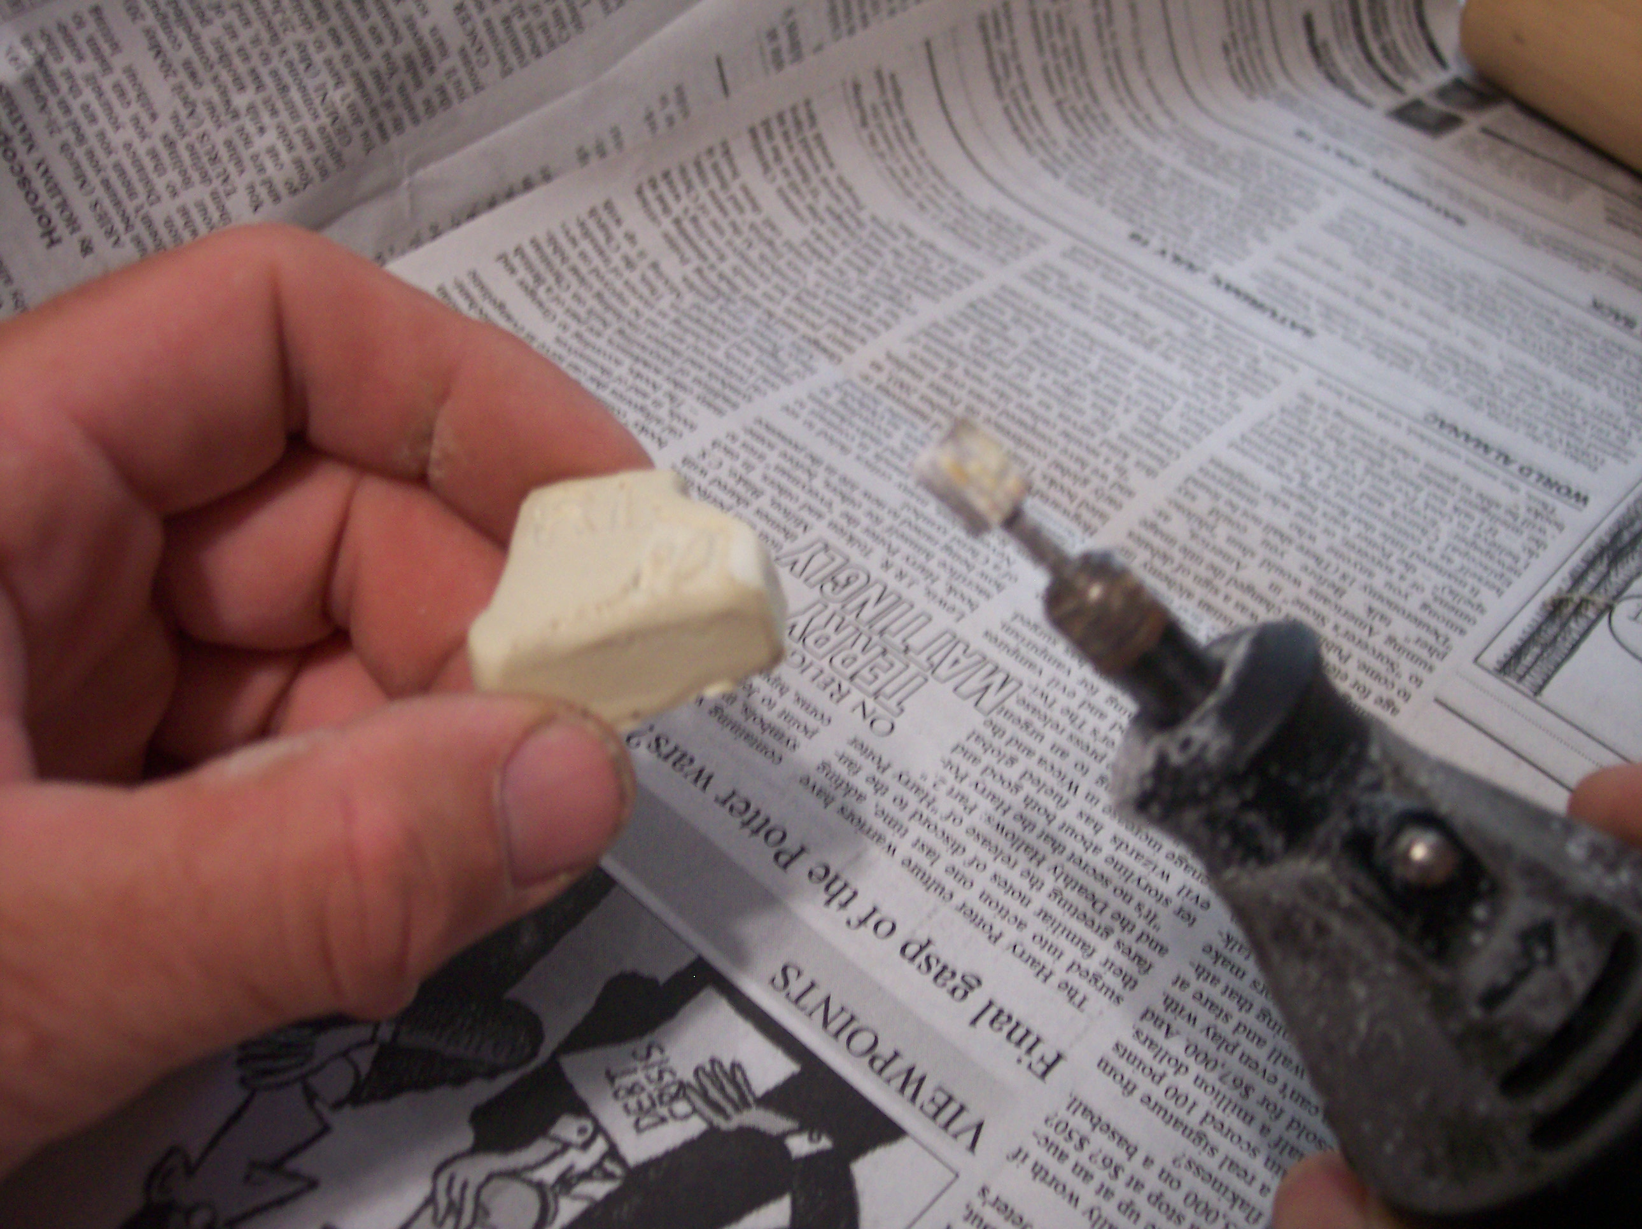
A dremel tool used to curve the corners after baking

Slide 8
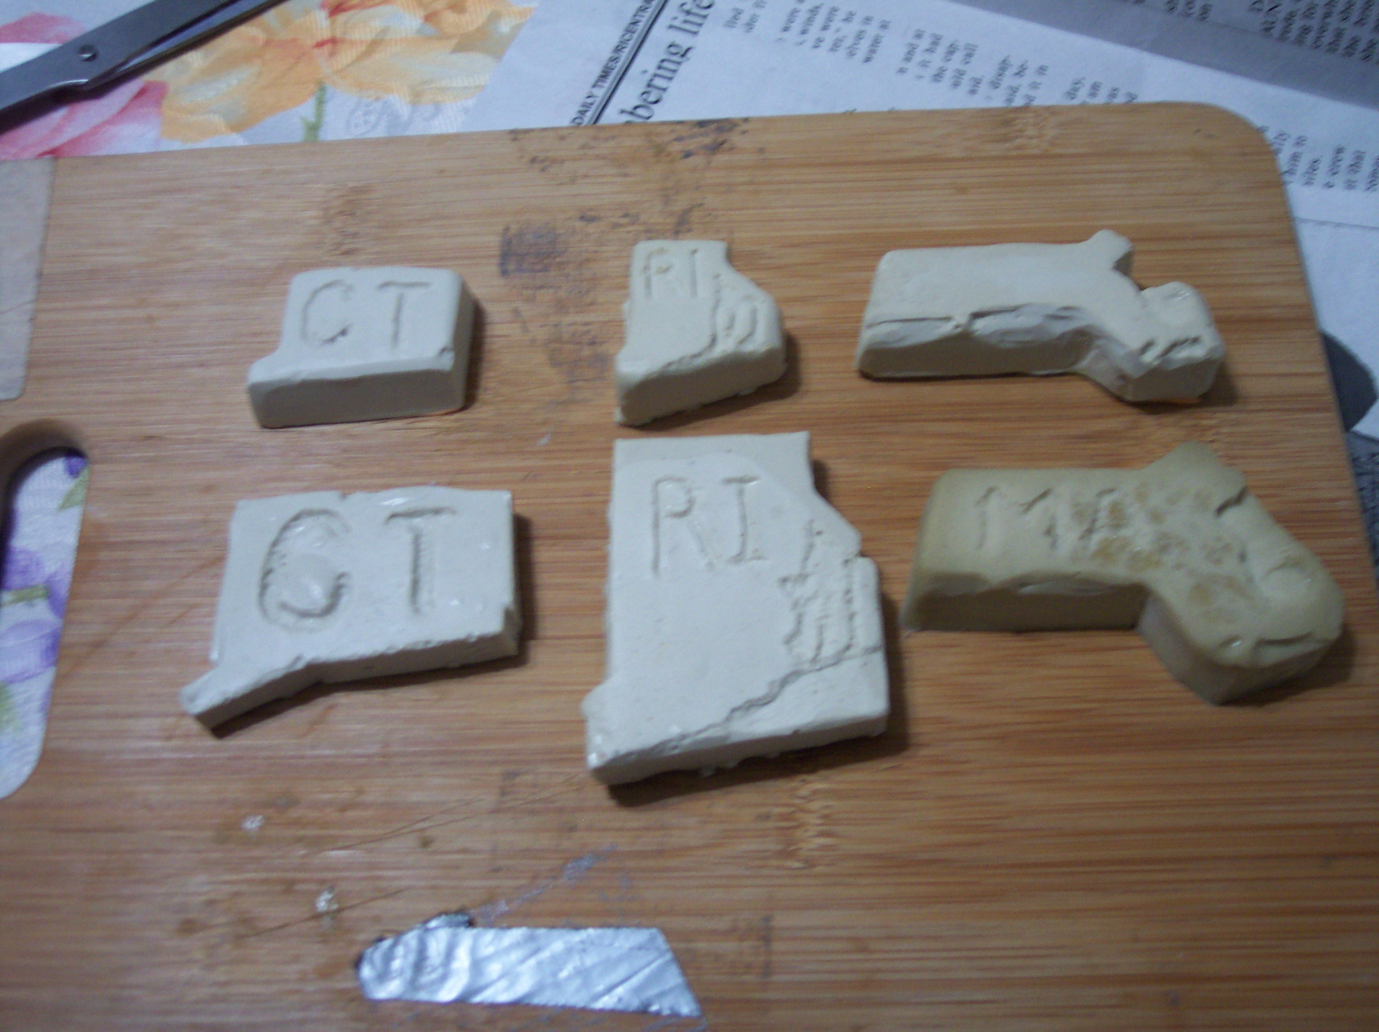
The complete set of state shapes

Slide 9
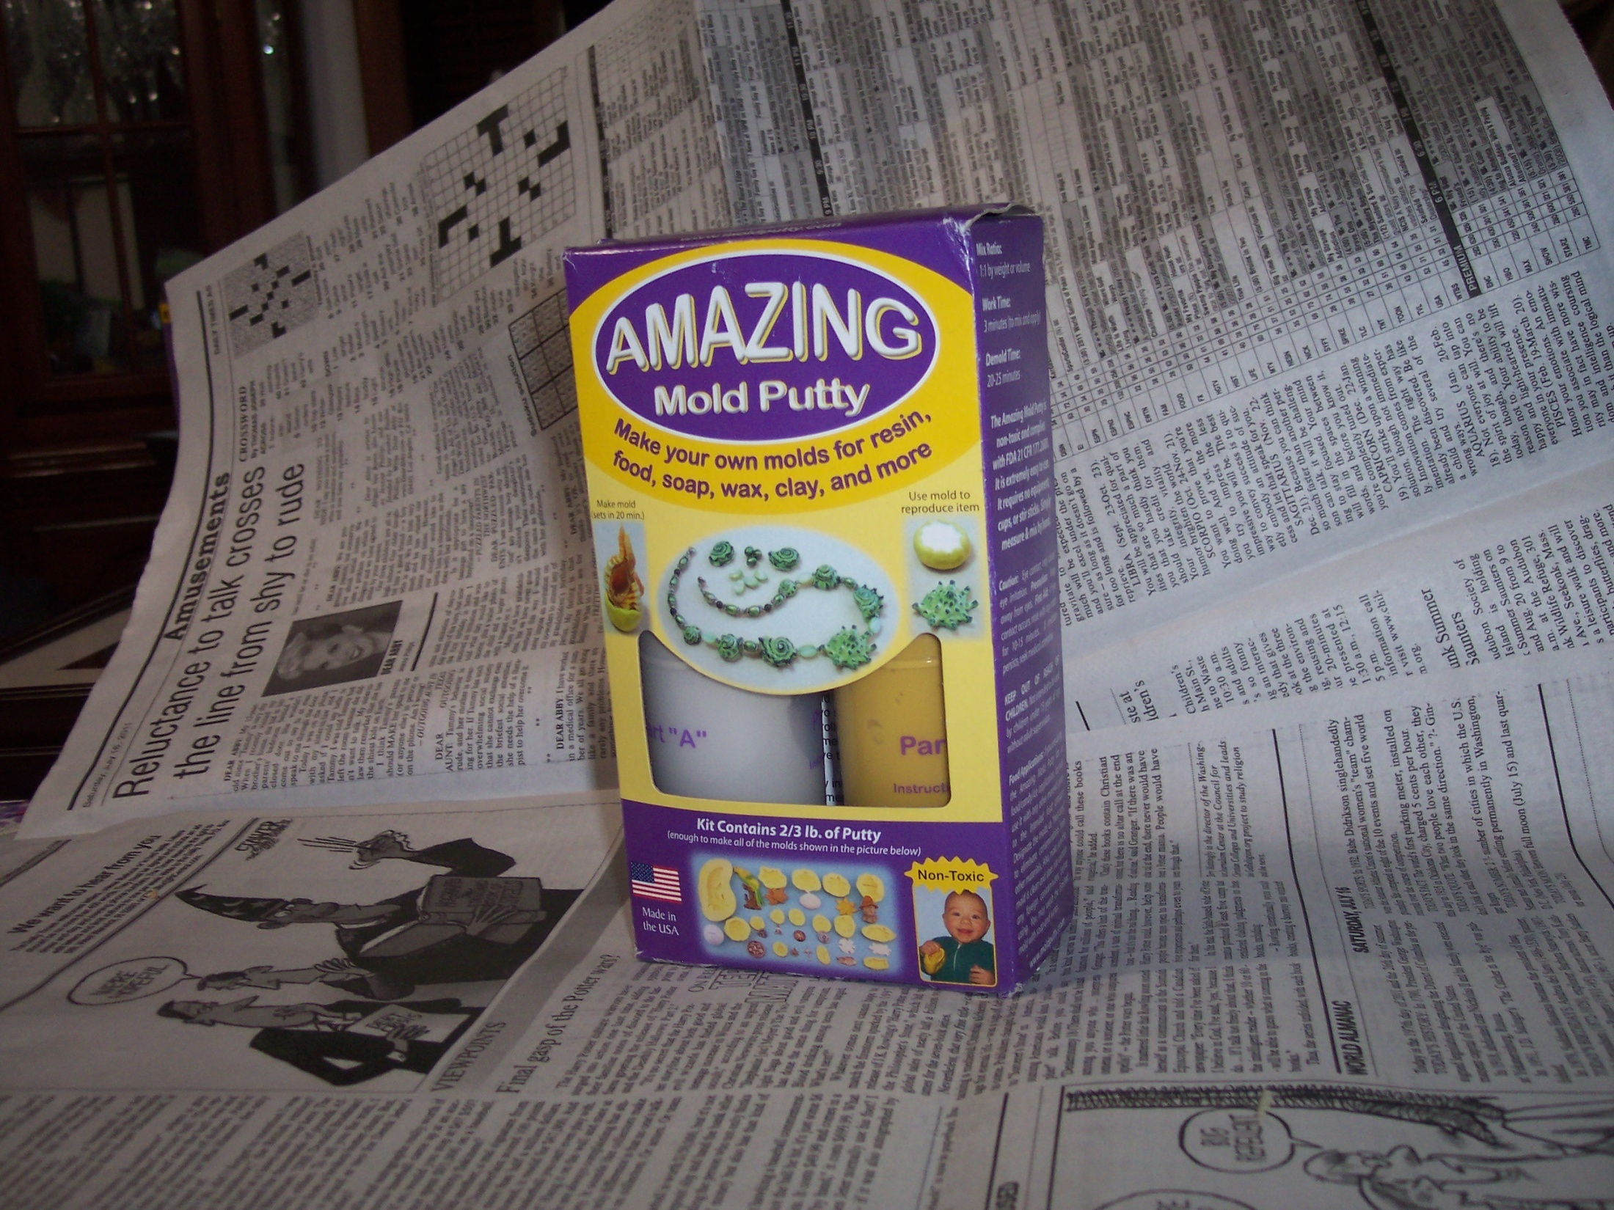
Amazing mold putty $20.00

Slide 10
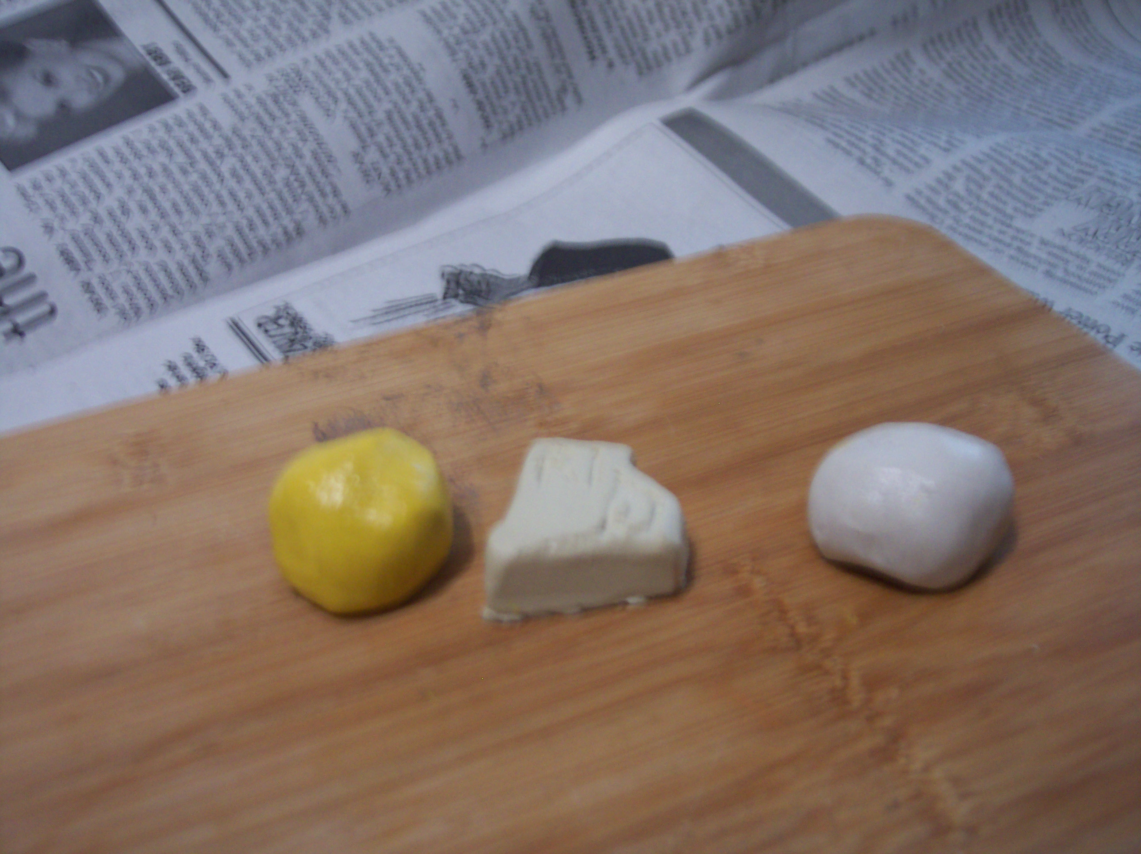
Approximately the amount of putty needed

Slide 11
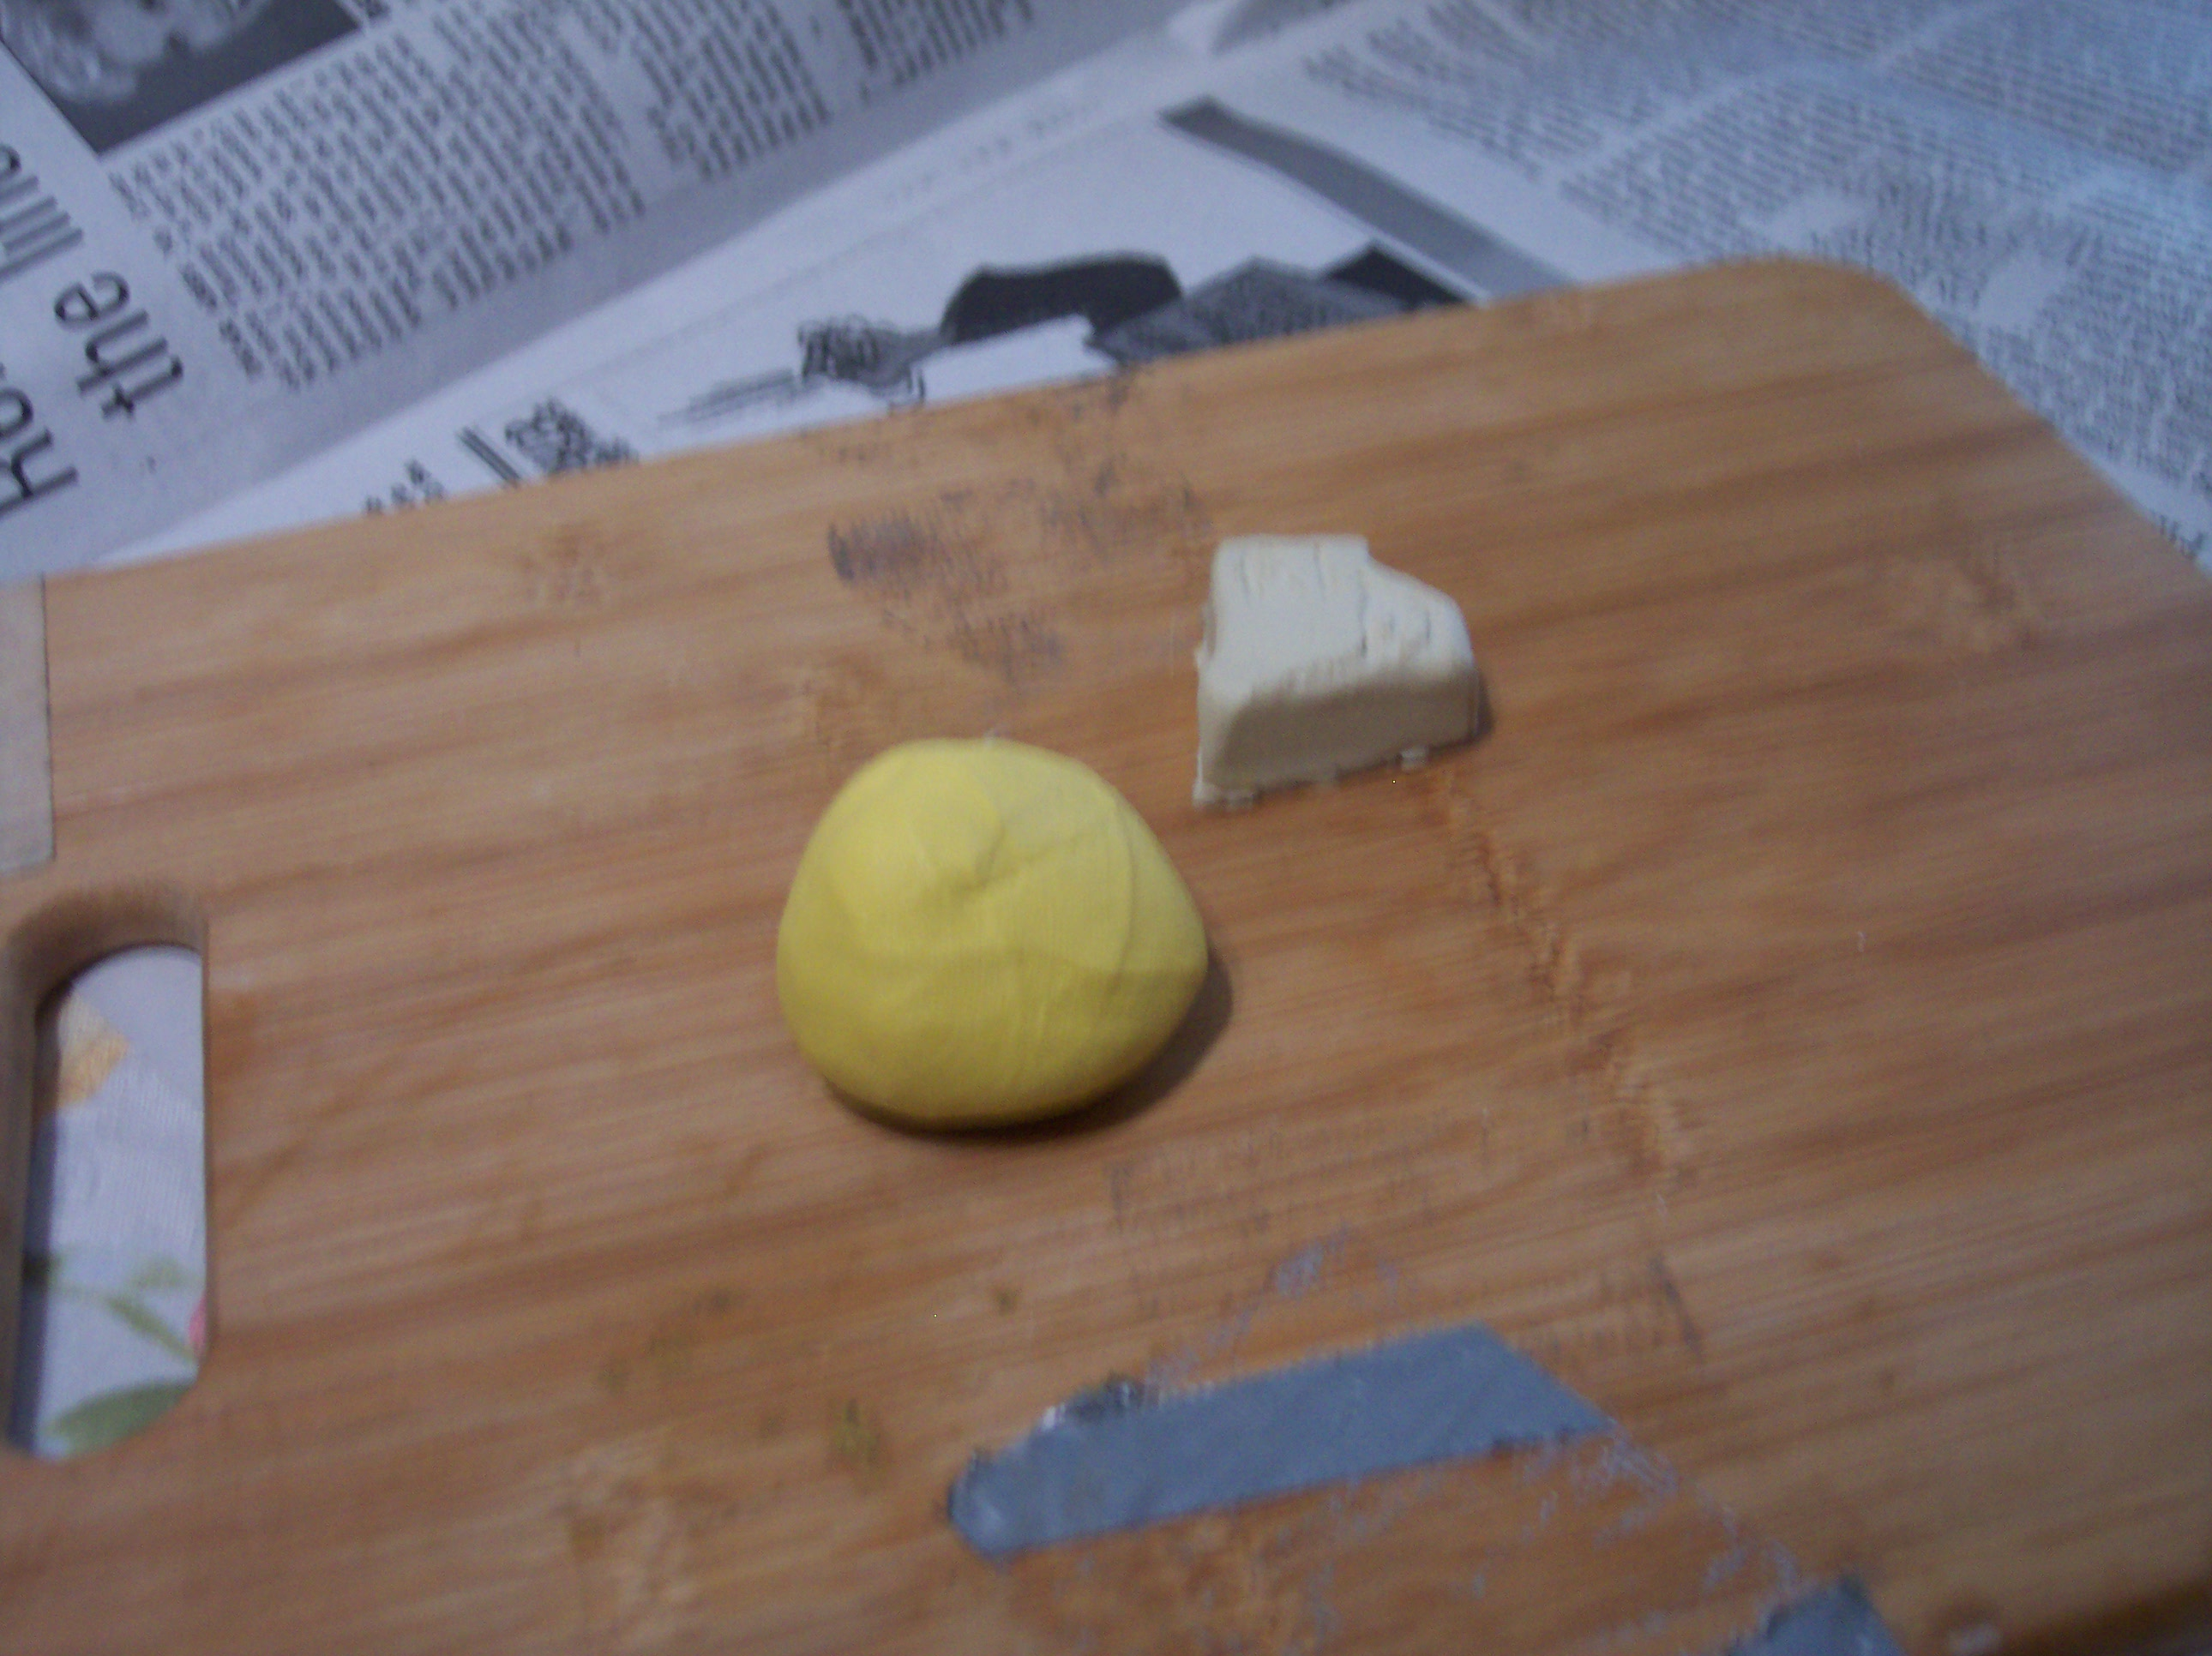
Mixed thoroughly

Slide 12
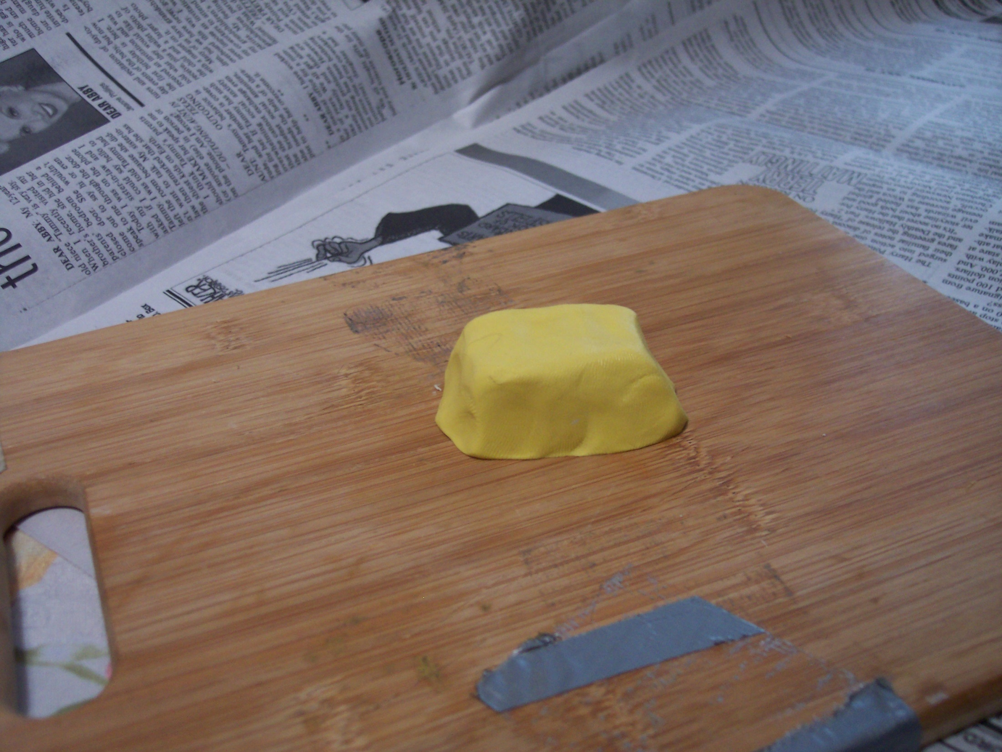
Press onto the sculpture then wait 20 minutes

Slide 13
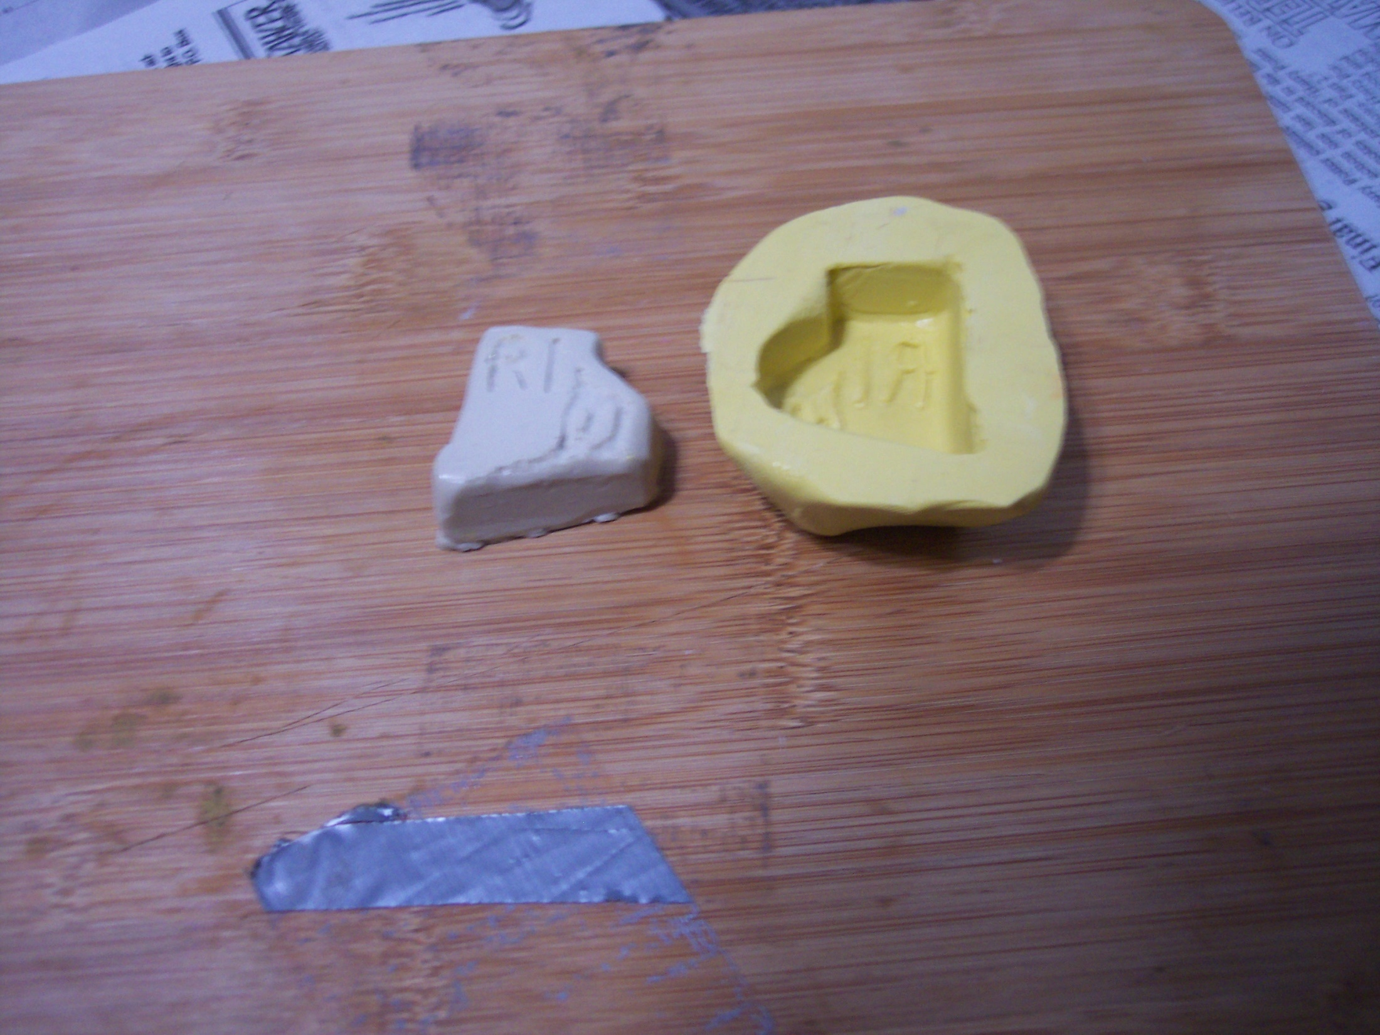
A finished mold

Slide 14
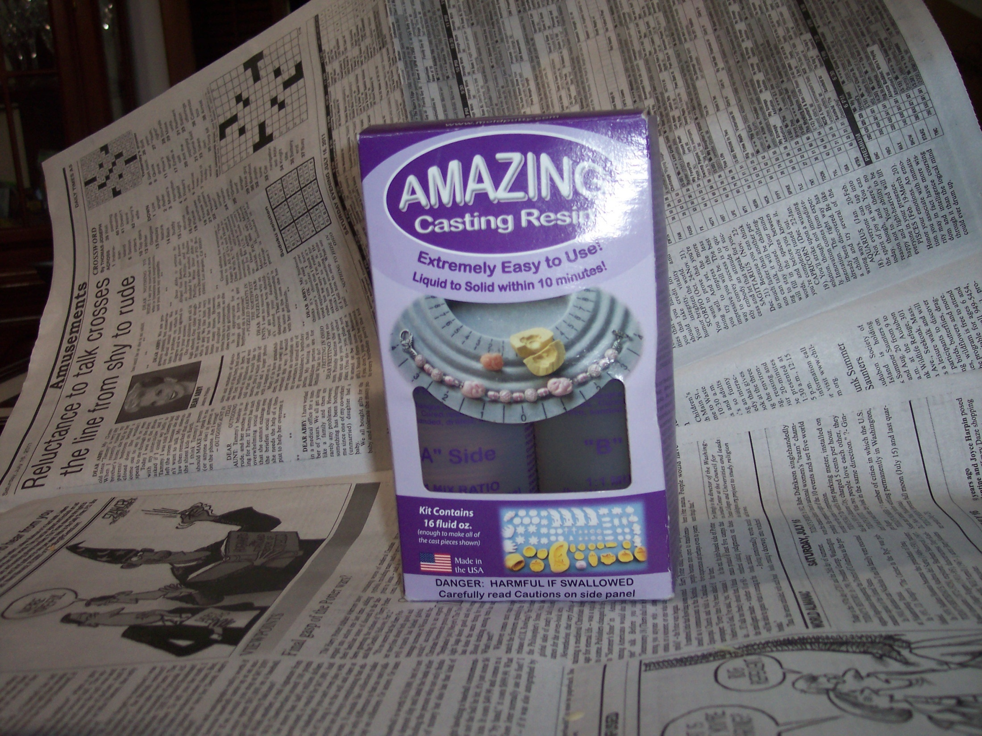
To make a sheet mold use Amazing resin to make copies in resin

Slide 15
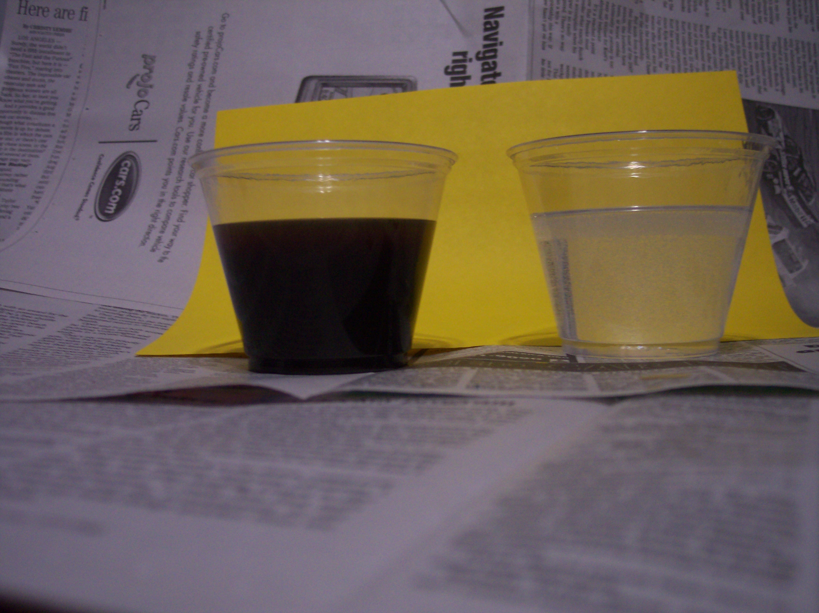
Measure out equal amounts of A and B and mix

Slide 16
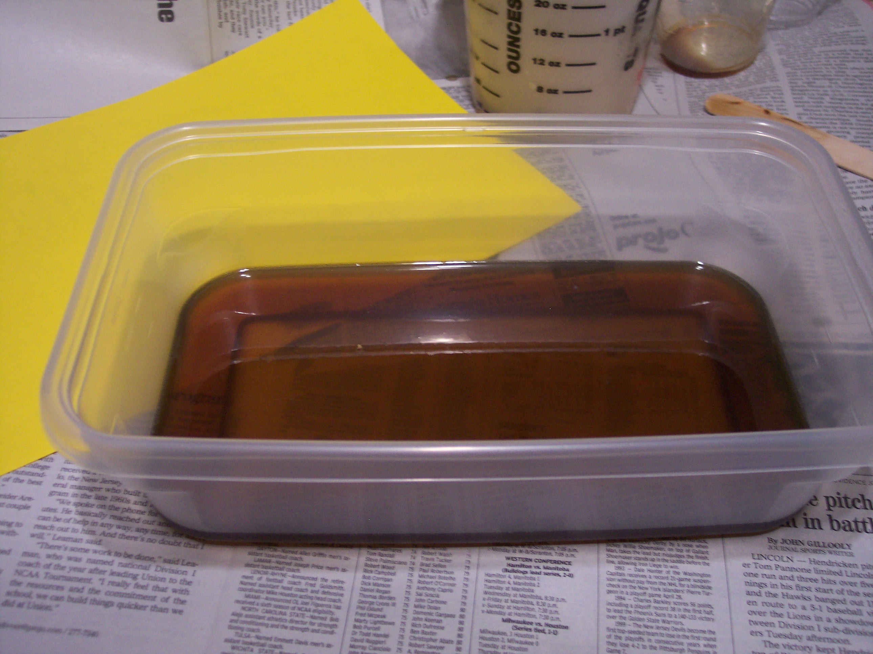
Pour into plastic container

Slide 17
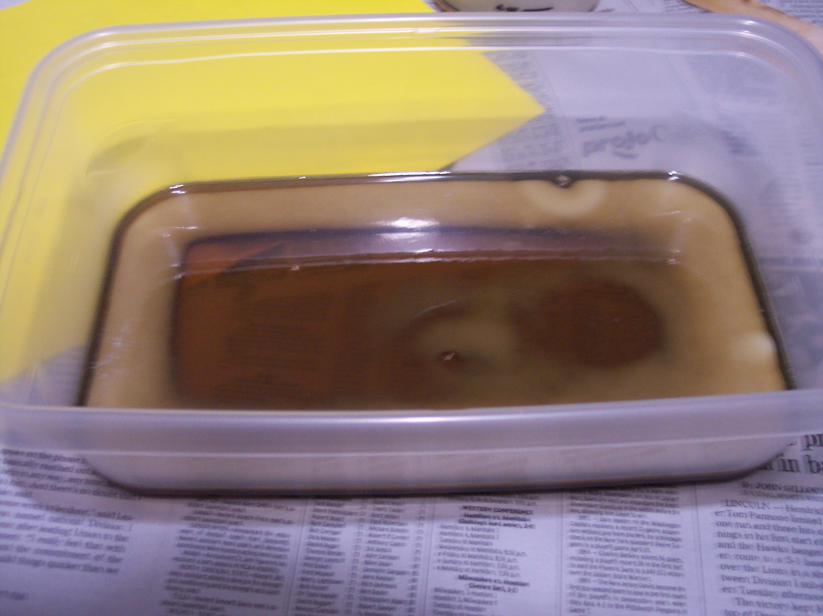
Resin changes color when it cures

Slide 18
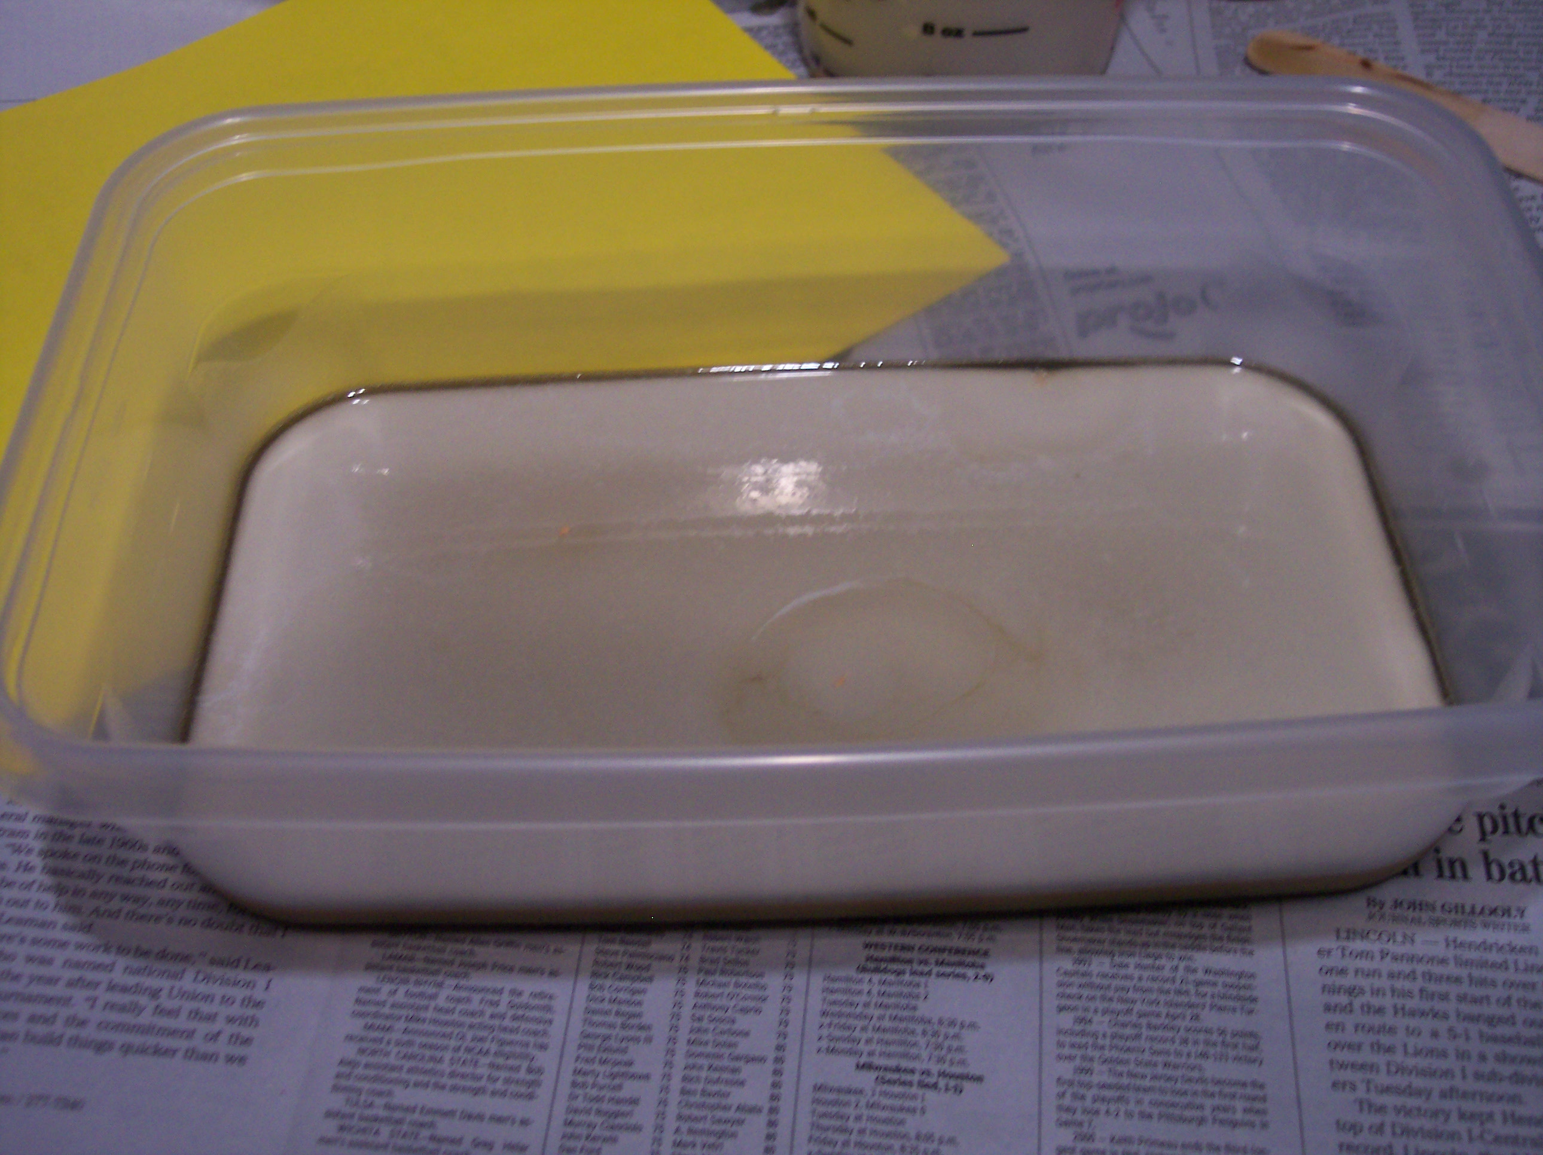

Slide 19
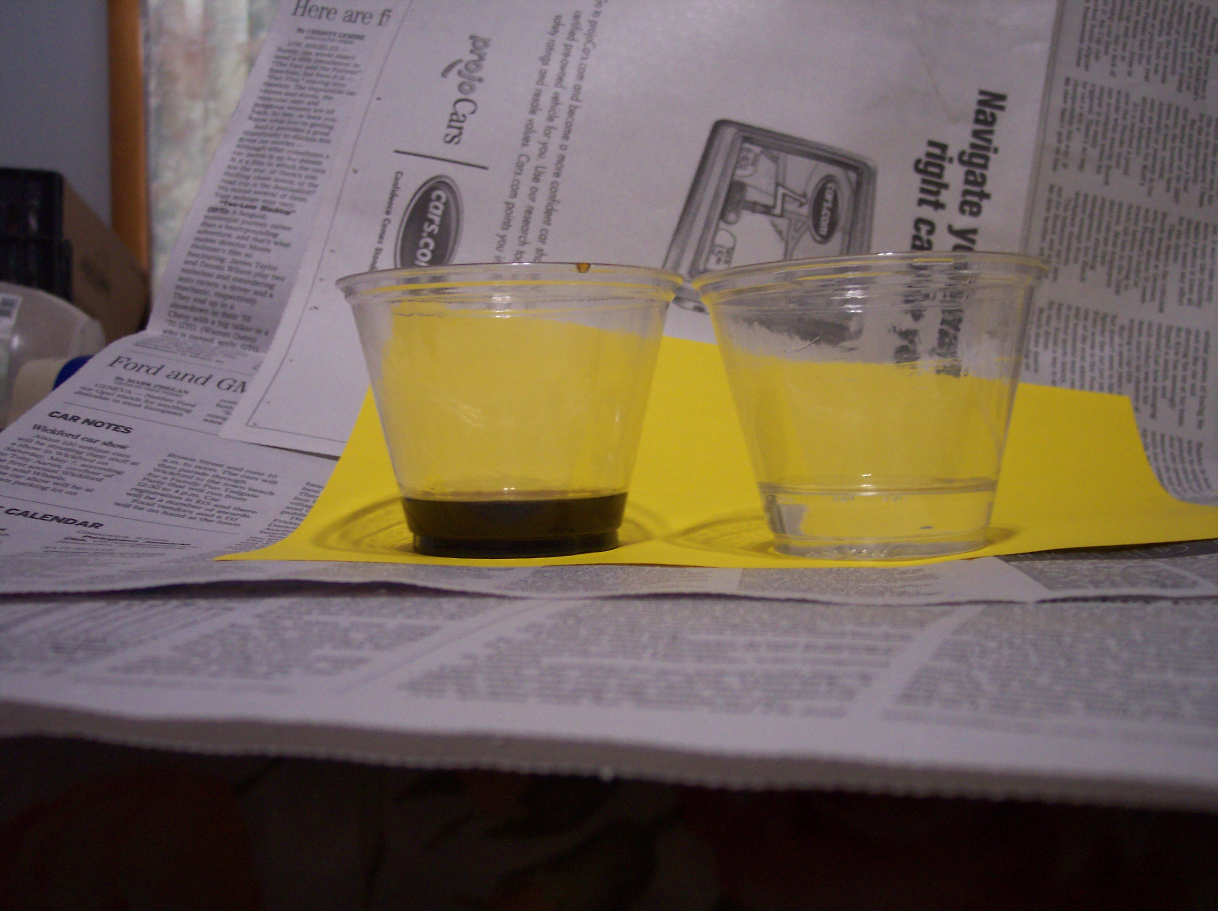
Measure small amount to use as glue for the multiple shapes

Slide 20
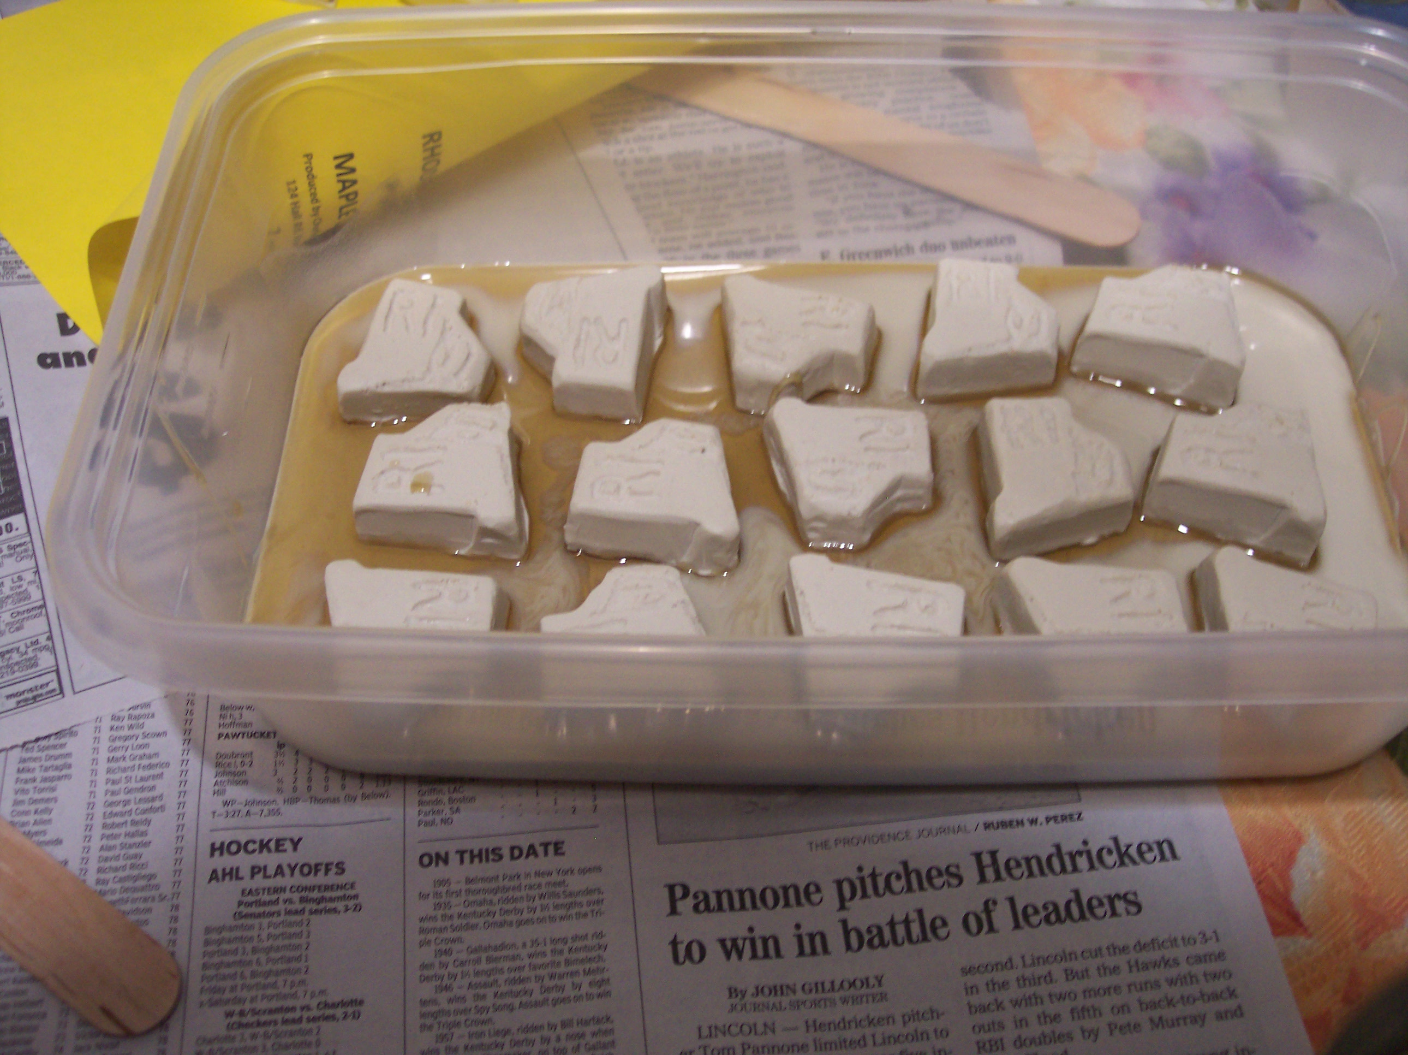

Slide 21
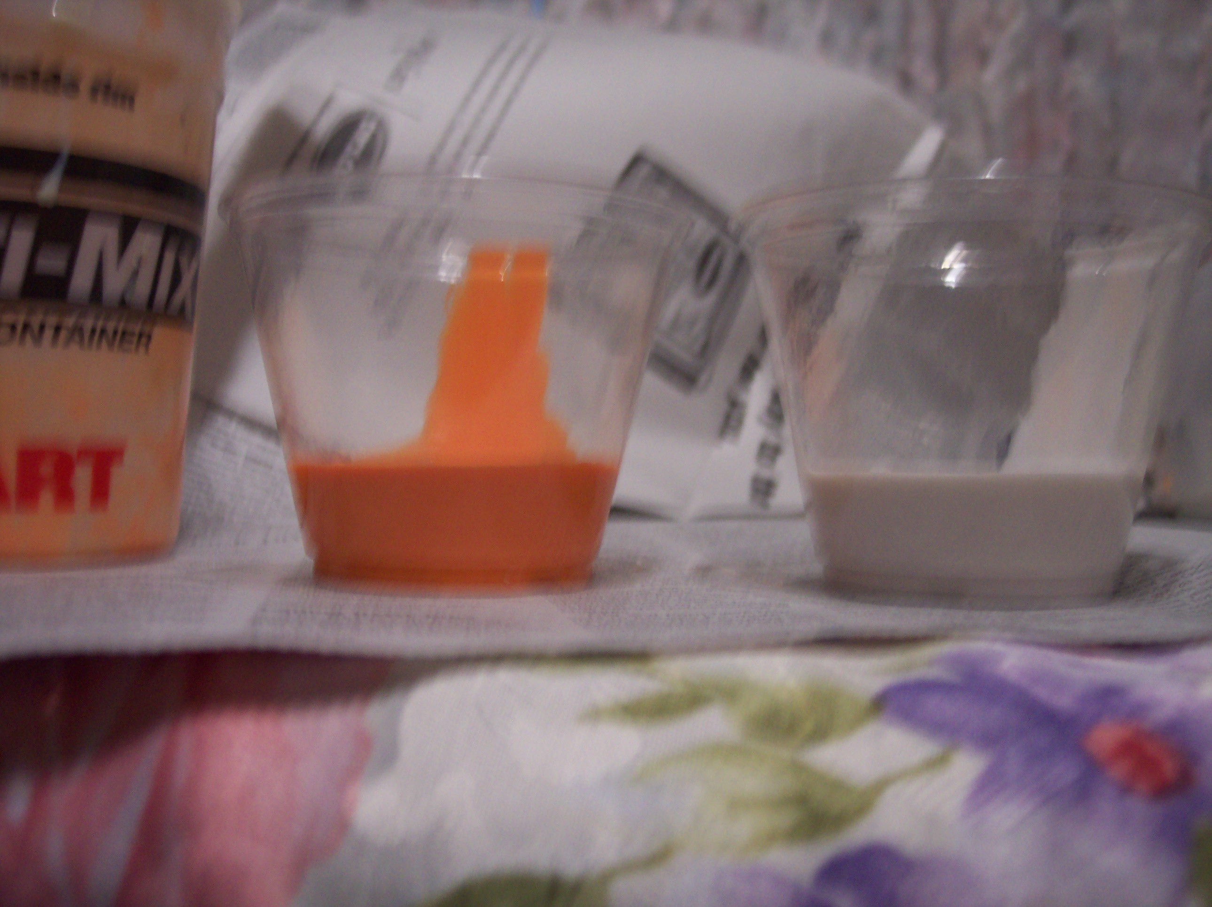
Measure equal amounts of Copyflex

Slide 22
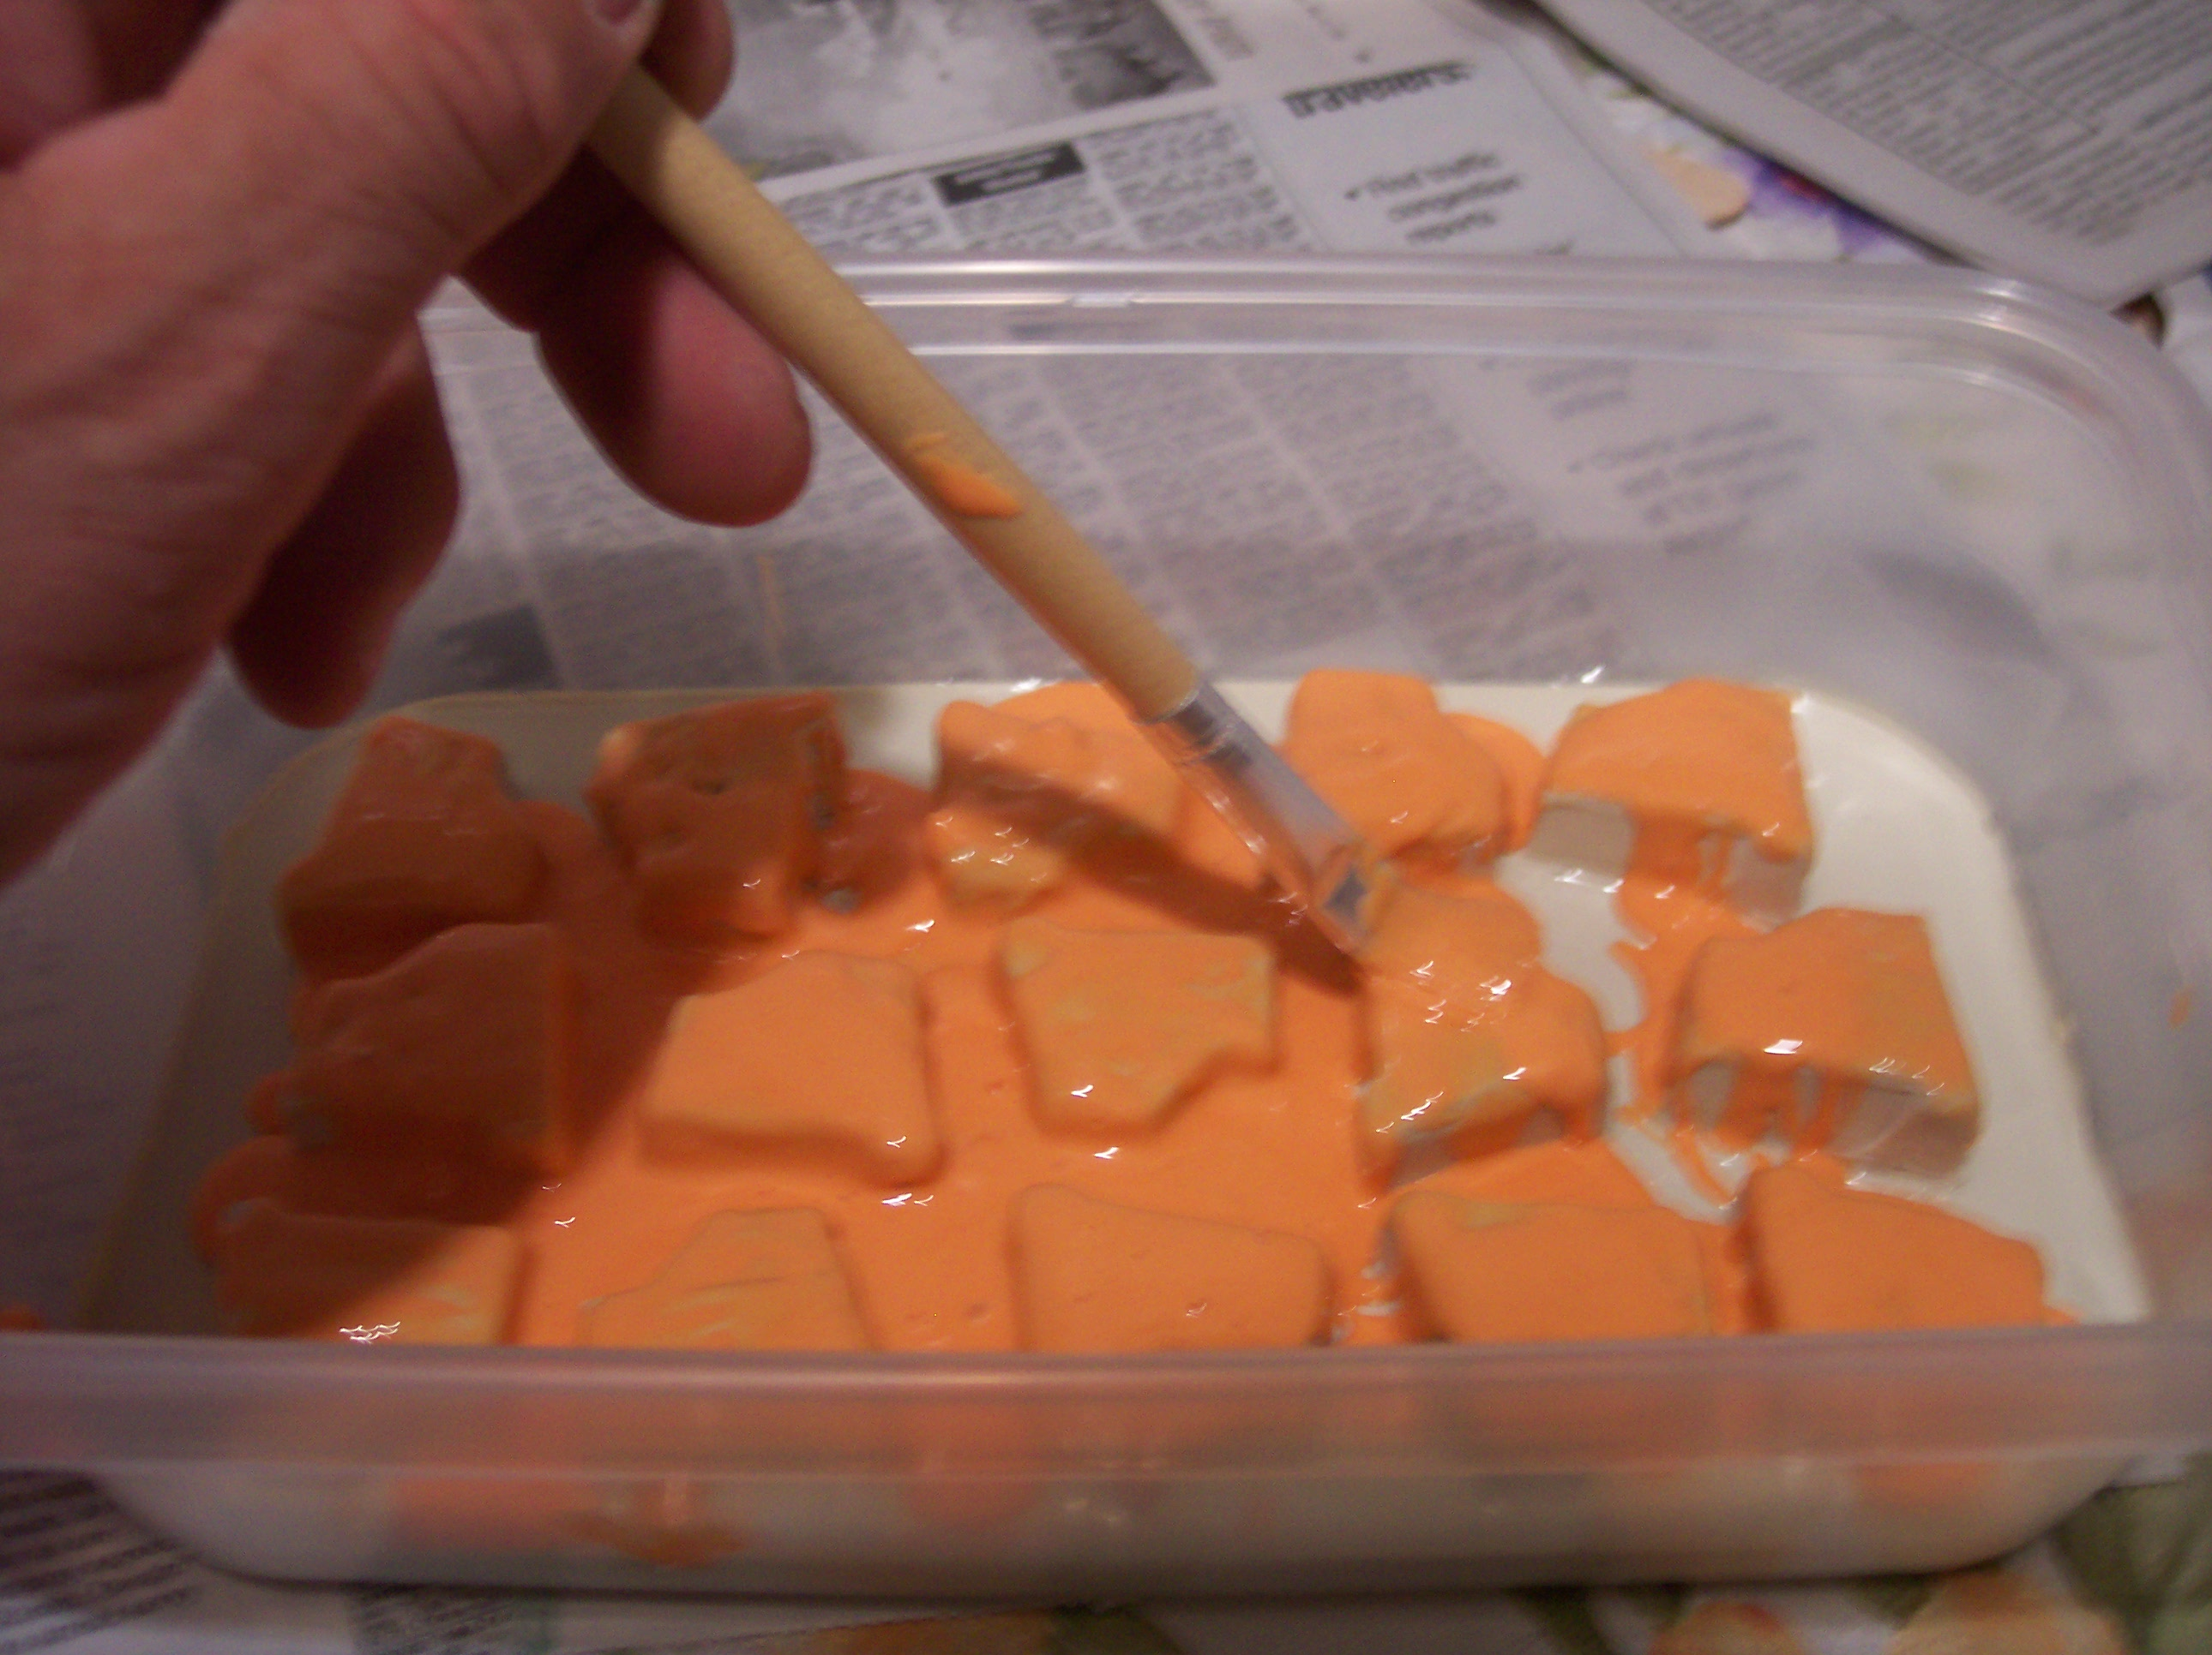
Use a disposable brush to apply the print coat

Slide 23
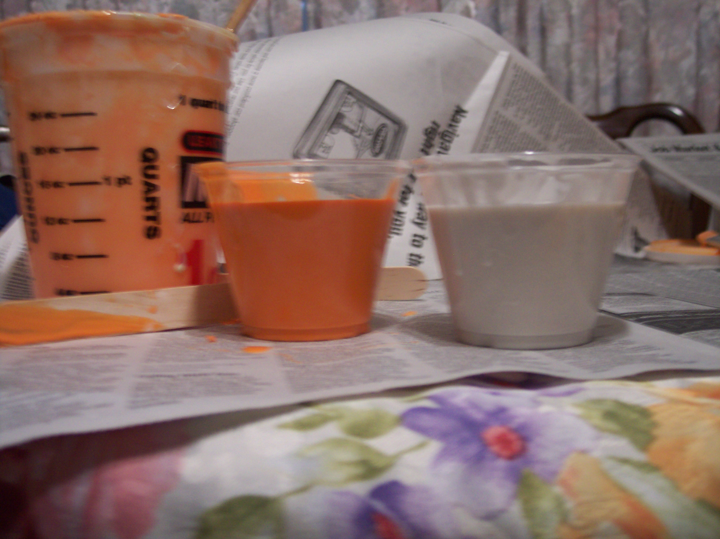
Measure a larger amount to cover state shapes

Slide 24
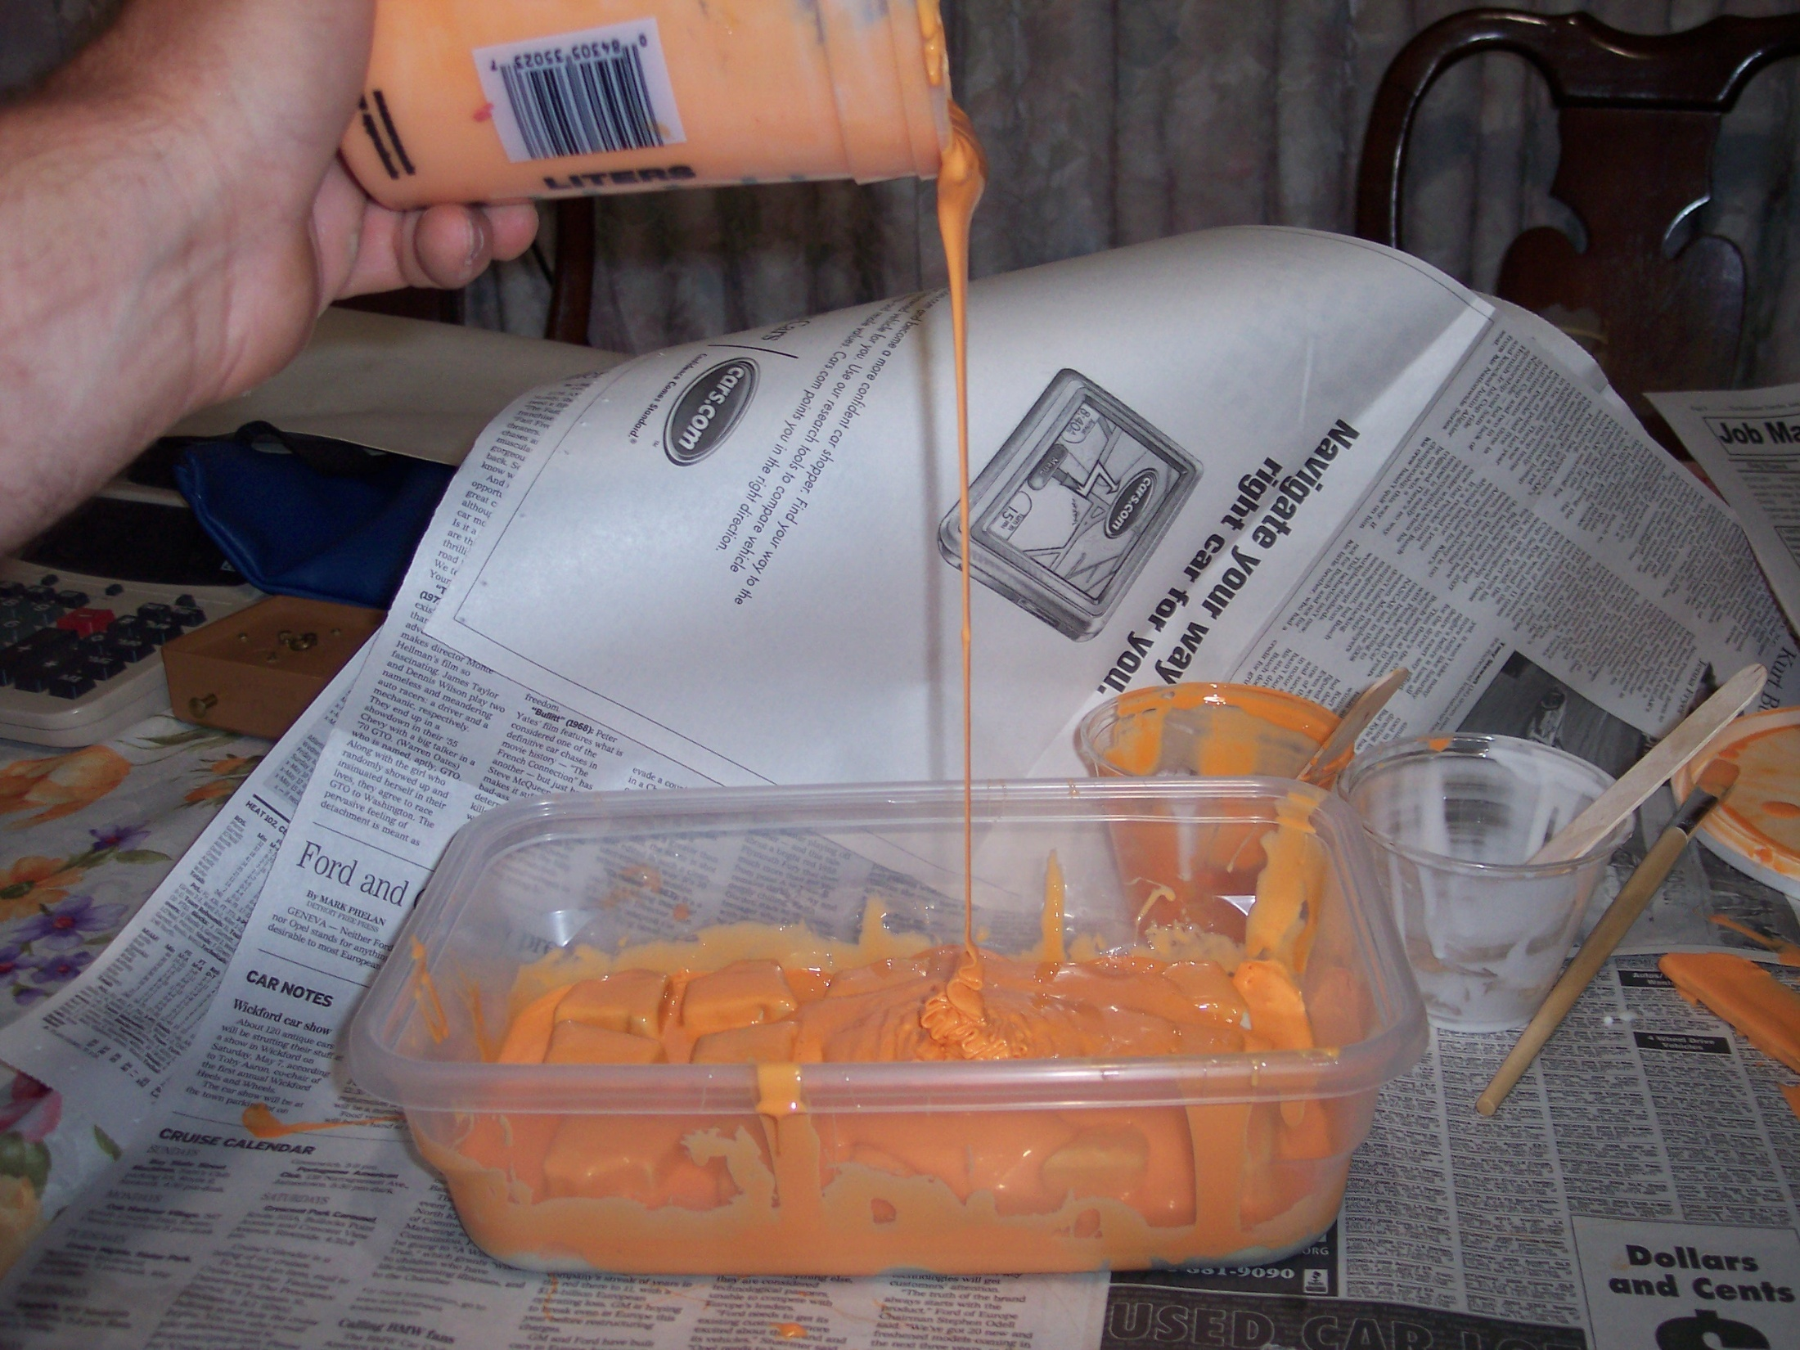
Pour in a thin stream for less air bubbles

Slide 25
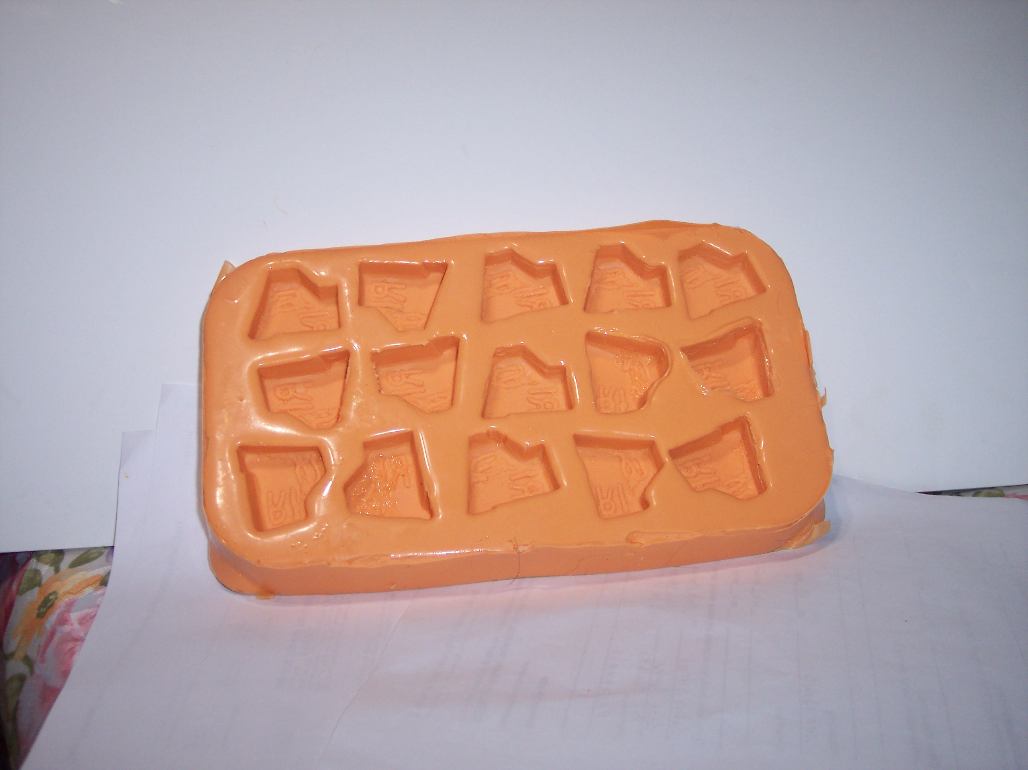
Ta da!

Slide 26
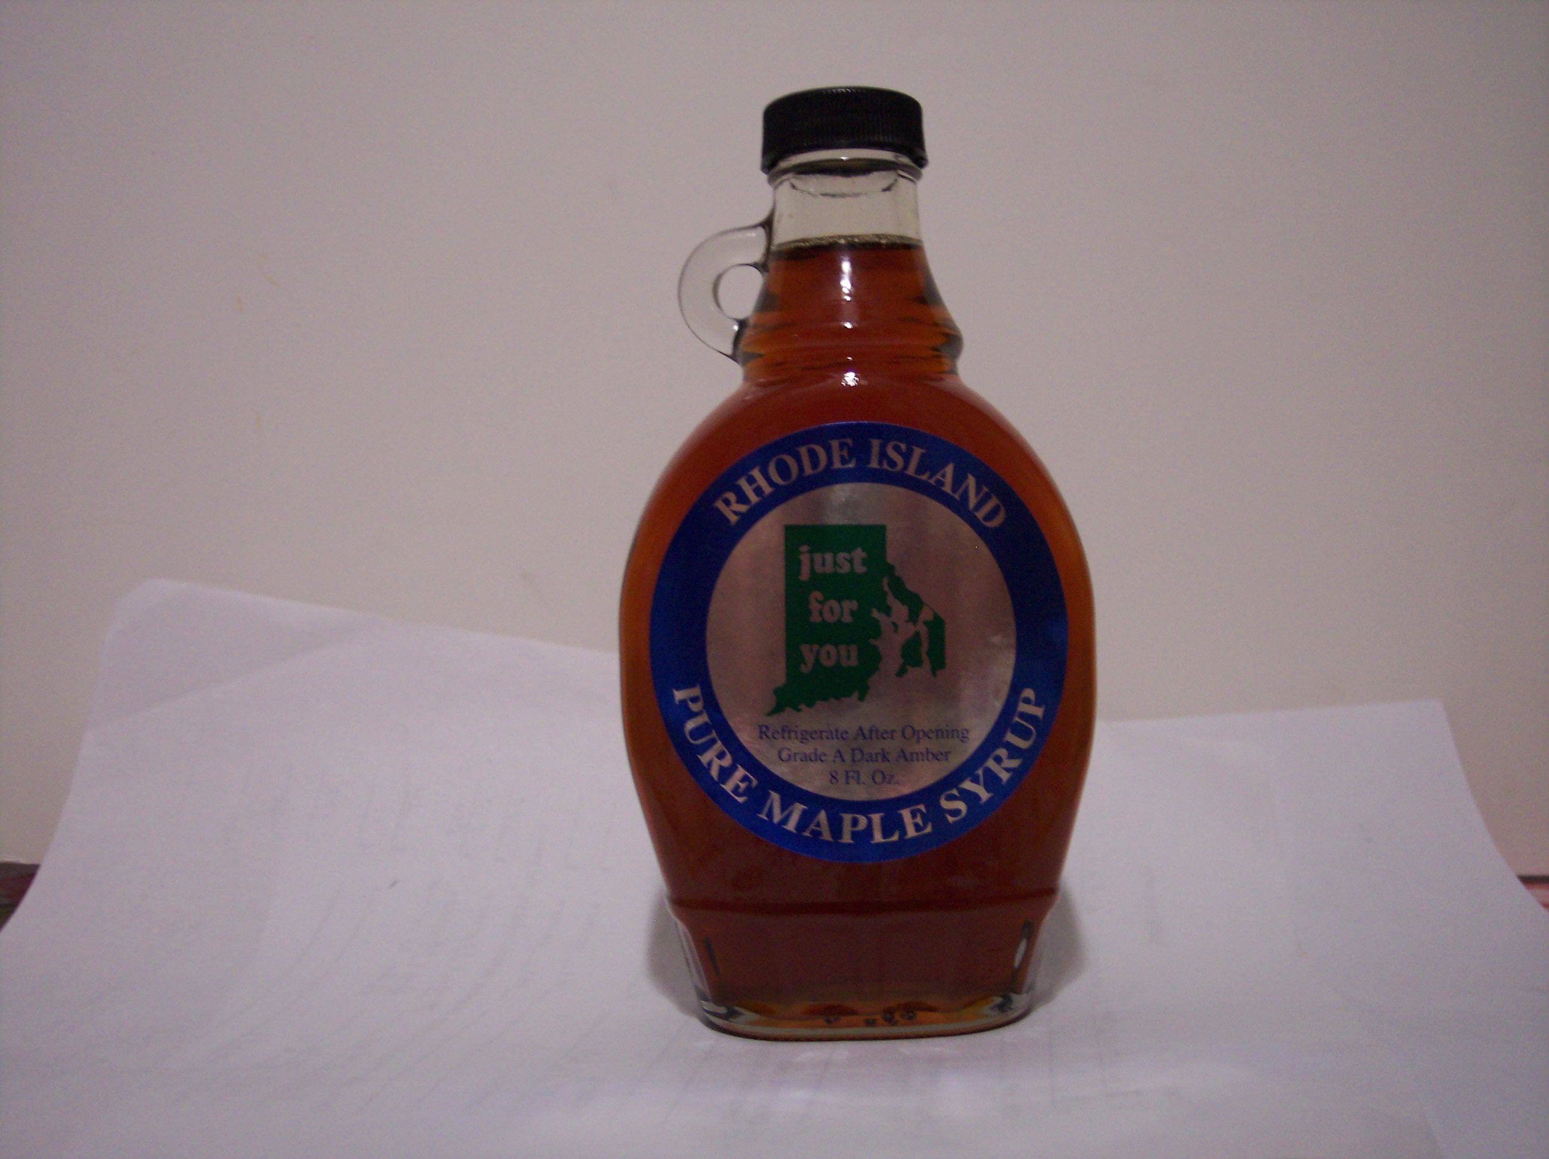
Thank You
For Watching
Power Point by Becky Chase

Slide 27

Project Funded by Northeast SARE
www.nesare.org

