Slide 1

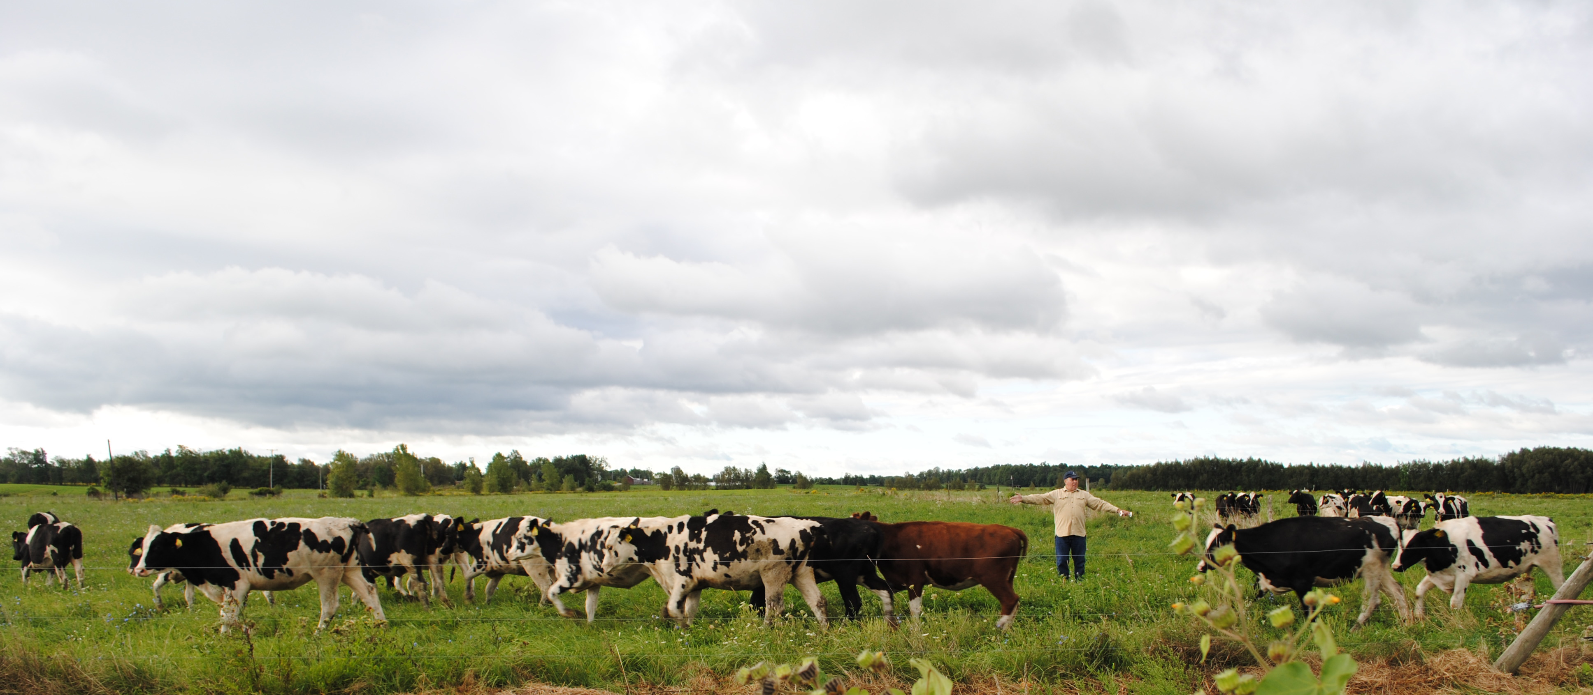
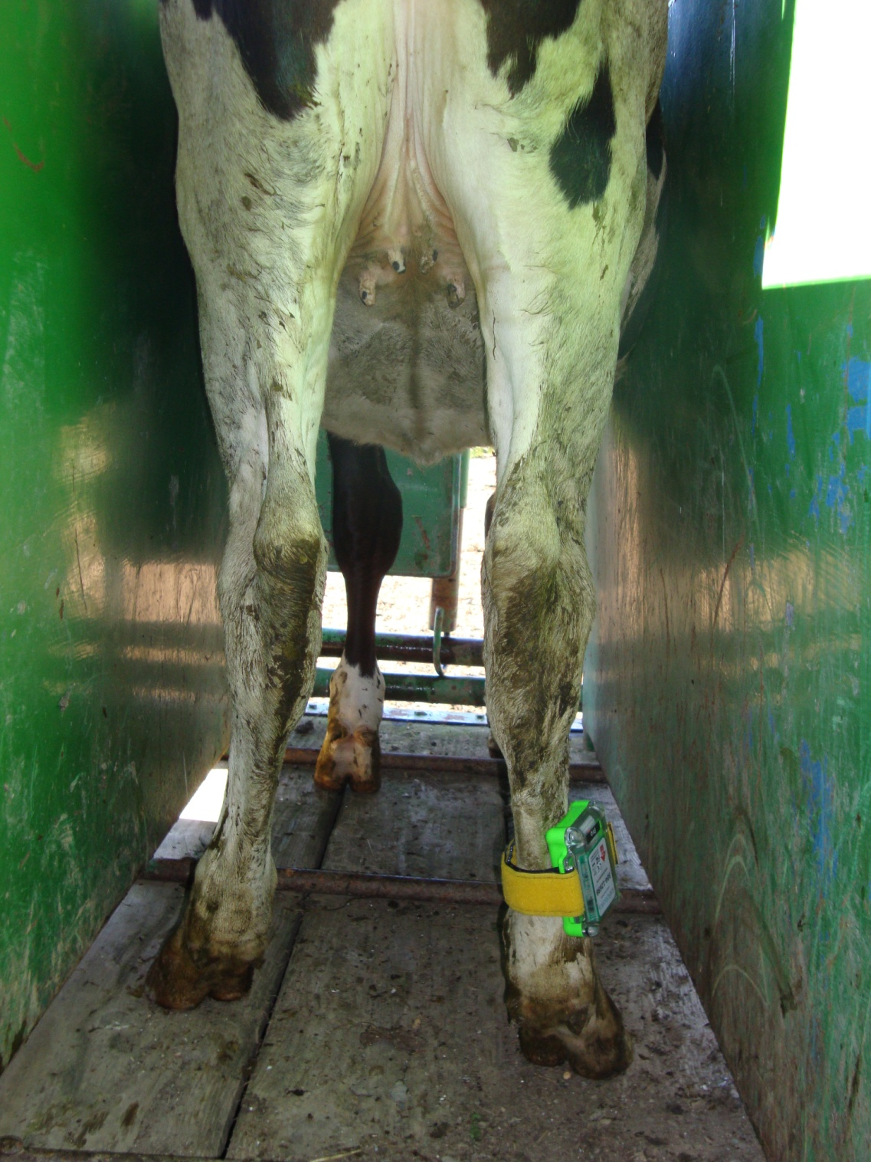

Management Intensive Grazing to Enhance
Heifer Rearing on Large Dairies in the Northeast
Large Dairies are particularly suited to taking advantage of Intensive Grazing Systems:
Opportunities:
Studies show health metrics can be improved
Farms have large groups of heifers of the same age
Can add more or subtract heifers to the systems to improve grazing efficiencies.
Due to CAFO requirements moving animals out of confinement can ease regulations.
Reduce cost of raising heifers.
Barriers:
Many Large Operators see grazing as “Backward”
Don’t understand the variation of forage composition that happen through the season.
Management more critical in grazing vs. confinement to prevent “train wrecks”.
Bergen | Antibiotic Treatment | Calving ease
Grazed | 6 | 1.26
Confinement | 12 | 1.60
Pine Hollow
Grazed | 0 | 1.62
Confinement | 12 | 1.75
The above chart shows how forage composition changes during the pasture season
In a 2009 study, 2 large dairies compared two groups of bred heifers, 25 animals in confinement and 25 on pasture.
After freshening health, parameters were compared. (See results above)
If pasture is the only feed for the heifers the above chart shows what Cornell’s Net Carbohydrate Model calculates Average Daily Gain for the corresponding forage composition.
In a 2010-11 study pedometers were
attached to a group of heifers.
Results established the difference in exercise heifers experience in grazing vs. in confinement. See results in graph above and to the right, notice estrous cycle captured in two of the animals.
Exercise is believed to be the basis of the health benefit for heifers. More study is needed to determine body fat and muscle differences between the two groups.

