Slide 1
Suppression of soybean diseases through the use of cover crops
Darin Eastburn
University of Illinois

Slide 2
Collaborators
Loretta Ortiz-Ribbing – U. of Wisconsin, River Falls
Jason Bond – Southern Illinois University
Joel Gruver – Western Illinois University
Steve Ayres – Aryes Farms
Brad Hunt – Hunt Farms
Michael Plumber – Plumber Farms

Slide 3
Macomb
Champaign-
Urbana
Carbondale

Slide 4
Cover Crops
On-station (40 x 200’ plots)
Cereal rye
White mustard
Rape
Canola
Winter fallow
On-farm (60 x 1000’ plots)
Cereal rye
Rape
Winter fallow

Slide 5
Rye

Slide 6
Rye

Slide 7
Soybeans in standing rye

Slide 8
Rape and Canola

Slide 9
Rape and Canola

Slide 10
Mustard
Winterkilled

Slide 11
Mustard
Winterkilled, replaced by weeds

Slide 12
Sample and data collection
Cover crop biomass
Soil samples
Fall and spring
SCN levels, DNA analysis, bioassay
Soybean stand counts
Soybean disease ratings
Early season (V3), foliar and root
Late season (R6), foliar and split stem
Soybean yields

Slide 13
Q-PCR ASSAYS – UIUC, Fall (pre cover crop)
Plots | BSR(pg/g) | CT(pg/g) | CR(pg/g) | Fv(pg/g) | Pso(Geq/g) | SCN(pg/g)
Rye 1 | 201.7 | 28.3 | 834.1 | 11. | No Ctr | No Ctr
Rape 1 | 609.2 | 186.4 | 7,181.3 | 197.4 | 2.5 | No Ctr
Mustard 1 | 145.2 | 101. | 2,873. | 59.3 | No Ctr | No Ctr
Canola 1 | 217.9 | 52.7 | 2,264. | 92.6 | No Ctr | No Ctr
Fallow 1 | 78.1 | 14.9 | 2,318. | 45.3 | No Ctr | No Ctr
Rye 2 | 313.5 | 80.9 | 300.4 | 331.1 | No Ctr | No Ctr
Rape 2 | 109.5 | 16.9 | 1,525.7 | 634.9 | No Ctr | No Ctr
Mustard 2 | 99.5 | 54.9 | 332.6 | 151.8 | 18,977.3 | No Ctr
Canola 2 | 85.3 | 424.2 | 976.2 | 129. | No Ctr | No Ctr
Fallow 2 | 53.5 | 96.1 | 1,047.4 | 71.3 | 4,568,030. | No Ctr
Rye 3 | 169.9 | 31. | 1,670.5 | 2.9 | No Ctr | No Ctr
Rape 3 | 76.9 | 36.2 | 1,831.4 | .2 | No Ctr | No Ctr
Mustard 3 | 93.9 | 83.1 | 2,297. | 130.8 | 2.6 | No Ctr
Canola 3 | 140. | 38.2 | 3,239.9 | 502.1 | No Ctr | No Ctr
Fallow 3 | 277.7 | 29.2 | 1,173.5 | 157.8 | No Ctr | No Ctr
Rye 4 | 659.2 | 47.2 | 765.8 | 564.8 | No Ctr | No Ctr
Rape 4 | 775. | 88.9 | 3,379.2 | 543.2 | No Ctr | No Ctr
Mustard 4 | 142.2 | 97.1 | 1,561.8 | 354. | No Ctr | No Ctr
Canola 4 | 298. | 25.7 | 662.4 | 199.1 | No Ctr | No Ctr
Fallow 4 | 253.6 | 60.9 | 1,683. | 378.4 | No Ctr | No Ctr

Slide 14
Q-PCR ASSAYS – Ayres Farm, Fall (pre cover crop)
Plots | BSR(pg/g) | CT(pg/g) | CR(pg/g) | Fv(pg/g) | Pso(Geq/g) | SCN(pg/g)
Rye 1 | 350. 0 | 21.3 | 1,203.4 | No Ctr | No Ctr | No Ctr
Rape 1 | 397.3 | 17.1 | 372.6 | No Ctr | No Ctr | No Ctr
Fallow 1 | 210. | 20.9 | 546.2 | 1.2 | No Ctr | No Ctr
Rye 2 | 2,135.1 | 28.2 | 1,799.8 | 2. | No Ctr | No Ctr
Rape 2 | 727.1 | 12.0 | 1,535.5 | 1.4 | 0.9 | No Ctr
Fallow 2 | 1,418.9 | 19.2 | 1,719. | 1.9 | No Ctr | No Ctr
Rye 3 | 5,120.7 | 77.4 | 4,877.8 | No Ctr | No Ctr | No Ctr
Rape 3 | 3,543. | 7.2 | 149.9 | No Ctr | No Ctr | No Ctr
Fallow 3 | 1,292.9 | 21.5 | 1,413.1 | No Ctr | No Ctr | No Ctr
Rye 4 | 1,661.2 | 16.0 | 736.9 | 1.6 | No Ctr | No Ctr
Rape 4 | 887.9 | 52.4 | 1,848. | No Ctr | No Ctr | No Ctr
Fallow 4 | 1,295.1 | 40.3 | 1,080.4 | 1.2 | No Ctr | No Ctr

Slide 15
Brown Stem Rot severity at Ayres Farm

Slide 16
Soybean Stand Counts - UIUC

Slide 17
Fallow Plots - UIUC

Slide 18
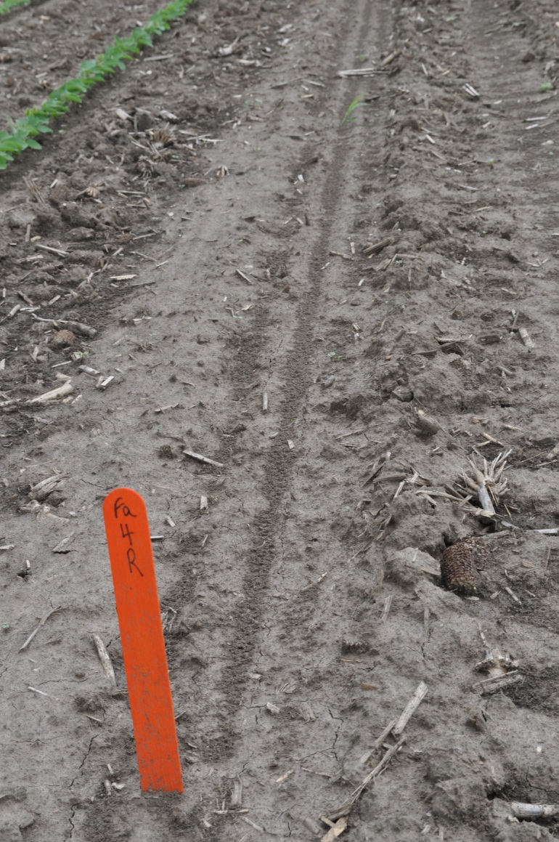
Fallow Plots - UIUC
Control
Rhizoctonia

Slide 19
Rye Plots - UIUC

Slide 20
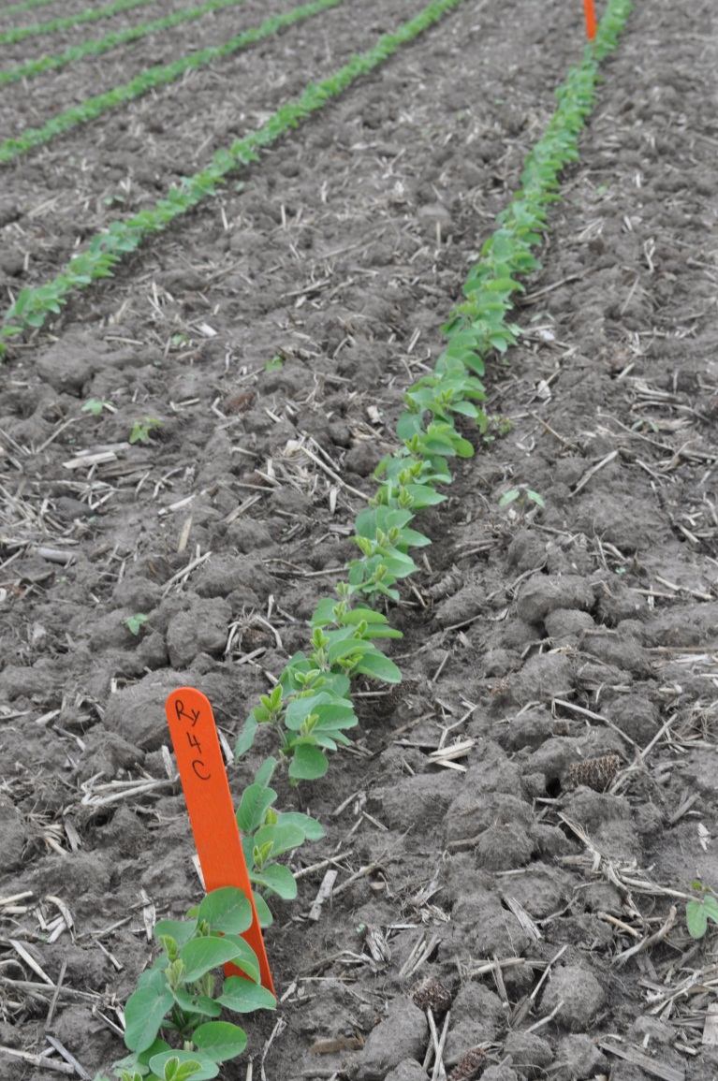
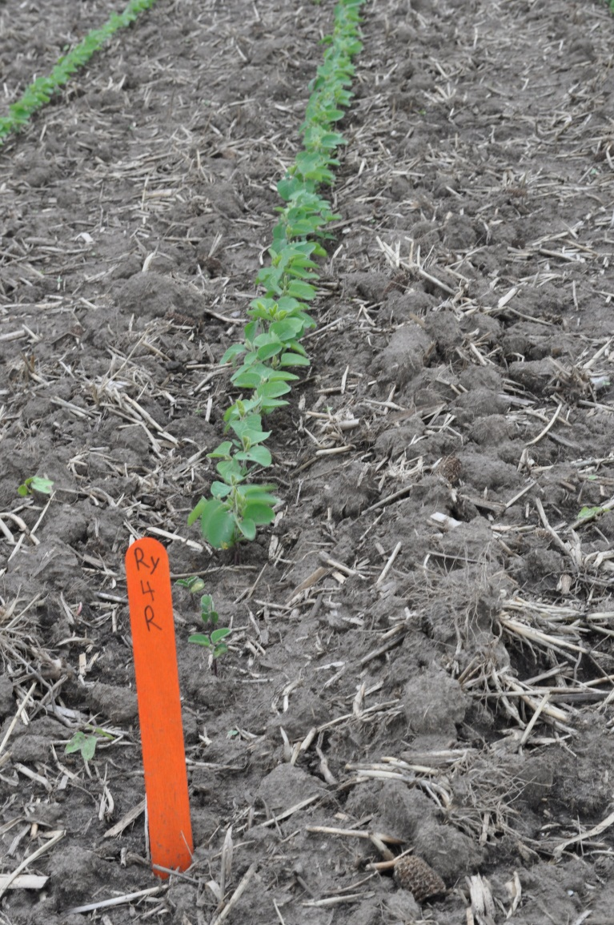
Rye Plots - UIUC
Control
Rhizoctonia

Slide 21
SDS Ratings – UIUC

