Slide 1
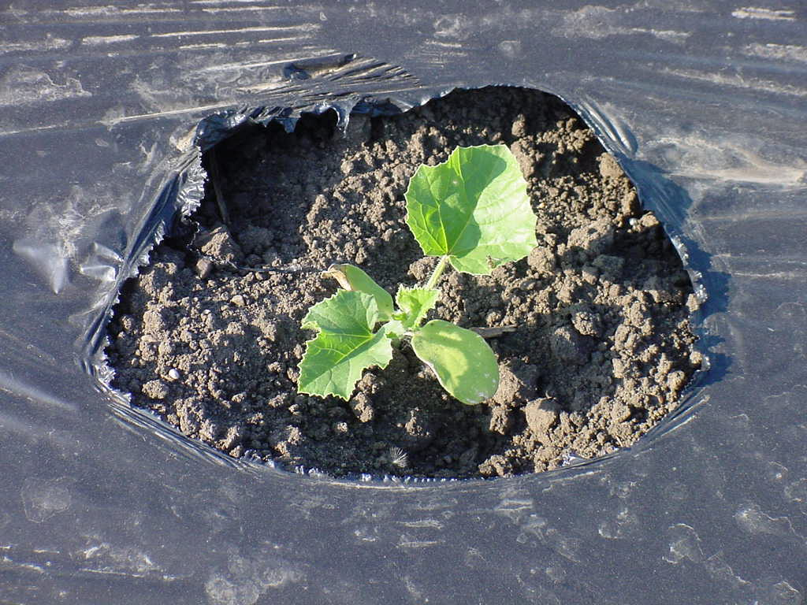
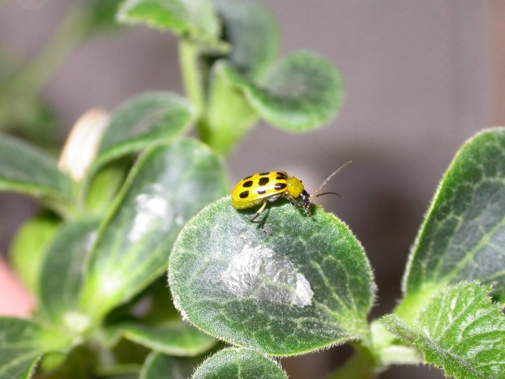
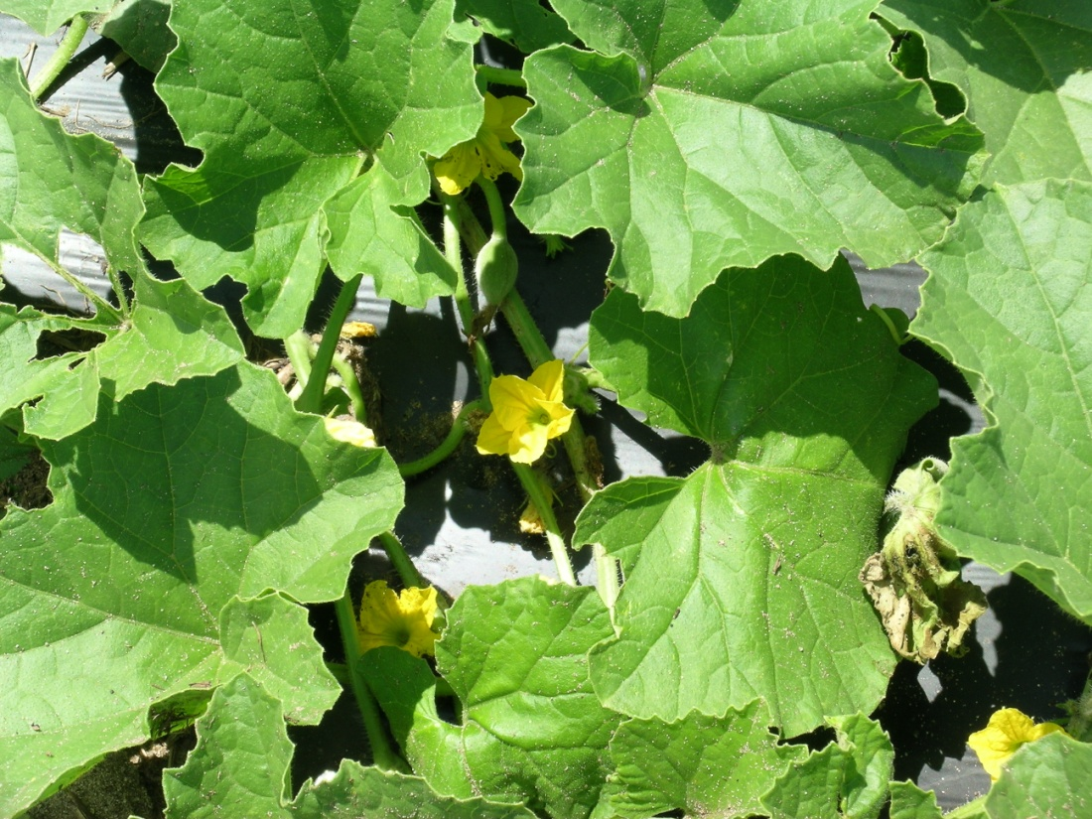
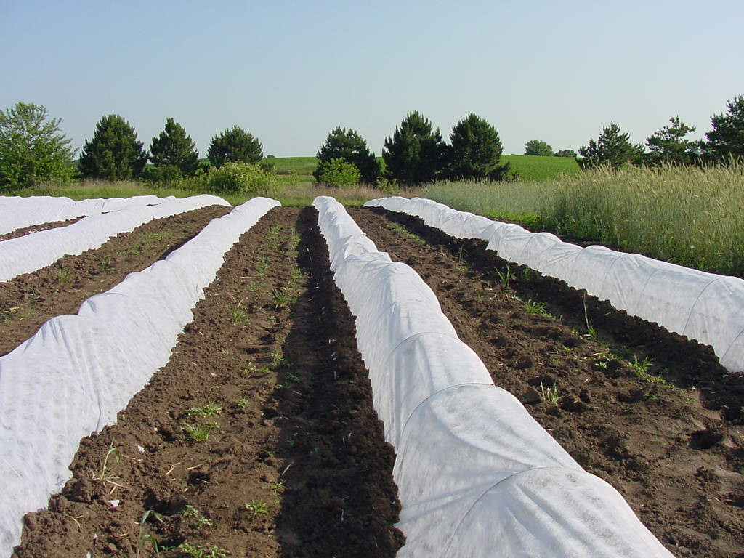
Fighting bacterial wilt with row covers
Erika Saalau and Mark L. Gleason
Plant Pathology Department
Iowa State University

Slide 2
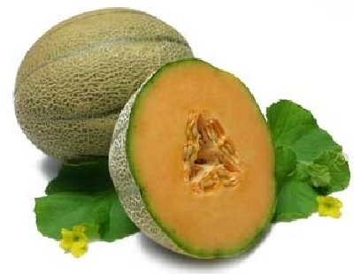
Muskmelons
Transplanted in May-June
First harvest by August
Early muskmelons = premium prices

Slide 3
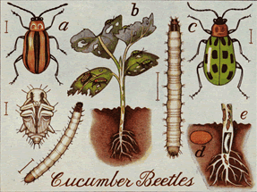
Cucumber beetles
Adult beetles overwinter near fields
Become active in May
Look for young cucurbits
Feed, reproduce, lay eggs
Next generation emerges in fields

Slide 4
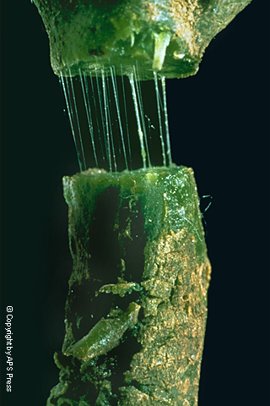
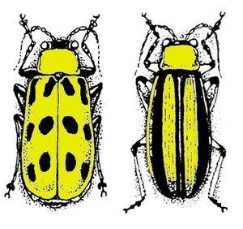
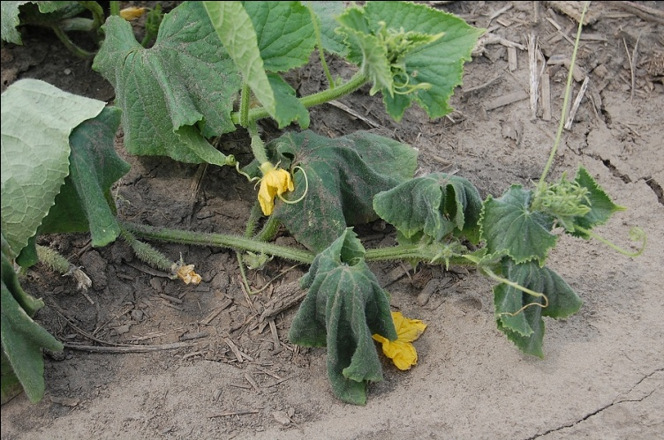
Bacterial wilt of cucurbits
Caused by Erwinia tracheiphila
Transmitted by cucumber beetles
Plants wilt and die

Slide 5
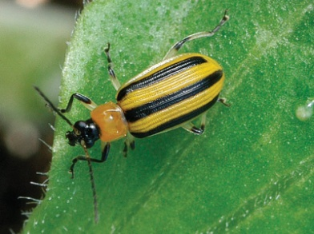
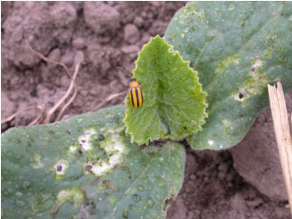
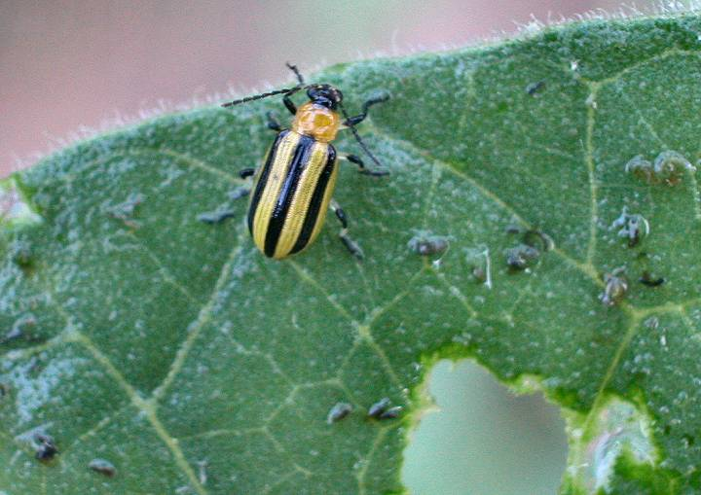
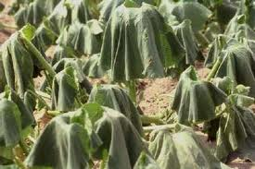
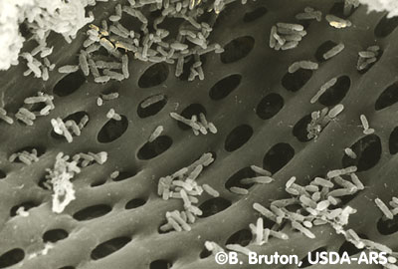
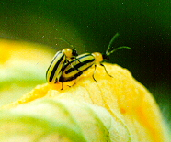
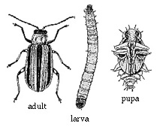
Overwintering adults
Cucurbit seedlings
Transmission
Acquire bacteria
Beetles reproduce
Symptoms

Slide 6
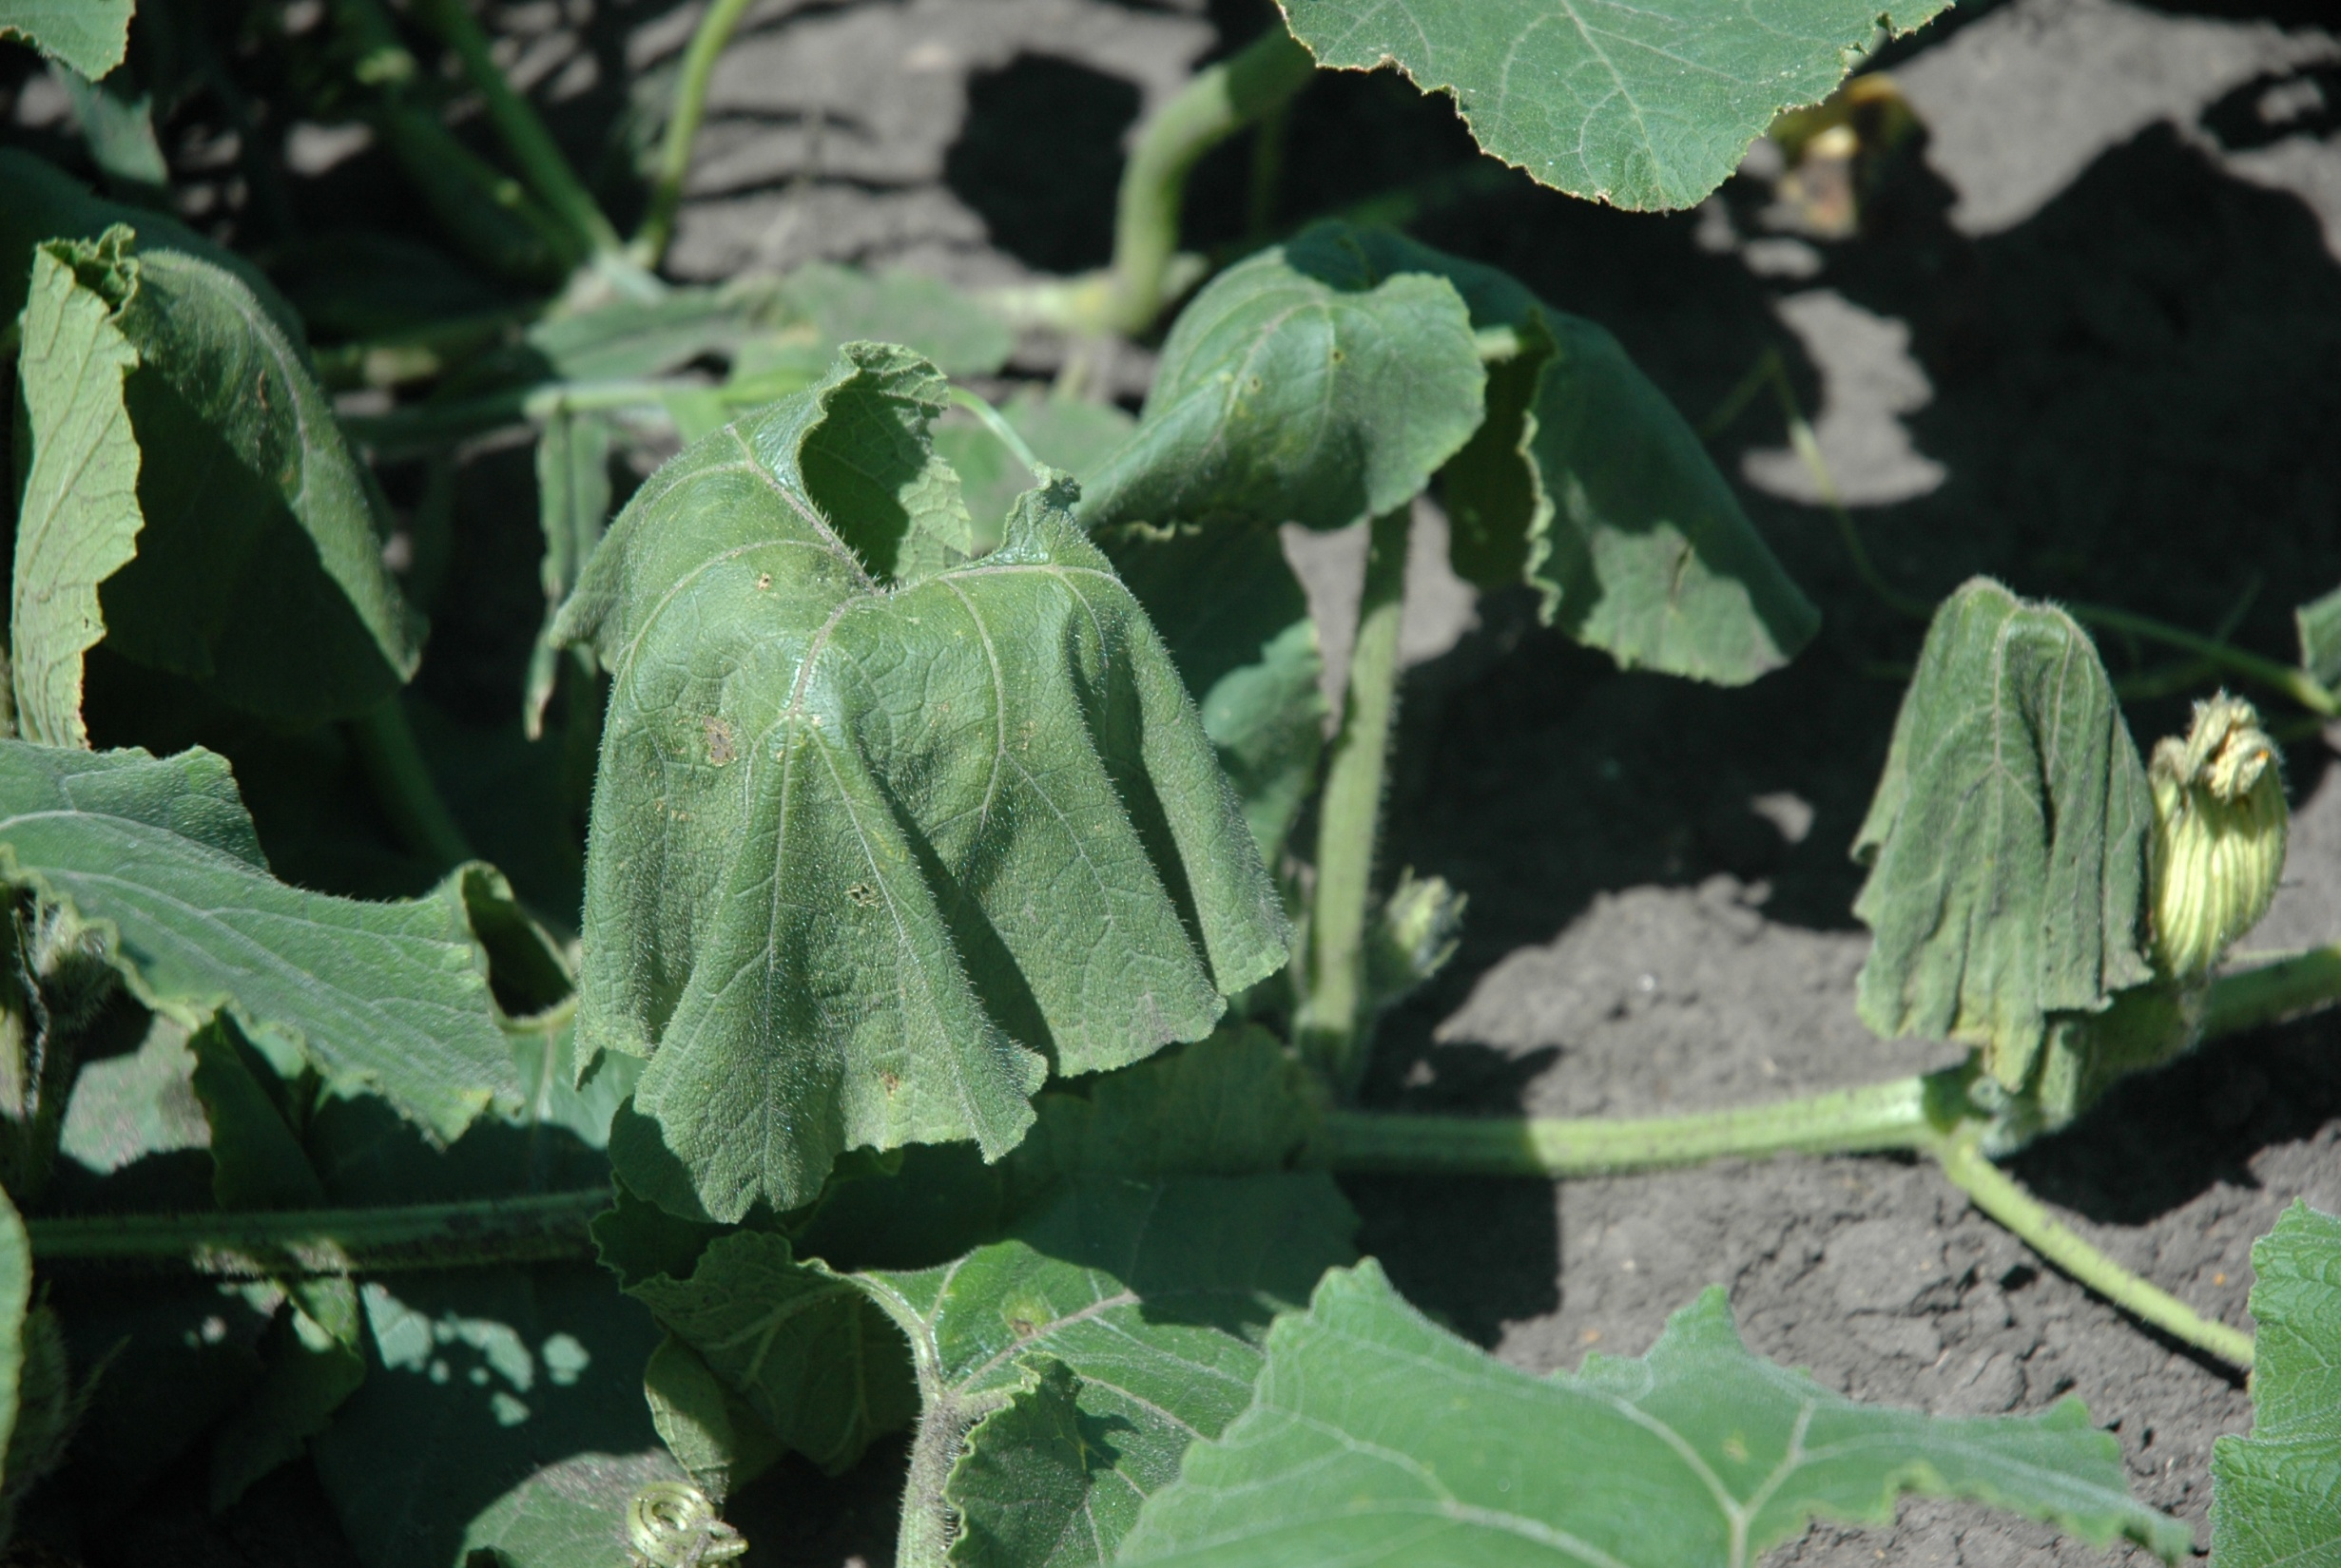
How do plants become infected with the disease?
??

Slide 7
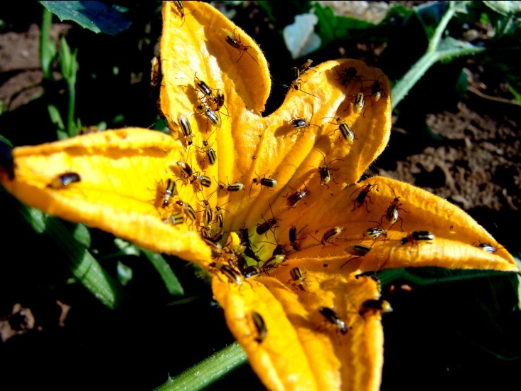
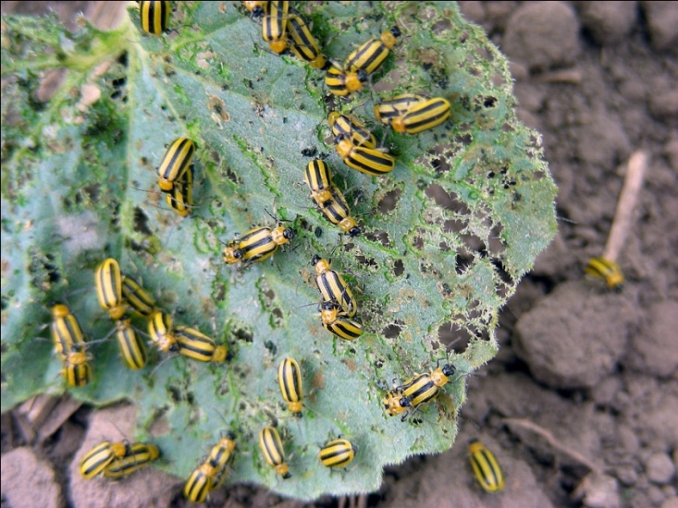
When should I protect my plants?
Early!!!
Highest risk period= early beetles

Slide 8
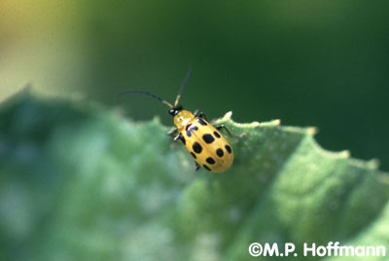
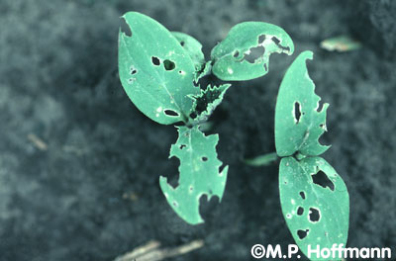
Management
Managing beetles!!!
Insecticides
Trap crops
Baited traps
Row covers

Slide 9
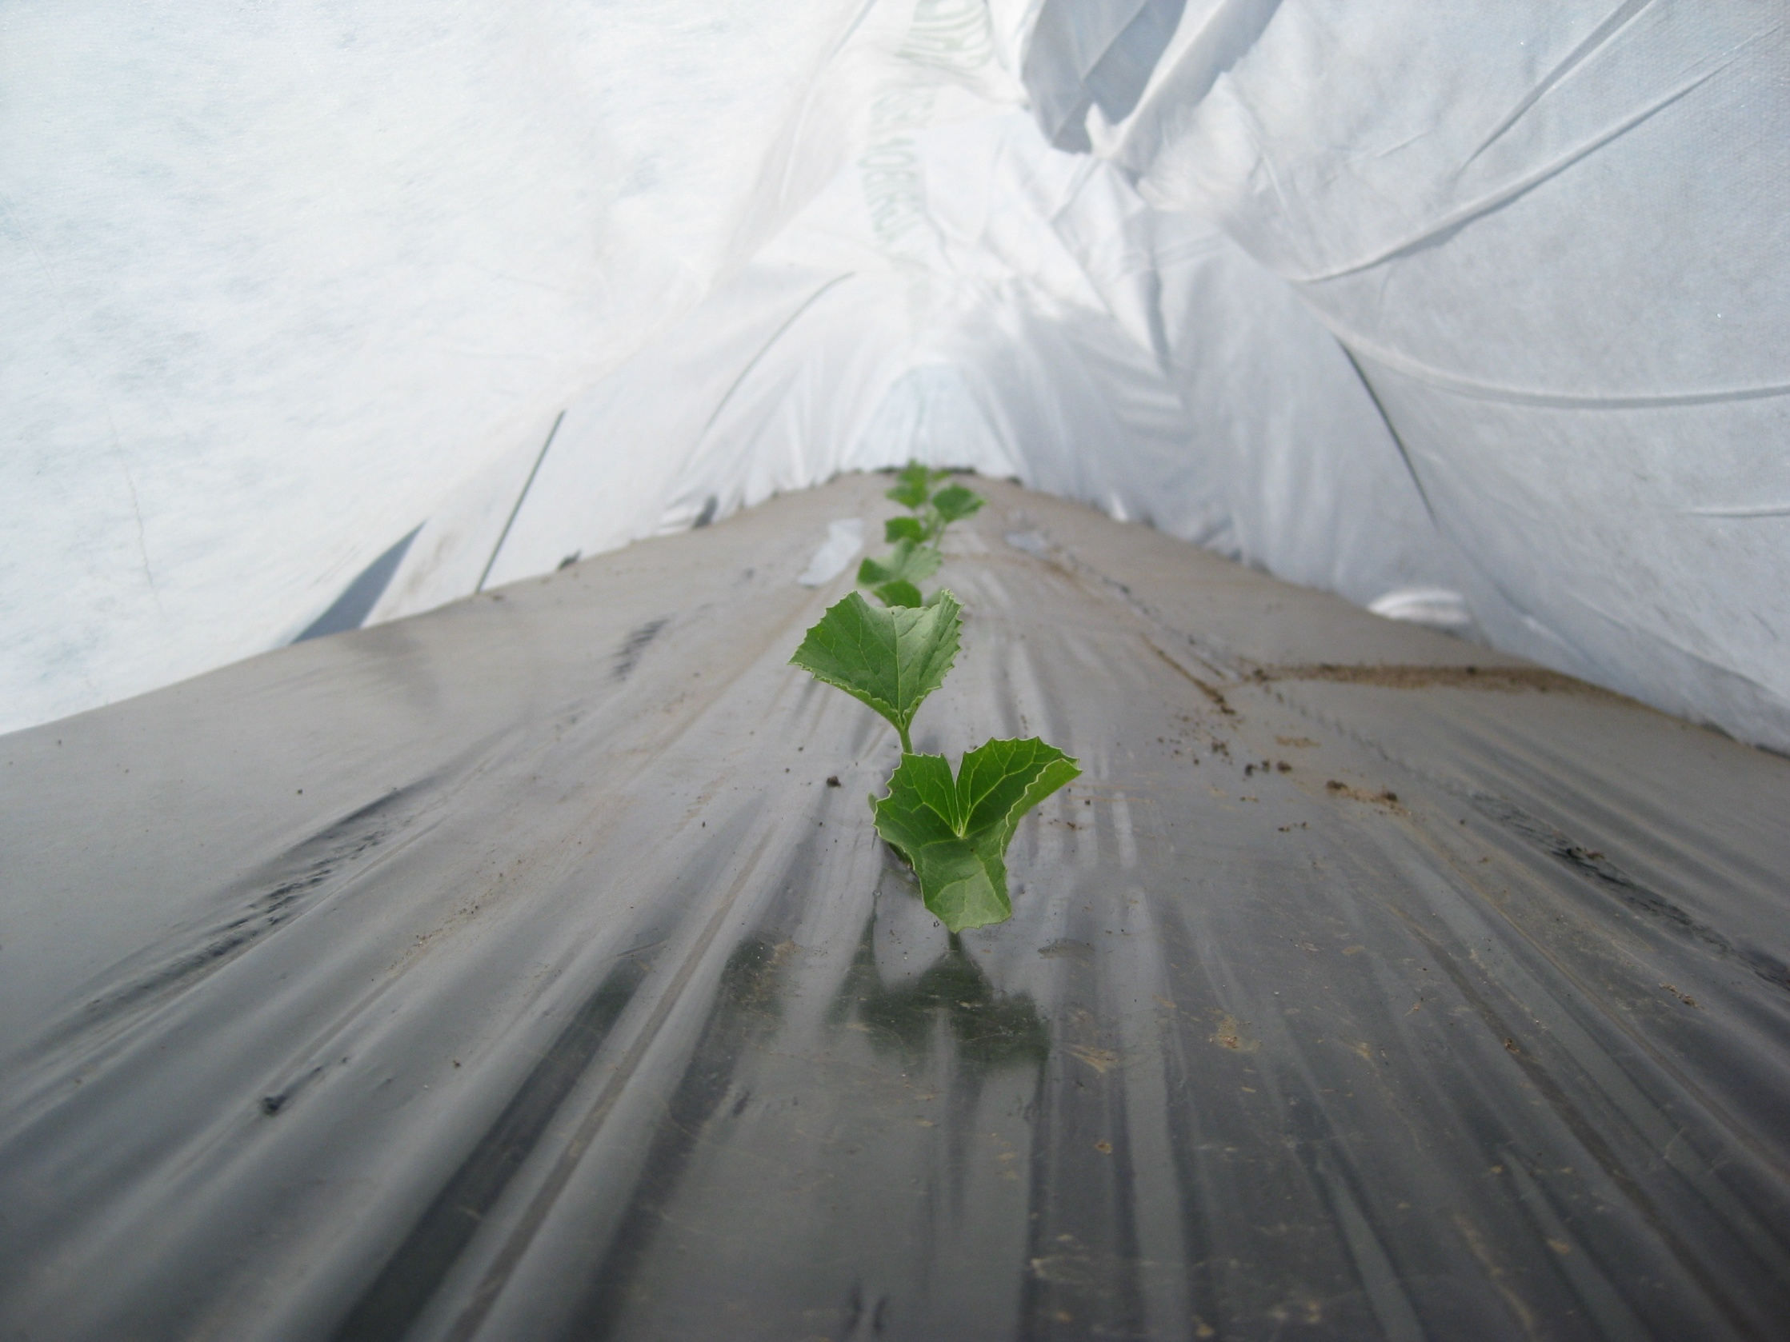
Why row covers?
Protect from frost and extreme weather conditions
Increase earliness and yield
Prevent insect damage
Protect from bacterial wilt!!!

Slide 10
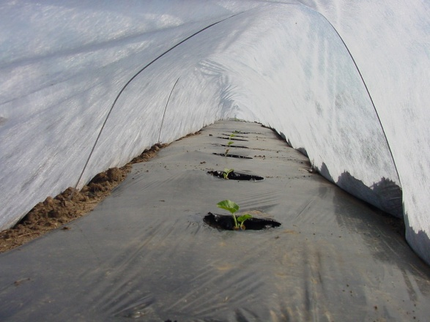
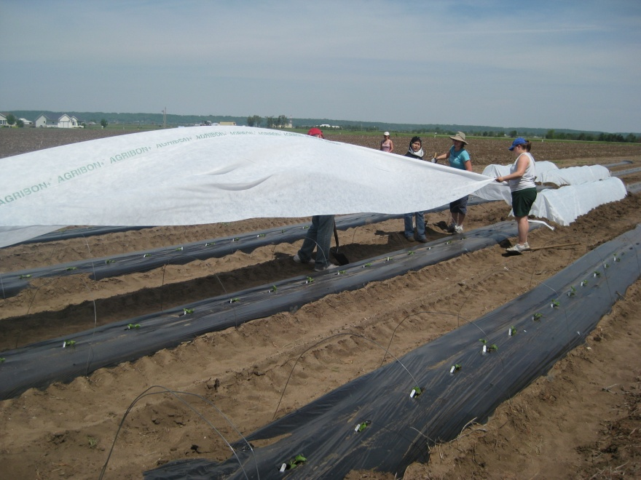
How do they work?

Slide 11

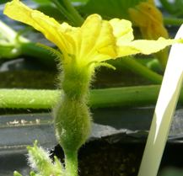
What about pollination?
Timing of removal
Conventional removal= flowering
Could row covers stay on a bit longer?

Slide 12
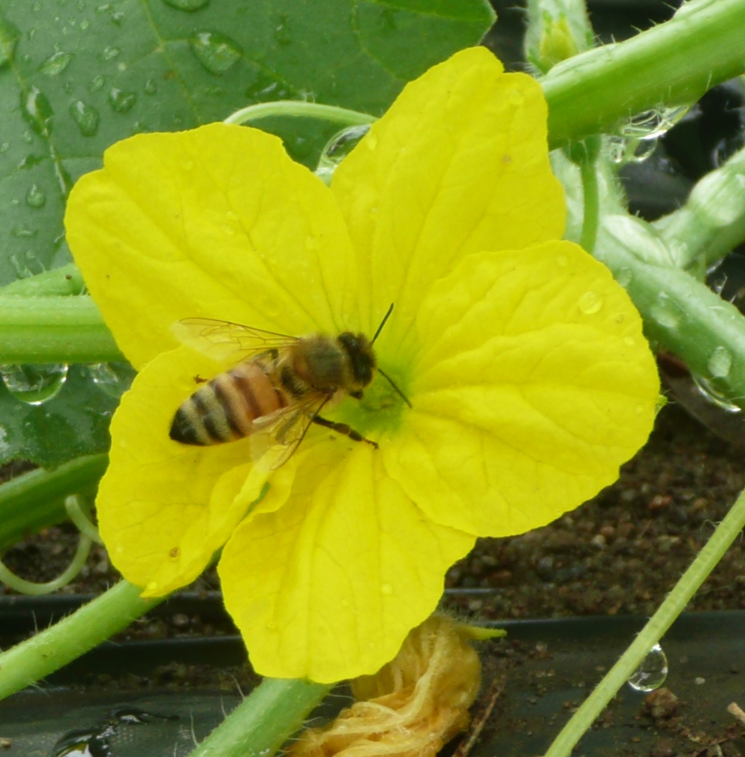
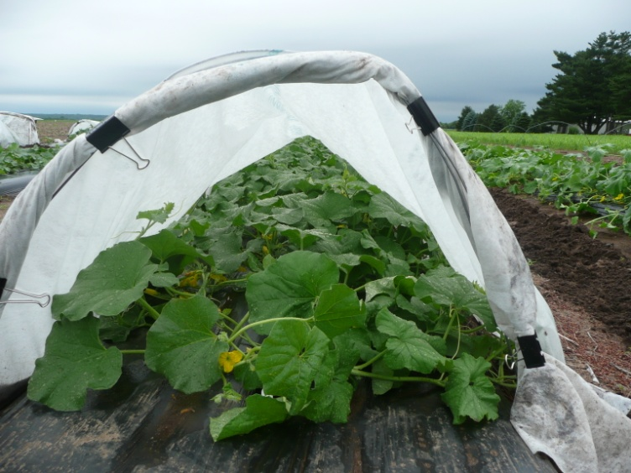
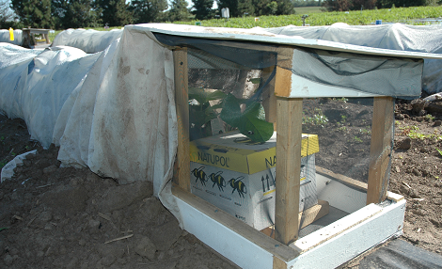
Timing of removal
Open row cover ends for pollinators
Add bumblebees
Remove row covers 10 days after flowering

Slide 13
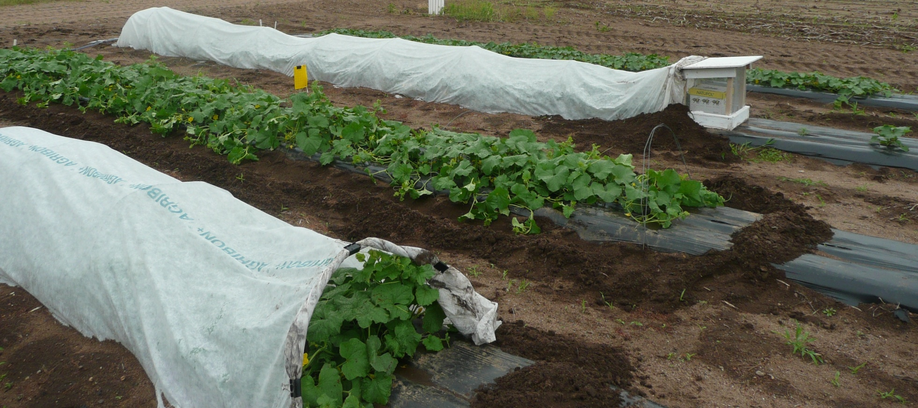
ISU field trials:
Plants were covered from transplant
No insecticides were applied!

Slide 14
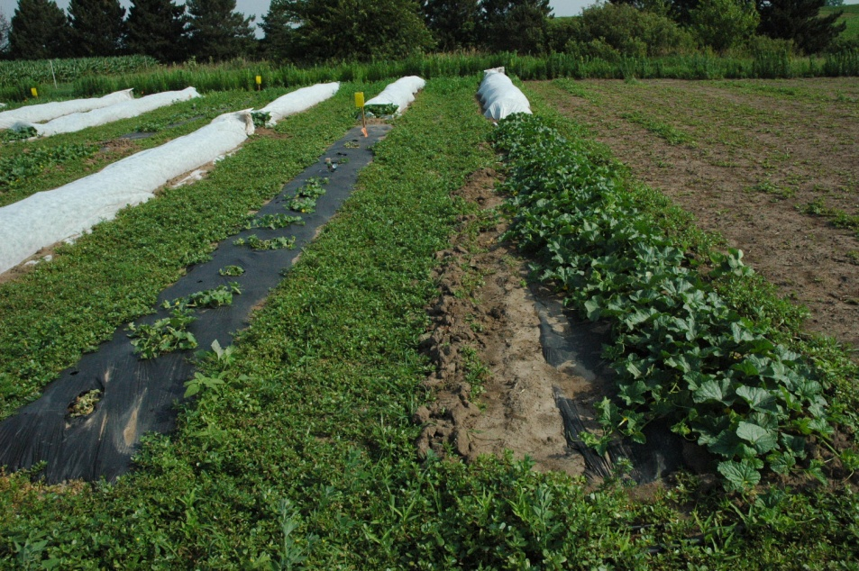
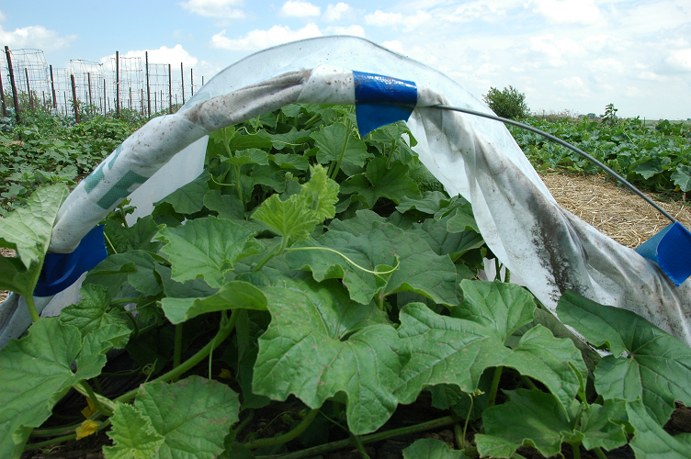
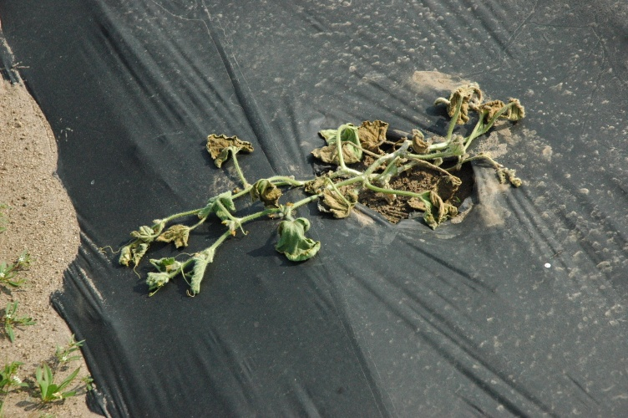
At flowering:
No Row Cover
Open ends
Remove covers at flowering
No Row Cover
Add bumblebees

Slide 15
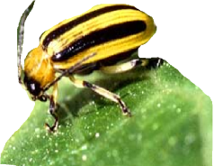
Bacterial wilt incidence
Row covers removed @ anthesis
No row covers
Delayed-removal row covers

Slide 16
Delayed row cover removal
Delaying removal by 10 days can provide season-long protection against bacterial wilt.
This strategy can reduce the need for insecticides.

Slide 17
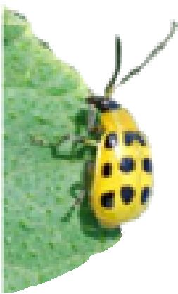
Delayed planting
No row covers
Row covers

Slide 18

Late planting
All row cover treatments suppressed bacterial wilt

Slide 19
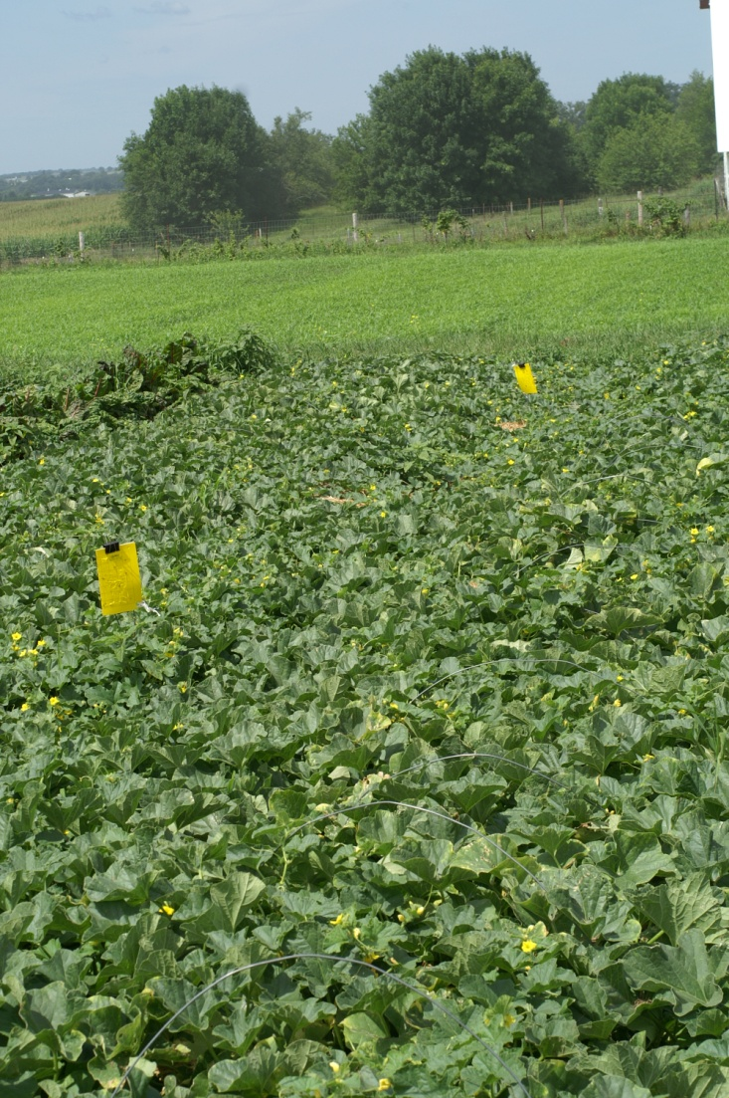
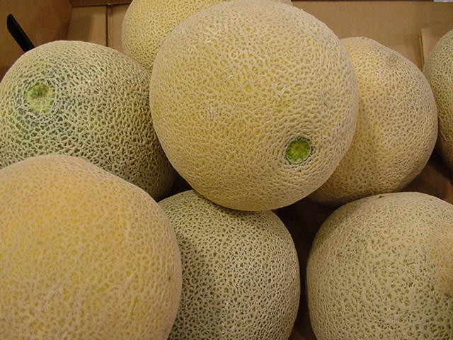
2009
No beetles!
=
No disease

Slide 20
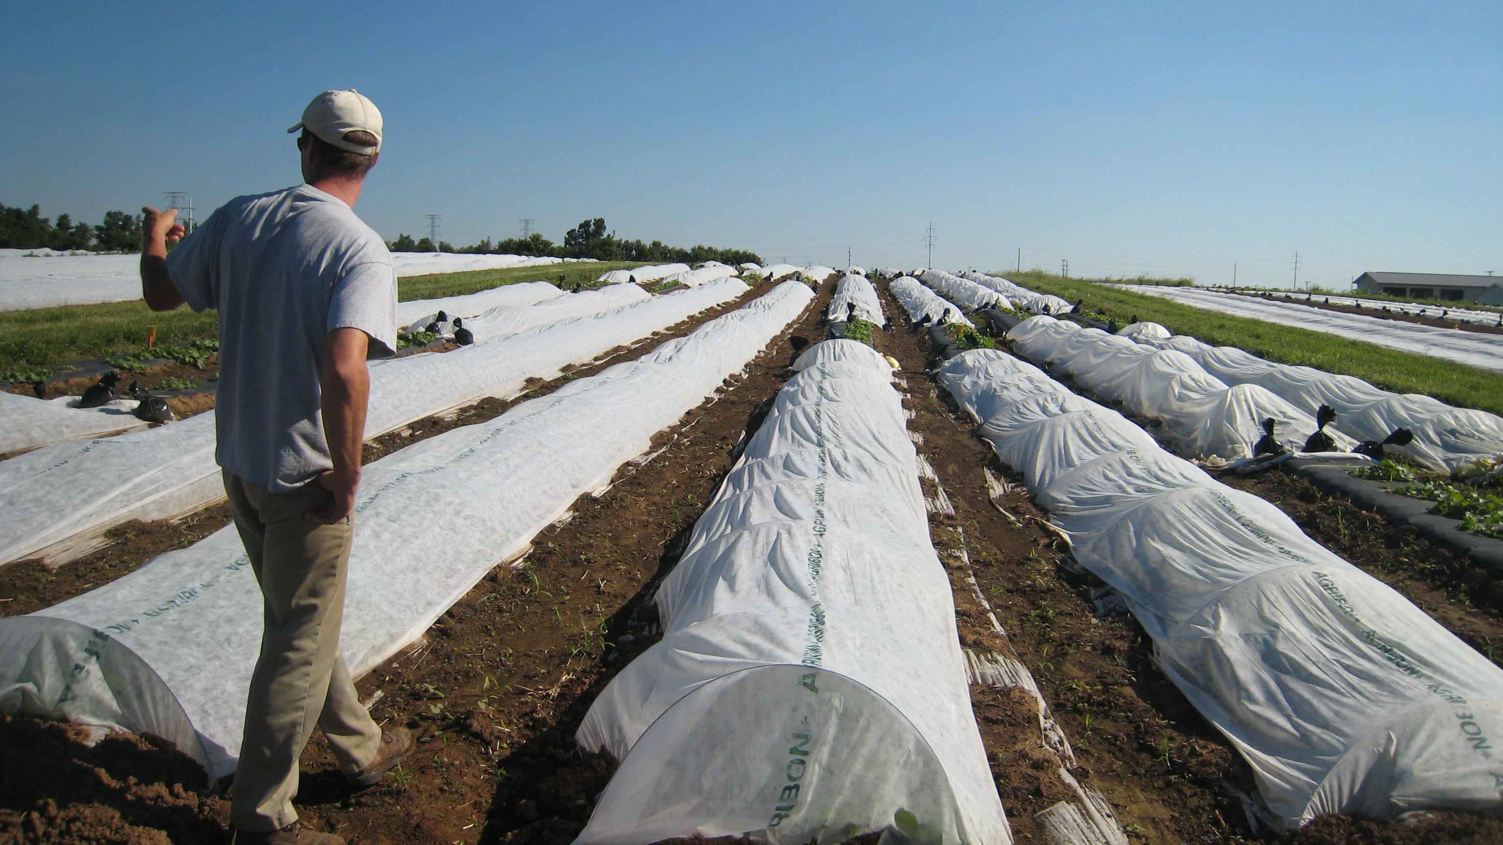
Are they affordable?

Slide 21
Are they affordable?
None
RC removed at bloom
Delayed RC
Delayed RC
RC removed at bloom
None

Slide 22
Take-home points
Sporadic disease in the Midwest
Delayed-removal strategy may provide consistent returns.

Slide 23
Do you feel lucky?

Slide 24
Take-home points
Cost effectiveness is affected by how often bacterial wilt outbreaks occur.
Delayed-removal strategy was advantageous when wilt occurred ≥ 50% of the growing seasons.

Slide 25

Current projects
USDA's Organic Research and Extension
Pennsylvania, Kentucky, and Iowa
http://organiccucurbit.org/

Slide 26
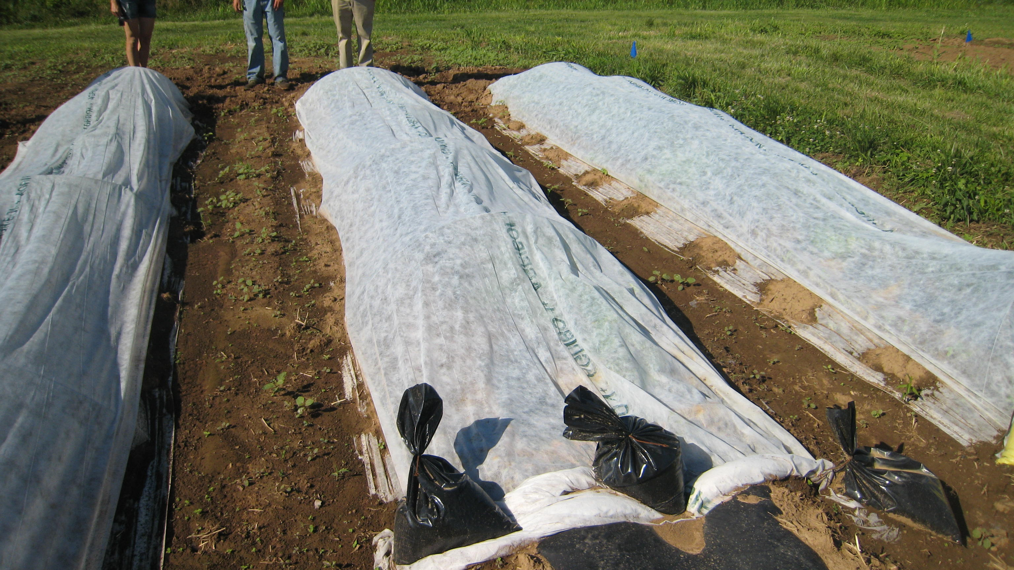
Other options

Slide 27
Thank you!

