Slide 1
Iowa State Univ/OSU PTC Study
2011-2012 – Conventional production
Main crop – ‘Strike’ muskmelons
Trap crop – Buttercup squash ‘Space Station F1’ – two rows surrounding main crop
Control melon plots surrounded by ryegrass
Buttercup squash transplanted June 14, 2011
Muskmelons planted June 30, 2011
Four on-station, two on-farm plots

Slide 2
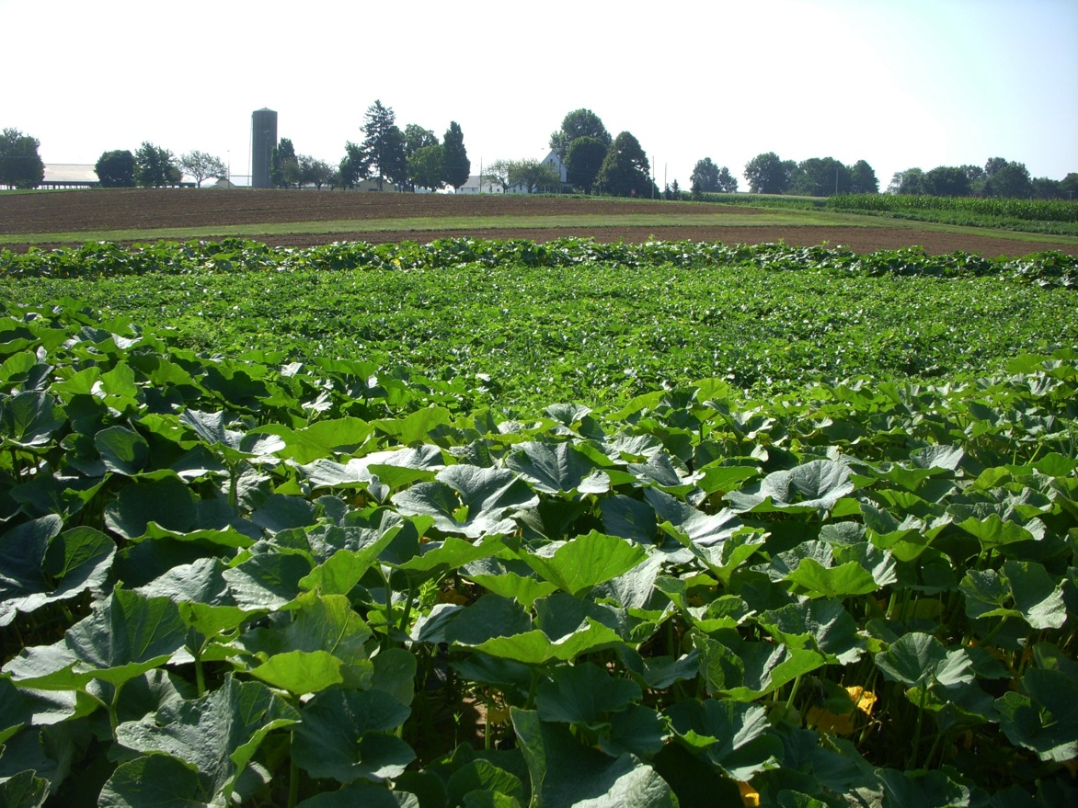
PTC Experiment – Fry Farm, Wooster OH

Slide 3
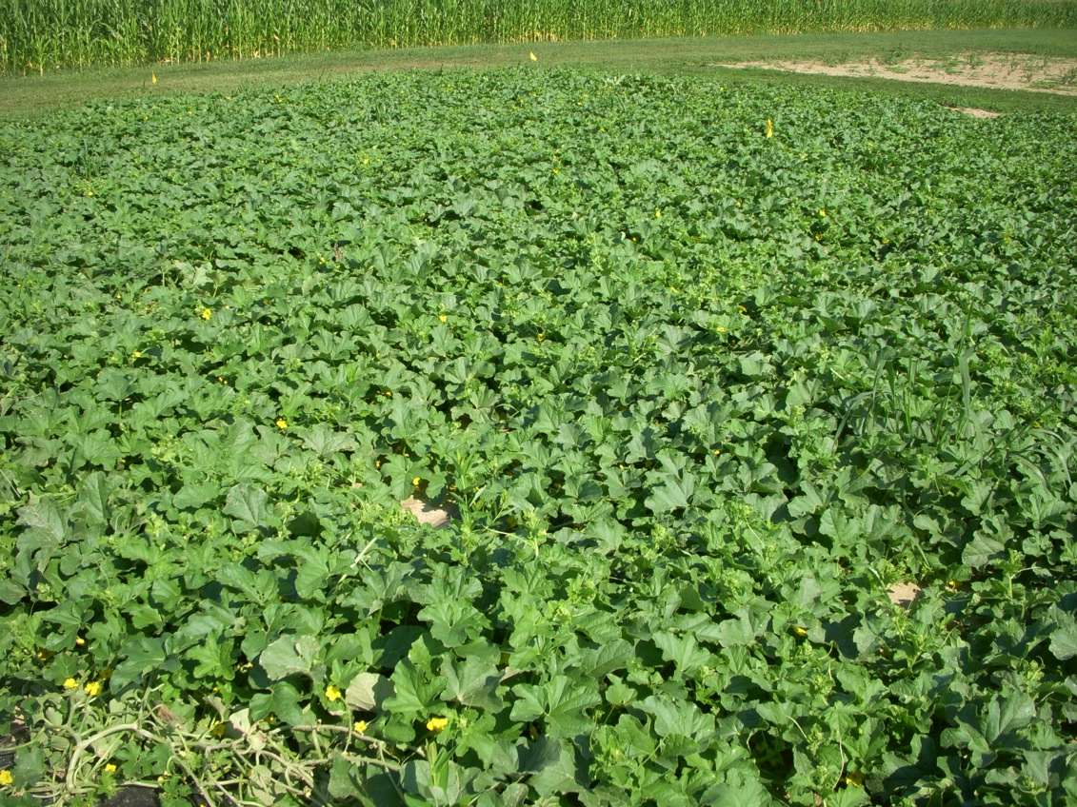
Control Melons – No Trap Crop

Slide 4
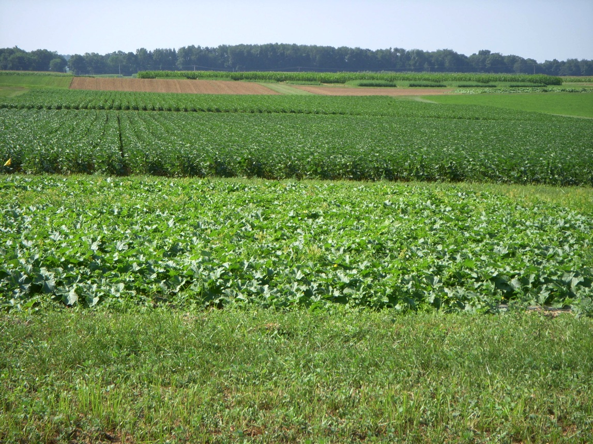
Fry Farm Plots
Control
plot

Slide 5
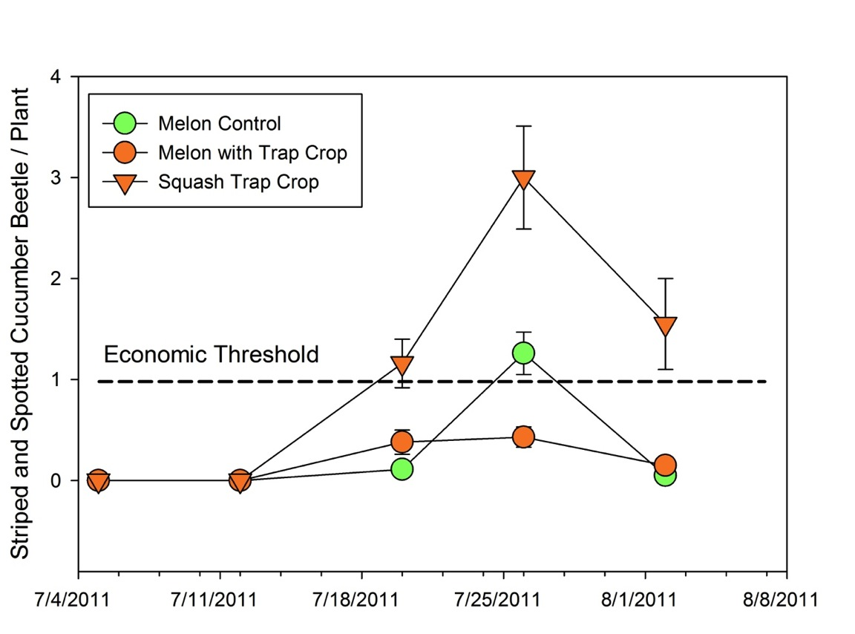
Cucumber Beetle Counts

Slide 6
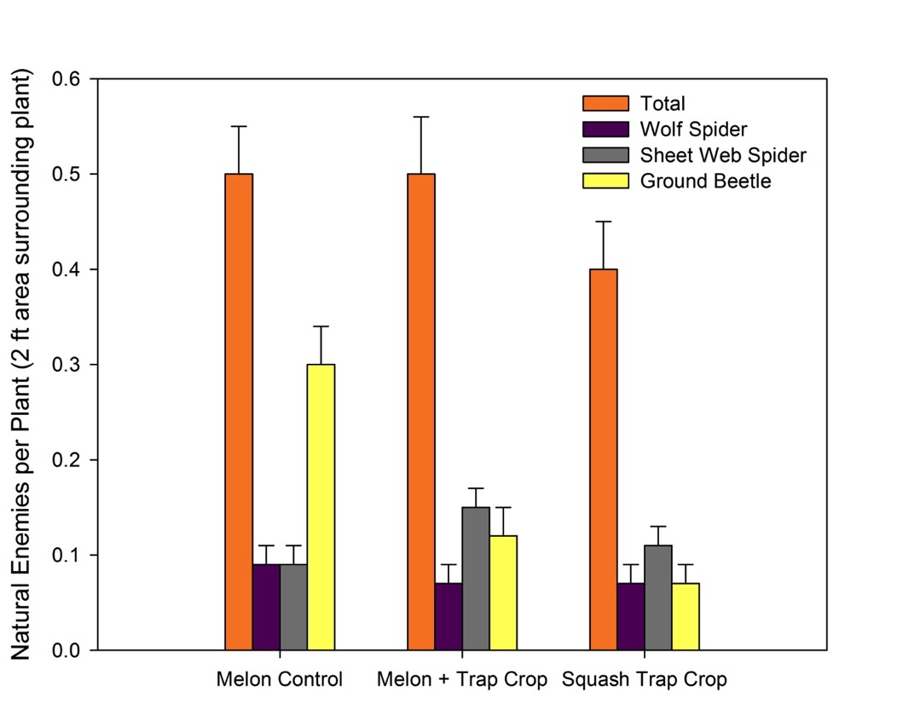
Natural Enemies

Slide 7
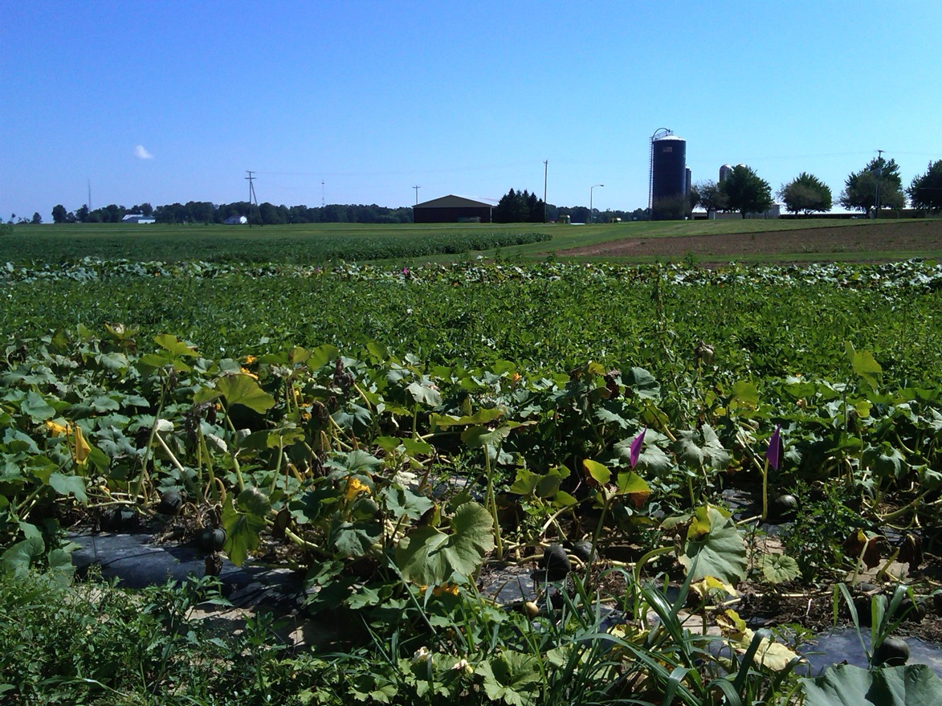
Bacterial Wilt – Trap Crop

Slide 8
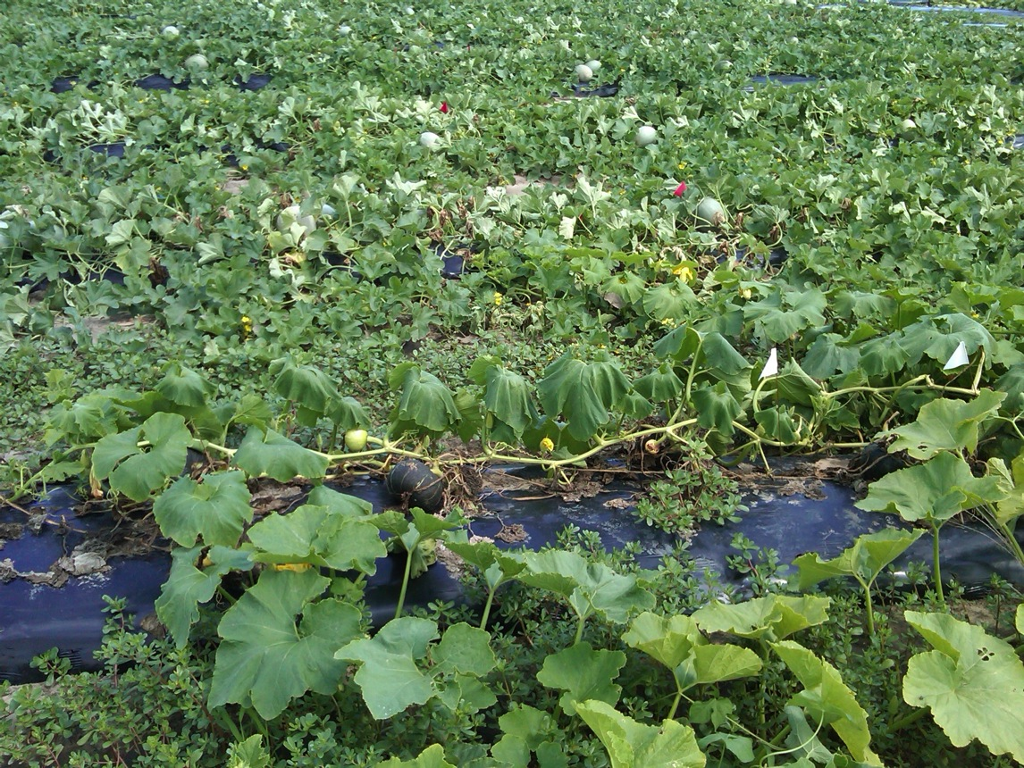
Bacterial Wilt in Trap Crop

Slide 9
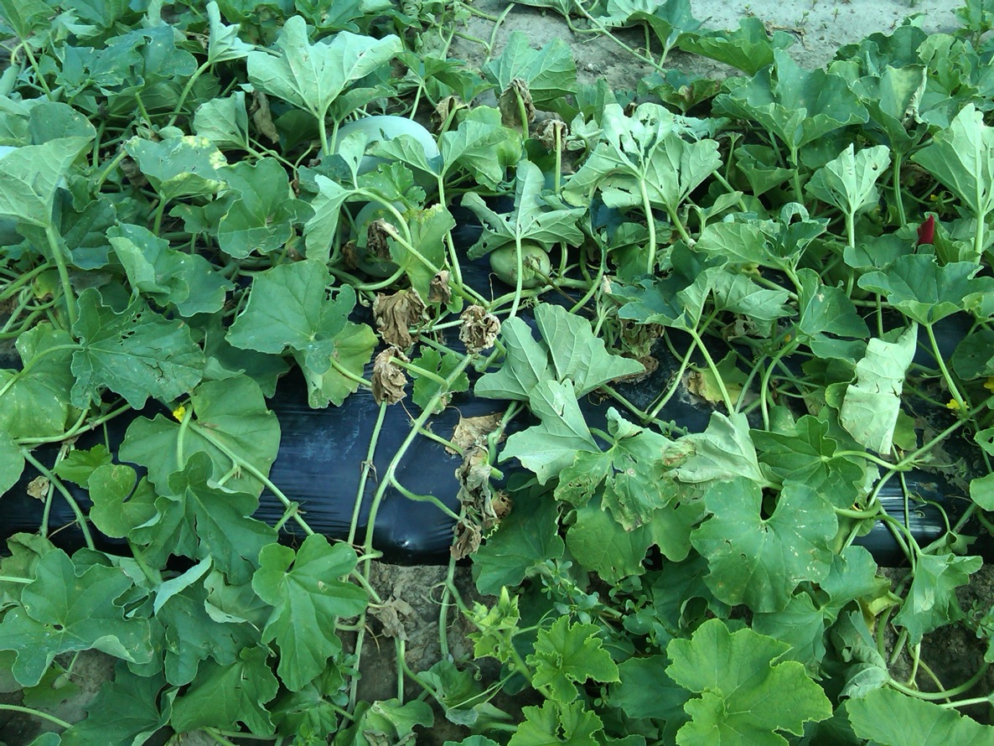
Bacterial Wilt - Melons

Slide 10
Bacterial Wilt Incidence – Fry Farm
% Wilt

Slide 11
Bacterial Wilt – Snyder Farm
% Wilt
Sep 8 Sep 16

Slide 12
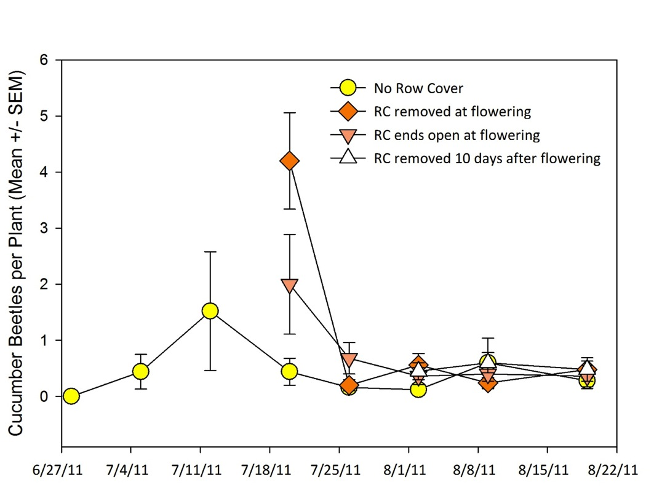

Slide 13
Conclusions -
Can trap cropping be adapted for organic cucurbit production as a bacterial wilt management tool?
Trap crop required several (four) insecticide sprays
Need to use a trap crop that is less susceptible to bacterial wilt than buttercup squash
Currently available organic approved insecticides may not be sufficiently effective against SCB to provide sufficient control
Options? Vacuuming, Surround(?), others?

Slide 14
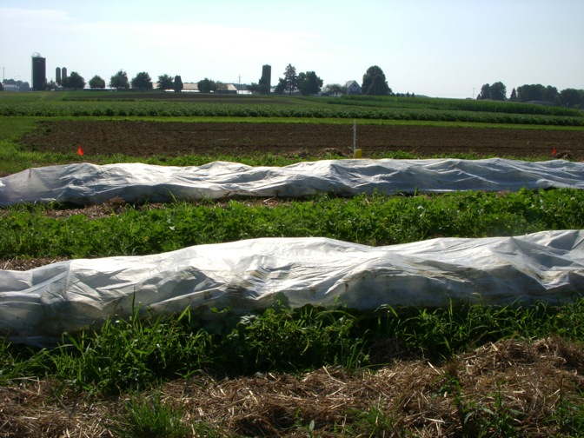
Row Covers
Used to protect cucurbit crops in the spring in northern regions
Accelerate crop development
Protect against environmental extremes
Exclude pests
Remain in place from seeding to anthesis; removed to allow pollination

Slide 15
Extended Duration Row Covers
Preliminary results in Iowa
Maintaining row covers until 10 days past anthesis held bacterial wilt incidence to <20% vs. 80% when row covers removed at anthesis vs. 100% when no row covers used
Row covers opened at ends to allow pollinators to enter

Slide 16
NC SARE ISU/OSU project - 2011
Extended Row Cover Evaluation
Untreated Strike muskmelon seed were sown on May 27
Fertrell Super N 4-2-4 fertilizer was applied in to the field on June 08
Beds were made; drip irrigation tape and black plastic layer were set into the field on June 16
Muskmelon seedlings were transplanted on June 20
Wire hoops, row covers, sand bags and organic rye straw were placed in to the field on June 20
Row covers were removed opened or on June 20 (anthesis) and June 30

Slide 17
Row Cover Treatments

Slide 18
Row Covers Removed – After June 30

Slide 19
Results
Beetles did not reach threshold levels in any of the treatments
No bacterial wilt was observed
Focus on yield data

Slide 20
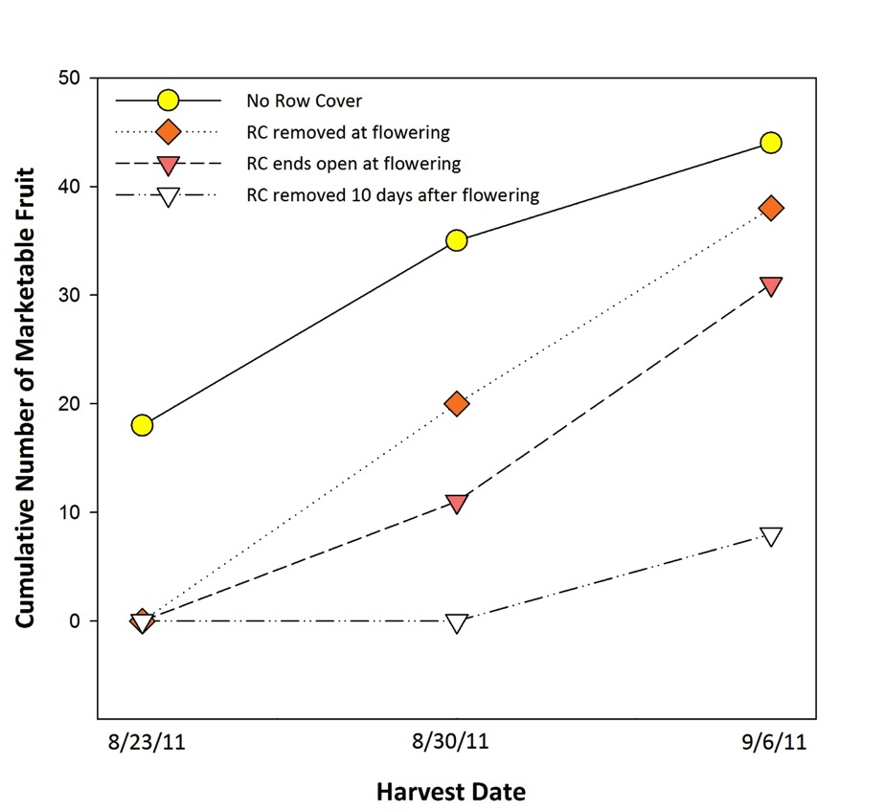
Yield Results – Marketable (number)

Slide 21
Conclusions…so far
The advantage of using Extended Duration Row Covers depends on SCB/bacterial wilt pressure
On-farm trials – beetle populations were very low
No bacterial wilt or beetle damage to crop
Reduced yield in row covers not balanced by losses in plots without row covers
Cost and Returns…
Row covers increase costs 45%
Delaying removal of row covers – highest returns when bacterial wilt is present; lowest returns when it is not
Most value in areas where bacterial wilt is a recurring problem

