Slide 1
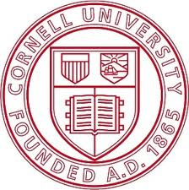
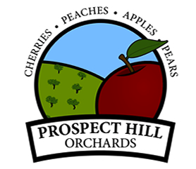
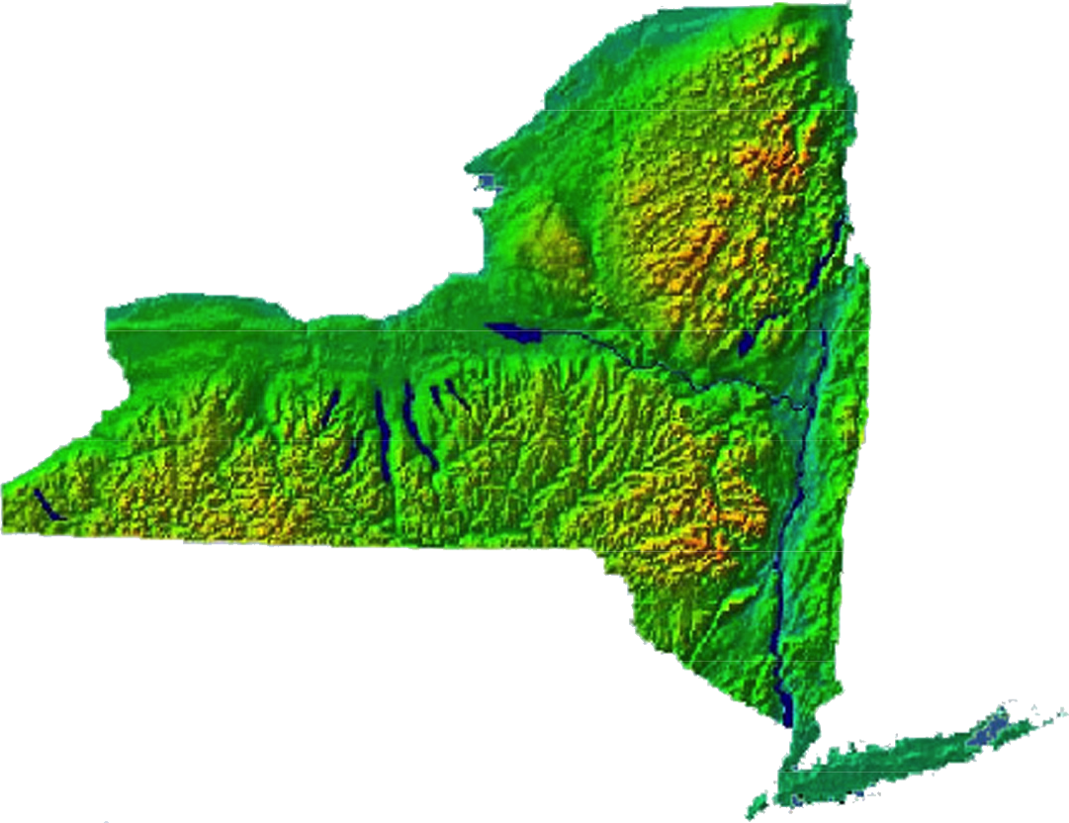
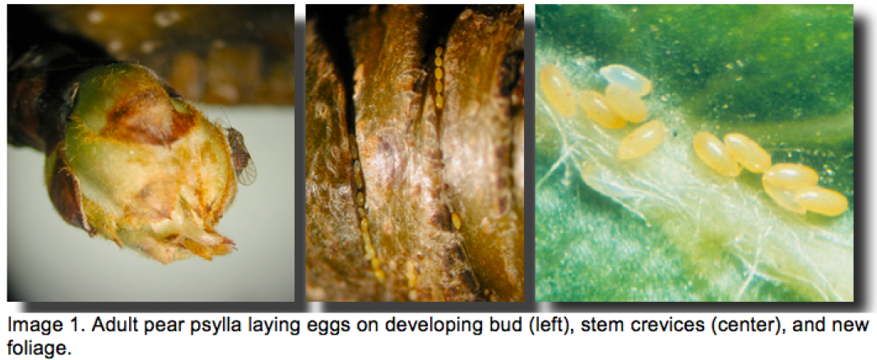
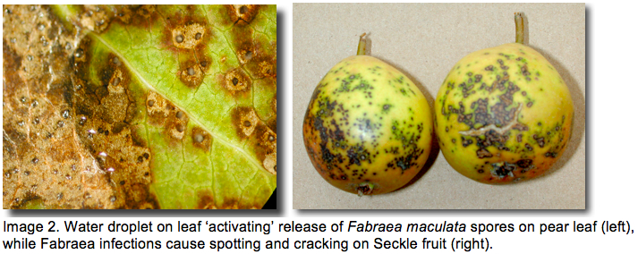
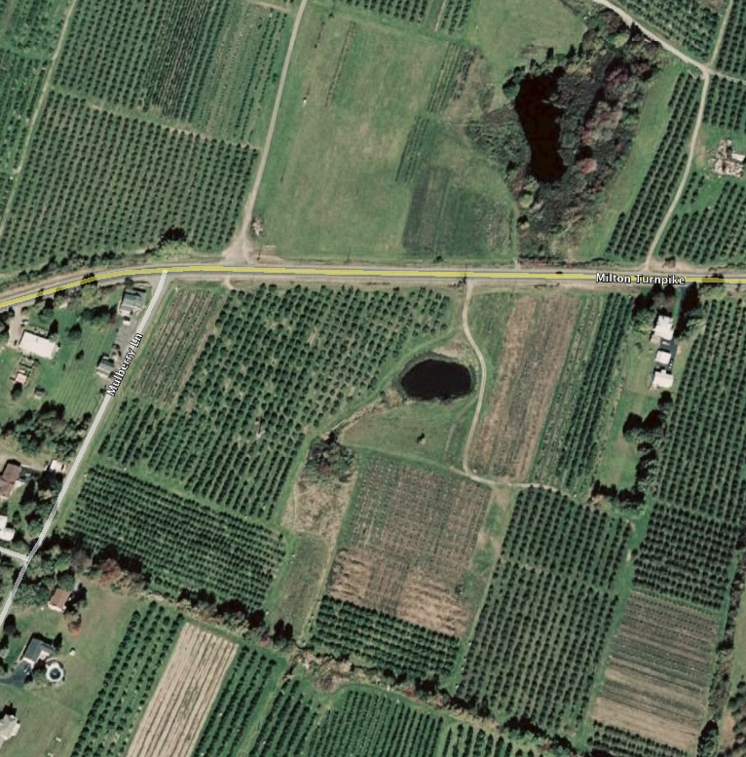
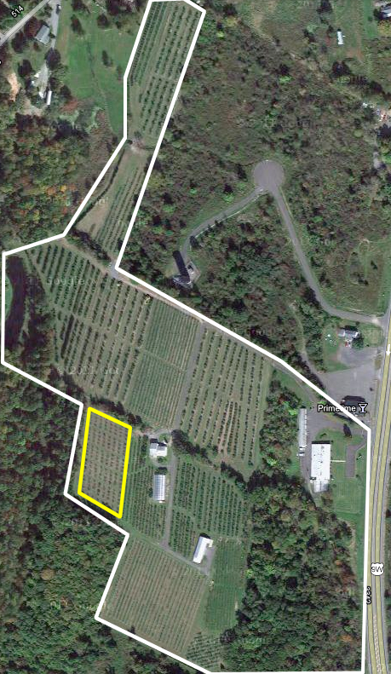
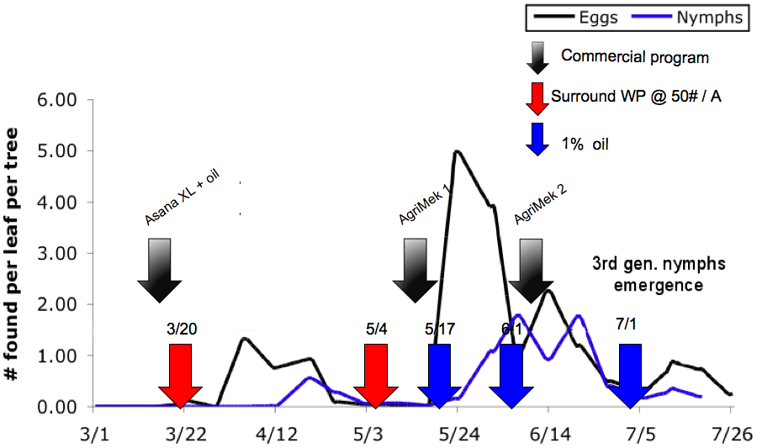
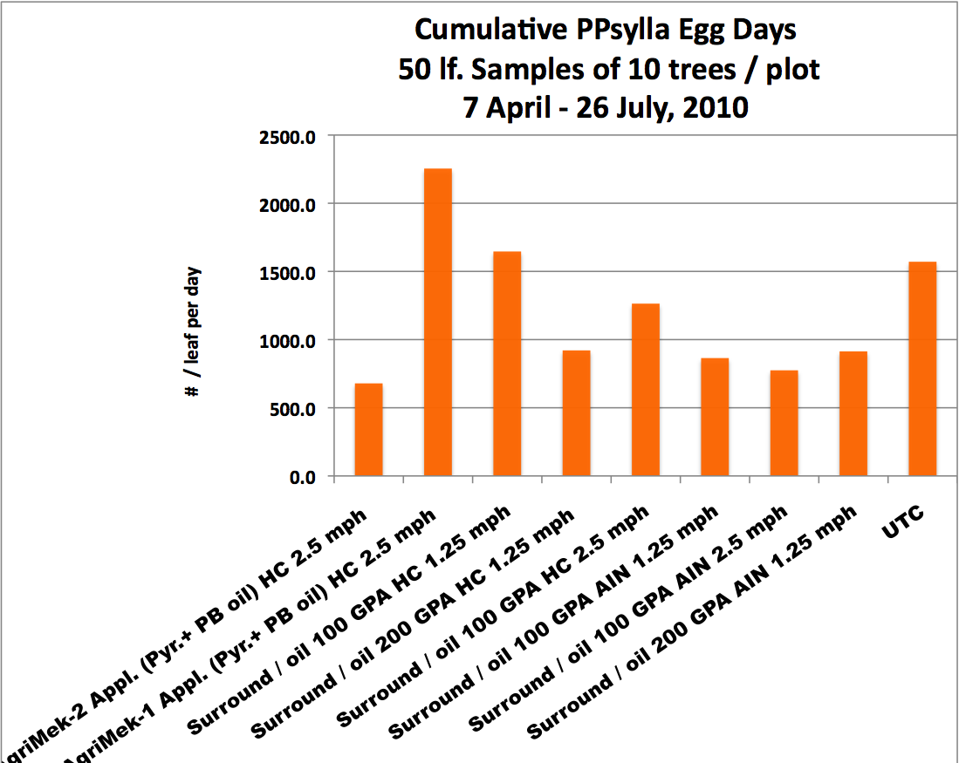
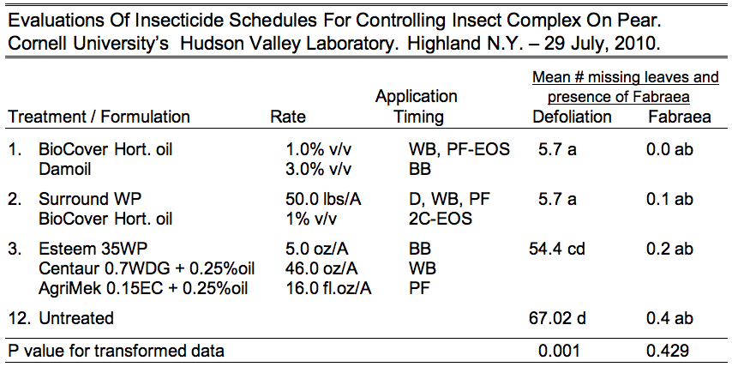
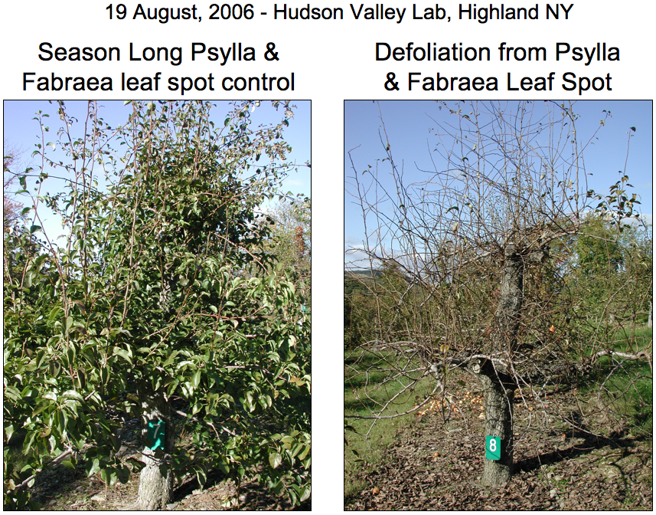
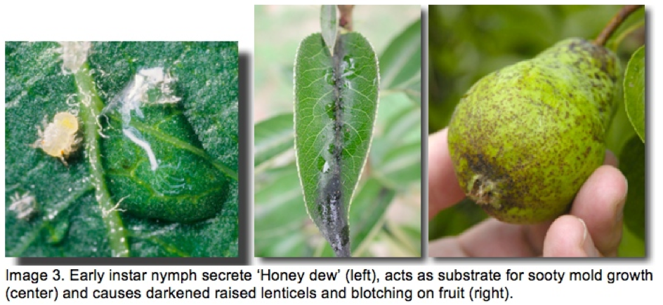
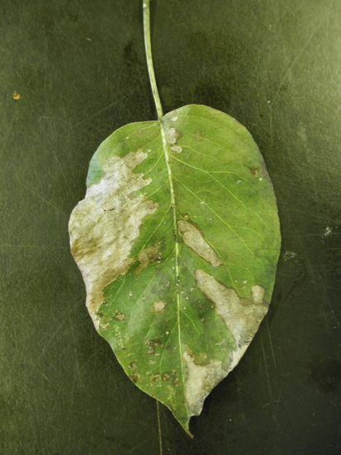
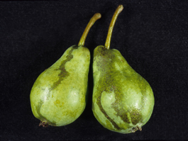
Use of Surround WP ® and Horticultural Oil to Manage Pear Psylla & Fabraea leaf spot P.J. Jentsch Cornell University’s Hudson Valley Laboratory, Highland, NY
Funded by:
Overview
Pear production in NYS is managed on nearly 2000 acres, with crop yields producing roughly 16,500 tons, valued at 3.85 million dollars. In the Hudson Valley region, pears comprise about 800 acres (USDA, 2005). The principle pests of pear production in the Northeastern US are pear psylla, Cacopsylla pyricola (Foerster) (Image 1), and Fabraea leaf spot, Fabraea maculata (Image 2). These two pests cause premature defoliation, reduced size, quality, yield, premature decline of susceptible varieties (Image 3 & 4).
Development of insecticide resistance to the insecticides, such as the OP’s, carbamates & pyrethroid classes, has resulted in lower levels of pear psylla susceptibility to conventional controls, reducing effectiveness of current pest management strategies. Recent studies conducted at Cornell University’s Hudson Valley Laboratory (HVL) have demonstrated excellent control of the pear psylla using two unique OMRI products. The kaolin clay product Surround WP (anhydrous aluminum silicate) applied pre-bloom and petal fall and highly refined horticultural oils (HRO’s) applied 1% dilute (1 gallon in 99 gallons of actual sprayed material) in post bloom seasonal programs maintained psylla populations below economic thresholds of 1 nymph per leaf. Furthermore, we observed applications of HRO’s suppressing Fabraea leaf spotting with subsequent reduction in defoliation compared to untreated trees. The need for season long management of Fabraea using fungicide applications at ten day to two-week intervals reduces the additional application costs of bi-weekly HRO applications for post bloom pear psylla management through the incorporation of HRO's when tank mixed to the fungicide program.
Research Objectives
To determine the efficacy of OMRI materials on populations of pear psylla throughout the season in a comparative commercial orchard and controlled research field plot study.
Procedure
Treatments for the control of pear psylla and defoliation induced by psylla and Fabraea on European pear varieties of Bartlet and Bosc were made in a commercial pear orchard (LM Clarke, in Milton, NY) divided into nine plots (Table 1a), applied using conventional equipment, and a one-acre experimental pear orchard at Cornell University’s Hudson Valley Laboratory in Highland, NY contained two OMRI plots (Table 2), applied with tractor mounted pecan handgun at 300 psi. dilute to drip. Both sites had commercial standards and untreated controls. In the commercial site, applications were made using a tractor mounted three-point hitch PTO powered airblast sprayer using flip hollow cone (HC) or air induction (AIN) nozzles, trees spaced 12’H x 10’W on 22’ row middles. Two travel speeds, two volume outputs and two nozzle types evaluating deposition, distribution, droplet size and off-target drift were evaluated. OMRI program application timing coinsided with the onset of egg deposition by overwintering adults on 20 March, Bosc petal fall on 4 May, 2nd generation egg deposition on 17 May, nymph hatch on 1 June, and 3rd generation egg deposition on 1 July (Table 1b). Psylla 3rd - 4th generations declined due to natural causes.
1
2
Clarks Orchard, Milton, NY
HVL,
Highland,
NY
7
8
3
4
5
2010 Pear Psylla Management Trial
Commercial Spray Schedule Commercial Farm Data
6
Table 1a
9
1. Asana XL/ oil; AgriMek 20.0 oz. / oil (2 Appl.) HC 2.5 mph
2. Asana XL / oil; AgriMek 20.0 oz. / oil (1 Appl.) HC 2.5 mph
3. Surround WP 50 lb./A ; 1% oil 100 GPA HC 1.25 mph
4. Surround WP 50 lb./A ; 1% oil 200 GPA HC 1.25 mph
5. Surround WP 50 lb./A ; 1% oil 100 GPA HC 2.50 mph
6. Surround WP 50 lb./A ; 1% oil 100 GPA AIN 1.25 mph
7. Surround WP 50 lb./A ; 1% oil 100 GPA AIN 2.50 mph
8. Surround WP 50 lb./A ; 1% oil 200 GPA AIN 1.25 mph
9. Untreated
HC = Hollow Cone; AIN = Air Induction Nozzle; Trmts 1 & 2 @ 100 GPA
Graph 1
Results
In 2010 we experienced relatively dry conditions, conducive for long residual of OMRI materials, requiring fewer applications than in ‘wet years’. Using the OMRI program we achieved control of the adult and egg form, comparable to the commercial standard (Graphs 1 & 2). All OMRI program plots achieved greater degrees of control of the pear psylla nymph than did the commercial standard (Graphs 3). We did not observe dramatic differences between hollow cone nozzles and air induction nozzles across plots. The general trend we did observe was a greater degree of control using slower tractor speeds (1.25 mph vs. 2.5 mph) and higher application gallonage (200 GPA vs. 100 GPA). Applications made using handgun treatments to our research plots at the HVL provided data for defoliation assessments (Table 2). We observed statistically lower levels of defoliation using the OMRI programs of Surround WP and 1% dilute oil than the commercial standard or untreated control (UTC).
Conclusion
From the first year use of this strategy in commercial pear insect management, we found the use of the OMRI programs using 2 early season applications of Surround WP at 50 lb./A followed by 3 mid to late season 1% dilute oil applications comparable in pear psylla management to the 3 grower applied in 2 conventional treatments of pyrethroids, followed by a single or a multiple AgriMek application at a 21d interval. The OMRI program provides an effective synthetic insecticide replacement strategy, to reduce the potential for insecticide resistance development in either conventional or organically grown pear.
The need for management of Fabraea maculata using 10 day to two week fungicide intervals reduces the cost of HRO management of pear psylla when applied as a tank mix. Material costs for growers transitioning into using barrier film and HMO’s showed a 24% savings in 2010 over the conventional program. Lower levels of defoliation occur using HRO’s, providing more photosynthate and better over wintering conditions. Use of Surround WP and mid-season HRO’s in Northeastern and Pennsylvania pear management appears to be gaining favor in commercial orchards.
Although results of the study show promise for the use of OMRI products as replacements for synthethic materials in pear pest management programs, additional testing for multiple years should be completed to determine the commercial efficacy of kaolin clay and HRO’s to control pear psylla in years of normal or excessive rainfall while evaluating its ability to reduce Fabraea maculata under adverse environmental conditions.
Table 1b
Graph 2
Table 2
2010 HVL Research Data
Graph 3
Image 3. Season long pear psylla and Fabraea control (left), complete defoliation in untreated Bosc (right).
Image 4. Early instar nymph secrete ‘Honey Dew’, acts as substrate for sooty mold on foliage
and fruit causing darkened raised lenticels, leaf scortch and blackened fruit blotching.

