Slide 1
Grazing Wedge Use In Beef Production Systems
W. J. Sexten, Ph.D
sextenj@missouri.edu

Slide 2
http://www.grazingbeef.missouri.edu

Slide 3
Critical points on a grazing wedge

Slide 4
Seasonal Quality

Slide 5
Seasonal Quality

Slide 6
Seasonal Quality

Slide 7
Pasture walk
12 pastures
4 paddocks per pasture
Fescue / clover mix
Stocked at
One 435 lb calf / 0.45 acre
990 lbs of beef / acre
Supplemented alternated days at 1% BW

Slide 8
April 20, 2009

Slide 9
April 28, 2009

Slide 10
May 5, 2009

Slide 11
May 18, 2009

Slide 12
May 29, 2009

Slide 13
June 24, 2009

Slide 14
July 20, 2009

Slide 15
June 16, 2009

Slide 16
Interpreting a grazing wedge

Slide 17
Typical beef wedge

Slide 18
More common beef pasture system

Slide 19
Objective pasture management
Removes operator bias on forage availability
Measured and monitored management during the first pass through pastures facilitates simple pasture management late season
Once reproductive plant portion is grazed, hayed, trampled or mowed manage re-growth remainder of season

Slide 20
Graze to < 1400 lbs of DM / acre on first pass

Slide 21
Non-Uniform grazing = non-uniform re-growth

Slide 22
Typical beef wedge

Slide 23
Which forage should be used first?

Slide 24
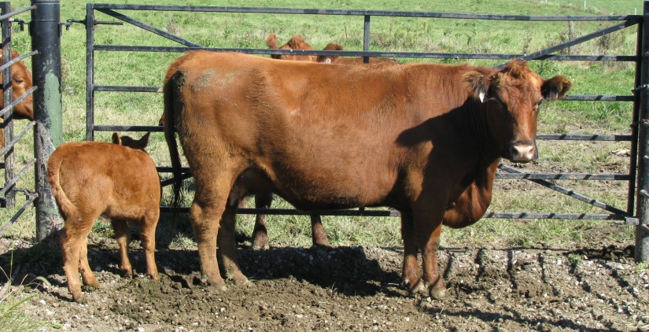
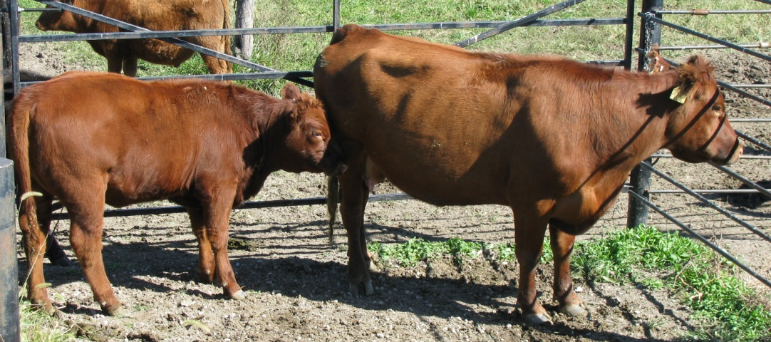
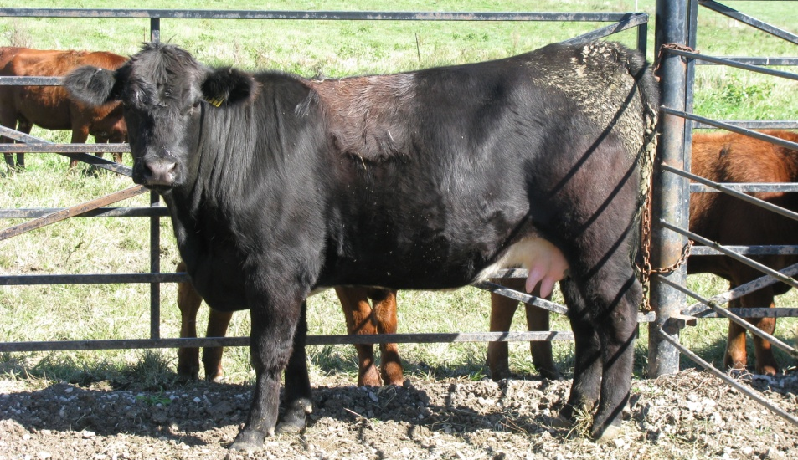
Prioritize forage quality
Graze cattle according to nutrient needs

Slide 25
Second pass forage

Slide 26
Calf ADG Mid April through Late July
a
a
b
c

Slide 27
Common second pass forage choice

Slide 28
Harvested Yield
Total forage disappearance
Identify
Productive
Unproductive
Underutilized
http://grazingbeef.missouri.edu/

Slide 29
Summary report
Estimated growth rate over time
Average pasture cover
Length of rotation
Pre and Post Grazing cover

Slide 30
Key indicators

Slide 31
July and August

Slide 32
Feed and forage budgeting
Stocking rate (lbs of cattle * % BW intake)
Utilization rate (% of forage used)
Length of grazing period (days)
Total forage available
(Forage inventory * acres) + (growth rate * acres)
Plan ahead for forage deficiencies
Comfortable managing excess
Manage availability during early and late season

Slide 33
Manage the system

