Slide 1
GOAT MEAT IS GREAT!
Open House & Free Chevon Tasting
September 17, 2011
Hagerman, Idaho
This project was funded by a grant from the Western Sustainable Agriculture Research
and Education Program.
http://wsare.usu.edu

Slide 2
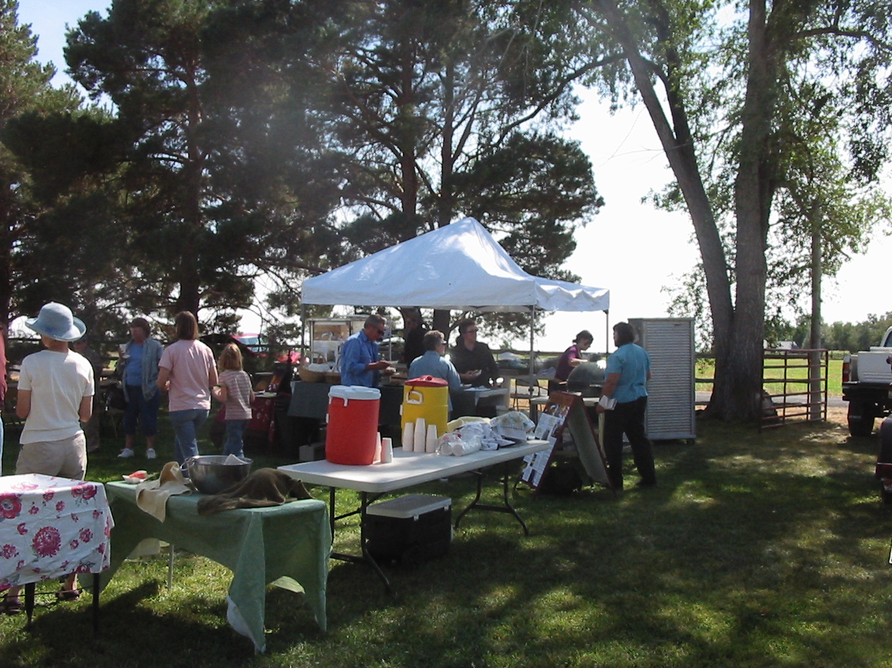
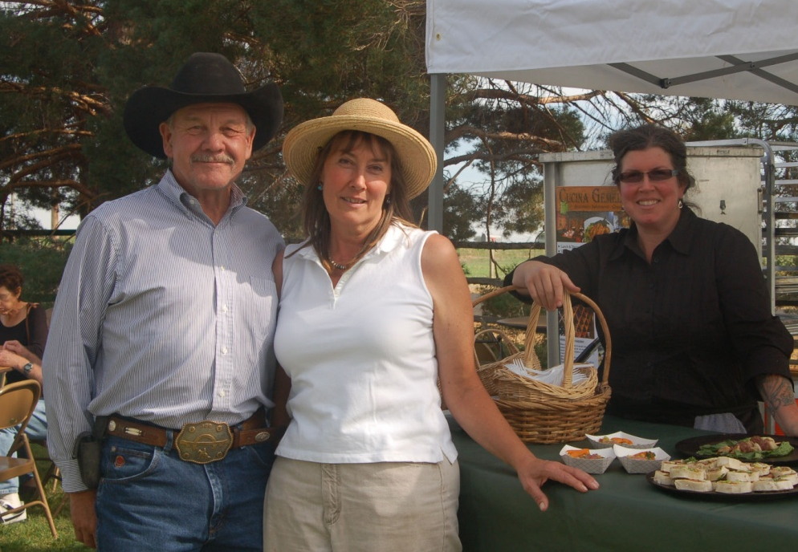
Chevon Tasting
Chef Lynn Sheehan, of Cucina Gemelli restaurant, Twin Falls, ID
She prepared our chevon four delicious ways; two wethers for BBQ, one for ground chevon, and two for chevon roasts.

Slide 3
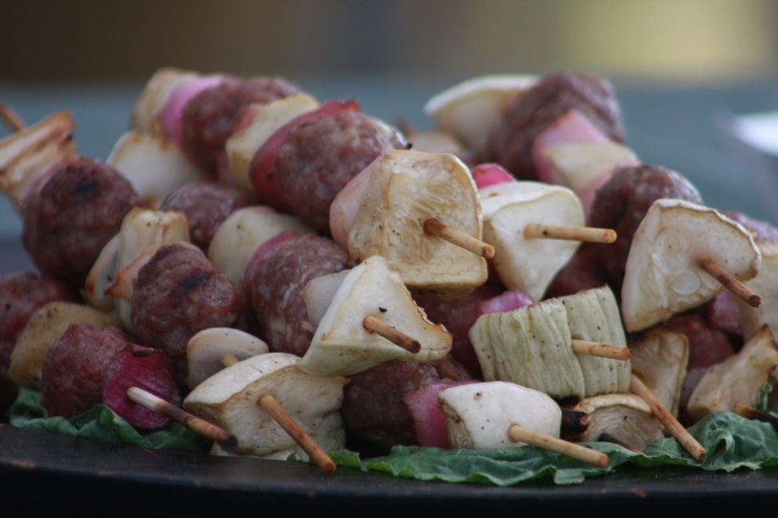
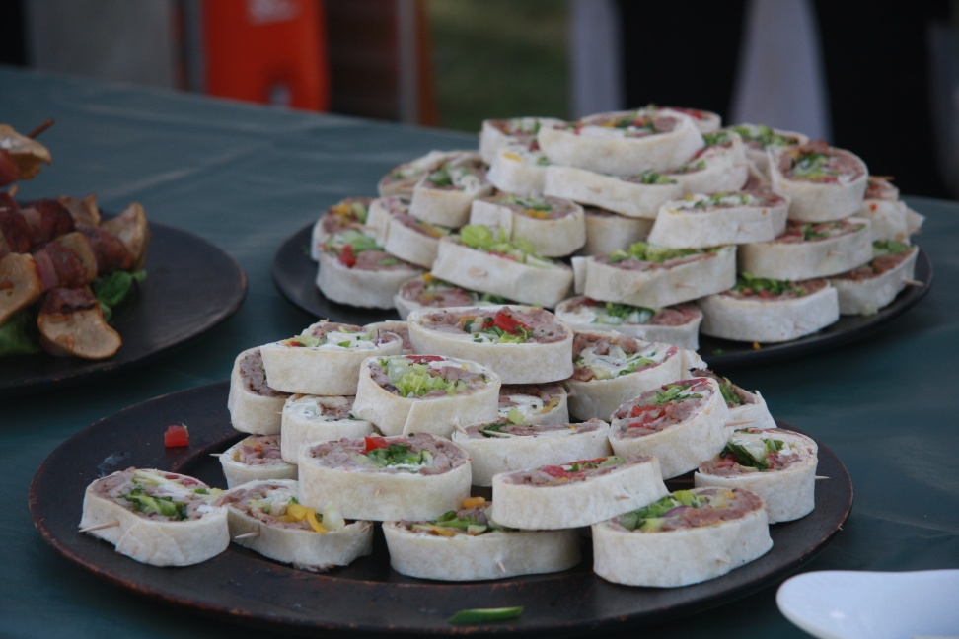
Chevon Four Ways
Shish kebab with ground chevon
& pickled vegetables
Afghani Wrap Slices
BBQ sandwiches
Roast chevon

Slide 4
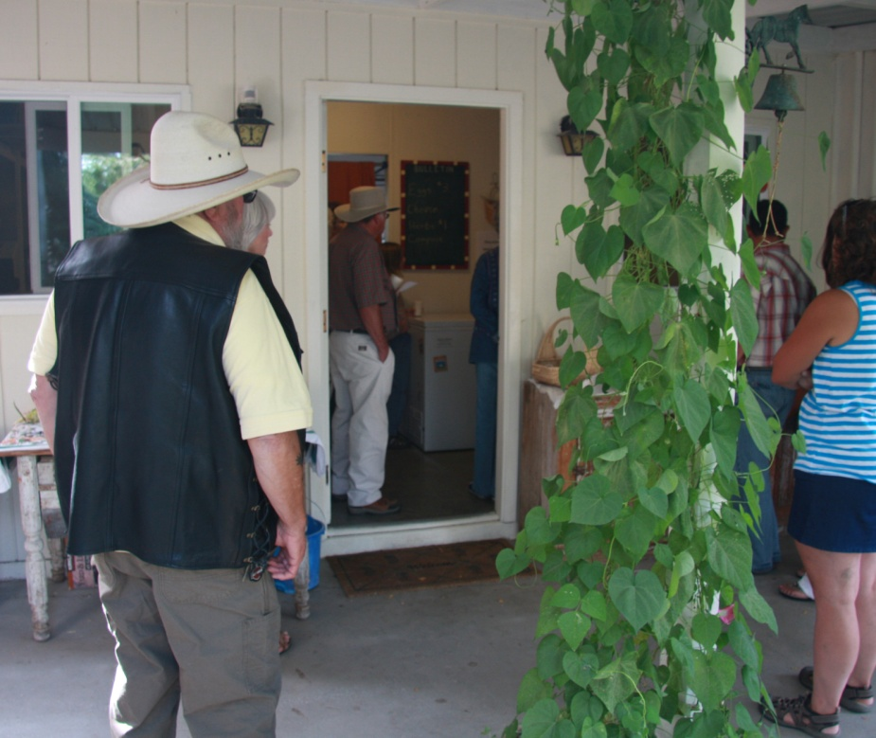
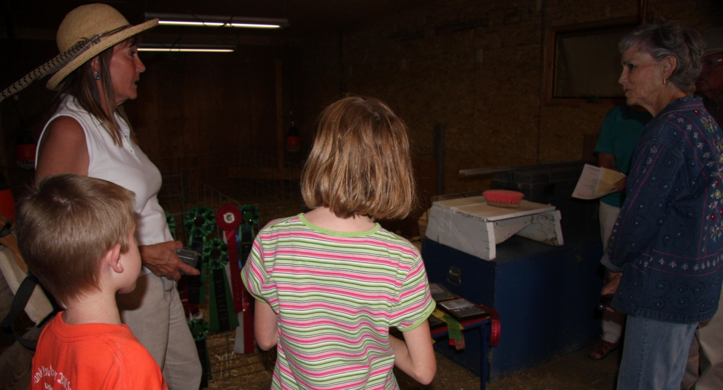
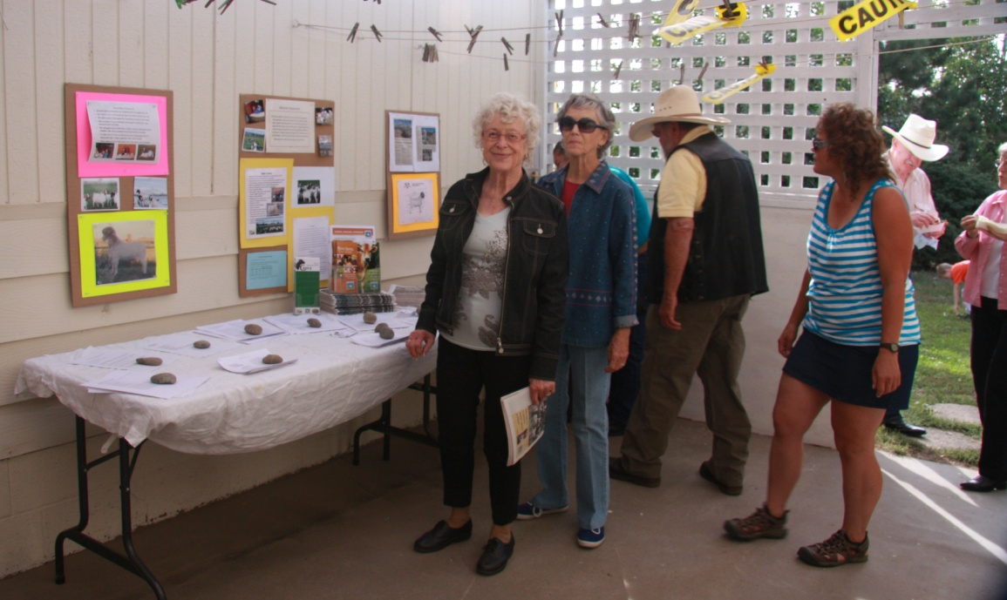
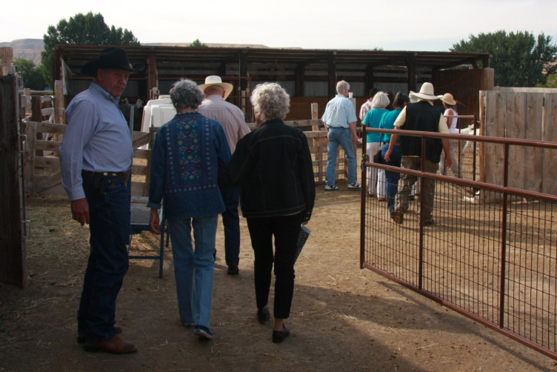
Tour Time
*Kidding Barn * Freezers
*Educational Materials *Recipes

Slide 5
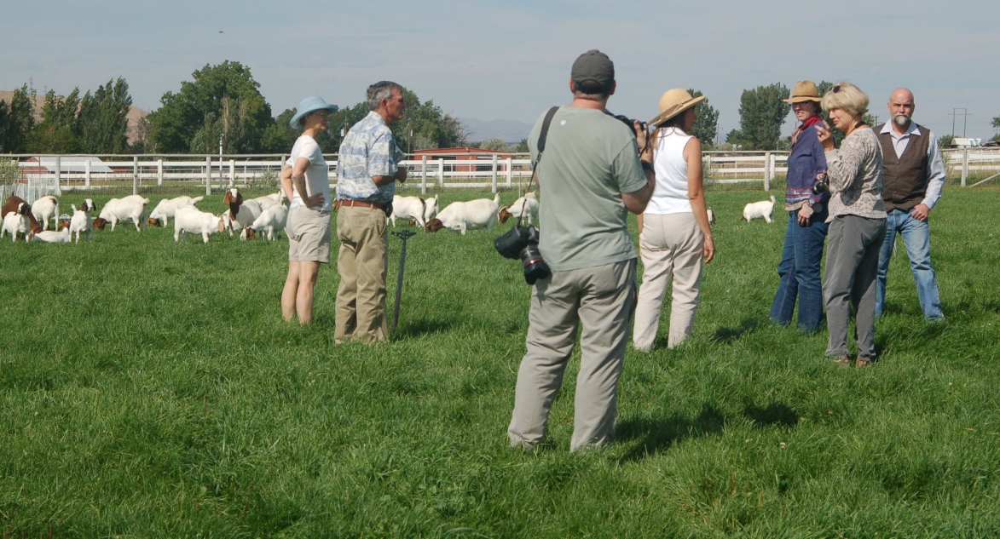
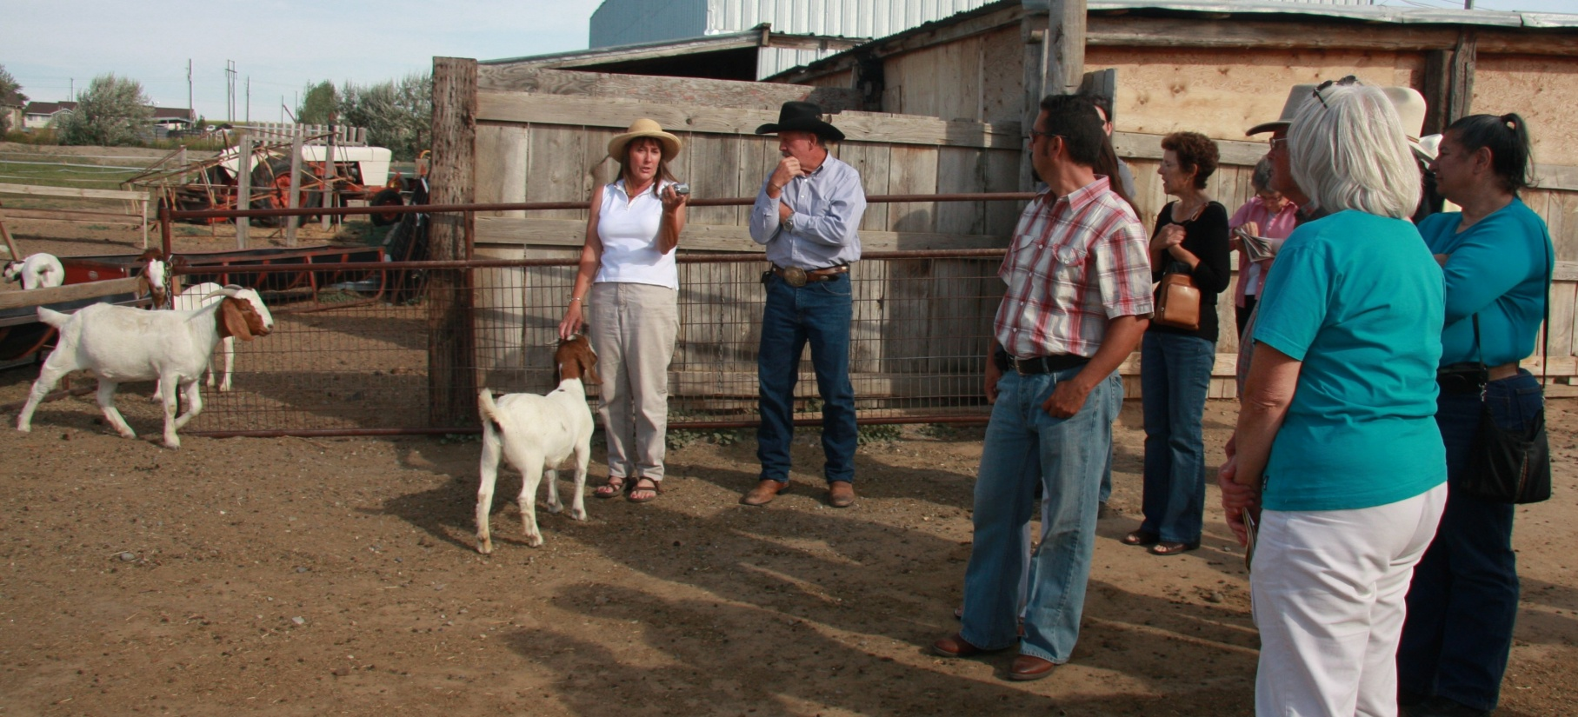
Touring the goats
Questions
&
more questions!

Slide 6
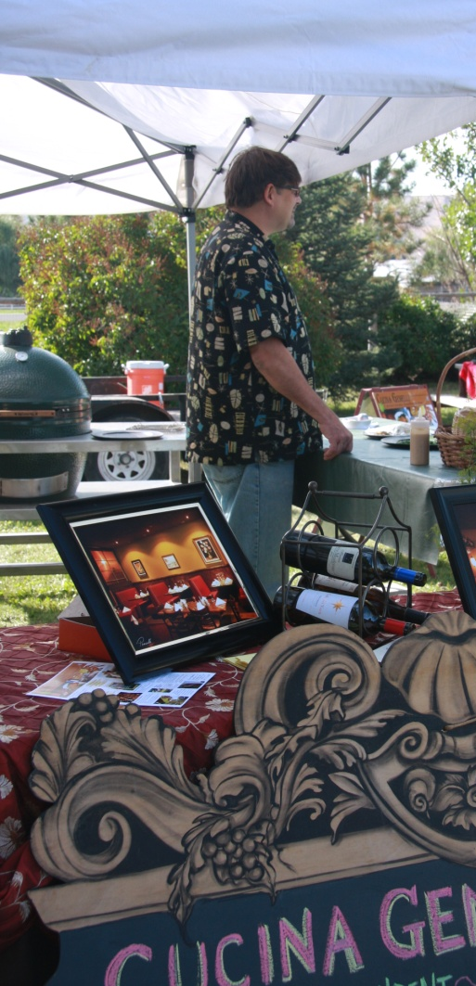
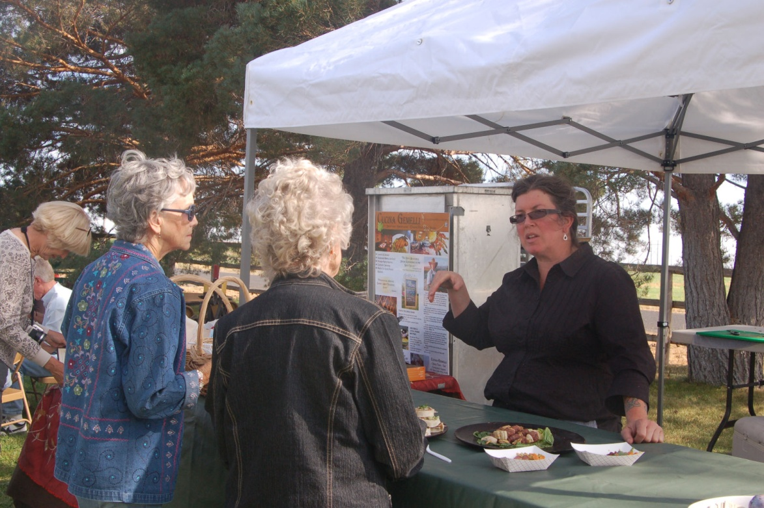
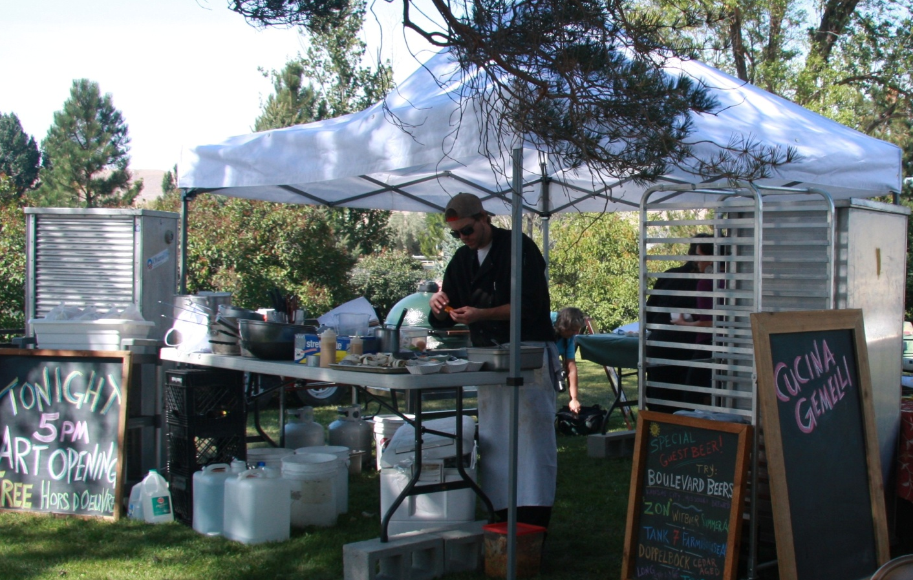
Perfect
weather
&
great food!

Slide 7
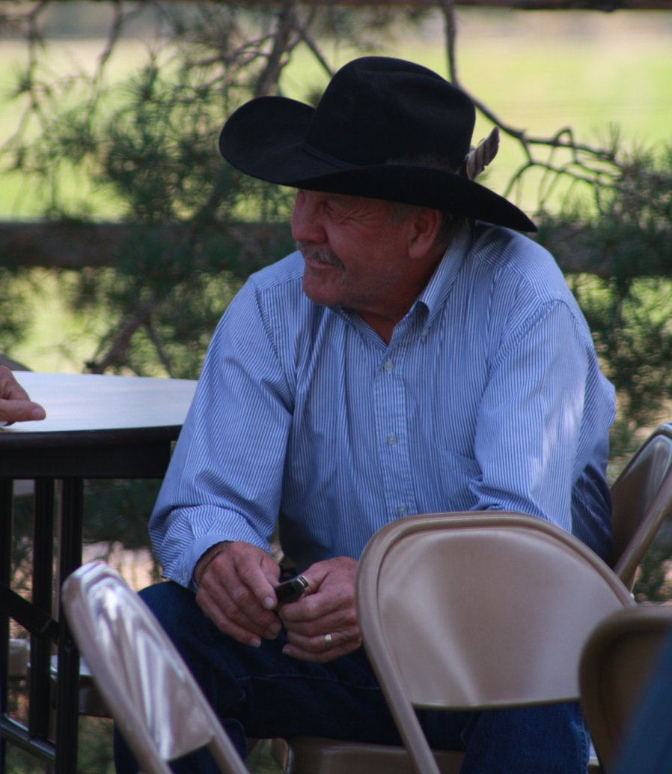
Thank you, everyone!
Visitors – Guests – Attendees
Volunteers:
Chris O’Brien
Leroy & Carolyn Buckner
The Burkholder family
Michelle Brown Photography
Kim Holt, freelance photos
Glenn Andersen, photos
Workers: Hannah & Matthew Wisniewski
What’s Next:
Open House in 2012?
Combine with SRMGA event?

