Slide 1
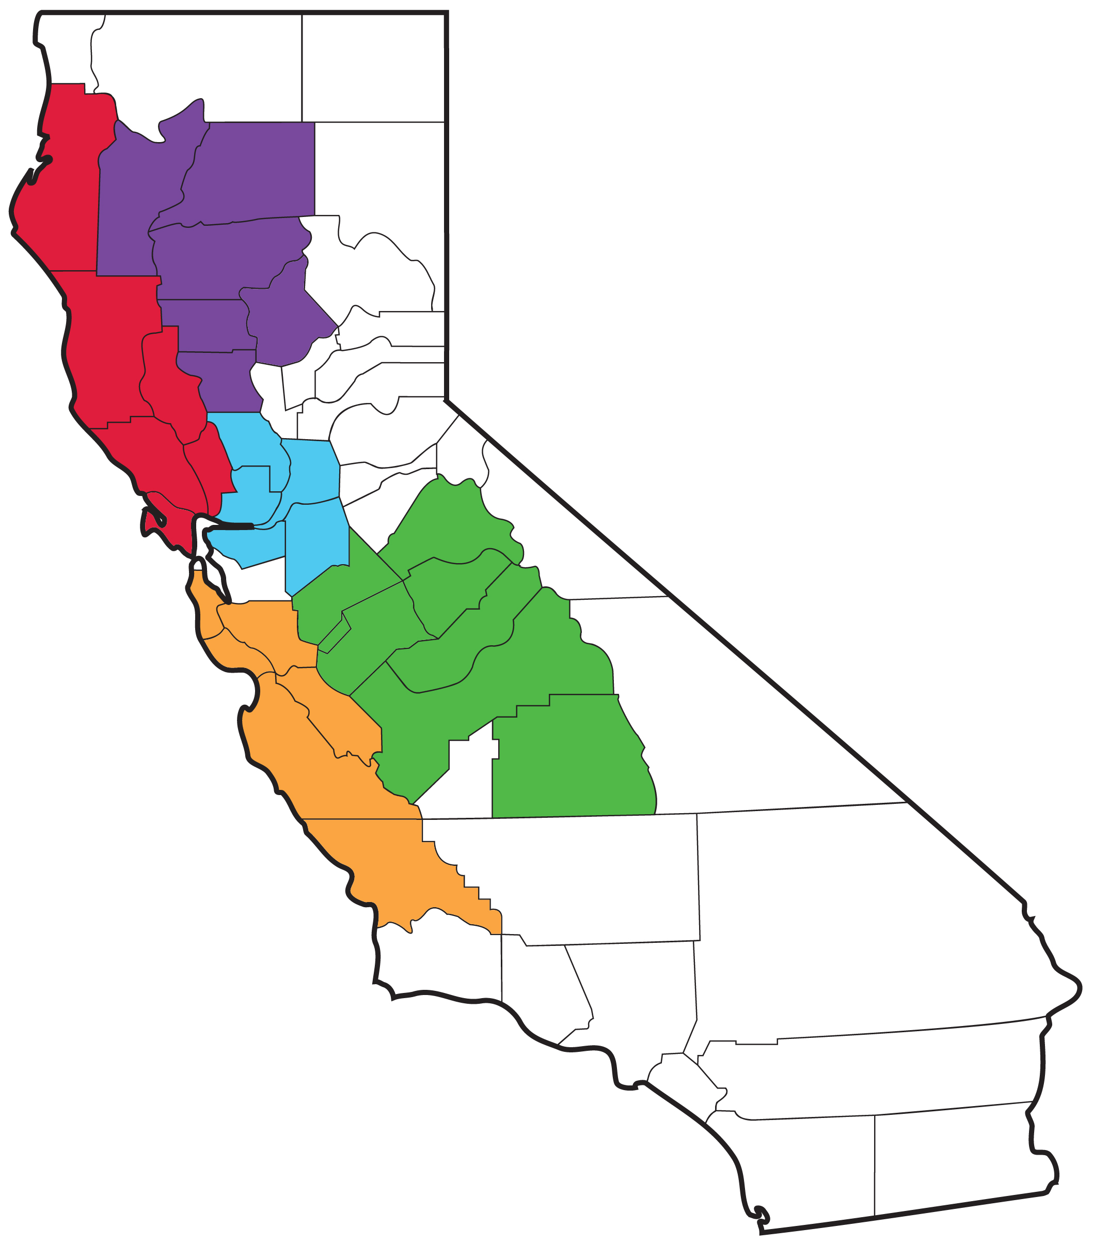
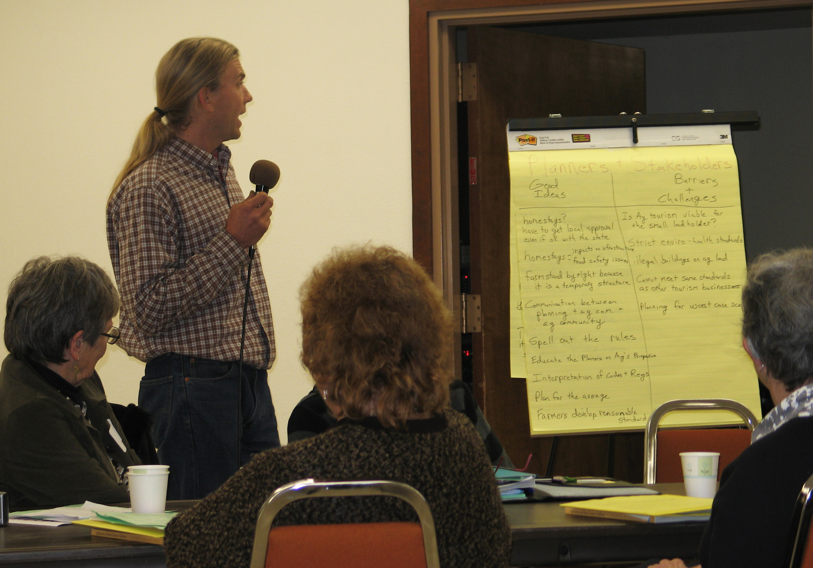
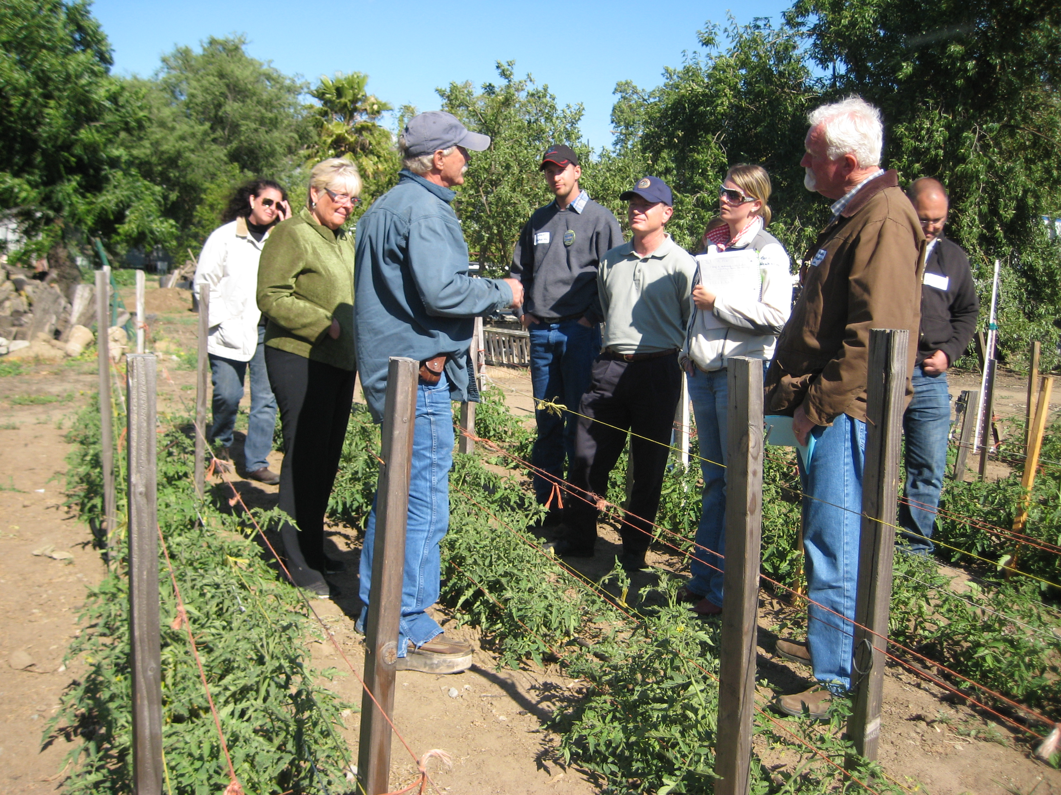
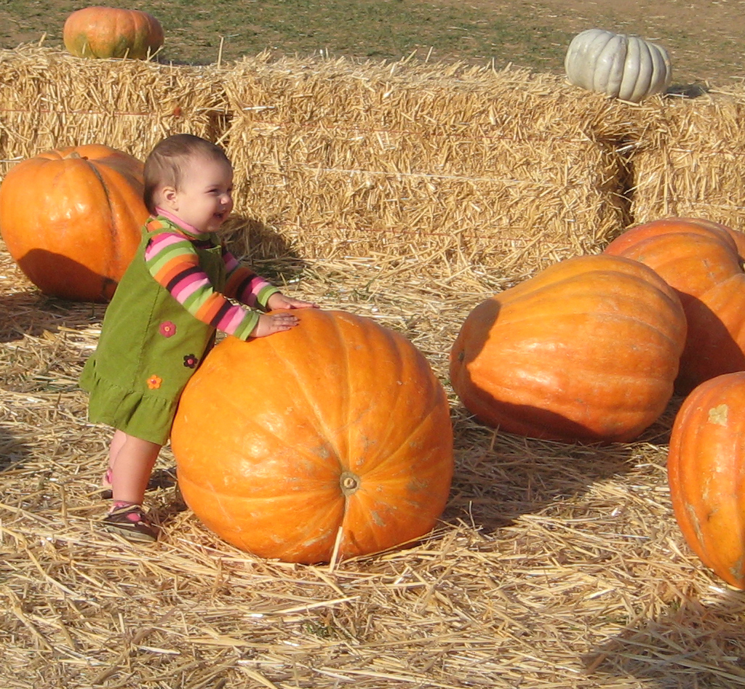
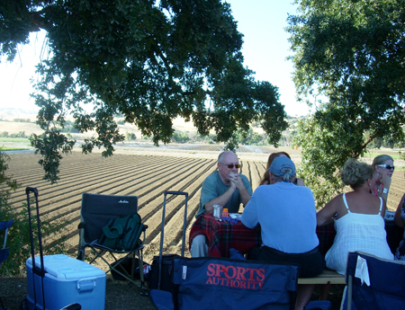
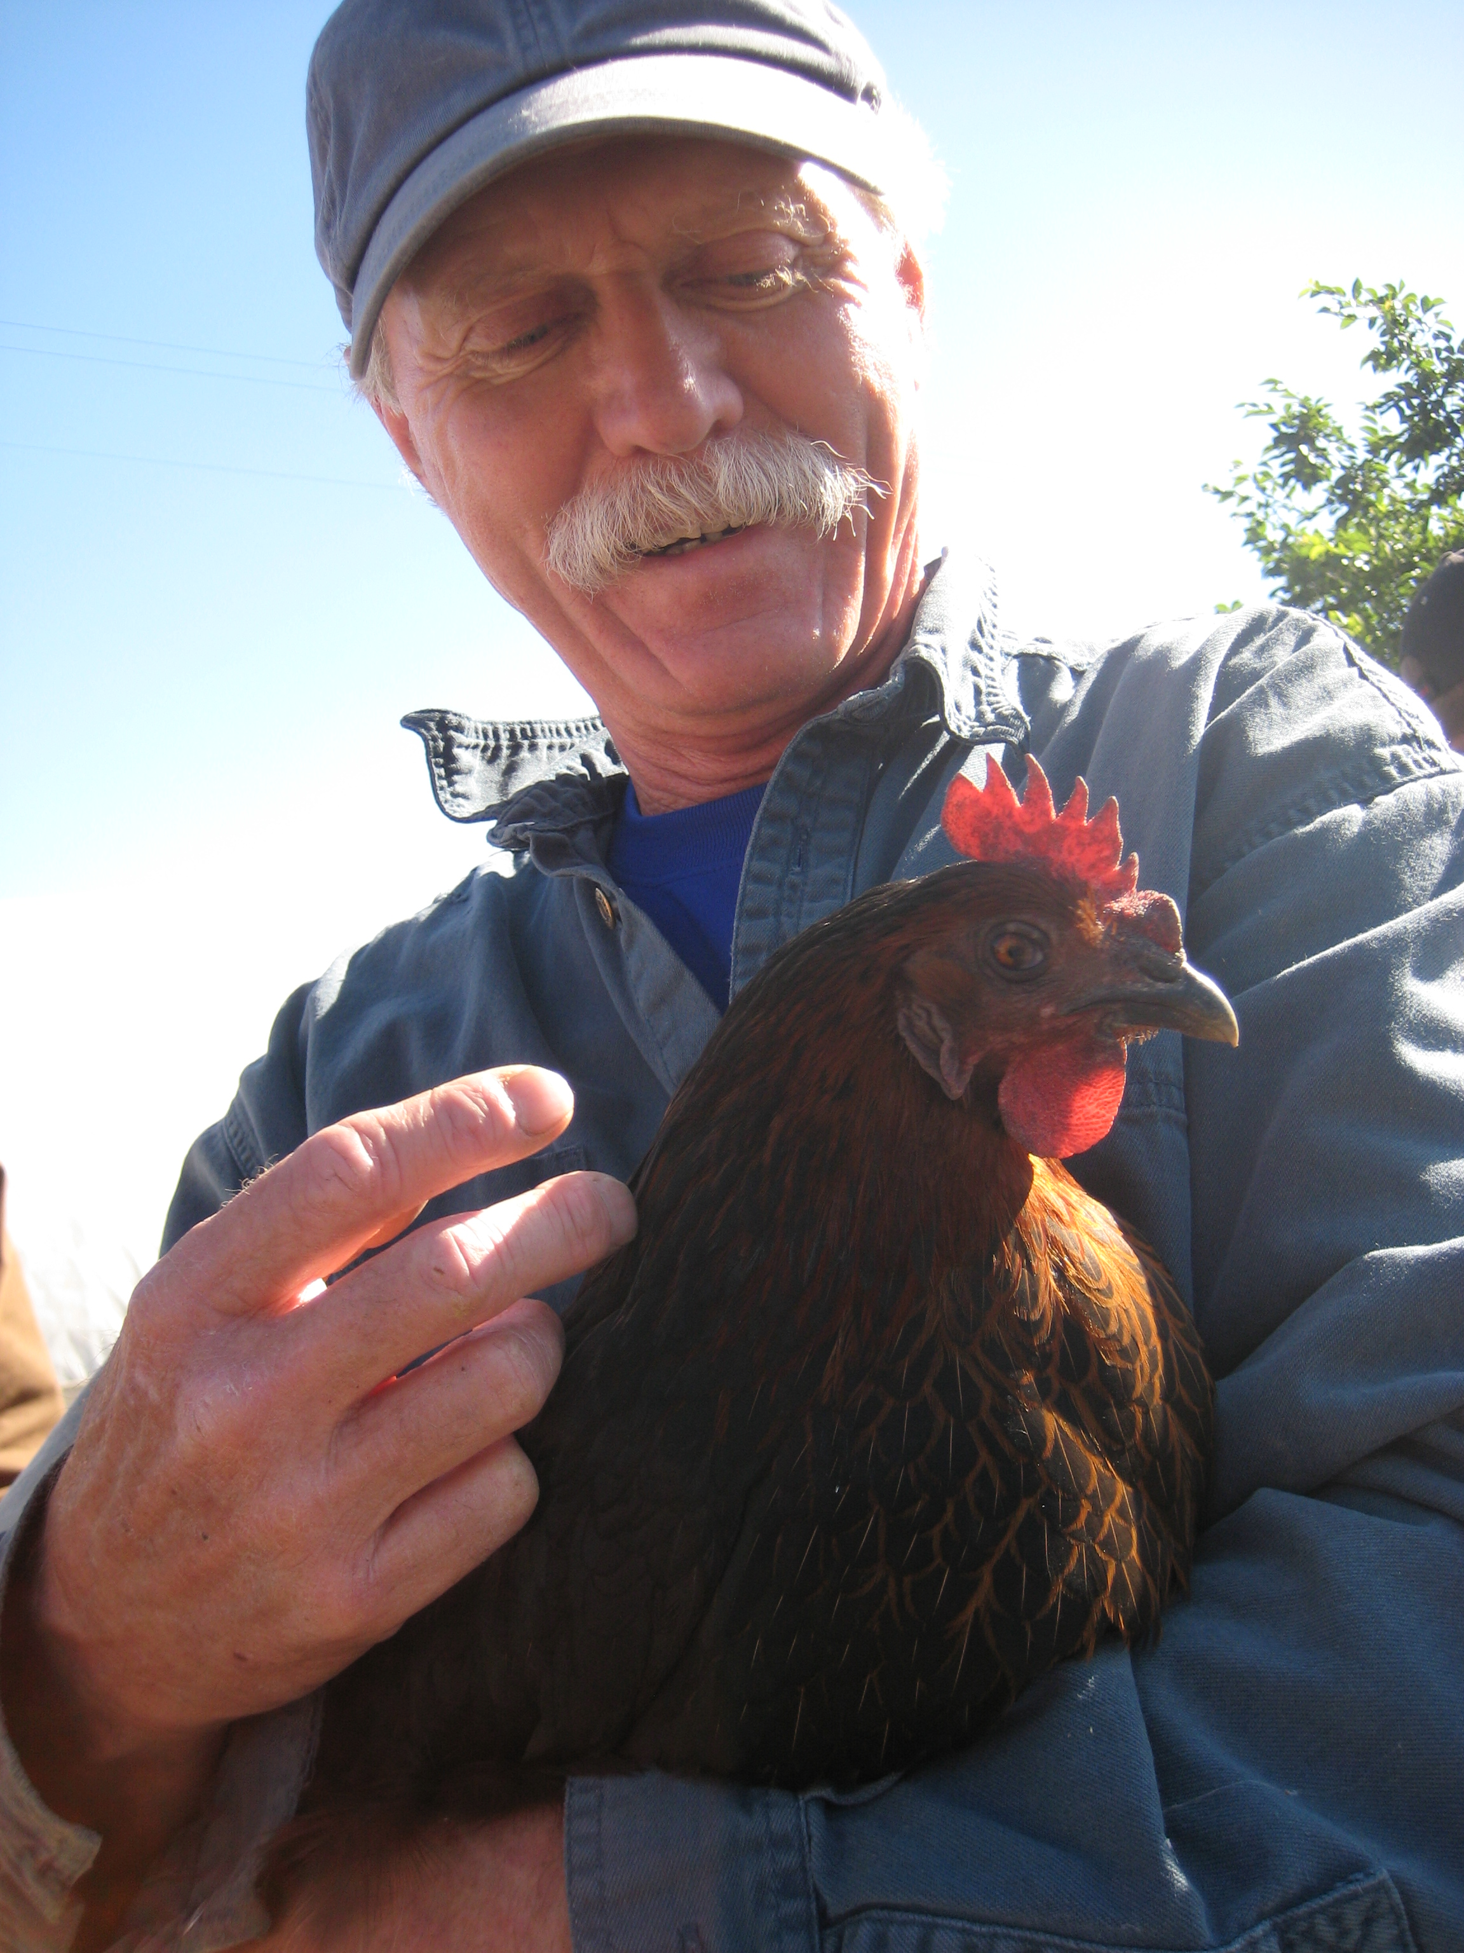
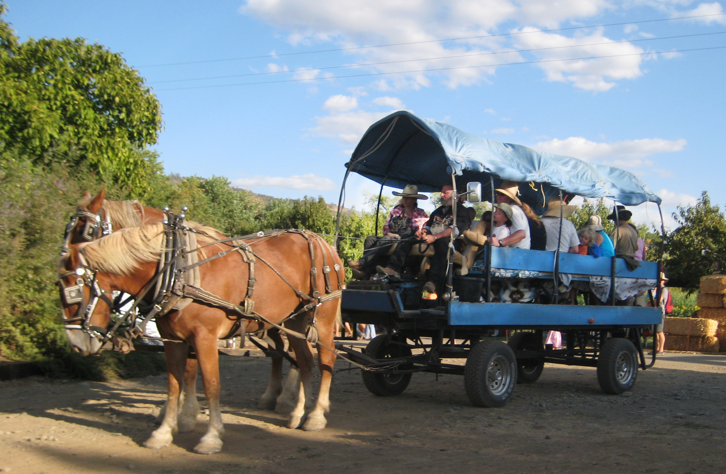
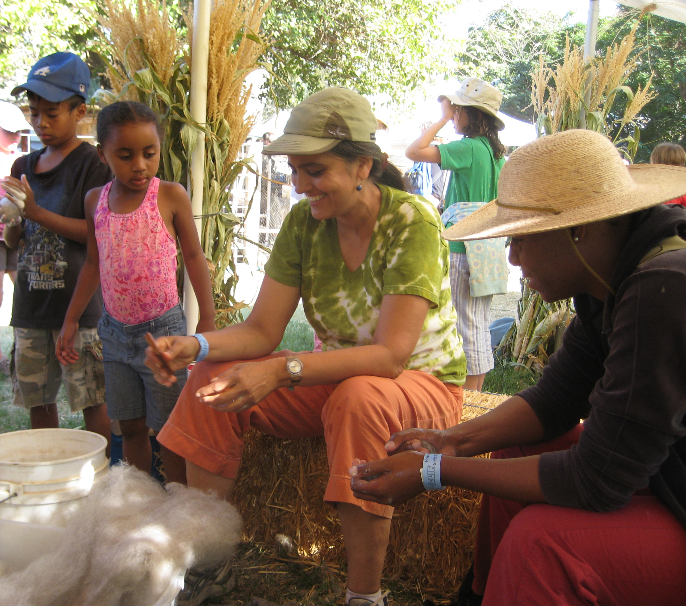
Capacity Building Workshops: Developing Regional Agritourism Networks for Agricultural Sustainability and Education
Project Director: Shermain Hardesty, Director, UC Small Farm Program ~ Senior Associates: Ellie Rilla, UCCE Marin, Holly George, UCCE Plumas-Sierra
Project Manager: Penny Leff, UC Small Farm Program Agritourism Coordinator
The context:
Consolidation throughout the supply chain, falling wholesale prices in the face of increased costs and lack of economies of scale push small and mid-scale farmers and ranchers increasingly to direct marketing and alternative enterprises to keep their operations sustainable.
The opportunity:
Public demand for local agricultural products and education about local farms and ranches is increasing. Agritourism, an enterprise on a working farm or ranch that welcomes visitors for education and enjoyment and provides additional income for the operator, has been reported by agritourism operators to be a profitable diversification strategy in California.
The challenge:
Agritourism requires producers to enter the hospitality business, which requires new skills and partnerships, and is regulated by zoning ordinances and permitting processes established independently by planners and stakeholders in each of California’s 58 counties.
5 Regions:
North Coast: Humboldt, Mendocino, Lake, Napa, Sonoma, Marin Counties
Northern Valley & Mountains: Butte, Tehama, Glenn, Colusa, Shasta, Trinity Counties
Sacramento-San Joaquin Delta: Yolo, Sacramento, San Joaquin, Contra Costa, Solano Counties
San Joaquin Valley & Foothills: Mariposa, Madera, Merced, Stanislaus, Fresno, Tuolumne, Tulare Counties
Central Coast: San Luis Obispo, Monterey, San Benito, Santa Cruz, San Mateo, Santa Clara Counties
355 Participants:
69 Agritourism operators
Farmers or ranchers considering agritourism
Tourism Professionals
Government staff or elected officials
Community or agricultural organization representatives
Economic development or community development professionals
Farm advisors or other agricultural professionals
(some participants indicated multiple affiliations)
Sean Kriletich, UCCE Amador County, reports on “planners & stakeholders” breakout session at the San Joaquin Valley & Foothills workshop in Merced
Preliminary results – Since the workshops:
14 percent of participating farmers or ranchers hosted visitors for the first time
30 percent of participating farmers or ranchers have begun planning new agritourism activities
24 percent of participants have helped educate farmers or ranchers about agritourism
92 percent of non-farmer participants have helped promote agritourism
“Since attending the workshop I have a heightened awareness of agritourism and have encouraged counties and organizations in counties to incorporate this into their displays.”
– California State Fair Art Coordinator
“I made many new contacts that will help me provide groups with Central Valley tours”
– tourism professional
“This workshop made us aware of the Agricultural Overlay zoning that was included in the Butte General Plan. We contacted Dan Breedon and added our farm to this very important zoning area.”
– small-scale citrus grower
Activities:
Formed regional planning teams
Held five regional workshops
Organized four follow-up gatherings including tours
Communicated with all participants using email newsletters and Facebook page
Conducted evaluation
Darrell Hartley, owner of the Farm Stand at Knightsen, talks about his operation with participants of the Delta region follow-up gathering, which included a tour of “Harvest Time in Brentwood” members’ farms
Objectives:
Increase all participants’ knowledge of agritourism challenges & opportunities
Share best practices and effective collaborations
Develop regional networks connecting all partners
Encourage easing of permitting and regulatory barriers to new agritourism operations
Encourage business planning, risk management, hospitality skill development and effective marketing by farmers and ranchers diversifying with agritourism
This project was partially funded by the Western Sustainable Agriculture Research and Education Program, with additional support provided by the Sierra Nevada Conservancy and Valley Land Alliance

