Slide 1
Managing fertility in Organic Systems
Timothy Coolong University of KY Horticulture

Slide 2
Soil test results

Slide 3
Reducing Fertilizer Use
Current N Recommendations {tomatoes, peppers, etc]
125 lbs of N per acre
50-75 lbs preplant
Granular lower cost fertilizer
50 lbs through fertigation or banding during season
Higher cost water soluble fertilizer

Slide 4
What would be recommended?
Without know cover crop history and what has been done the current recommendation would be based on using organic fertilizers
For organic production a high N or general purpose granular fertilizer is recommended. Examples of such available products are Fertrell Earth Friendly All purpose 5-5-3 ($24.75/ 50 lb) Approximately 2000 pounds of Fertrell Earth Friendly 5-5-3 would be required per acre of production to reach 100 pounds of total N.
$990/acre
This is very expensive

Slide 5
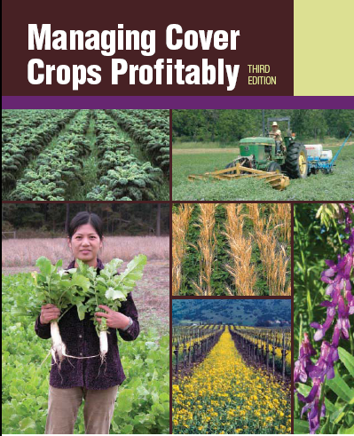
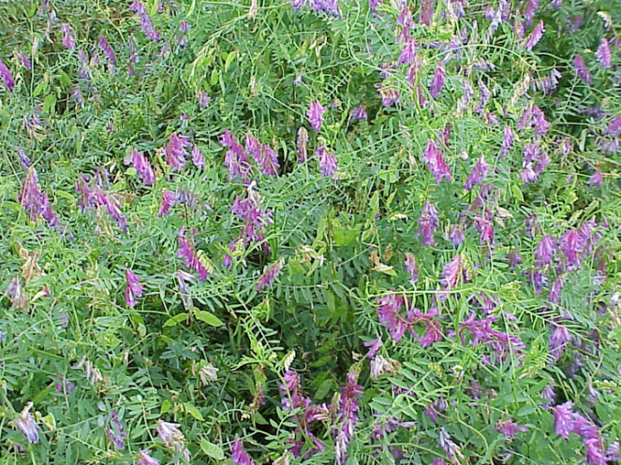
Reducing Fertilizer inputs by Building soil fertility
Cover cropping and crop rotation
Composting and/or manure
Supplemental fertilizers
Hairy Vetch

Slide 6
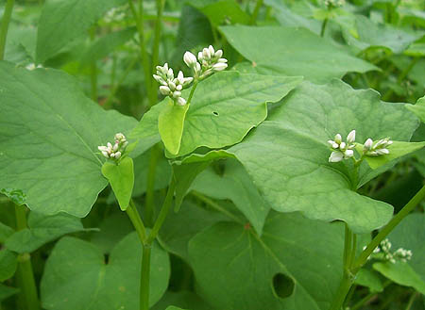
Cover crops and nutrition
Deep rooted cover crops will scavenge nutrients and prevent leaching from winter rains
Cereal rye is probably best suited for this role Kentucky-
Many legumes do not establish as well in fall and do not scavenge nutrients well

Slide 7
Biomass yield and nutrient accumulation of cover crops
Biomass yield (dry weight) and nutrient accumulation
Crop | Biomass (lbs/ac) | Nitrogen (lbs/ac) | Potassium (lbs/ac) | Phosphorous (lbs/ac) | Magnesium (lbs/ac) | Calcium (lbs/ac)
Hairy Vetch | 3,260 | 141 | 133 | 18 | 18 | 52
Crimson Clover | 4,243 | 115 | 143 | 16 | 11 | 62
Austrian W.P. | 4,114 | 144 | 159 | 19 | 13 | 45
Rye | 5,608 | 89 | 108 | 17 | 8 | 22
Hoyt, G.D. 1987. Legumes as a green manure in conservation tillage. P. 96-98. In: J.F. Powers (ed) The role of legumes in conservation tillage systems. Soil Conservation society of America, Ankeny, Iowa.

Slide 8
Nitrogen fixing cover crops
N production from legumes can vary from 40-200 lbs+ of N per acre
Affected by: plant stand, soil pH, nodulation, and soil moisture
The portion of N available in the first year is usually 30-60% the total amount in the plant
Usually lower (30%) when just left on the surface and higher (60%) when incorporated
Do not incorporate too deep (top 6”)

Slide 9
Determining Fertility from Cover Crops
To be completely accurate you could do a tissue analysis of crops, but……
A lot of work has been done determining the typical N levels in different cover crops
This (N) is very consistent from year to year
The biggest changes are in biomass per acre

Slide 10
Taking a sample
Picture from: Cover Crop Sampling Instructions
For Use with the OSU Cover Crop Calculator
http://smallfarms.oregonstate.edu
N. Andrews, D. Sullivan, J. Julian and K. Pool

Slide 11
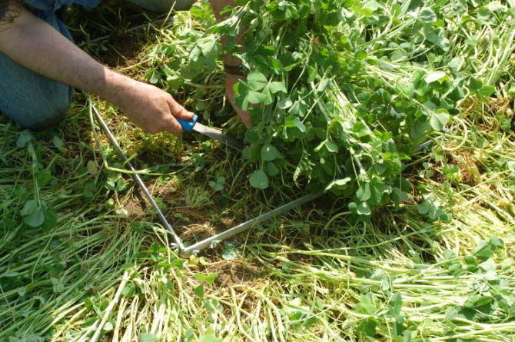
Sampling
Pictures from: Cover Crop Sampling Instructions
For Use with the OSU Cover Crop Calculator
http://smallfarms.oregonstate.edu
N. Andrews, D. Sullivan, J. Julian and K. Pool

Slide 12
Sampling
After getting representative samples
Do not combine samples, do several reps to get a feel for the uniformity of a field
Separate the cover crop and get a dry weight
They should be “crispy dry”
Then you can begin your calculation

Slide 13
Sample Data
Taken 5/7/2011

Slide 14
Vetch Dry Weights
Sample | Fresh Weight (lb) | Dry Weight (lb) | % DM
1 | 0.616 | 0.093 | 14.9
2 | 0.617 | 0.094 | 15.2
3 | 0.748 | 0.110 | 14.7
4 | 0.627 | 0.088 | 14.0
5 | 0.814 | 0.121 | 14.9
6 | 0.825 | 0.121 | 14.7
Avg: |  | 0.105 | 14.7
All data is per square foot

Slide 15
Determine how much Biomass
We had approximately 0.1 lb of vetch per square foot
This is the biggest factor that can change from year to year
So then we can multiply lbs of cover crop by square feet per acre
43,560 sq ft/acre x 0.1 lb/sq ft = 4356 lb/acre

Slide 16
Let’s Determine How much N

Slide 17
Non Legumes N

Slide 18
Determining N in cover crop
Take your percentage of N
Vetch was 3.7%
For legumes this varies 3.5-4% prior to flowering
For legumes 3-3.5% after flowering
Grasses are typically 2-3% N prior to flowering
Grasses are 1.5-2.5% after flowering

Slide 19
Determining N
Take your biomass per acre and multiply by percent N
4356 lbs x 3.7% = 162 lbs N per acre in the vetch planted
Keep in mind that 4356 lbs of dry matter is high
Is that it?

Slide 20
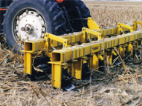
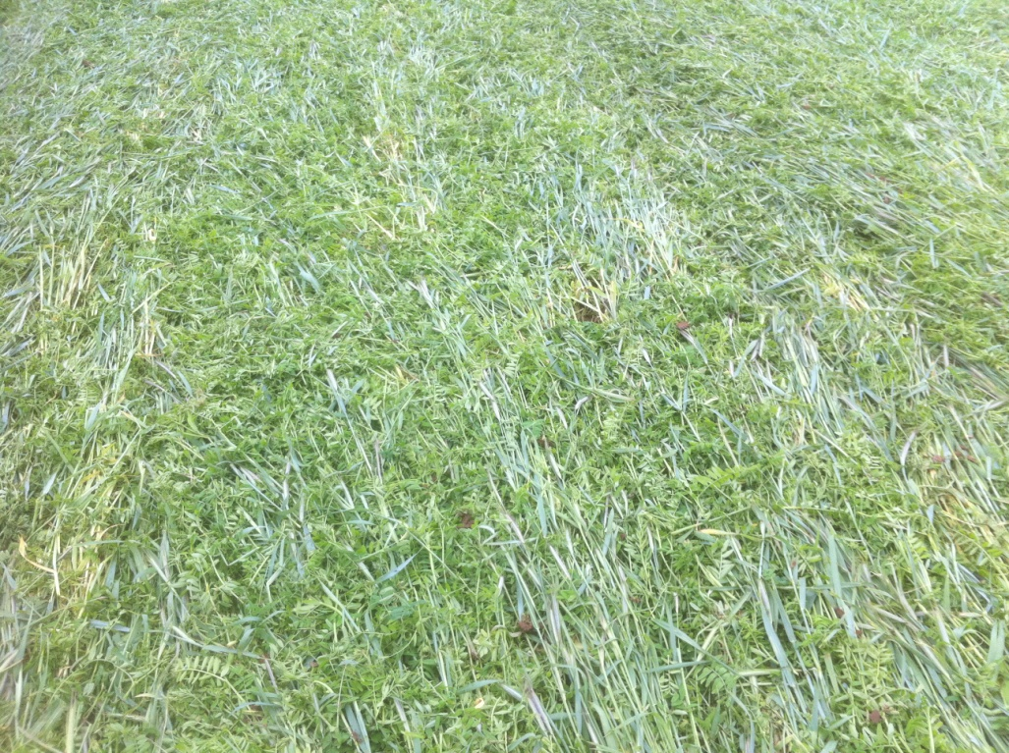
Rolling or conventional tillage?

Slide 21
Method of Incorporation
If you are laying it down on top of the ground estimate 25-30% of the N is available that season
If you are mowing and incorporating it then assume 50% is available that season
Succulent cover crops are also more available to plants
162 lbs N/acre x 50% = 81 lbs N from just vetch
We had about 28 lbs from rye

Slide 22
So to determine your N contribution
Take your samples using a square
Get an average dry weight of just your cover crop
Crunchy dry-don’t vaporize it (140 F if drying)
Figure cover crop dry mass per acre or area
Get %N-available from many sources
Figure total N per acre
Figure amount available N for the season

Slide 23
So how much will this cost?
Vetch seed $2.24/lb
Should seed out around 40-50 lbs acre
The plot we used got around 80 lbs/acre
So we spent $180 on vetch seed for 81 lbs of fertility
$2.22/lb of N
Calcium nitrate (15.5% N) @ $16.00/50 lb bag
7.75 lbs N @ $2.06
http://smallfarms.oregonstate.edu/calculator

Slide 24
Would you still add Fertility?
Yes-a good general purpose organic fertilizer prior to planting will be available and give a jump start to plants
Adding organic fertilizers preplant
Hartz and Johnstone (2006) found that 47-60% of organic N was made available in 2 weeks from organic fertilizers
Up to 70% was available after 8 weeks
Temperature had some effect, but not large
“Chilean Nitrate”= Sodium nitrate

Slide 25
N Availability
Nitrogen availability from high nitrogen containing organic fertilizers, Hartz and Johnstone 2006, HortTechnology

Slide 26
Water soluble organic fertilizers: Fertigation?
Fewer organic fertilizers are suitable for fertigation purposes
Must have a good filtration system after injector
However Hartz, et al., 2010 found that:
Most of the N is available rapidly
For animal based fertilizers nearly 79-93% within 1 week
For plant based fertilizers 48-92% within 4 weeks
Not recommended
Nitrogen availability from liquid organic fertilizers, 2010, Hartz, et al. HortTechnology

Slide 27
Cover cropping
Crop | Rate per 1000 ft² | Time to seed | Comments
Winter Rye | 3 lbs | Sep-Nov | Excellent growth and yield
Wheat | 3 lbs | Sep-Nov | Plant early for best emergence
Hairy Vetch | 1 lbs | Aug-Sept | Need to get in early, provides much N,
Winter Pea | 2 lb | Sep-Oct | May winter kill, have to mix with a grain for coverage
Buckwheat | 2 lb | Sp-Su | Great crop-bees!
Sudangrass | 1 lb | Su | Tremendous biomass-allelopathic

Slide 28
Cover Crops
Hairy Vetch
Winter Pea

Slide 29
Cover crops
Cowpea
Millet

Slide 30
Cover Crops
Buckwheat
Sudan grass

Slide 31
Cover Crops
Sunn hemp

Slide 32
Cover crops-Mixes
Some work has shown that a diversity of cover crops increases microbial biodiversity in the soil-
But that doesn’t necessarily mean more N mineralization
Mixing cover crops however does a couple of things
Winter killed legumes mixed with a grass crop allow for coverage and nitrogen fixation
A quicker covering crop will choke out weeds

Slide 33
Other sources: Adding compost
Compost is typically added to build soil quality and give a boost in nutrition
Composted manures typically do not provide nutrients in the ratio that plants take them up
Source | Average nutrient composition (% DW)
 | N | P2O5 | K20
Dairy cows | 1.3 | 0.9 | 3.0
Horse | 2.3 | 0.9 | 1.7
Poultry | 3.2 | 5.2 | 1.8
Hogs | 3.5 | 0.5 | 0.7
Tobacco Stems | 1.5 | 0.5 | 7.0
Sewage Sludge | 1.5 | 1.3 | 0.4

Slide 34
Adding compost
Typically 10-20% of the N in compost is available in a given year
Can vary widely between 10-50% in a year
Depends on moisture, pH, temperature, compost quality
If you add 1 ton per acre then of 2.5% N compost…..
You get 50 lbs of N….but at 20% availability then you get 10 lbs of N
If you add enough compost to get total N needs then other nutrients will be imbalanced
Works well as a supplement

Slide 35
Compost and Persistant herbicides

Slide 36
The issue
Some herbicides used in pasture and turf applications are extremely persistent in hay and grass clippings
They bind tightly to plant material
They can also persist in manure because they do not metabolize in the animal and pass right through
When the manure or hay/straw is used in compost or applied to sensitive crops they can be taken up by the crop and cause damage

Slide 37
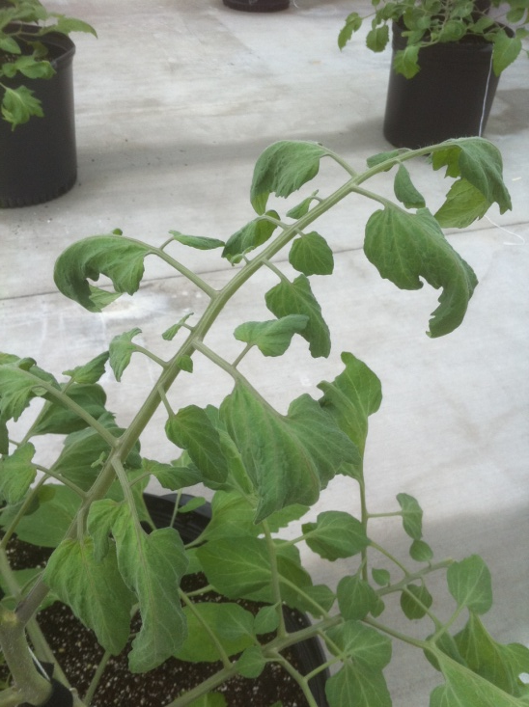
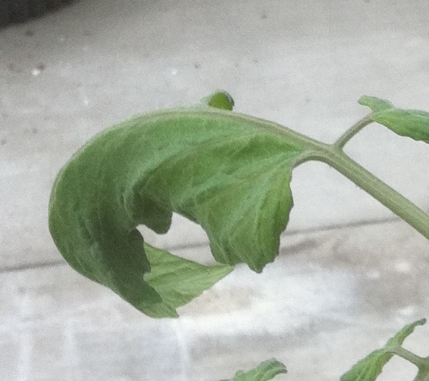
Symptoms
Tomato
Leaf curl, distortion, cupping, “cobra head”, stem bending
Primarily on new growth

Slide 39
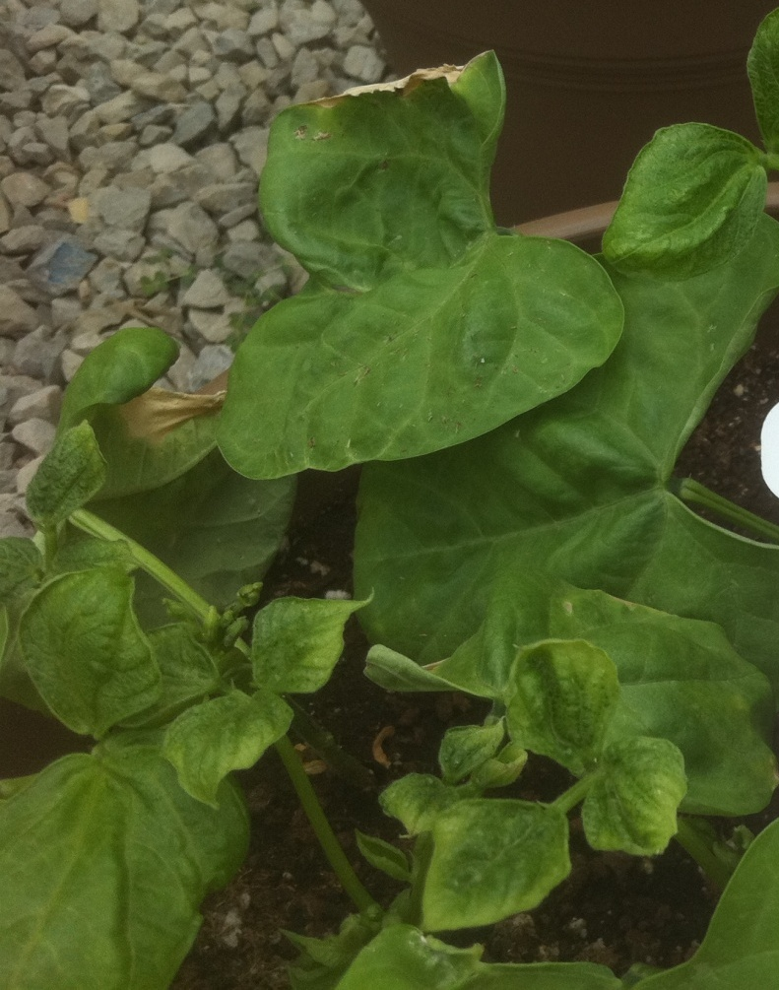
Symptoms
Beans
Distortion in leaves, bumpy
Viruses are similar in expression

Slide 40
Pepper
Picture from: WSU Whatcom County Extension, Herbicide Contamination of Organic Matter

Slide 41
Why now?
It has been happening for a few years
Documented in other locations- Washington State, North Carolina, United Kingdom
Spokane WA facility in 2000, lawn clippings contained Clopyralid - 25,000 cubic yards of compost went unsold
Was a problem at the WSU compost facility in 2000, manure contained Picloram, cost WSU $250,000
Recently in KY
Organic farmers are using compost-

Slide 42
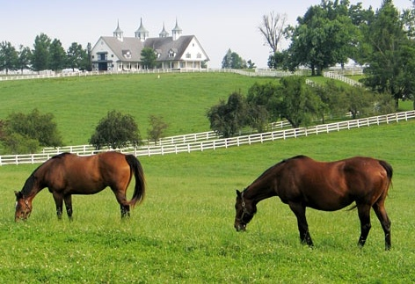
What are the culprit chemicals
Aminopyralid, clopyralid, picloram, and aminocyclopyrachlor [a recently introduced herbicide]
Used on pastures, turf, and rights-of-way areas and some crops
Pass quickly through livestock without being metabolized
Tightly bound in hay or grass clippings
When composted, the composting process does not break them down.

Slide 43
Aminopyralid
Aminopyralid (Dow): controls broadleaves and some woody plants in pasture and rangeland
ForeFront, Milestone, Chaparral
Pastures and rangeland
Milestone, Opensight
Rights-of-way and wildlife management areas

Slide 44
Clopyralid
Clopyralid: broadleaf weed control in turf, pastures, and some cropland application sites
Confront, Lontrel (turf)
Curtail (wheat and rangeland)
Hornet, Surestart (field corn)
Redeem (pastures)
Stinger, Transline (non-cropland, pastures)
Stinger labeled in asparagus, sweet corn, spinach and greens

Slide 45
Picloram
Picloram: broadleaf and brush control in non-crop areas and pasture
Tordon K, Pathway
Rights-of-way, cut stump treatment
Surmount
Permanent pastures and rangeland
NOTE: Not registered for use in KY

Slide 46
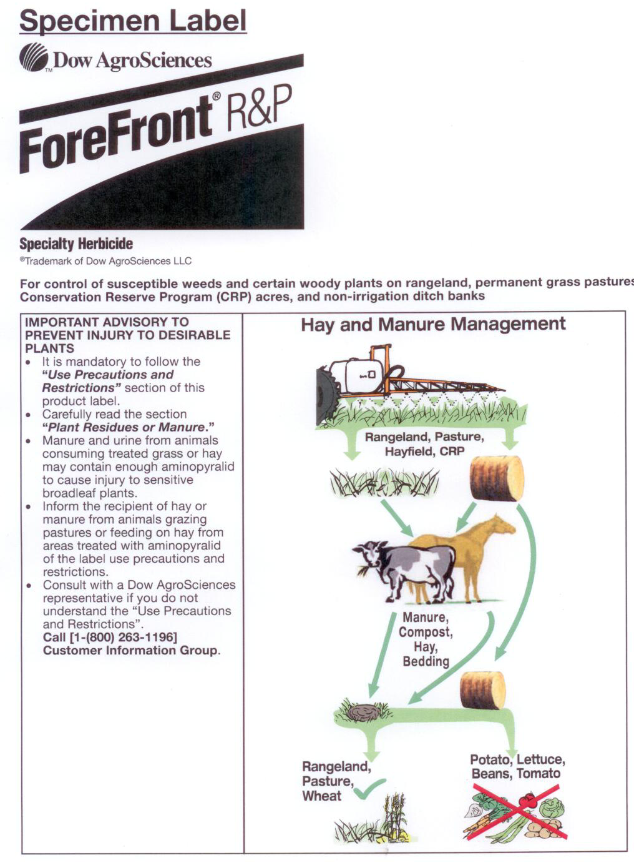
Aminopyralid products all have this disclosure on the label
Clopyralid and picloram do not, but do have precautions on labels

Slide 47
Making it though the compost process
To be considered compost you must?
According to NOP Organic Standards it must
Initial C:N ratio between 25:1 and 40:1
Windrow system must hold temps between 131-170 oF for 15 days
Turn a minimum of 5 times
The chemicals in question are typically not decomposed during composting process

Slide 48
IMPORTANT
Compost material and hay can be imported from other states
Thus, difficult to know specific herbicide to test for unless you know the specific source and the product(s) involved

Slide 49
How do you know your compost is fine?
Chemical testing
Expensive $250 + per sample
Potentially not accurate enough
In some cases contamination levels of 0.5-0.25 ppb can cause problems
Many labs only provide detection limits of 5-20 ppb
Sampling also an issue- contamination may not be uniform.
How many samples to take and where?

Slide 50
Plant Bioassay
WSU has developed a bioassay using peas
http://www.puyallup.wsu.edu/soilmgmt/Pubs/CloBioassay.pdf
Have both a researcher and grower procedures
Not always practical unless test can be performed under controlled conditions

Slide 51
Bioassay: WSU
3 pots (negative control) with known potting soil
3 seeds in each pot, 3 pots
Compost blend 2:1 compost to potting mix by volume
3 seeds in each pot, 3 pots
Grow plants in random order, do not splash water
Wait 21 days

Slide 52
Bioassay: Results from WSU
Picture from: Bioassay test for herbicide residues in compost: Protocol for gardeners and researchers in Washington State. WSU Cooperative Extension.

Slide 53
Bioassay suggestions
We saw very different responses from different plants
Bioassay with plant of interest-particularly with tomato
Run the bioassay for 5-6 weeks with tomato

Slide 54
What if bioassay is inconclusive?
If unsure, don’t use it
If you are dealing with this as an agent
Do not overlook other possibilities
Nutrient deficiency?
Cu, Ca, and B deficiencies will show some distortion in new growth
If corrected new growth will resume as normal

Slide 55
Resources
Bioassay test
http://www.puyallup.wsu.edu/soilmgmt/Pubs/CloBioassay.pdf
WSU Herbicide contamination of organic matter
http://whatcom.wsu.edu/ag/aminopyralid/
Dow AgroSciences
http://www.dowagro.com
NCSU publication on herbicide carryover
http://www.ces.ncsu.edu/fletcher/programs/ncorganic/special-pubs/herbicide_carryover.pdf

Slide 56
Questions/Thoughts

