Slide 1
High Tunnels For Vegetable Production
Timothy Coolong
Assistant Professor
Department of Horticulture
University of Kentucky

Slide 2
High Tunnels
What is a tunnel?
Galvanized tube steel frame
1 or 2 layers of 6 mil thick plastic
No heat
No exhaust fans
Huge in other parts of the world
Tons of interest in KY and elsewhere

Slide 3
The NRCS EQIP Grant Program
Environmental Quality Incentives Program (EQIP)
Seasonal High Tunnel Initiative 2012
Program has been offered for several years in other states, first year in KY

Slide 4
Seasonal High Tunnel Initiative 2012
Three application deadlines
Feb 3
March 30
June 1
Rolling application deadline
Applications are ranked locally and then sent to DC to be approved
Cannot start purchasing until approved and paperwork signed

Slide 5
Seasonal High Tunnel Initiative 2012
The maximum size is 5% of 1 acre or 2178 ft²
Realistically this means a 30 x 72 (2160 ft²) tunnel
Do not pay for materials and supplies just installation of equipment BUT you can install yourself
$2.57/ft² so $5551 for a 30 x 72 tunnel
Must be a kit from a manufacturer

Slide 6
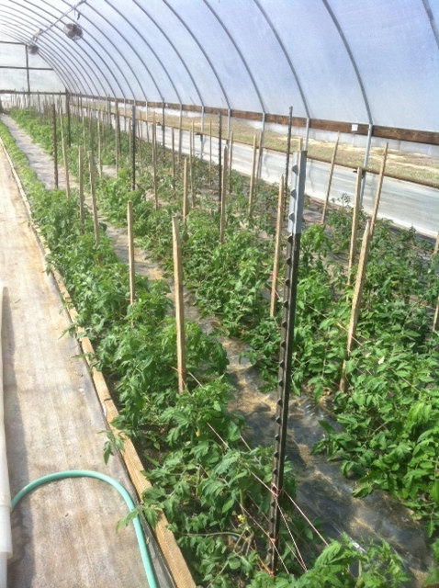
Seasonal High Tunnel Initiative 2012
Must be a high tunnel NOT treated as a greenhouse
Must grow in the soil NOT on benches or containers
Can grow in raised beds on the ground

Slide 7
Seasonal High Tunnel Initiative 2012
Can be fixed or movable, but have different payment schedule scenarios for each
Supposed to have a 4 year life-span
4 year plastic not structure
Within the 4 years you are responsible for repairs to tunnel
http://www.nrcs.usda.gov/wps/portal/nrcs/detailfull/national/programs/?&cid=stelprdb1046250
Google “Eqip nrcs high tunnel”

Slide 8
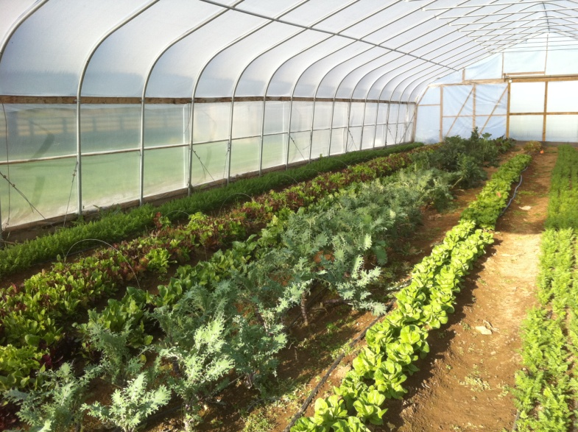
Types of tunnels
Offered by many manufacturers
Atlas , Jaderloon, FarmTek, Haygrove
Typically range from $0.85-$2.00/ ft²
Atlas 30 x 72 ran about $5500 + materials for end walls

Slide 9
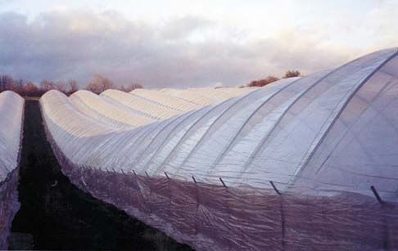
Types of high tunnels: Haygrove
“Haygrove” tunnels
Taller than most tunnels
Can be connected to form
large structures
Photo: Bachman, J. 2005. Season Extension Techniques
for Market Gardeners. ATTRA Publication #IP035

Slide 10
Haygrove Tunnels
Benefit is height and connectivity
Can easily get implements in and out
Can grow “large” crops
Great for small fruit crops
Not well insulated better as a rain shield

Slide 11
Traditional High Tunnels

Slide 12
Traditional Tunnels

Slide 13
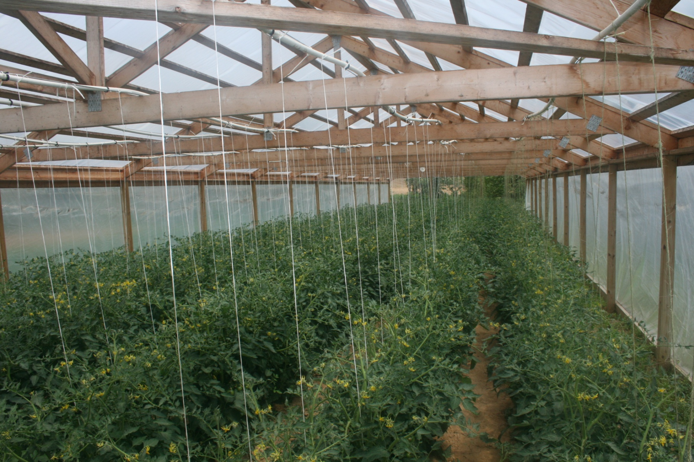
Wood Trusses for High Tunnels

Slide 14
Small- Cold Frames

Slide 15
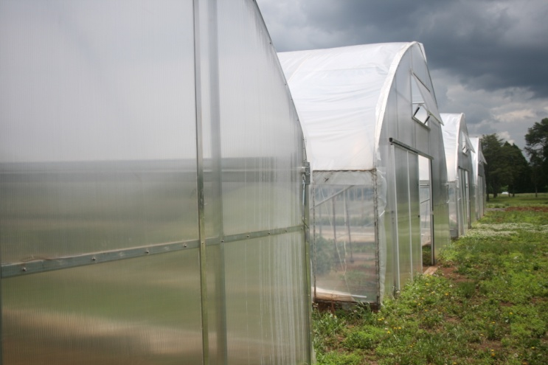
End walls
Double layer polycarbonate has about the same R value as double layer plastic
Single layer plastic has a very poor R value

Slide 16
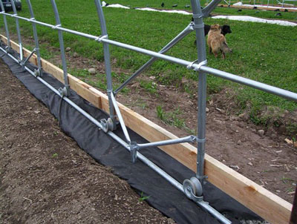
Movable tunnels
Tunnels can be moved if planned from the start
Skid system-
Wood with angle iron “ski” on end
Trex decking
Rail system
Wheels for rail system
Rimol: Rolling Thunder

Slide 17
Rail System
Used heavy duty 14 gauge galvanized rail from fence company and wheels from fence gate
Added about $1500-$2000 to cost of tunnel
BUT- normally growers can buy a 6’ side wall- since the bows are above ground you can purchase 4’ side walls for less $$$
Used “Earth Anchors”: $6.50 each

Slide 18
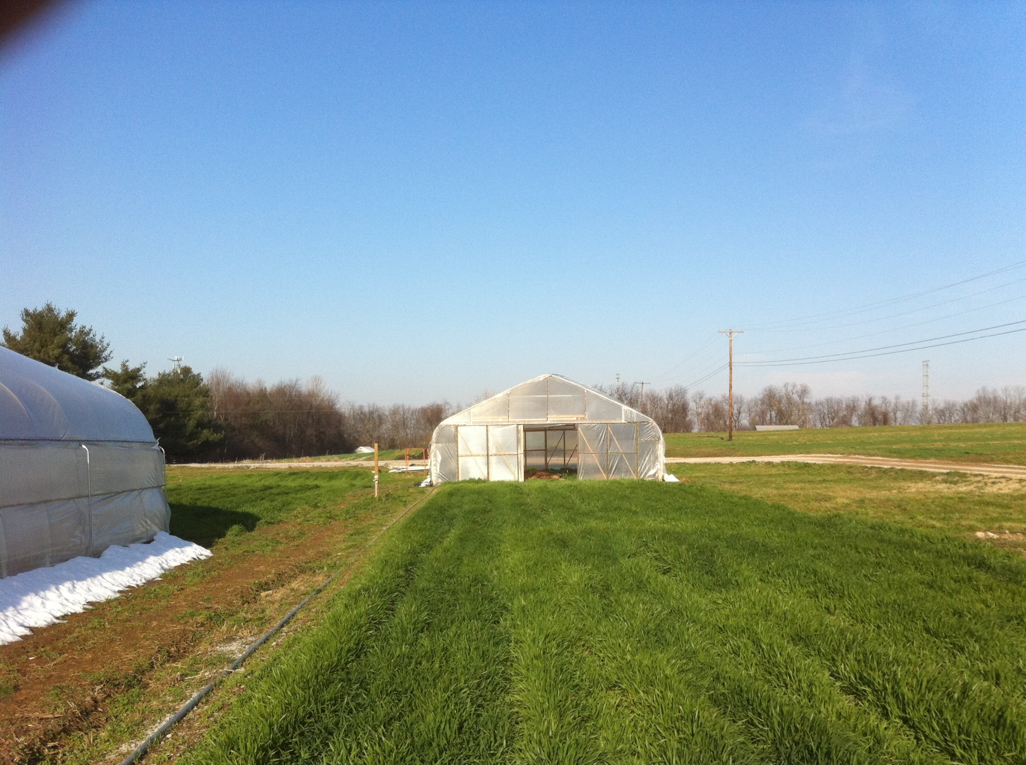

Slide 20
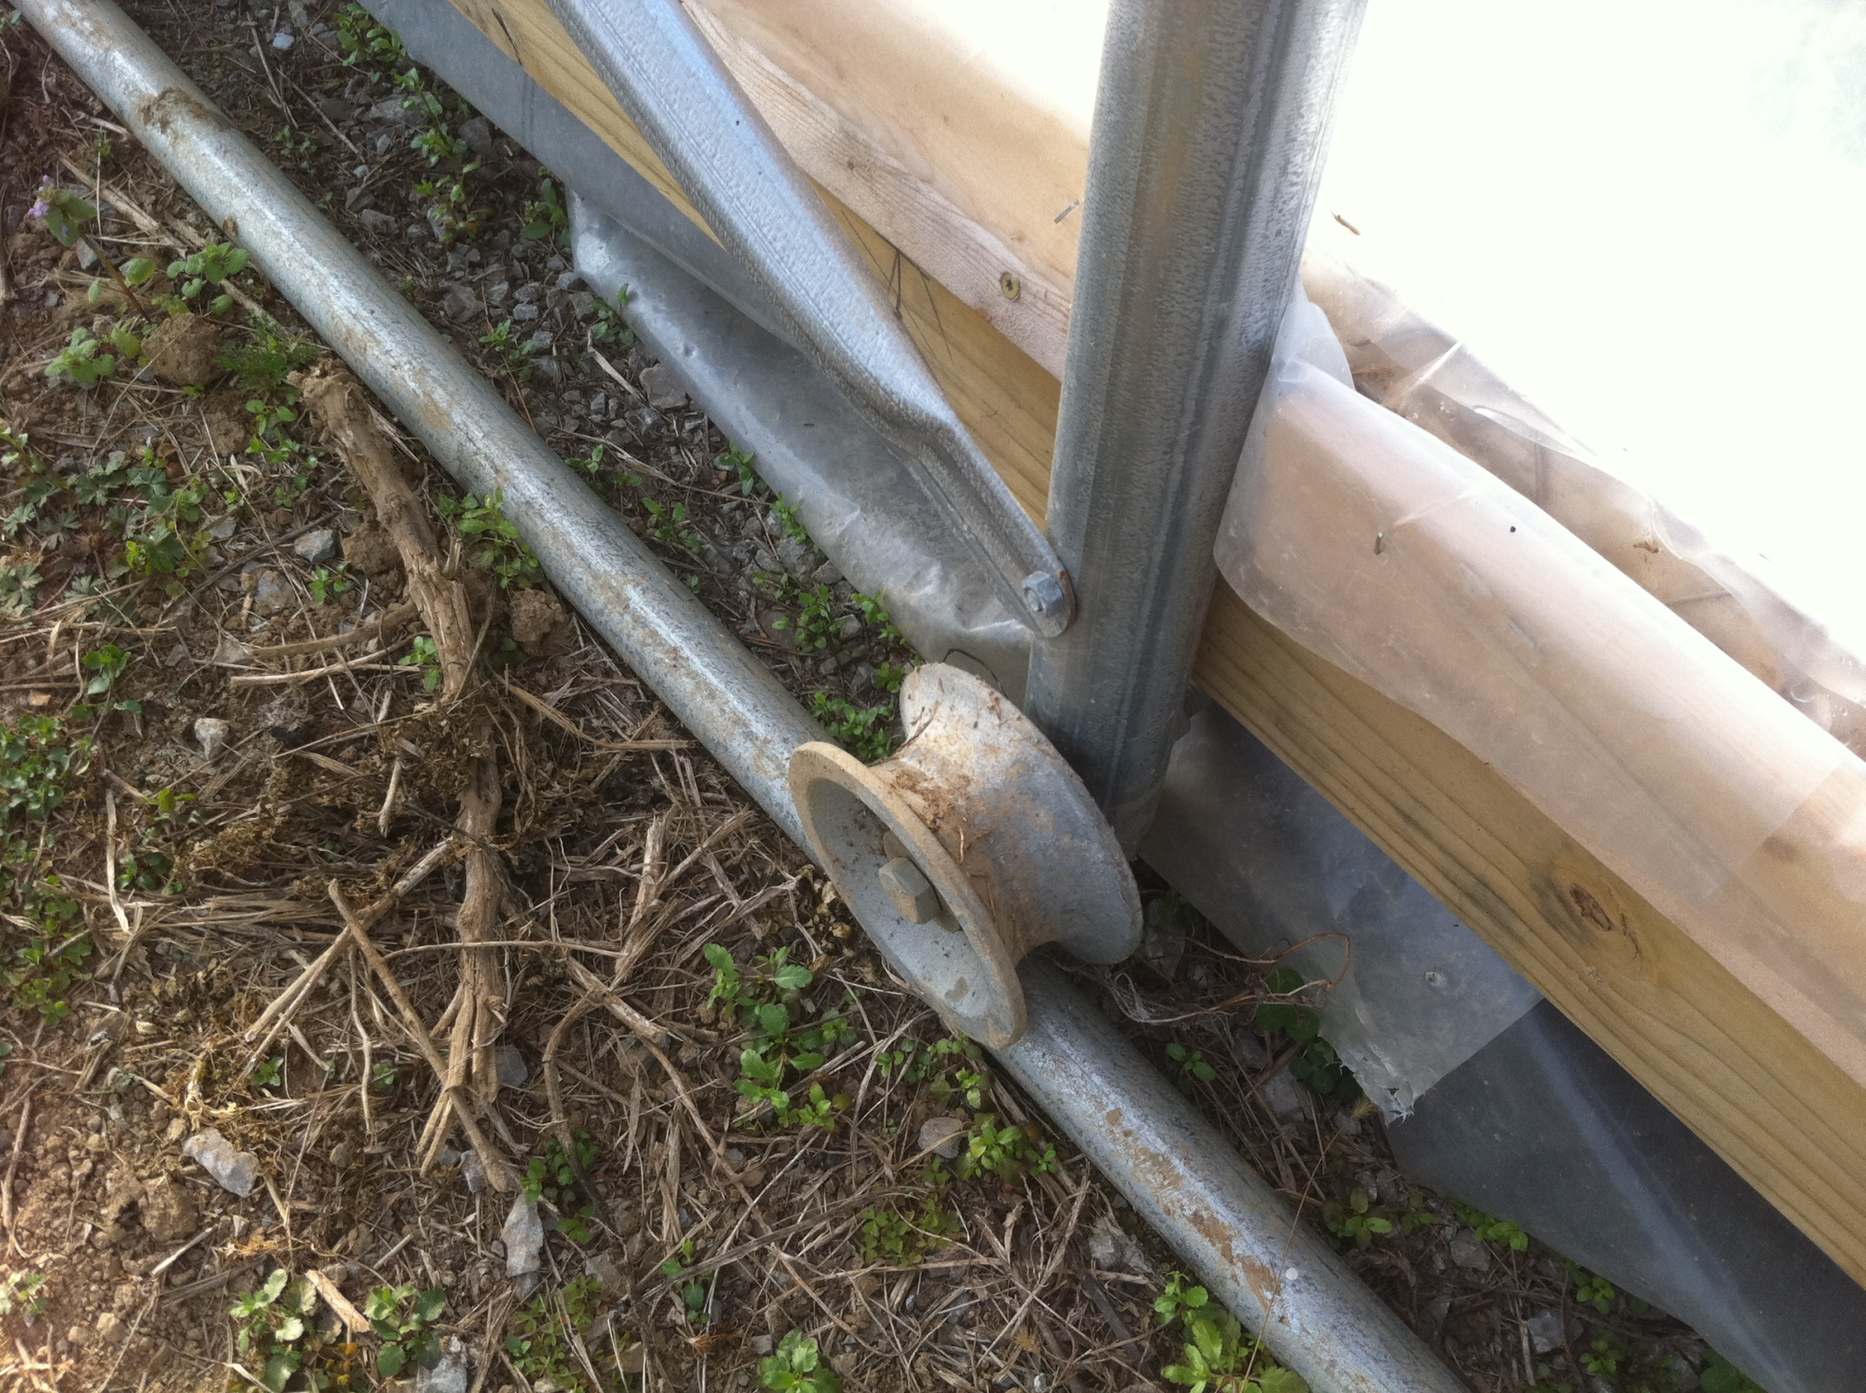

Slide 21
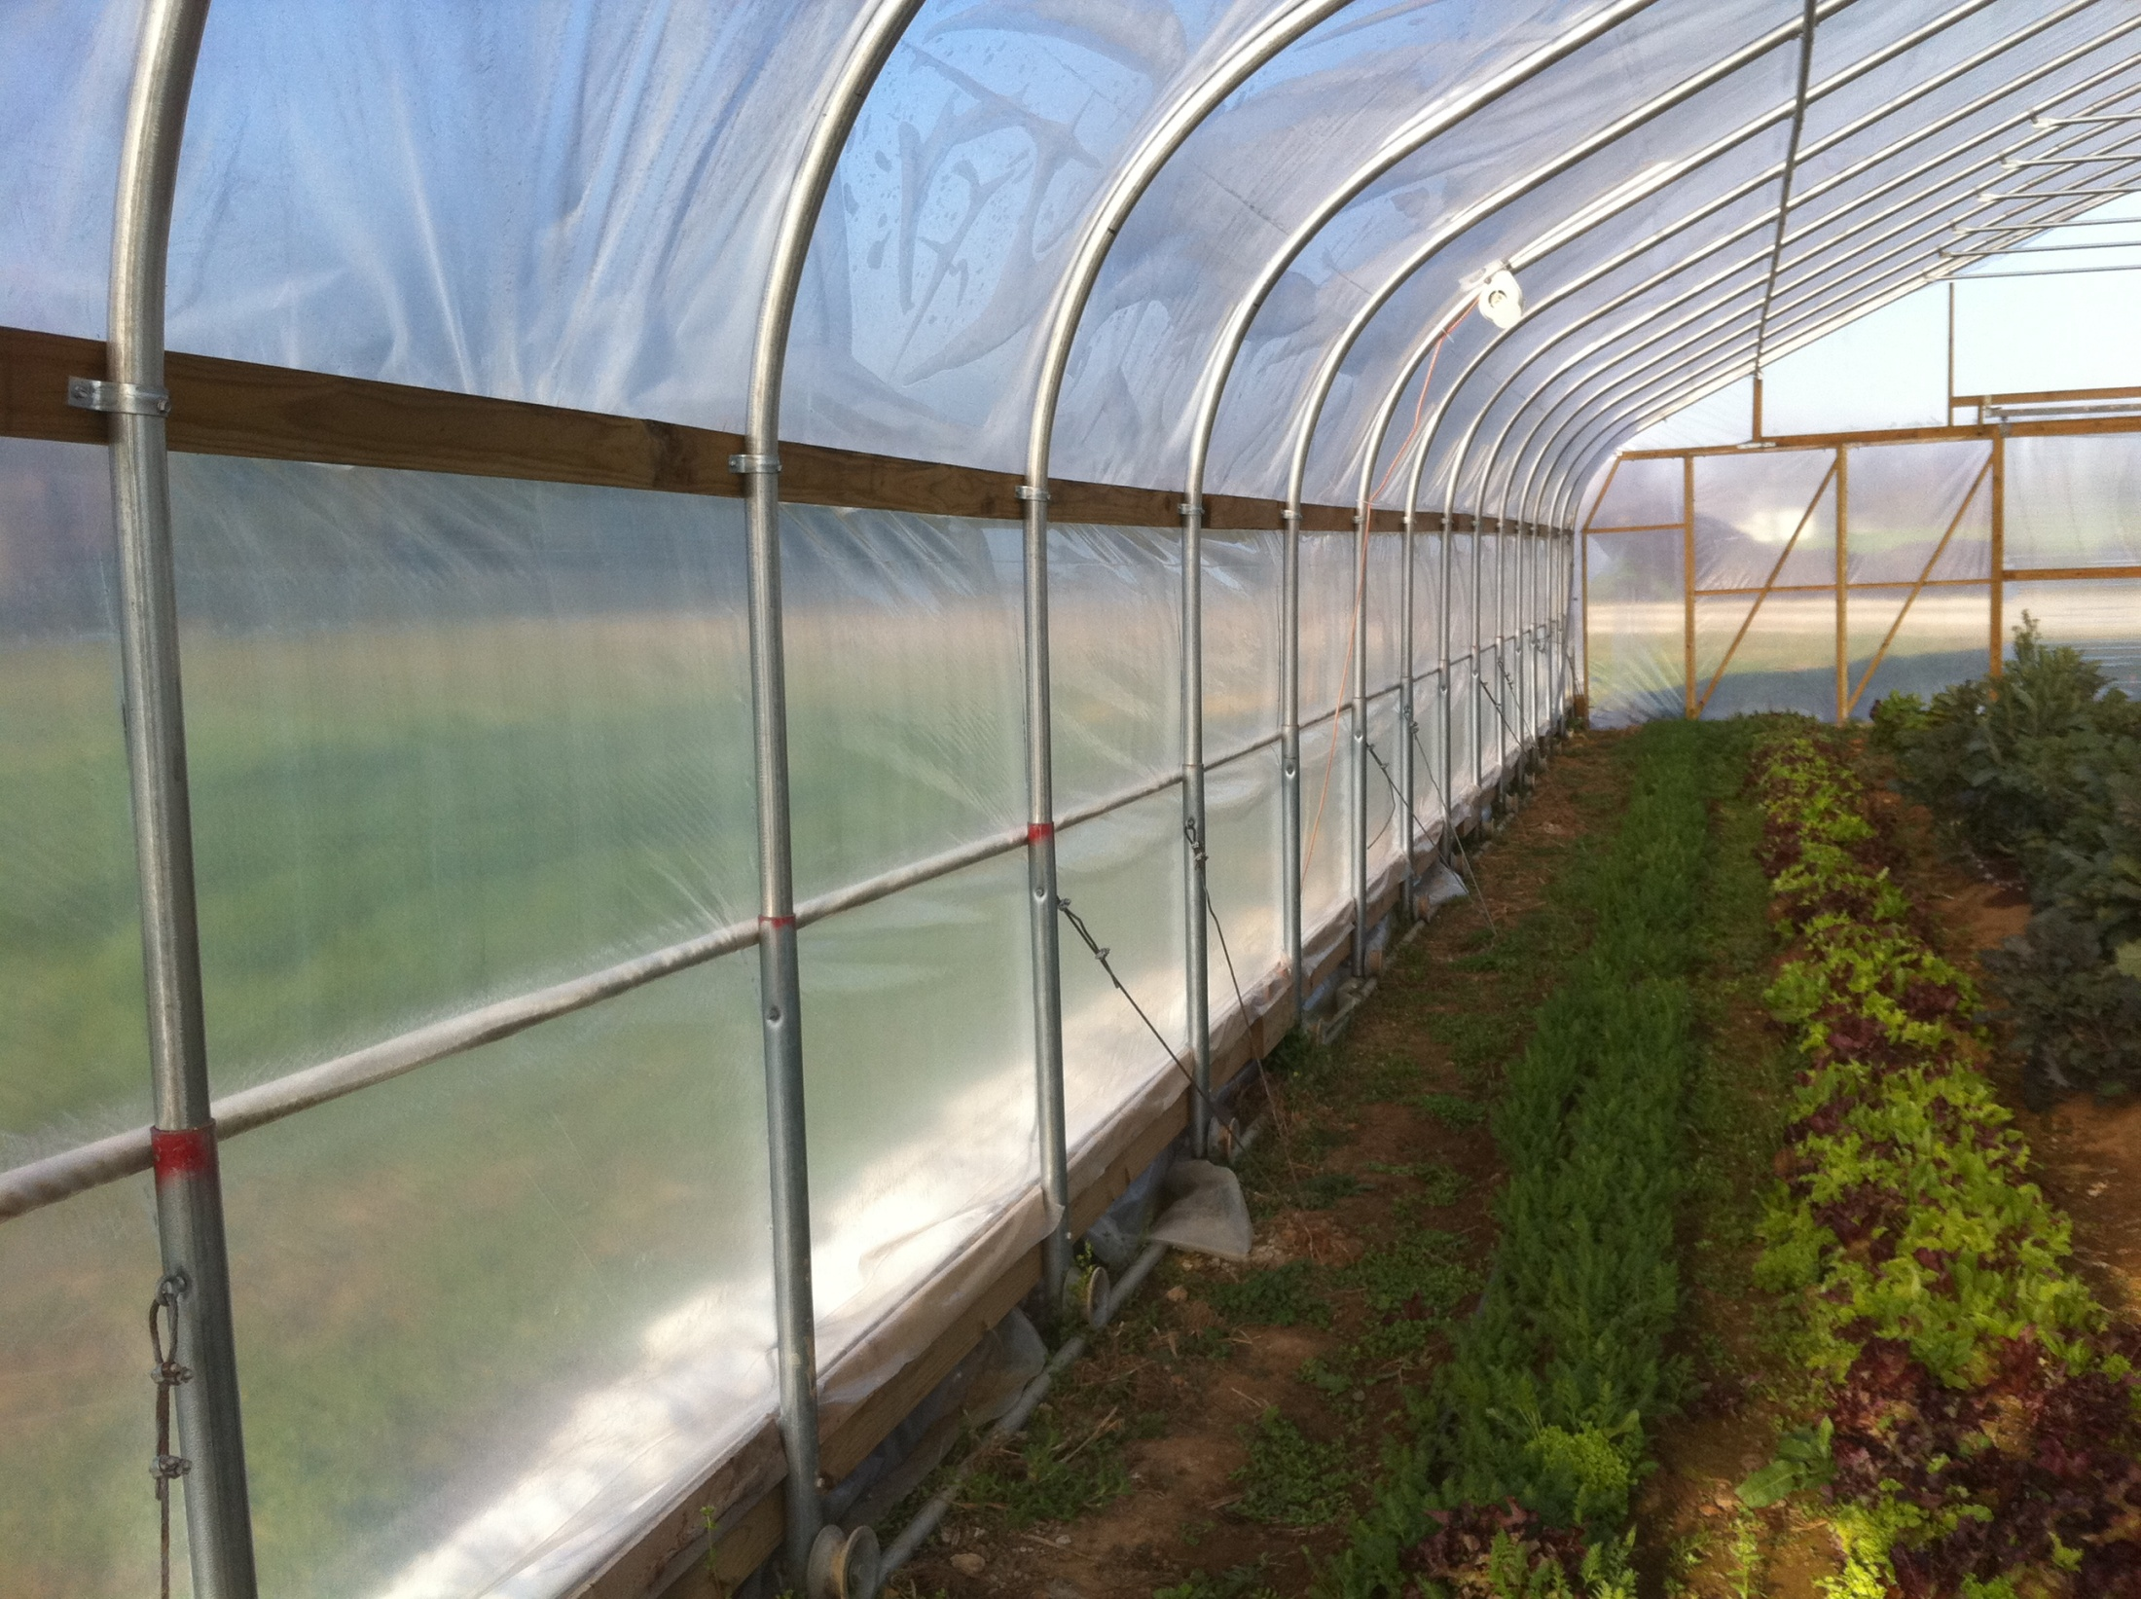

Slide 23
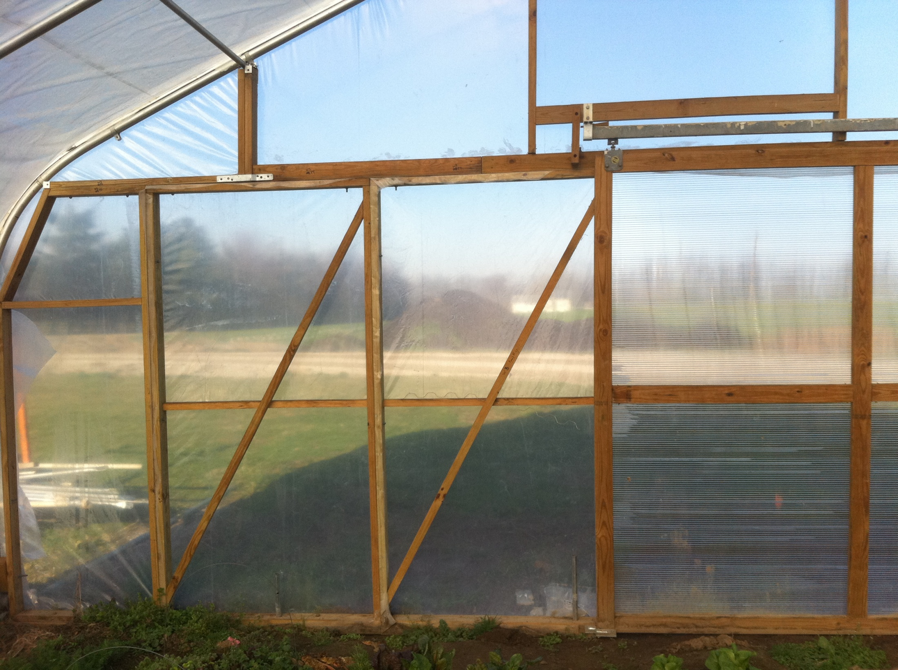

Slide 24
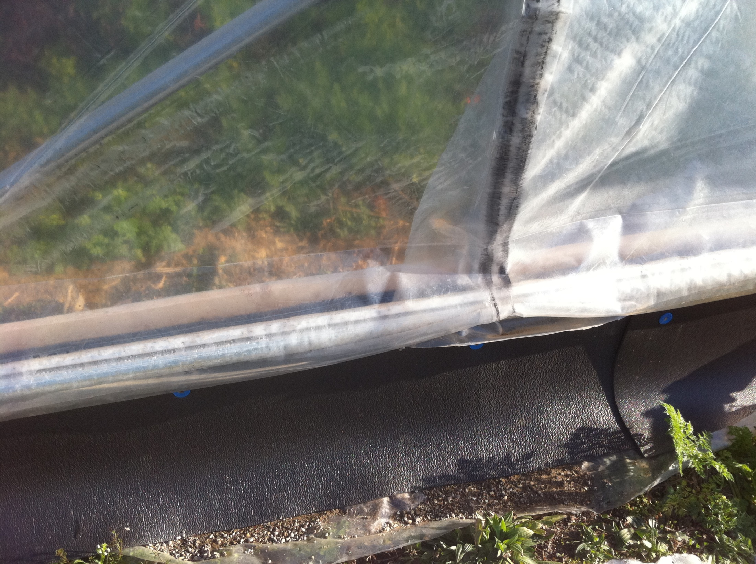

Slide 25
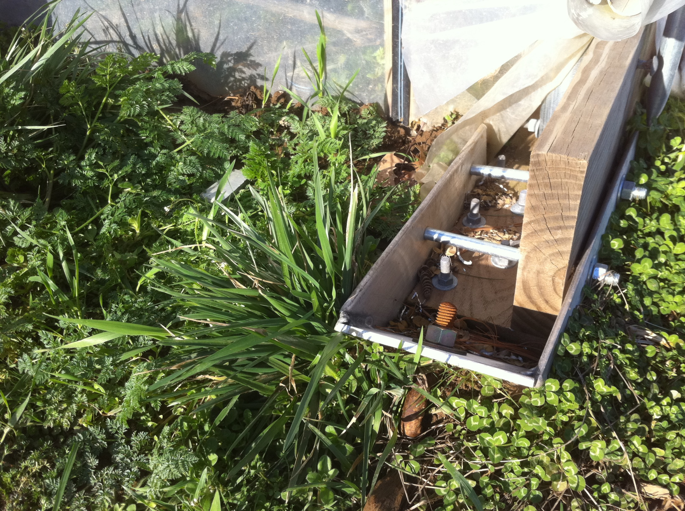

Slide 26
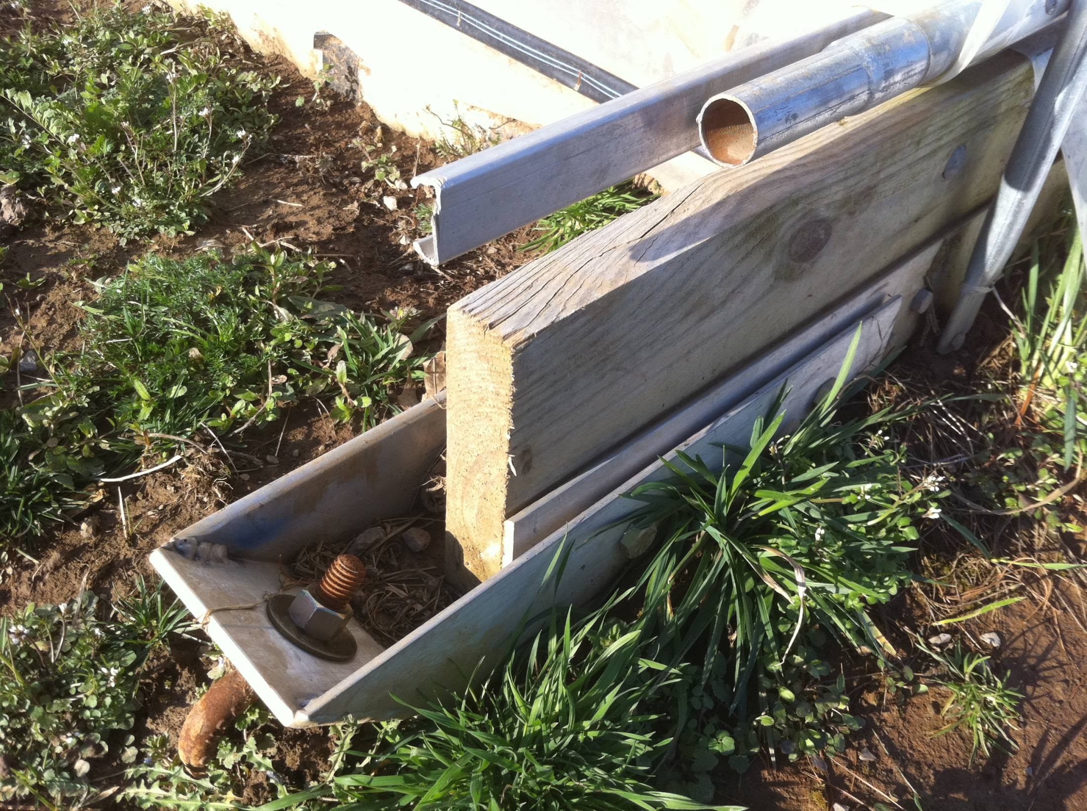
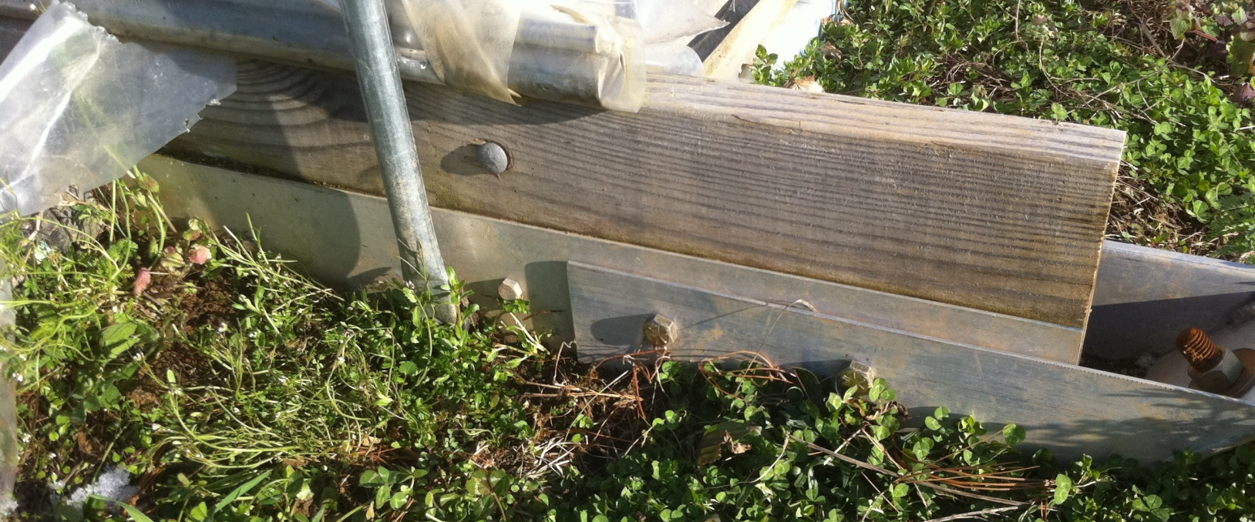

Slide 27
Movable Tunnels
Avoid many rotation issues
Can be done reasonably cost effectively
Do not seal as “tight” as stationary tunnels
Temperature benefits were slightly less
Because they move you must think about electric (to run a squirrel fan) and water possibly

Slide 28
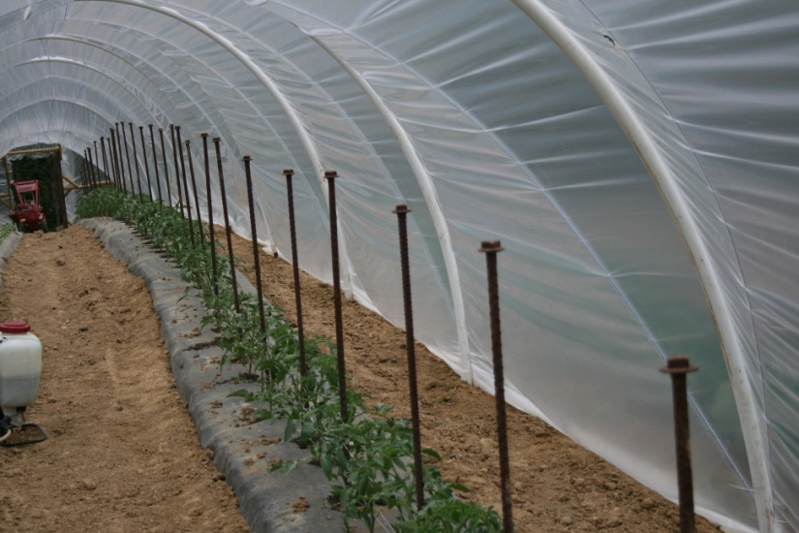
Low cost high tunnels
Cheap ($0.30 square foot)
Easy to assemble and move
Not for year round use
Not as sturdy as traditional tunnels
Other companies have recently come out with “smaller” tunnels

Slide 29
Inexpensive tunnel

Slide 30
Cost
Estimates for a 30 x 96 tunnel with 5’ side walls and a quonset type structure
Returns from one season (spring-summer)
$2.21/ft² mixed production (tomatoes, peppers, beans – 8ft²/plant-Quonset Structure
$6.80/ft² indeterminate tomato production (4.9 ft²/plant)-Sidewalls
Difficult to grow

Slide 31
Costs
Tunnels should range around $5000-$6000 for a 30 x 72 tunnel
Add costs for end walls, extra bracing, and installation (about same as cost of materials)

Slide 32
High Tunnel Temperature Benefits
Temperature advantages
Typically 15-50º F increase in day temperatures
Minimum night temperatures
Double layer poly
6-7º F increase at most farms
Single layer poly
Only 2-3º F increase in Eastern Kentucky (33 vs. 30º F)
“Double Tunnel”
Tunnel inside a tunnel add 3-4º F

Slide 33
Amanda Sears and Brent Rowell, 2004

Slide 34
Plastic
4 mil is considered 1 year plastic
6 mil is considered 4 year plastic
Super Strong Woven Poly- 11mil
Can outlast hail even and can be walked on
Costs 30-50% more
Shade cloth
Is it worth it? Wouldn’t go more than 40%.

Slide 35
Single Layer

Slide 36
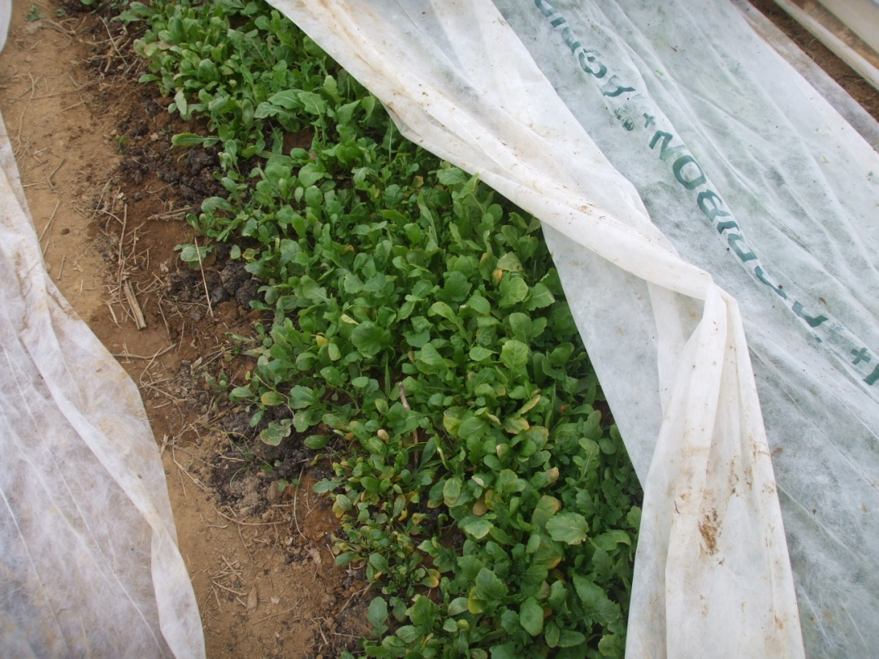
Tunnel within a tunnel: January 2011

Slide 37
Double layer- need electric…

Slide 38
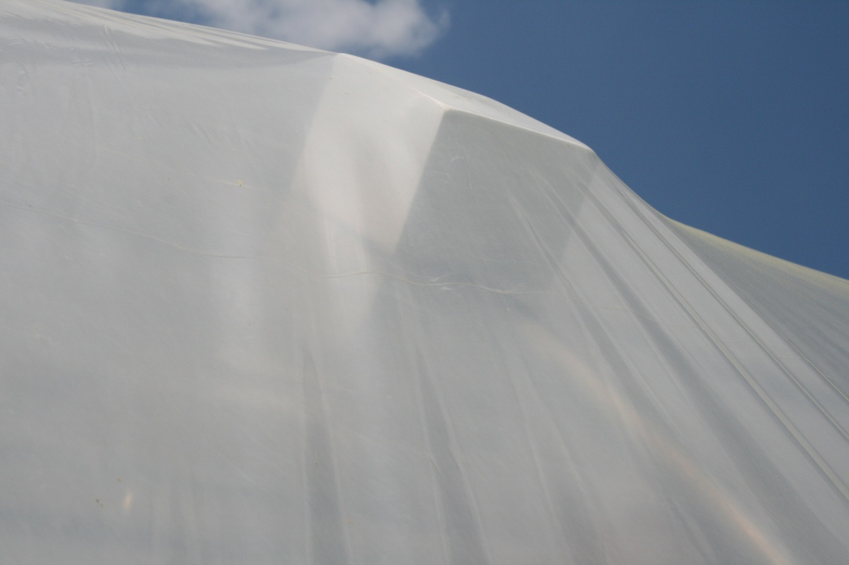

Slide 39
High Tunnel Basics
Should have reasonable side walls for venting
Ridge vents are not a great option
Some complete ridge vents are good, but expensive
Taller tunnels tend to keep heat up away from plants

Slide 40
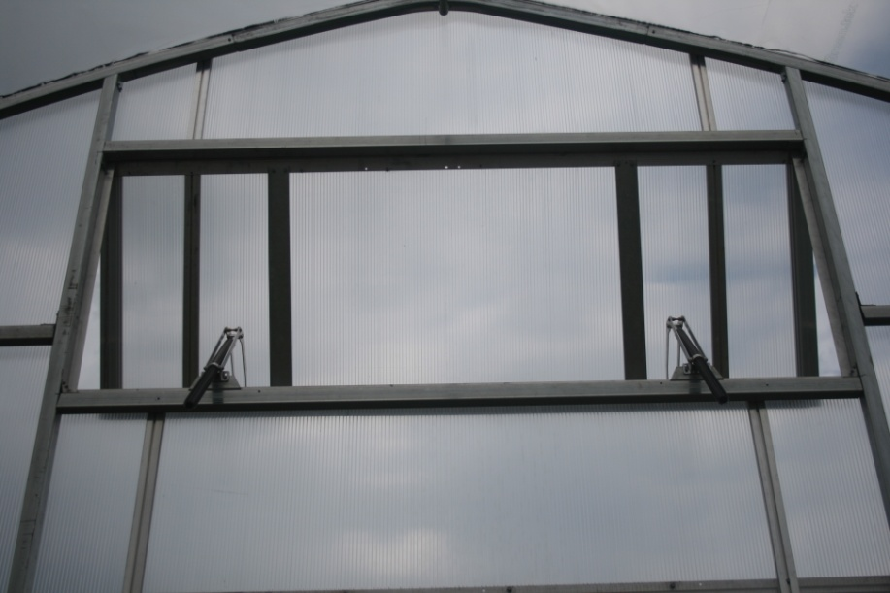
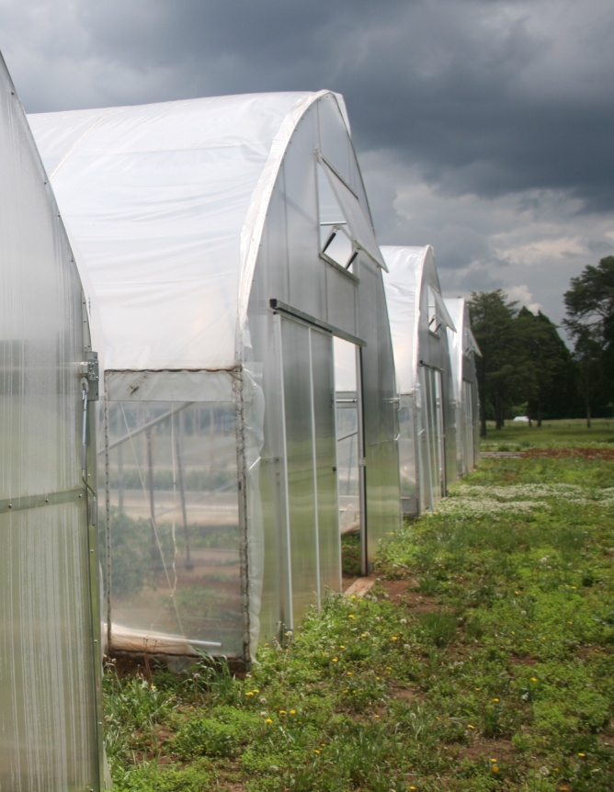

Slide 41
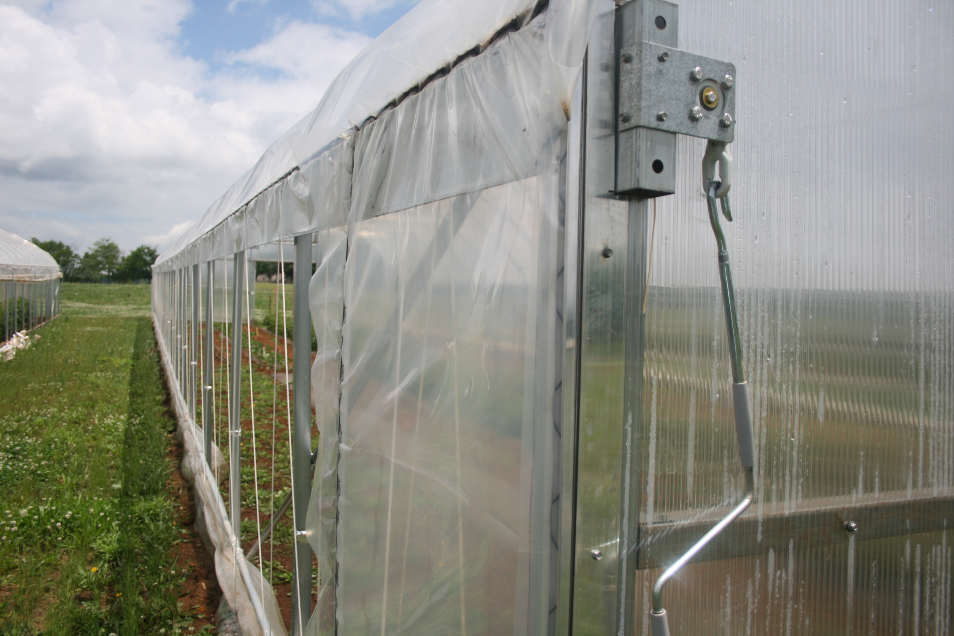

Slide 42
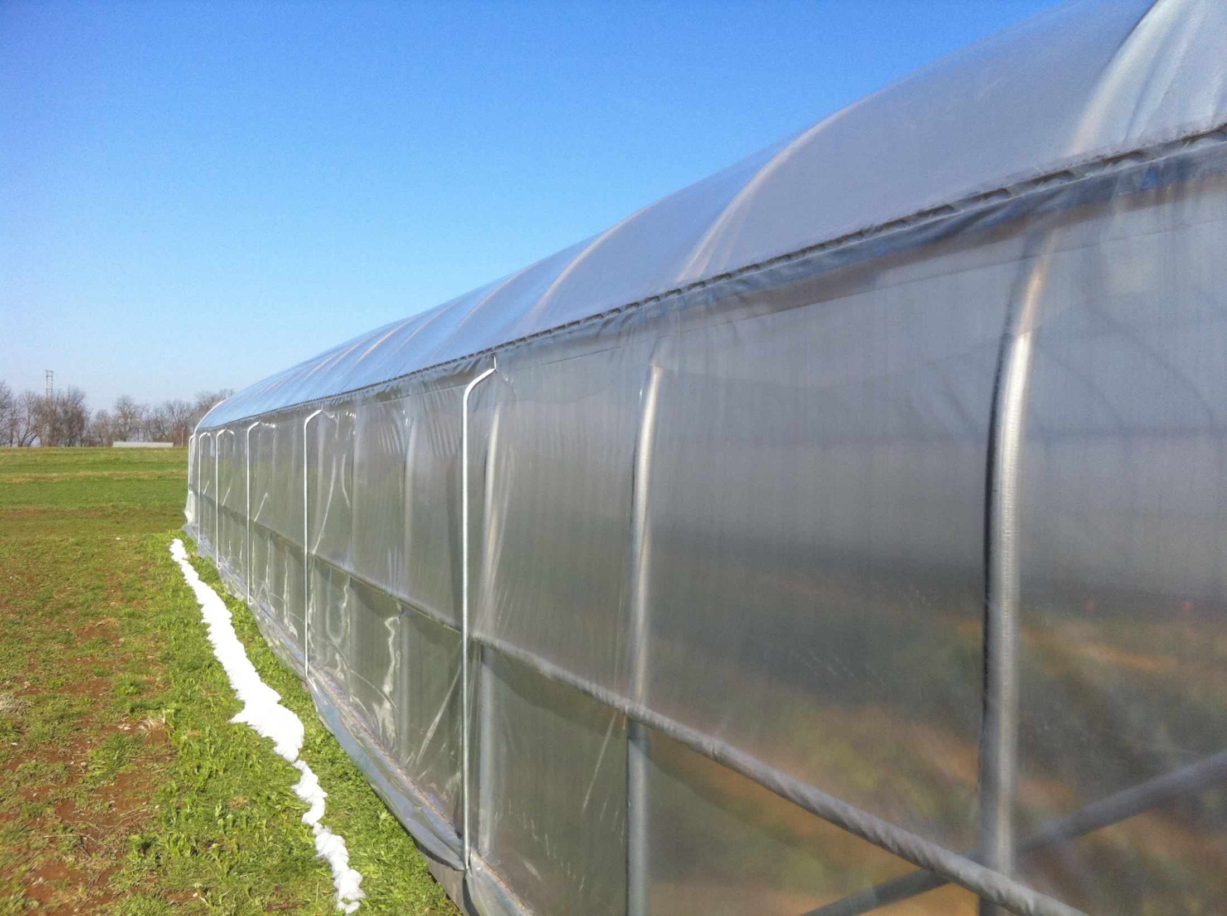

Slide 43
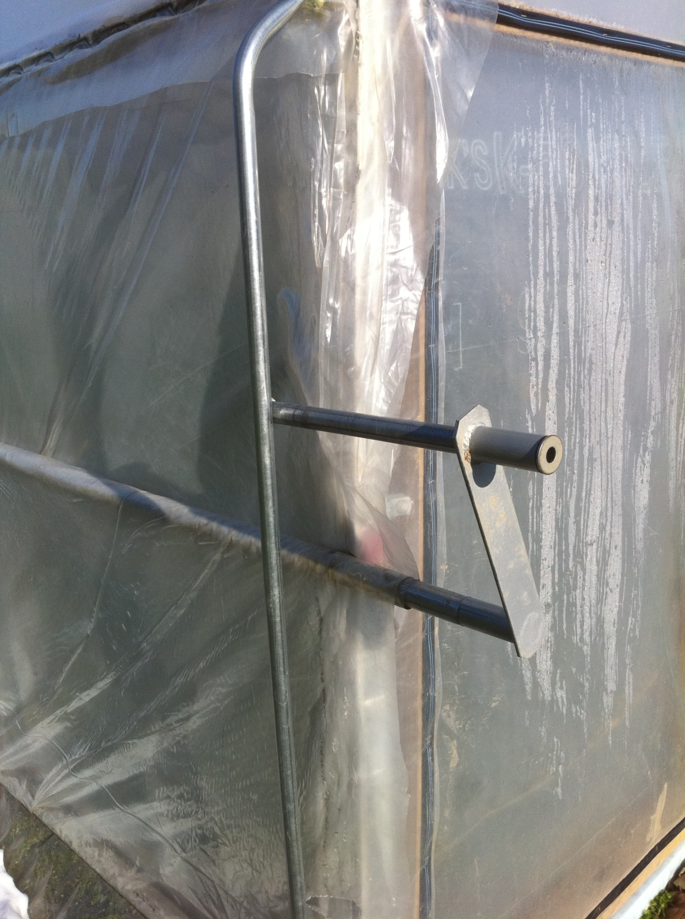

Slide 44
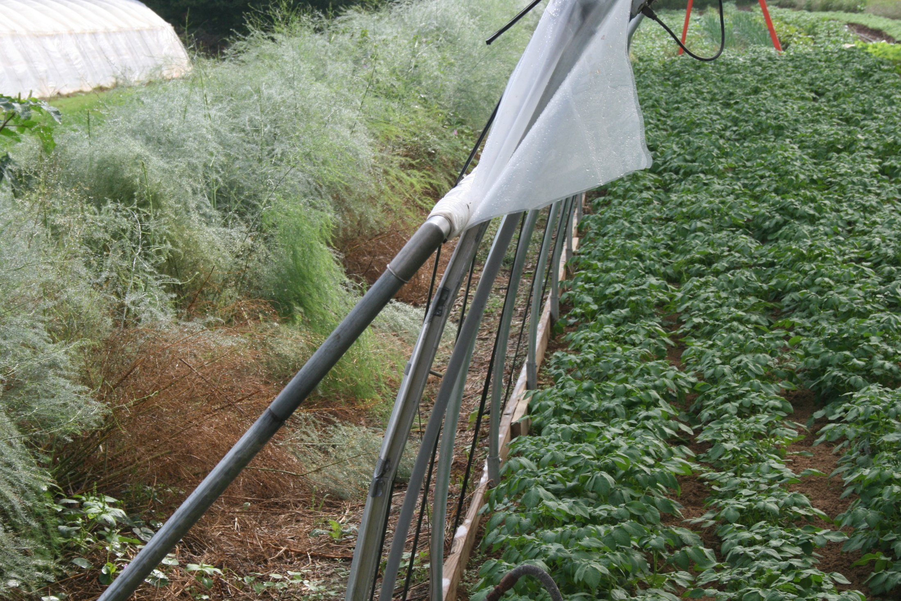

Slide 45
Locating Tunnels
For maximum and most uniform sunlight interception locate tunnels in a N-S orientation if at 40 ºN or further south
If above 40ºN orient E-W
If multiple bay tunnels then orient N-S
In winter E-W orientation tends to capture more light as sun is low in the horizon, but in spring it is distributed poorly in E-W orientation
Hightunnels.org

Slide 46
Locating Tunnels
Wind is also an issue
High winds can destroy tunnels
UPLIFT is important – anchoring tunnels
Consider wind breaks
Single bay high tunnels oriented perpendicular to prevailing if structure has roll-up sides *
Multi-bay high tunnels should be oriented parallel to prevailing winds

Slide 47
Wind Damage to greenhouses

Slide 48
Light Intensity
Total accumulated daily light levels in KY in January are about 14% of July levels
The result of shorter days and less intense light/more cloud cover
Even if temperature is high enough, plants may grow, fruit development slows-
Typical succession is tomatoes in spring followed by greens in early winter fall

Slide 49
Data from Dr. Bob Anderson

Slide 50
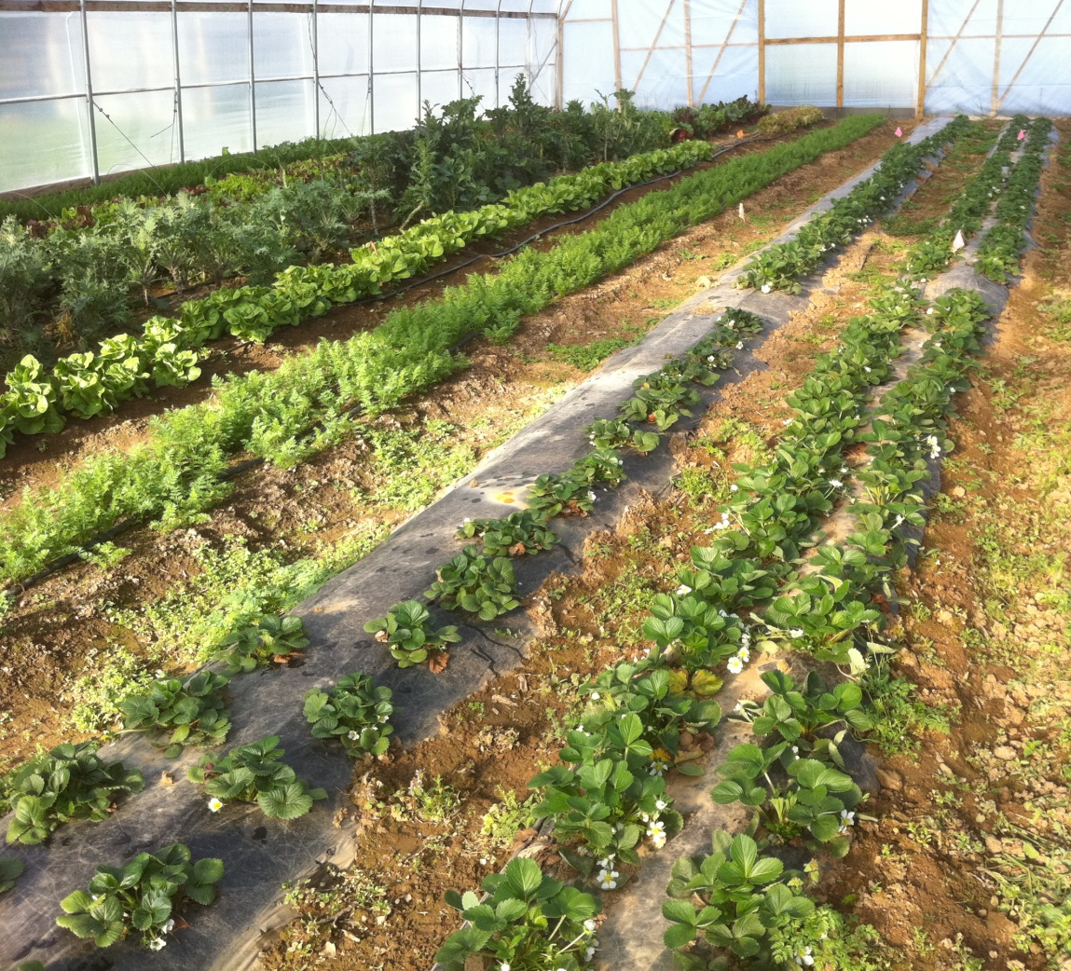
What Can You Grow In a High Tunnel
Whatever your market will support
Tomatoes
Greens
Beans
Flowers
Peppers
Potatoes
Carrots
Cucurbits-maybe
Anything!

Slide 51
Tomatoes

Slide 52
Lettuce

Slide 53
Potatoes

Slide 54
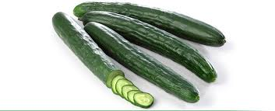
Cucumbers
Parthenocarpic-do not need pollination
Should in fact keep pollinators away
Can keep relatively close
Seed can be expensive

Slide 55
Flowers!
Cut flowers do great in tunnels
NO RAIN
Clean-quick turn around and do not take up much space
Very profitable
www.attra.org

Slide 56
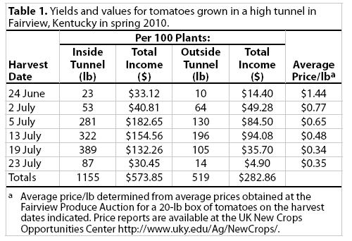
Returns Providing Realistic Expectations for Growers

Slide 57
Think about space!
Tomatoes might require 5 square feet per plant
96’ tunnel=72 plants per row-
Squash will require twice that easily
96’ tunnel = 48 plants per row-
Beans, peppers, greens, onions can be planted very densely
Even potatoes-fingerling types have done well because they can be tight together

Slide 58
Planting Density

Slide 59
Pollination

Slide 60
Pollinators
Bumble bees are good pollinators for high tunnels
Particularly early in season pollinators will increase fruit set
Essential on most cucurbit crops
Generally a class C hive will have enough bees for 600-700 tomato plants
Large number of visits will “bruise” flowers
If no bruising then not enough visits

Slide 61
Class C hive

Slide 62
The hive

Slide 63
“Bruised” flower

Slide 64
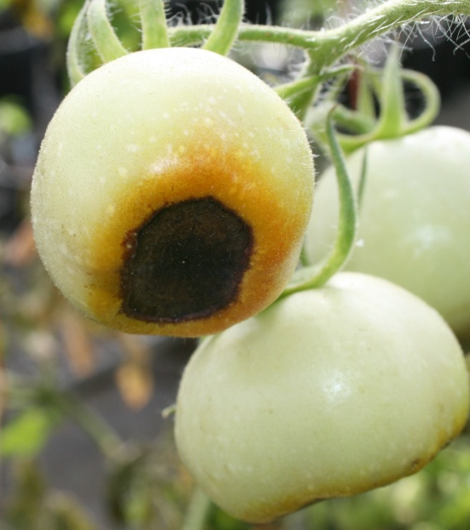
Fertility and irrigation
In tunnels many have gone to a 4” drip tape
Fertility is often nearly doubled for tunnel tomatoes
5 ft² vs 9 ft²
Easier to use a proportional injector vs. a Mazzei type injector

Slide 65
Injectors

Slide 66
Nutrient Issues in tunnels: Blossom End Rot

Slide 67
Calcium Uptake
Calcium and moves in the transpirational stream
Calcium deficiencies are related to anything that influences transpiration and water movement
High humidity
Cool temperatures and cloudy weather
Lack of water
Fruit with a waxy/impermeable coating
Lack of mobility also impacts fruit deficiencies

Slide 68
Calcium
Because calcium is not mobile within a plant deficiencies occur in new growth
Short term deficiencies result in irreversible damage
Blossom end rot
Foliar sprays are often ineffective

Slide 70
Nutrient Issues in Tunnels: Potassium Deficiencies on Tomato
Potassium is often deficient on high Magnesium and Calcium soils- even if K levels are sufficient according to soil test
Tomatoes are extremely sensitive
Some growers put out 1.5-2x potassium as nitrogen every year for tomato
Deficiency appears as death on leaf margins of older leaves
Blotchy ripening

Slide 72
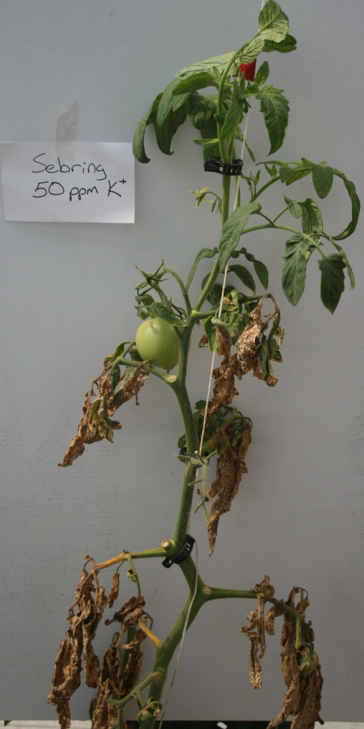
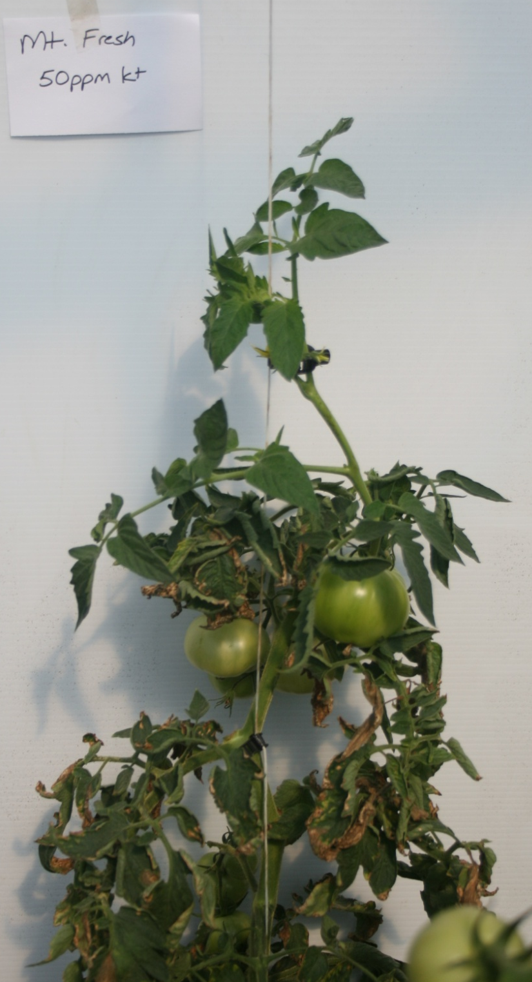

Slide 73
K and Mg interaction: Blotchy ripening

Slide 74
Nutrient Issues in Tunnels: Bullishness in Tomato
Excessive N can be an issue in tomatoes
High tunnels generally require greater fertility than field
Excessive N fertility: Bullishness
Affects determinate more than indeterminate
Occurs more in cloudy or cool weather (spring or fall)
Plants will grow out of it
Hinders pollination

Slide 75
Bullishness (tomato)

Slide 76
Fertility Issues in Tunnels: Salt stress
Over time no leaching occurs and salts build up
Either from fertilizer or city water
Can leach them
To leach salts from top 1 foot of soil (on a silt soil, heavy soils with higher CEC may take more)
6” water will leach 50% salts
12” water will leach 80% salts
24” water will leach 90% salts

Slide 78
Salt stress In high tunnels

Slide 79
High Salts

Slide 80
Tomato production
Tomatoes represent one of the most profitable high tunnel crops for farmers in Kentucky
Can often get a 4-5 week advantage on the season with a double layer tunnel
If unheated double layer tunnel you can plant in early March
Tomatoes in a single layer tunnel will have to go in later
Late March or first of April

Slide 81
Tomatoes on Feb 18th

Slide 82
Tomatoes March 12

Slide 83
Cover between rows
Have not seen a big benefit from black plastic mulch in tunnels
Often too shaded to get the benefit & soil is already warm
Use whatever works best
Straw can be difficult to till

Slide 84
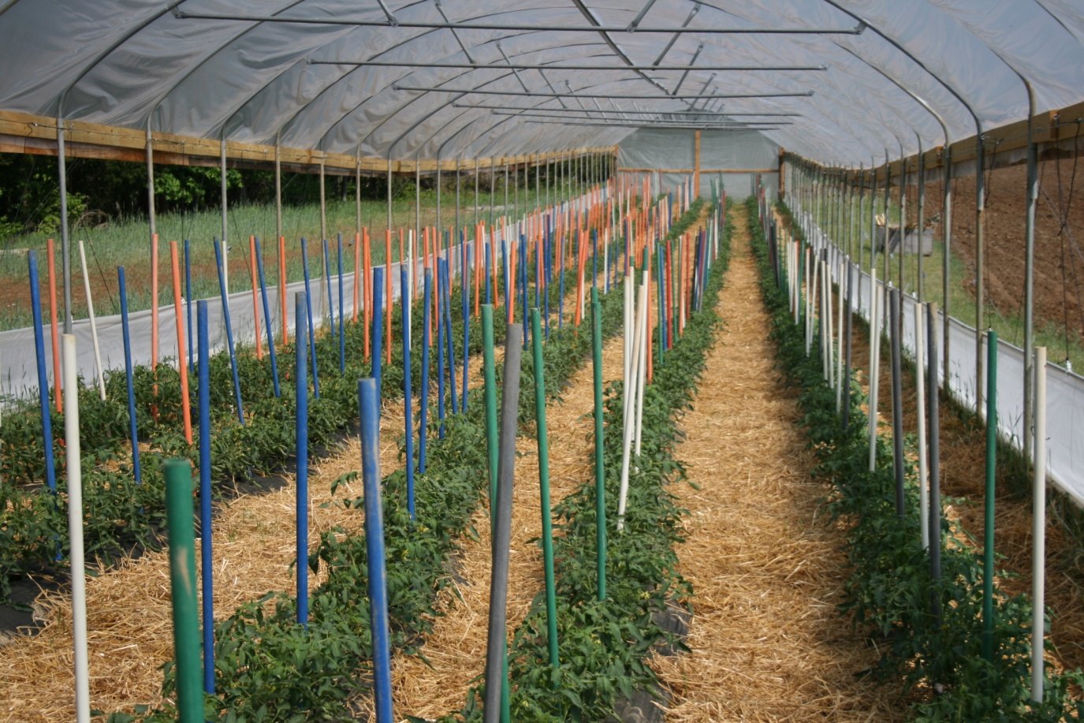

Slide 85
Varieties
Determinate or indeterminate- depends on if you want to string them up or not
Indeterminate have a better yield potential, but require more work (pruning, etc)
Heirloom types often yield tremendously well

Slide 86
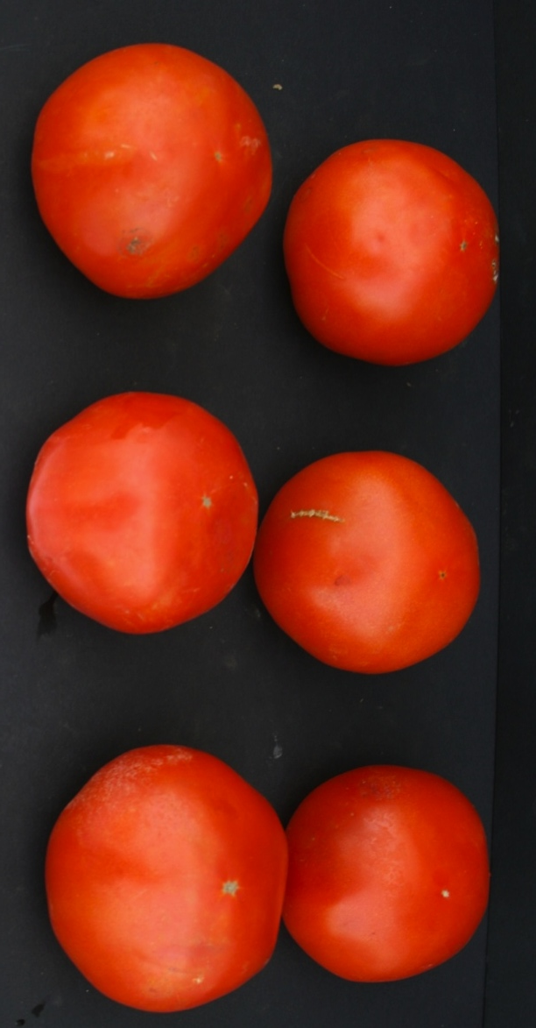
Geronimo-Hydroponic
Very vigorous vine
8-9 oz fruit
Very small stem scar
Few problems with blotchy ripening, deficiencies

Slide 87
Trust-Hydroponic Type
Common variety
Normal vigor, 8-9 oz fruit
Prone to cracking in periods of rapid water uptake
To reduce cracking increase fruit

Slide 88
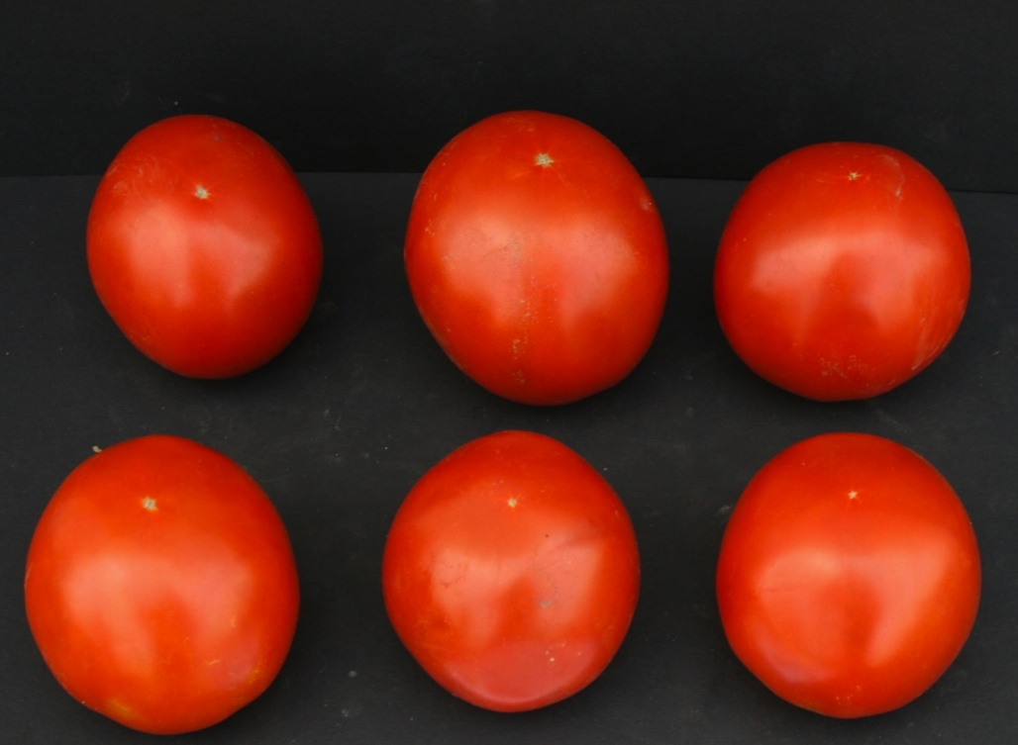
Big Beef-Tunnel
Many grow it for perceived flavor benefits
Seed are cheaper than hydroponic types
Yields earlier
Stems getting small/weak in mid/late summer

Slide 89
Determinate Varieties
Have seen determinate varieties get between 14 and 20 lbs per plant in a tunnel
Yield is comparable to field usually, but earlier
Mt. Series have been hit and miss
BHN 543 has done well
Charger has done well

Slide 90
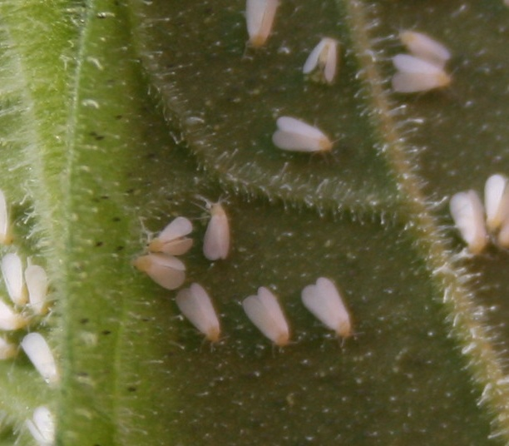
Insects in tunnels management
Due to limited air movement and high plant populations, insect pests such as white fly and aphids may become problematic
Beneficial insects have worked well in tunnels-
Lady Beetles* and Lace wings have worked well

Slide 91
Common soil diseases
Sclerotinia sclerotiorum: Timber rot

Slide 92
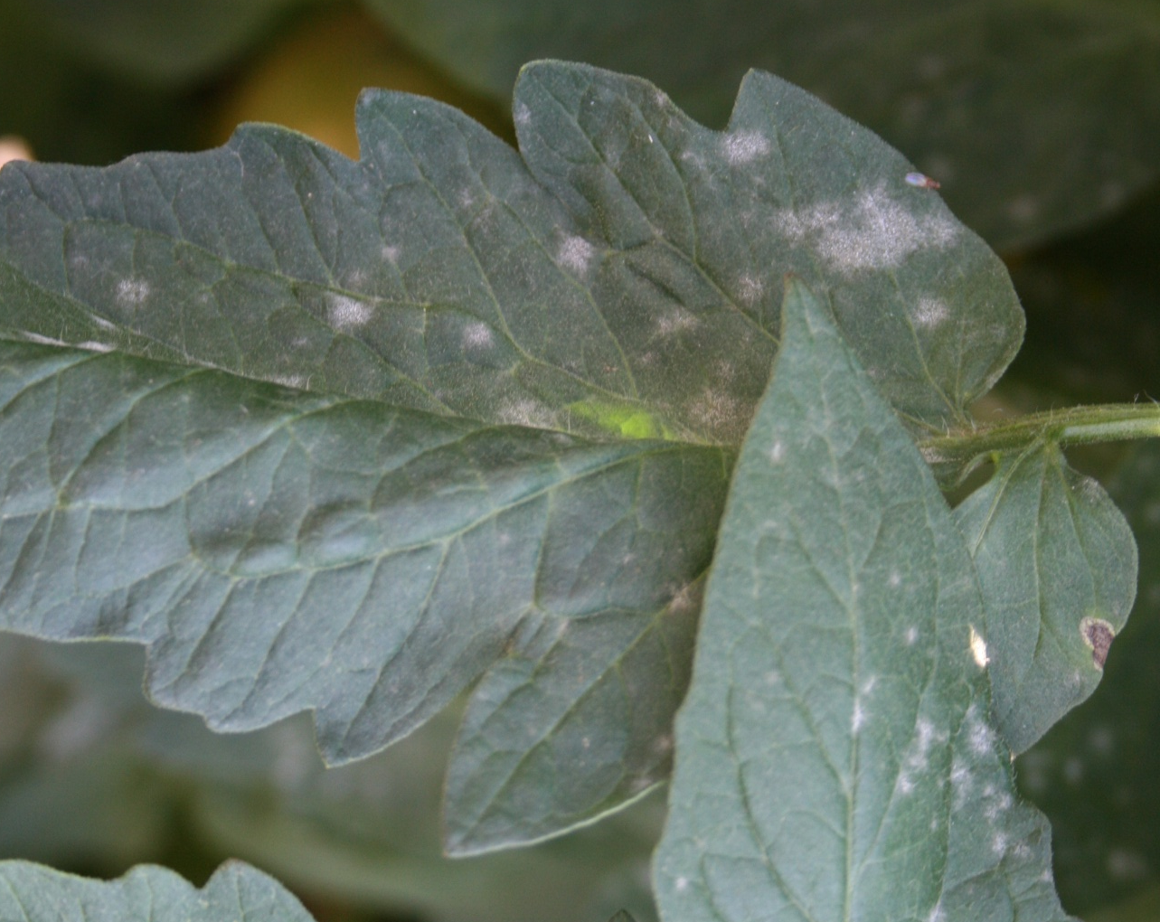
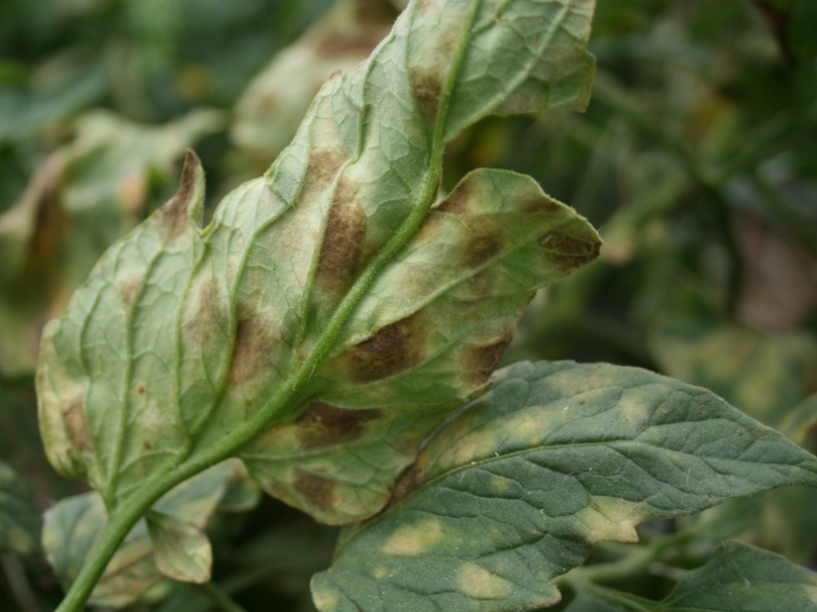
Disease Considerations
Other Diseases
Humidity can also be high resulting in the spread of some diseases
Leaf mold, Botrytis, and powdery mildew (no rain) can occur at a higher incidence.

Slide 93
Solarization and Biofumigation
Growers must rotate within tunnel or move tunnel
Eliot Coleman has popularized using skids to move tunnels-must use end bracing.
Dr. Mike Bomford at Kentucky State University along with Dr. Paul Vincelli and Kenneth Seebold led a SARE funded project looking solarization and biofumigation of high tunnels
Findings
Solarization worked well killing nearly all sclerotia
Biofumigation in there study did not
There was no interaction
http://organic.kysu.edu/biofumigation3.shtml

Slide 94
Soil Steaming

Slide 95
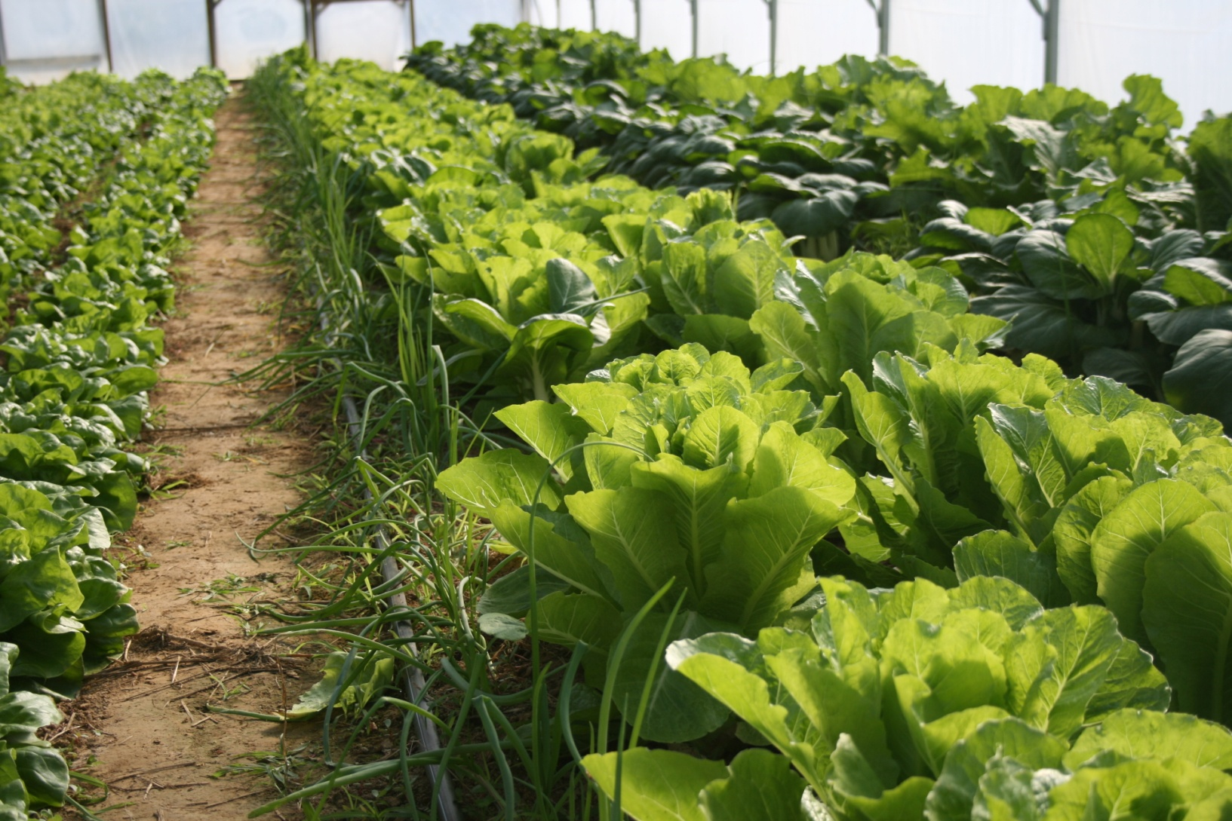
Resources
Hightunnels.org
Attra.org
eXtension
Eliot Coleman

Slide 96
Thank you

