Slide 1
Nutrient and Water Management in Vegetables: Principles of Plant Nutrition and Irrigation
Timothy Coolong
Department of Horticulture
Vegetable Academy 2012

Slide 2
Overview
Soil pH
Essential nutrients plus toxicities and deficiencies
Fertilizing for vegetables
  Conventional and organic including manures

Slide 3
Nutrients as Anions and Cations
Anions are negatively charged
  Nitrate, phosphate, sulfate, chloride, borate, molybdate
Cations are positively charged
  Potassium, calcium, magnesium, iron, zinc, copper, manganese
Nitrate
-
Calcium
++

Slide 4
Soil and water pH
What is pH?
  The measure of H+ and OH- ions
  Logarithmic scale 0-14
    A change of 1 unit in pH is a 10x increase in H+ or OH- concentration
  Why is it important?
    It impacts nutrient availability for plants

Slide 5
pH
Source: Bailey, 1996

Slide 6
Source: Argus, 2000

Slide 7
pH and alkalinity
pH and alkalinity are not always the same
  Alkalinity measures the ability of a water solution to resist (buffer) change
  A high pH in a soil that has low buffer [carbonates (Ca/Mg)] is easy to change
  A high pH in a highly alkaline (large amounts of Ca/Mg) is hard to change
  Very important for container production

Slide 8
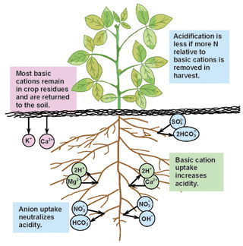
Nutrient uptake and soil acidification
Over time crop accumulation of cations by crops will slowly drop soil pH
Usually 1-2 tons of lime every few years of production
Changes based on fertilizer used
Source: Management strategies to reduce the rate of soil acidification. http://www.ianrpubs.unl.edu/pages/publicationD.jsp?publicationId=111

Slide 9
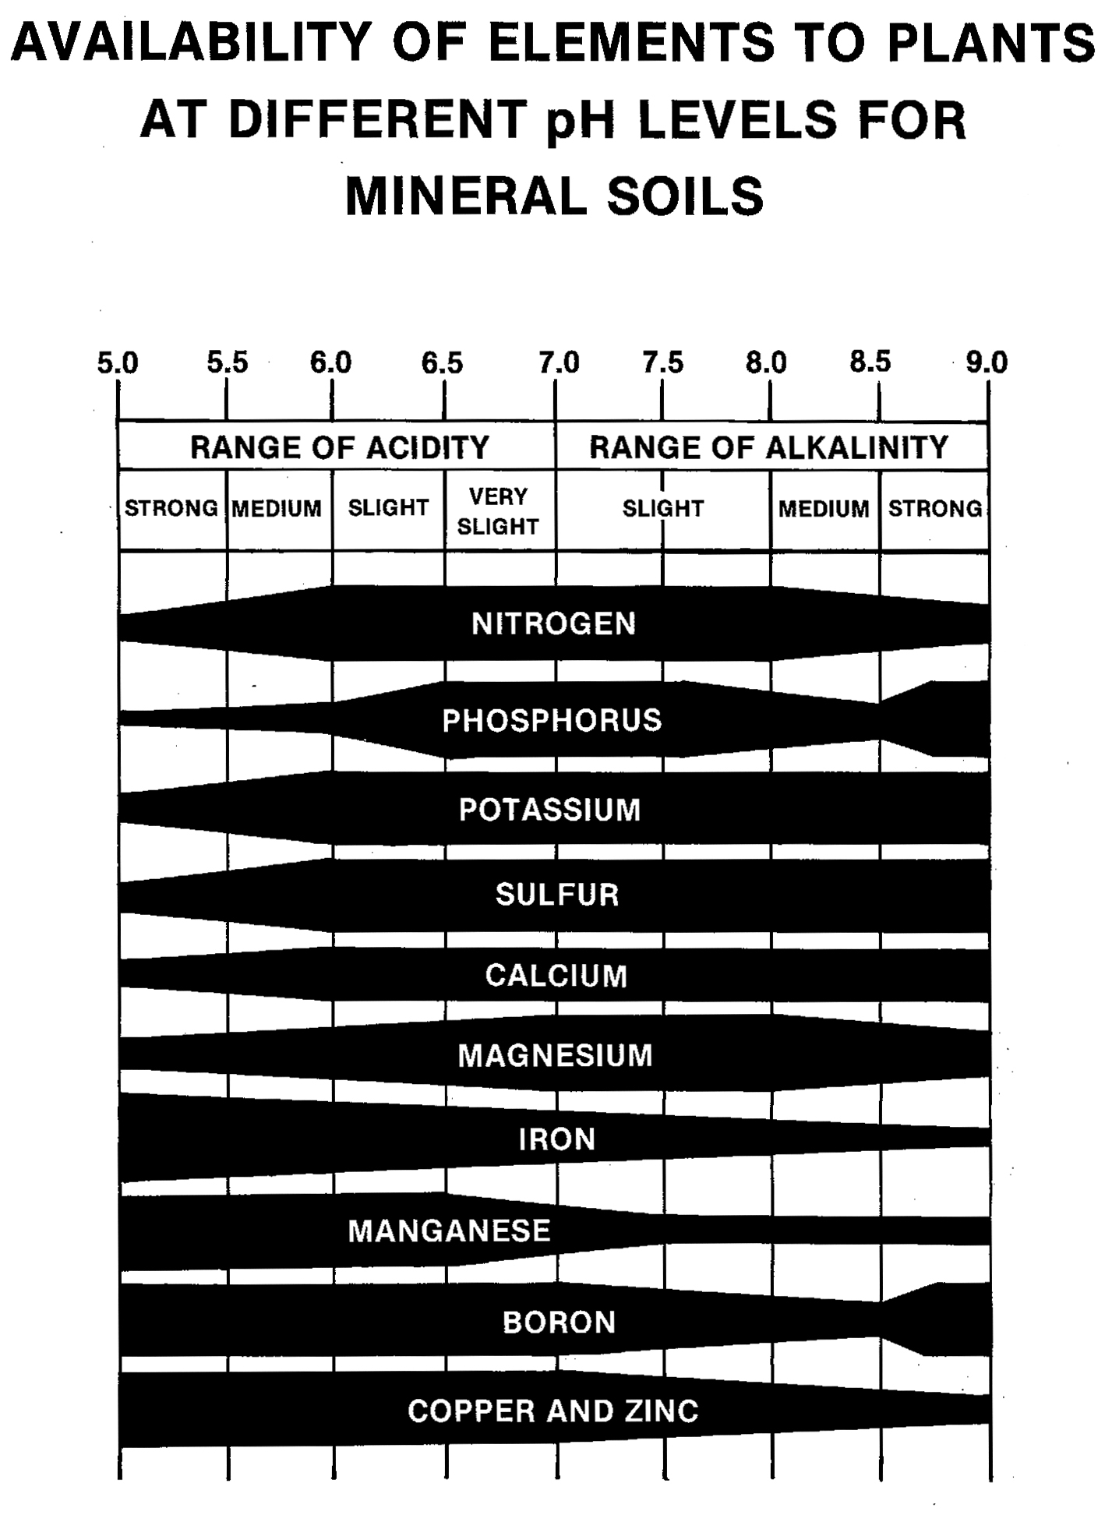
How does pH/alkalinity impact fertility
At 6.5-6.8 all nutrients are available
Micronutrients decrease at high pH

Slide 10
Irrigation water
Water can also impact soil pH
  You can measure water alkalinity-the same as soil
  It is the amount of carbonates in water
  It is measured in units of ppm
VERY important for hydroponics

Slide 11
Essential Nutrients
17 total nutrients determined essential for plant growth
  3 of them Carbon (C), Hydrogen (H), Oxygen (O) come from air and water
6 Macro and 7 or 8 Micro nutrients

Slide 12
Macro Nutrients
Primary Macro nutrients
  Nitrogen (N): 3 - 5% (dry weight)
  Phosphorous (P): 0.5 – 0. 8%
  Potassium (K): 3.5 - 5.5%
Secondary Macro nutrients
  Calcium (Ca): 1-2%
  Magnesium (Mg): 0.3 – 1%
  Sulfur (S): 0.3 - 0.5%

Slide 13
Micro Nutrients
Iron (Fe): 60-250 ppm (.006-0.025%)
Manganese (Mn): 50-250 ppm (0.005 – 0.025%)
Chloride (Cl): 50-250 ppm (0.005 – 0.025%)
Zinc (Zn): 20-250 ppm (0.002 – 0.025%)
Boron (B): 25-75 ppm (0.002 – 0.007%)
Copper (Cu): 10-50 ppm (0.001 – 0.005%)
Molybdenum (Mo): < 1ppm (<.0001%)
Nickel (Ni) : 1 ppm (0.0001%)

Slide 14
Relative Values of Nutrients

Slide 15
Nutrient Mobility in Plants
Generally Macro nutrients are very mobile in plants
Micro nutrients are mobile, but much less so than Macro nutrients
Calcium is virtually non mobile, manganese has low mobility

Slide 16
Nutrient Mobility in Plants
High Mobility | Intermediate Mobility | Low Mobility
Potassium | Iron | Calcium
Magnesium | Zinc | Manganese
Phosphorous | Copper
Sulfur | Boron
Nitrogen | Molybdenum
Chloride

Slide 17
Nutrient Mobility and Deficiencies
In general very mobile nutrients appear deficient in old tissue first
  Macro nutrients are very mobile
Less mobile nutrients appear deficient in new tissue first
  Micro nutrients are less mobile
Calcium is almost always in newest growth

Slide 18
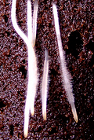
Nutrient Uptake
Most nutrients move into roots via root hairs then throughout the plant in the xlyem and phloem
Calcium and Boron move in transpirational stream

Slide 19
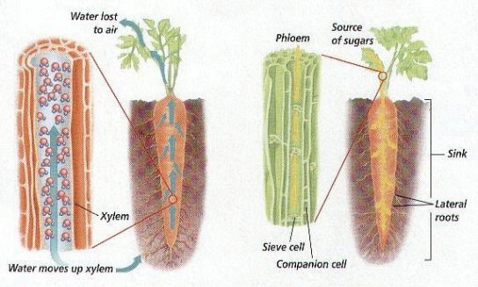
http://universe-review.ca/R10-34-anatomy2.htm

Slide 20
Nitrogen
Nitrogen is necessary for making amino acids, proteins, and DNA in the plant
Found in two forms
  Ammonium (NH₄⁺)
  Nitrate (NO₃⁻)
Both forms can be taken up by the plant
Ammonium can be toxic at high concentrations

Slide 21
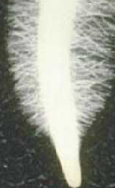
Fertilizer reactions
NH₄NO₃
NO₃⁻
Nitrosomonas
Nitrobacter
2NH₄⁺ 2 NO₂⁻ + 4H⁺ + 2H₂O 2 NO₃⁻
Nitrification-conversion of ammonium to nitrate

Slide 22
Ammonium and Nitrate
Ammonium is often said to “green” a plant while nitrate “grows” a plant
  Ammonium-based fertilizers will lower pH over time
  Ammonium fertilization has been linked with poor quality and storage when applied late in production
  Ammonium can compete with anions (calcium and potassium)

Slide 23
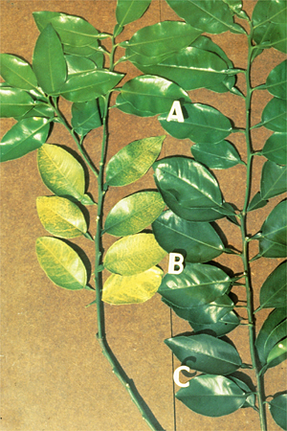
Nitrogen Deficiency
Typical deficiency symptoms
Yellowing on older leaves
  Why?....mobile
Stunting

Slide 24
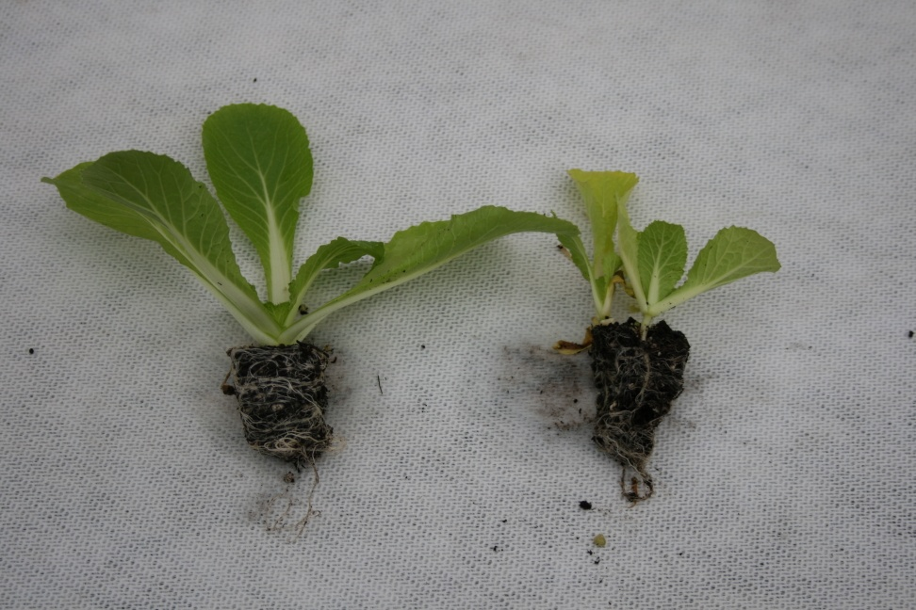
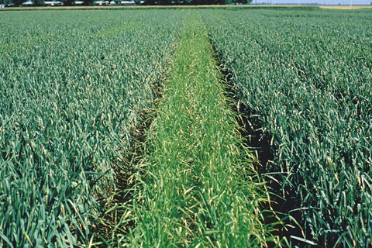
Nitrogen Deficiencies

Slide 25
Phosphorous
Essential for plant metabolism, enzyme production, etc.
Not very soluble
pH has a significant impact on solubility
  High pH >7.5 reduces availability
Moves very slowly through soil profile
  Plants with poor root systems may be P deficient

Slide 26
Phosphorous
Deficiencies often occur under cool temperatures in spring
In high pH soils ammonium fertilizers increase P availability (acidify the soil)
Typically see a purpling of leaves

Slide 27
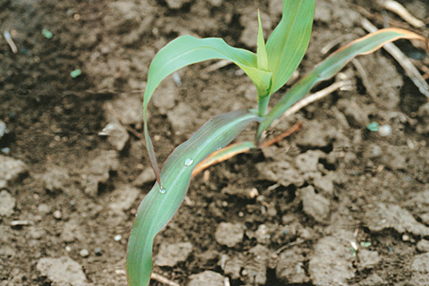
Phosphorous Deficiency Sweet Corn

Slide 28
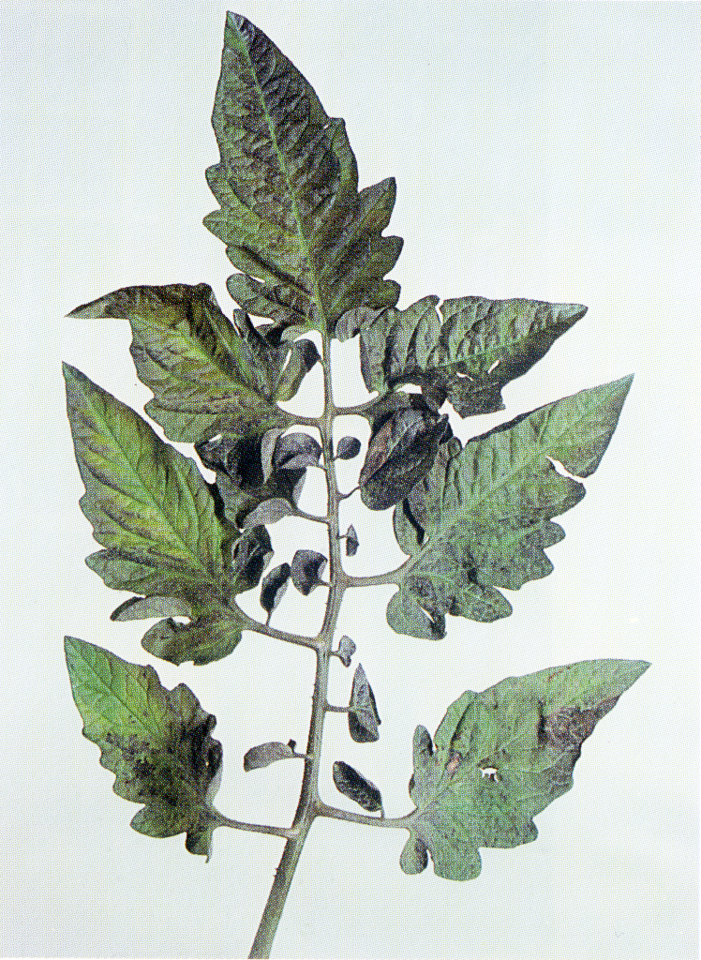
Phosphorous Deficiency in Tomato

Slide 29
Adding Phosphorous to the Soil
Phosphorous moves slowly in soil and gets bound up easily
For a loam soil it takes bout 8.8 lbs of P₂O₅ (fertilizer) to increase the soil test (available P) by 1 lb

Slide 30
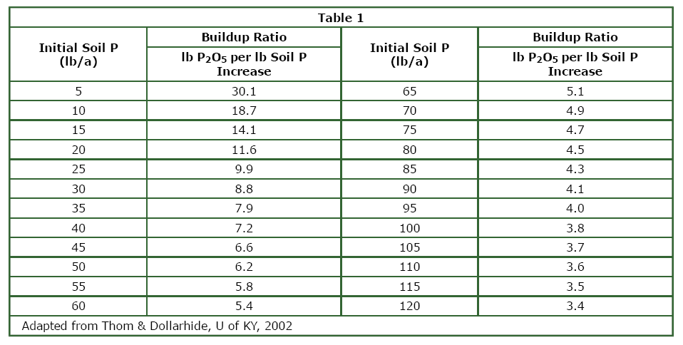
Depending on P levels in soil you have to add more P than you might think

Slide 31
Potassium
Potassium is critical for movement of sugars through plant and essential for fruit development
Typically found in a 1:1 ratio with N in leaves
Many plants remove excessive (more than necessary) K from soil
Antagonistic with Magnesium and Calcium
  All cations

Slide 32
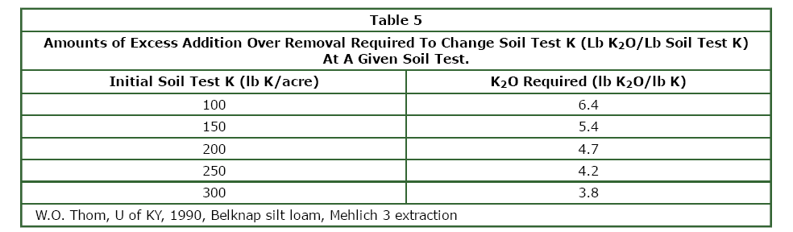
Adding Potassium to the Soil
Potassium, like phosphorous gets bound in soil
  0.5 – 2.5% of soil K is available
Approximately 4.7 lbs of K₂0 will increase K levels by 1 lb per acre on soil test

Slide 33
Potassium Deficiencies
Potassium is often deficient on high Magnesium and Calcium soils- even if K levels are sufficient according to soil test
Tomatoes are extremely sensitive
  Some growers put out 1.5-2x potassium per acre as nitrogen every year for tomato
Deficiency appears as death on leaf margins of older leaves
  Blotchy ripening

Slide 34
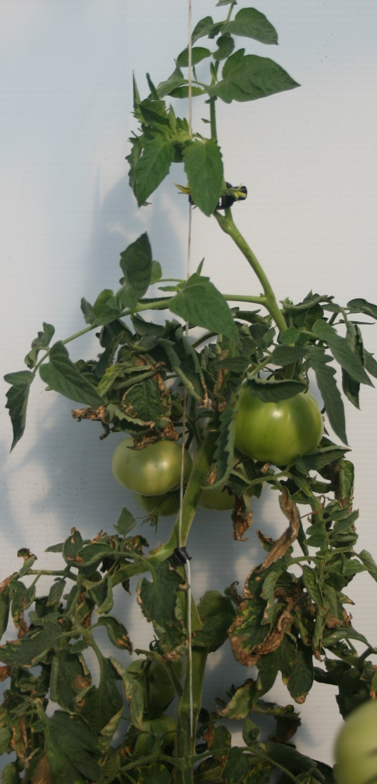
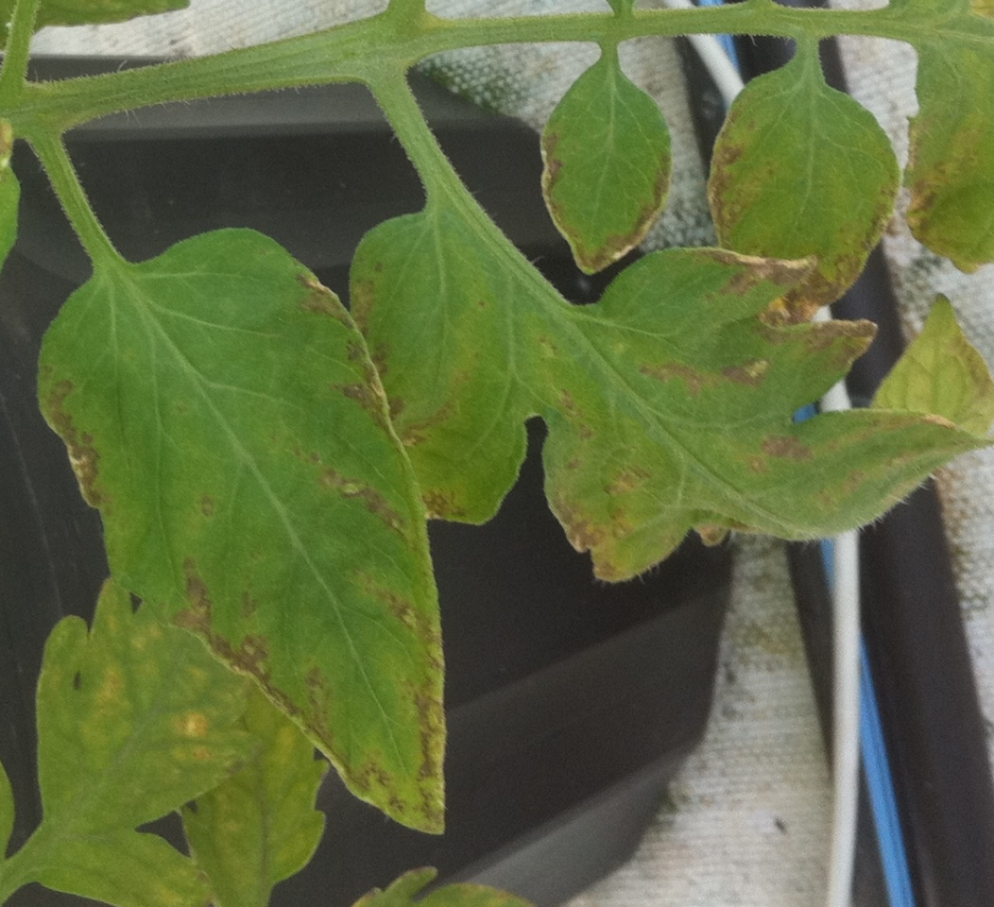

Slide 35
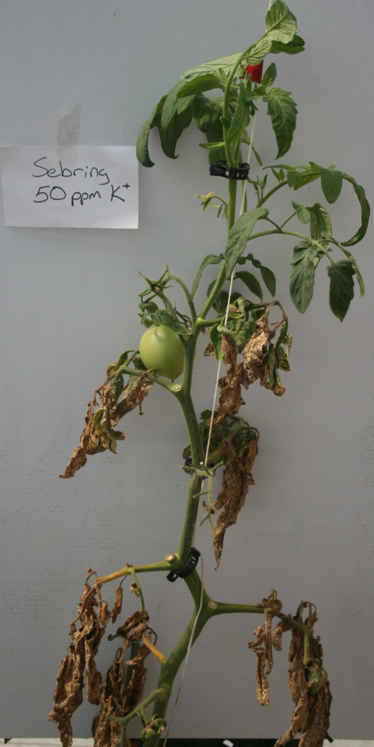
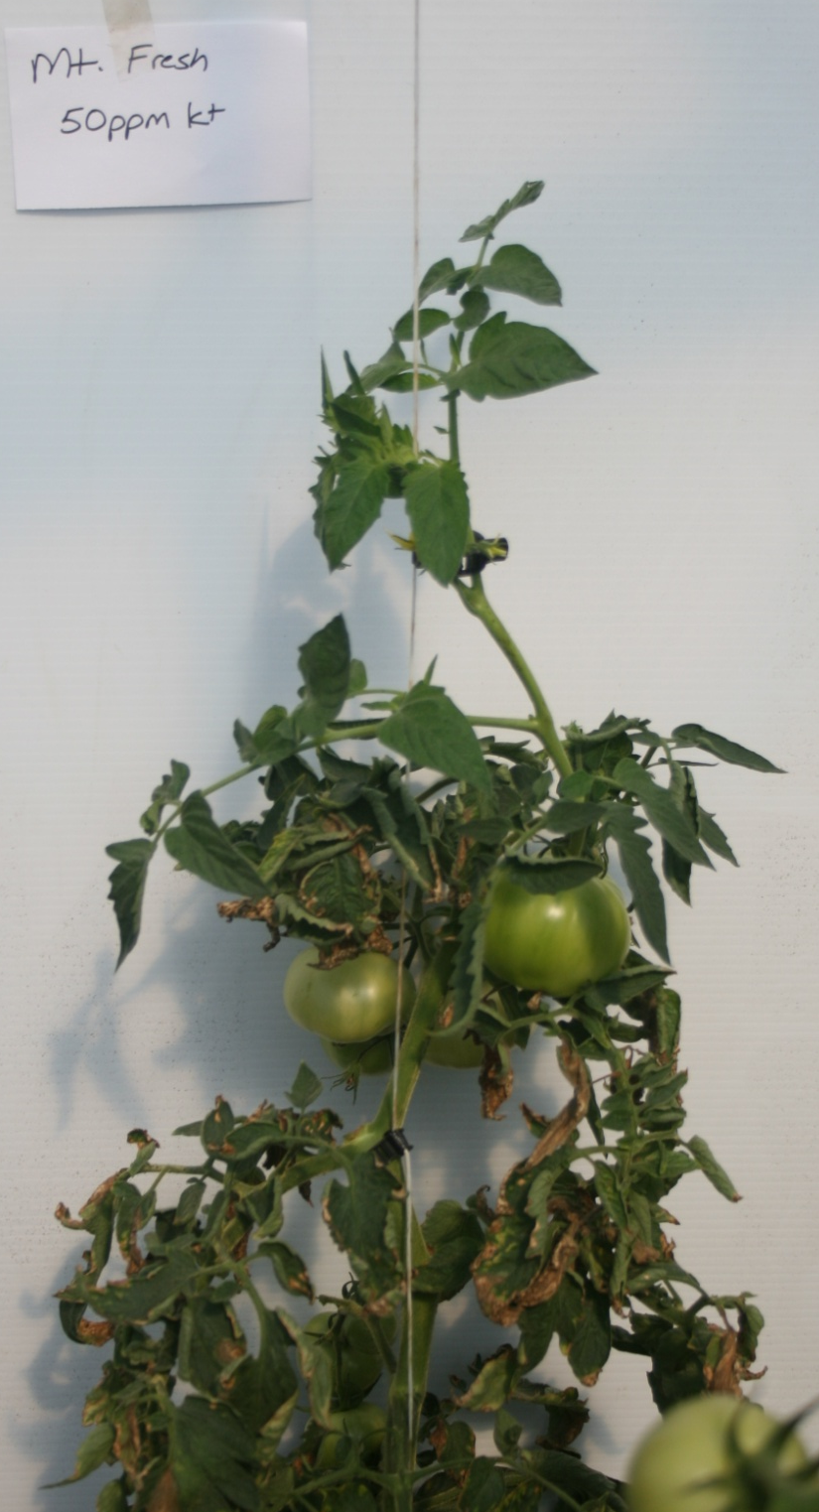

Slide 36
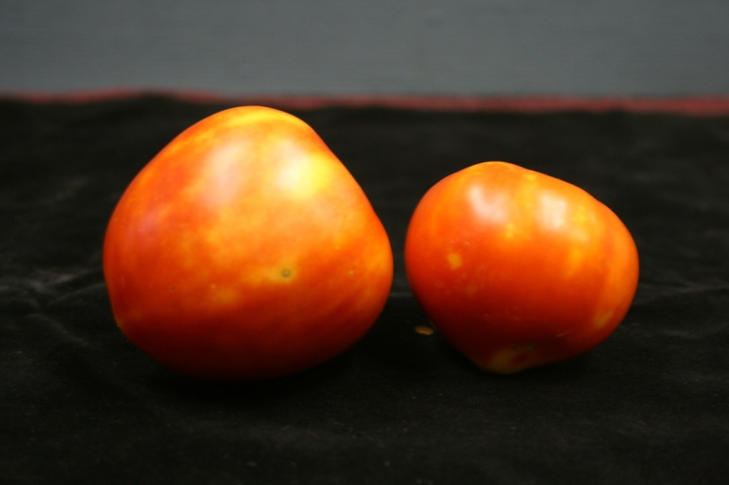
K and Mg interaction: Blotchy ripening

Slide 37
Magnesium
Found in chlorophyll and in demand during fruiting and fruit set
Often see deficiencies in older tissue (mobile)and during fruit set
Interacts with potassium and calcium
Supplied with dolomitic limestone BUT is released slowly and intensive cropping systems require more

Slide 38
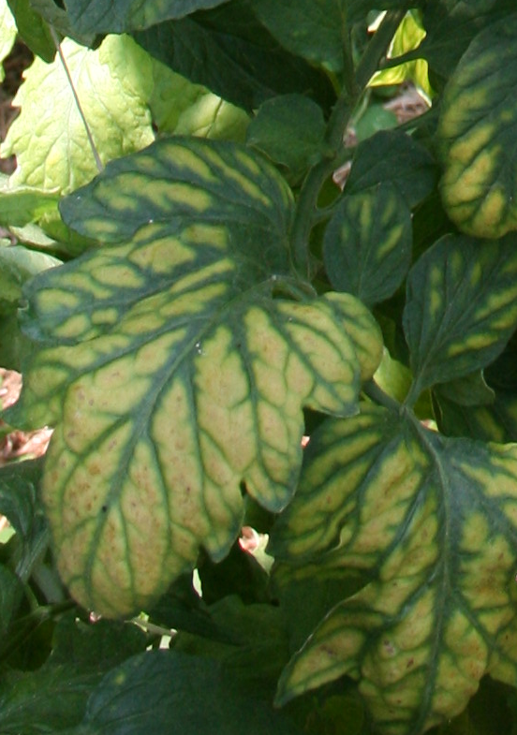
Magnesium Deficiencies

Slide 39
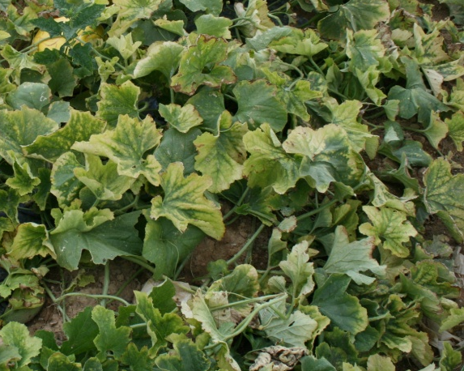
Extreme Magnesium Deficiency in Melon (not Command injury)

Slide 40
Magnesium Applications in the Season
Fertigate weekly
  Magnesium sulfate (epsom salts)
    10-12 lb/A
  Magnesium oxide
    2-4 lb/A
Foliar sprays of epsom salts are usually less effective

Slide 41
Calcium
Necessary for cell walls and cell development
Will dramatically impact firmness and storage quality
Deficiencies are almost always related to factors which alter/prevent calcium uptake.

Slide 42
Calcium Cont.
Calcium is not mobile within a plant
Deficiencies occur in new growth
Short term deficiencies result in irreversible damage
  Blossom end rot
Foliar sprays are often ineffective

Slide 43
Calcium Uptake
Calcium and Boron move on the transpirational stream
  Calcium deficiencies are related to anything that influences transpiration and water movement
    High humidity
    Cool temperatures and cloudy weather
    Lack of water
    Fruit with a waxy/impermeable coating
      Lack of mobility also impacts fruit deficiencies

Slide 44
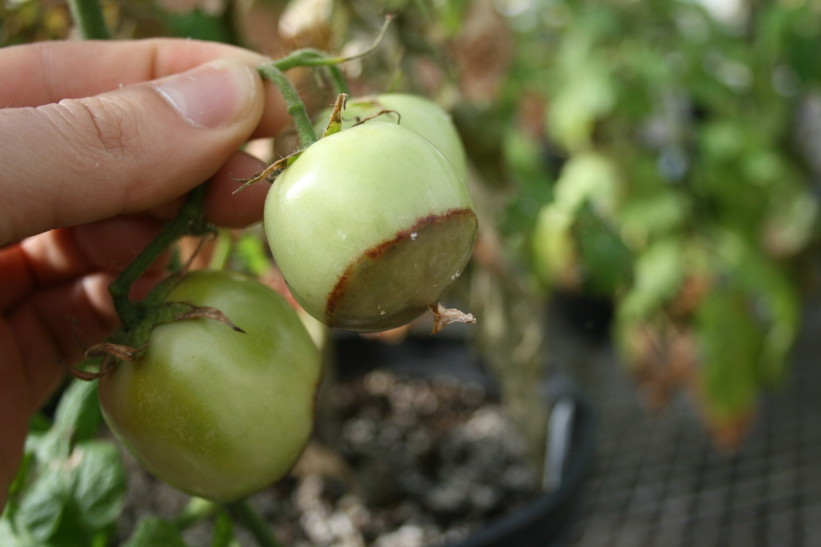
Blossom End Rot

Slide 45
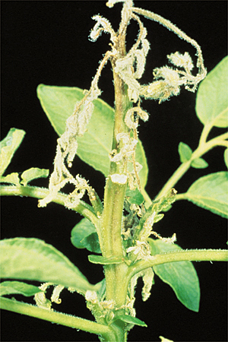
Calcium Deficiency in New Growth: Potato

Slide 46
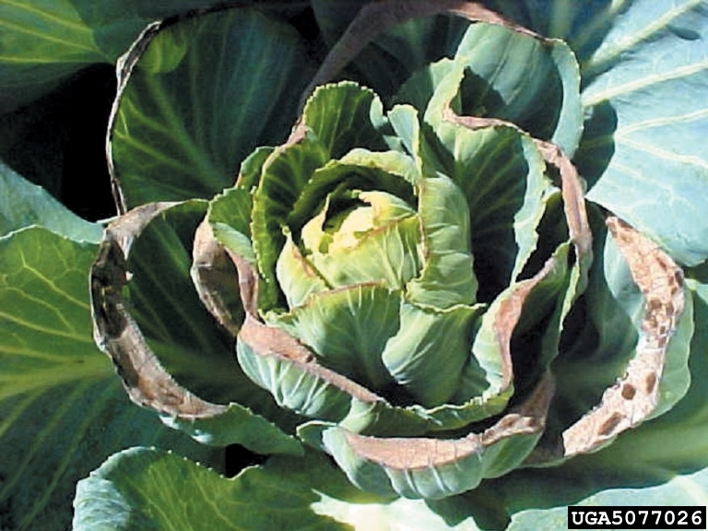
Calcium Deficiency
www.bugwood.org

Slide 47
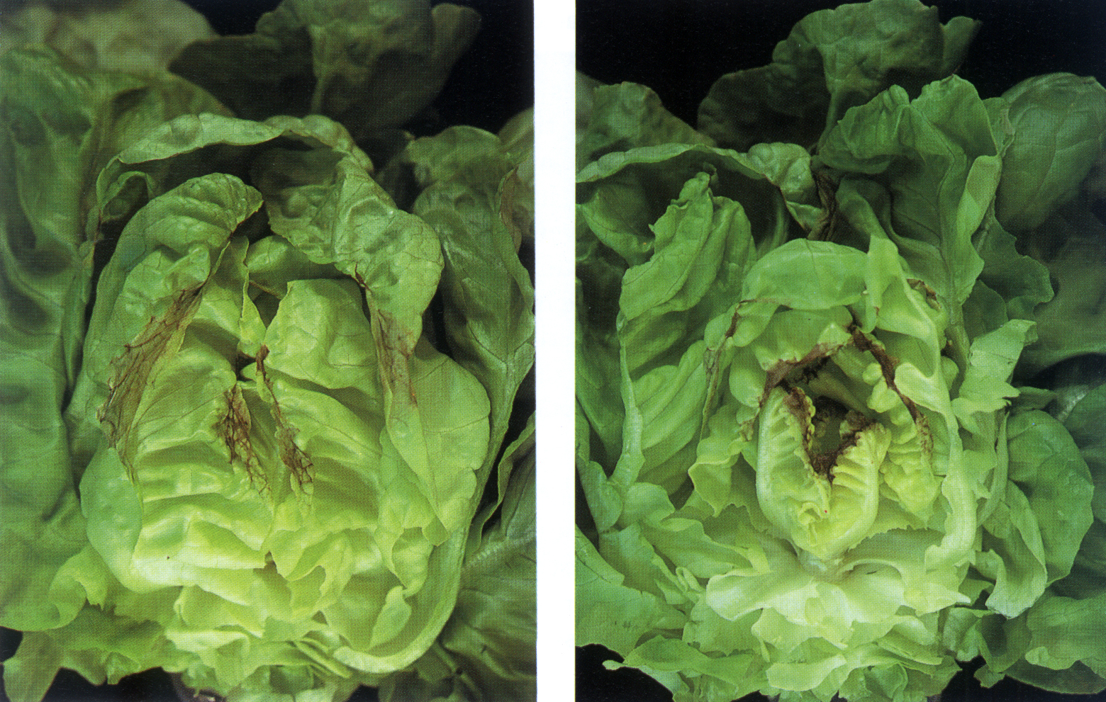

Slide 48
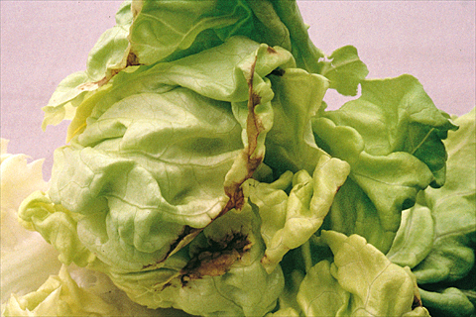

Slide 49
Sulfur
Sulfur is required for protein production and several secondary metabolites (flavor compounds)
Usually sufficient on organic soils
Deficiencies are typically on sandy soils
Less mobile in the plant and deficiencies occur as yellowing in new leaves

Slide 50
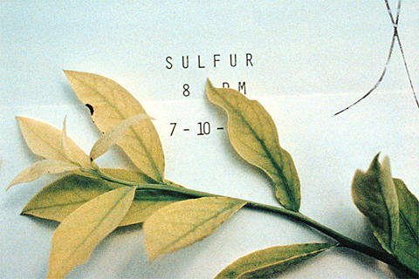
Sulfur Deficiency

Slide 51
Boron
Like calcium Boron moves in the transpirational stream, but more mobile in plants than calcium
  Involved in meristematic growth including pollen tube growth (supplemental B can help fruit set if low)
Deficiencies are often interior parts of plants
  Cole crops are particularly sensitive

Slide 52
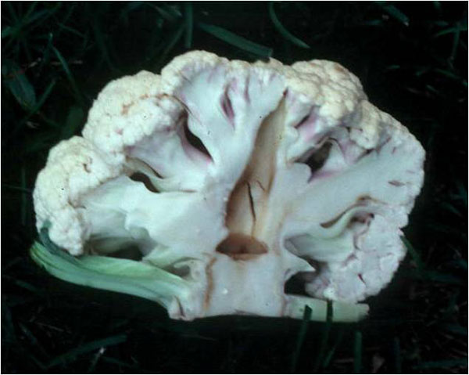
Boron Deficiency
http://www.extension.umn.edu/distribution/horticulture/images/M1247-3-lg.jpg

Slide 53
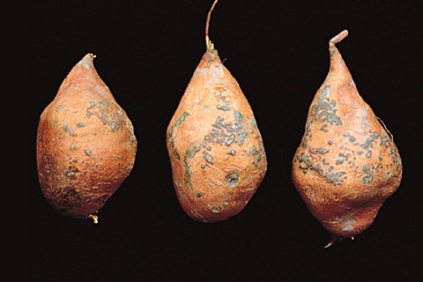
Boron Deficiency: Blister on Sweetpotato

Slide 54
Boron Cont.
Boron has a very narrow window between deficiency and toxicity
Apply only 1-2 lbs of Boron per acre if needed
Toxicity shows up as burn on margins of older leaves

Slide 55
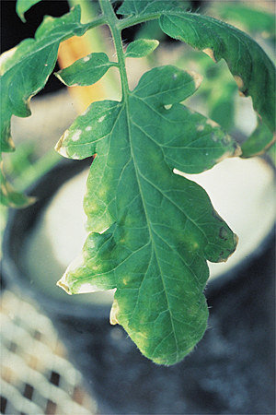
Boron Toxicity in Tomato

Slide 56
Iron
Iron is a micro nutrient with similar functions as magnesium
Deficiencies show up in new tissue because it is less mobile, but appear as interveinal chlorosis
A problem on high pH soils (>7.5)

Slide 57
Why are micronutrients (Iron) less available at high pH?
Iron: forms insoluble compounds at pH 7.5-8.5
FeSO₄
Fe ²⁺ + SO₄²⁻
Fe(OH)₂
Not available
OH-
OH-
Fe²⁺
- -
- -
OH-
OH-
OH-
H+
Iron is 1000x less available at pH 8.5 than 7.5

Slide 58
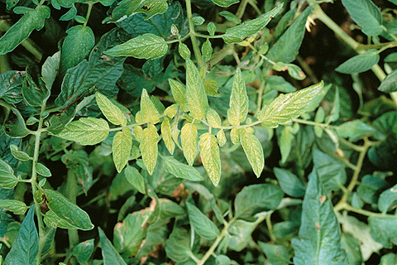
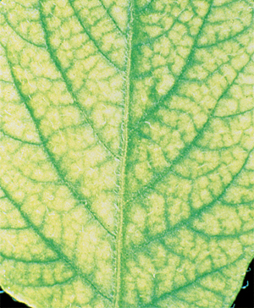
Iron Deficiency in Tomato

Slide 59
Manganese
Manganese involved as a coenzyme
It is not often deficient on soils in Kentucky
Can be toxic at a low (<5.8) pH
  Particularly toxic to cucurbit crops

Slide 60
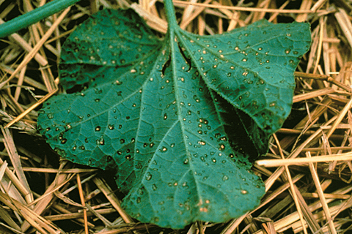

Slide 61
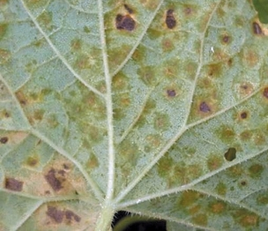

Slide 62
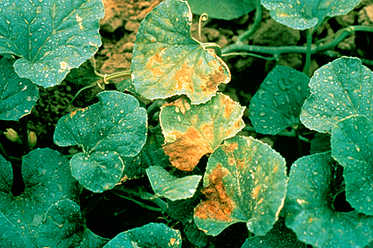

Slide 63
Zinc
Zinc is a coenzyme for photosynthesis
Zinc moves very poorly in soils and can be bound on high pH soils
  High pH soils zinc sulfate is bound easily, chelates must be used
Often deficient in early spring (cool) plantings
  Applications of a small amount of zinc in setter water can help 1-2 lbs/100 gallon
Banding applications at a rate of 20-30 lb/acre of zinc sulfate

Slide 64
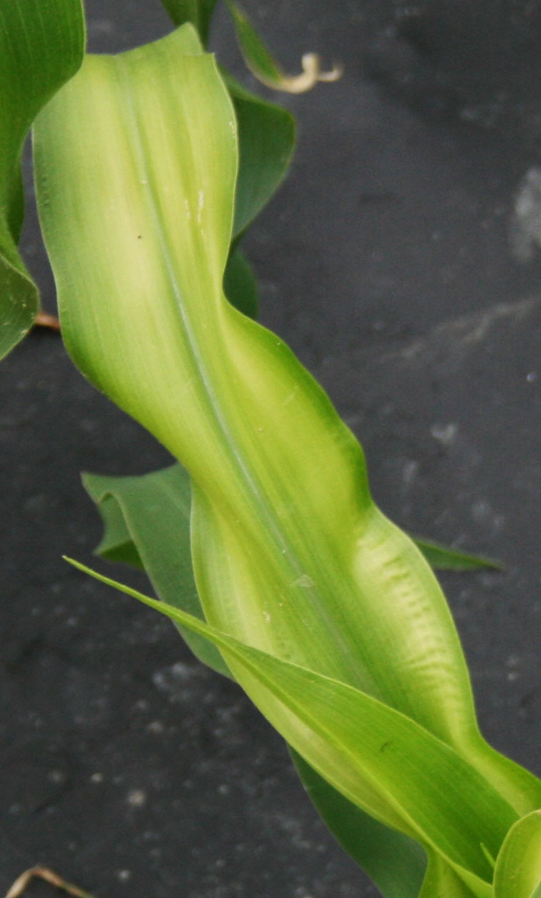
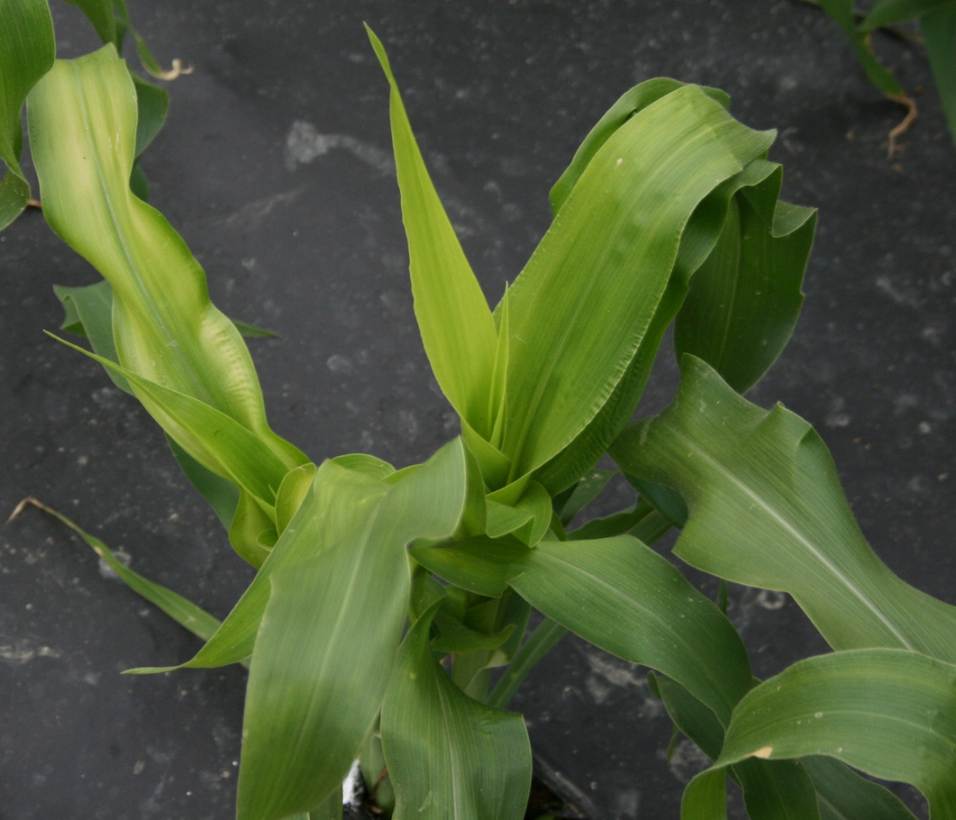
Zinc Deficiency

Slide 65
Molybdenum
A coenzyme for nitrate reductase, when deficient plants resemble slight nitrogen deficiency but in new leaves
Really only observed in melons in Kentucky
Required in very low quantities

Slide 66
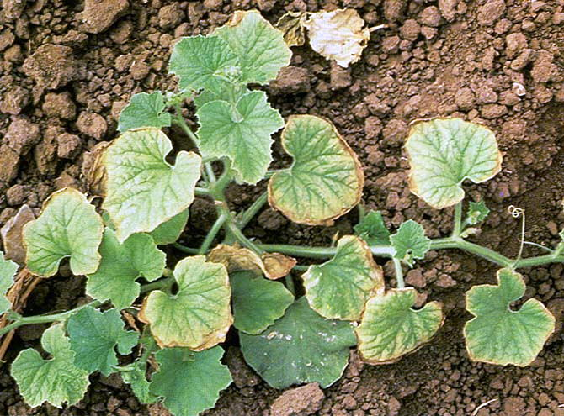
Molybdenum Deficiency in Melons
Primarily on young cantaloupe plants
Heavy dark soils
Setter Moly (liquid molybdenum 4%) will correct symptoms

Slide 67
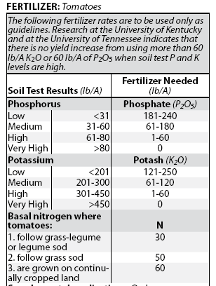
Tomato Fertility Recommendations
These recommendations are for a Loam soil
For sands they would be higher
For clay slightly lower

Slide 68

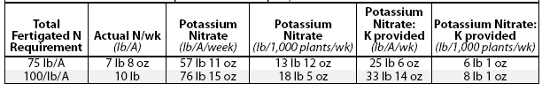
Fertility Programs

Slide 69
Calculating a Fertigation Program
You can calculate based on row feet
1 acre is 43,560/6 = 7260 linear row feet
7260 linear feet row in 1 acre
43,560 ft² in 1 acre

Slide 70
Calculating Fertigation
If you have 7260 row-feet per acre
You put out 4000 row-feet of tomatoes
4000/7260 = 0.55 acre
So you need 7.5 lbs of N per week per acre
7.5 lbs x 0.55 = 4.1 lbs of N
Using calcium nitrate (15.5% N)
4.1/0.155 = 26.7 lbs calcium nitrate/week

Slide 71
Fertilizer make-up
Common fertilizers used for fertigation and the amount of fertilizer needed to apply nitrogen per a
 | N (lb/a)
 | % N | 1 | 2.5 | 5 | 7.5 | 10
Ammonium nitrate | 33 | 3.3 | 8.3 | 16.6 | 62.3 | 33
Ammonium sulfate | 21 | 4.7 | 11.8 | 23.6 | 35.3 | 47
Monoammonium phosphate | 11 | 9.1 | 22.8 | 45.6 | 68.3 | 91
Diammonium phosphate | 18 | 5.6 | 14 | 28 | 42 | 56
Calcium nitrate | 15.5 | 6.5 | 16.3 | 32.6 | 48.8 | 65
Potassium nitrate | 13 | 7.7 | 19.3 | 38.6 | 57.8 | 77
Urea | 46 | 2.2 | 5.5 | 11 | 16.5 | 22
20-10-20 | 20 | 5.0 | 12.5 | 25.0 | 37.5 | 50

Slide 72
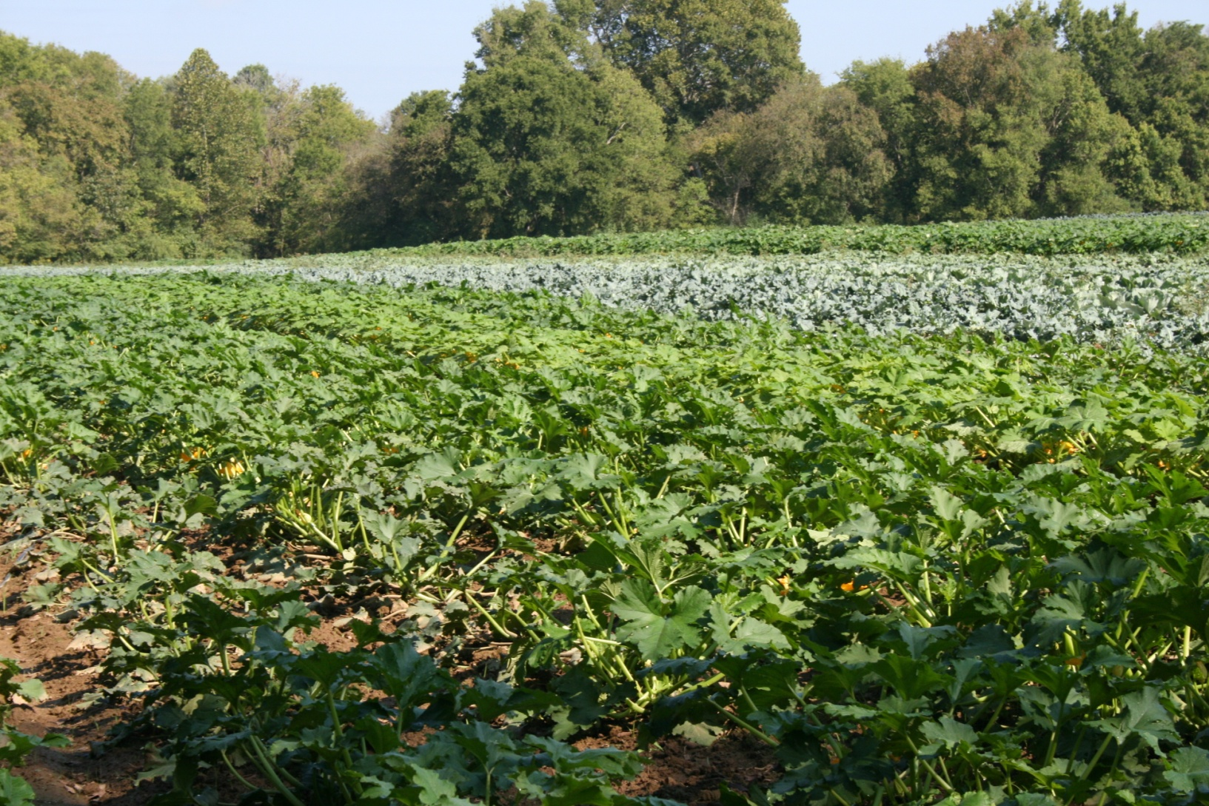
Organic Nutrient Management
Delvin Farms- College Grove TN

Slide 73
Current Recommendations
Current N Recommendations {tomatoes, peppers, etc]
  125-150 lbs of N per acre
    50-75 lbs preplant
      Granular lower cost fertilizer
    50 lbs through fertigation or banding during season
      Higher cost water soluble fertilizer

Slide 74
How to Manage Inputs
General purpose organic fertilizer: Examples of products are Fertrell Earth Friendly All purpose 5-5-3 ($24.75/ 50 lb) Approximately 2000 pounds of Fertrell Earth Friendly 5-5-3 would be required per acre of production to reach 100 pounds of total N.
  $990/acre
This is unacceptable and does not fit with the ethos of organic production

Slide 75

Organic nutrient managment
Cover cropping and crop rotation
Composting and/or manure
Supplemental fertilizers

Slide 76
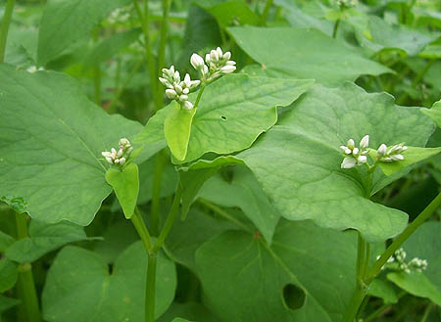
Cover crops and nutrition
Deep rooted cover crops will scavenge nutrients and prevent leaching from winter rains
  Cereal rye is probably best suited for this role Kentucky-
  Many legumes do not establish as well in fall and do not scavenge nutrients well

Slide 77
Biomass yield and nutrient accumulation of cover crops
Biomass yield (dry weight) and nutrient accumulation
Crop | Biomass (lbs/ac) | Nitrogen (lbs/ac) | Potassium (lbs/ac) | Phosphorous (lbs/ac) | Magnesium (lbs/ac) | Calcium (lbs/ac)
Hairy Vetch | 3,260 | 141 | 133 | 18 | 18 | 52
Crimson Clover | 4,243 | 115 | 143 | 16 | 11 | 62
Austrian W.P. | 4,114 | 144 | 159 | 19 | 13 | 45
Rye | 5,608 | 89 | 108 | 17 | 8 | 22
Hoyt, G.D. 1987. Legumes as a green manure in conservation tillage. P. 96-98. In: J.F. Powers (ed) The role of legumes in conservation tillage systems. Soil Conservation society of America, Ankeny, Iowa.

Slide 78
Nitrogen fixing cover crops
N production from legumes can vary from 40-200 lbs+ of N per acre
  Affected by: plant stand, soil pH, nodulation, and soil moisture
The portion of N available in the first year is usually 30-60% the total amount in the plant
  Usually lower (30%) when just left on the surface and higher (60%) when incorporated
  Do not incorporate too deep (top 6”)

Slide 79
Determining Fertility from Cover Crops
To be completely accurate you could do a tissue analysis of crops, but……
A lot of work has been done determining the typical N levels in different cover crops
This (N) is very consistent from year to year
The biggest changes are in biomass per acre

Slide 80
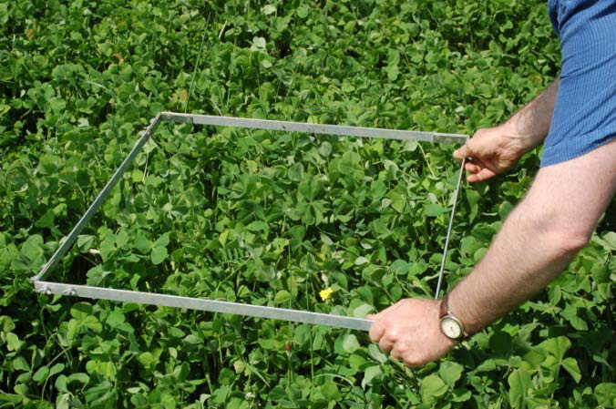
Taking a sample
Cover Crop Sampling Instructions
For Use with the OSU Cover Crop Calculator
http://smallfarms.oregonstate.edu
N. Andrews, D. Sullivan, J. Julian and K. Pool

Slide 81
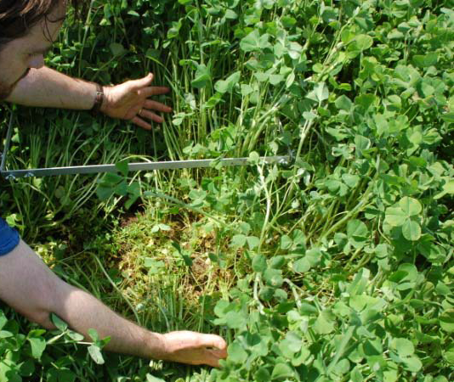
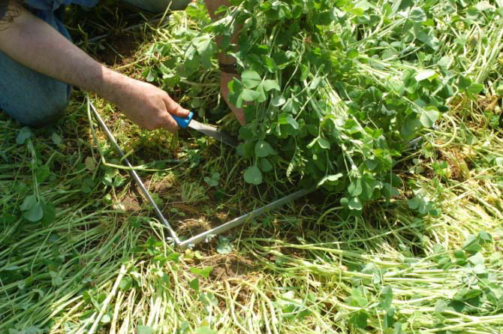
Sampling
Cover Crop Sampling Instructions
For Use with the OSU Cover Crop Calculator
http://smallfarms.oregonstate.edu
N. Andrews, D. Sullivan, J. Julian and K. Pool

Slide 82
Sampling
After getting representative samples
  Do not combine samples, do several reps to get a feel for the uniformity of a field
Separate the cover crop and get a dry weight
  They should be “crispy dry”
Then you can begin your calculation

Slide 83
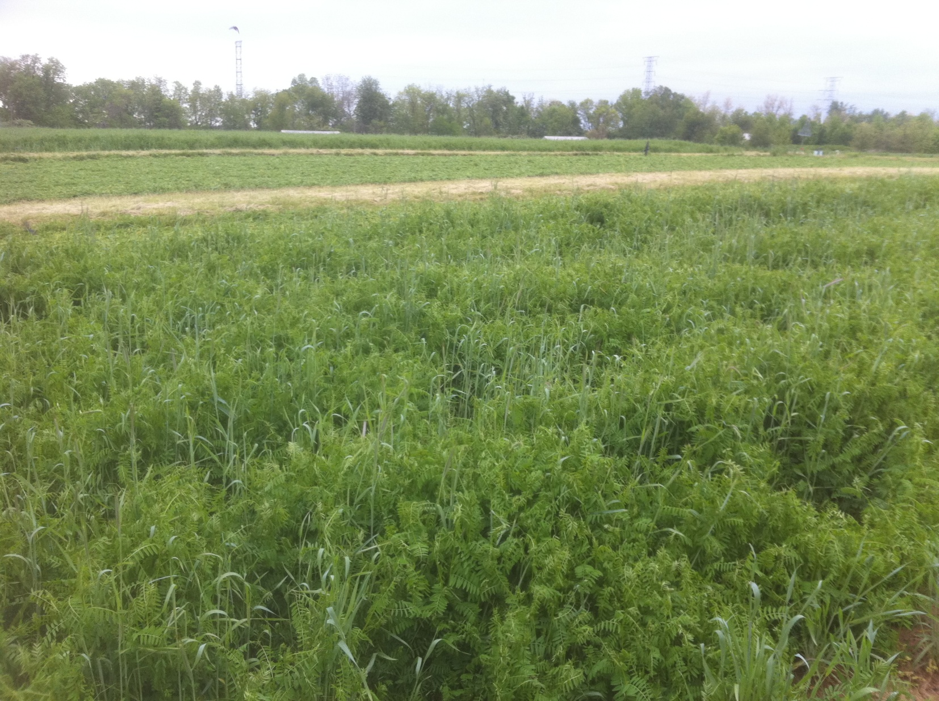
Sample Data
Taken 5/7/2011

Slide 84
Vetch Dry Weights
Sample | Fresh Weight (lb) | Dry Weight (lb) | % DM
1 | 0.616 | 0.093 | 14.9
2 | 0.617 | 0.094 | 15.2
3 | 0.748 | 0.110 | 14.7
4 | 0.627 | 0.088 | 14.0
5 | 0.814 | 0.121 | 14.9
6 | 0.825 | 0.121 | 14.7
Avg: |  | 0.105 | 14.7
All data is per square foot

Slide 85
Determine how much Biomass
We had approximately 0.1 lb of vetch per square foot
  This is the biggest factor that can change from year to year
So then we can multiply lbs of cover crop by square feet per acre
43,560 sq ft/acre x 0.1 lb/sq ft = 4356 lb/acre

Slide 86
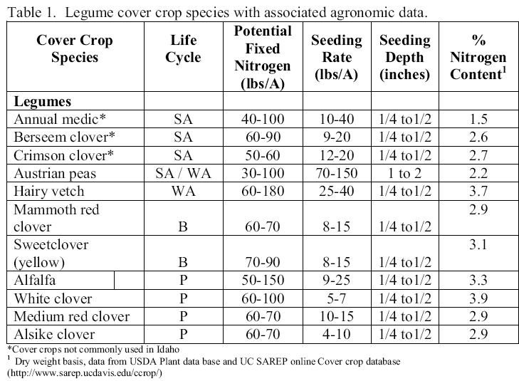
Let’s Determine How much N

Slide 87
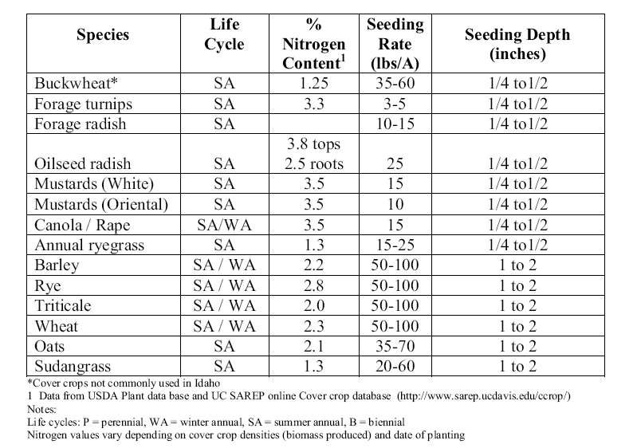
Non Legumes N

Slide 88
Determining N in cover crop
Take your percentage of N
  Vetch was 3.7%
  For legumes this varies 3.5-4% prior to flowering
  For legumes 3-3.5% after flowering
  Grasses are typically 2-3% N prior to flowering
  Grasses are 1.5-2.5% after flowering

Slide 89
Determining N
Take your biomass per acre and multiply by percent N
  4356 lbs x 3.7% = 162 lbs N per acre in the vetch planted
  Keep in mind that 4356 lbs of dry matter is high
Is that it?

Slide 90
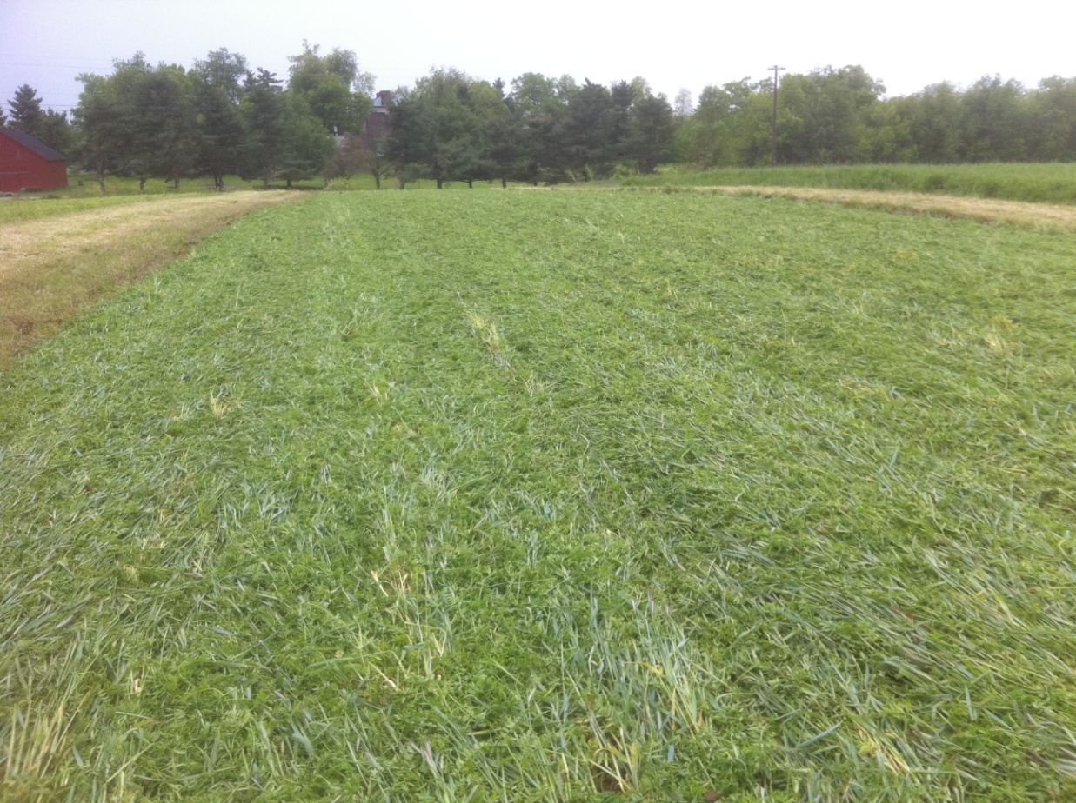
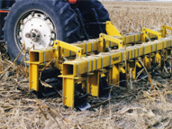
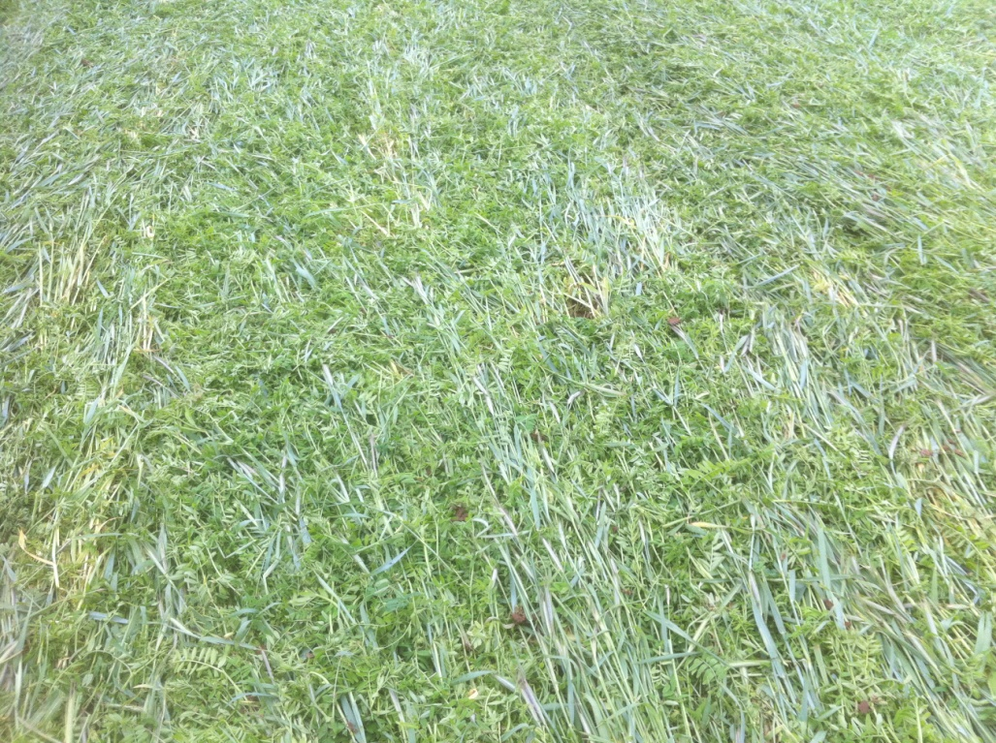
Rolling or conventional tillage?

Slide 91
Method of Incorporation
If you are laying it down on top of the ground estimate 25-30% of the N is available that season
If you are mowing and incorporating it then assume 50% is available that season
  Succulent cover crops are also more available to plants
162 lbs N/acre x 50% = 81 lbs N from just vetch
We had about 28 lbs from rye

Slide 92
So to determine your N contribution
Take your samples using a square
Get an average dry weight of just your cover crop
  Crunchy dry-don’t vaporize it (140 F if drying)
Figure cover crop dry mass per acre or area
Get %N-available from many sources
Figure total N per acre
Figure amount available N for the season

Slide 93
So how much will this cost?
Vetch seed $2.24/lb
  Seeded out around 40-50 lbs acre
  The plot we used got around 80 lbs/acre
  So we spent $180 on vetch seed for 81 lbs of fertility
    $2.22/lb of N
    Calcium nitrate (15.5% N) @ $16.00/50 lb bag
      7.75 lbs N @ $2.06
http://smallfarms.oregonstate.edu/calculator

Slide 94
Manure composition
A complete fertilizer contain all essential nutrients
  Though not likely in the correct ratio
Plants typically take up nutrients in the following ratio: 4 : 0.5 : 3.5 or similar
That is the ratio of N-P-K found in plants
Fertilizers have a ratio of N-P₂O₅-K₂O
That works out to: N : (0.44 x P) : (0.83 x K)
For a fertilizer that is 4 : 1 : 3

Slide 95
Types of manure
Wet/Fresh: 70-80% water
Dry (non composted): 20% water
  Highest concentration
Composted: 20-30% water or more BUT composted
  Will have a lower nutrient level, similar to wet/fresh manure

Slide 96
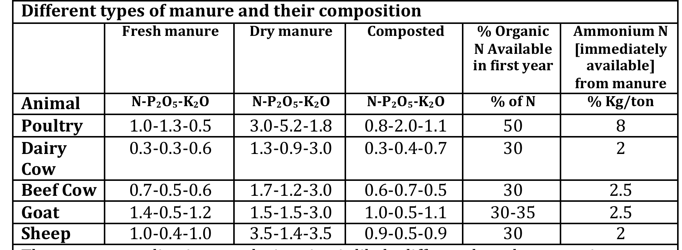
Typical manures

Slide 97
N availability in manure
Not all of the N in manure is available right away
Some of it is-as ammonium NH₄- but this is a small portion of it
The remainder is held as organic-N
Nearly all N in compost is organic-N

Slide 98

Incorporate your manure
Manure N losses as ammonia can be very high, especially if it is hot and wet
Composts lose a lot N through this process

Slide 99
Manure recommendations
Manure can supply a wide range of nutrients that other fertilizers cannot
It takes a long time to break-down
  N can be lost
  Be sure to incorporate it in soil
Be careful of high salts and weed seeds

Slide 100
Vegetable crop irrigation
Water is the single biggest determinate of yield and quality in plants
  Many plants benefit from mild drought stress
  Tomatoes and melons can increase sugars
Traditionally water has been cheap
We have developed increasingly better methods of application, increasing efficiency
  Drip irrigation can make up for a lack of a clear water management strategy

Slide 101

Mulch, temperature, and water use
Plastic mulches often increase temperatures around plants
Mulches tend to increase leaf area
Plants consistently transpire more water with warmer temperatures and more leaves
  On a per plant basis plastic mulch increases water use
http://www2.yk.psu.edu/~sg3/ist311/games/team3/phasethree.html

Slide 102
Rooting Depth
Typically roots from plants grown with plastic mulch are much shallower than bare ground
This impacts how long to irrigate

Slide 103

Rooting Characteristics
Bare Ground
Plastic Mulch

Slide 104

Rooting Characteristics
cm
Bare Ground
cm
Plastic Mulch

Slide 105
Rooting Depth- Raised Beds Black Plastic

Slide 106
New and Better Recommendations
Using tensiometers we automated irrigations
  Determine how much water used by irrigating based on soil moisture- How long do we really need to irrigate?
  How should we irrigate
    To maintain soil moisture at a constant level or allow to wet and dry?

Slide 107




Slide 108
So how much to irrigate?
Our research is indicating that we should be irrigating about 5 times a week for 60 – 90 minutes each
A total of 3300 - 4950minutes over 11 week season
Average 5-7.5 hours/week in a dry season (2010)

Slide 109
How much will you put out?
How many row feet?
1 acre is 43,560/6 = 7260
7260 linear feet of drip tape in 1 acre
43,560 ft² in 1 acre

Slide 110
How much are you putting out?
1 acre is 7260 linear feet
How much water per minute do you put out?
Typical 12” emitter spacing drip tape is 0.45 gpm/100 ft/min
  (7260 ft / 100 ft) x 0.45 gallon/min = 32.7 gallon/minute

Slide 111
How much cont.?
If you put out 32.7 gallons/minute
Lets say we irrigate 6 hours/week
You would put out 6 h x 60 min/h x 32.7 gal/min
  11,772 gallons/week
  Research shows you could go a little less than that

Slide 112
How many inches is this?
13,700 gallons / week
Crop water requirements.
  1 acre inch is 27,000 gallons of water
  Usually 33-50% of land is drip irrigated
    27,000 x 0.33 or 0.5 = 9,000-13,500 gallons/week
  11,772 gallons is about 1 inch per week

Slide 113
Findings
Consistently on plastic mulch we are using between 85,000- 130,000 gallons per acre per season for tomatoes, bell peppers, poblano peppers, etc.- In 2011 used much less water than other years
Frequent shallow irrigations better than infrequent deep irrigations

Slide 114

Additional Findings: Emitter Spacing
12” spacing
8” spacing
Picture Source: Toro micro irrigation owners manual

Slide 115
Additional Findings
Strip tillage
  In dry situations strip tillage has a higher water use efficiency than plastic mulch
  In well watered plastic mulch is slightly more efficient
  Implications for non-irrigated crops

Slide 116
Thank You
Resources:
  http://www.ca.uky.edu/agcomm/pubs.asp
  www.bugwood.org
This program is funded in part by a KDA Specialty Crops Block Grant and KY Farm to School Program

