Slide 1

Organic and Reduced Input Disease Management
Kenny Seebold
Plant Pathology Dept.

Slide 2
Basics of Disease Management
Prevention – the basis of a sound disease management plan
  Particularly important in organic systems due to limited availability of fungicides & bactericides
Sound cultural practices can reduce the occurrence of many diseases in the field
  Any practice used or decision made to manage plant diseases by manipulating cropping system details that do not involve the use of pesticides or plant resistance/tolerance.
  Preventative in nature; not therapeutic.

Slide 3
Basics of Disease Management
Avoidance
Exclusion
Eradication
Protection
Resistance
Site selection
  Avoid areas with a history of disease problems!
  Pick a location with good soil and air drainage
  Avoid shady areas

Slide 4
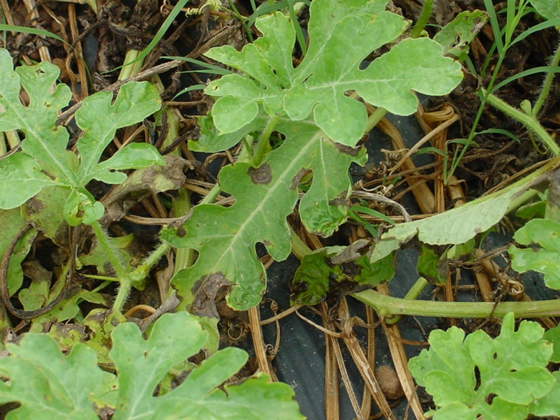
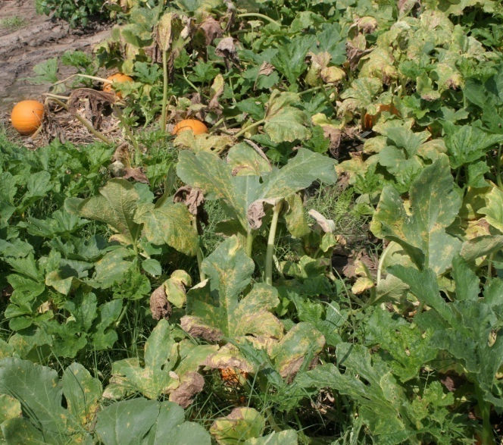
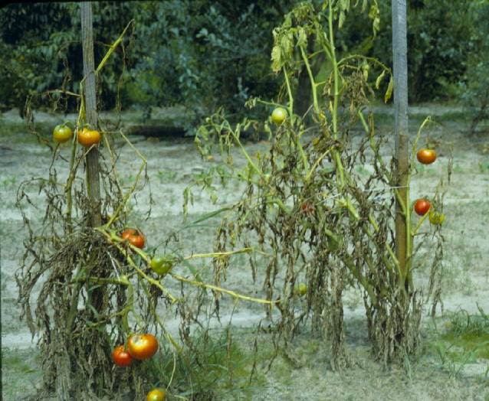
Exclusion / Eradication
Crop rotation
  Continuous planting of related crops can lead to the buildup of certain plant pathogens in that area
  Maintain a 2+ year rotation away from related crops in the same area for best effect
Rotation with a non-host crop
  Deprives pathogen of preferred host(s)
  Most effective against pathogens with small host range or those that don’t persist for long times in the environment
  Not as effective against pathogens with multiple hosts
  Not as effective against pathogens that don’t overwinter
  Not as effective against pathogens that persist for a long time
Watermelon
Pumpkin
Tomato
Gummy stem blight
Downy mildew
Fusarium wilt

Slide 5

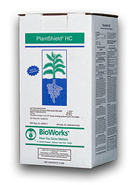
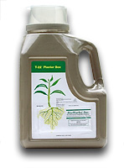
Exclusion / Eradication
  Pathogen-free seed & transplants
    Quarantine
    Biologicals (Trichoderma, Bacillus)
    Chemical treatments
      Bleach, trisodium phosphate
    Hot water treatment
    See ID-36 for details

Slide 6
Exclusion / Eradication
Other tactics
  Sanitize tools & equipment
  Don’t work plants when foliage is wet
  Destroy crop debris promptly
    allows time for residue to decompose
  Staking and trellising
    improves airflow, minimizes contact by splashing soil & water
  Mulches and physical barriers
    will minimize soil-splash after rains
  Use trap & barrier crops
    May lessen incidence of insect-borne diseases

Slide 7
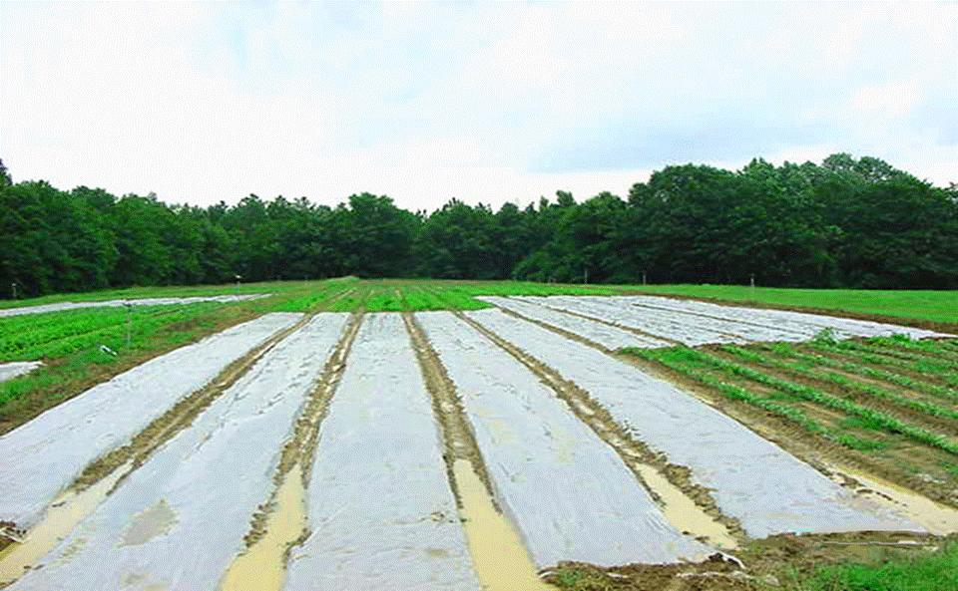
Soil Solarization
Soil covered with clear plastic mulch
Heated by sunlight
Max 45-52ºC at 4 in. depth
Shown to suppress numerous soilborne diseases
Notes:
Temps in mid- to high 40’s C common in top 4 inches (45C = 13F)

Slide 8
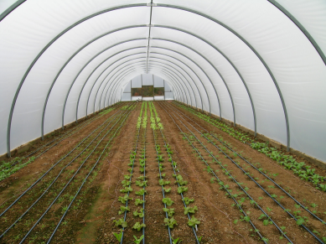
Limitations of Solarization
Not practical in northerly climates (fewer “sunshine” days than in southern areas
Unproductive during summer
Disposal of plastic

Slide 9
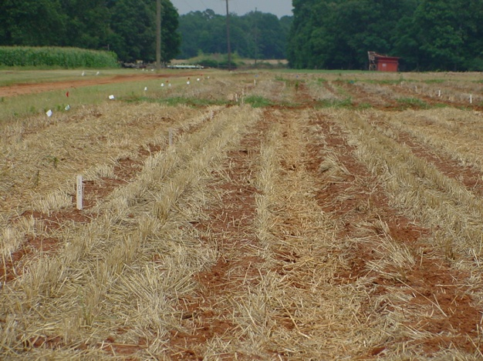
Cover Crops and Disease Management
Cover crops – important for:
  Prevention of erosion
  Improvement of soil quality (OM, texture, water holding capacity)
  Management of fertility
  Management of water
  Management of weeds between crops
The role of cover crops and management of disease
  Cover crops may actually promote certain diseases
  Certain cover crops can be used to reduce soilborne microbes and nematodes

Slide 10
How Cover Crops Suppress Plant Diseases
Promotion of antagonistic soil microflora
  Breakdown of organic matter increases populations of organisms that will displace soil pathogens
Production of antagonistic / toxic compounds during growth
  Marigolds inhibit many species of nematodes – toxin production
Production of antagonistic / toxic compounds from decomposing biomass (green manures)
  Sesame, castor bean: breakdown of green manures releases toxins that kill or inhibit nematodes in soil
  Brassicas: mustards and their relatives contain glucosinolates
    Glucosinolates break down in soil to form isothiocyanates
    Isothiocyanates are antifungal and nematicidal
    Numerous reports in literature of brassicas used as “biofumigants”
    Effect is small for a given year, but cumulative over years – several pathogens shown to be significantly decreased over time

Slide 11
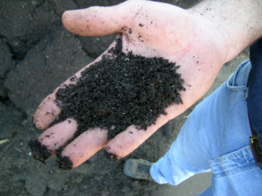


Organic Amendments
Compost

Slide 12
Evaluation of 36 Commercial Composts*
36 commercial composts evaluated
Rhizoctonia damping-off of cabbage
  17% of composts reduced disease
  44% increased disease
Pythium damping-off of cucumber
  56% of composts reduced disease
  44% provided at least 80% healthy seedlings
*Phytopathology (Scheuerell et al, 95:306-315, 2005)

Slide 13
Perspective on Organic Amendments
If you find a compost that “works”, stick with it.
Don’t rely on them alone for disease control
  Use organic amendments for other reasons
Rely on other cultural practices (sanitation, water management, etc.)

Slide 14
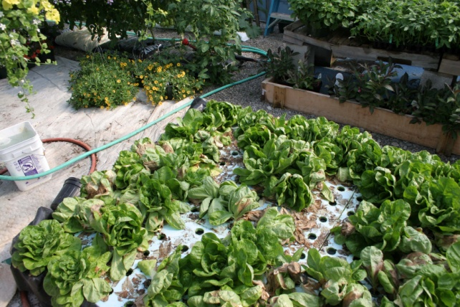
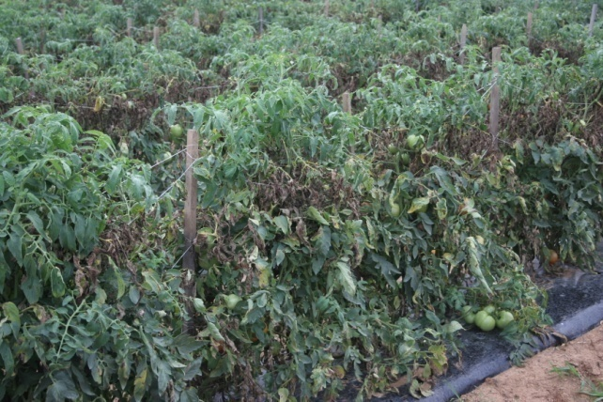
Other Cultural Practices
Planting & harvest timing
  Follow recommended planting dates for the vegetables being grown
  Try to avoid seeding when soils are cool (< 60 °F) to avoid problems with damping-off & stem rots
  Harvest in a timely manner
Plant populations (spacing)
  Avoid dense plantings to permit air movement within the crop
  Avoid overlap that can allow disease to ‘jump’ from plant to plant
Fertility
  Adequate fertilizer levels are critical to management of disease
  Test soils several months before planting to ascertain pH and nutrient levels

Slide 15
Other Cultural Practices
Control weeds
  Can harbor a number of insects and pathogens
Control insects
  Transmit several viral and bacterial diseases
Irrigation management
  Don’t over-water
  Use soaker hoses, trickle irrigation, etc. where possible – this avoids wetting foliage
  If watering overhead, irrigate early in the day to allow foliage to dry quickly

Slide 16
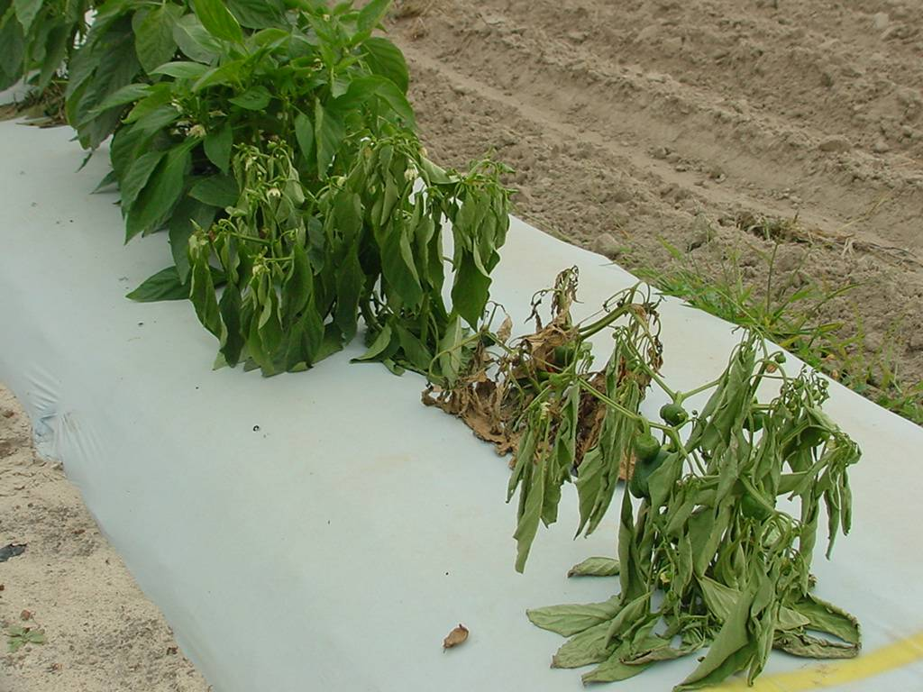
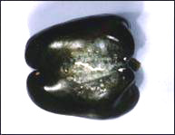
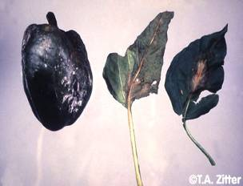
Phytophthora Blight
Phytophthora capsici
Pepper

Slide 17
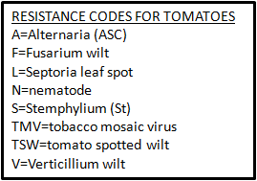
Host Resistance
Resistant varieties
  Effective and relatively cheap control measure
  Can reduce requirements for fungicides & bactericides
  Information listed in most seed catalogs or on seed packets
  Resistance doesn’t mean “immunity”
  Resistance ‘package’ will vary by crop

Slide 18
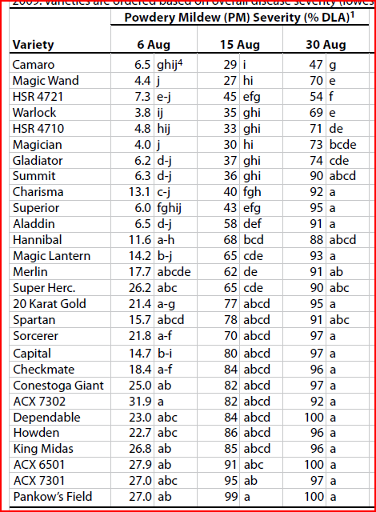
Effect of Resistance on
Powdery Mildew of Pumpkin
2009 Study – Lexington, KY

Slide 19
Fungicides/Bactericides as Management Tools (Protection)
Don’t rely solely on chemicals or biologicals to manage disease!
Timely applications are critical
  Apply before symptoms appear OR at first signs
  Maintain a regular schedule
  Make sure that equipment is calibrated for accurate delivery
Safety & protective clothing
Re-Entry Interval after spraying
  Follow REI guidelines on product labels
  Post warnings on entrance to greenhouse
Choices are limited – how well do these products work?

Slide 20
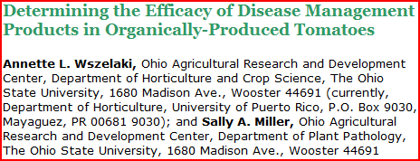
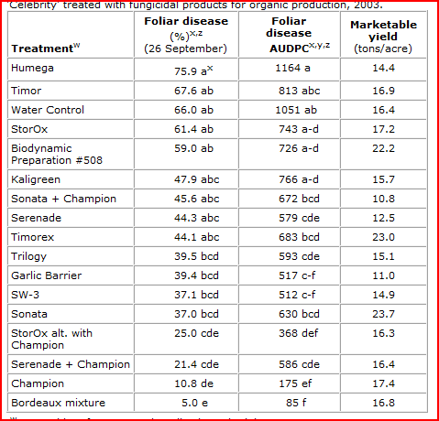

Slide 21

Seed or Media-Applied Materials
Labeled for damping-off, root rots, & some foliar diseases
Trichoderma spp.
  T-22
Streptomyces
  Mycostop
Bacillus spp.
  Subtilex
  PlantShield HC

Slide 22
OMRI-Approved Fungicides
Products are not normally “stand-alone” controls for disease
  Must be used in conjunction with other practices
  Must be applied correctly (timing & rate) for best efficacy
  Efficacy is typically lower than conventional products
Bacillus subtilis: broad-spectrum fungicide
  Serenade, Sonata
Botanicals
  Garlic Barrier spray
  Neem oil: broad spectrum fungicide / insecticide
    Garden Defense Multi-Purpose spray
    Garden Safe Fungicide 3

Slide 23
OMRI-Approved Fungicides
Coniothyrium minitans: Sclerotinia minor & S. sclerotiorum
  Contans WG: Soil-applied biocontrol product
Copper compounds: broad-spectrum fungicides / bactericides
  Not all fixed coppers are OMRI-approved – see labels
  Bordeaux mixture (Basic Copper 53)
  Copper hydroxide (Badge X2, Champ,Nordox, NuCop, COC WP)
Potassium bicarbonate: powdery mildew
  Bi-Carb Old Fashioned Fungicide
  Kaligreen
Sulfur: powdery mildew / miticide (protectant)
  Britz Magic Sulfur Dust, Kumulus DF
  Not all formulations are OMRI-approved – see labels
  Avoid application when temperatures are above 90F (phyto)

Slide 24
Resources
  Resource Guide for Organic Disease & Insect Management (Cornell University)
    http://www.nysaes.cornell.edu/pp/resourceguide/index.php
  Organic Materials Review Institute (OMRI)
    http://www.omri.org/index.html
  USDA National Organic Program (NOP)
    http://www.ams.usda.gov/nop/indexIE.htm
  KY Pest News
    http://www.uky.edu/Ag/kpn/kpnhome.htm
  ID-36 (2010-2011 Veg. Production Guide for Commercial Growers)
    http://www.ca.uky.edu/agc/pubs/id/id36/id36.htm
  Plant Pathology Dept.
    http://www.ca.uky.edu/agcollege/plantpathology/index.html
  Hort. Dept.
    http://www.ukyu.edu/Ag/Horticulture

