Slide 1
Don’t treat it like Dirt: how to manage Soils Organically
David Butler, Ph.D.
Assistant Professor
Organic, Sustainable & Alternative Crop Production
Plant Sciences Department, The University of Tennessee
Tennessee Horticulture Expo JAN 28, 2011

Slide 2
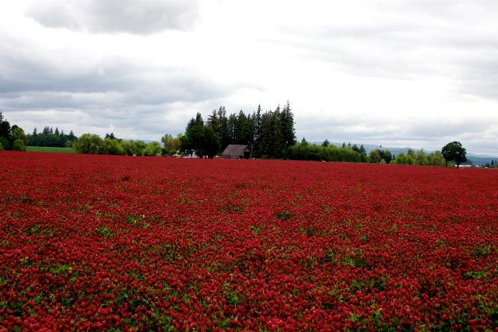
Overview: Soil management
NOP standard
Soil quality
Functions of soil organic matter
Building soil organic matter
Soil fertility
N,P, K
Soil testing
Cover crops
(Image from: oregonclover.org)

Slide 3
Soil management for organic production
All inputs must be approved substances
Natural products can be used, unless otherwise prohibited by the national list (e.g. sewage sludge)
Synthetic products cannot be used, unless there is an exception on the national list (e.g. soluble boron products)
(CFR 205.601 and 205.602)

Slide 4
Soil management for organic production
NOP soil fertility and crop nutrient management practice standard
(a) “Select and implement tillage and cultivation practices that maintain or improve the physical, chemical, and biological condition of the soil and minimize erosion”
(b) “Manage crop nutrients and soil fertility through rotations, cover crops, and the application of plant and animal materials”
Soil quality
Soil fertility
(CFR Title 7, Part 205.203)

Slide 5
Soil management for organic production
(c) “Manage plant and animal materials to maintain or improve soil organic matter content in a manner that does not contribute to contamination of crops, soil, or water by plant nutrients, pathogenic organisms, heavy metals, or residues of prohibited substances. Animal and plant materials include:”
Raw animal manure, which must be composted unless
Applied to crop not for human consumption
Incorporated in the soil 120+ days prior to harvest of crop with edible portion in contact with soil or soil particles
Incorporated in the soil 90+ days prior to harvest of crop with edible portion not in contact with soil or soil particles
Food safety
(CFR Title 7, Part 205.203)

Slide 6
Soil management for organic production
(c) “Manage plant and animal materials to maintain or improve soil organic matter content in a manner that does not contribute to contamination of crops, soil, or water by plant nutrients, pathogenic organisms, heavy metals, or residues of prohibited substances. Animal and plant materials include:”
Composted plant and animal materials
Initial C:N ratio between 25:1 and 40:1
Temperatures 131 F to 170 F for 3 days
Uncomposted plant materials
Food safety
(CFR Title 7, Part 205.203)

Slide 7
Soil management for organic production
(c) “Manage plant and animal materials to maintain or improve soil organic matter content in a manner that does not contribute to contamination of crops, soil, or water by plant nutrients, pathogenic organisms, heavy metals, or residues of prohibited substances. Animal and plant materials include:”
Composted plant and animal materials
Initial C:N ratio between 25:1 and 40:1
Temperatures 131 F to 170 F for 3 days
Uncomposted plant materials
Food safety
(CFR Title 7, Part 205.203)

Slide 8
Soil management for organic production
(d) “A producer may manage crop nutrients and soil fertility to maintain or improve soil organic matter content in a manner that does not contribute to contamination of crops, soil or water by plant nutrients, pathogenic organisms, heavy metals or residues of prohibited substances by applying:”
A synthetic substance included on the National List (e.g. micronutrients with documented need)
A mined substance of low solubility (e.g rock phosphate, lime)
A mined substance of high solubility, with conditions (e.g. chilean nitrate)
Ash from burning of animal or plant material, with conditions
A plant material chemically altered by manufacturing, provided it is listed on National List (e.g. aquatic plant extracts)
Exceptions & Integrity
(CFR Title 7, Part 205.203)

Slide 9
Soil management for organic production
(e) The producer must not use:
Any fertilizer or composted material containing an prohibited synthetic substance
Sewage sludge
Burning for disposal of crop residues, except for disease suppression or to stimulate seed germination
(CFR Title 7, Part 205.203)

Slide 10
Overview: Soil management
NOP standard
Soil quality
Functions of soil organic matter
Building soil organic matter
Soil fertility
N,P, K
Soil testing
Cover crops
(Image from: oregonclover.org)

Slide 11
What is soil?
Mineral solids
Sand, silt, clay
Mainly consist of O, Si, Al, Fe, Ca*, Mg*, Na, K*
Water/soil solution
Air
Organic matter
C (~ 58%), O, H
N*, S*, P*, all other nutrients*
Mineral solids

Slide 12
Soil quality
Soil quality-"the capacity of a specific kind of soil to function”
“to sustain plant and animal productivity”
“maintain or enhance water and air quality”
“support human health and habitation“
Assessments focus on dynamic (management-affected) soil properties
Organic matter, structure, bulk density, water and nutrient holding capacity, etc.
(Karlen et al., 1997; soilquality.org)

Slide 13
Functions of soil organic matter
Soil quality: “to sustain plant and animal productivity”
Provide nutrients to plant roots in appropriate time, space, and form
Retain water in sufficient quantity and appropriate potential energy for availability over time
Provide a network of interconnected pores to support plant root growth, supply oxygen, and remove CO₂ and toxic gases
Support plant growth promoting microorganisms
Provide sufficient rooting depth and physical support for plant growth
All, except last, are greatly influenced and increased by soil organic matter
(Magdoff and Weil, 2005)

Slide 14
Functions of soil organic matter
Soil physical properties
Soil aggregation
Formation of granular structure of soil minerals and their resistance to slaking by water (slaking = breaking apart)
Greatest role of OM is binding macroaggregates (>0.25mm)
Soil water availability
Direct absorption of water
Enhancing and stabilizing aggregation
(Magdoff and Weil, 2005)

Slide 15
Functions of soil organic matter
Soil chemical properties
Nutrient uptake and release
Nearly all N and large proportions of P and S occur as constituents of OM
Even in conventional systems, much of applied N cycles through the microbial biomass prior to plant uptake
Microbial enhancement of nutrient availability
N fixation, mycorrhizal fungi, micronutrient chelation
(Magdoff and Weil, 2005)

Slide 16
Functions of soil organic matter
Soil chemical properties
Cation exchange capacity (CEC)
Controlled by colloidal fraction (i.e. clay and OM)
Relative contribution depends on amount of SOM, amount and mineralogy of clay, and pH
OM very important in coarse-textured and highly-weathered soils
Anion sorption
Allows P to be more available in acid soils, rather than bound to Fe and Al oxides
pH buffering
Plant growth regulating substances
(Magdoff and Weil, 2005)

Slide 17
Functions of soil organic matter
Soil biological properties
SOM is the raw material for soil biological activity
Microbial biomass
Provide labile C, N, P, S
Sink for C, N, P, S
Nutrient transformation
Mineral weathering
Influence aggregation
Some antagonistic to plant pathogens and parasitic nematodes
Macrofauna (earthworms, ants, termites), mesofauna (arthropods), and microfauna (nematodes, protozoa, rotifers)
Play role in cycling of C and nutrients, regulate microbial activity, enhance porosity, infiltration, etc.
(Magdoff and Weil, 2005)

Slide 18
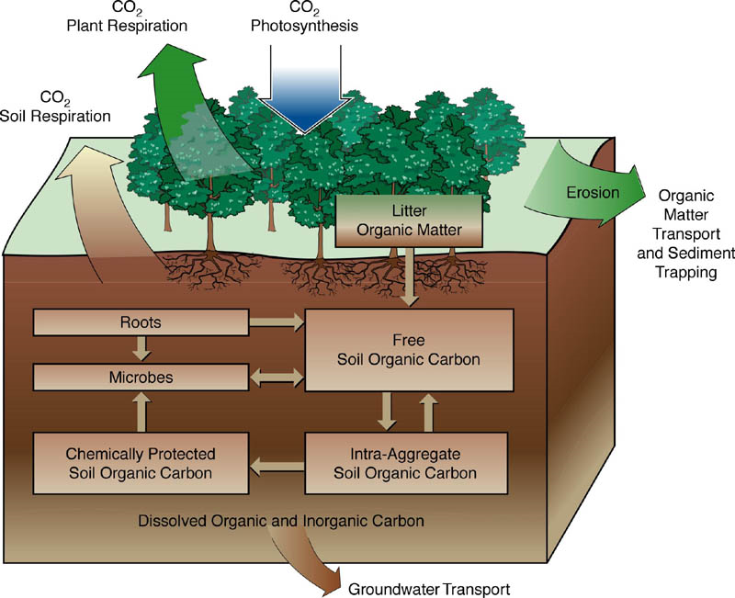
Soil organic matter management
(www.climatescience.gov)

Slide 19
Environmental factors
Climate
Temperature
Greater biomass produced, but decomposition is faster with higher temperatures
Less accumulation of SOM in warmer climates
Rainfall
Generally, SOM increases as precipitation increases
Very little biomass produced in arid regions
Soil texture
Greater SOM in fine-textured soils (clay, silt)
Organic matter protected in aggregates, mineral associations
Smaller pores limit oxygen and thus decompostion
(Magdoff and van Es, 2009)

Slide 20
Preventing losses of SOM
Erosion
Utilize conservation tillage practices
Maintain cover by residues at > 30%
Reduce tillage (many options…)
Utilize cover crops
Incorporate perennials
Soil respiration
Reduce tillage and soil disruption
Reduce use of synthetic fertilizers

Slide 21
Environmental factors
Drainage and landscape position
Greater SOM in wetter soils
Greater SOM in lower landscape positions
Vegetation
Greatest SOM in soils that developed in grasslands
Acidic soils
Slows SOM decomposition
(Magdoff and van Es, 2009)

Slide 22
Building soil organic matter
Maximize plant productivity
Cover crops
Perennials
Conserve crop residues
Recycle local ‘wastes’
Composts
Manures
(Magdoff and Weil, 2005)

Slide 23
Building soil organic matter
Balance decomposition of residues (nutrient mineralization) and accumulation of humus (i.e. “steady burn”)
C:N ratio of residues
>25 to 30 (immobilization of N)
<25 to 30 (mineralization of N)
Incorporate high residue crops in rotation (e.g. grains)
10 to 20% of biomass converted to stable humus
Mix small grains with legume cover crops
Root biomass plays an important role (perennials and biennials)
Slower decomposition, more stable organic matter
Continual root turnover
Well-distributed without using tillage
(Magdoff and van Es, 2009)

Slide 24
Overview: Soil management
NOP standard
Soil quality
Functions of soil organic matter
Building soil organic matter
Soil fertility
N,P, K
Soil testing
Cover crops
(Image from: oregonclover.org)

Slide 25
Nutrients and soil fertility
Reductionist vs. systems approach
Goal is not to replace synthetic conventional input with organic input
Must shift management to a whole systems approach
“input substitution”
How do the diversity of organisms within the soil and the diversity of plants in the cropping system interact and affect soil fertility?
How can the ecological system be managed to optimize fertility and sustainability?

Slide 26
Nitrogen cycle
(Graphic from: msu.edu)

Slide 27
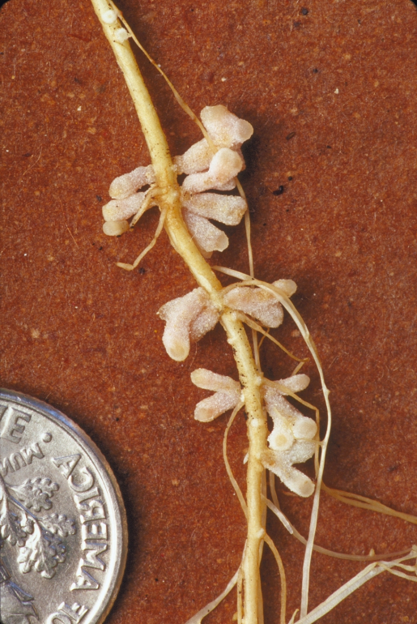
Nitrogen fixation
Atmospheric
Lightning breaks N₂ molecules
Dissolved in rainwater as nitrates
~ 5% of N fixation
Biological
About 70% of N fixation
Rhizobia form symbiotic associations with plants in the family Fabaceae (legumes)
A few non-legumes also form symbiotic associations with N-fixers (e.g. alders), but none agriculturally important
Free-living N-fixing bacteria
e.g. Azotobacter, Azospirillum important in soils
(Photo from: umn.edu)

Slide 28
Mineralization
What is the mineralization rate of SOM?
General assumption:
~ 20 lbs N acre⁻¹ for every 1% SOM mineralized annually
So, for a soil with 2% organic matter (0 to 6” sample), we would expect a release of 40 lbs N per acre⁻¹ yr⁻¹
Temperature, precipitation, aeration, management…
(Grubinger, 1999 )

Slide 29
NOP allowed N sources
Material | % N | Availability
Manures | 1 to 4 | moderate
Composts and residues | < 1 | slow
Legumes! | 0.5 to 4 | slow to moderate
Blood meal | 12 | rapid
Feather meal | 15 | moderate
Seed meals | 5 to 7 | moderate to rapid
Alfalfa meal | 4 | moderate to rapid
Fish emulsion | 2 to 5 | rapid
Chilean nitrate* | 13 | rapid
Other animal, plant residues and byproducts | N/A | N/A
(Barker and Pilbeam, 2007)

Slide 30
NOP allowed N sources
Legume cover crop | Total N (lbs acre⁻¹)
Cowpea | 100 to 150
Crimson clover | 70 to 130
Hairy vetch | 90 to 200
Red clover | 70 to 150
White clover | 80 to 200
Most legumes have a N content of about 3 to 3.5% at flowering
40% C / 3% N = C:N ratio of 13
(Clark (ed.), 2007)

Slide 31
Cover crops
N availability to subsequent crop is variable
10% to more than 50%
Mineralization controlled by interaction of factors:
Environment (temperature, moisture, soil properties)
Management (incorporation, mowing, etc.)
Tissue quality (C:N ratio, carbohydrates, lignin)
(Seiter and Horwath, 2005)

Slide 32
Carbon to nitrogen ratio
Important property affecting cover crop residue persistence, nutrient release, etc.
High C:N ratio
Greater persistence as surface mulch, slower nutrient release
In general: grasses > broadleaves > legumes
Increase with maturity
Low C:N ratio
Quicker nutrient release and breakdown, poor persistence
Unlikely to tie-up soil nutrients

Slide 33
Residual N mineralization
Years | N mineralized, lbs N acre⁻¹ Single application | N mineralized, lbs N acre⁻¹ Two applications | N mineralized, lbs N acre⁻¹ Annual application
1 | 100 (50%) | 100 | 100
2 | 16 (8%) | 116 | 116
3 | 10 (5%) | 26 | 126
4 | 4 (2%) | 14 | 130
5 | 2 (1%) | 6 | 132
Broiler litter application at 4 tons acre⁻¹ (assuming 2.5% total N)
200 lbs total N acre⁻¹
(Adapted from Barker, 2010)

Slide 34
Phosphorus
Many agricultural soils have ample P due to history of manure and fertilizer application
Imbalance when manures applied to meet N needs
Availability of P may be limited due to soil minerals, pH (adsorption, precipitation)
Solutions:
P solubilizing cover crops (e.g. buckwheat, lupins)
Increase organic matter
Encourage mychorrizal fungi

Slide 35
NOP allowed P sources
 | P₂O₅ (%) | P (%) | Availability
Broiler litter | 2.5 | 1.1 | Moderate
Composts and manures | 1 | 0.4 | Moderate
Rock phosphate | 30 | 13 | Very low
Phosphatic clays | 20 | 9 | Very low
Bonemeal | 13 | 6 | Moderate
Alfalfa meal | 3 | 1.3 | Moderate
Other animal, plant residues and byproducts | N/A | N/A | N/A
(Adapted from Barker, 2010)

Slide 36
Potassium
High levels of K in soils (up to 50,000 lb acre⁻¹ in clay loam)
However, most of this is fixed in primary minerals (90 to 98%; feldspar, mica)
Nonexchangeable (1 to 10%)
Exchangeable (1%)

Slide 37
NOP allowed K sources
 | K₂O (%) | K (%) | Availability (%)
Manures | 2 to 3 | 1.7 to 2.5 | 100
Composts | 1 | 0.8 | 100
Vegetative plant residues | 4 | 3.3 | 100
Seed residues | 1.5 | 1.2 | 100
Wood ashes | 10 | 8.3 | 100
Greensand | 7 | 5.8 | limited
Potassium sulfate* | 48 | 40 | 100
Potassium magnesium sulfate* (langbeinite) | 22 | 18 | 100
(Adapted from Barker, 2010)

Slide 38
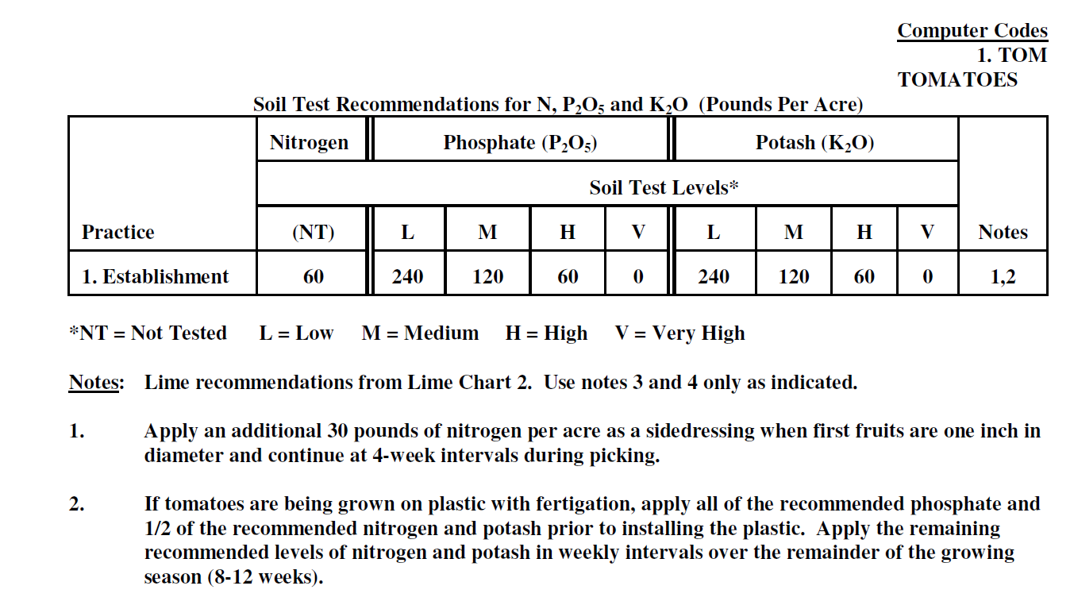
Soil test recommendations

Slide 39
Overview: Soil management
NOP standard
Soil quality
Functions of soil organic matter
Building soil organic matter
Soil fertility
N,P, K
Soil testing
Cover crops
(Image from: oregonclover.org)

Slide 40
Cover crops
Primary fertility and soil management tool available to organic farmers
Important for preventing nutrient and soil loss
Grown primarily for soil or agroecosystem improvement rather than for market
Provide a variety of ecosystem services
Can also have negative impacts if improperly managed or poor species selection
(portions adapted from Center for Agroecology and Sustainable Food Systems, University of California, Santa Cruz)

Slide 41
Cover crops
Cover crop: “covers” the soil with living plants, mainly as erosion prevention
Green manure: cover crop grown mainly to be turned under for soil improvement
Catch crop: cover crop grown to “catch” water-soluble nutrients remaining after cash crop harvest to prevent leaching, runoff losses
Most cover crops serve multiple functions, i.e. functions are not mutually exclusive

Slide 42
Choosing a cover crop
Step 1: Identify what function is needed from the cover crop
What is limiting production in a given system? (e.g. low fertility, poor soil structure, weed or pathogen populations, low soil organic matter?)
What functions can cover crops serve?

Slide 43
Functions of cover crops
Provide nitrogen
Legumes- symbiotic relationship between legumes and rhizobia bacteria that fix atmospheric nitrogen in plant root nodules
Increase soil organic matter and soil biological activity
Major influence on most soil properties (bulk density, porosity, nutrient and water holding capacity, etc.)
High biomass producing cover crops, generally grass species
Solubilize less soluble nutrients such as phosphorus

Slide 44
Functions of cover crops
Scavenge nutrients remaining after a cash crop
Potentially available to following cash crop
Prevents leaching losses, which improves soil fertility and decreases environmental impact
Generally non-legumes, primarily grasses
Prevent soil erosion
Covers soil during fallow periods, preventing loss of soil and associated nutrients
Rapidly growing species are best, but most cover crops fill this role

Slide 45
Functions of cover crops
Improve soil structure
Increasing soil organic matter is key
Non-legumes, which break down slowly best serve this function (grasses)
Improve drainage
Deep-rooted cover crop species can break through compacted soil layers and improve drainage
Organic matter improves soil aggregation
Fava beans, clovers, cereal grains, etc.

Slide 46
Functions of cover crops
Protect water quality
Prevent erosion
Scavenge nutrients
Provide mulch to suppress weeds and conserve soil moisture
High biomass and high C:N ratio species
Primarily grasses

Slide 47
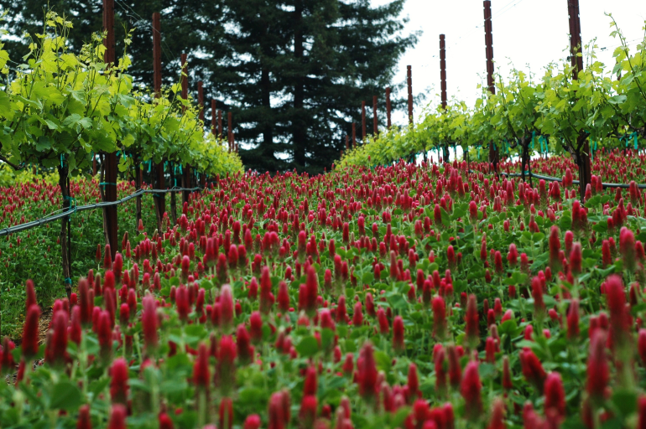
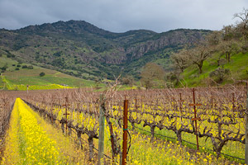
Functions of cover crops
Provide habitat for beneficial insects
Most applicable in permanent systems (e.g. orchard groundcovers) but also applicable in annual systems
(Clark, 2007; photos: marabelgroup.com, panoramio.com)

Slide 48
Functions of cover crops
Suppress weeds
Through competition, allelopathy, shading, etc.
Cereal rye, sorghum-sudan, other grasses
Rotation of cover crops as well, so that weeds that compete well with that cover crop do not build up
Can be used as a mechanically-killed mulch in no-till organic systems to suppress weeds
Suppress soilborne pests and diseases
Some species known for their ability to suppress certain pathogens (e.g. sorghum-sudan or sunn hemp and root-knot nematodes)
Others are good hosts for root-knot nematodes (certain clovers)
Brassicas used for biofumigation, nematode-trapping effects

Slide 49
Choosing a cover crop
Step 2: Identify the cover crop planting niche
Where does the cover crop fit in the crop rotation?
Warm-season or cool-season
Other climatic variables
Precipitation
Temperature (summer highs, winter lows)
Day-length
Compatibility with previous and subsequent cash crops
Define timing of critical cash crop operations, so that cover crop management does not conflict

Slide 50
Choosing a cover crop
Step 3: Select cover crop that meets goals and requirements of steps 1 & 2
Consider benefits and drawbacks (perfect fit is unlikely)
Consider cost and availability of seed (even more so with organic and untreated seed)
Consider management costs (field operations needed to plant, kill, etc.)

Slide 51
Cover crop classes
Cool-season annuals
Legumes
Non –legumes
Grasses
Broadleaves
Warm-season annuals
Legumes
Non-legumes
Grasses
Broadleaves
Perennials and biennials/ley/sod crops

Slide 52
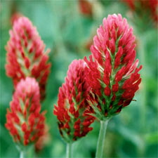
Cool-season annual legumes
Crimson clover (Trifolium incarnatum)
N contribution 70 to 150 lbs/acre
Planted in mid-fall in TN, rapid spring growth
Grows well mixed with small grain (rye, triticale, wheat)
Good pollen source for bees
Not winter-hardy in colder climates (zone ~ 6 to 7 +)
(Clark, 2007; photos: oregonclover.org)

Slide 53
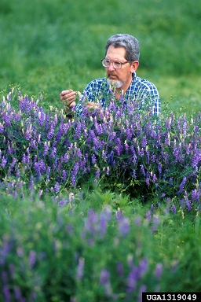
Cool-season annual legumes
Hairy vetch (Vicia villosa)
N contribution 100 to 150 lbs/acre
Planted in mid-fall in TN
Grows well mixed with small grain (rye, triticale, wheat)
Quickly smothers spring weeds
Hard-seeded, can become a weed problem
Very winter hardy (zone ~ 4 +)
(Clark, 2007; photo: USDA-ARS)

Slide 54
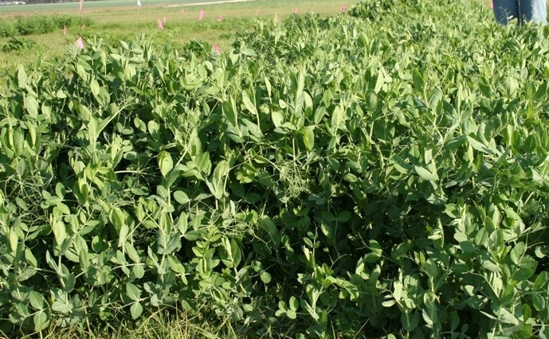
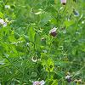
Cool-season annual legumes
Winter Pea (Pisum sativum ssp. arvense)
N contribution 90 to 150 lbs/acre, as much as 300 lb/acre reported
Planted in mid-fall in TN
Low water use
Not as winter hardy as hairy vetch or crimson clover (zone ~ 7 +)
(Clark, 2007; photos: agronomy.ifas.ufl.edu, seedsofchange.com)

Slide 55
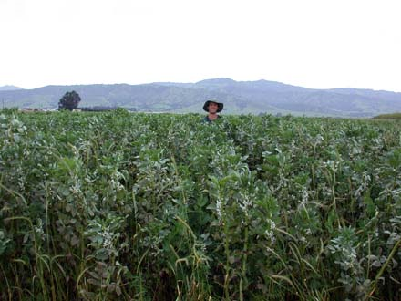
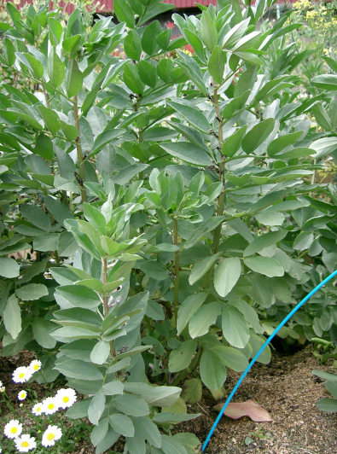
Cool-season annual legumes
Fava bean (Vicia faba)
Grows well in cool conditions
High biomass producer
Deep taproot
Over 100 lbs N/acre
Not as winter hardy as other cool-season legumes (zone ~ 7 to 8 +)
(Clark, 2007; photos: ofrf.org, wikimedia.org)

Slide 56
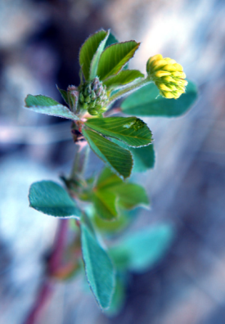
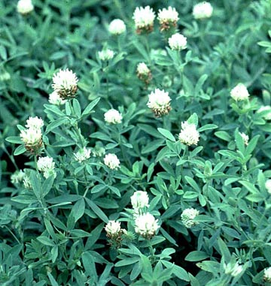
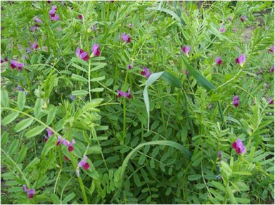
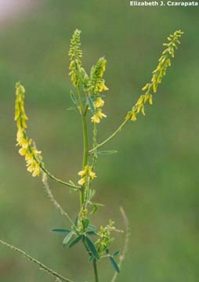
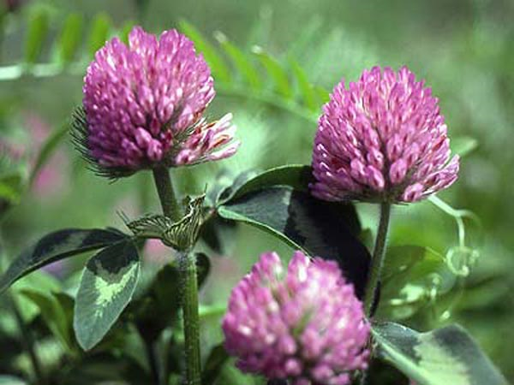
Other cool-season annual legumes
Berseem clover (Trifolium alexandrinum)
Medics (Medicago spp.)
Common vetch (Vicia sativa)
Red clover* (Trifolium pratense)
Sweet clover* (Melilotus officinalis and M. alba)
*biennials
(Clark, 2007; photos: USDA-ARS; tamu.edu, nps.gov, permaculture.org.au, dnr.wi.gov, www.uwyo.edu)

Slide 57
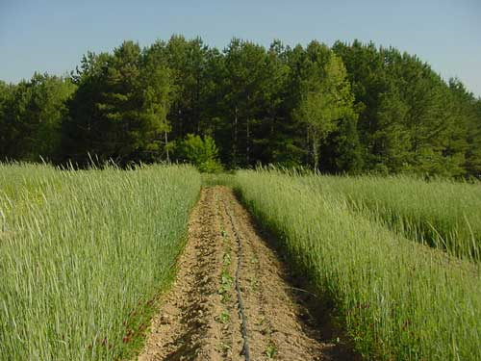
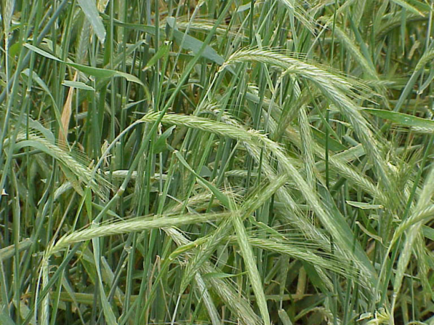
Cool-season non-legumes
Rye (Secale cereale)
Should not be confused with ryegrass
Very cold hardy
Good nutrient scavenger
High early season biomass
Allelopathic (DIBOA)
Other cereal grains
Wheat (Triticum aestivum), oats (Avena sativa), barley (Hordeum vulgare), triticale (× Triticosecale)
(Clark, 2007; photos: ces.ncsu.edu, tamu.edu)

Slide 58
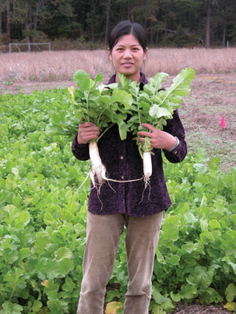
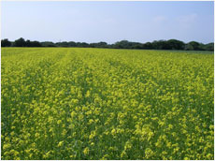
Cool-season non-legumes
Brassicas
Mustards (Brassica juncea, Sinapsis alba, B. carinata, B. nigra)
Rapeseed (B. napus, B. rapa)
Radish (Raphanus sativus)
Arugula (Eruca sativa)
Pest suppression
Good nutrient scavenging ability
Winter hardiness varies
Attract beneficial insects
(Clark, 2007; photos: plantsolutionsltd.com, USDA-SARE)

Slide 59
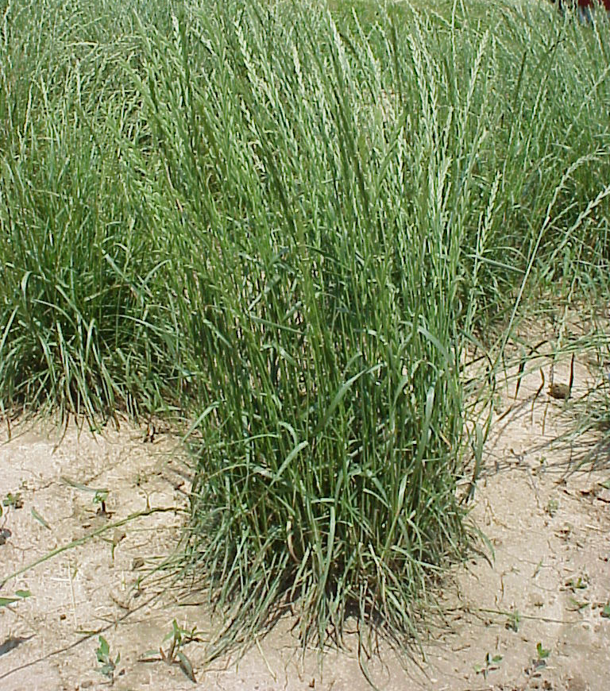
Cool-season non-legumes
Annual ryegrass (Lolium multiflorum)
Good nutrient scavenging
Good biomass production with sufficient N and moisture
Residue does not persist as well as cereal grains
Not as cold hardy as cereal rye
Can become a weed
(Clark, 2007; photos: osu.edu)

Slide 60
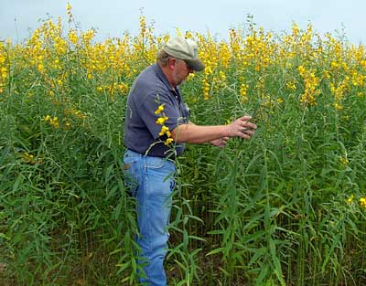
Warm-season legumes
Sunn hemp (Crotalaria juncea)
Rapid biomass and N production (120 lbs N/acre in 9 weeks)
Does best in very warm conditions
Limited by seed cost and availability in U.S.
Suppressive to root-knot and reniform nematodes
(Clark, 2007; photos: J. Cotton Sci.)

Slide 61
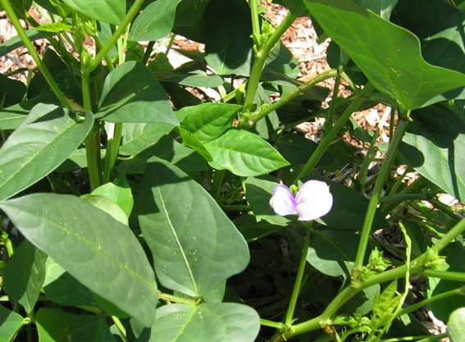
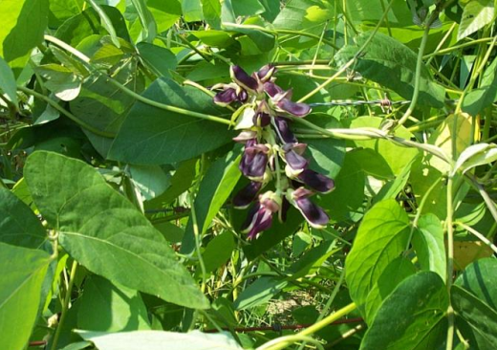
Warm-season legumes
Cowpea (Vigna unguiculata), Velvet bean (Mucuna pruriens), Soybean (Glycine max)
High biomass and N production
Work well mixed with warm-season grasses
(photos: J. Cotton Sci.; velvetbean-mucuna.com; cilr.uq.edu.au)

Slide 62
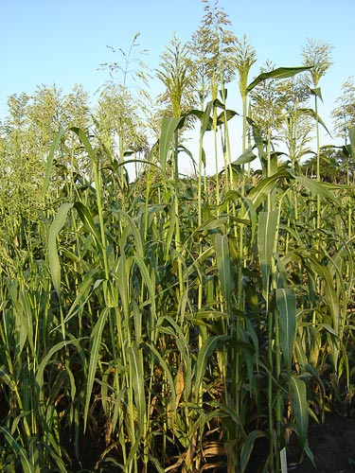
Warm-season non-legumes
Sorghum-sudangrass hybrid (Sorghum bicolor x S. bicolor var. sudanense)
Very high biomass production, good for building soil organic matter
High allelopathy and very competitive with weeds
Suppressive against many pathogens and nematodes
(Clark, 2007; photos: agroatlas.ru)

Slide 63
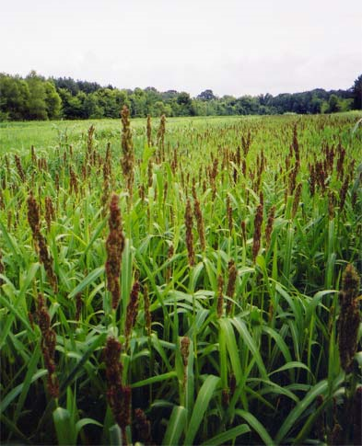
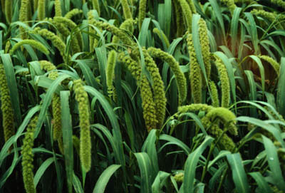
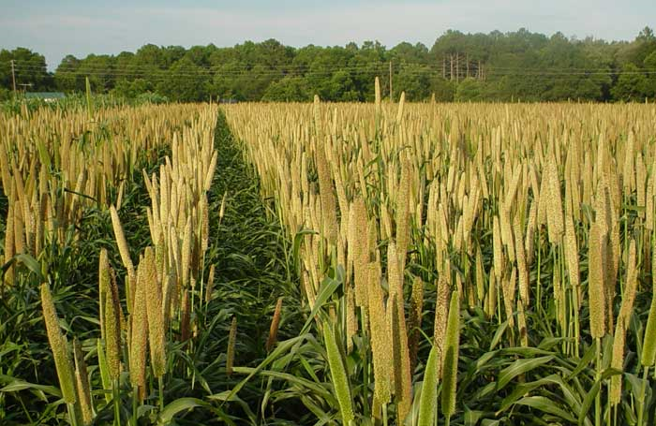
Warm-season non-legumes
Millets
Pearl millet (Pennisetum glaucum), Japanese millet (Echinochloa frumentacea), & German (foxtail) millet (Setaria italica)
High biomass
Tolerant of drought, heat, low fertility
(photos: preferredseed.com, uga.edu, hffinc.com)

Slide 64
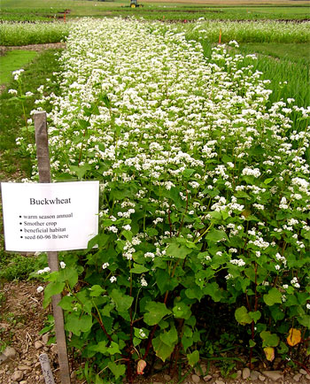
Warm-season non-legumes
Buckwheat (Fagopyrum esculentum)
Rapid growth (maturity in 45 days)
Good smother crop
Attracts pollinators
Can seed easily and become weedy if not well-managed
(photos: cornell.edu)

Slide 65
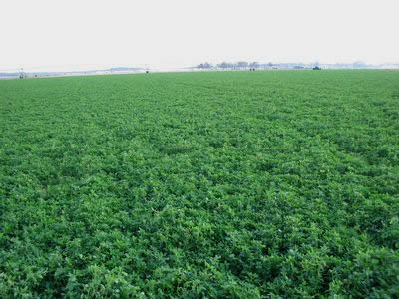
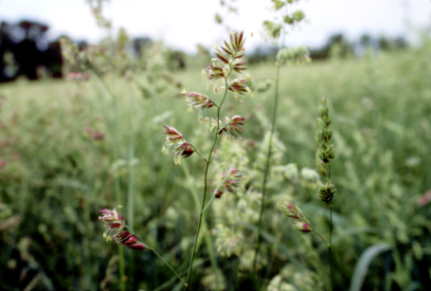
Perennial/ley/sod crops
Longer fallow periods
Build soil organic matter!
Root biomass
Legumes contribute high N
Used for grazing, haying, etc.
Options
Alfalfa, red clover, white clover
Orchardgrass, tall fescue, etc.
(photos: uga.edu; uvm.edu; nrcs.usda.gov)

Slide 66
Cover crops
In what ways do cover crops serve to improve or maintain the nutrient availability of agricultural soils?
Fix atmospheric N (legumes)
Scavenge nutrients after cash crop harvest (grasses)
Can solubilize more insoluble nutrients (e.g. P)
Build soil organic matter

Slide 67
Cover crops
In what ways do cover crops serve to improve or maintain the physical properties of agricultural soils?
Minimize erosion
Increase soil biological activity
Through decomposition, soil organisms help bind soil particles into aggregates
Improve drainage/infiltration
Build soil organic matter

Slide 68
Cover crop exercise
Choose an appropriate cover crop in the following situations
Very short (30 to 45 day) fallow following spring vegetables, want limited residue for subsequent crop
Summer cover crop for a field with low soil organic matter and a history of root-knot nematodes
Winter cover crop prior to spring planted bell peppers (a high nutrient requiring crop)

Slide 69
Cover crop exercise
Choose an appropriate crop in the following situations
Prior to no-till planted fall broccoli
Prior to no-till planted summer eggplant
Prior to early spring greens

Slide 70
Cover crop exercise
Choose an appropriate cover crop in the following rotations
Sp Su F W Sp Su F W Sp Su F W Sp Su F W
Corn
1
Soybean
2
Corn
3
Soybean
Wheat
4
Potato
5
Snap bean
6
Tomato
7
Lettuce
8
Spinach
9
Beets
Broccoli
10

