Slide 1
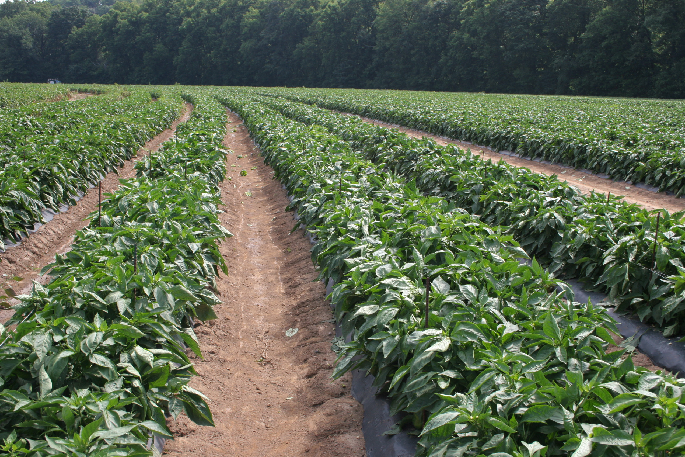
Organic Weed Management
Mark Williams
University of Kentucky
Department of Horticulture

Slide 2
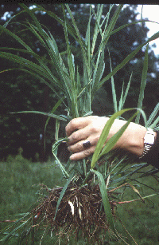
Organic Weed Management - Overview
“Weeds are plants that are especially successful at colonizing disturbed but potentially productive sites, and at maintaining their abundance under conditions or repeated disturbance” (Mohler 2001)
Weed Impact
Weed biology
Control Techniques

Slide 3
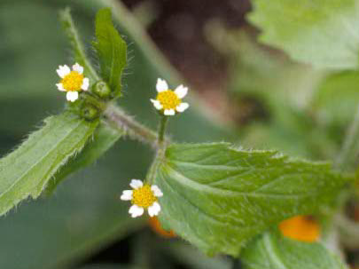
How do weeds impact crop production?
Competition (light, water, nutrients, space)
Consistently present every year (not host specific)
May encourage insect and disease problems
Poor wedding = increased pressure
“One year’s seeding…’
Increased harvest cost
Primary pest problem for organic
growers
Hairy Galinsoga

Slide 4
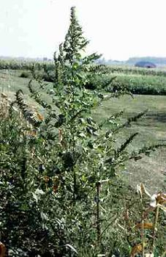
Weed Management
About 1000 seeds/yd² on average
About 50% of the seedbank is from previous year
Can reduce weeds by 50% by controlling for one year
One pigweed can produce 500,000 seed
Forcella and Teasedale, 2003, Agricultural Research

Slide 5
Squash Yields
Yield decreases of 20%

Slide 6
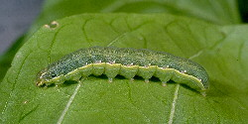
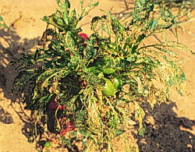
Weed Management
Weeds harbor insect pests (pigweed and beet armyworm)

Slide 7
Weeds harbor diseases
Tomato spotted wilt virus

Slide 8
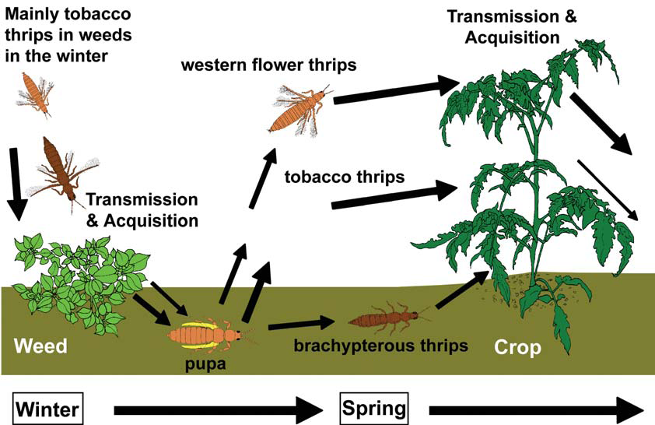
Weeds Harbor Diseases
Riley et al., 2005. Thrips as vectors of TSWV, In: Tospoviruses in solanaceous and other crops in the coastal plain of GA.

Slide 9
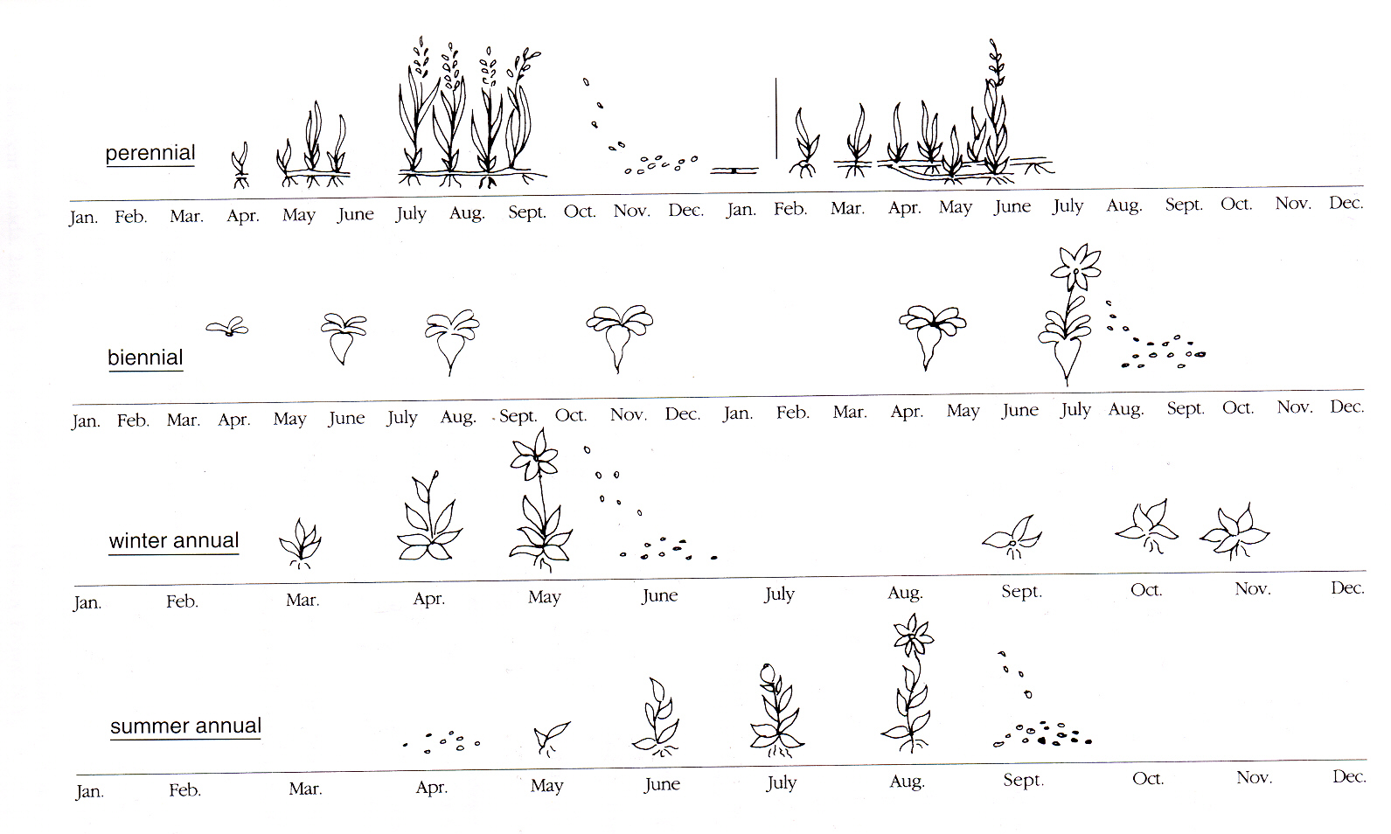
Plant Life Cycles

Slide 10
Types of Perennial Weeds and Examples
Nature of the root system | Examples
Stationary perennials
Taprooted | Dandelion, burdock
Fibrous rooted | Broadleaf plantain
Wandering perennials
Bulb or tuber | Yellow nutsedge, wild garlic
Shallow storage organ | Quackgrass, johnsongrass
Deep storage organ | Bindweed, Canada thistle
Mohler, 2003. In Organic Vegetable Management, NRAES-165

Slide 11
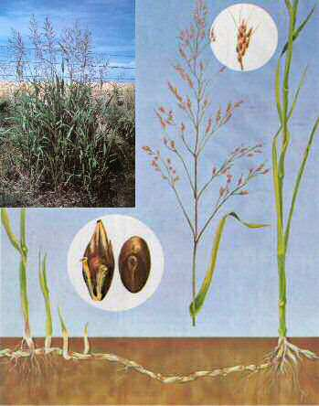

Slide 12
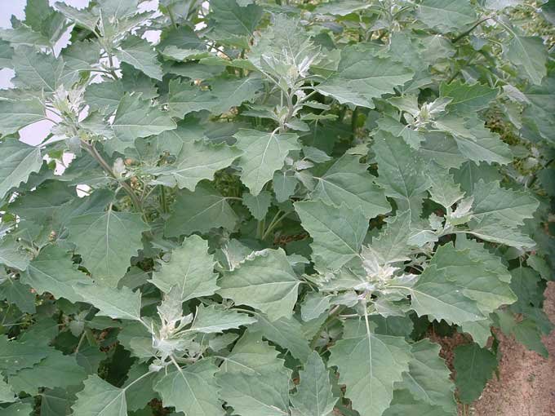
Annual Weeds
Produce many small seeds (less then 2 mg)
  Spreads risk of death by disturbance
  Competition, in-row weeding, mulches
Limited resources
  Emerge from top 1-2 inches
  Tiny seedlings
Germination cues are important for
survival
  Light, soil temp., oxygen, nitrate
  Important for fallow cultivation
Season of germination
  Germination-dormancy cycle
Lambsquarters

Slide 13
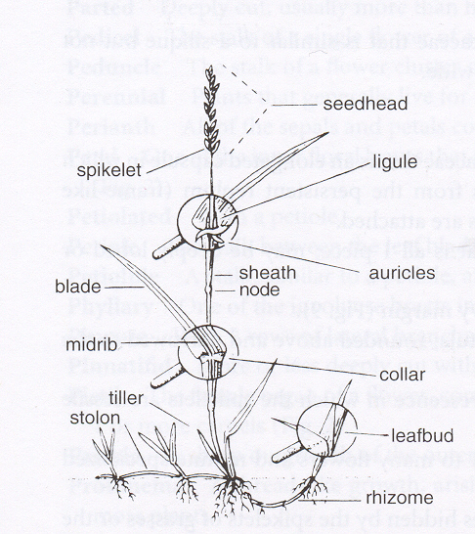
Parts of a Grass Plant

Slide 14
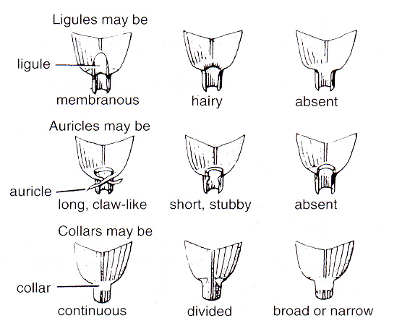

Slide 15
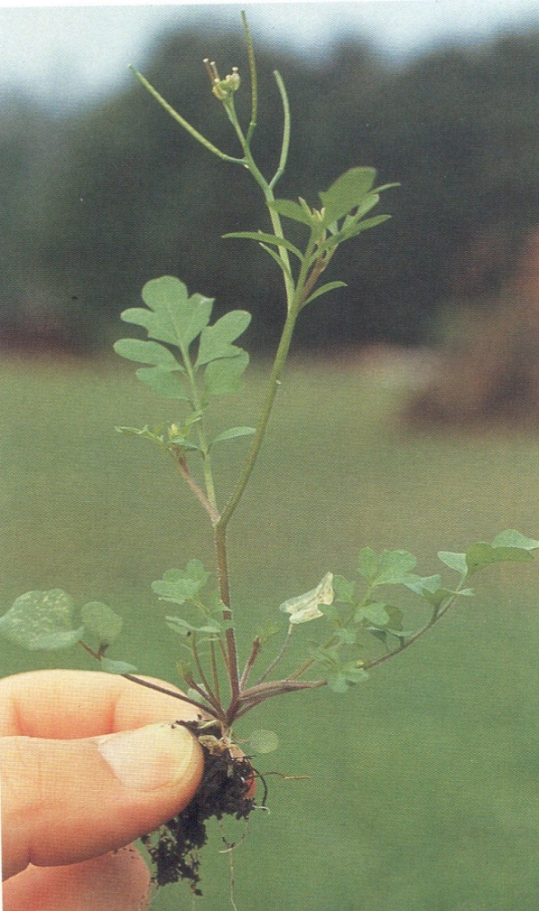
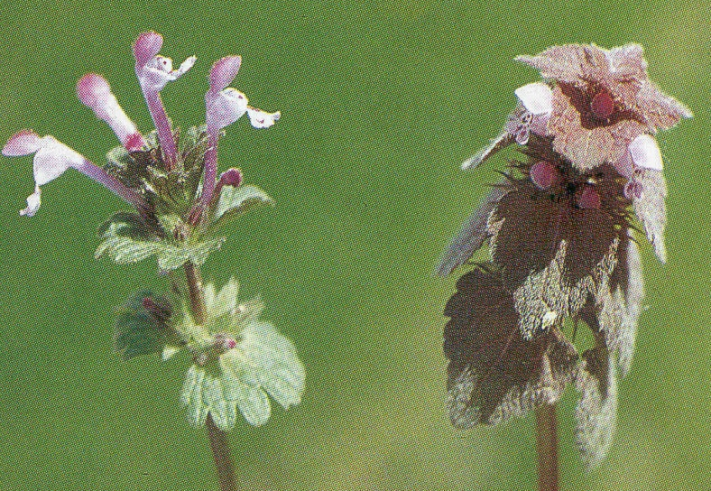
Identifying Broad Leaf Weed Seedlings
Cotyledons (Seed Leaves): shape, venation, hairy or glabrous, coloration
2. True Leaves: arrangement on stem, shape, margins, venation, hairy or glabrous, pinnately or palmately lobed
3. Root System: perennial or annual
4. Other Characteristics: stem hairiness, odor, ocreas
Bittercress
Henbit, Purple deadnettle

Slide 16
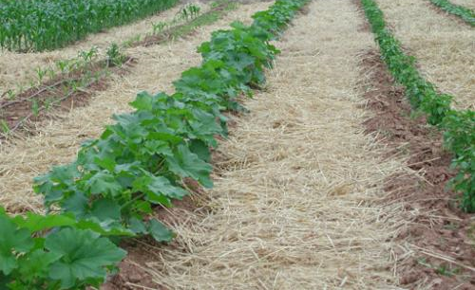
Organic Weed Control Techniques
Management decisions influence weed pressure
Prevention
Rotation or crops, fields and tools
Growing cover crops
Composting animal manure
Cleaning implements
Controlling weeds in non-crop areas
Mulching
Suppression
Mechanical cultivation
Hand-hoeing and pulling
Flame-weeding

Slide 17
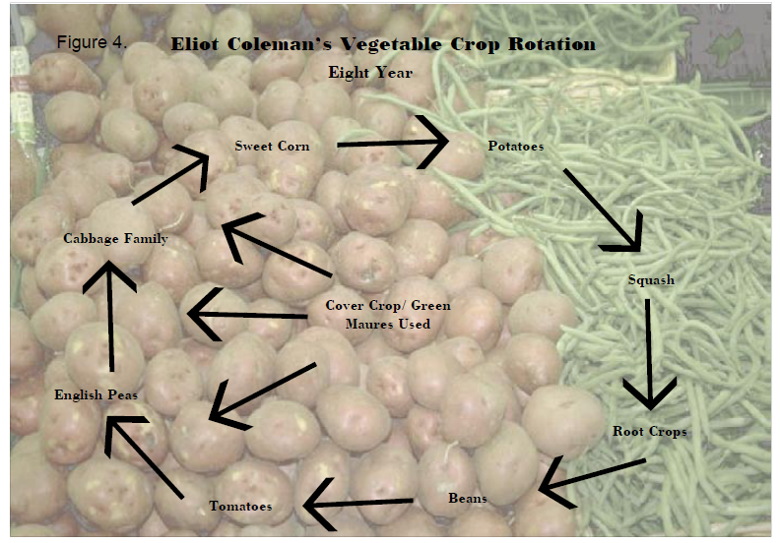
Cultural Practices -Crop Rotations
Crop rotation subject weeds, diseases and insects to an ever-changing habitat, thereby reducing the proliferation of species that prefer certain conditions.
Cultivation regimes can be continuously changed with the rotations.
Coleman, 1995. The New Organic Grower

Slide 18
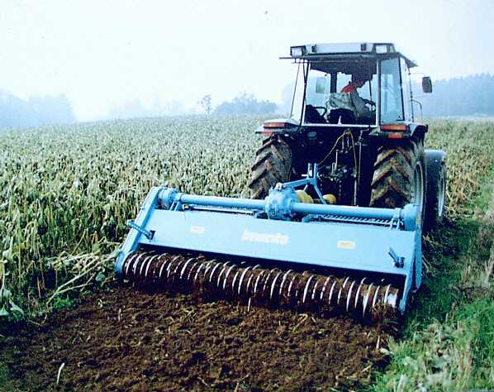
Cultural Practices-Cover Crops
Short and long term control
Starves weeds of light, nutrients
Weakens perennials and reduces annual seed populations
Allelopathy – Sudex, ryegrass
Warm-season: buckwheat, sudex, millet
Cool-season: oats, field peas, ryegrass, hairy vetch

Slide 19
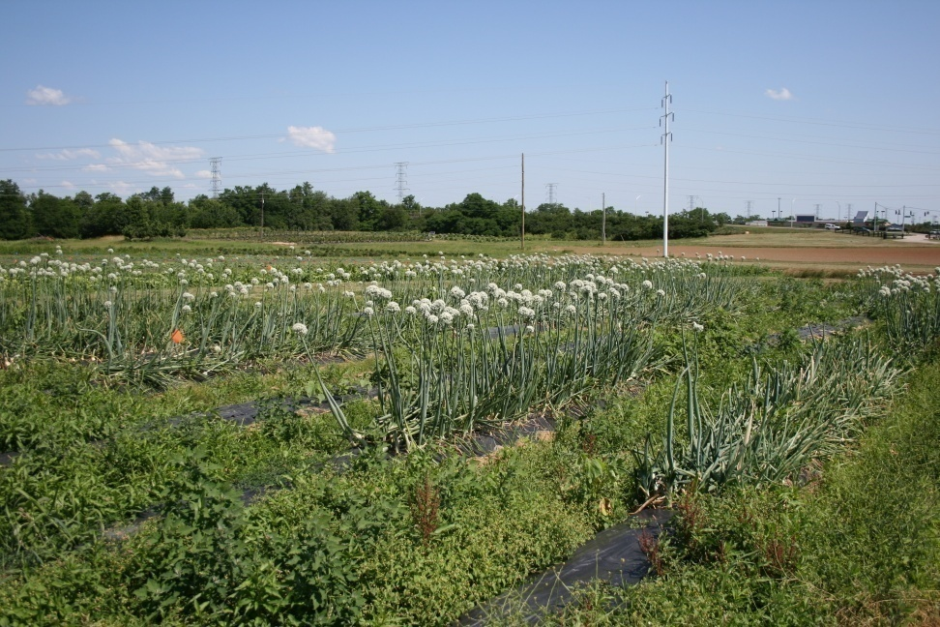
Additional Cultural Practices
Stale seedbeds
Interseeding
Mowing
Placement of resources
Crop establishment

Slide 20
Weed Control Through Cultivation
Equipment for preemergence cultivation (blind cultivation) (flex-tine weeders, rotary hoes)
Equipment for postemergence cultivation (basket weeders, finger weeders, rolling cultivators, sweeps, flamers)
Cultivation tools vary in aggressiveness and can cultivate between rows or within rows
Cultivation implements may dislodge, cut or bury plants
Proper timing of cultivation is critical (get weeds when they are small), setup for speed
Matching the tool to the crop, the weed and the soil condition is key. Versatility is important.

Slide 21
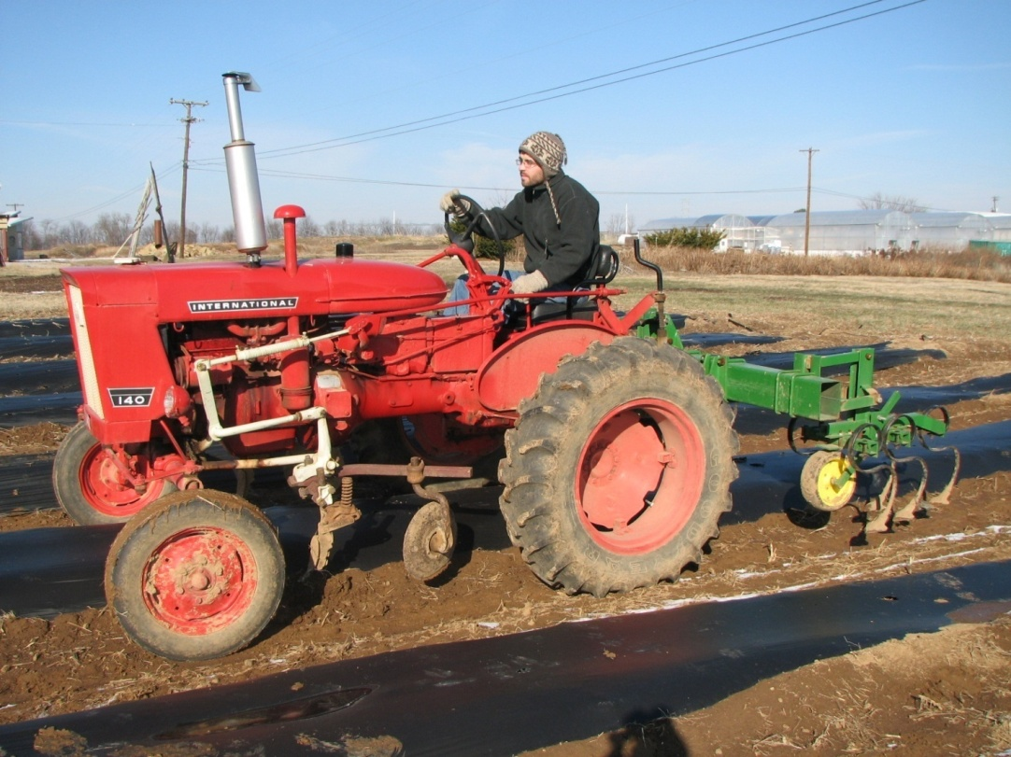
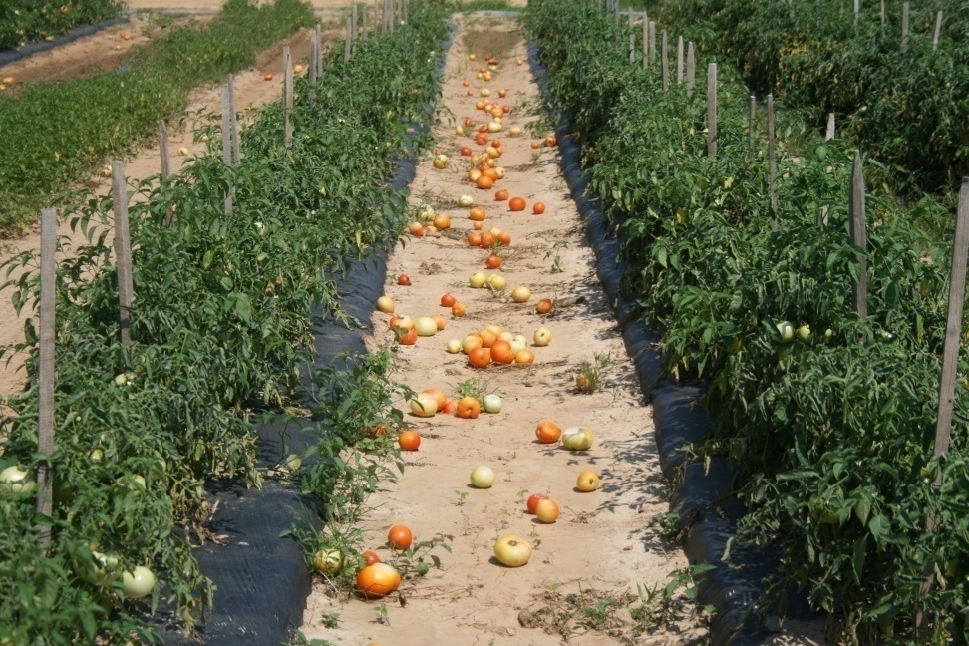
Cultivation - Matching the tool to the production system

Slide 22
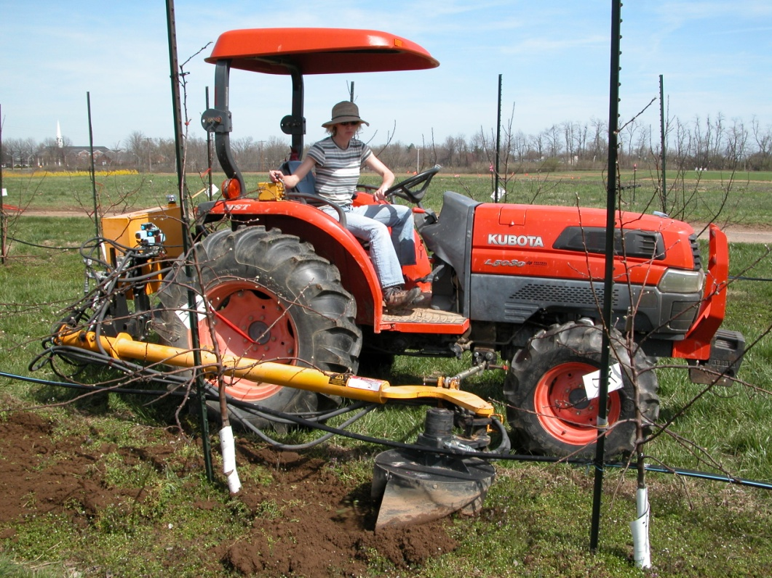
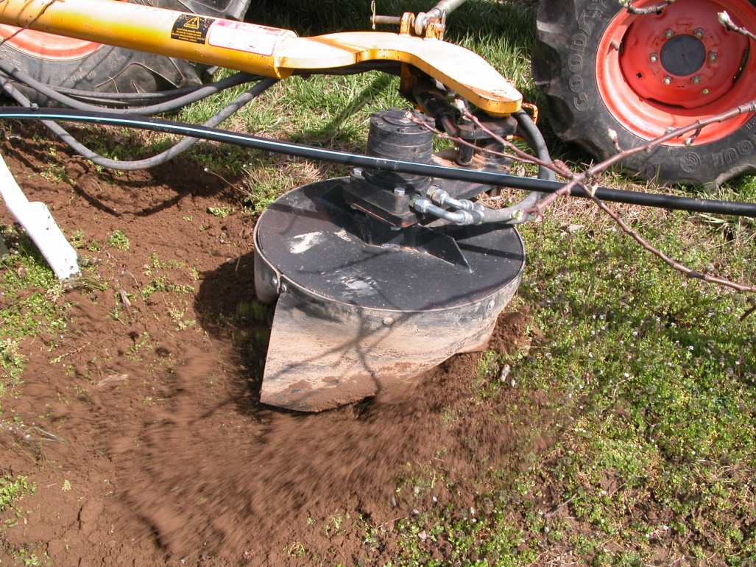
Cultivation - Matching the tool to the production system

Slide 23
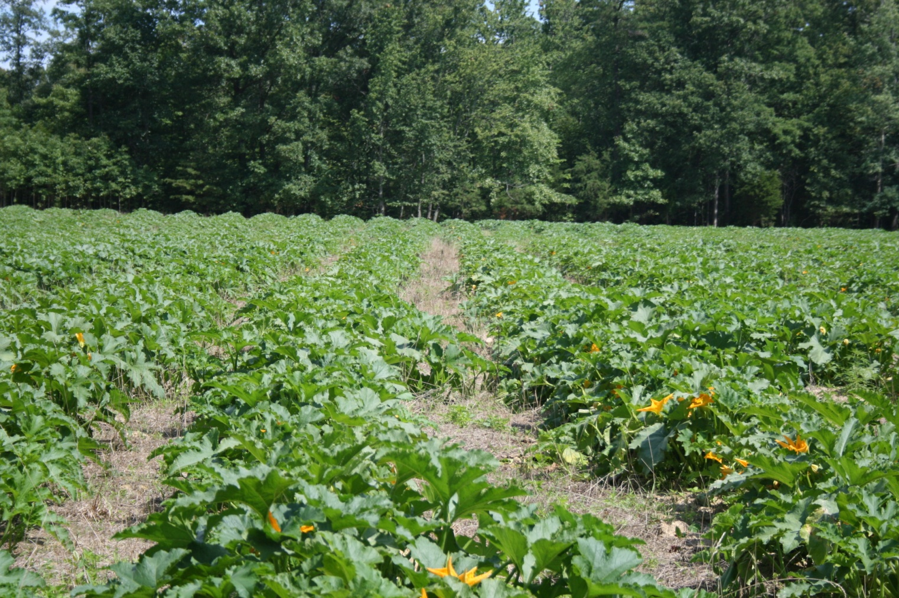
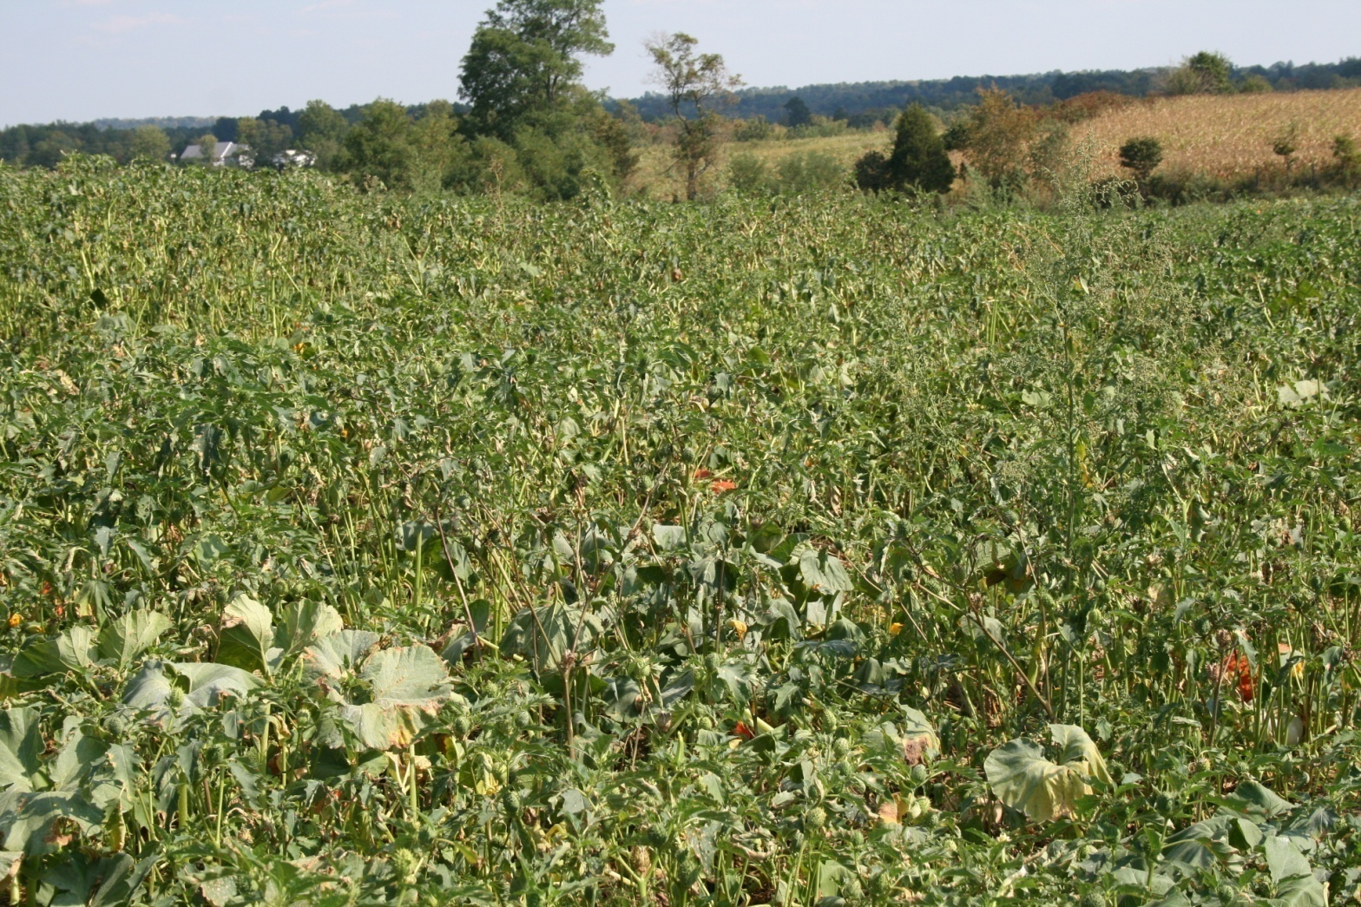
It’s all in the
management

Slide 24
http://newfarm.rodaleinstitute.org/depts/weeds/index.shtml

