Slide 1
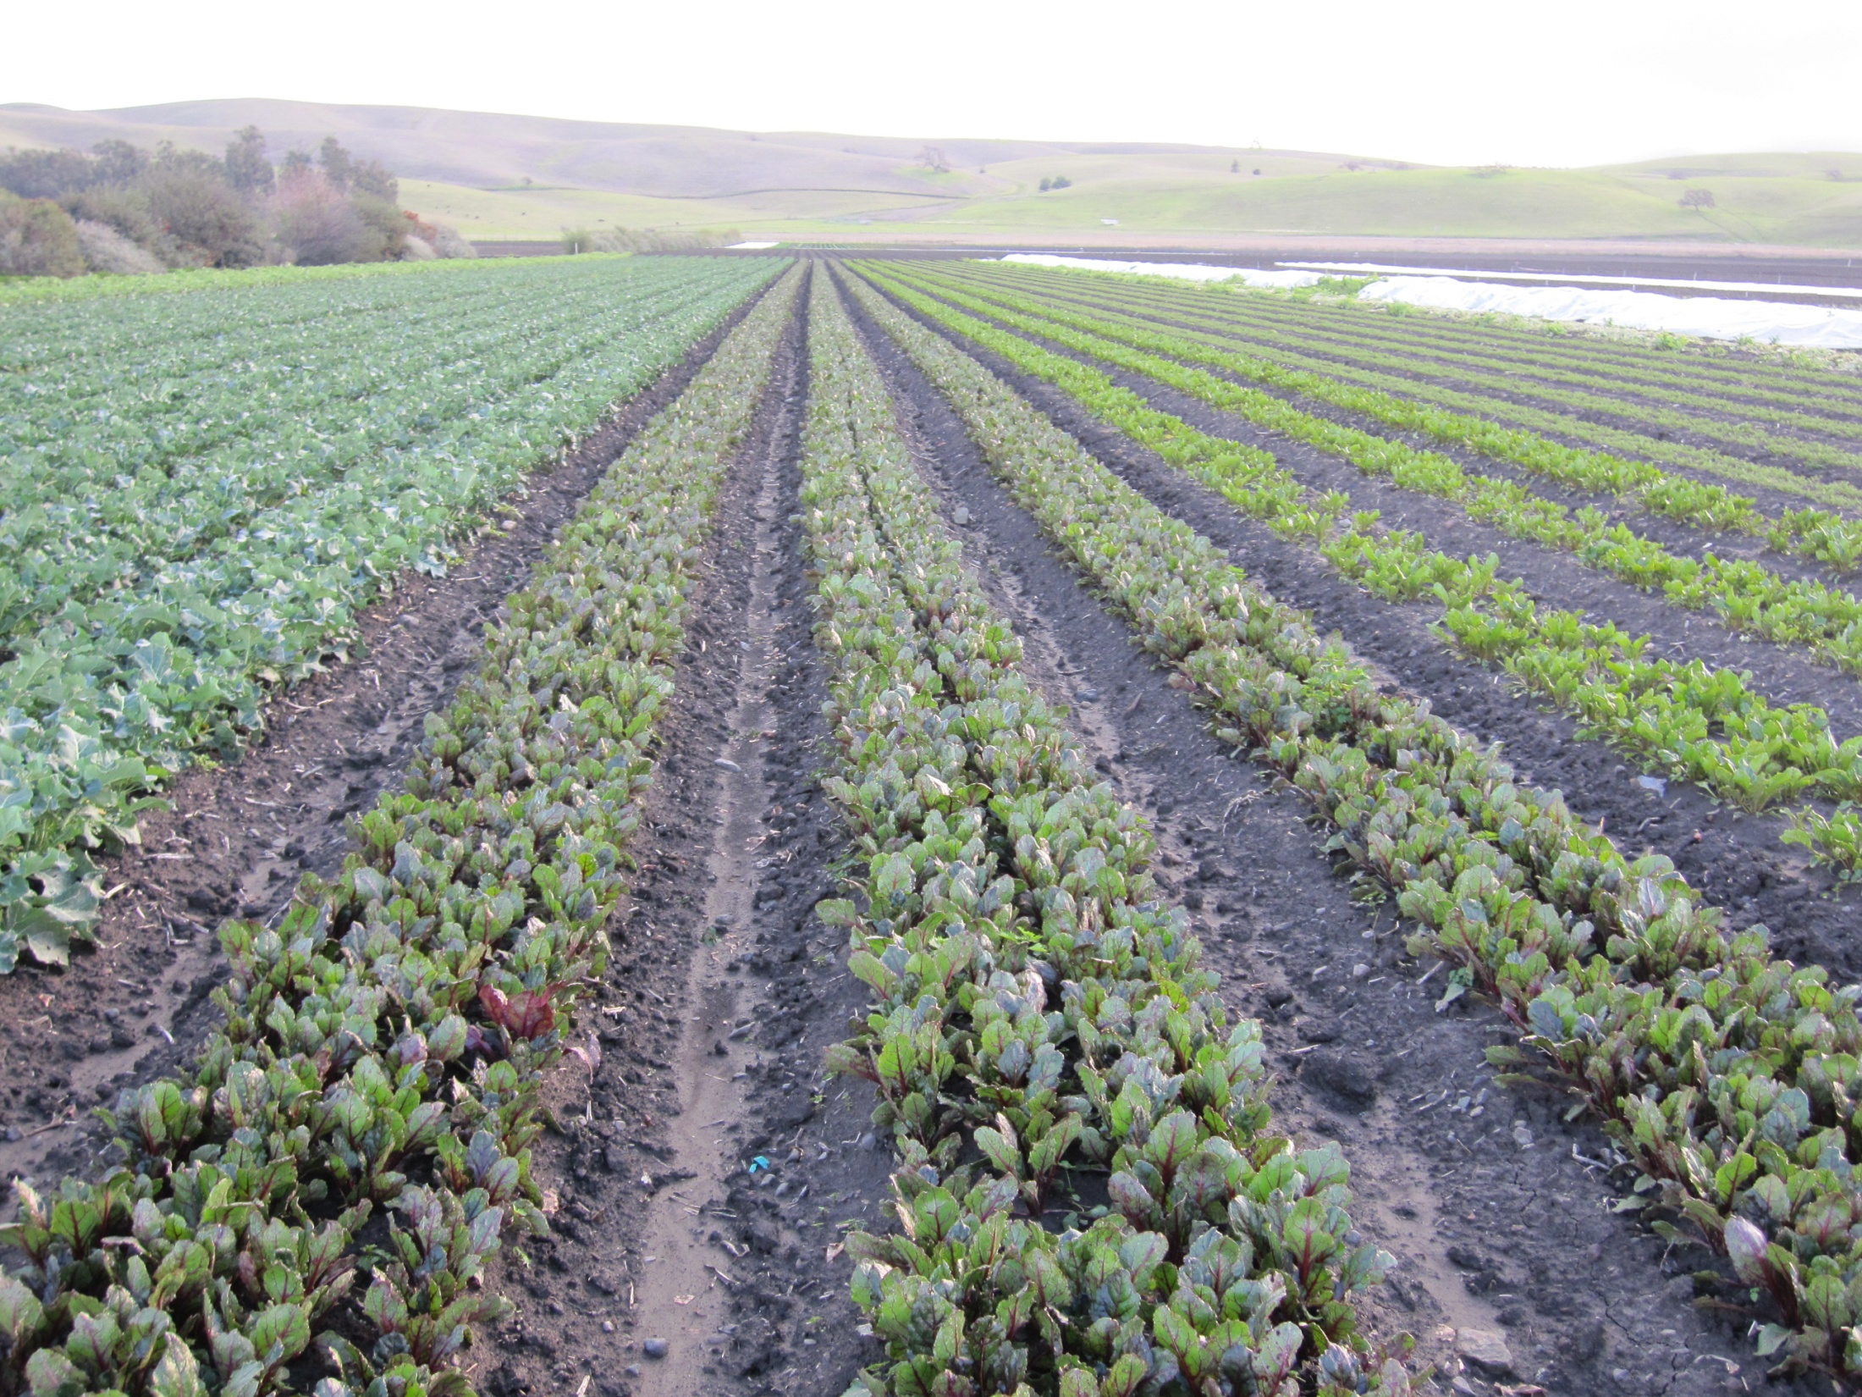
Weed Management on an Organic Farm: A Systems Approach
Mark Williams, Ph.D.
University of Kentucky
Department of Horticulture

Slide 2
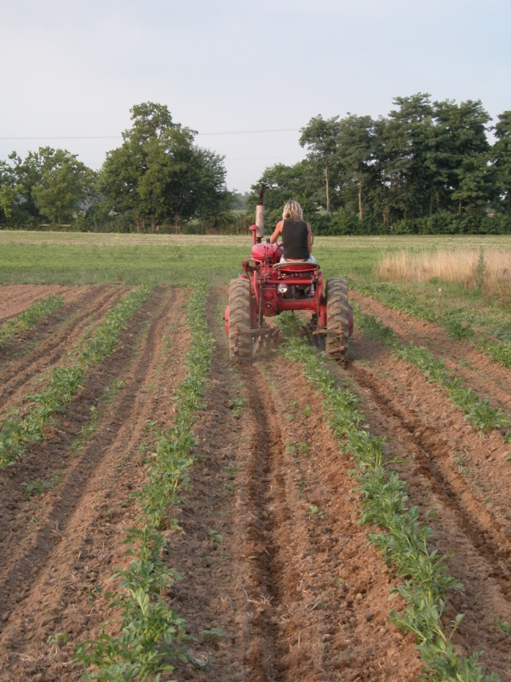
UK Sustainable Agriculture Undergraduate Degree Program
Three Pillars of Sustainability:
Environmental Stewardship 21 hours
Economic Profitability 10 hours
Social Responsibility 9 hours

Slide 3
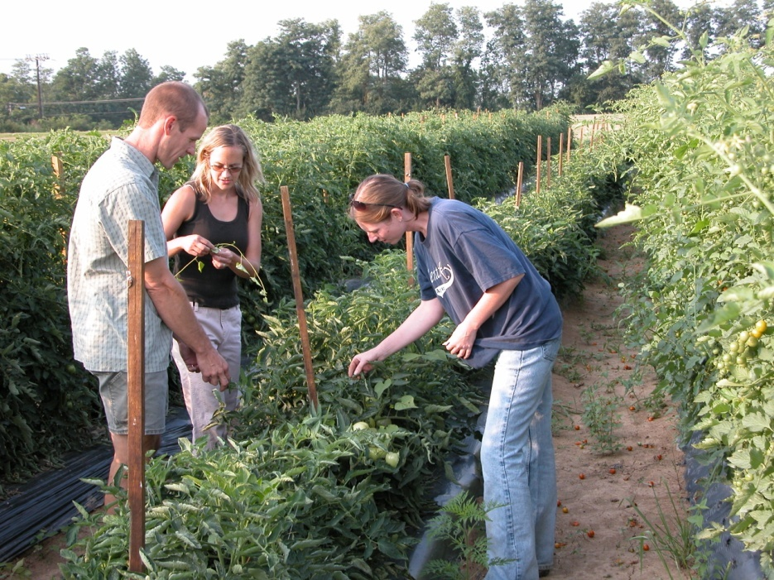
Sustainable Ag Core – 16 hours
Introduction to Sustainable Agriculture - SAG 101
Cultural Perspectives on Sustainable Agriculture SAG 201
Sustainable Plant Production Systems SAG/PLS 386
Apprenticeship in Sustainable Agriculture SAG 397
Capstone in Sustainable Agriculture – SAG 490

Slide 4
SAG 397: Apprenticeship in Sustainable Agriculture
___________________________
250 hours over the growing season
Started in 2007 with 4 apprentices and 42 shareholders
2010: 174 Shareholders and 14 apprentices
Structured to provide holistic learning

Slide 5
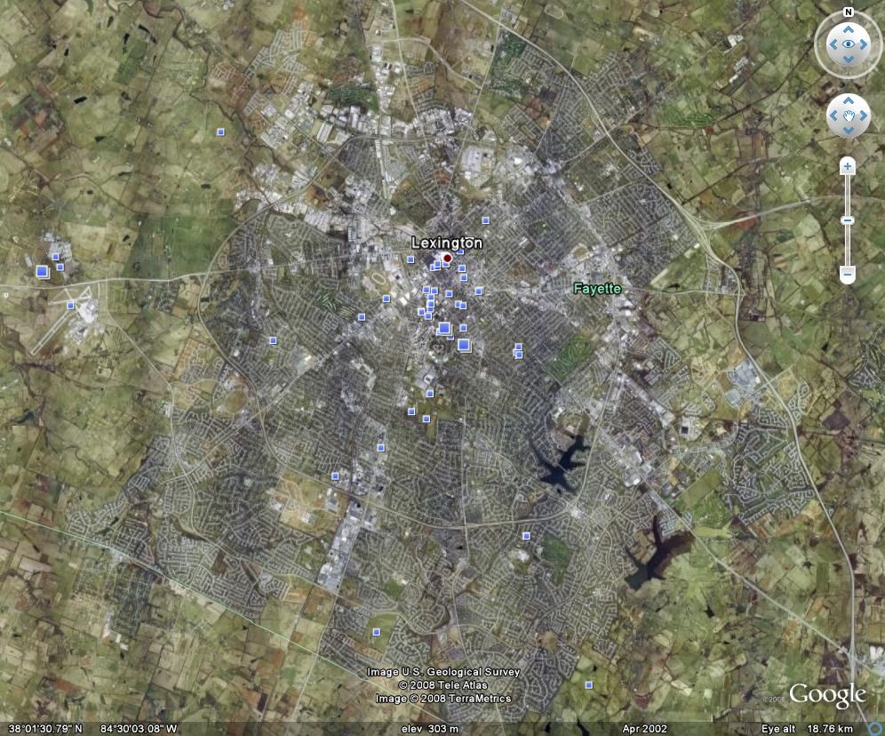
Nicholasville Rd
New Circle Rd
Man O War
UK Horticulture Research Farm

Slide 6
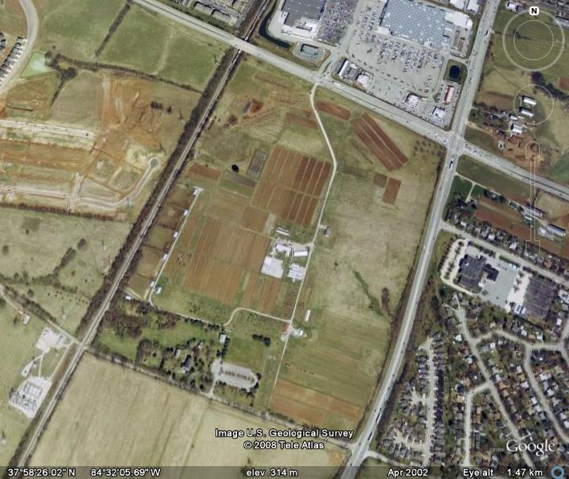
Man O War Blvd
N
Nicholasville Rd
Organic Farming Research and Education Unit
Waveland State Historic Site

Slide 7
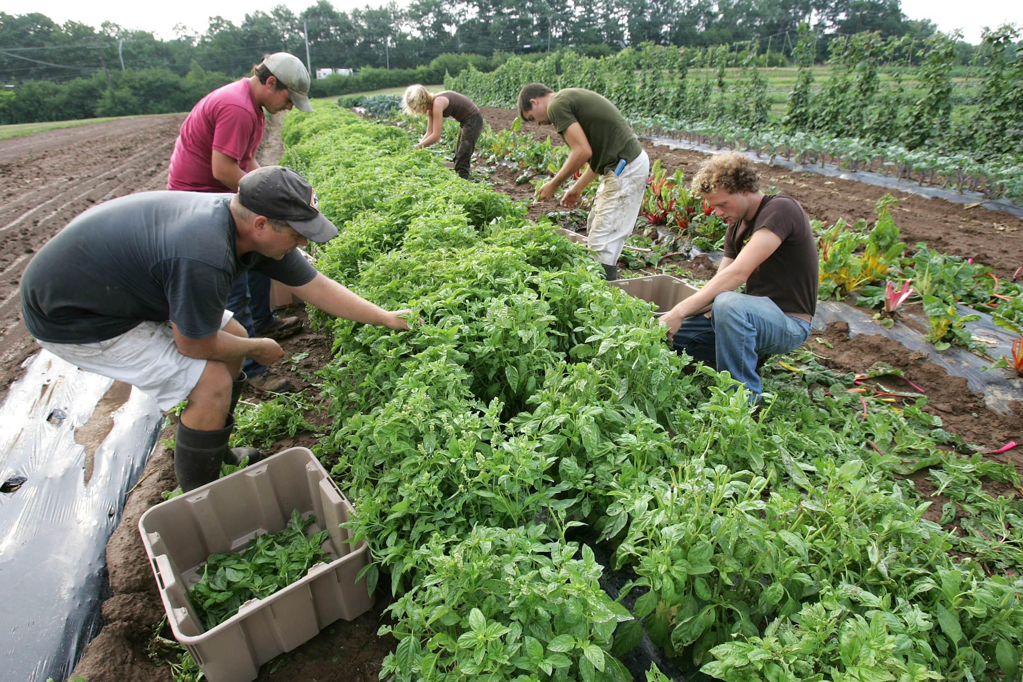

Slide 8
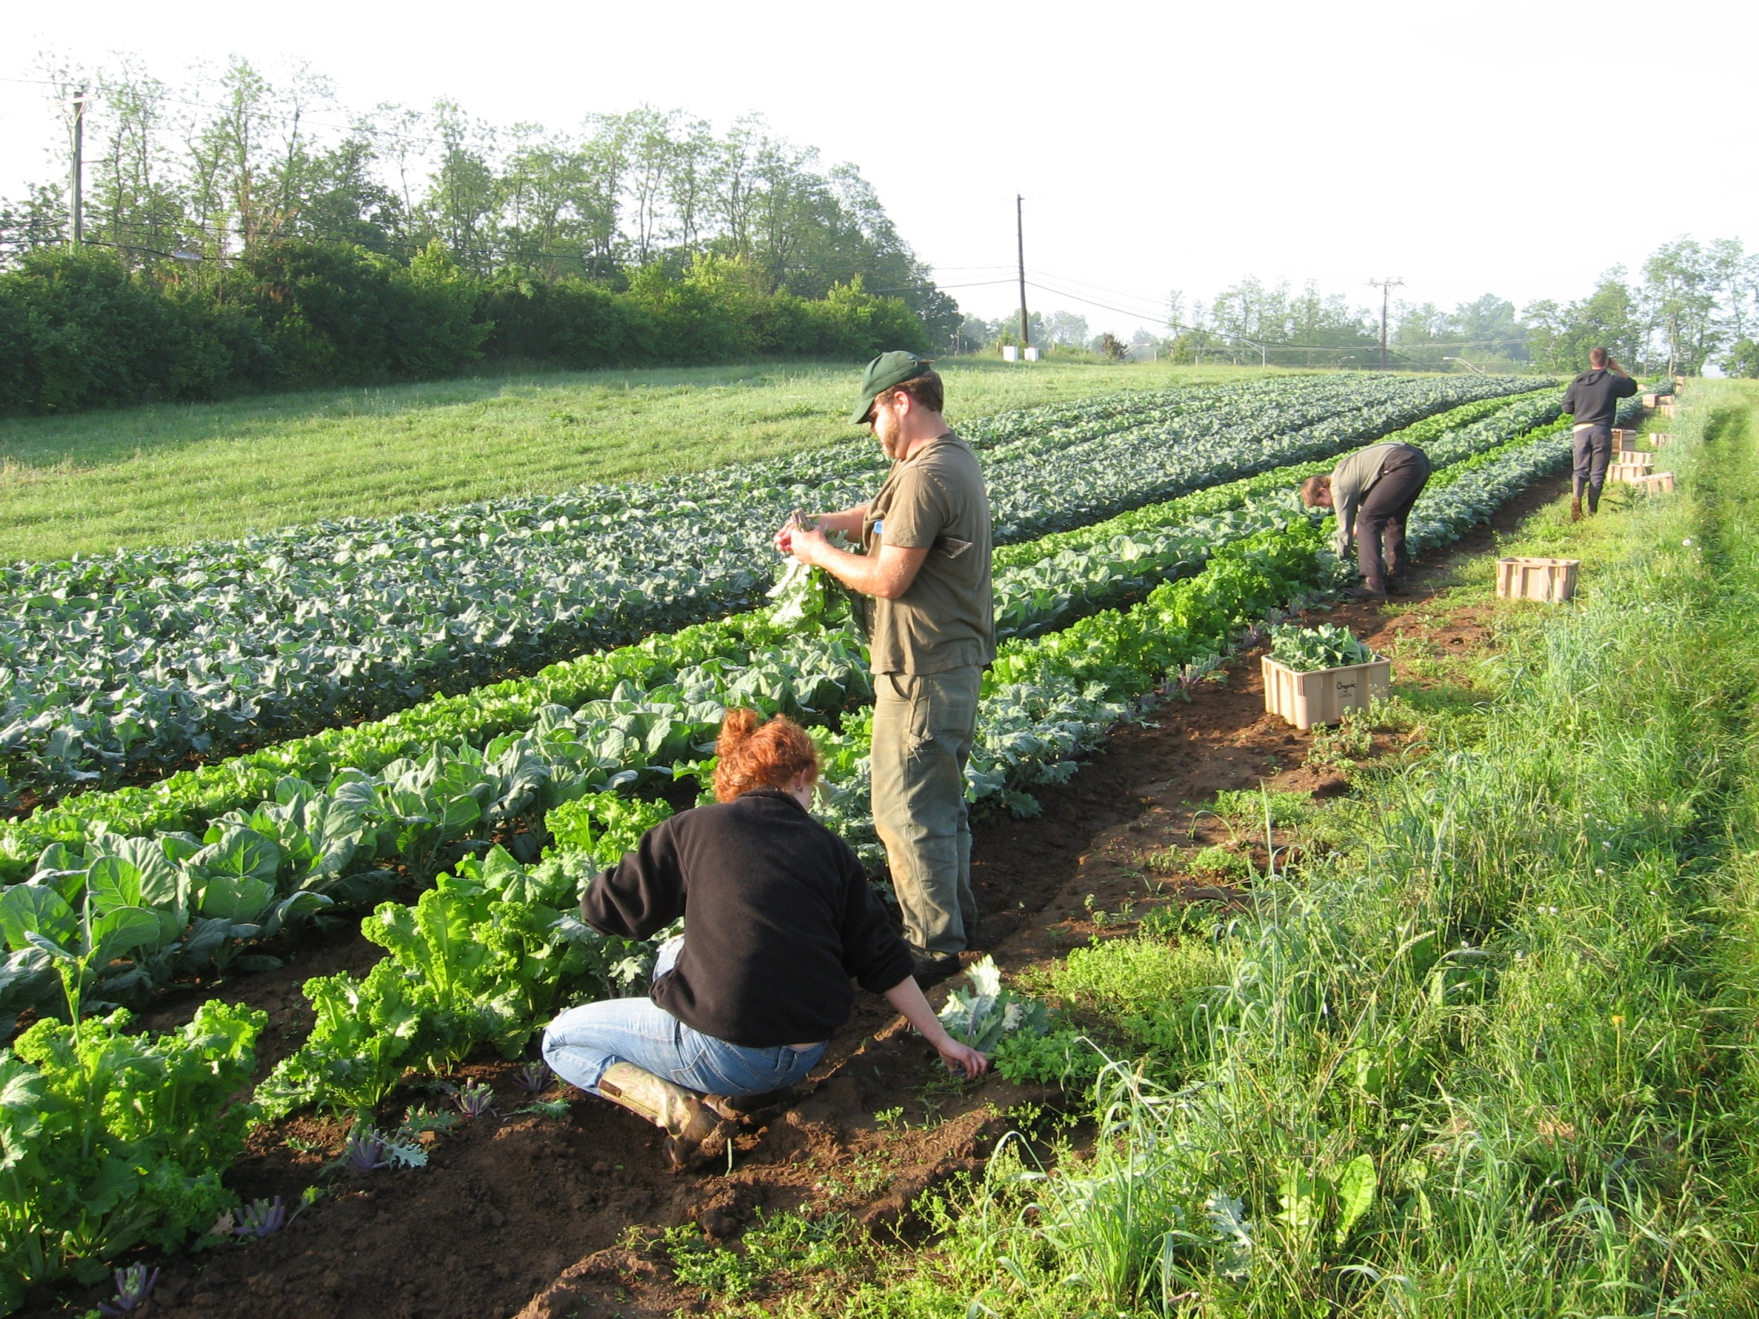

Slide 9
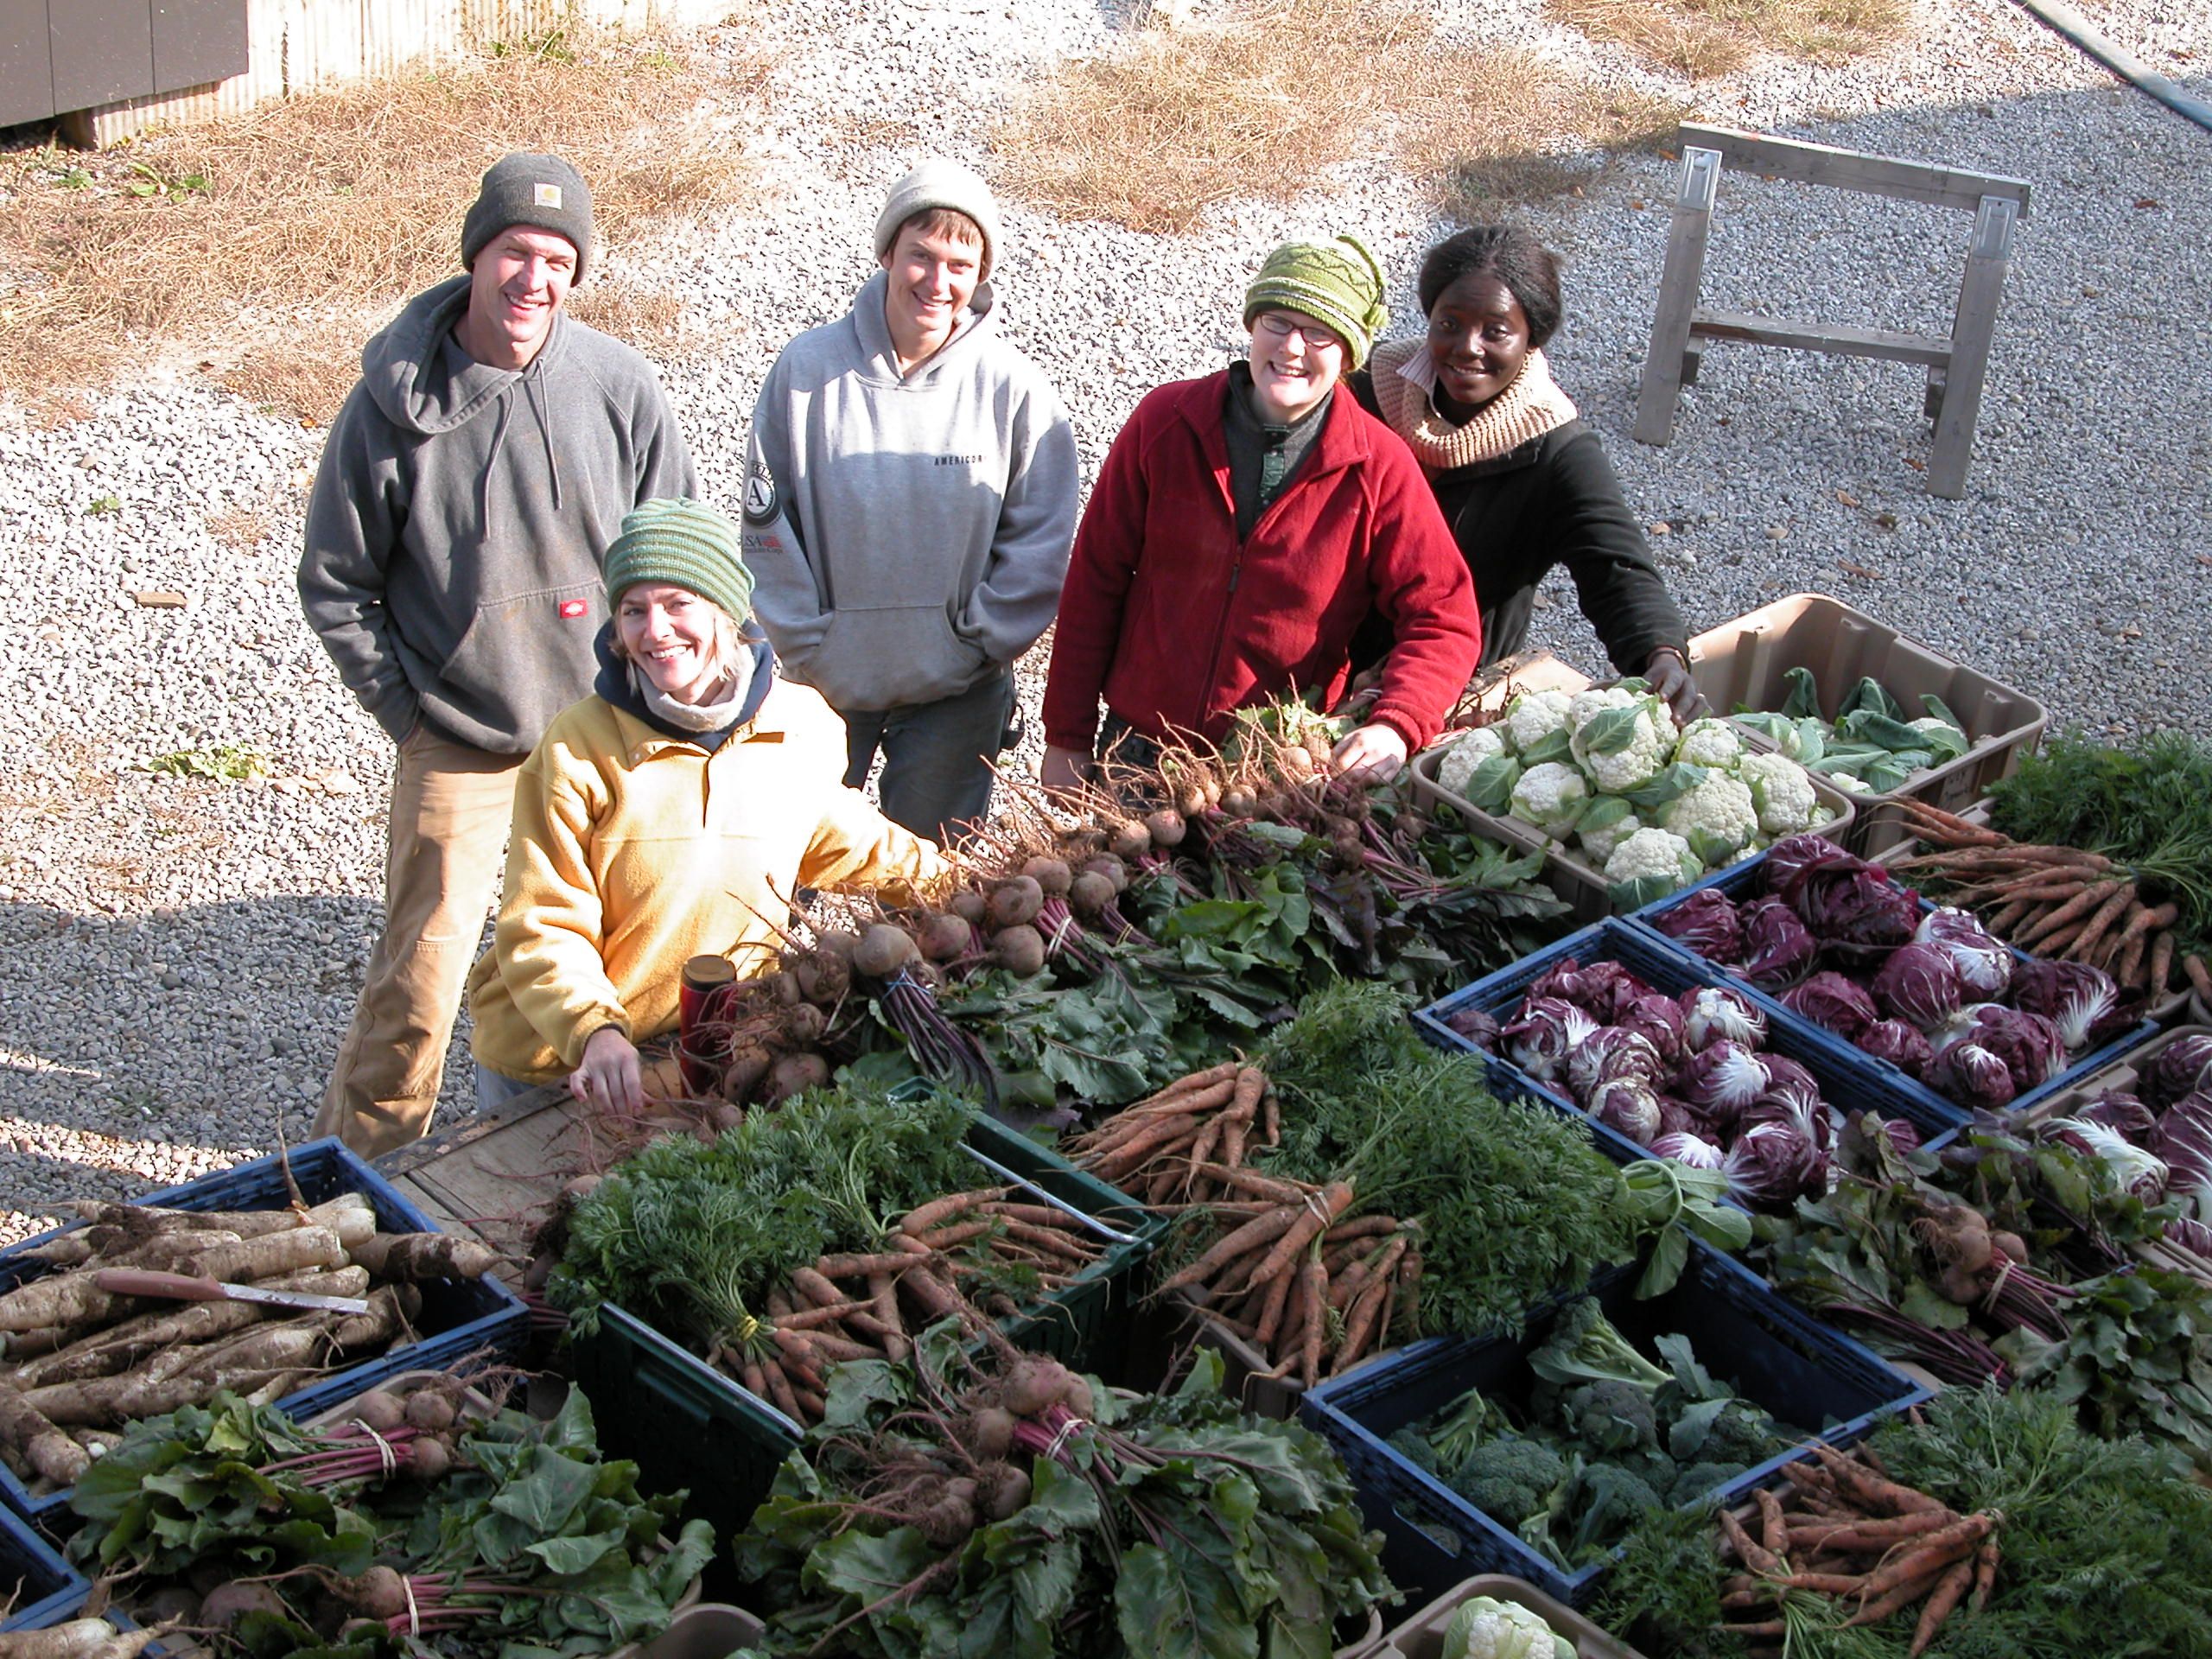

Slide 10
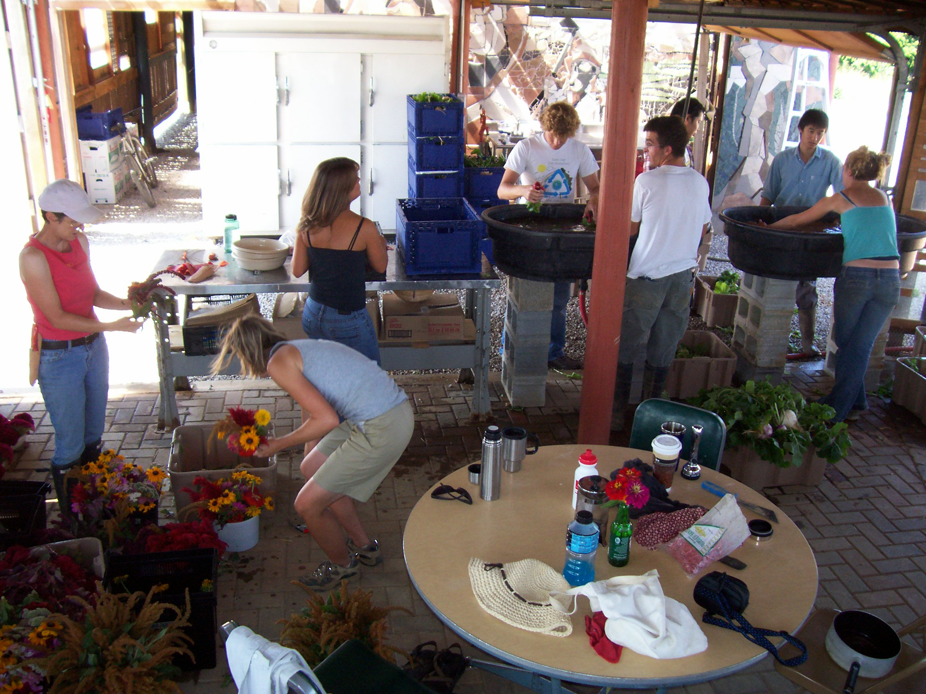

Slide 11
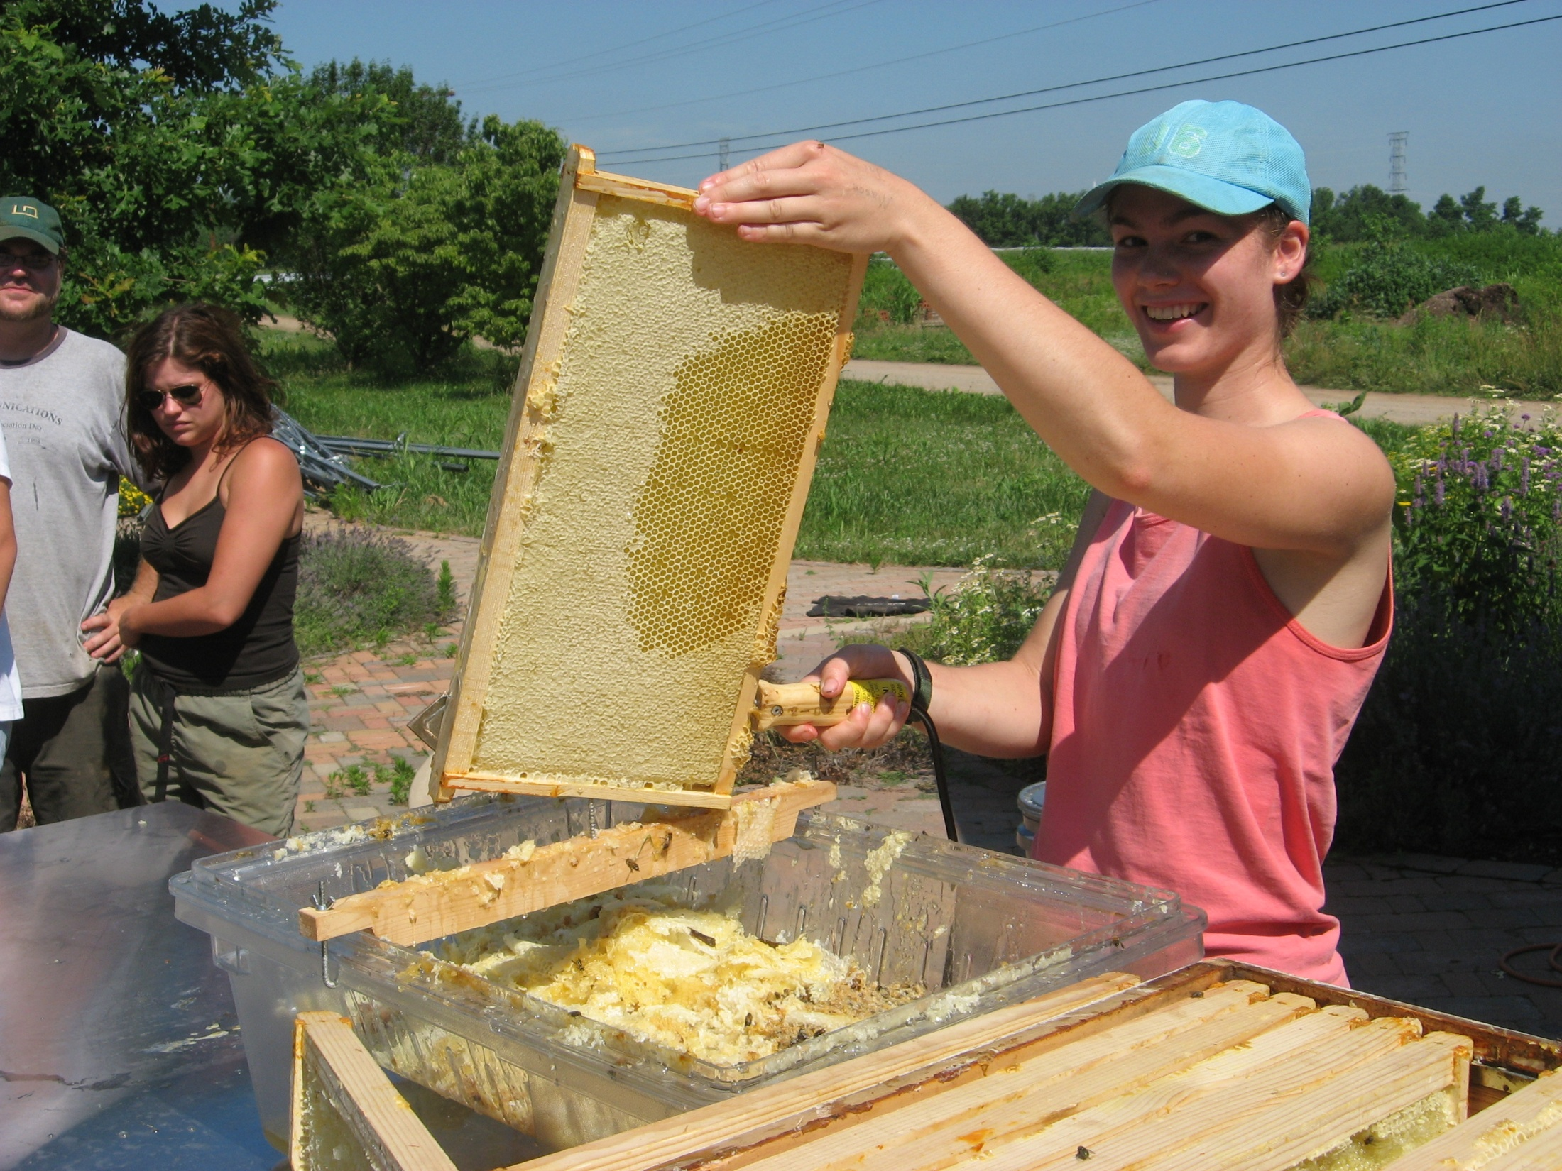

Slide 12
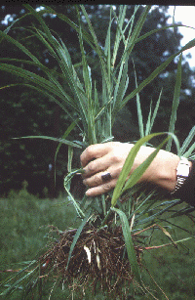
Organic Weed Management
“Weeds are plants that are especially successful at colonizing disturbed but potentially productive sites, and at maintaining their abundance under conditions or repeated disturbance” (Mohler 2001)
Primary pest problem for organic growers
Johnsongrass

Slide 13
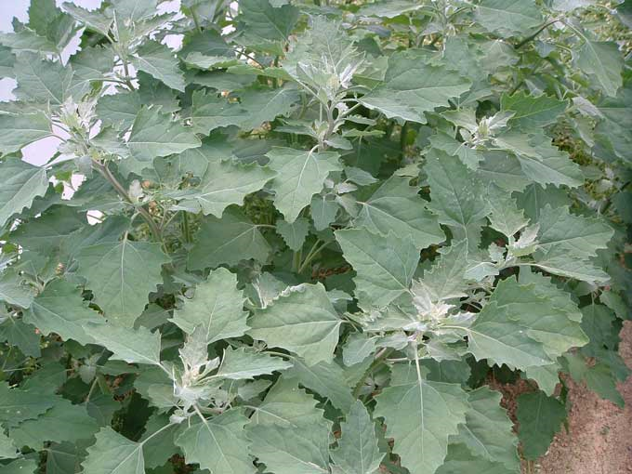
Weed Biology
About 50% of the seedbank is from previous year
Can reduce weeds by 50% by controlling for one year
One pigweed can produce 500,000 seed
Produce many small seeds (less then 2 mg)
Spreads risk of death by disturbance
Limited resources -Tiny seedlings
Emerge from top 1-2 inches
These attributes allow competition, in-row weeding, and mulches to work
Lambsquarters
Forcella and Teasedale, 2003, Agricultural Research

Slide 14
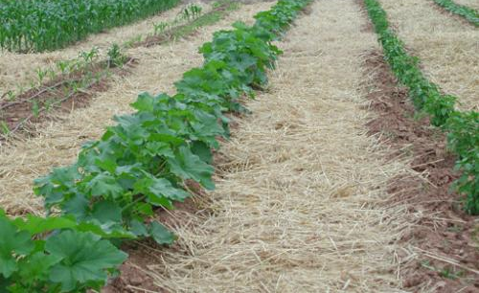
Organic Weed Control Techniques
Prevention – Managing the Seed Bank
Rotation or crops, fields and tools
Growing cover crops
Composting animal manure
Cleaning implements
Controlling weeds in non-crop areas
Mulching
Suppression
Hand-hoeing and pulling
Mechanical cultivation
Flame-weeding

Slide 15
Crop Rotations
Crop rotation subject weeds, diseases and insects to an ever-changing habitat, thereby reducing the proliferation of species that prefer certain conditions.
Cultivation regimes can be continuously changed with the rotations.
Coleman, 1995. The New Organic Grower

Slide 16
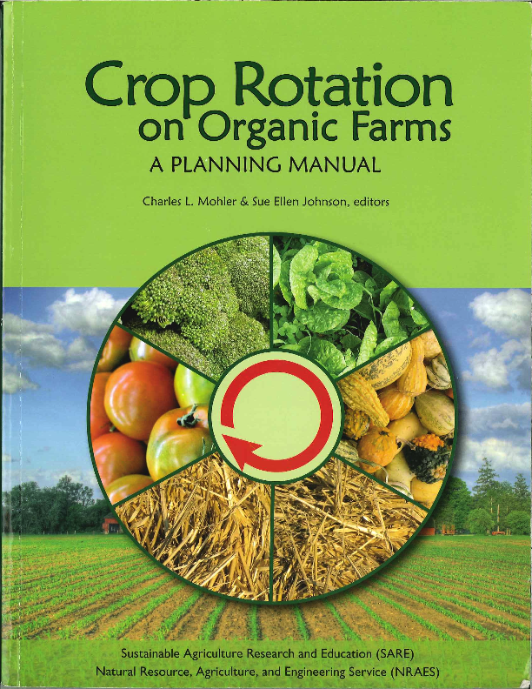
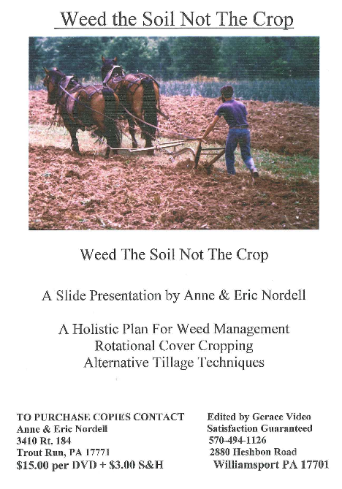

Slide 17
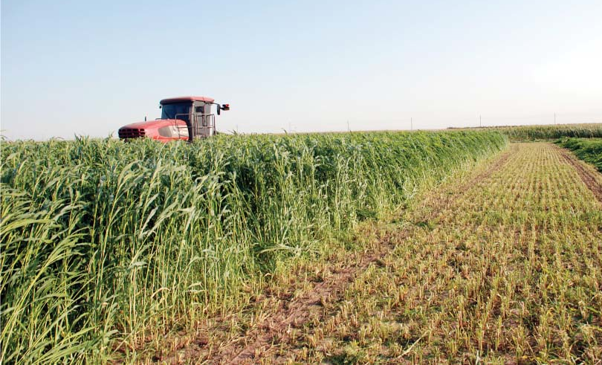
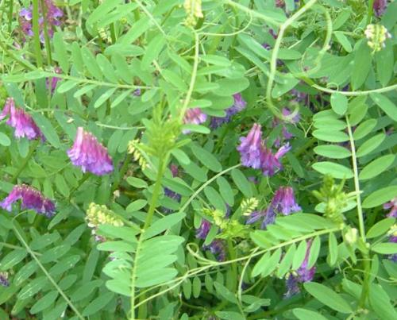
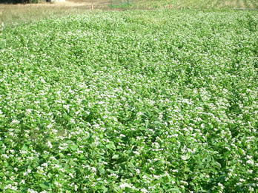
Cover Crops
Short and long term control
Starves weeds of light, nutrients
Weakens perennials and reduces annual seed populations
Allelopathy – Sudex, ryegrass
Warm-season: buckwheat, sudex, millet
Cool-season: oats/peas, ryegrass/hairy vetch

Slide 18
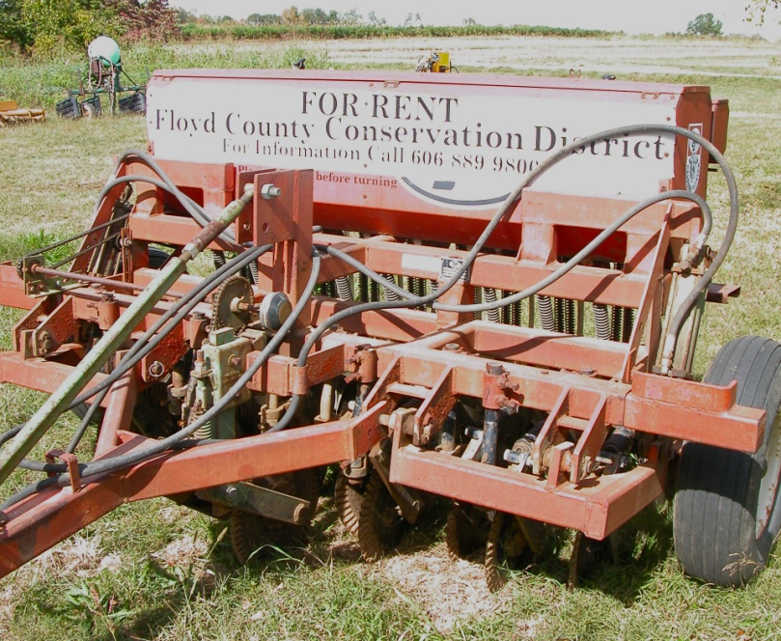
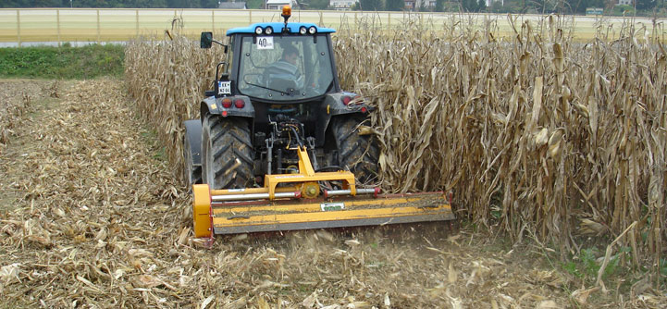
Managing Cover Crops
No-till Grain Drill
Flail Mower

Slide 19
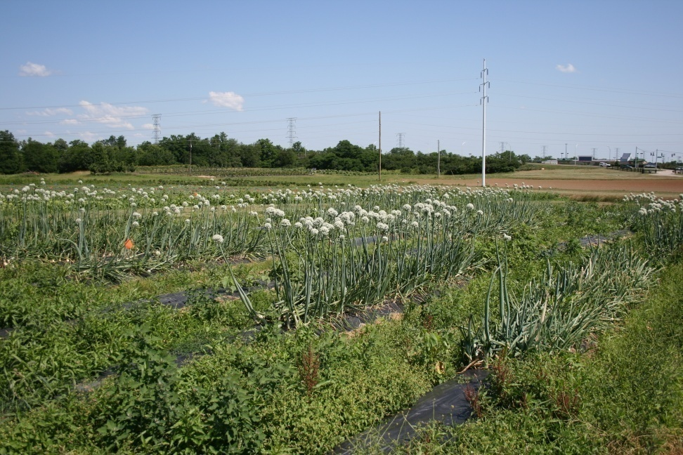
Additional Control Techniques
Stale seedbeds
Crop establishment
Placement of resources
Interseeding
Mowing

Slide 20
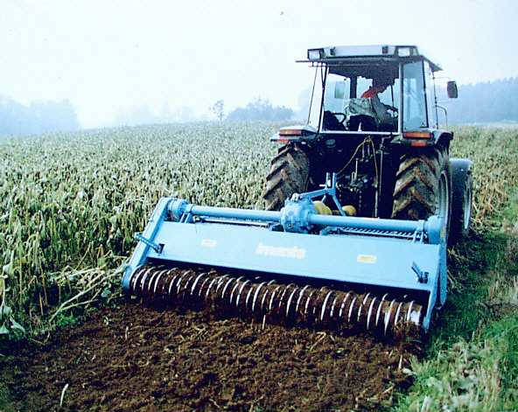
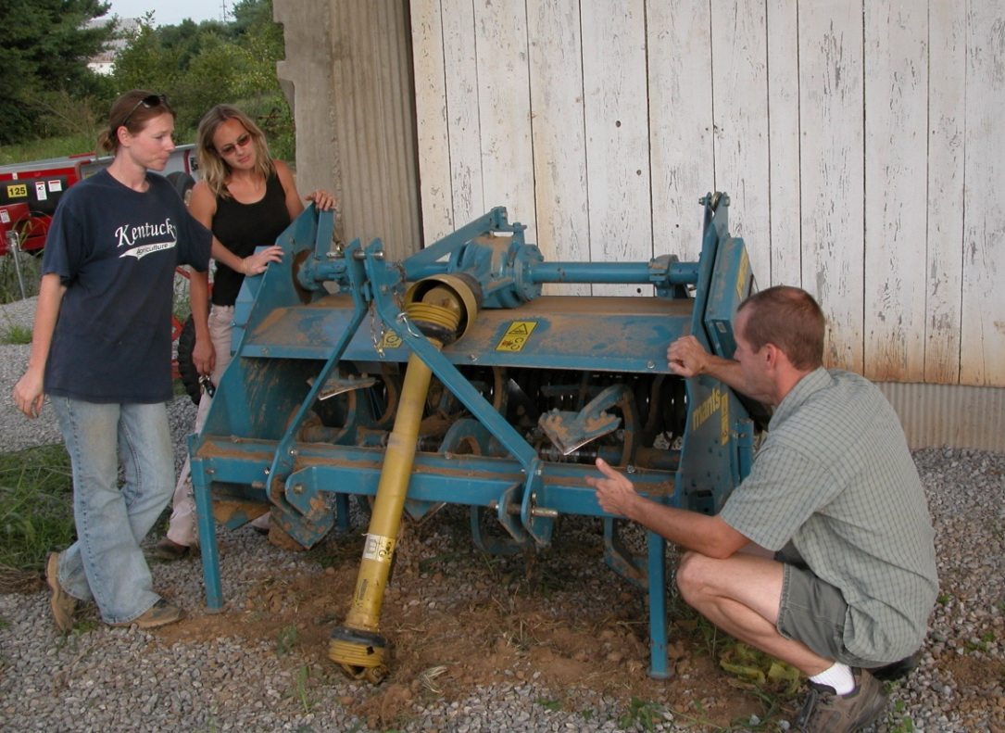
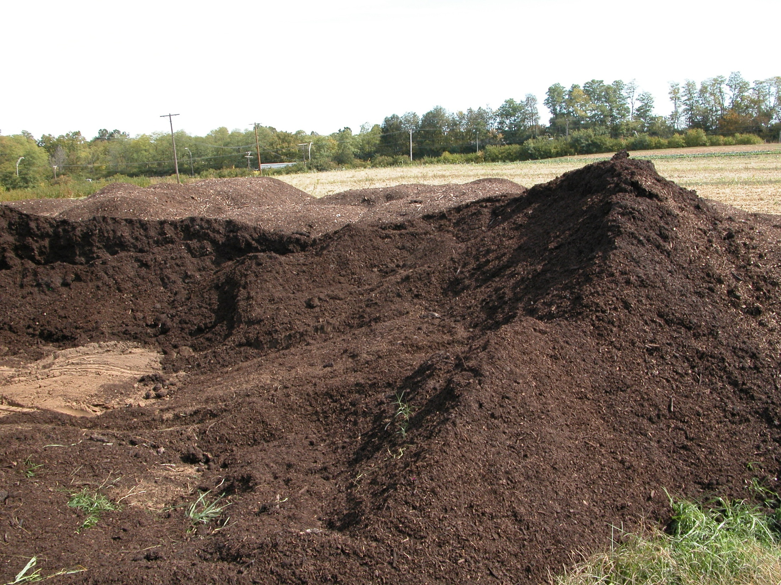
Primary Tillage
Imants Spader

Slide 21
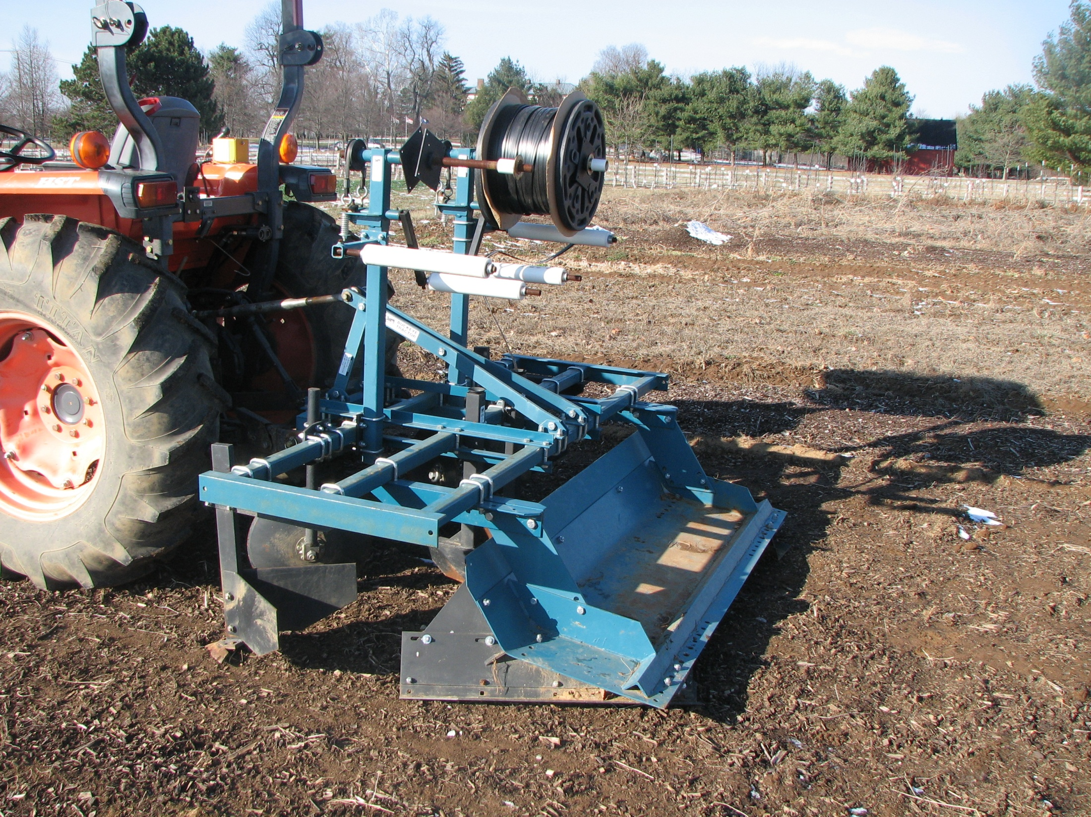
Buckeye Tractor Co. Bed Shaper

Slide 22
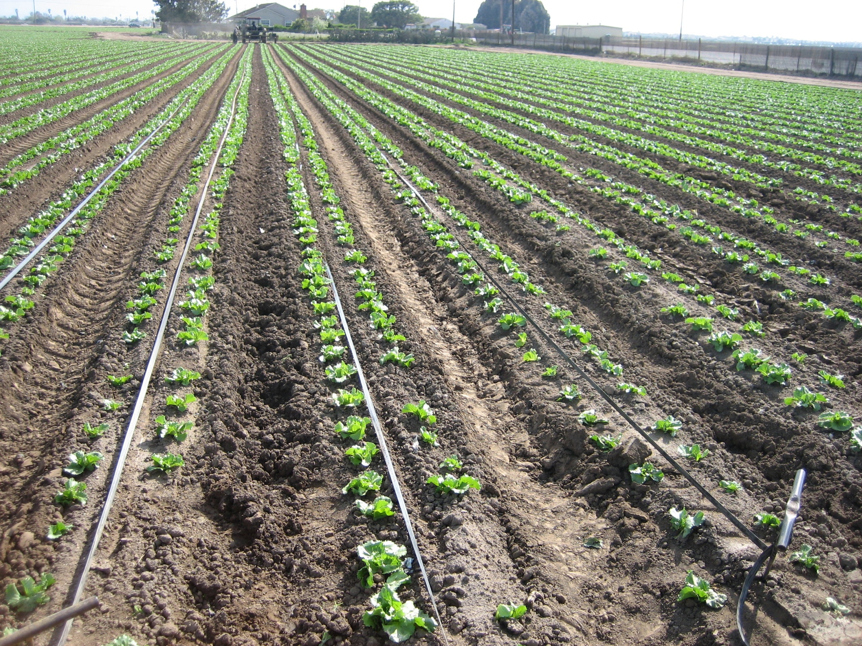

Slide 23
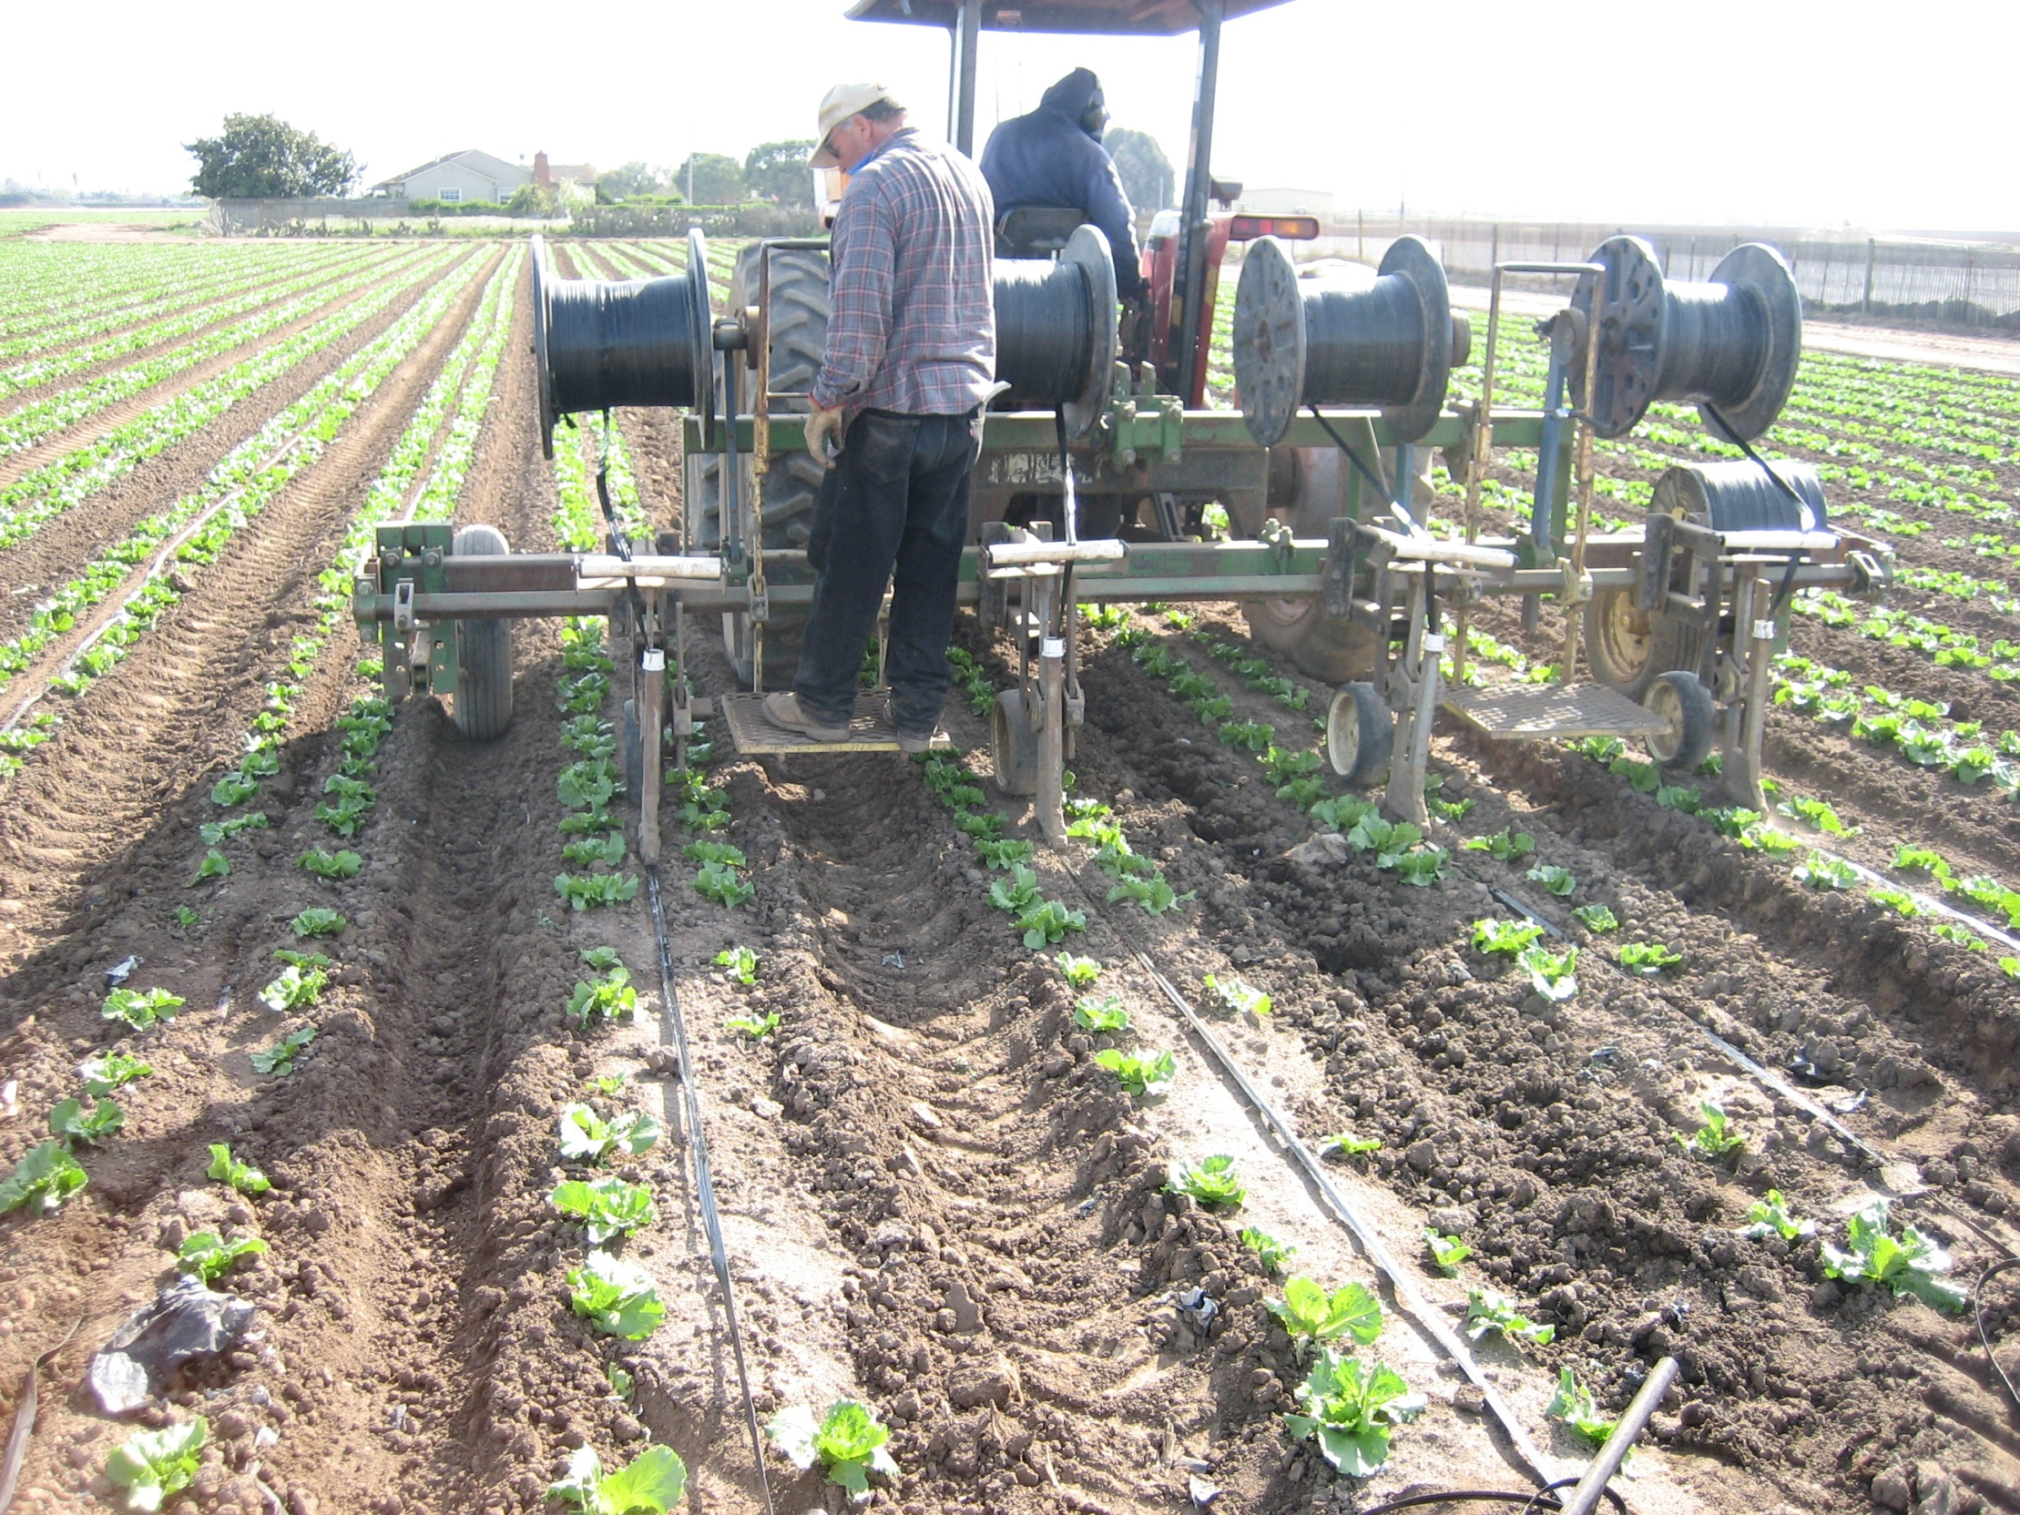
Salinas Valley, CA.

Slide 24
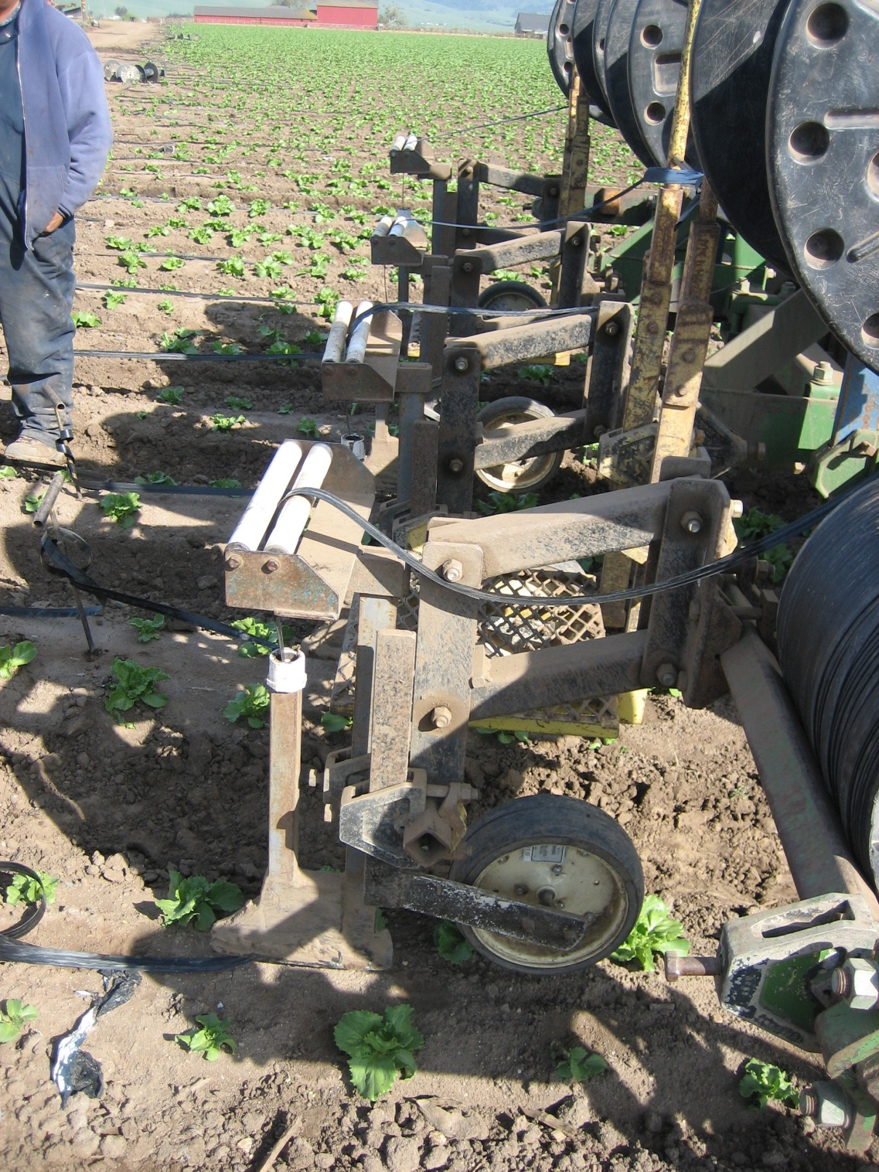

Slide 25
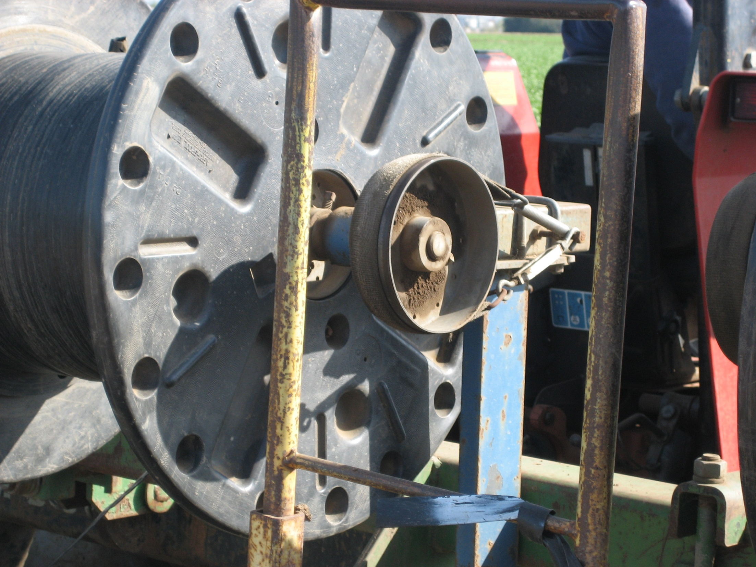

Slide 26
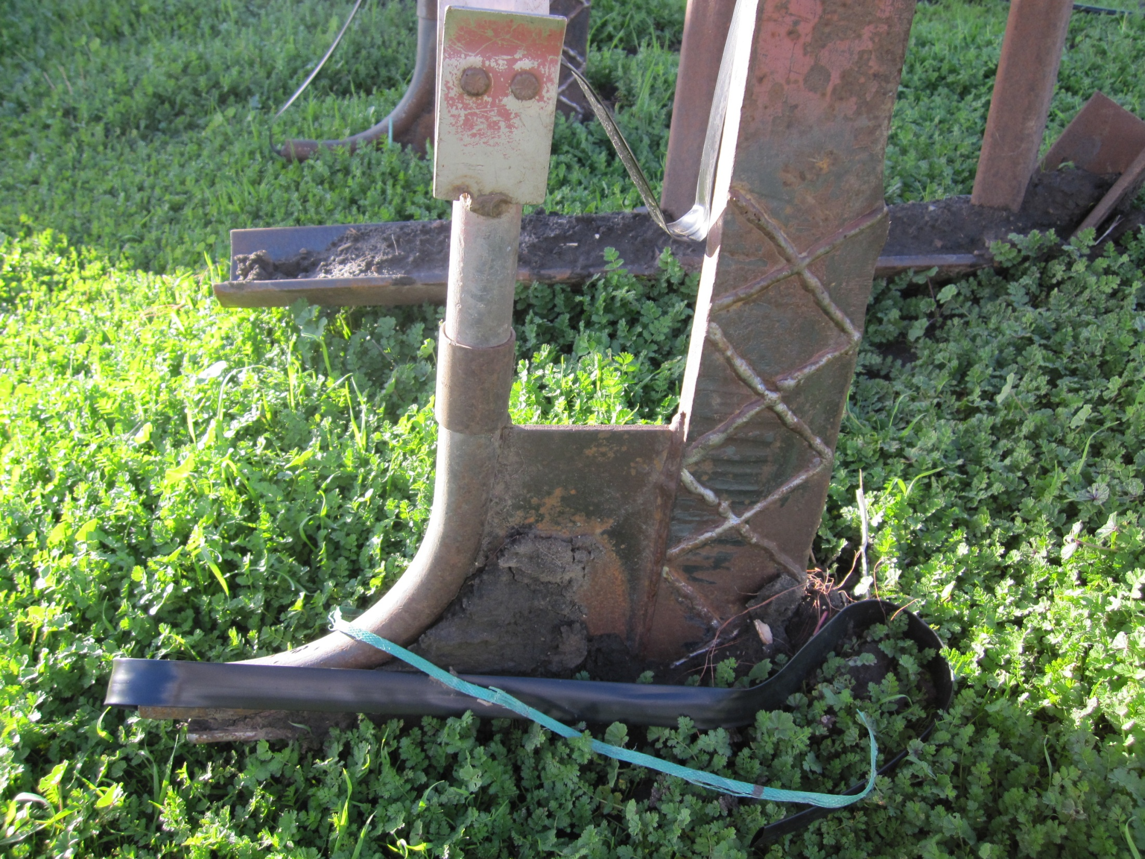
Pinnacle Organic, San Jose, CA.

Slide 27
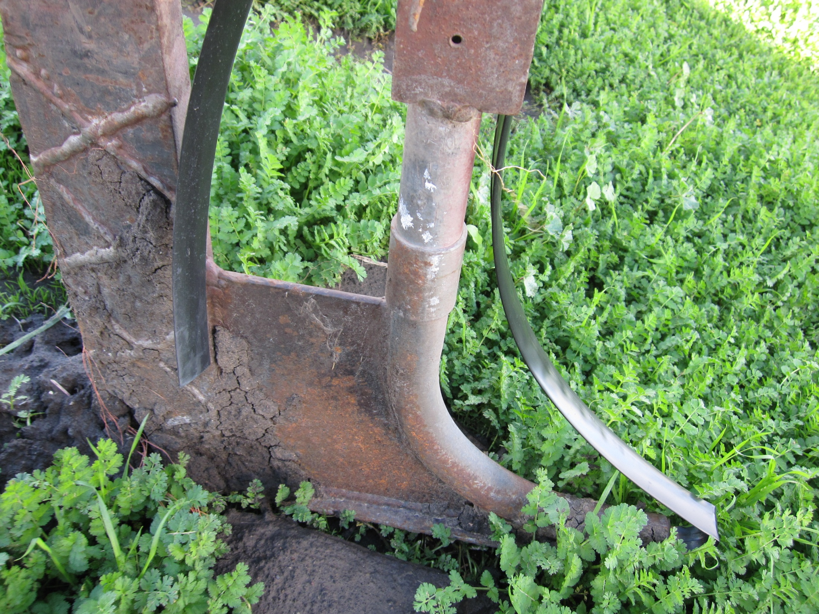

Slide 28
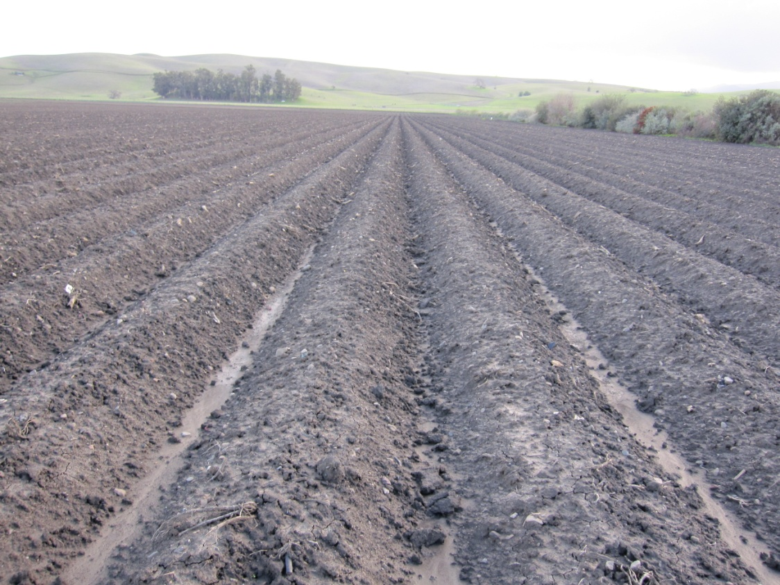
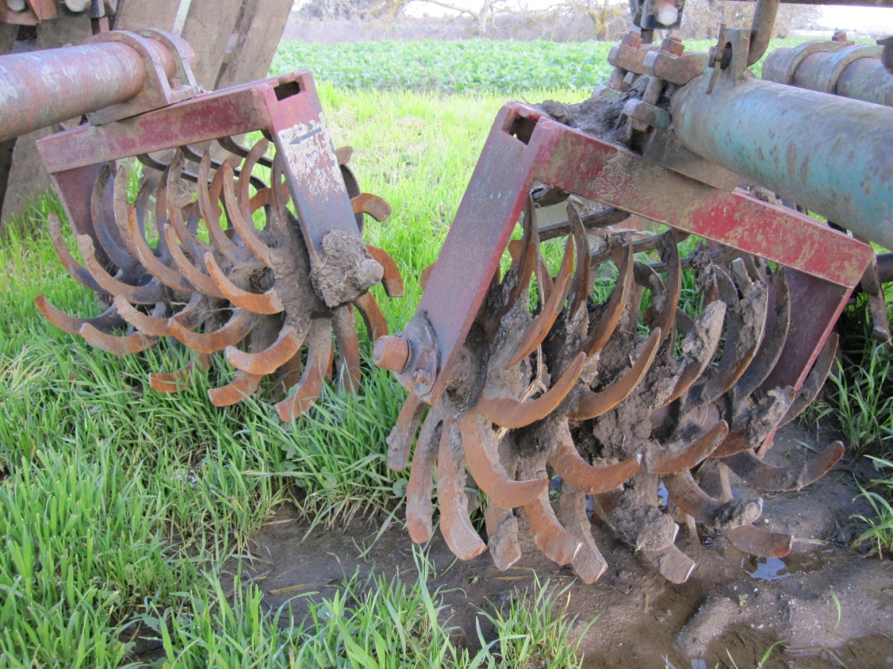
Stale Seed Bedding
Lilliston Rolling Cultivators – Pinnacle Organic, CA.

Slide 29
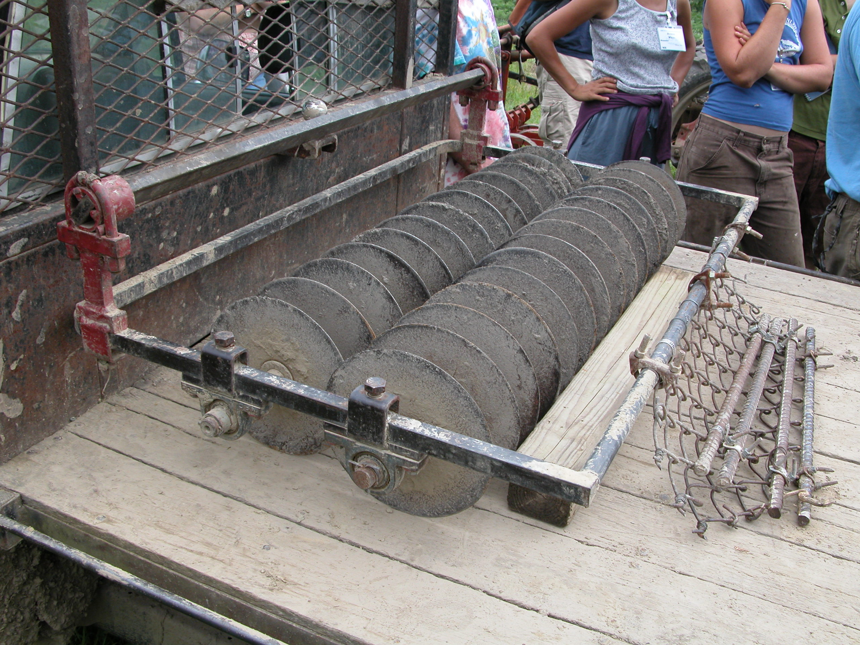
Food Bank Farm, Hadley, MA

Slide 30
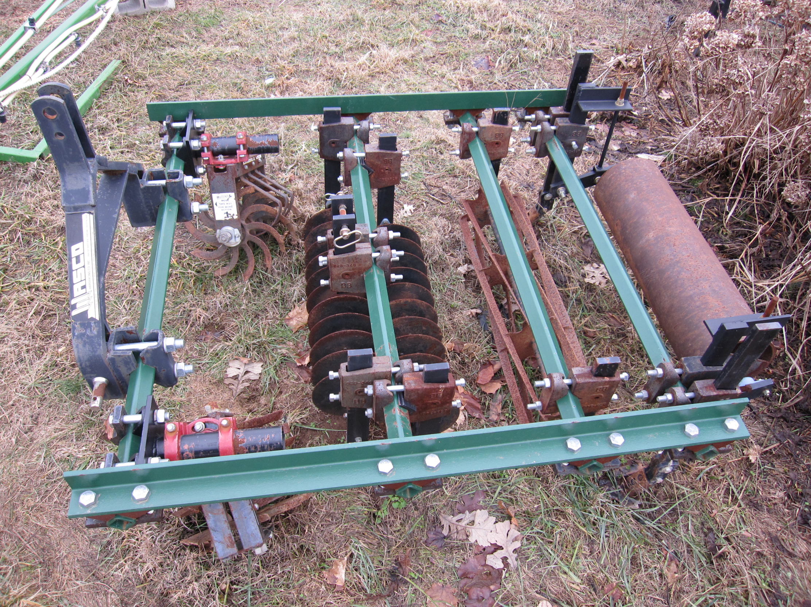

Slide 31
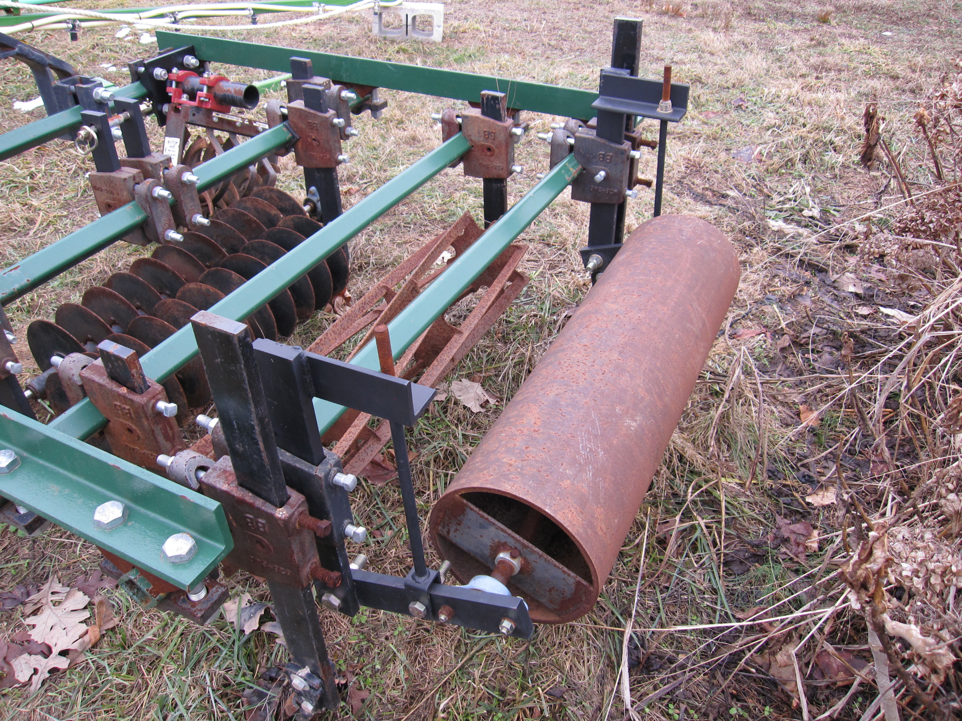

Slide 32
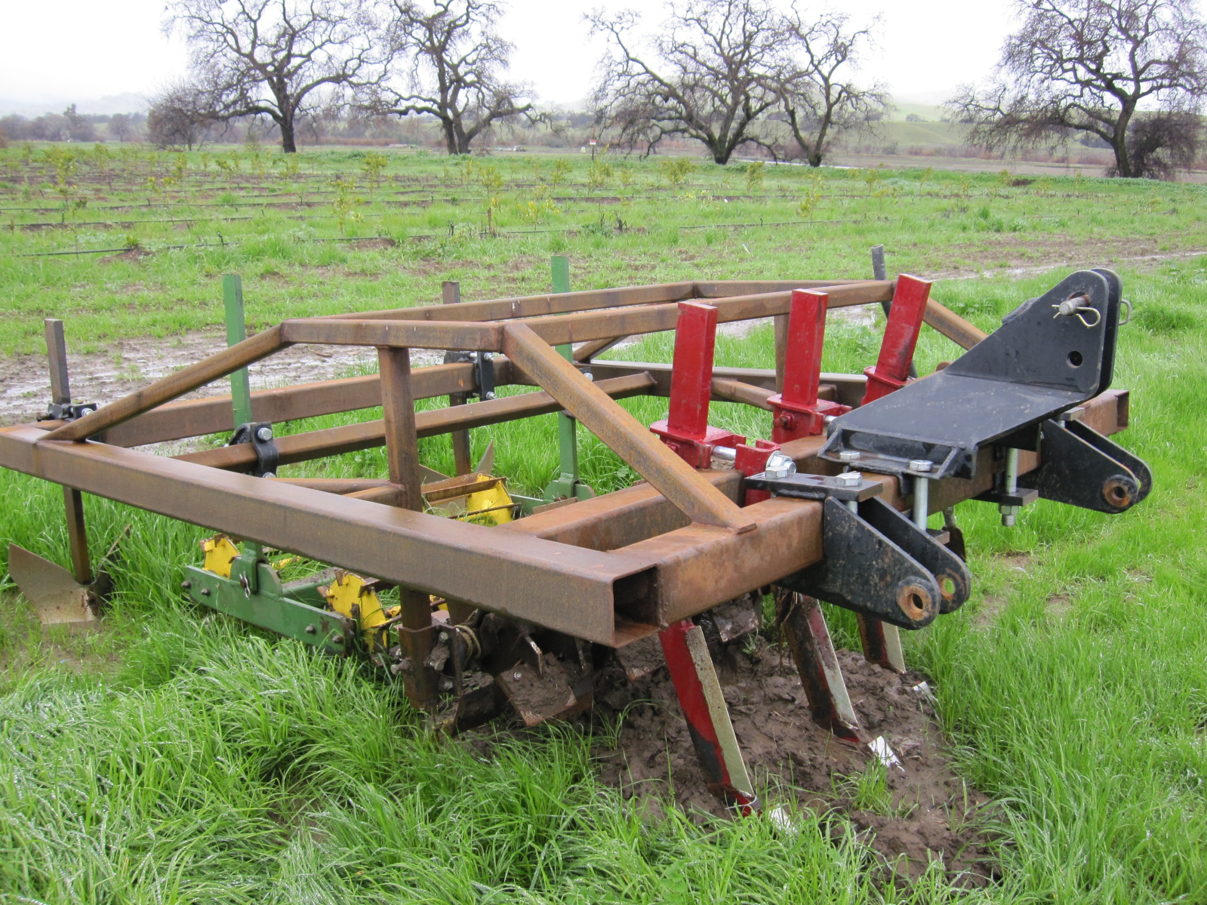
Capay Organic, Capay Valley, CA.

Slide 33
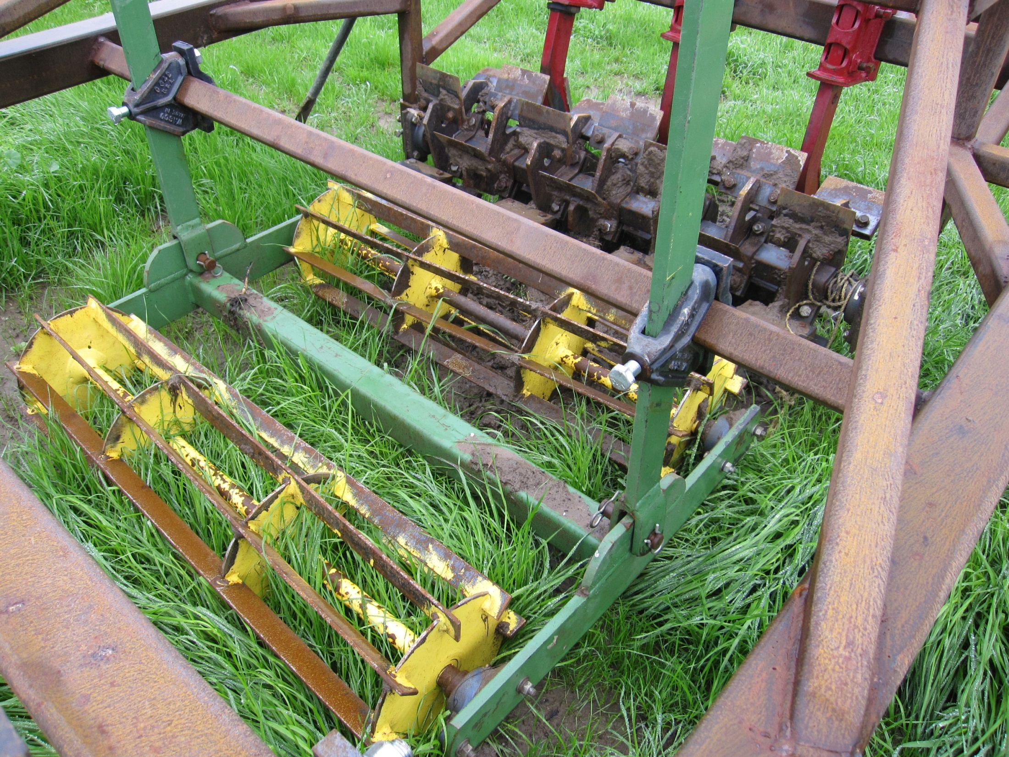

Slide 34
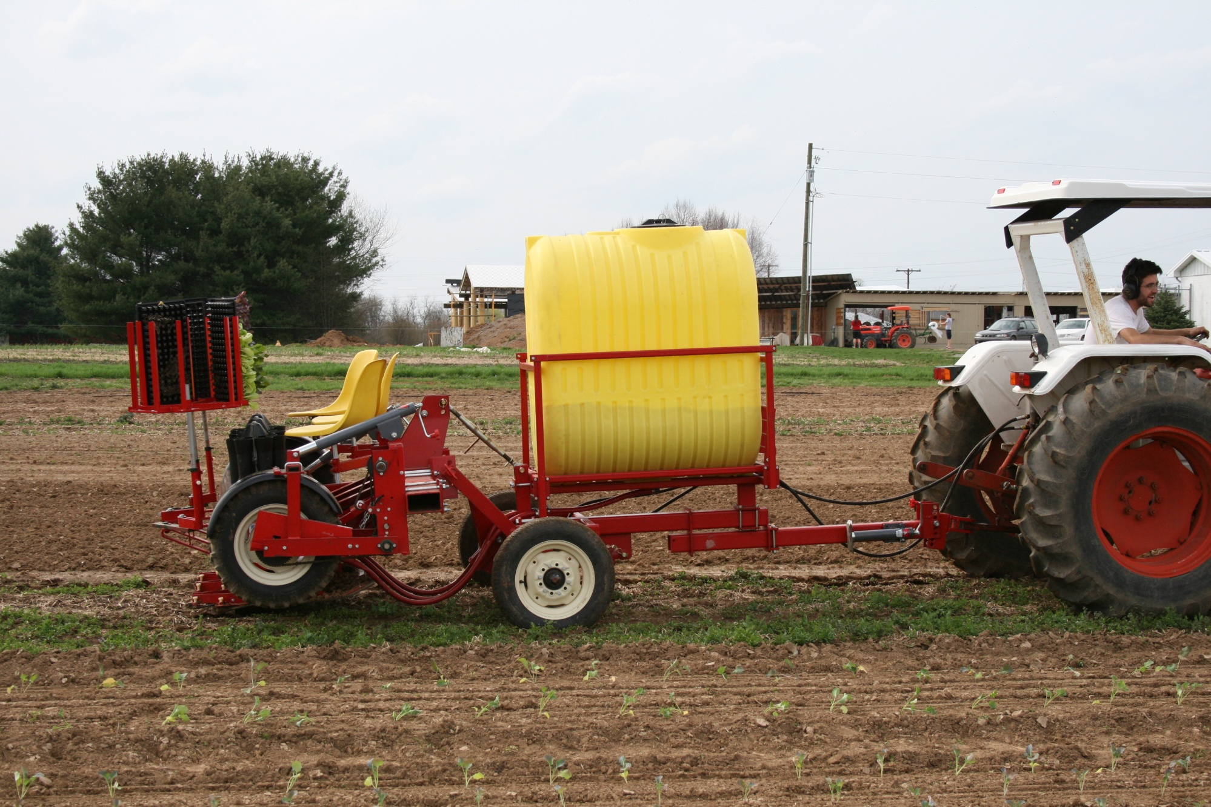
Machanical Transplanter Model 5000

Slide 35
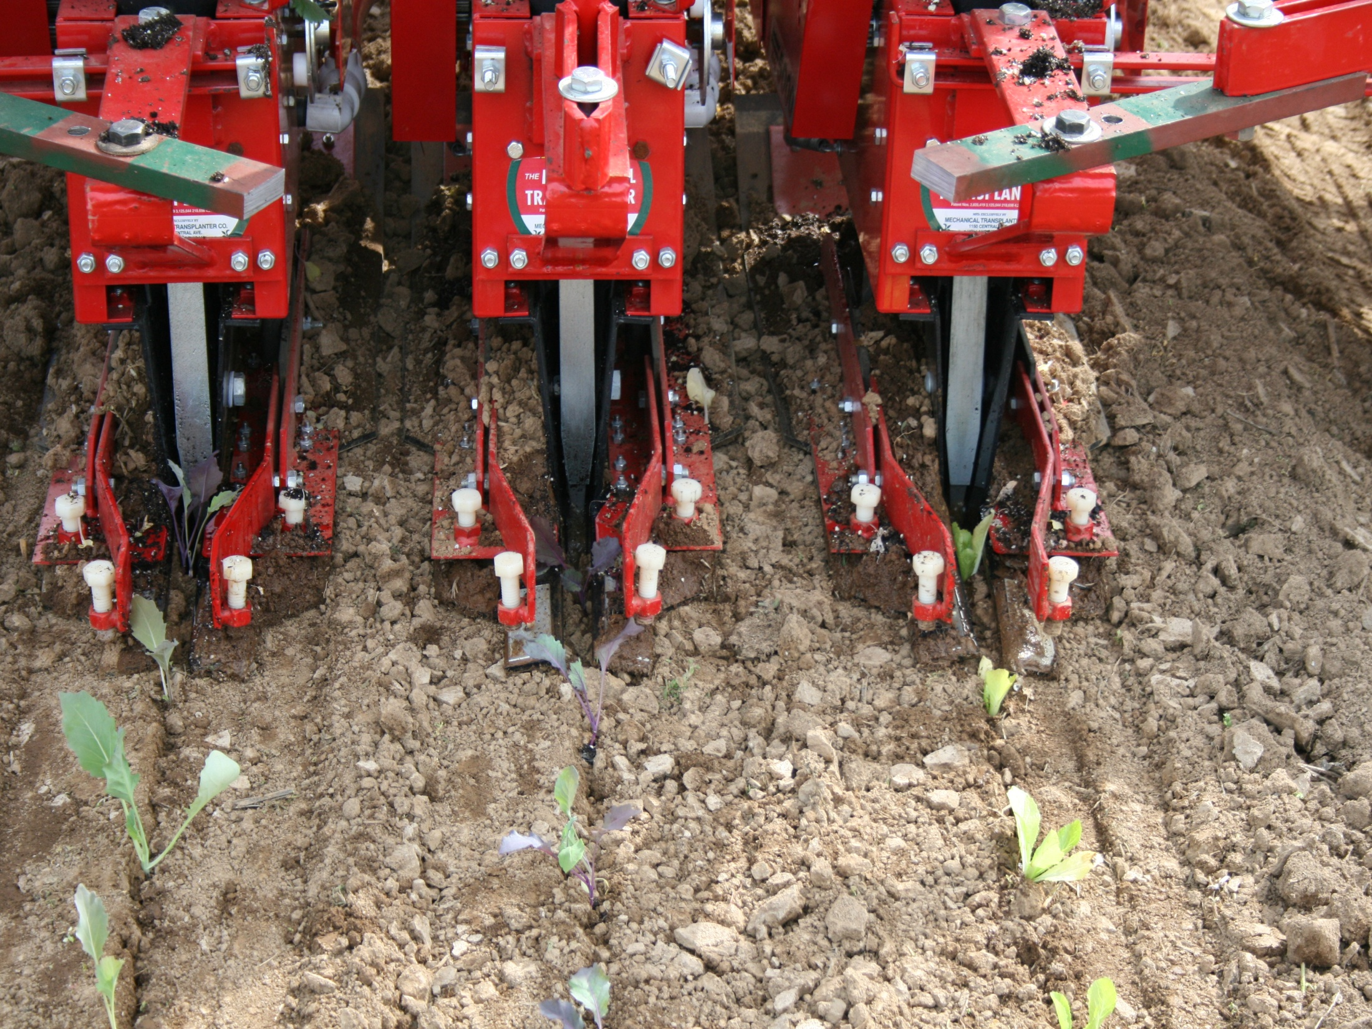
Straight rows are critical

Slide 36
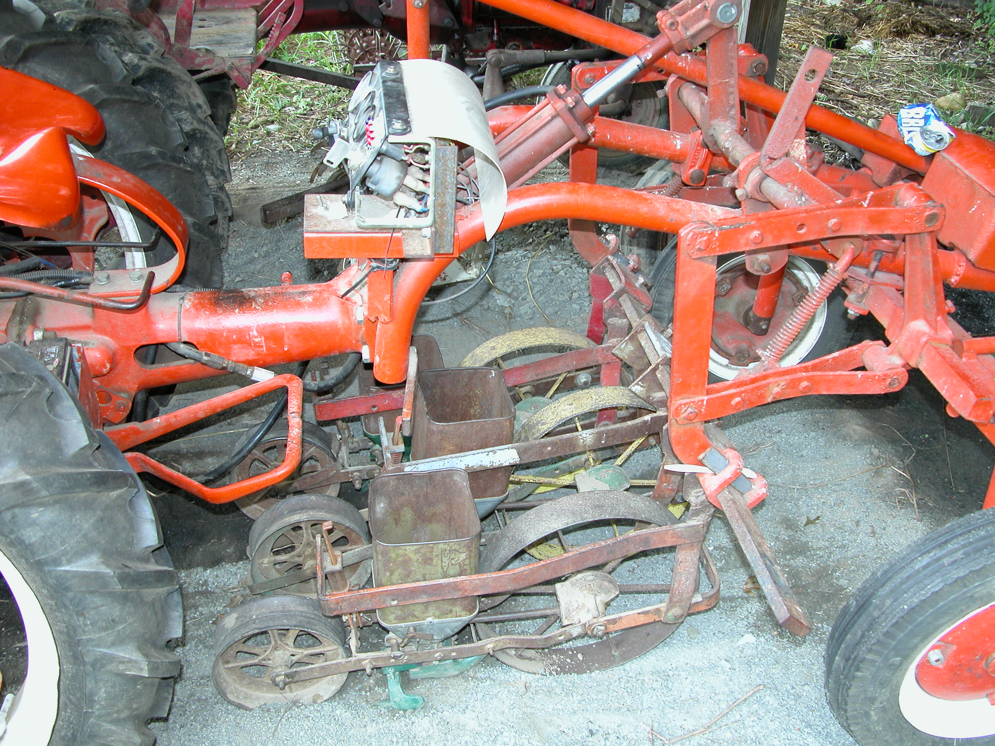
Amherst College, MA

Slide 37
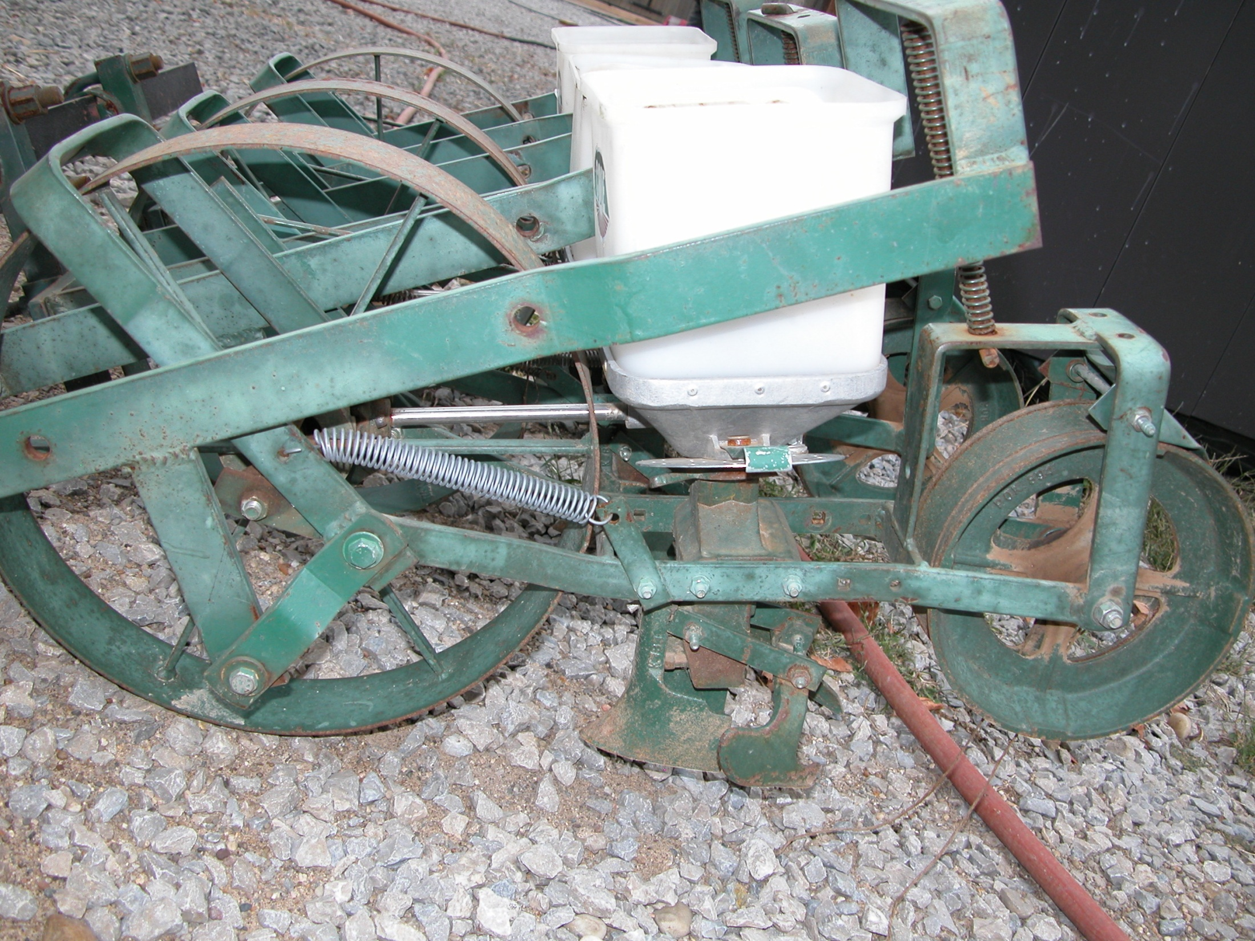
Cole Planter Junior seeder

Slide 38
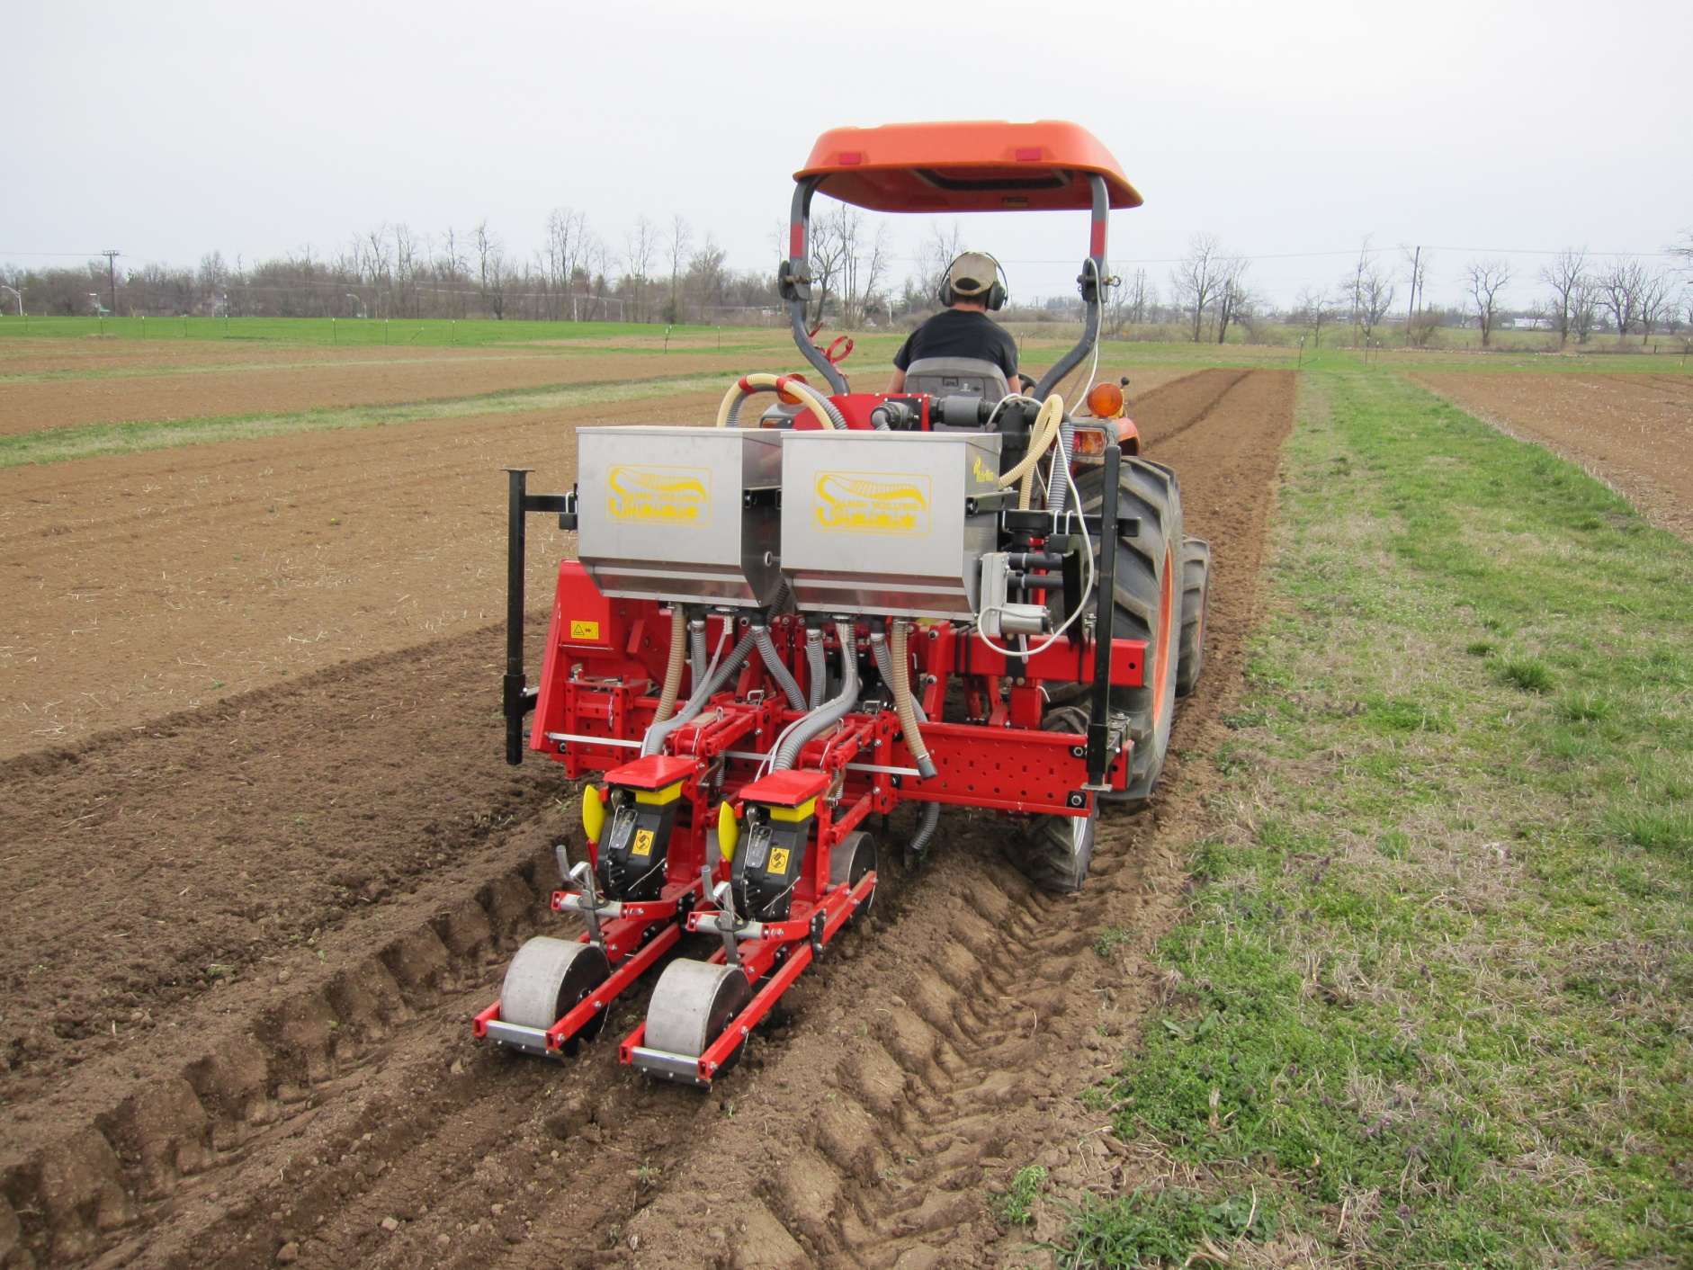
MaterMacc VeggieMacc seeder
Feed the crop, not the weeds

Slide 39
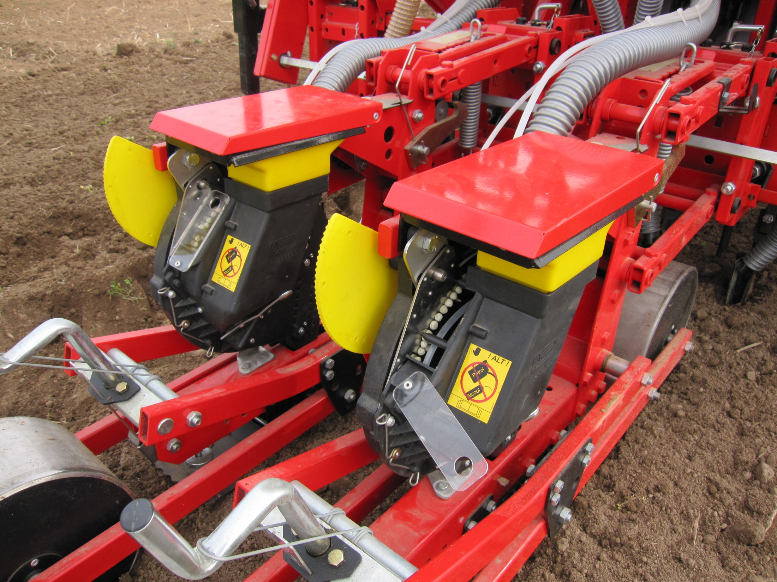

Slide 40
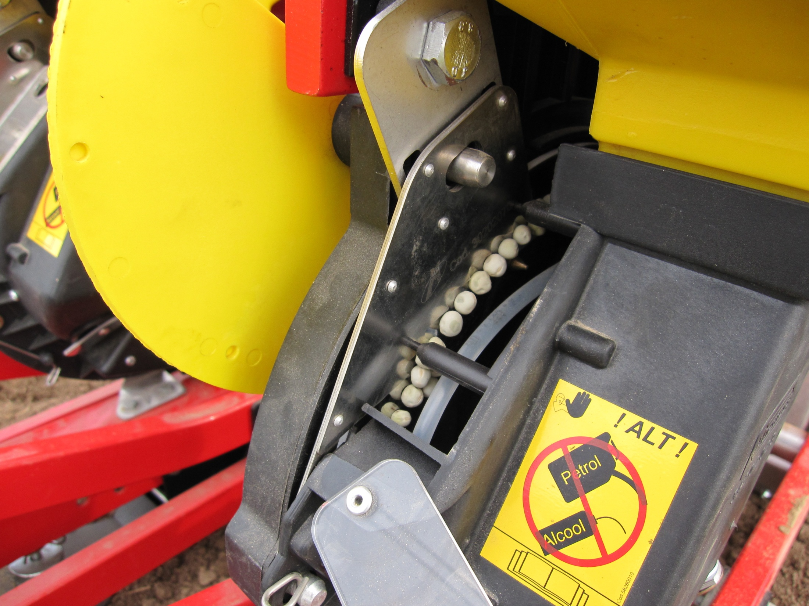

Slide 41
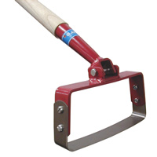
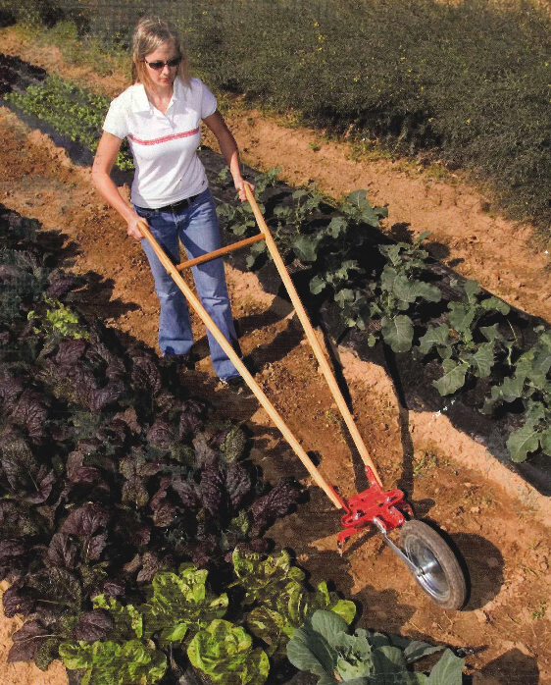
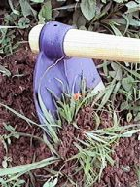
Weed Control Through Hand Cultivation
Glaser Scuffle Hoe
Grubbing Hoe
Glaser Wheel Hoe

Slide 42
Weed Control Through Mechanical Cultivation
Equipment for preemergence cultivation (blind cultivation) (flex-tine weeders, rotary hoes)
Equipment for postemergence cultivation (basket weeders, finger weeders, rolling cultivators, sweeps, flamers)
Cultivation tools vary in aggressiveness and can cultivate between rows or within rows
Cultivation implements may dislodge, cut or bury plants
Matching the tool to the crop, the weed and the soil condition is key. Versatility is important
Proper timing of cultivation is critical (get weeds when they are small), setup for speed

Slide 43
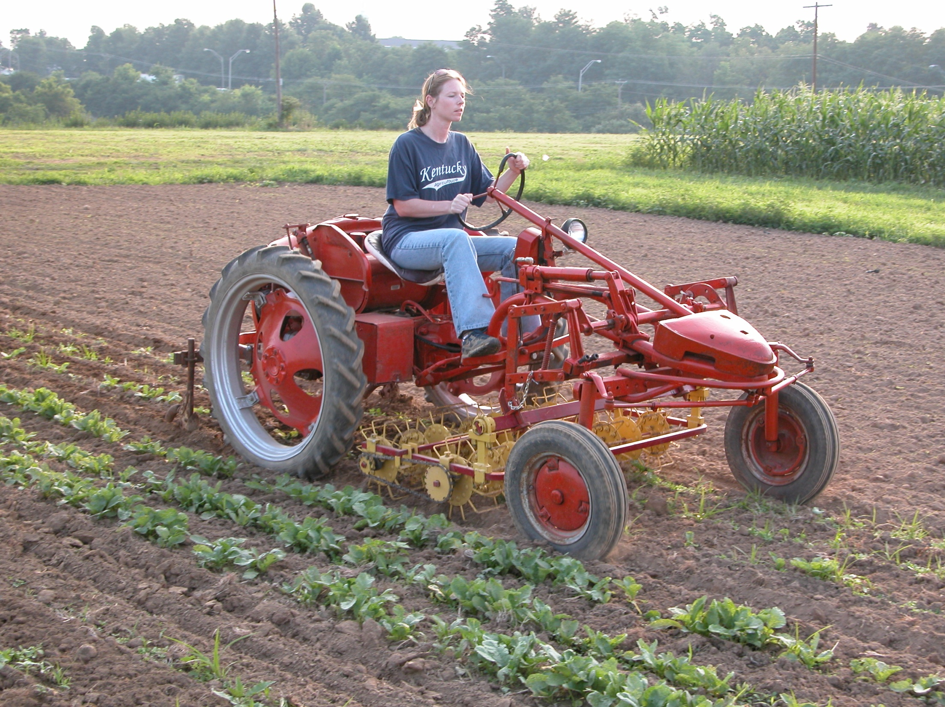

Slide 44
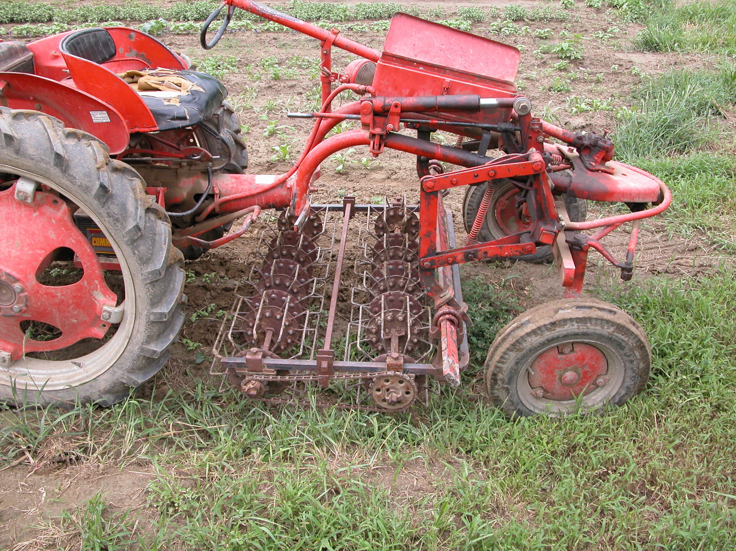
Food Bank Farm, Hadley, MA

Slide 45
Full Belly Farm, Capay Valley, CA.

Slide 49
Bezzerides Spring Hoes
Side Knives
Combinations of tools maximizes efficiency

Slide 52
Cultivation for Plasticulture Systems

Slide 53
Plastic Cultivator

Slide 55
Orchard Cultivation: Matching the Tool to the Job
Weed Badger

Slide 58
Good Weed Management -
It’s All About the System

Slide 59
Bacterial Wilt in Cucurbits is caused by Erwinia tracheiphila, which is vectored by Cucumber Beetles
Spotted Cucumber Beetle
Striped Cucumber Beetle

Slide 60
2009 USDA OREI Grant: Sustainable Systems for
Cucurbit Production on Organic Farms

Slide 62
Mechanical Transplanter Co. Hoop Layer

Slide 63
Brown Marmorated Stink Bug
Halyomorpha halys

Slide 64
Pinnacle Organic, CA

