Slide 1
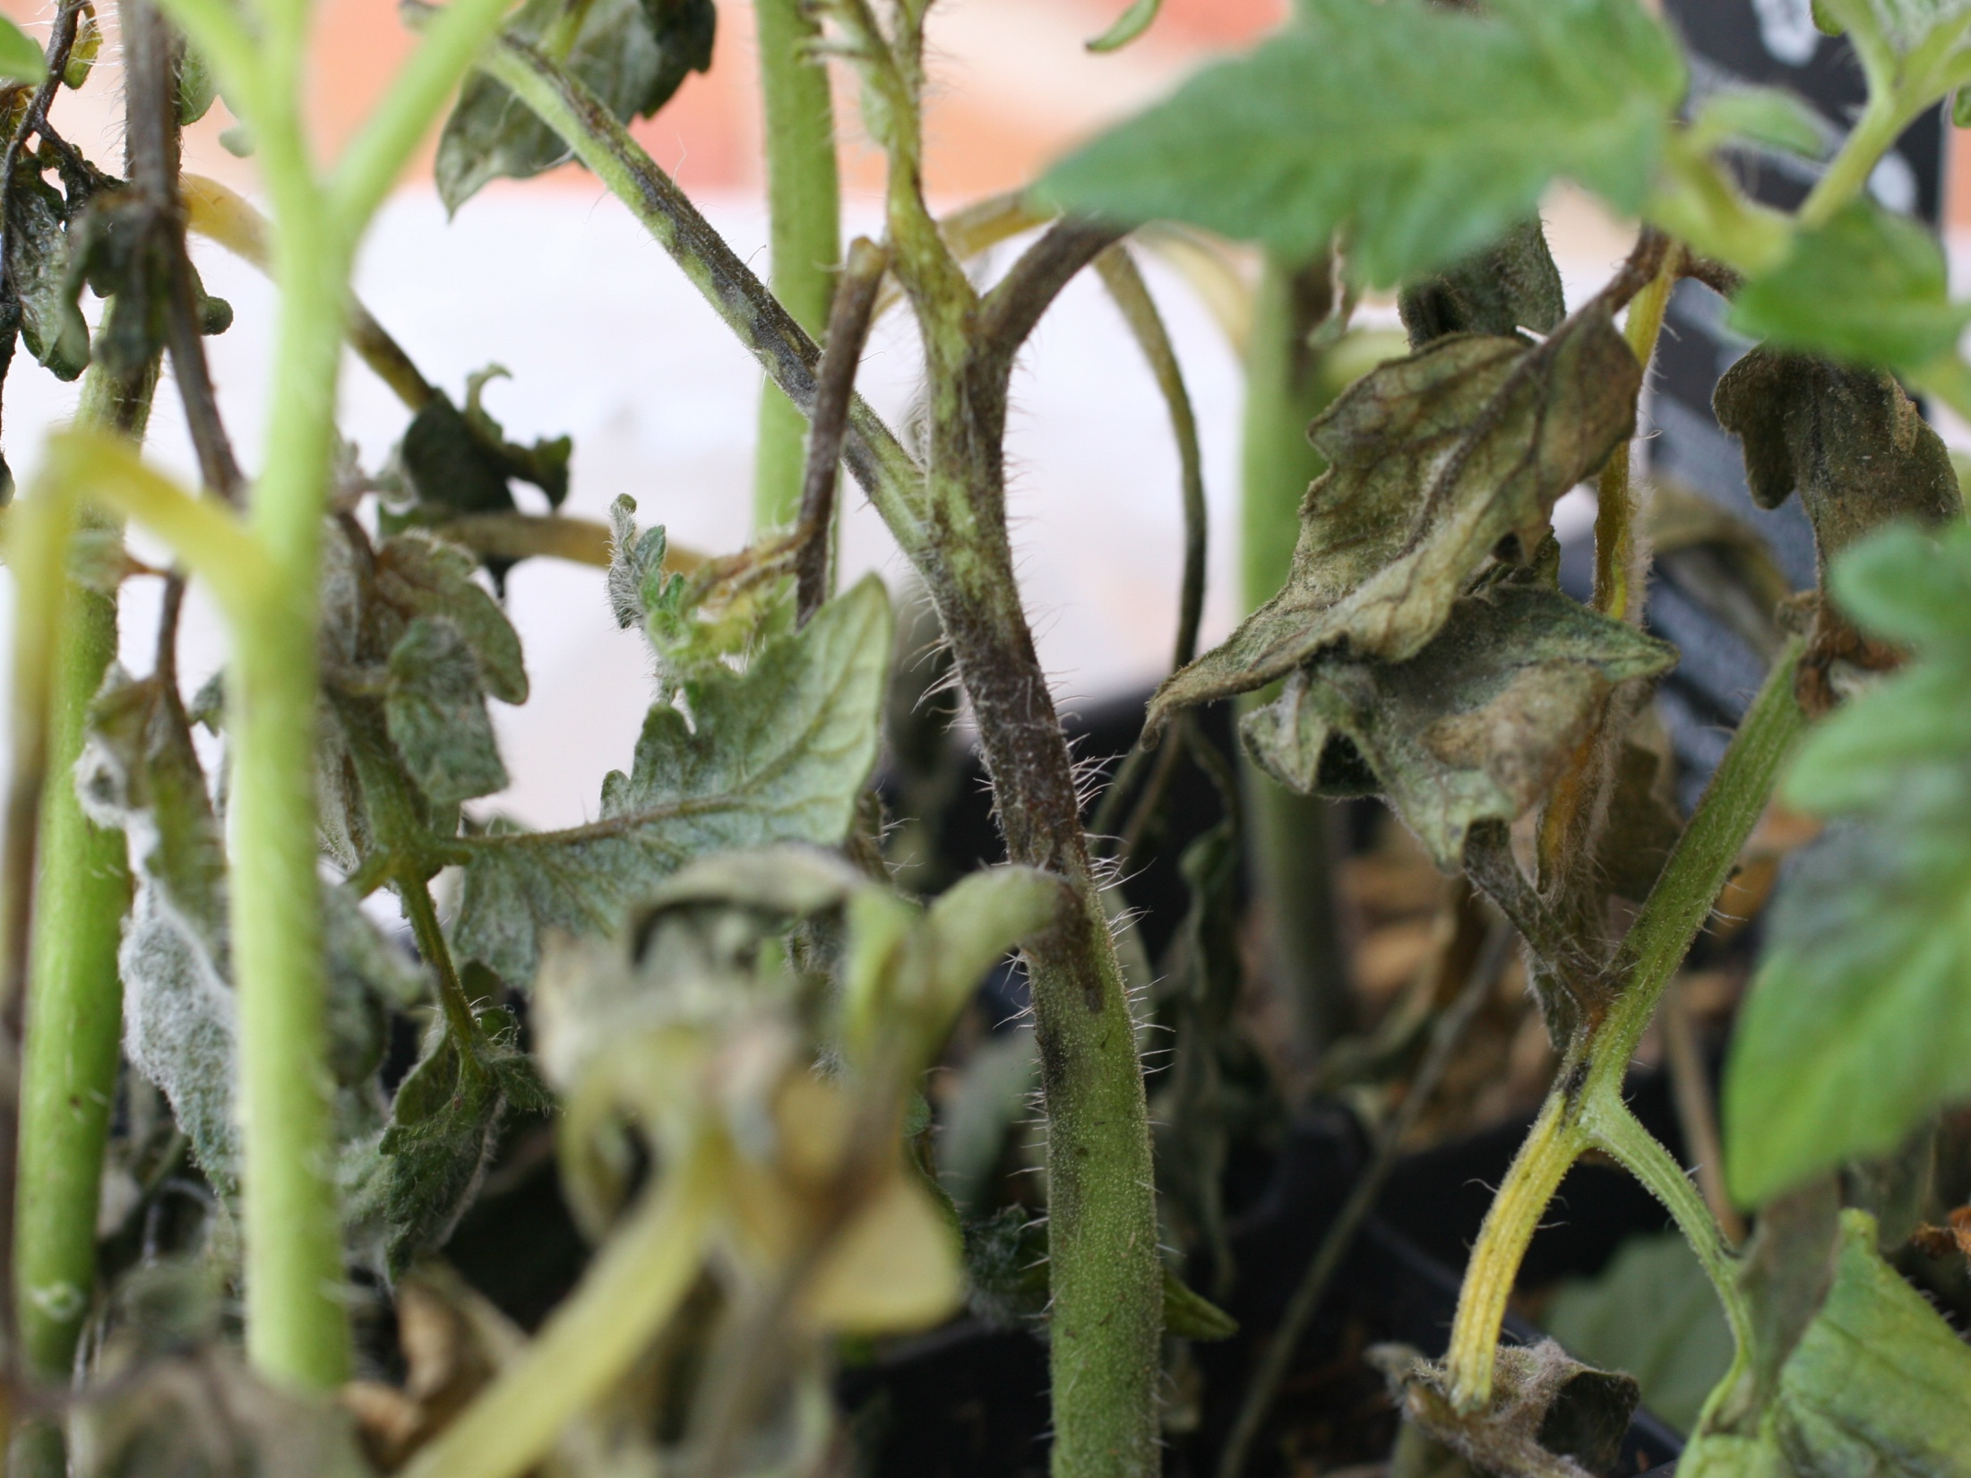

Vegetable Disease ID 2011 Training, South Farm - Lexington
Kenny Seebold
Plant Pathology Department

Slide 2
Common Cucurbit Diseases

Slide 3
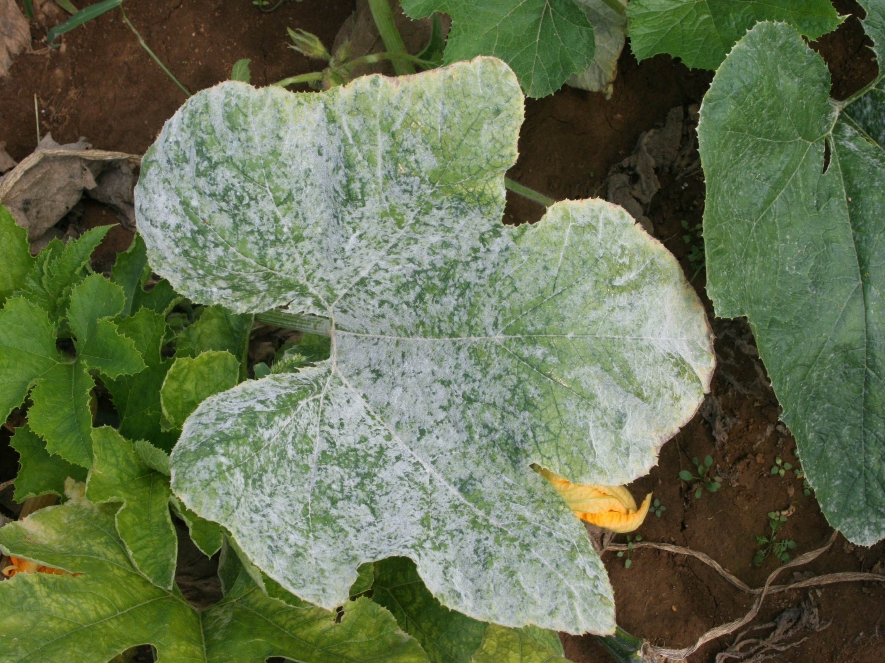
Powdery Mildew Pumpkin

Slide 4
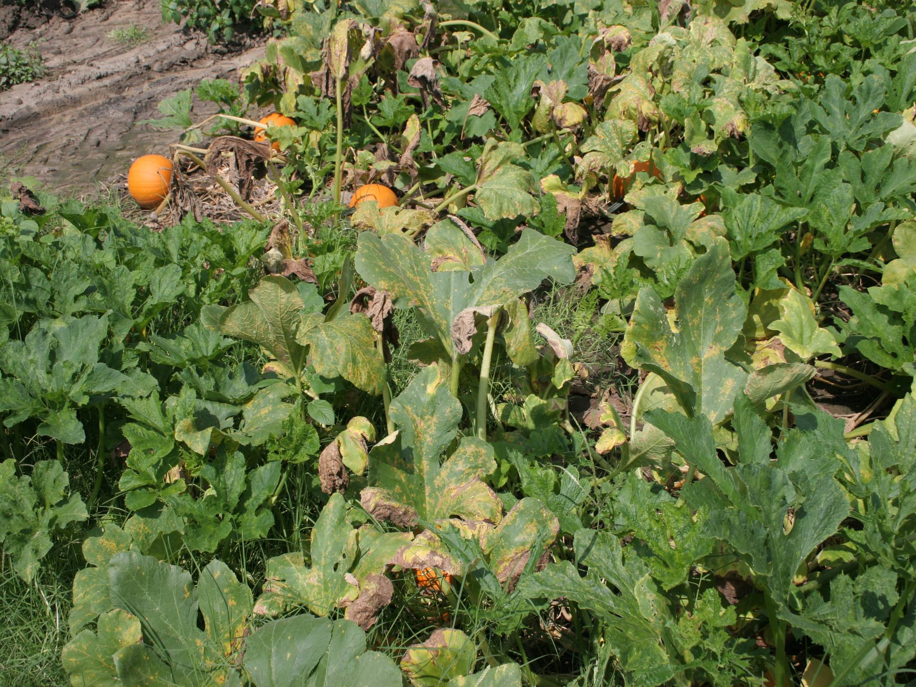
Downy Mildew Pumpkin

Slide 5
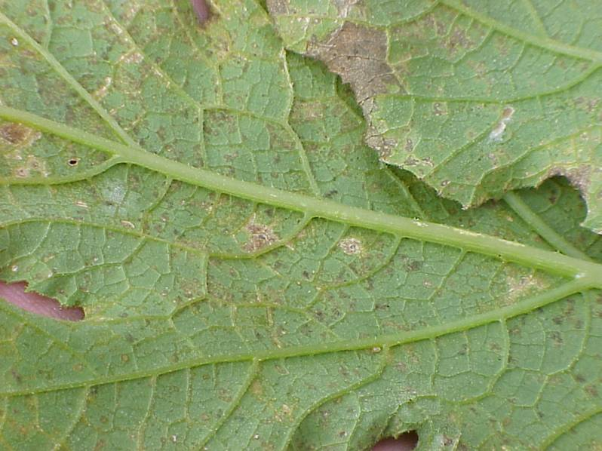
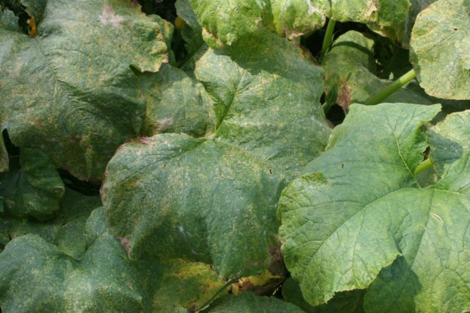
DM on pumpkin

Slide 6
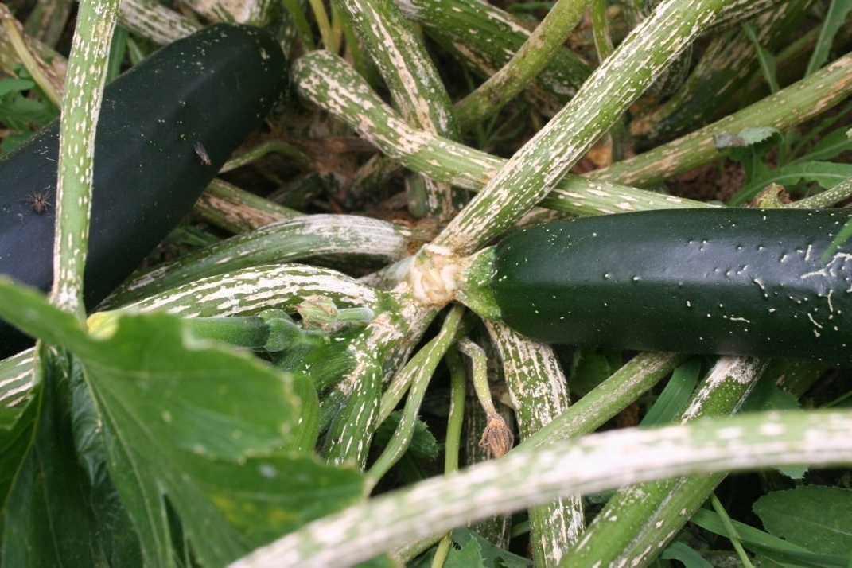
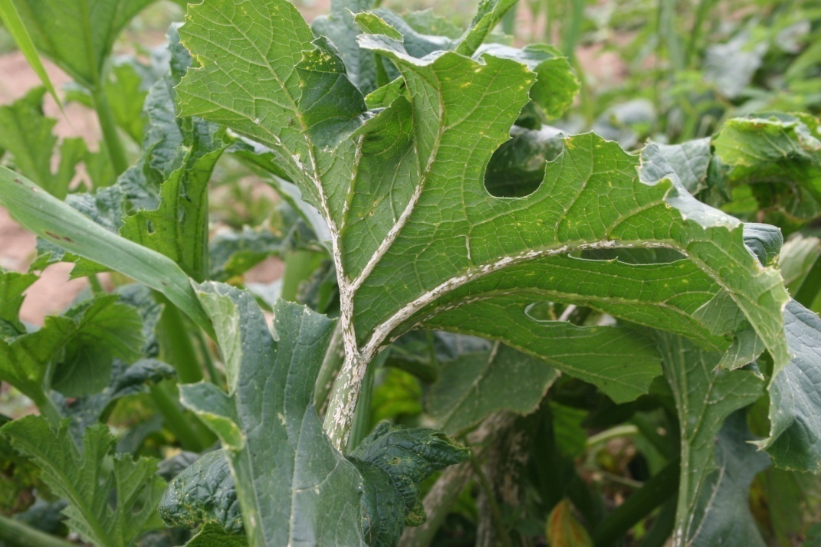
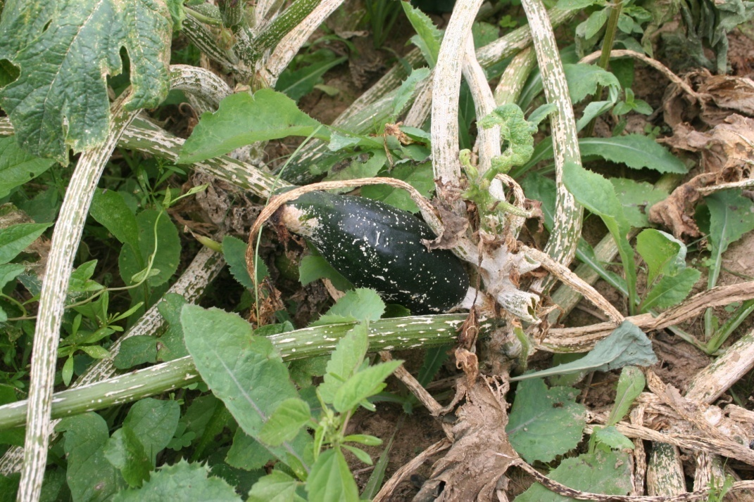
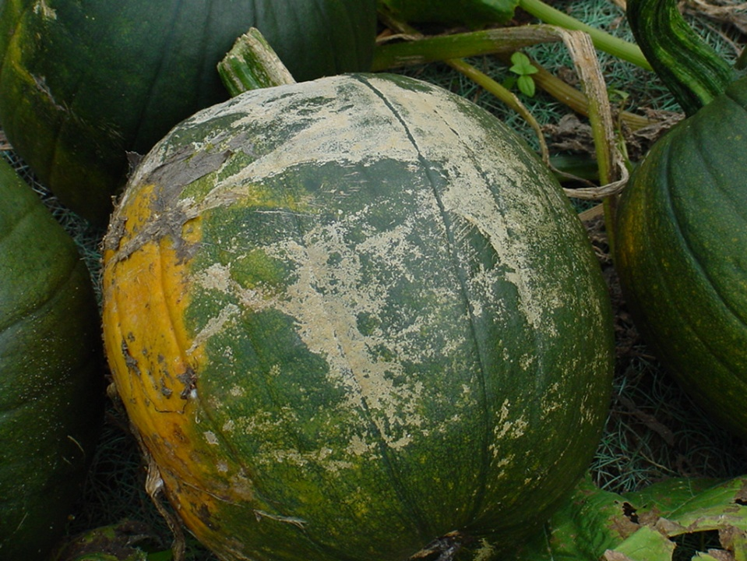
Plectosporium Blight
Zucchini
Pumpkin

Slide 7
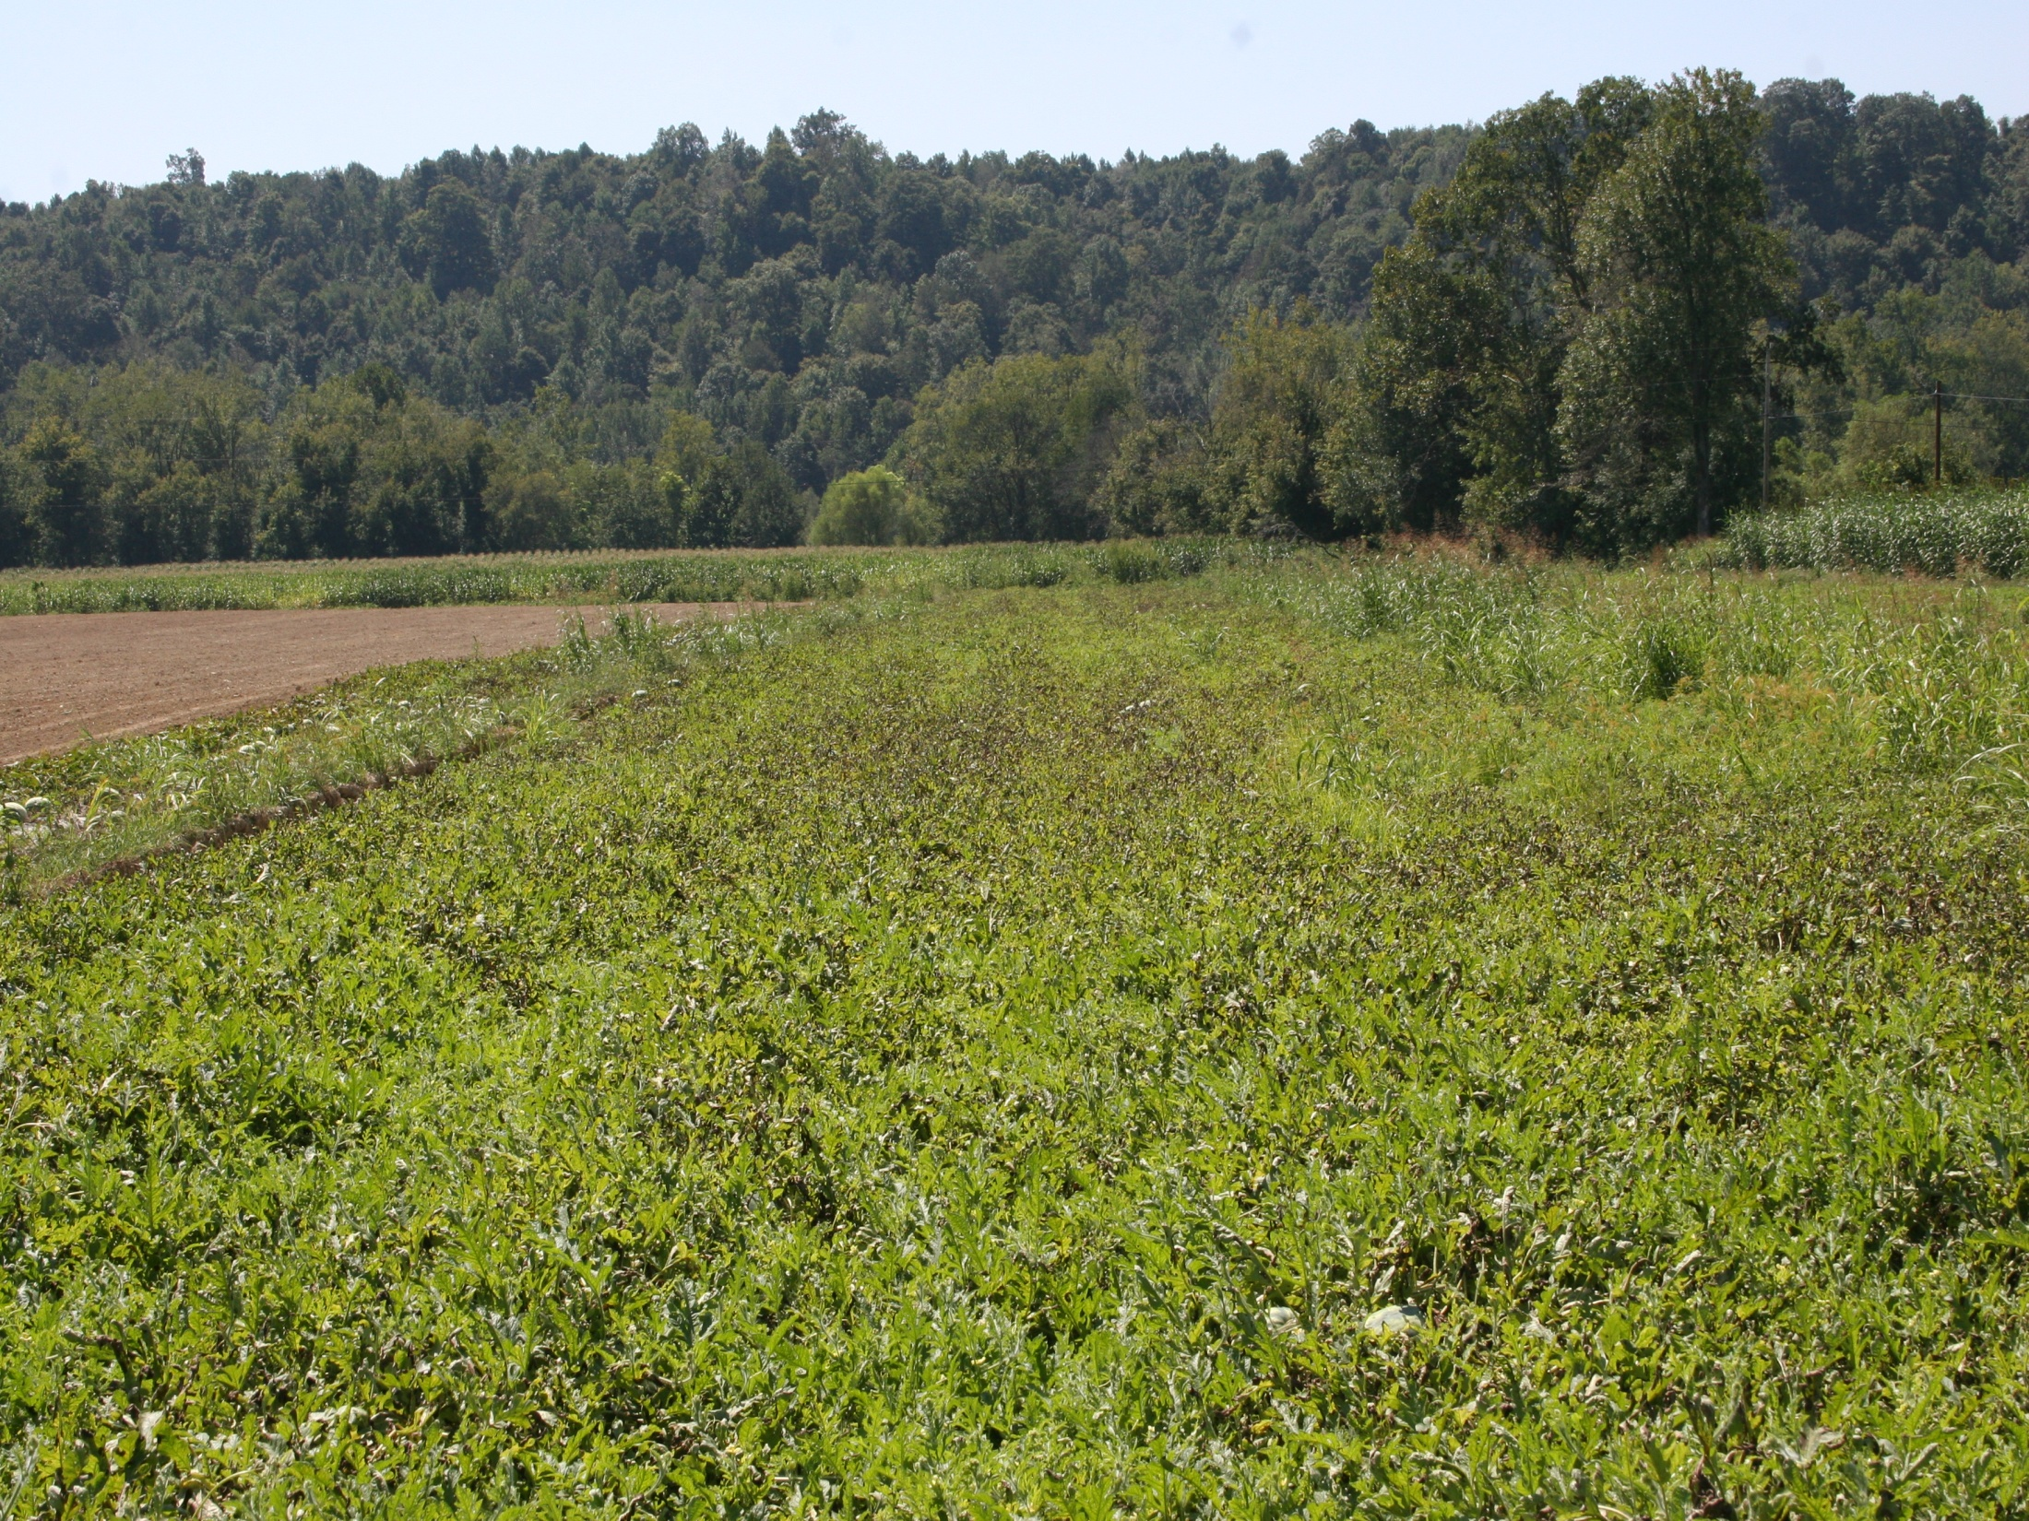
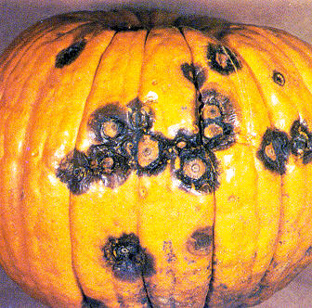
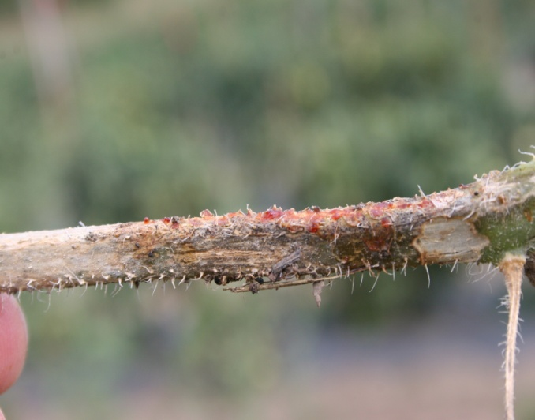
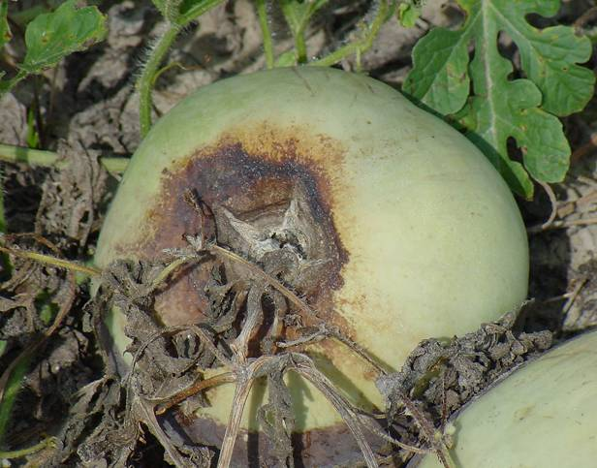
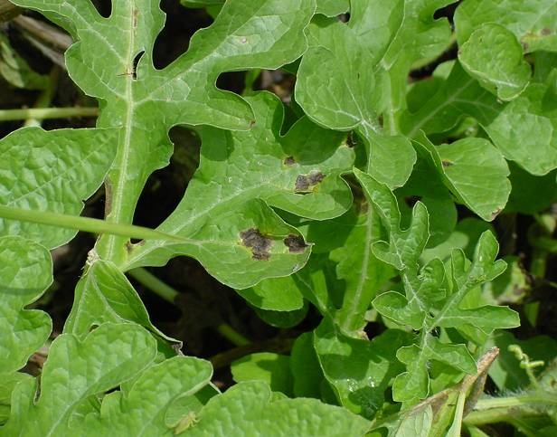
Gummy Stem Blight Watermelons, Melons, Pumpkins

Slide 8
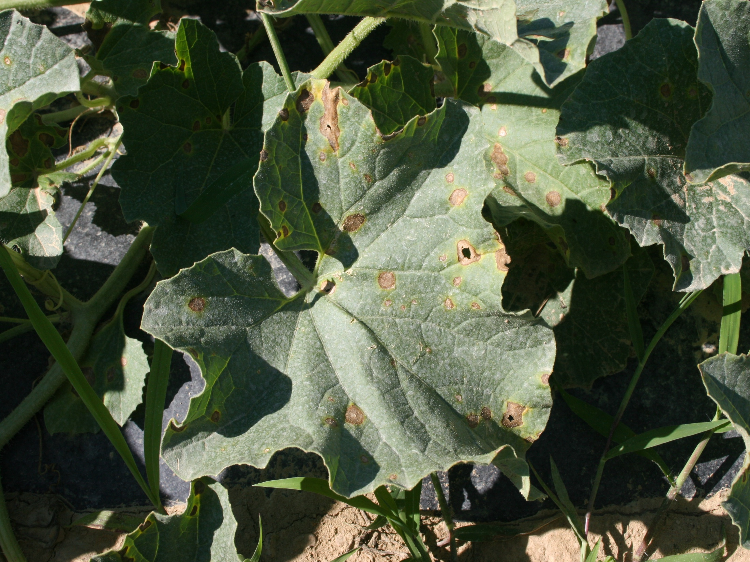
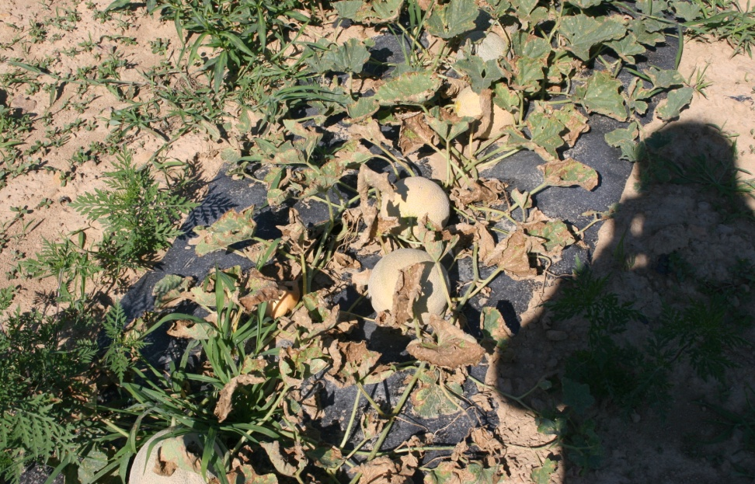
Alternaria Leaf Blight
Cantaloupe is particularly susceptible
Watermelon
Melon
Pumpkin
Cucumber
Gourds
Squash

Slide 9
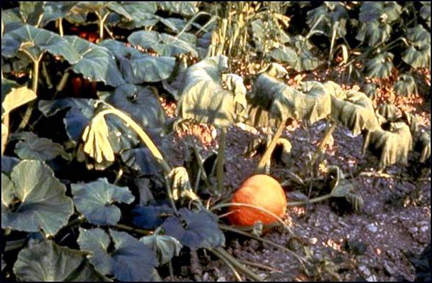
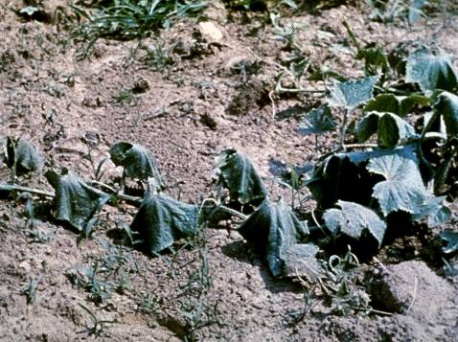
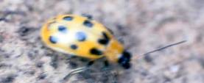
Bacterial Wilt of Cucurbits
Affects cucumber, melon primarily
& may affect pumpkins, gourds
EARLY control of cucumber beetle is
critical factor for management

Slide 10
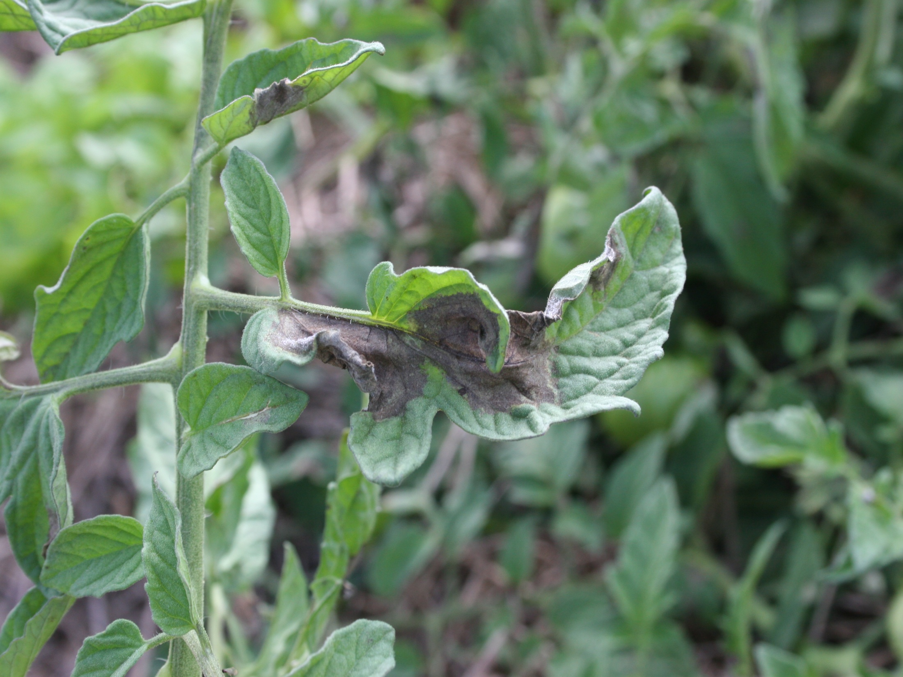
Disease Control for Tomatoes

Slide 11
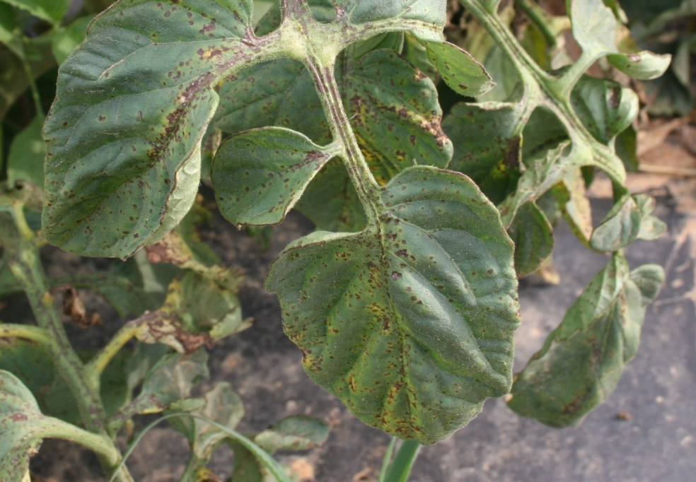
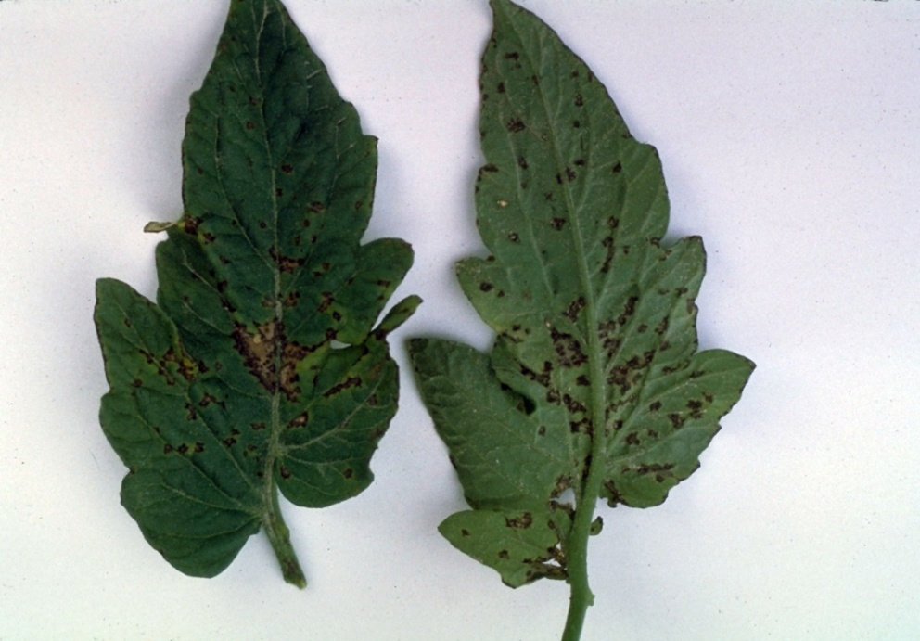
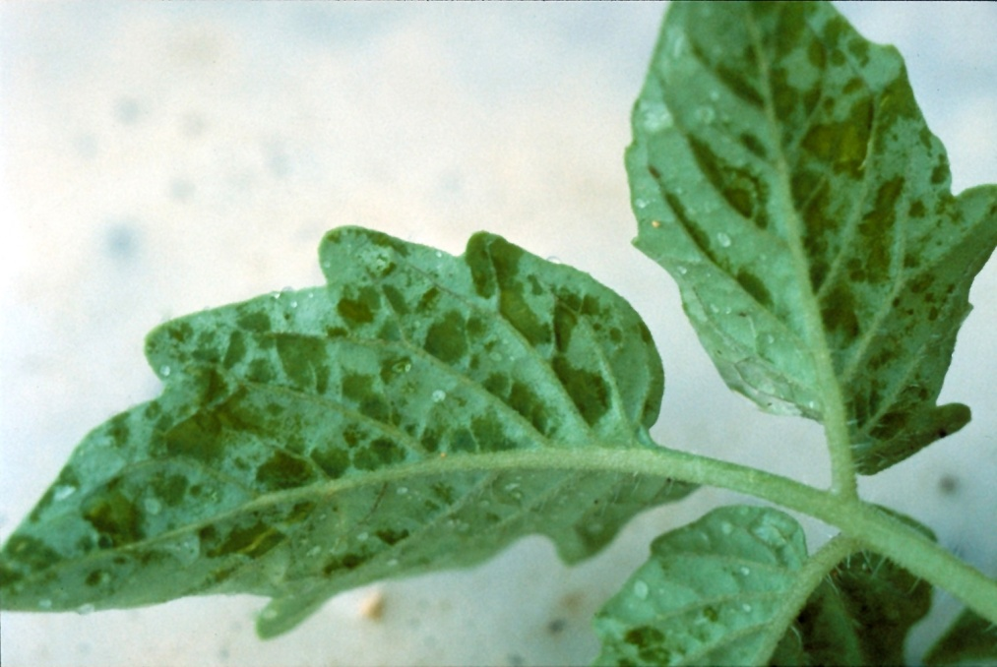
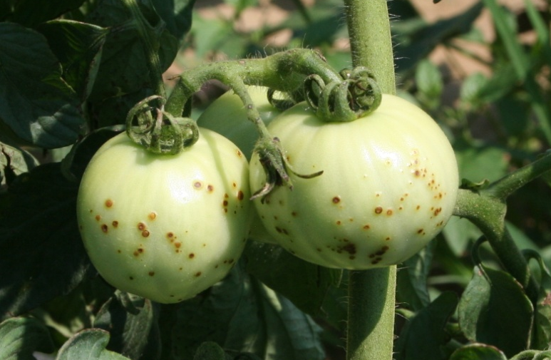
Bacterial Spot - Tomato

Slide 12
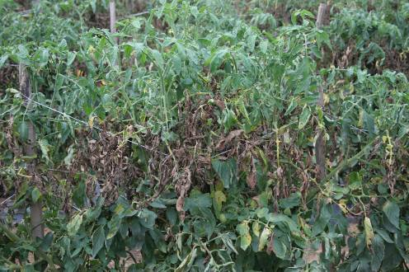
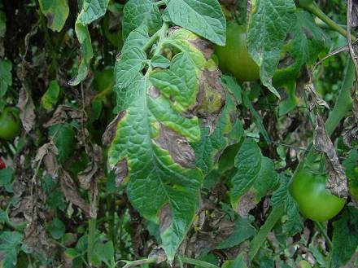
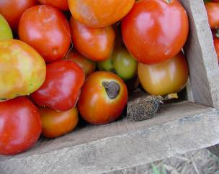
Early Blight

Slide 13
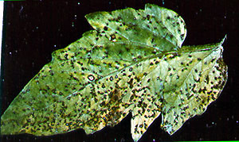
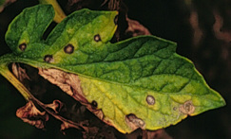
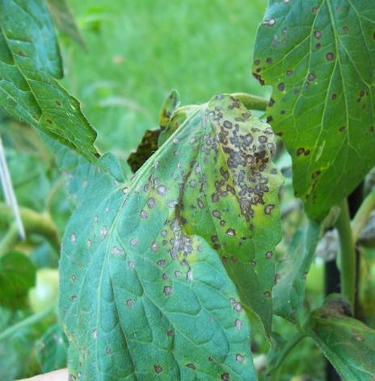
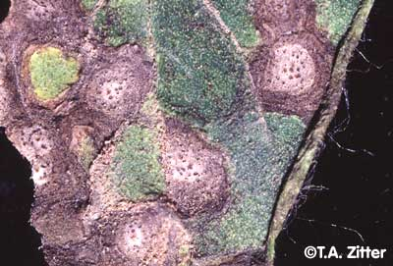
Septoria Leaf Spot / Blight

Slide 14
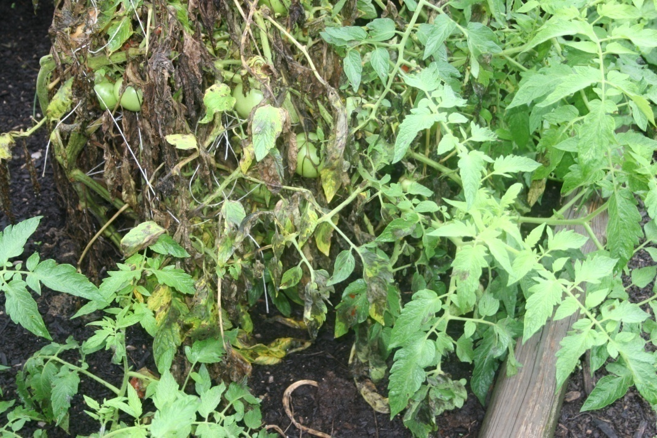
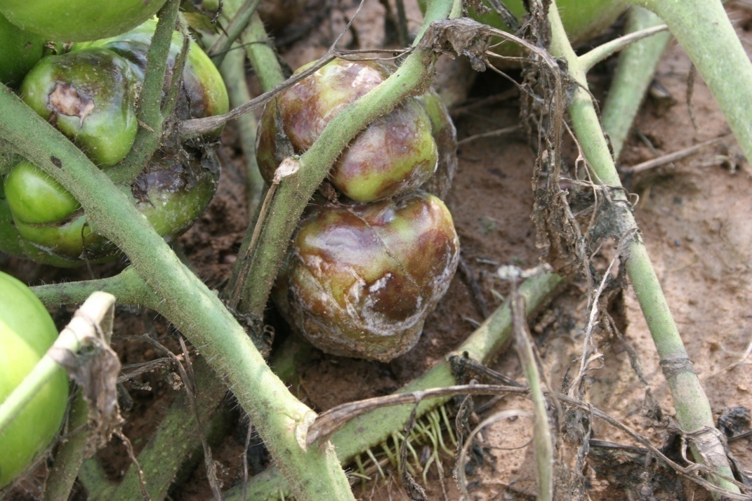
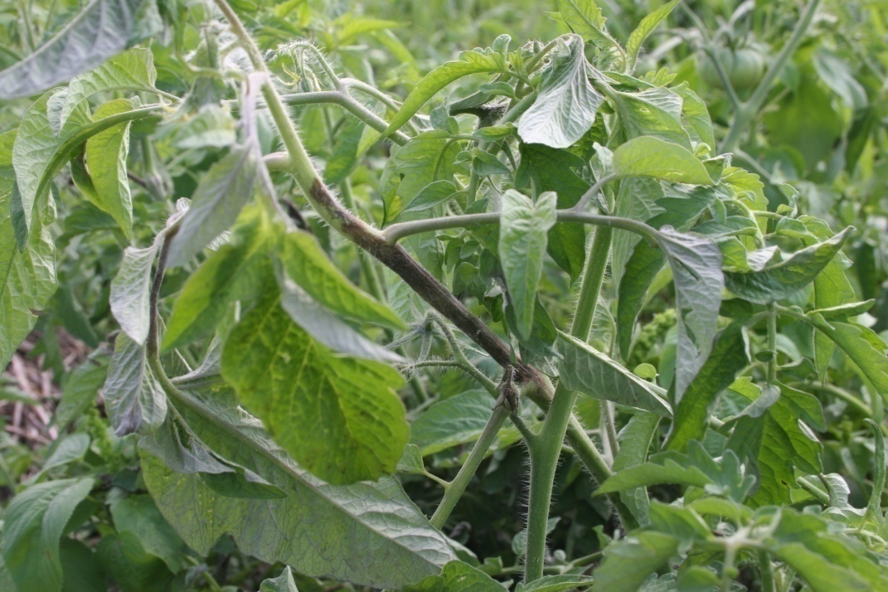
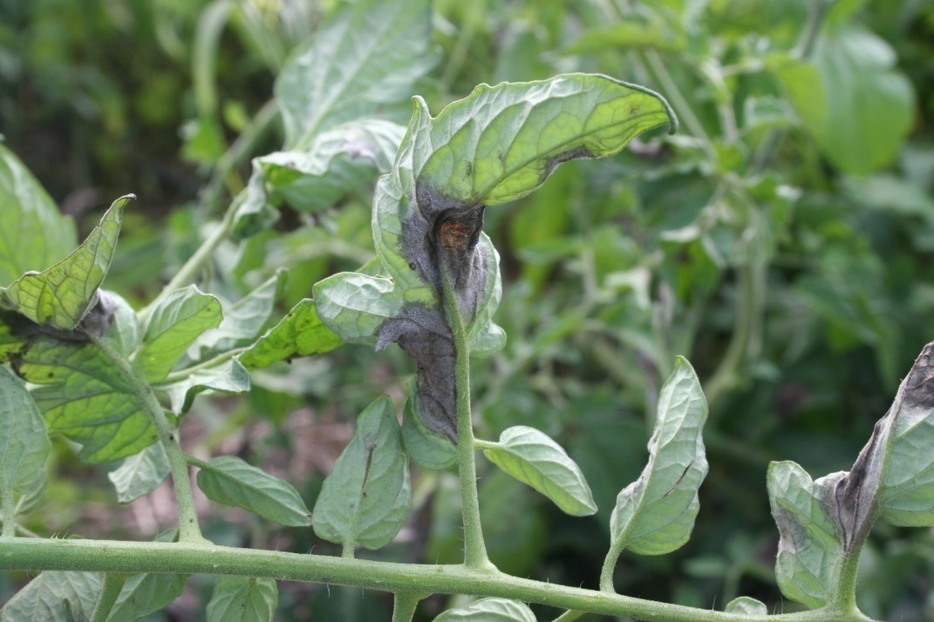
Late Blight of Tomato

Slide 15
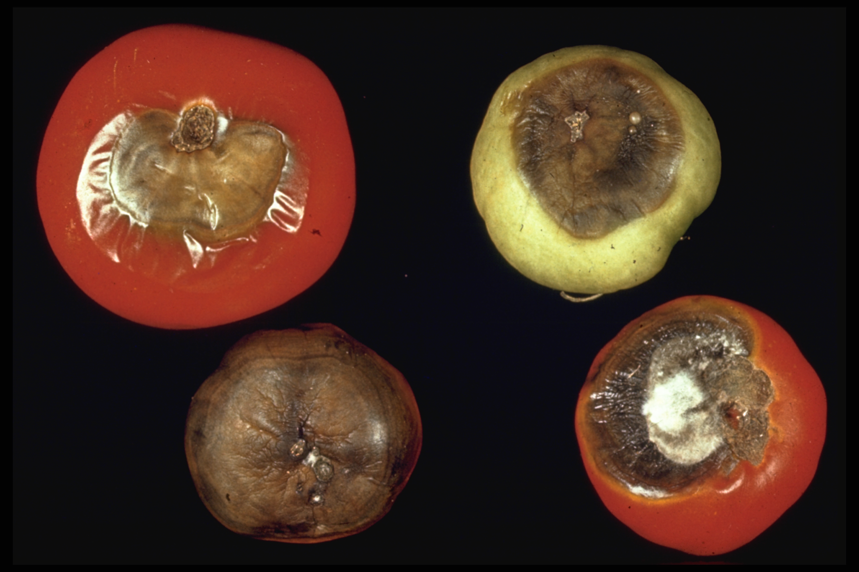
Blossom End Rot Calcium deficiency

Slide 16
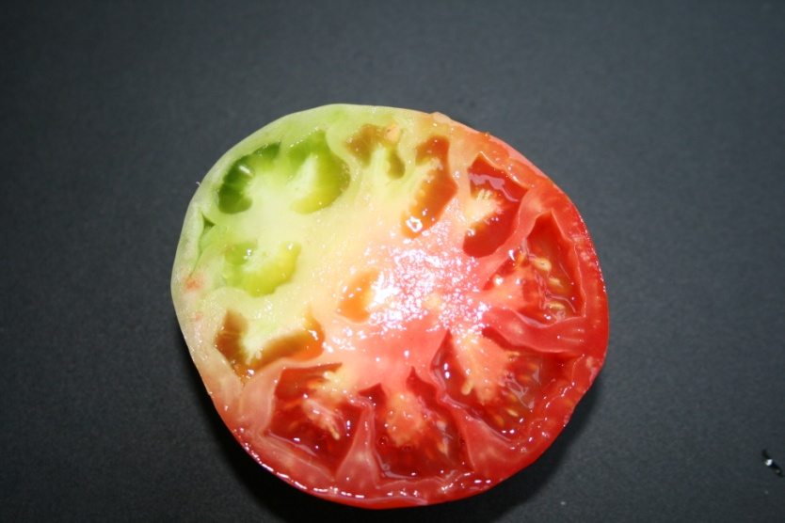
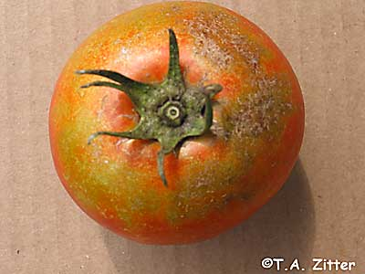
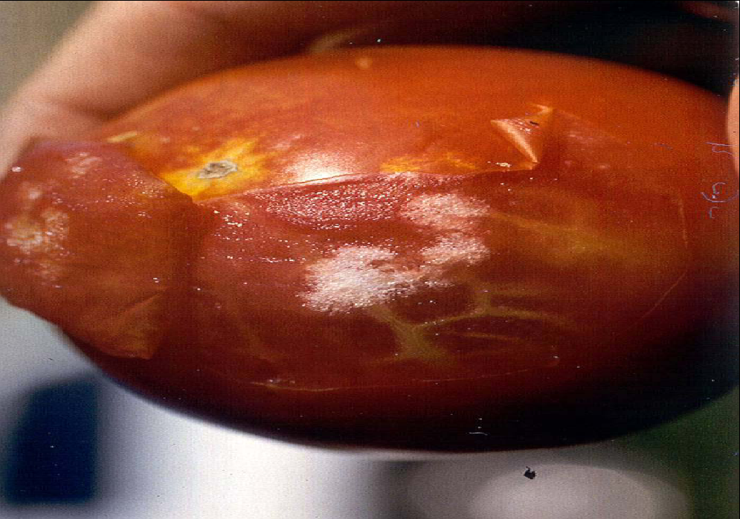
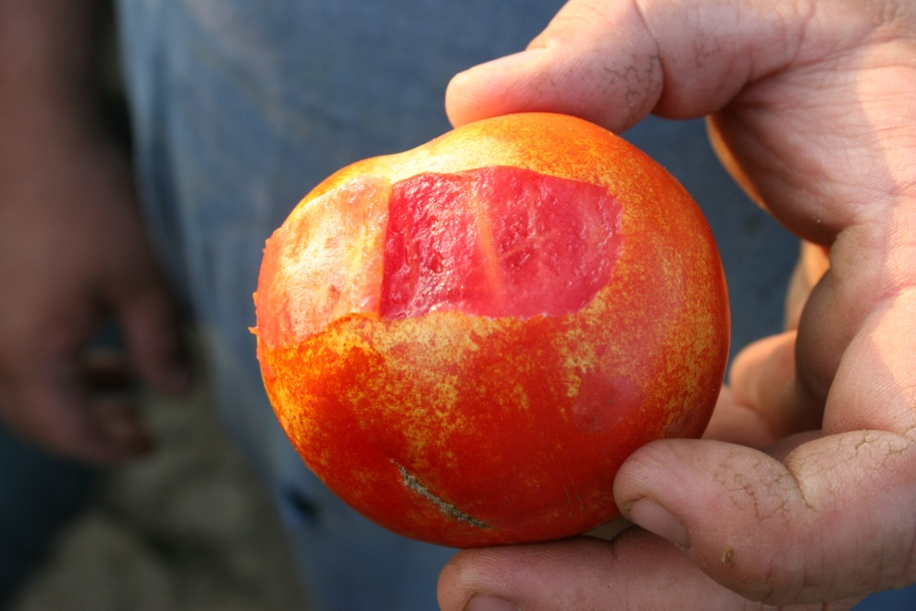
Insect Damage
Irregular ripening (silverleaf whitefly)
Thrips injury
Stinkbug damage
Mite injury

Slide 17
Fungicides for Vegetable Disease Control OMRI-approved
Bacillus subtilis: broad-spectrum fungicide
Serenade Garden Disease Control
Bordeaux mixture
Botanicals
Fungastop: broad spectrum citrus/mint oil
Garlic GP Vegetable and Garden spray
Neem oil: broad spectrum fungicide / insecticide
Garden Defense Multi-Purpose spray
Garden Safe Fungicide₃
Ferti-lome Rose, Flower, & Vegetable Spray
Safer 3-in-1 Garden Spray

Slide 18
Fungicides for Vegetable Disease Control OMRI-approved
Copper compounds
Bonide Liquid Copper
Ortho Elementals Garden Disease Control
Badge X2
Cueva
Nordox 75
Potassium bicarbonate: powdery mildew
Bi-Carb Old Fashioned Fungicide
GreenCure Organic Fungicide
Kaligreen
Sulfur: powdery & downy mildew / miticide (protectant)

