Slide 1
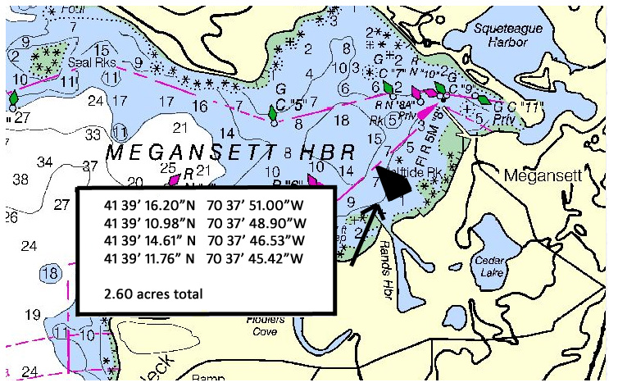
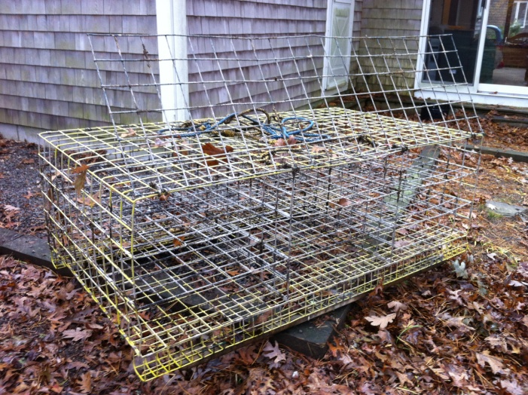
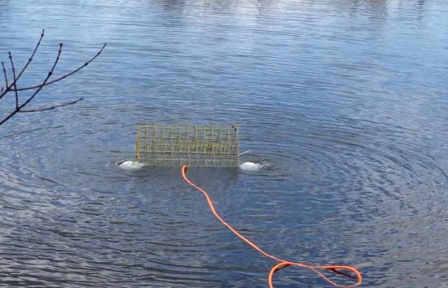
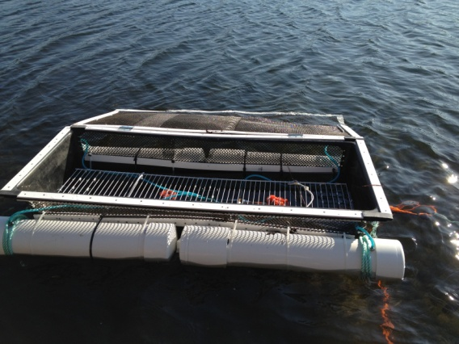
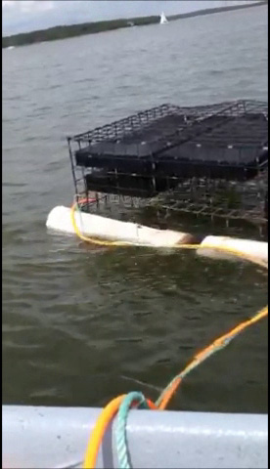
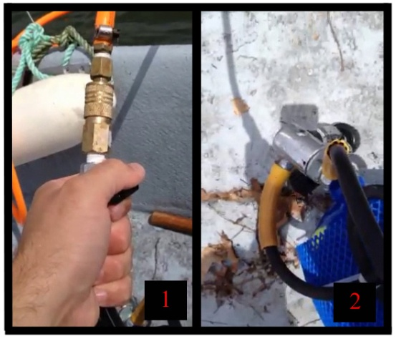
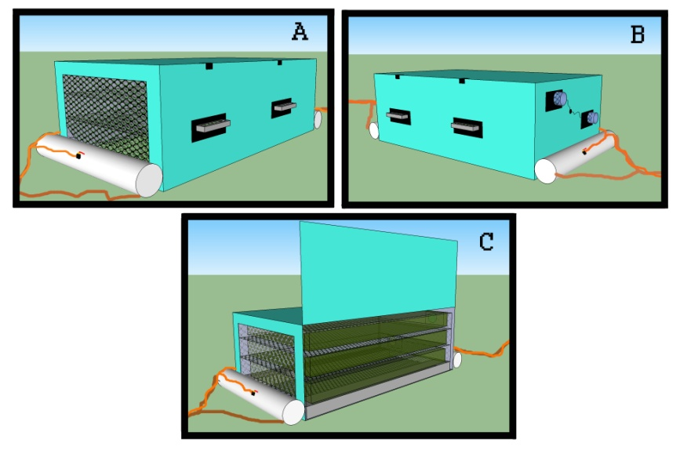
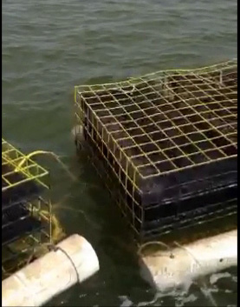
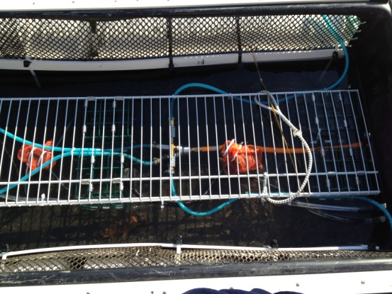
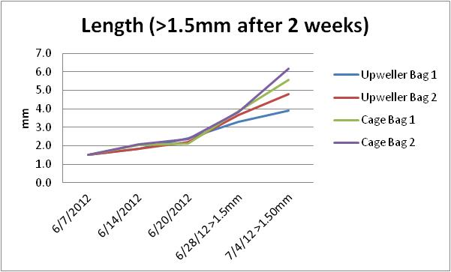
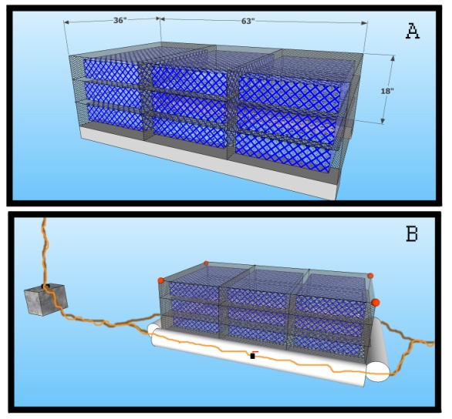
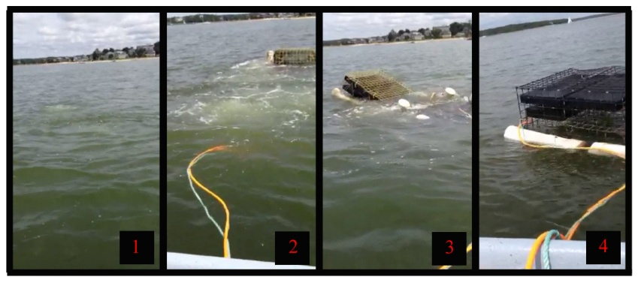
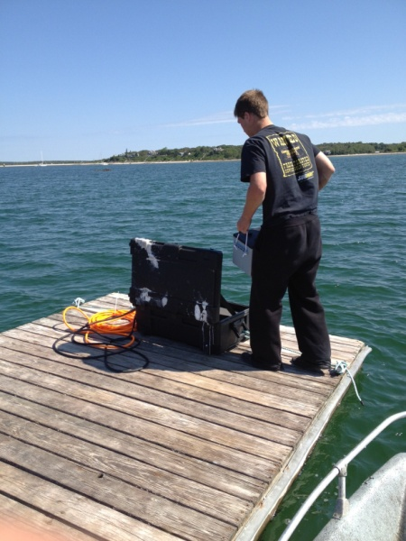
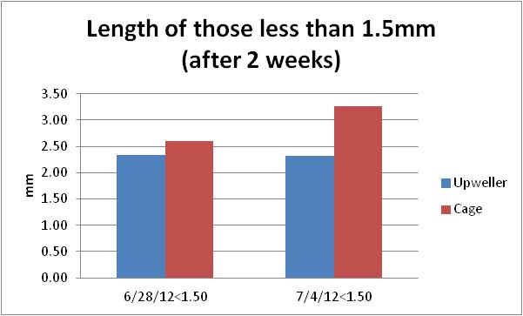
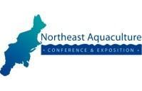
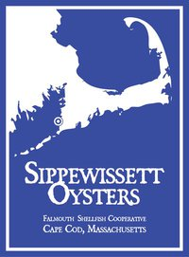
Subtidal oyster aquaculture: Creating safe and efficient production techniques through sustainable innovations
Daniel Ward1, Diane Murphy2
1Ward Aquafarms, 54 Surrey Ln. East Falmouth, MA 02536 phone: 603-505-0865 email: danward33@gmail.com
2Cape Cod Cooperative Extension & Woods Hole Sea Grant, PO Box 367 Barnstable, MA 02630 USA phone: 508 375-6953 email:dmurphy@whoi.edu
Airlift System
Underwater upweller
Upwellers work on the premise that very small (<1mm-6mm) oysters are very susceptible to predators, and need both protection and increased food to be able to grow quickly. Upwellers protect the growing oyster seed, making them less susceptible to predation, while also creating a constant flow of water (containing phytoplankton, ie. food) so they can grow quickly (Rice and Leavitt, 2009). Upwellers are often located under docks, or other floating structures (MA CZM, 1995). Current subtidal shellfish aquaculture regulations limit structures in the water column to no higher than 18” off the ocean floor. This prevents subtidal farmers from taking advantage of current upweller systems that protect oyster seed and pass large amounts of food by the shellfish to increase their growth rate. A system was designed to mimic the same principles of protection and increased food in typical upwellers, however move the system to the bottom of the ocean below 18” to fit within current regulations. Through a battery powered system located on the ocean floor, subtidal farmers can buy smaller seed and take advantage of the gains in growth and survival without needing the upweller to be located on the surface.
Figure 11. Underwater upweller floating on the surface with lid open.
Figure 1. Megansett Harbor located in North Falmouth, MA in Cape Cod. The site is located outside Rand’s Canal in 8-20’ of water.
Figure 3. Oyster cage used for deep water
oyster culture. Dimensions are 63”Lx36”Wx18”H The air-lift system which was designed started with the same cages, and then modifications were made to allow the cage to be lifted using air instead of the typical hauler system .
Figure 5. Initial design with four, 4” PVC tubes lifting the cage. Orange line is air being put into the floats from a SCUBA tank.
Oyster aquaculture is rapidly expanding in the Northeast, providing sustainable jobs to farmers while producing an environmentally friendly product. Until recently, oyster aquaculture has taken place in tidal areas where at low tide the shellfish is either exposed, or the water height allows the farmer to wade out to work on the farm. However, as aquaculture expands, the land available for growing shellfish close to shore and easily serviceable by wading out at low tide is becoming scarce. As shellfish farmers move into subtidal waters, this leaves the farmers in Falmouth (and other towns around New England) with two ways to farm shellfish on their site: (1) buy a large boat with a pot hauler, string the oyster cages together, and haul the gear to the surface like lobster traps. This creates a barrier to entry because there is a large capital expense to starting a farm, which the other farmers using intertidal aquaculture leases do not have to deal with. The other option (2) is to use SCUBA to dive down every time to remove the bags containing oysters and use lift bags or ropes to bring them to the surface. This method is what the majority of farmers in Falmouth (as well as Ward Aquafarms) use, and it is both labor intensive and dangerous.
Since diving to the bottom using SCUBA in order to bring the shellfish to the surface is dangerous and not very efficient, this project proposes a novel technique to bring cages to the surface using air to lift the cages.
Figure 4. Typical oyster cage with float modifications being lifted using SCUBA tanks on the boat.
Figure 6. Using SCUBA tanks to put air into the system. 1. Airline with ball valve leading to the cages, 2. SCUBA tank with modified first-stage regulator to lower tank pressure to 150psi.
Instead of the large wire-mesh cage to hold the oyster spat bags, a 6’x2’ fiberglass tank was purchased, and large 6” windows were cut along the entire length on both sides. The windows were fitted with 9mm APDI mesh and connected to the tank with 2” strapping to seal the edges (Fig. 8). A vinyl-coated rack was attached to the tank in order to keep the bags centrally located in the water column within the cage. This way water would be able to flow freely around the upweller instead of only from the top down. A lid was then constructed and installed on top of the upweller in order to keep any predators from entering the upweller. The lid was put on hinges and constructed out of the same 9mm ADPI materials and 2” strapping. The lid was then held down on either end of the upweller with shock cord and S clips. Installed within the underwater upweller were two submersible pumps, individually connected to battery power, so that each could function independently of the other in case of failure. Each pump was wrapped in 1.5mm nylon mesh to act as a crude filter to remove large particles in the water column before they clogged the pump. Each pump had a 3/8” plastic hose leading from the pump to a hole drilled in the exterior of the fiberglass tank by which water was removed from the system. The removal of water from the system would cause more water to enter through either the top lid or the windows on the side. The pumps were strategically located below the oyster bags, this way when water was pumped out of the system, the new water would be forced to travel through the oyster bags before getting to the pumps, thereby increasing food passing by the oysters.
Using air to lift the cages is safer and less labor intensive than SCUBA, and less expensive than buying a larger boat which also requires the use of hydraulics to raise the cages out of the water. In order to employ the air-lift technique, a farmer would have to buy a compressor and a tank, and would then be able to work their farm in a safer and more efficient method.
By bringing compressed air to the site (in a SCUBA tank or similar apparatus), farmers can attach an airline hose to the tank and begin filling PVC tubes surrounding the cage. As the PVC tubes inflate, the cage will rise to the surface. Since the cage is attached to an anchor on one side, and to the next cage in the line on the other, it also will not move laterally while on top of the water, which means the cage will sink back to approximately the same footprint once tending the shellfish is complete. Once the farmer is done tending to the oysters, he simply opens the valve at the surface and water pressure will push the air out of the PVC, allowing the cage to return to the bottom.
Figure 9. Proposed Design: A. Front of the cage with mesh where water with phytoplankton enters structure. B. Two submersible pumps increasing water flow throughout the structure and past the juvenile oysters. C. Model showing the open door on one side to allow for maintenance of the shellfish and cleaning of the structure.
Figure 7. Two cages with the airlift system installed connected in series floating at the surface.
Figure 10. Inside of underwater upweller with lid open. 6” windows fitted with 9mm ADPI mesh across the whole length on both sides (upper part of picture). Vinyl-coated mesh shelf to hold spat bags off the bottom (white mesh in center of picture).
Figure 14. Length of oysters that were less than 1.5mm at the two week sampling period. They were kept separate from the larger oysters at that point and were tracked separately.
Figure 2. A. Normal oyster cage used for deep water oyster culture. B. Oyster cage with proposed modifications to allow it to be raised using air. Note rope attaching it to an anchor, orange air line attaching to the PVC tubes holding the rubber bladder which is filled with air. Also note orange air-filled balls on the top corners to keep the cage moving up and down in the water column without tipping over.
Figure 12. Jordan Ward (summer research assistant) switching out the 120lb. battery which powered the two submersible pumps within the underwater upweller. Black cable leads from the battery down to the pumps; orange airline also leads to the upweller to lift it to the surface with the airlift system.
Figure 13. Length of oysters that were greater than 1.5mm after 2 weeks and therefore were moved to bigger size mesh bags.
The underwater upweller system worked exactly as planned, and did a great job at sheltering the oysters from any predators. The only drawback was the lack of power which dictated the reduction in pumping power. If there was a way to either connect to shore power, or have solar panels recharging the batteries that would allow for the upgrading of the pumps, the system would most likely function exactly like a dock-based normal upweller system, while still allowing subtidal aquaculturists to adhere to current guidelines.
Figure 8. Steps 1-4 in raising a cage to the surface. 1. Air pushes the water out of the PVC tubes, 2. One cage begins to rise, 3. Multiple cages are coming to the surface at once, 4. All three cages are at the surface and stable.
Literature Cited:
Rice, M. A. 2006. A Brief History of Oyster Aquaculture in Rhode Island. Aquaculture in Rhode Island: 2006 Yearly Status Report. RI CRMC publication.
Rice, M. A. and Leavitt D. 2009. Aquaculture situation and outlook report 2009: Rhode Island. NRAC Publication No. 110-2009.
MA CZM. 1995. Massachusetts Aquaculture White Paper - Shellfish Bottom and Off-Bottom Culture. http://www.mass.gov/czm/wpshell.htm
Printing services provided by the RI-INBRE Centralized Research Core Facility
supported by Grant # P20 RR16457 from NCRR/NIH.

