Slide 1
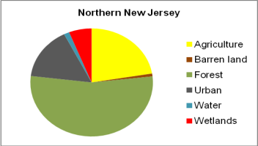
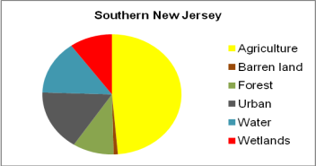
Fig. 1. The proportion of land use types within 1 km around peach orchards north of Trenton and south of Trenton

