Slide 1
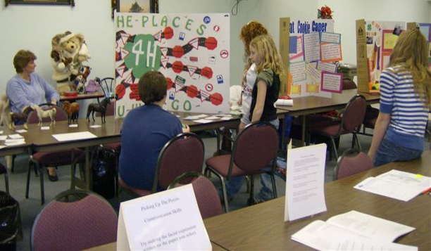
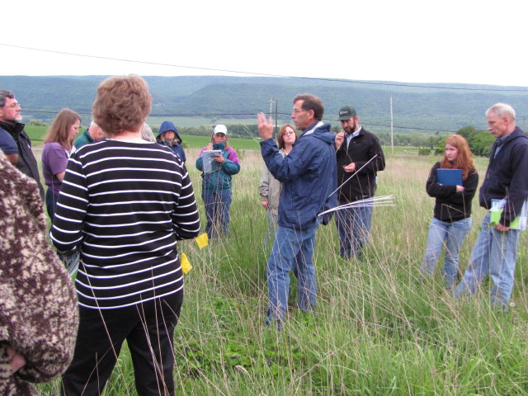
Involving Youth in Livestock and Horse Environmental Stewardship Projects H. McKernan, A. Swinker, D. Foulk, M. Hall, Penn State University, L. Blazure, Clinton County Conservation District Donna Pennsylvania State University, University Park, Pennsylvania
Introduction
Evaluation
The traditional purpose of involving youth in 4-H livestock projects is to educate youth in the management and production of livestock while developing personal growth, responsibility, critical thinking and communication skills. The traditional 4-H projects do not include guidance and information on Environmental Stewardship Best Management Practices (BMPs). 4-H youth, family members, and volunteer club leaders, who manage equine and livestock projects, need experience and education in strengthening environmental knowledge and skills to implement, modify, and enhance pasture quality, odor control and nutrient and sediment management within the farm system.
2010 to 2012 Clinton County, Pennsylvania
Forty-five youth and nine leaders participated in the Stewardship Project.
Four farm visits provided opportunity to view and apply learned objectives.
Hands on activities during both the farm visits and educational workshops include: soil samples, manure samples, feed analysis, mapping, gathering and identifying grasses and weeds and evaluating farms’ operational layouts.
Youth participants assist in conducting public workshops and demonstration during events such as 4-H camps, county fairs and other events showcasing agriculture.
The participants plan and develop their method of delivery through speeches, visual displays, demonstrations and other appropriate methods.
Methods
Twenty-one volunteer non-formal educators (4-H leaders, parents, teen leaders) participated in an environmental short course to focus on knowledge and application of environmental issues of sustainability of water and air quality. The BMP information included enabled volunteers to transmit information to youth when directing them in the management of horse and livestock projects.
Whole and small group educational workshops
Farm visits
Hands on activities through utilization of specialists, educational material resources and environmental guidelines
Summary
The youth, families and volunteer leaders that manage limited acreage need to be aware of government programs and sources of assistance. Participants involved in this project assess the environmental issues on their premises, promote and apply BMPs to improve air/water quality and strengthen the environment and community relationships. In a non-traditional classroom setting, this project provides education on environmental stewardship to youth involved in farm operations, while providing the participants the ability to problem solve and apply critical thinking to the issues affecting their farm operations.

