Slide 1
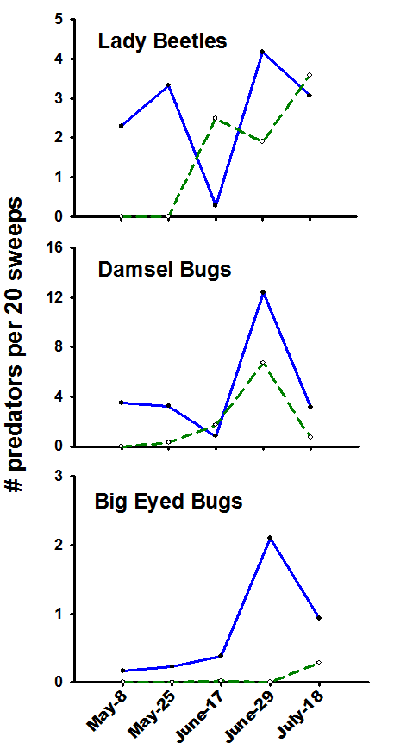
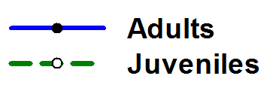
Figure 1. Sampling events are listed along the x axis and number of predators captured per 20 sweeps along the y axis. One sweep is a 180⁰ arc made in front of the collector with an 18 inch diameter sweep net. This shows multiple predator species and life stages occur together during a growing season, suggesting natural pest suppression be examined in the context of seasonal predator phenology.

