Slide 1
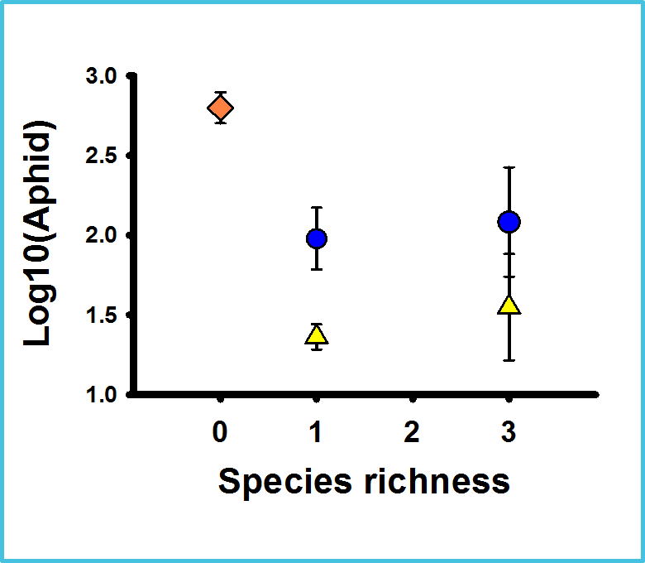
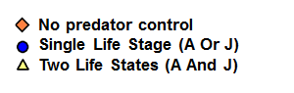
Figure 3. Number (log10) of pea aphids retrieved from cages containing either no predators (control), a single life stage (either adults only or juveniles only), or two life stages (a combination of both adults and juveniles in equal proportions). 2-way ANOVA showed no significant interaction between species richness and number of life stages present, and no main effect of species richness. However, the combined presence of both adults and juveniles, regardless of species richness, significantly depressed pea aphid populations better than treatments containing one life stage (adults only or juveniles only) (p < 0.05).

