Slide 1
Okra
3 ’
Tomato
Aisle
3 ’
Sweet Pepper
Summer Squash
Figure 1. Field plot set-up, showing uniform crop orientation within 4 30’ rows

Slide 2
Minimum 30’ buffer
Okra
Okra
Tomato
Tomato
Sweet Pepper
Sweet Pepper
Summer Squash
Summer Squash
Figure 2. One replicate, showing control (left) and BMSB treatment (right) plots, with trap crop perimeter shown in black and RESCUE traps shown as red dot

Slide 3
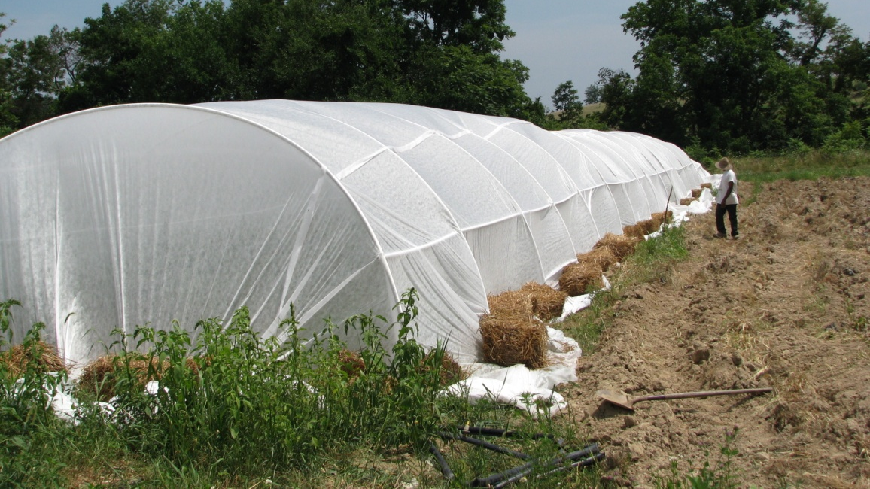
Figure 3. BMSB exclusion cage system covering 3 rows of staked tomatoes at Redbud Farm, 2011.

