Slide 1
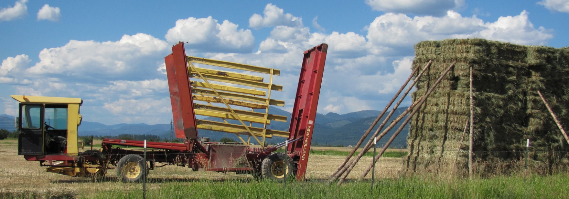

Ecology & Management of Ventenata in the Inland Northwest
John Wallace, Tim Prather, Andrew Mackey & Pam Pavek
University of Idaho & USDA-NRCS Plant Materials Center
jwallace@uidaho.edu

Slide 2
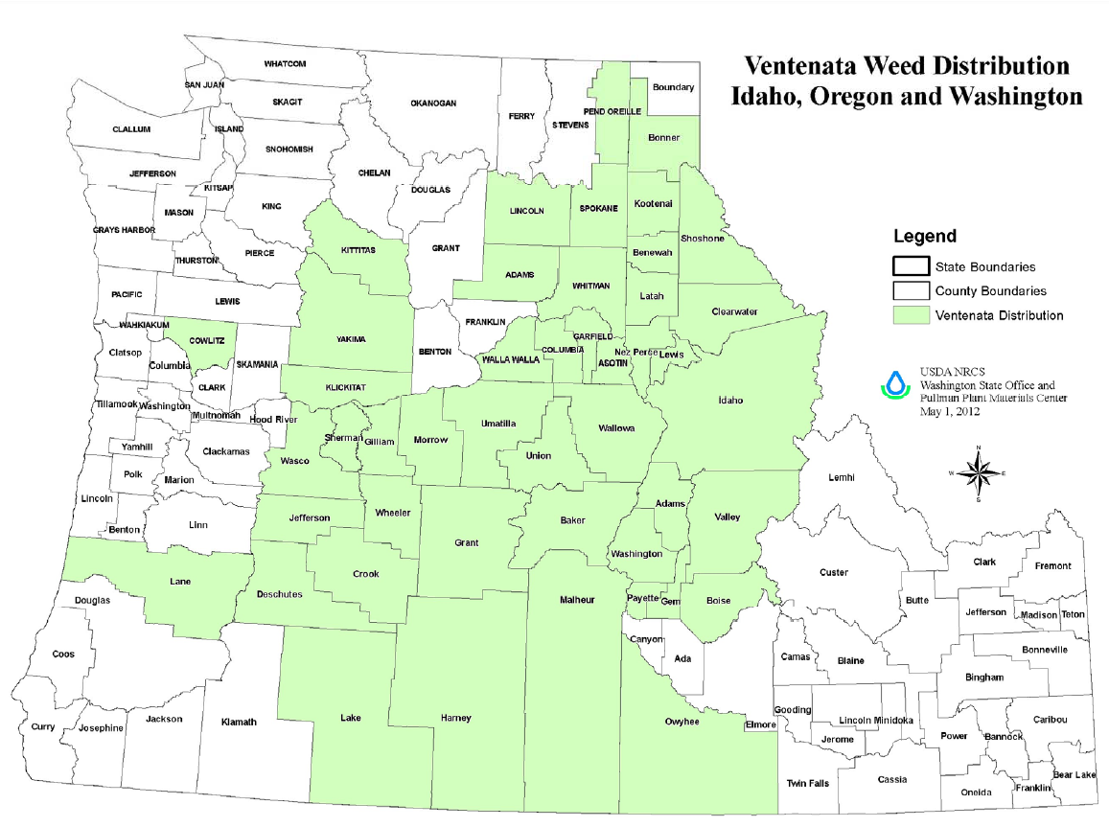
Annual Grass Invasion
Ventenata (African wiregrass) distribution in Inland Northwest
Figure: P. Pavek, USDA-NRCS-PMC
Notes:
[Pavek] Updated VEDU distribution map in Pacific Northwest, produced by NRCS Plant Materials Center.

Slide 3
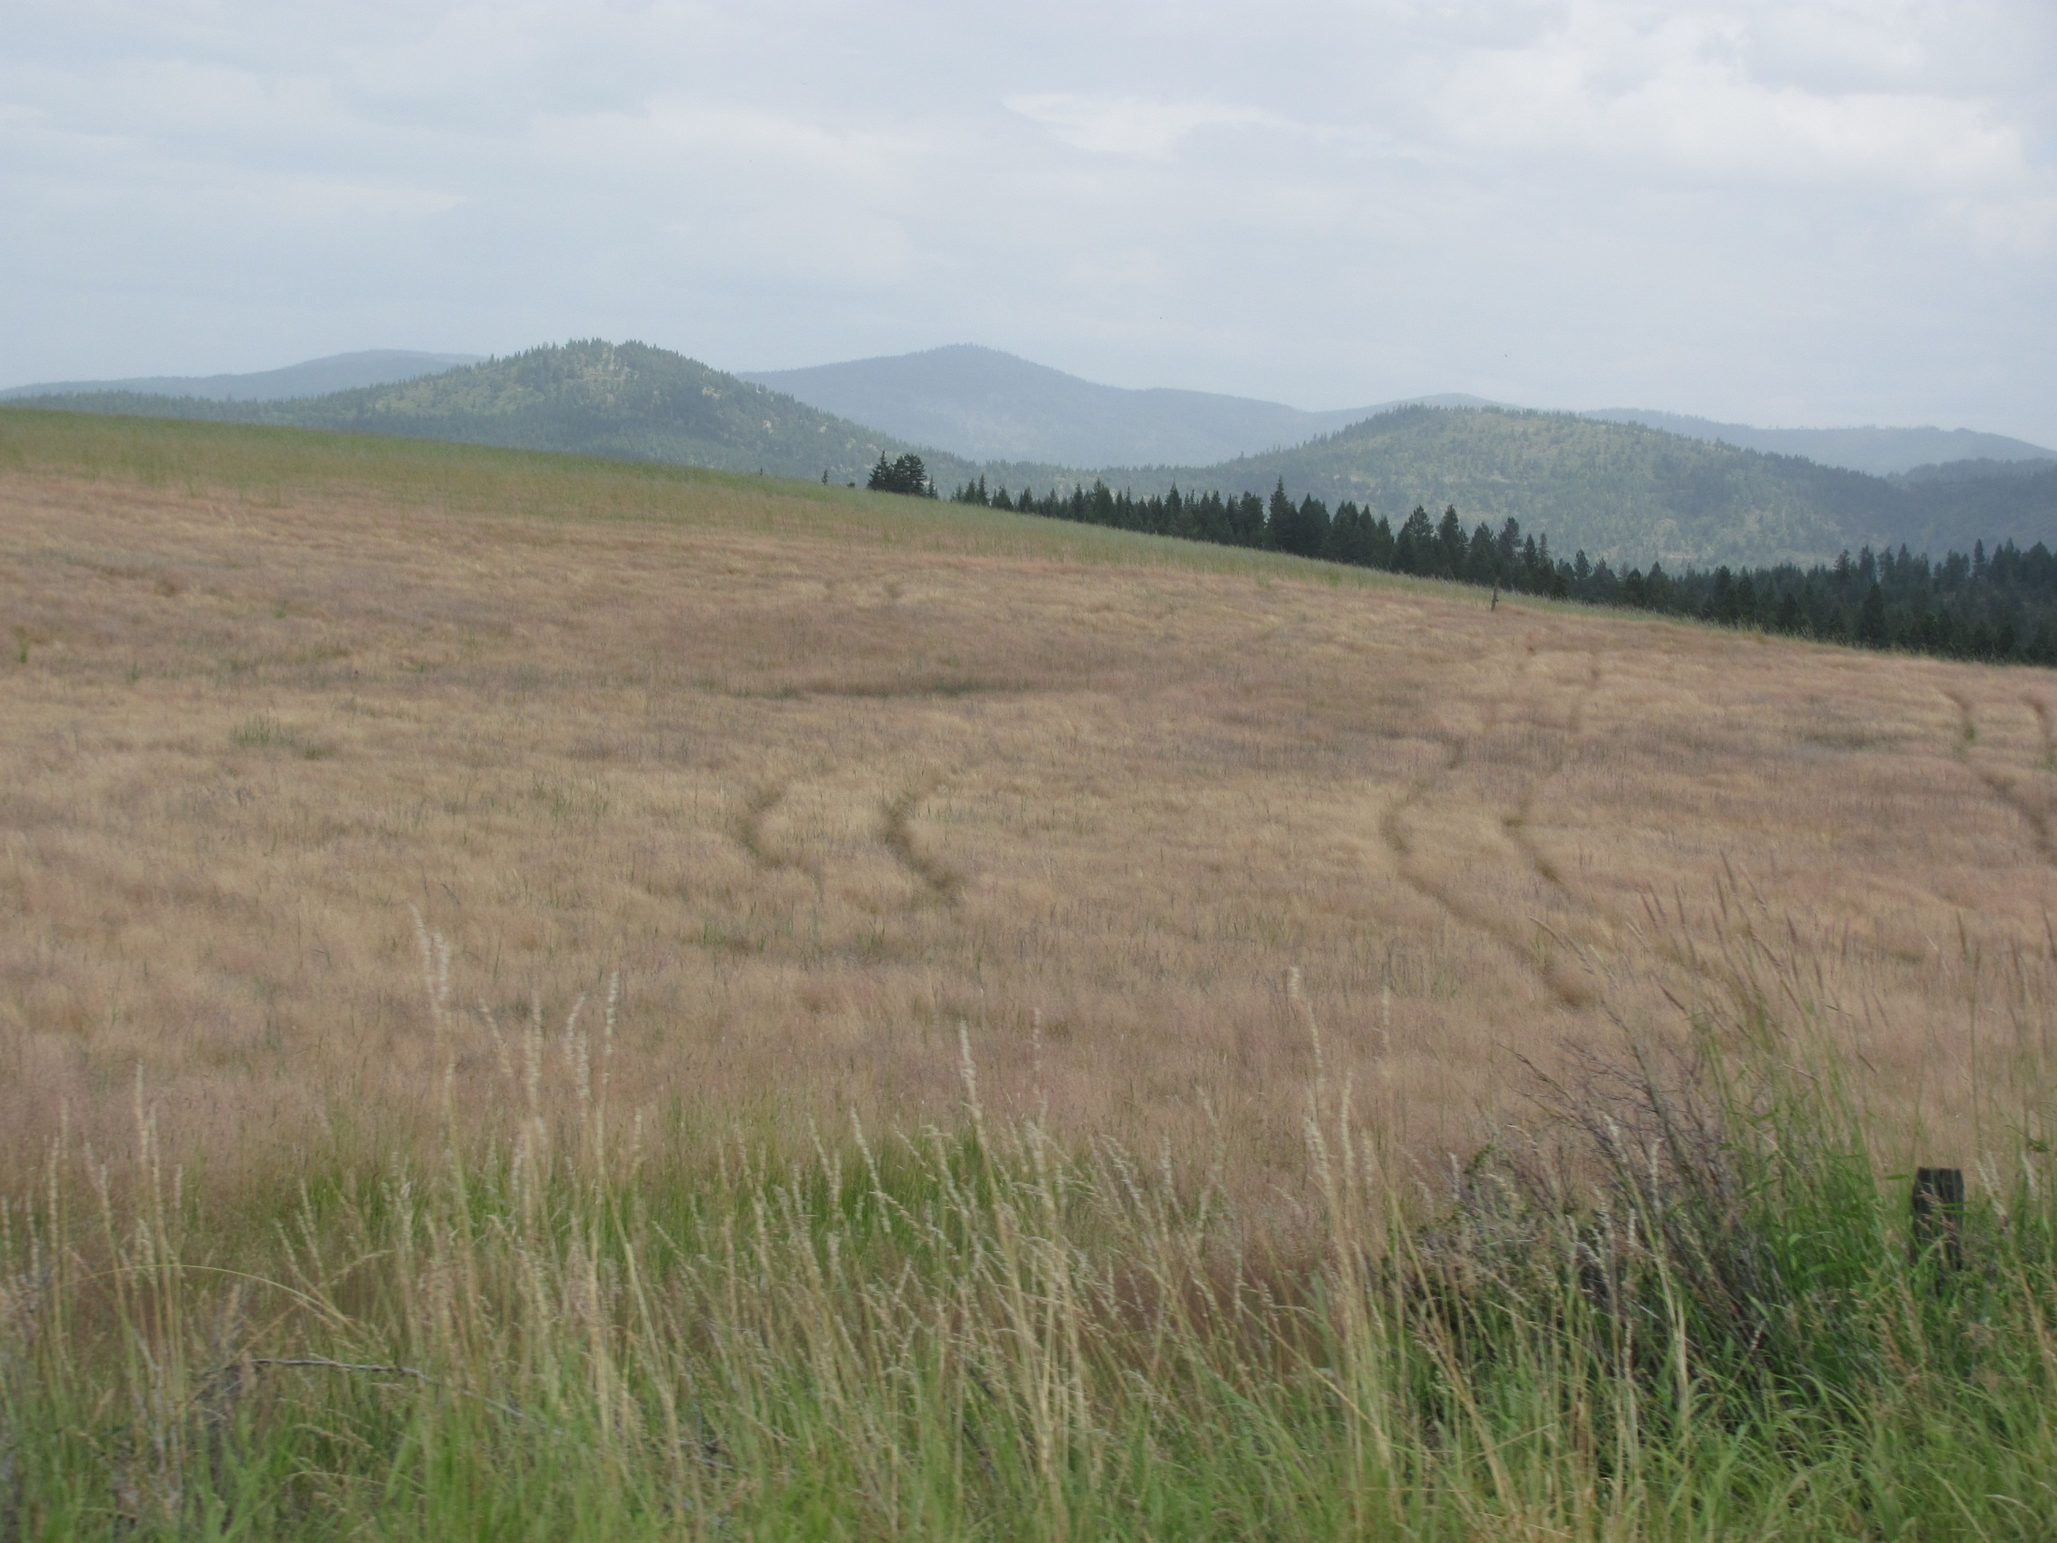
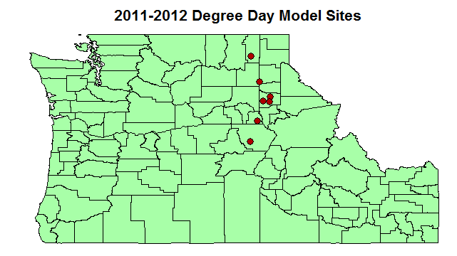
Phenological Development of Ventenata in the Inland NW (2011-2012)
Notes:
[Wallace] Location of 2011-2012 degree day monitoring sites.

Slide 4
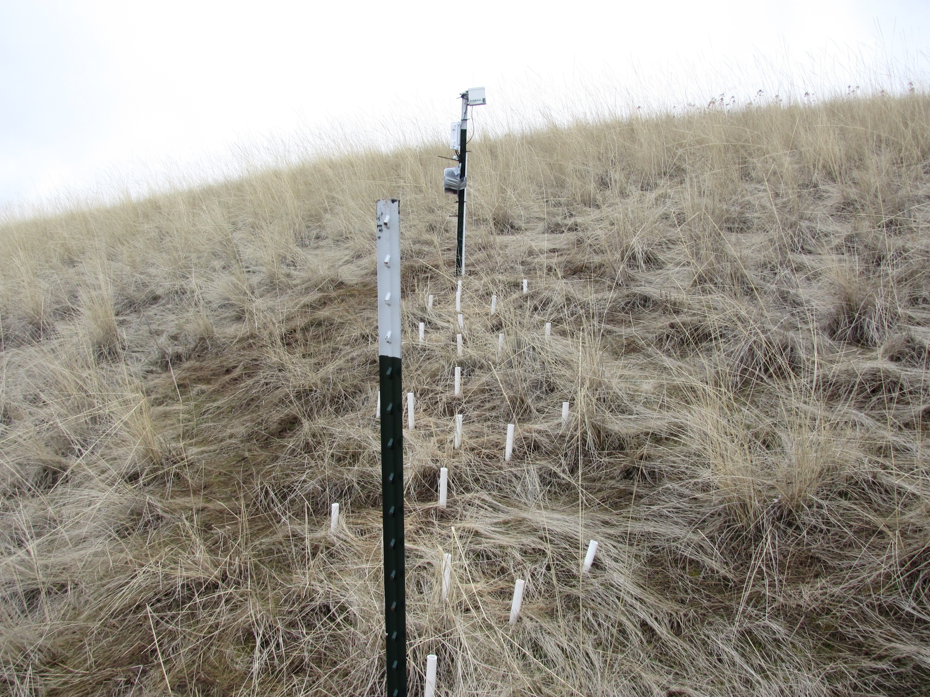
Site Location | System | Soil Texture | % Organic Matter | Soil pH
Moscow ID | CRP – Intermediate Wheatgrass | silt loam | 1.4 | 6.4
Deary ID | Pasture | silt loam | 4.8 | 5.8
Harvard ID | Timothy Hay | silt loam | 4.8 | 5.3
Worley ID | CRP – Smooth Brome | silt loam | 3.9 | 5.8
Usk WA | Timothy Hay | clay loam | 9.8 | 5.0
Usk WA | Pasture | loam | 9.8 | 5.0
Anatone WA | Rangeland | silt loam | 5.9 | 6.4
Enterprise OR | Rangeland | loam | 8.9 | 6.2
Notes:
[Wallace] Site characteristics of 2011-2012 degree day model sites in Pacific Northwest.

Slide 5
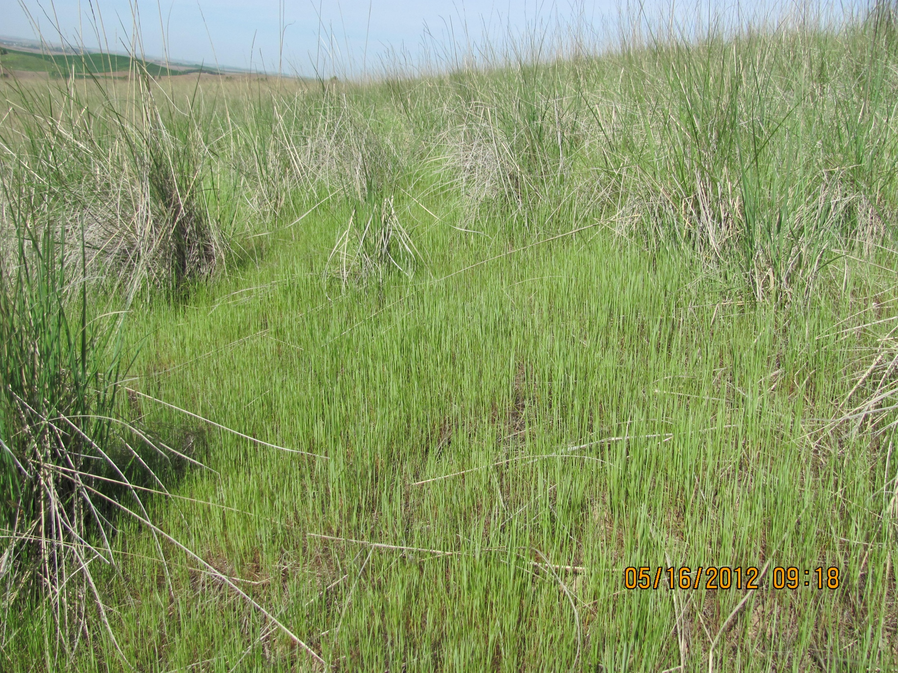
Notes:
Cumulated VEDU seedling emergence of 2011-2012 growing season across eight degree day model monitoring sites in the Pacific Northwest.

Slide 6
Source: J. Wallace

Slide 7
Source: J. Wallace
Notes:
Phenological development of VEDU from vegetative to seed ripening stage in 2011-2012 growing season across eight degree day modeling monitoring sites.

Slide 8
Anatone WA - Range
Notes:
Example of raw weather data in Anatone WA, including cumulative seedling emergence and phenological development plotted against soil volume water content and daily max and min temperatures.

Slide 9
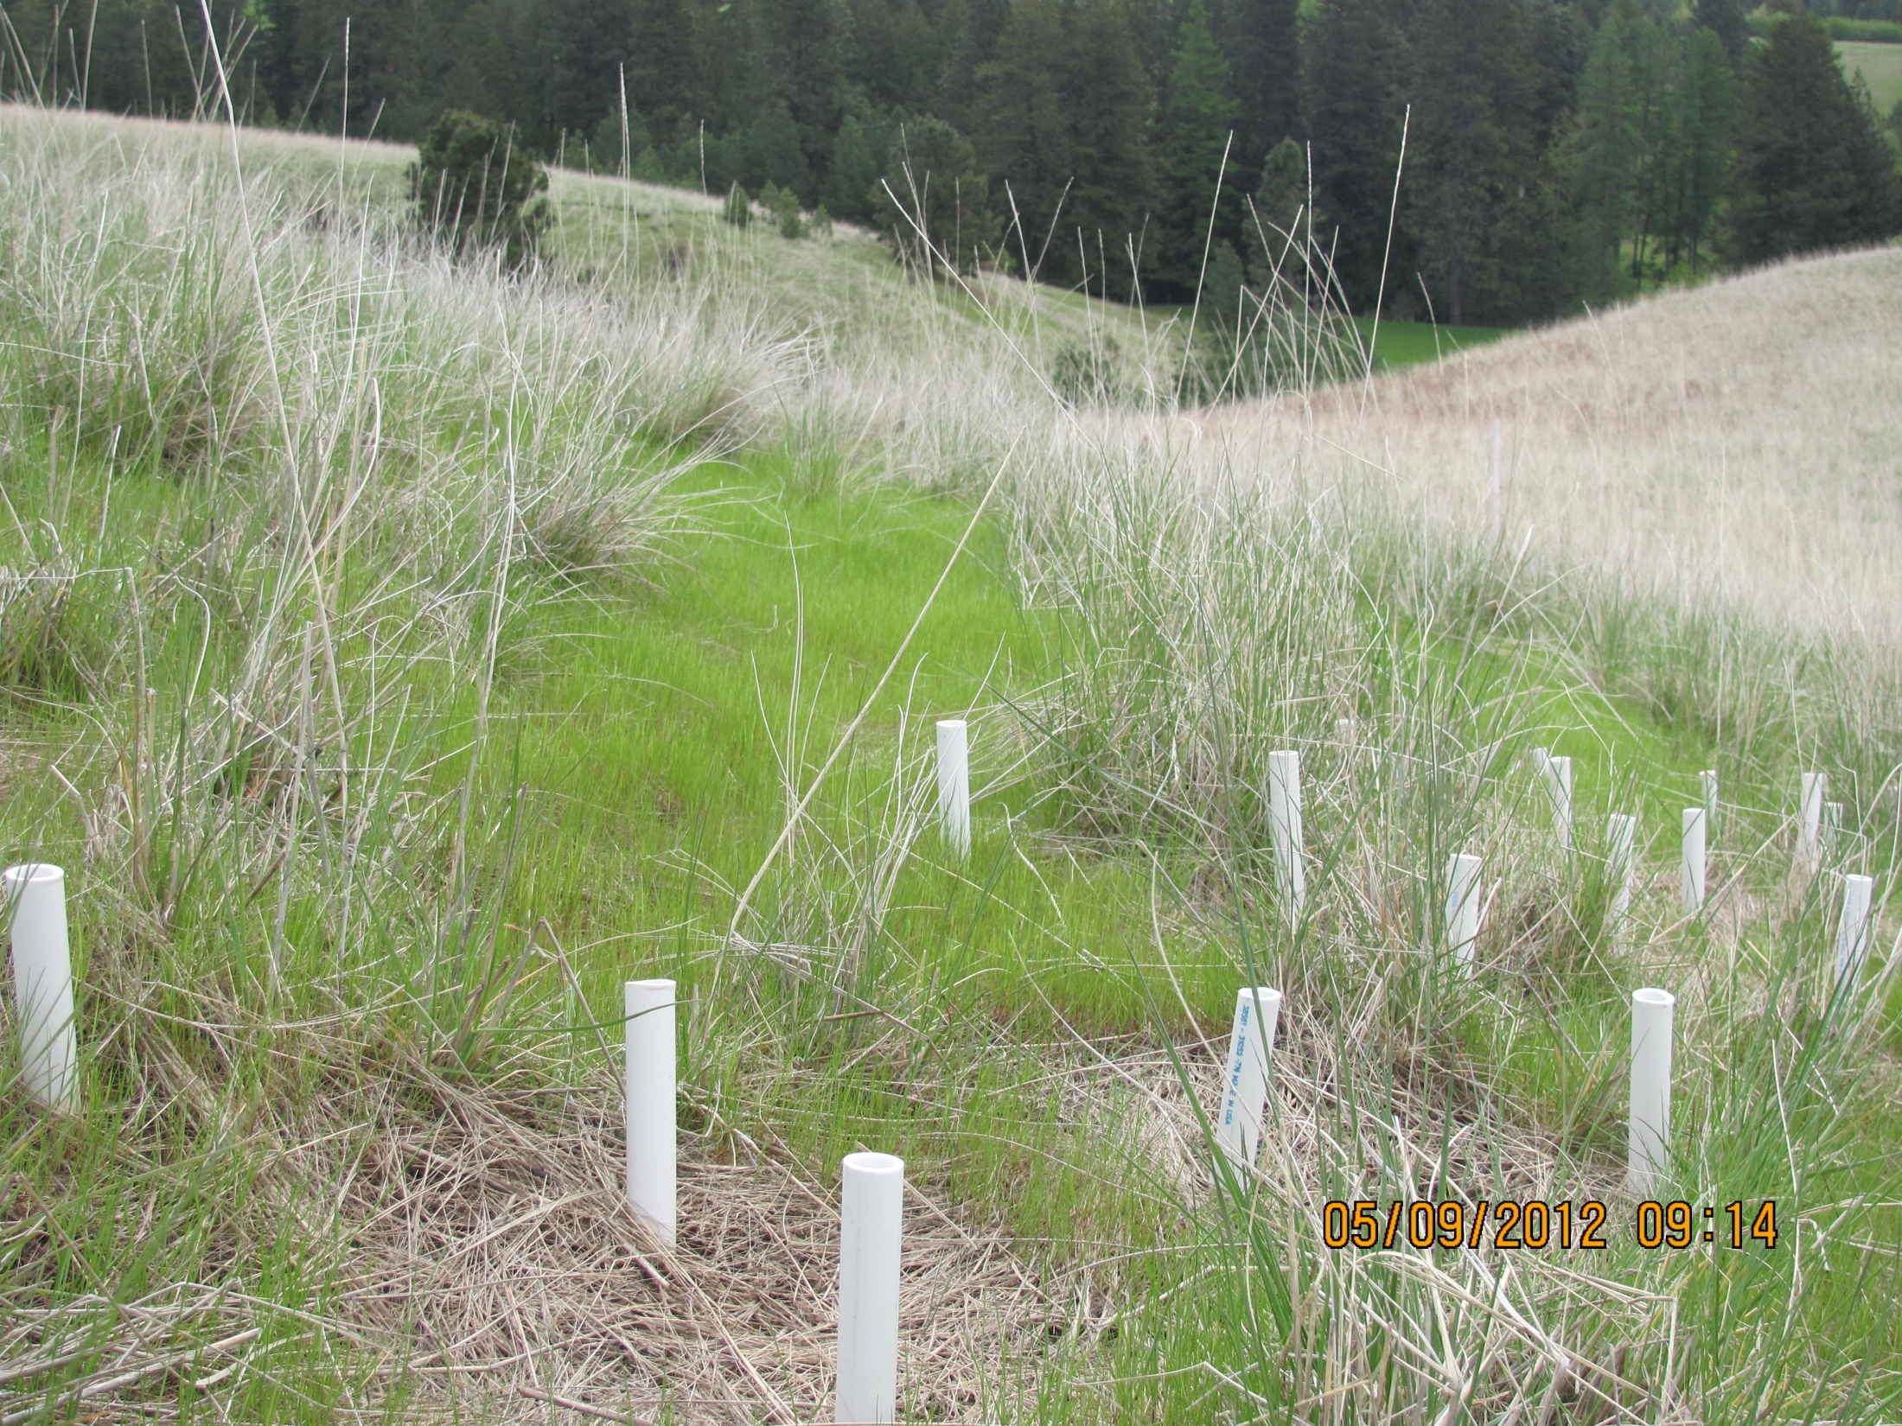
Notes:
Soil volume water content prior to ventenata seedling emergence in 2011-2012 growing season.
Soil volume water content at time of vententata seedling emergence through 50% cumulative seedling emergence.

Slide 10
≈ 2 cm of precipitation required for seedling emergence.
Source: J. Wallace
Notes:
Soil volume water content at time of vententata seedling emergence through 50% cumulative seedling emergence.
Relationship between soil volume water content and cumulative precipitation.

Slide 11
Threshold > 27 C
T_{base} = 7 C
Laboratory study suggests that base temperature for emergence is >7 C
Upper threshold for emergence >27 C
Source: J. Wallace
Notes:
Effect of temperature of total VEDU germination (%) tested under laboratory conditions.
Cumulative growing degree days at dates corresponding to observed 0, >1 and >50% cumulative VEDU seedling emergence at seven monitoring sites in the Pacific Northwest.

Slide 12
Source: J. Wallace
Notes:
a) Box plots of cumulative seedling emergence across eight monitoring sites in the Pacific Northwest (n = 10 microplots).

Slide 13
Phenological Development of Ventenata in the Inland Northwest
(2011-2012)
Management Implications
Improve timing of fall pre- and post-emergent herbicide applications
Improve timing of NPK applications to benefit forage production
Future Work
Refine degree day model for seedling emergence
Model seed production using degree day model approach
Compare VEDU growth patterns with perennial grass phenology

Slide 14
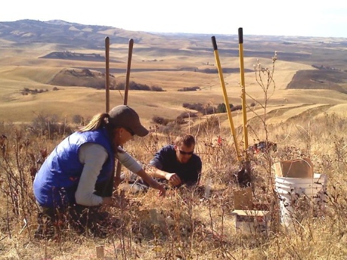
Ventenata Seed Biology (2010-present)
NRCS-PMC & UI

Slide 15
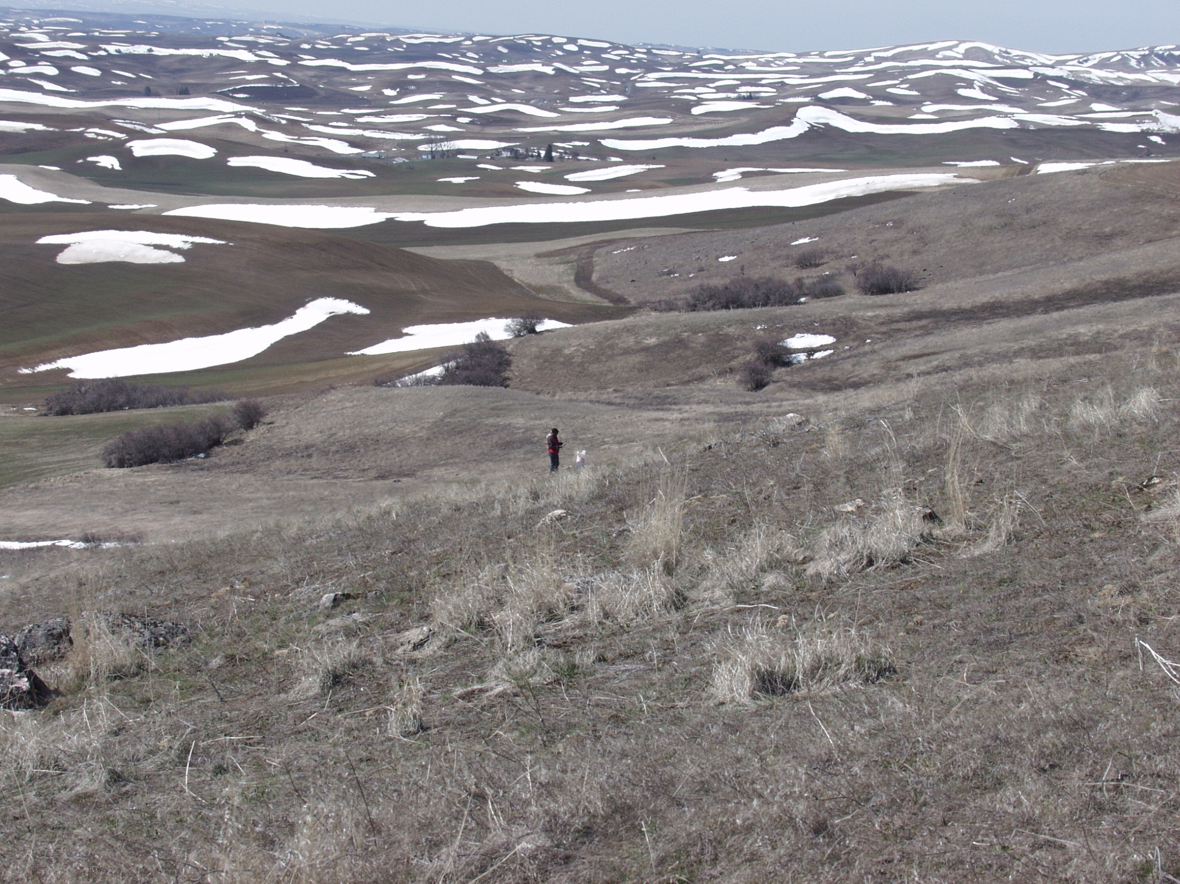
 |  |  | Months after VEDU seed burial
Site |  |  | 1 | 6 | 12 | 24
 |  |  | --------- % germination (mean) ------------
PMC Farm, Pullman WA
 | 2 cm burial depth |  | 81 | 0 | 0.0025 | 0
 | 8 cm burial depth |  | 80 | 0 | 0 | 0
Paradise Ridge, Moscow ID
 | 2 cm burial depth |  | 83 | 0 | 0 | 0.0025
 | 8 cm burial depth |  | 80 | 0 | 0 | 0
Site |  |  | Viability of non-germinated seeds 1 mo after burial
PMC Farm, Pullman WA |  |  | --- % ---
 | 2 cm burial depth |  | 3
 | 8 cm burial depth |  | 3
Paradise Ridge, Moscow ID
 | 2 cm burial depth |  | 4
 | 8 cm burial depth |  | 0
Notes:
[Pavek]
Results of VEDU seed burial study at two sites and two burial depths (2 and 8 cm). Mean germination (%) at 1, 6, 12 and 24 months after burial.
Laboratory results of VEDU viability tests of non-germinated seeds collected from burial studies. Germination (%) after 30 d.

Slide 16
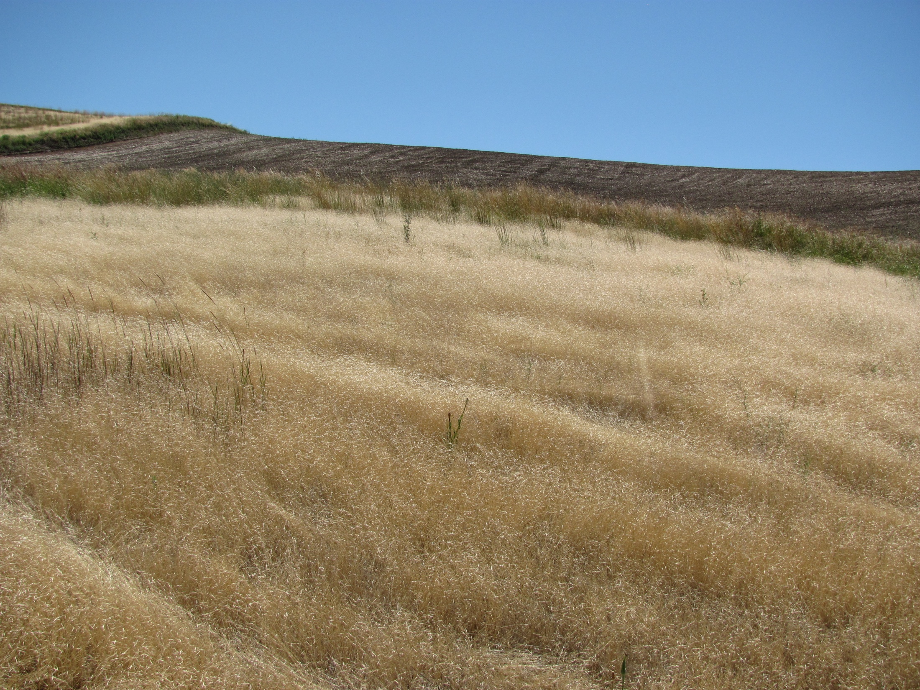
The Effects of VEDU Litter (2011-2012)
Litter Effects
Litter modifies light environment, soil temperature and soil moisture.
Litter may act as a physical barrier for seeds, seedlings and shoots.
Chemical characteristics of litter regulate rate of nutrient release from organic matter.
Decomposition or leaching of litter may have phytotoxic effects.
Notes:
Introduction to litter effects on VEDU growth and development.

Slide 17
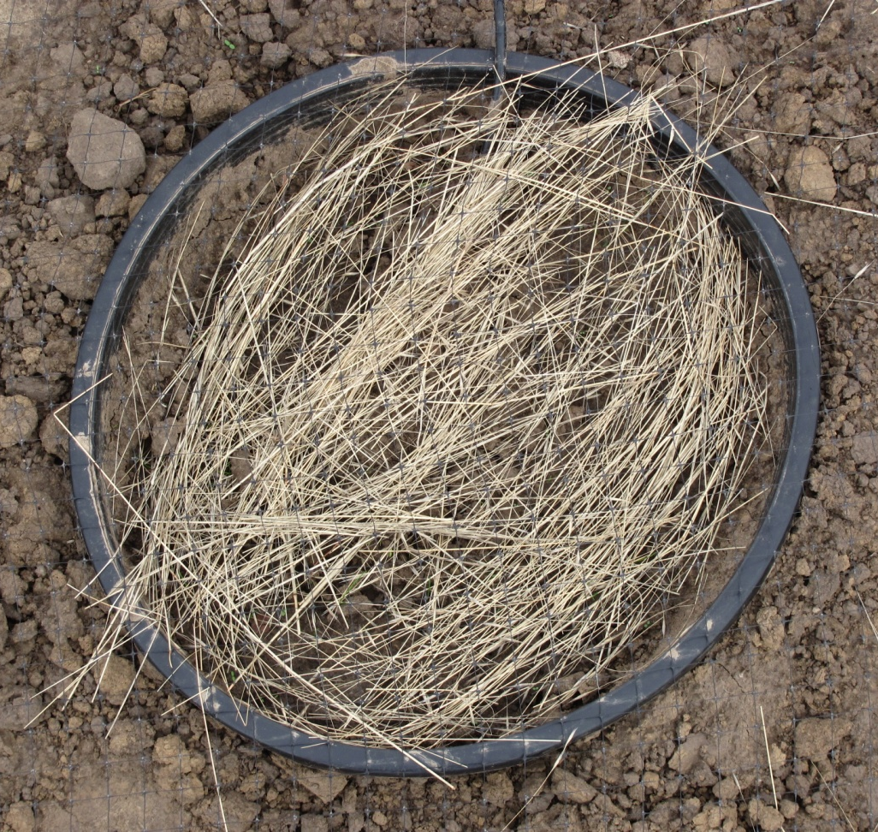
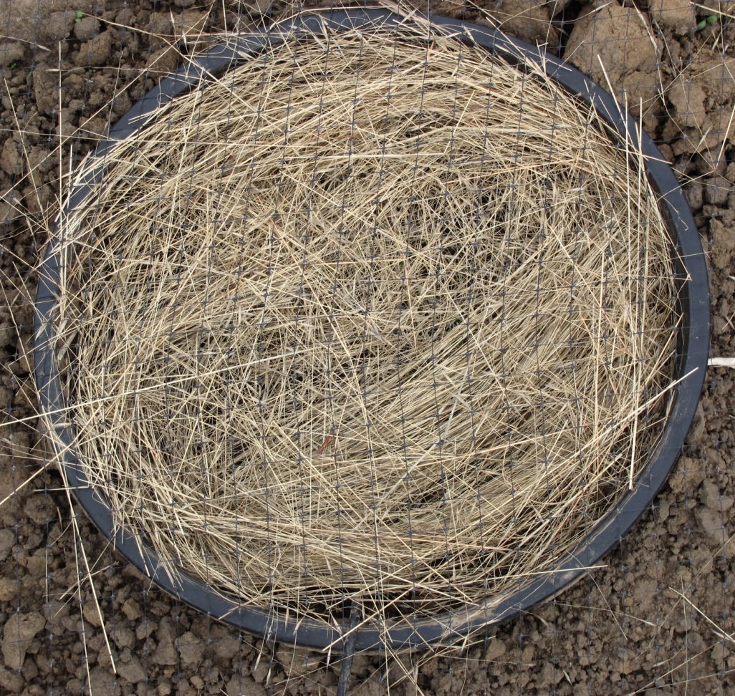
2011-2012 VEDU Litter Study
Notes:
Example of low (5 g; 33% cover) and high (20 g; 99% cover) litter treatments.

Slide 18
No Litter
No Litter
Summary
Seedling emergence and survival increases under higher litter levels
Seedling growth is greater under high litter levels
Notes:
Effect of four litter treatments (0, 5, 10, 20 g) on VEDU seedling densities in Fall 2011.
Effect of four litter treatment (0, 5, 10, 20 g) on VEDU seedling heights in Fall 2011.

Slide 19
Summary
High levels of VEDU litter mediate soil temperature; benefit fall growth
Notes:
Raw Max/Min temperature data for litter control (0 g)
Raw Max/Min temperature data for high-litter (20 g) treatment.

Slide 20
Summary
VEDU litter increases soil moisture throughout fall growing season.
Notes:
a) Raw soil volume water content data across four litter treatments in 2011-2012 growing season.

Slide 21
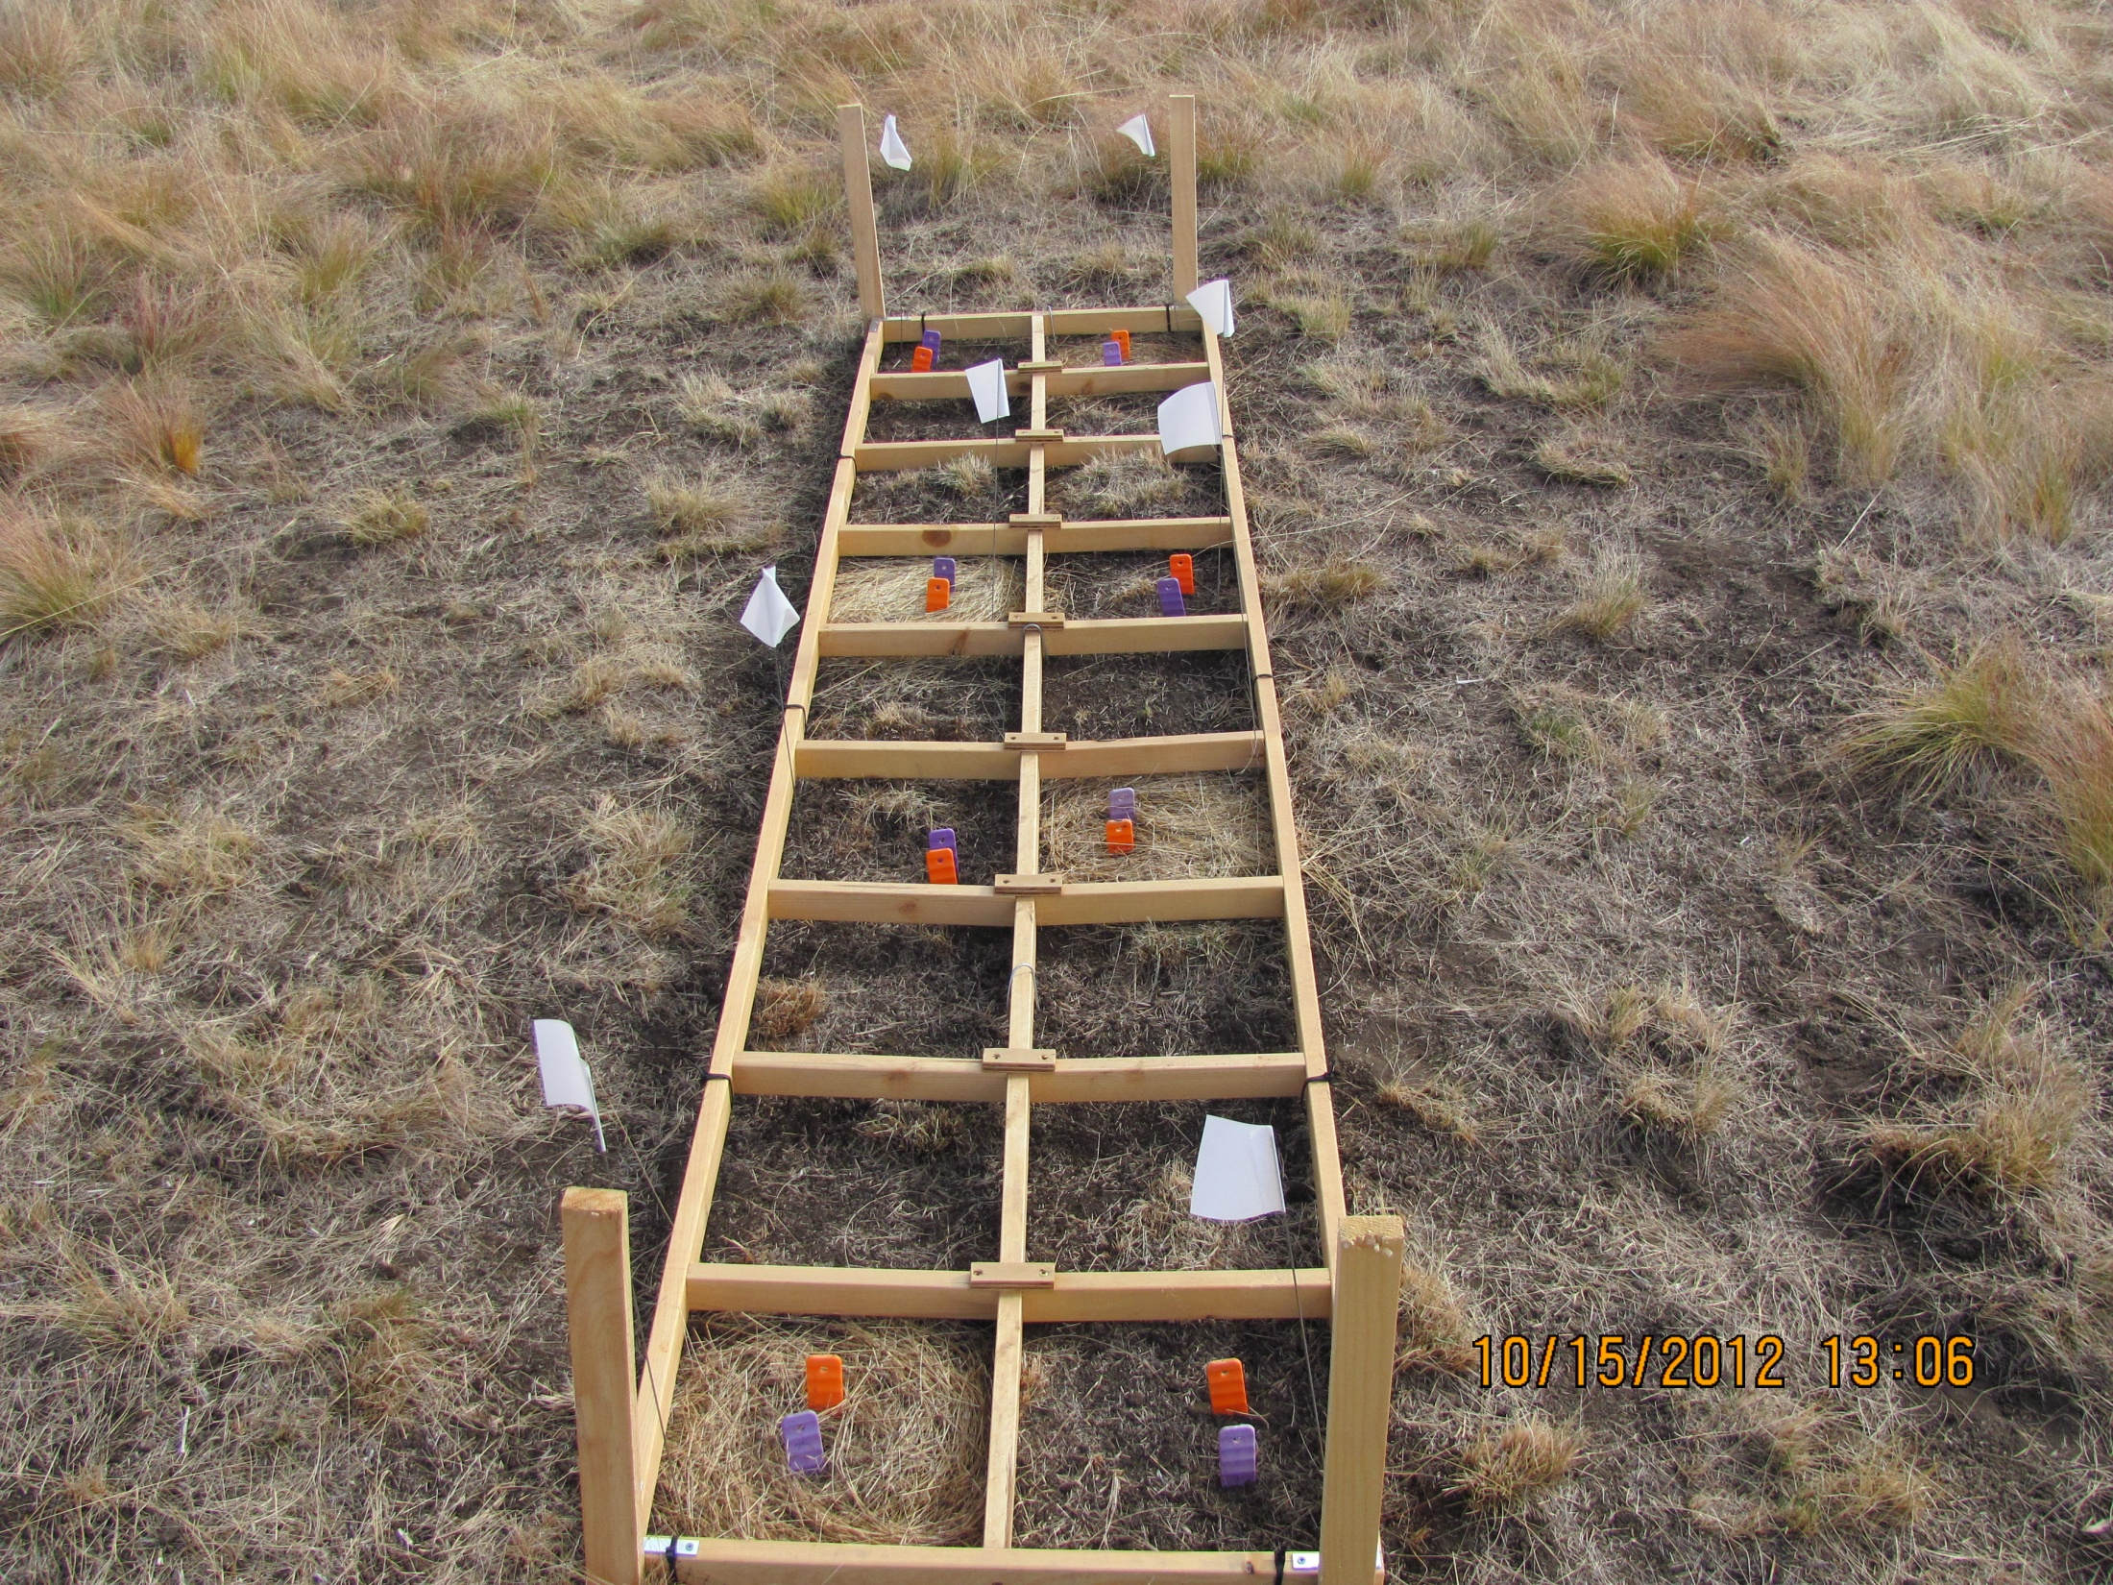
2012-13 VEDU Litter N-cycling Study
Notes:
Study initiated on October 15 2012. Ion-exchange resin probes in high VEDU litter (20 g) and no VEDU litter (0 g)

Slide 22
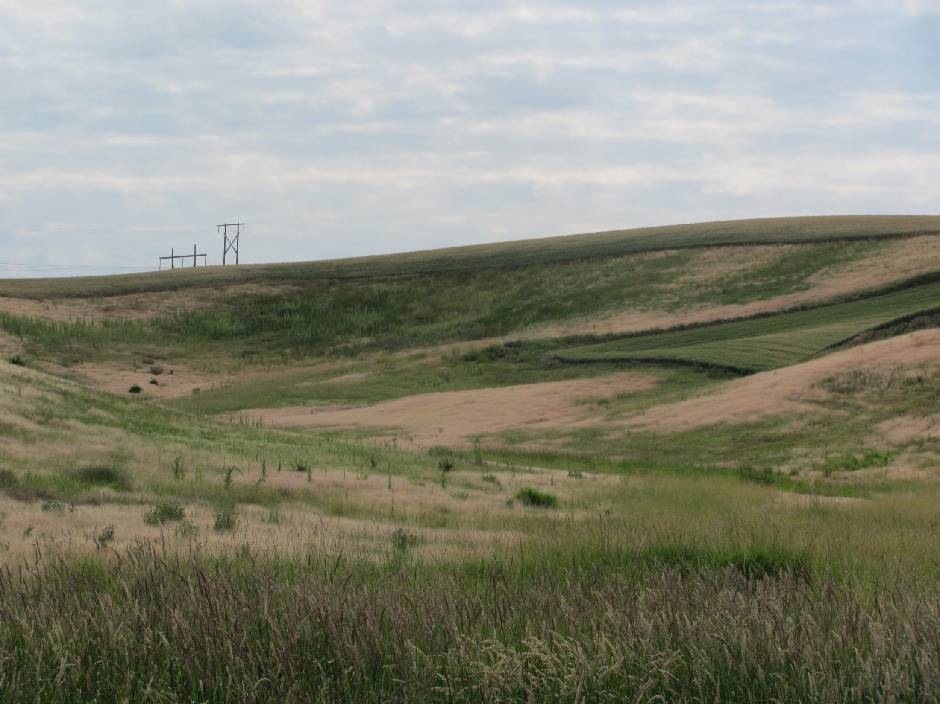
Endophyte Fungi & Ventenata
UI-CRISSP Program (2012)
Observations
Fusarium strains were 16% of observed endophyte types in VEDU plants.
Fusarium genus contains plant pathogens that decrease plant fitness.
Ventenata fitness was not negatively affected by Fusarium infection.
Hypothesis
Fusarium strains that ventenata is associated with cause disease or negative fitness to plant competitors.

Slide 23
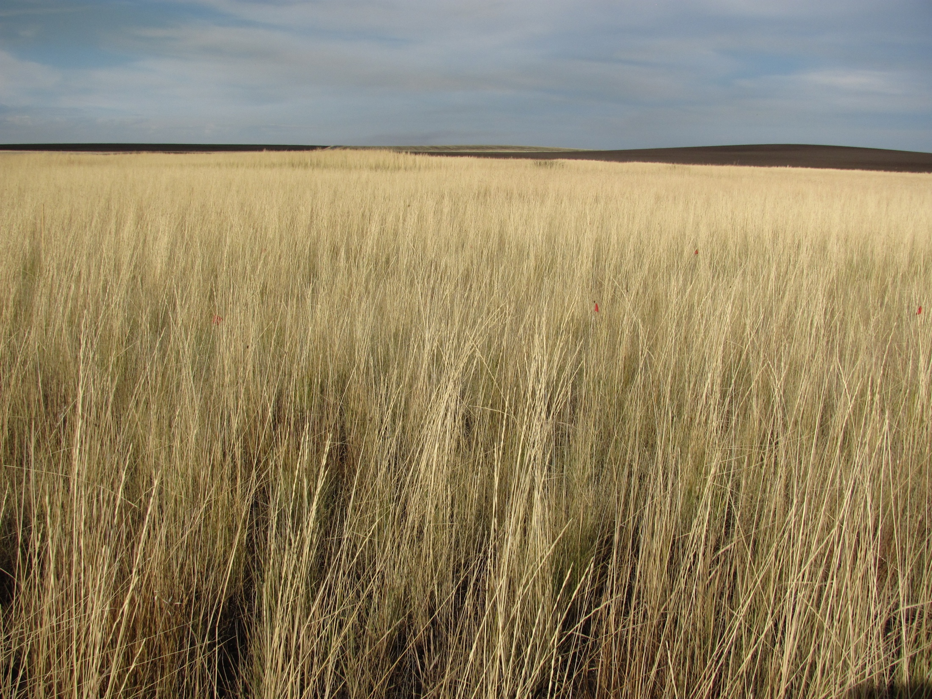
Ventenata Control in CRP & Rangeland
(2011-2012)
Objectives
Compare efficacy of a range of potential VEDU-labeled herbicides
Compare herbicide injury levels on range of perennial grasses
Compare pre- and post-emergent applications

Slide 24
 | Label Summary
Product (chemical) | fl oz/ac ($/ac) | Labeled for VEDU | Labeled for Use | Other Weedy Grasses Controlled | Grazing Restrictions
Outrider (sulfosulfuron) | 1.0 ($17/ac) | No | non-crop pasture rangeland CRP natural areas | downy brome bulbous bluegrass | No grazing restriction; Rest 2 wks before and after application for best results.
Plateau (imazapic) | 6.0 ($10/ac) | No | aerial application forage grass grass/legume forage CRP Land small pasture rangeland | downy brome medusahead meadow foxtail Italian ryegrass | No grazing restriction; Do not harvest hay for 7 d after treatment
Matrix (rimsulfuron) | 3.0 ($40/ac) | No | aerial application non-ag wildlife non-crop agriculture federal EDRR | downy brome Italian ryegrass meadow foxtail medusahead | No established tolerance for forage grass or grazing; 1 yr grazing restriction
Canter (propoxycarbazone) | 1.0 ($14/ac) | No | CRP land pasture rangeland | downy brome rattail fescue windgrass | No grazing restriction
Axiom (flufenacet/metribuzin) | 8.0 (n/a) | No | none applicable | downy brome meadow foxtail rattail fescue | --

Slide 25
Table 1. Soil characteristics of study sites used in ventenata control trials.
Site Location | CRP planting | Soil Texture | % Organic Matter | Soil pH
Anatone WA | Bluebunch wheatgrass | silt loam | 6.5 | 6.2
Grangeville ID | Timothy | loam | 7.4 | 5.4
Moscow ID | Smooth brome/Orchardgrass | silt loam | n/a | n/a
Moscow ID | Intermediate wheatgrass | silt loam | 4.1 | 5.7
Grangeville ID | Intermediate wheatgrass | clay loam | 3.7 | 5.6
Notes:
a) Site characteristics of five study sites used for 2011-2012 herbicide control trial.

Slide 26
 |  | Application Timing
Treatment | CRP planting | PRE (Oct 7-10) | POST (Nov 1-10)
Outrider | Bluebunch wheatgrass | -- | 98
(1 oz/ac) | Timothy | -- | 98
 | S. brome/Orchardgrass | 85 | 94
 | Intermediate wheatgrass (dry) | 91 | 92
Plateau | Bluebunch wheatgrass | -- | 91
(6 oz/ac) | Timothy | -- | 93
 | S. brome/Orchardgrass | 82 | 90
 | Intermediate wheatgrass (dry) | 63 | 70
Matrix | Bluebunch wheatgrass | -- | 98
(3 oz/ac) | Timothy | -- | 98
 | S. brome/Orchardgrass | 98 | 95
 | Intermediate wheatgrass (dry) | 96 | 88
Canter | Bluebunch wheatgrass | -- | 75
(1 oz/ac) | Timothy | -- | 87
 | S. brome/Orchardgrass | 73 | 78
 | Intermediate wheatgrass (dry) | 58 | 81
Axiom | Bluebunch wheatgrass | -- | 75
(8 oz/ac) | Timothy | -- | 92
 | S. brome/Orchardgrass | 91 | 88
 | Intermediate wheatgrass (dry) | 89 | 75
Notes:
a) Mean VEDU control approximately 8 MAT following pre- and post-emergent treatments at four CRP study sites.

Slide 27
PSSP
PHPR
THIN
BRIN/DAGL
Notes:
Mean forage production (tn/ac) 8 months after herbicide treatments in a) bluebunch wheatgrass, b) timothy, c) smooth brome/orchardgrass, and d) intermediate wheatgrass plantings.

Slide 28
Summary
Outrider & Matrix resulted in high levels (>90%) of control as POST- treatment and moderate to high levels (>80%) of control as PRE-treatment. Acceptable levels of injury across perennial grass species.
Plateau resulted in moderate to high levels of control but perennial grass injury is greater in comparison to other treatments.
Axiom resulted in moderate to high levels of control and perennial grass injury was negligible, notably for timothy. PRE-treatments resulted in higher levels of control than POST.
Canter resulted in moderate levels of control. Perennial grass injury was negligible. May provide a spring application timing tool.

Slide 29

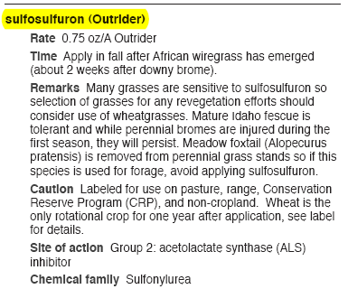
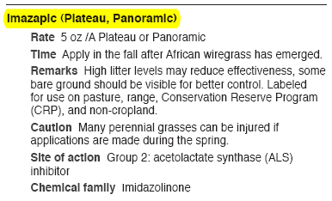
Ventenata Control Options
PNW Weed Management Handbook 2011
Problem Weeds
Summary
Outrider (1 oz/ac) or Plateau (4-8 oz/ac)
Early post-emergent applications in fall
PNW Weed Management Handbook: Pacific Northwest Extension Publication, OSU-WSU-UI

Slide 30
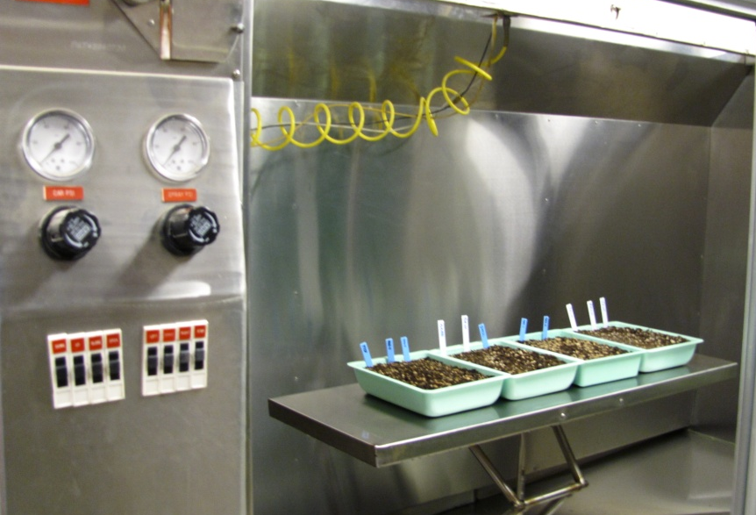
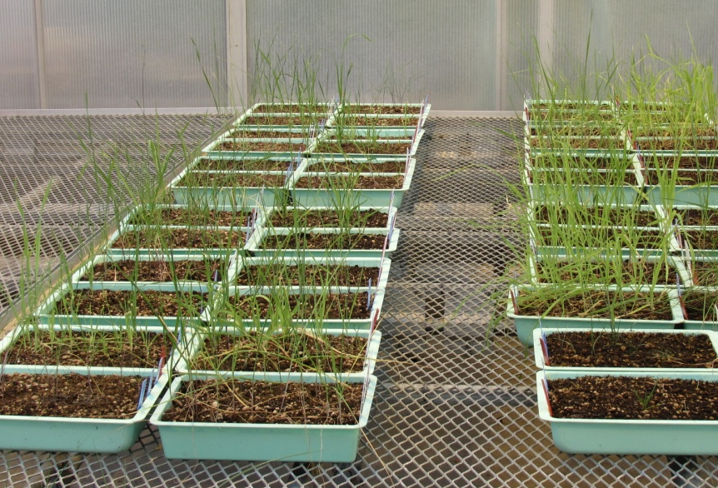
Seedling Tolerance to Outrider
Planting CRP and Pasture Grasses in Outrider Treated Soil
1 half-life
2 half-life
Pictures: J. Wallace
Notes:
Perennial CRP and pasture grass yields as a percentage of the control at fives rates of sulfosulfuron.

Slide 31
Plant Back Considerations
Biomass yield as % of control (60 days after Outrider treatment)
Source: J. Wallace
Notes:
Perennial bunchgrass yields as a percentage of the control at fives rates of sulfosulfuron.
Timothy yields as a percentage of control at five rates of sulfosulfuron.

Slide 32
Plant Back Considerations
Outrider Soil Residual: Half-life in soil
Outrider Soil Residual: Half-Lives
Bare ground field study: 14 to 75 d
Silt loam (0.8% OM, pH 7.5): 32 d
Sandy loam (1.5% OM, pH 6.8): 35 d
Species
Bluebunch wheatgrass
Intermediate wheatgrass
Sandberg bluegrass
Western wheatgrass
Orchardgrass
Meadow brome
Idaho fescue
Canada bluegrass
Timothy
Smooth brome
Tolerance
Higher
Lower
Summary
Wheatgrass species may be planted 150 d (2 half-lives) after treatment.
Other perennial grass species may be injured when planted at 150 d.
Source: J. Wallace
Notes:
Relative tolerance of perennial grass species to sulfonylurea.

Slide 33
Herbicide Field Trial Priorities
Fall or spring timed treatments with glyphosate
Late season seed production control with growth regulators
Effect of existing tools on legumes in grass hay or CRP
Plant-back issues vs. restoration of existing stands

Slide 34
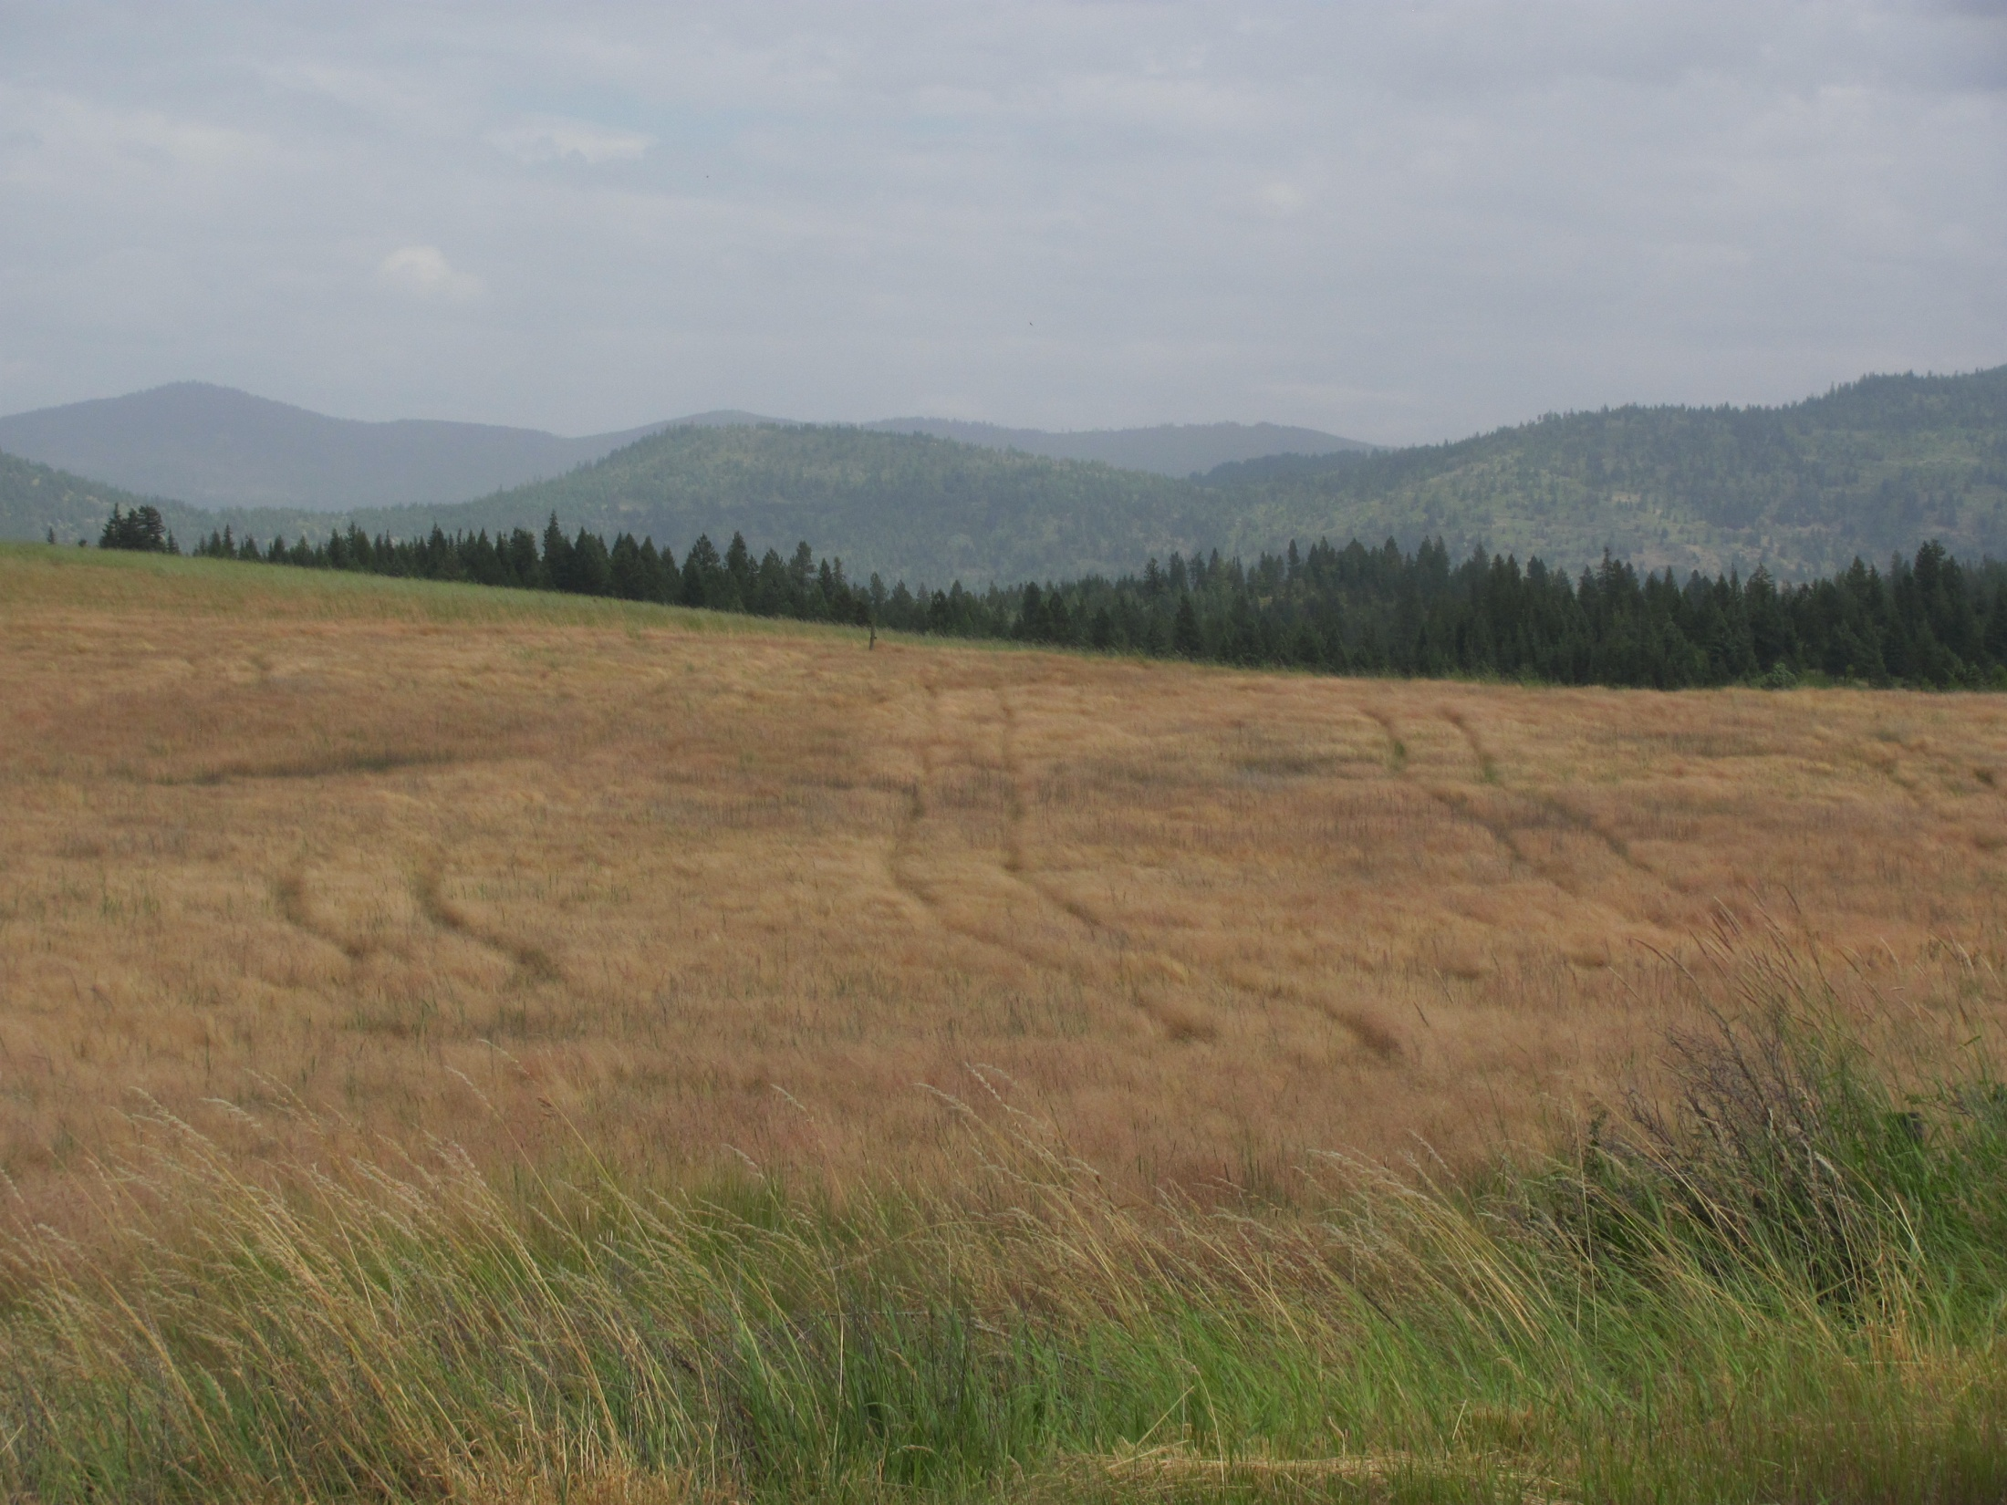
Ventenata IPM Development for CRP, Small Pasture & Timothy Hay (2012-2013)
Ventenata Management Decision Tool
Site Condition
Litter Management
Fertilizer Program
Chemical Control

Slide 35
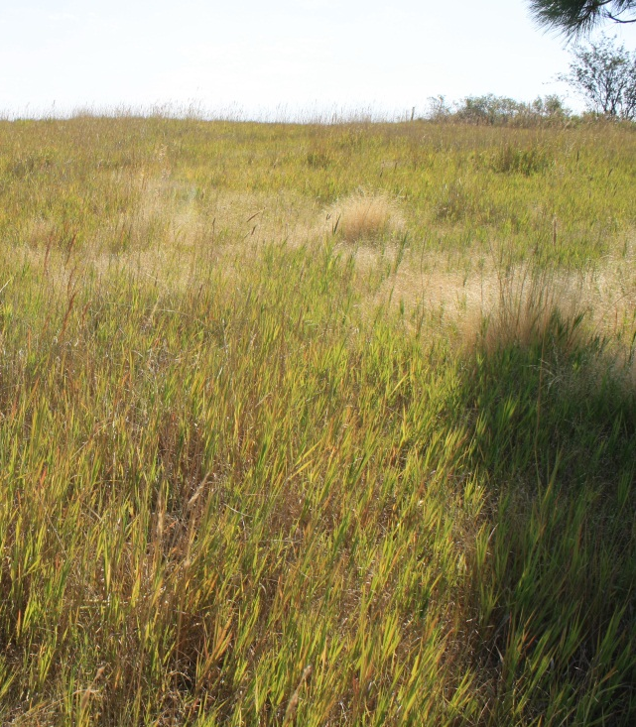
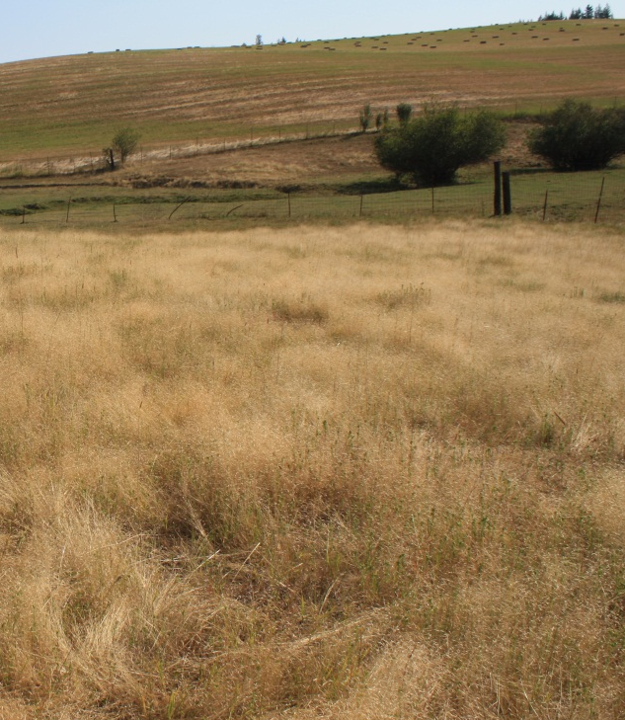
Ventenata IPM
High vs Low VEDU sites
Low VEDU
High VEDU
Pictures: Andrew Mackey

Slide 36
IPM Treatment Structure (2012-2013)
CRP Litter Trt
Mow
Mow & Remove
Fall Burn
Spring Burn
Control
Herbicide/Fertilizer Trt
Fall Herbicide
Split Fertilizer (Fall PK + Spg N)
Herbicide + Fertilizer
Control
Grazing Litter Trt
Fall
Summer
Control
Timothy Hay Litter Trt
Cut 2”
Cut >4”
Cut 2” + Fall Graze
Notes:
a) See Mackey’s proposal for dates of treatment initiation.

Slide 37
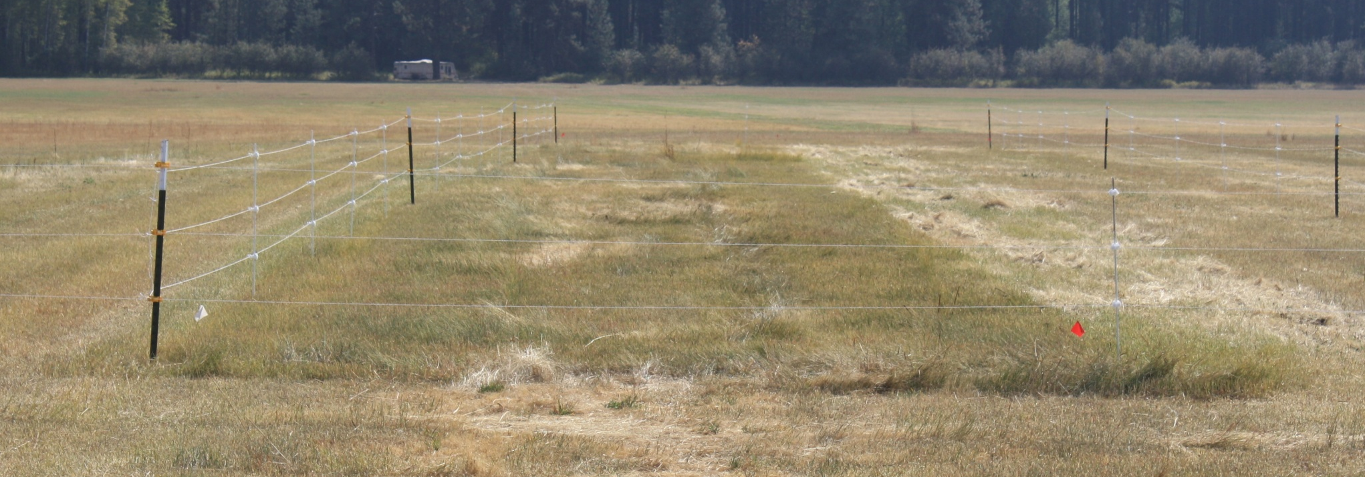
Grass Hay IPM Strategies
Harvest Heights
September 2012
Timothy Hay Management Guidelines
Higher harvest heights preserve stored sugars important for surviving drought stress and growth
P&K fertilization increase root and shoot development, resulting in earlier spring green-up.
What are the implications for weed management?
Source: Steve Fransen, WSU-IAREC, Prosser WA

Slide 38
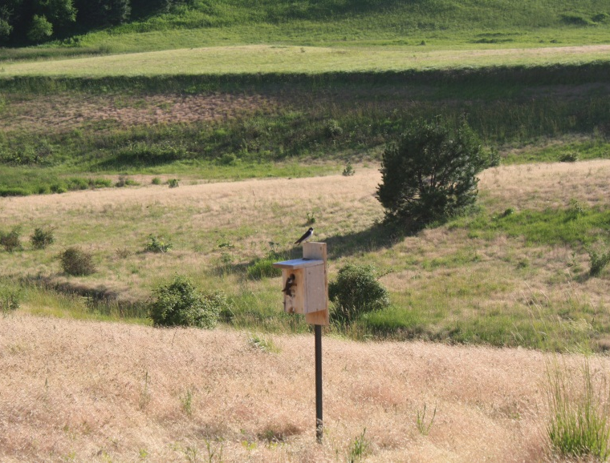
Indirect Effects of Ventenata on Wildlife Habitat
Picture: Andrew Mackey

Slide 39
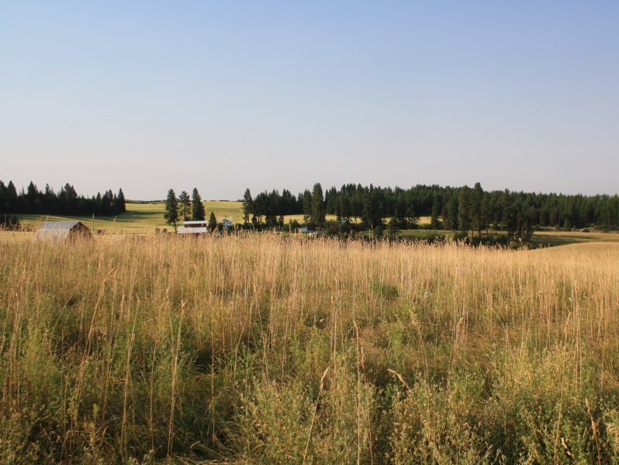
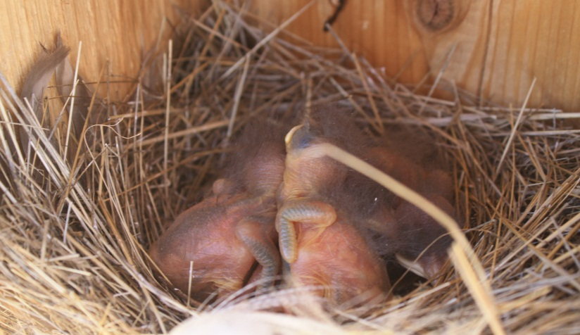
Nest armored w/VEDU)
 | Total Boxes | Avg. Clutch Size | Empty Boxes | Eggs not Viable | Nest Failure | Eggs Laid to Fledge | Survival after Hatch
 |  |  | --------------------------- % ----------------------------
High | 24 | 5.00 | 33 | 45 | 25 | 48 | 86
Low | 31 | 5.23 | 29 | 17 | 0 | 79 | 95
Source: Andrew Mackey

Slide 40
Questions & Discussion
John Wallace, Tim Prather, Andrew Mackey & Pam Pavek
University of Idaho & USDA-NRCS Plant Materials Center
jwallace@uidaho.edu

