Slide 1
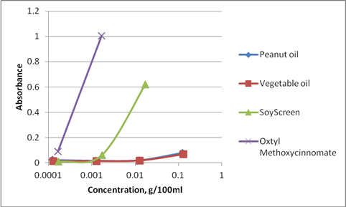
Fig. 1. This graph (above) shows that vegetable or peanut oils have little absorbance, soyscreen is intermediate and OMC is good for absorbing 300nm wavelength. OMC (Oxtyl MethoxyCinnomate) is commonly used in sunscreens.

Slide 2
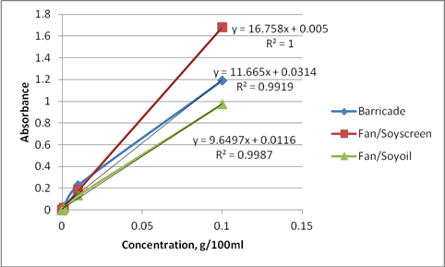
Fig. 2. Similarly with the barricade, greater concentration resulted in greater absorbance. Fantesk/soyscreen (starch encapsulated oil) and mixed in water had greater absorbance than Fantesk/soybean oil.

Slide 3
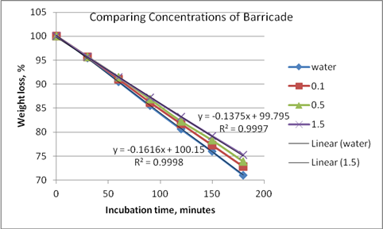
Fig. 3. barricade did not drastically reduce water evaporation; Thus, the benefit of Barricade for the nematodes is the amount of water that can be retained on the tree.The thicker the coating the better.

Slide 4
Fig. 4. None of the formulations indicated any toxicity relative to the control (C= water) except Ss-F (Soyscreen-Fantesk) and NemaProtect (NemaP). Barric = Barricade, Ss = soyscreen, TD = titanium dioxide, Yucca = yucca foam.

