Slide 1
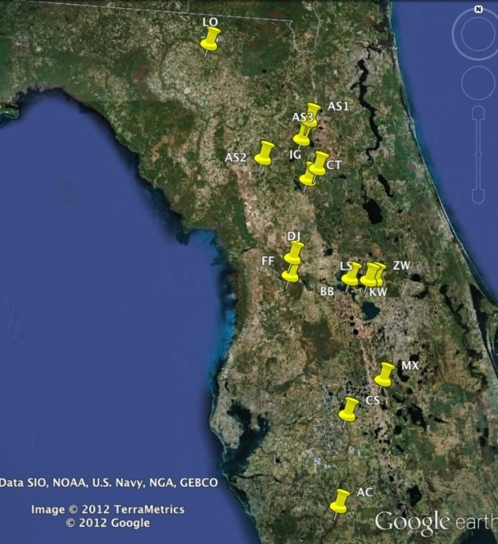
Mean SWD By County
a
P < 0.05
b
bc
bcd
cd
cd
d
d
d
Notes:
- present in all except 1, DeSoto southern-most
- Citrus significantly higher than all others with 40 mean SWD & 37% greater numbers than the next county, Alachua (15), and 24% greater than Orange (9.8)
Citrus 40.08
Alachua 15.06
FES judge notes: add one sentence to slide that explains the graphs

