Slide 1
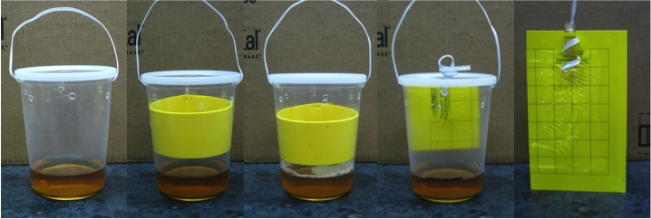
Trap Treatments
A
B(yel)
C(soap)
D(card)
Control
Notes:
Trap treatments were based on current recommendations for capture of SWD and other drosophilids. All traps were baited with ACV.
A – basic cup trap
B – basic cup trap with a yellow visual stimulus amendment
C – basic cup trap with yellow visual stimulus and 2 drops odorless dishsoap which acts as a surfactant thought to help prevent fly escape.
D – basic cup trap with a YSC inside to help prevent fly escape
Cont – YSC with vial of ACV
----- Meeting Notes (7/21/12 16:19) -----
change trt a and b

