Slide 1
Maintaining Companion Planting Techniques
While Mechanizing in Diverse, Small-Farm Vegetable Operations
Rob Faux
Genuine Faux Farm
Tripoli, Iowa

Slide 2
Old Spacing – No Tractor (2011)
Flowers and Spices
Double Row Kohlrabi
Double Row Onion
Single Row Cauliflower
Single Row
Broccoli
Double Row Onion

Slide 3
New Spacing – Tractor (2011)
Wheel Track
40 “ Bed
Wheel Track

Slide 4
Planting in Tractor ‘Spaced’ Beds
Triple Row – Onion & Kohlrabi

Slide 5
Modified Spacing – No Tractor (2012)
Each Double Bed Approx 56”

Slide 6
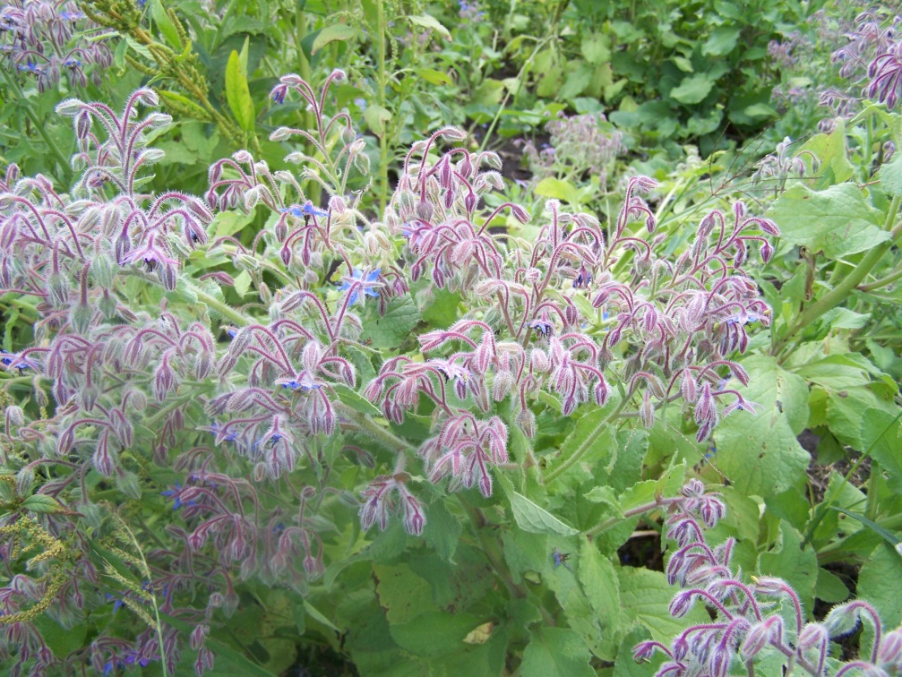
Intercropping
Brassica, Allium, Sage
Potatoes, Beans, Marigolds
Tomatoes, Basil, Parsley, Cilantro
Winter Squash, Zinnia, Nasturtium, Borage
Summer Squash, Garlic, Root Crops
Peas, Cucumbers, Carrots, Pole Beans
Peppers, Eggplant, Beans, Okra
Melons, Zinnia, Marigold, Borage

Slide 7
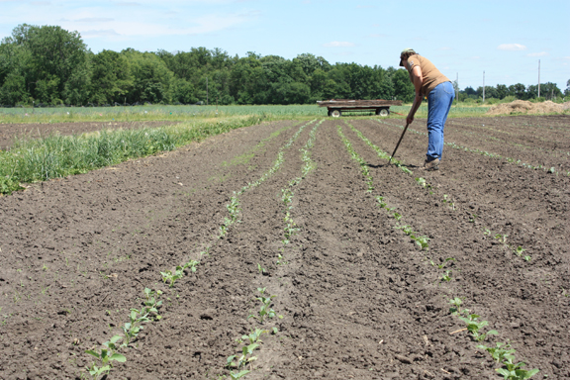
Brassica/Allium 2012
No Tractor Spacing – 2nd method
Tractor Spacing

Slide 8
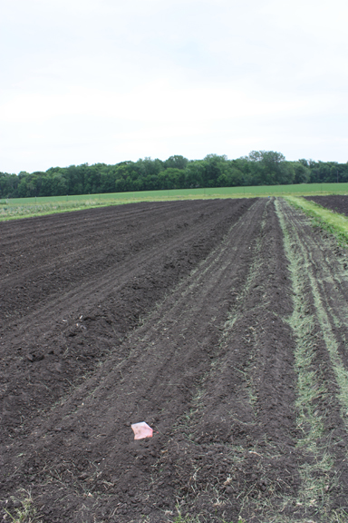
Potato/Bean 2012
Tractor Spacing
No Tractor – 1st Method
Potatoes
Beans
Potatoes
Beans

Slide 9
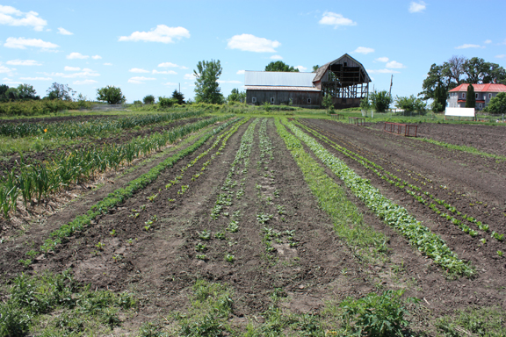
May - No Tractor – 2nd Method

Slide 10
June – Brassica/Allium
Tractor Spacing
No Tractor Spacing (2)

Slide 11
June – Potato/Bean – Tractor

Slide 12
June – Potato/Bean – No Tractor (1)

Slide 13
June – Potato/Bean – Weed Problem is In Row

Slide 14
July – Brassica/Allium – No Tractor (2)

Slide 15
July – Brassica/Allium - Tractor

Slide 16
Tractor Spacing – After Harvest

Slide 17
July – Potato/Bean - Tractor

Slide 18
July – Potato/Bean – No Tractor

Slide 19
A Little Diversion From the Planned Season

Slide 20
August – Brassica/Onion
Just a little rain
A little distraction
Weeds reestablish
Wind roll of larger brassica onto allium in both spacing
More issue with wind roll in tractor spacing

Slide 21
October – Brassica/Onion

Slide 22
Cultivation – Wheel Hoe & Hand Tools

Slide 23
Cultivation - Tractor

Slide 24
Cultivation - Tractor
S Tine Cultivator
Removable gangs
Can be used to ‘rake’ big weeds if set high
Catches “trash” proficiently
Ideally cultivate before weeds much bigger than 6 inches.

Slide 25
New Option – Paper Mulch

Slide 26
Flat Bed Mulch Layer

Slide 27
Irrigation
Fewer row feet of drip tape in tractor spacing
Different root zones provides opportunity to share drip line
Laying drip line effort similar for both spacing options
Drip line sharing worked better for beans/potatoes than brassica/allium

Slide 28
Potato Harvest

Slide 29
Potato Harvest – Non Tractor Spacing

Slide 30
Bean Harvest Comparisons
Bean harvest results depended on variety of green bean.
 |  | Pounds | Pounds/ Seed Foot | Pounds/ Row Foot
Provider | Tractor | 193 | 0.97 | 0.97
Provider | No Tractor | 235.65 | 0.59 | 1.18
Jade | Tractor | 169.85 | 0.85 | 0.85
Jade | No Tractor | 353.5 | 0.88 | 1.77
Double row in non-tractor spacing not worth seed spent on Provider
Double row in non-tractor well worth it for Jade
Proximity to potatoes not an issue for either bean

Slide 31
Potato Harvest Comparison
One variety seems unaffected
Second may be impacted, but not statistically significant
Harvest on our farm waits until beans are done, so no difference
Potato digger stayed on track better in non-tractor spacing
Able to hill potatoes in non-tractor
Potato size similar in both spacings
Rio Grande | No Tractor | 213.4
Rio Grande | Tractor | 151.2
Purple Majesty | No Tractor | 173
Purple Majesty | Tractor | 182.6
Bullwinkle the Potato

Slide 32
Maintaining Companion Planting Techniques
While Mechanizing in Diverse, Small-Farm Vegetable Operations
Rob Faux
gff@genuinefauxfarm.com
www.genuinefauxfarm.com
Genuine Faux Farm
Tripoli, Iowa

