Slide 1
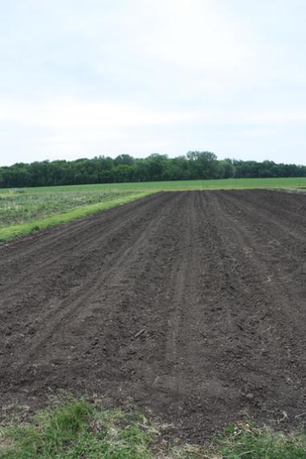
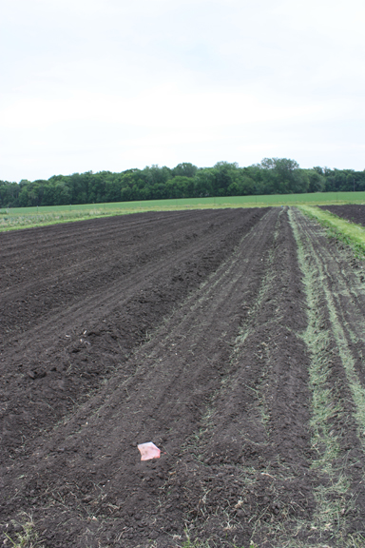
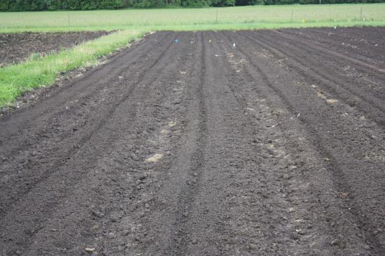
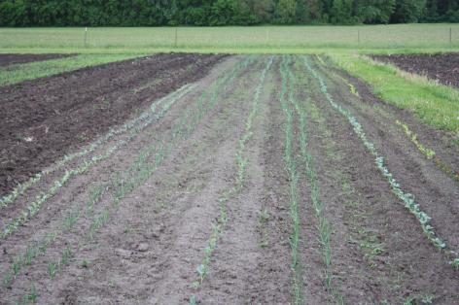
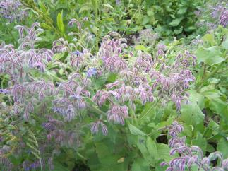
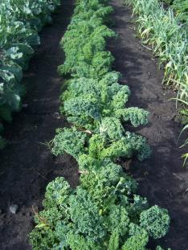
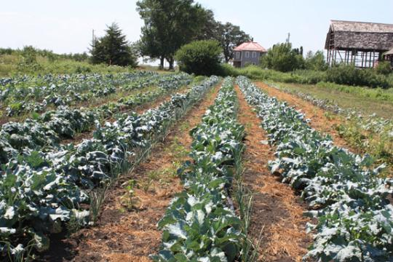
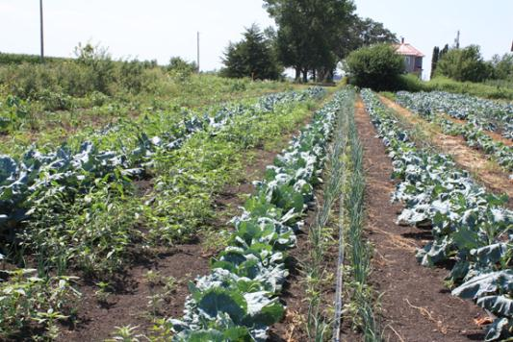
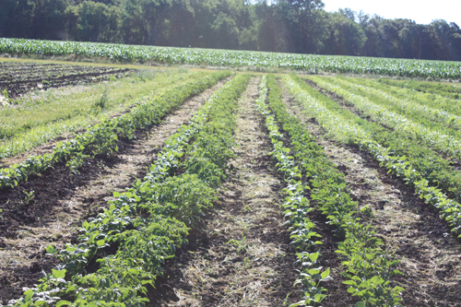
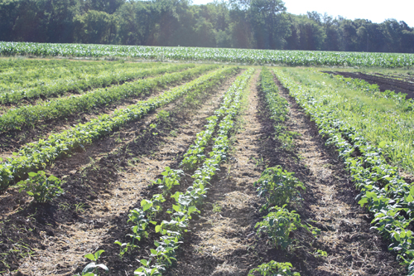
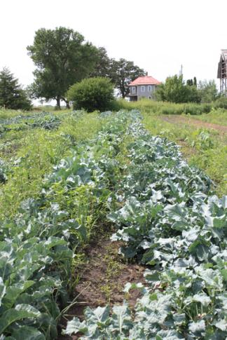
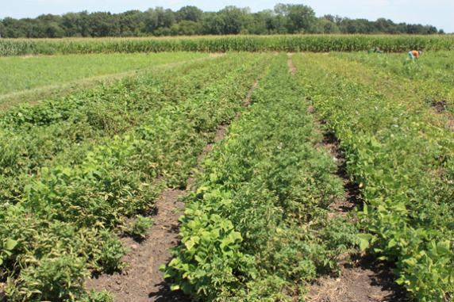
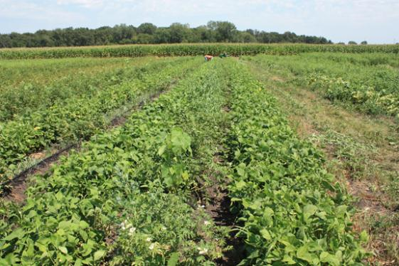
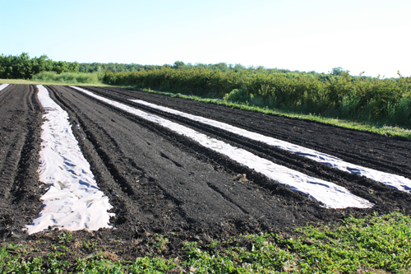
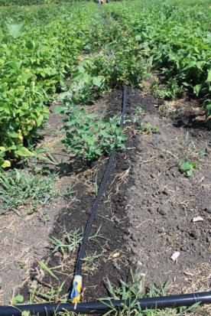
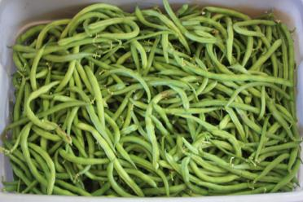
Maintaining Companion Planting Techniques While Mechanizing in Diverse, Small Farm Vegetable Operations SARE Funded Research – Genuine Faux Farm, Tripoli, Iowa
Potato/Bean Tractor Spacing
Potato/Bean
No Tractor
Purpose
New Spacing – Tractor
Old Spacing – No Tractor
Trial row spacing that will allow a farm to mechanize and intercrop vegetables without losing the benefits of selected companions.
Observations were taken to determine workability, intercrop benefit levels and bottom line considerations such as yield and labor cost.
Intercropping
Double Row Kohlrabi
Double Row Onion
Single Row
Broccoli
Double Row
Onion
Single Row Cauliflower
Wheel Track
40 “ Bed
Wheel Track
Potatoes
Brassica, Allium, Sage
Potatoes, Beans, Marigolds
Tomatoes, Basil, Parsley, Cilantro
Winter Squash, Zinnia, Nasturtium, Borage
Summer Squash, Garlic, Root Crops
Peas, Cucumbers, Carrots, Pole Beans
Peppers, Eggplant, Beans, Okra
Melons, Zinnia, Marigold, Borage
July – Brassica/Allium
Tractor
Potatoes
July – Brassica/Allium
No Tractor
Beans
Double Row
Beans
Potatoes
June – Potato/Bean
Tractor
June – Potato/Bean
No Tractor
Why Intercropping?
Increased diversity in crop environment
Pest control
Beneficial attraction
Reduction of disease spread
Diverse crops are their own form of insurance
Why NOT Intercropping?
Planting times for one crop may not be optimal
Complex planning
Difficult to scale up
New Potato/Bean Spacing a Winner
Wins
Labor wins for between row cultivation, irrigation and bean harvest
Slight reduction for in row weeding labor costs
50% reduction in drip tape
Can increase number of rows planted for potatoes in same plot size and maintain beans
Losses
Hilling potatoes very difficult with companion bean so close
A cropping system that does not mulch beans or does not do double rows will result in an increase in labor for mulch application.
Ties
Yield is sufficiently maintained for both crops
Colorado Potato Beetle control. In both plantings pest only observed on the edges of the field
Mulching labor has similar difficulties
Potato harvest ease and labor similar
Questions
Would Colorado Potato Beetle control still be effective if each 40” bed were a single crop ?
Can a modified planting schedule address some of remaining problems.
Bottom Line
Labor cost reduced by 18%, drip tape by 50% and yield maintained.
We will adopt new spacing for our entire bean/potato planting
We will continue to explore options to address additional issues.
August – Brassica/Onion
July – Potato/Bean
Tractor
July – Potato/Bean
No Tractor
Just a little rain
A little distraction
Weeds reestablish
Wind roll of larger brassica onto allium in both spacing
More issue with wind roll in tractor spacing
Brassica did equally well in each spacing
Onions failed in tractor spacing
Issue: Planting Times Must Be Within One Week in Tractor Bed
Possible Solution: Paper Mulch
Bean Harvest Comparisons
 |  | Pounds | Pounds/ Seed Foot | Pounds/ Row Foot
Provider | Tractor | 193 | 0.97 | 0.97
Provider | No Tractor | 235.65 | 0.59 | 1.18
Jade | Tractor | 169.85 | 0.85 | 0.85
Jade | No Tractor | 353.5 | 0.88 | 1.77
Potato Harvest Comparison
One variety seems unaffected
Second may be impacted, but germination issue renders statistically insignificant
Harvest on our farm waits until beans are done, so no difference in picking labor
Potato digger stayed on track better in non-tractor spacing
Easier to hill potatoes in non-tractor
Potato size similar in both spacings
Irrigation
Double row in non-tractor spacing not worth seed spent on Provider
Double row in non-tractor well worth it for Jade
Proximity to potatoes not an issue for either bean
Labor for picking double row slightly higher
Fewer row feet of drip tape in tractor spacing
Different root zones provides opportunity to share drip line
Laying drip line effort similar for both spacing options
Drip line sharing worked better for beans/potatoes than brassica/allium
Results and Recommendations – Brassicae/Allia:
If same companion set maintained, old spacing preferred to maintain onion crop.
A different companion, such as sage or summer thyme with brassica in tractor spacing
Establish onions sooner than larger brassica, or companion with smaller brassica
Labor cost similar, most of effort is in row weeding driven by number of allia, paper mulch may serve to reduce cost better, but this results in a new spacing technique
Companion effect maintained in both spacings for brassicae.
Shared drip line may not be as effective in this intercrop set as potato/bean
Pest pressure very low in 2012 for both crops
Rio Grande | No Tractor | 213.4
Rio Grande | Tractor | 151.2
Purple Majesty | No Tractor | 173
Purple Majesty | Tractor | 182.6

