Slide 1
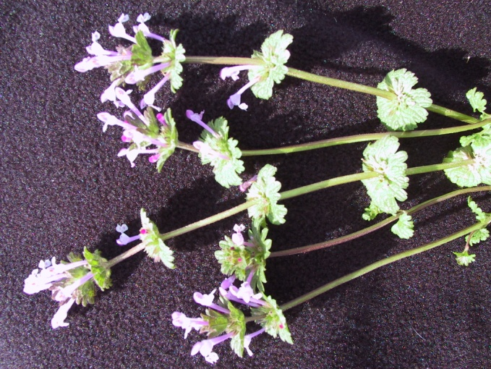
What is the best herbicide for New Apple Plantings?
Deborah I. Breth
Elizabeth Tee
Cornell Cooperative Extension-LOF
NESARE Partnership Grant

Slide 2
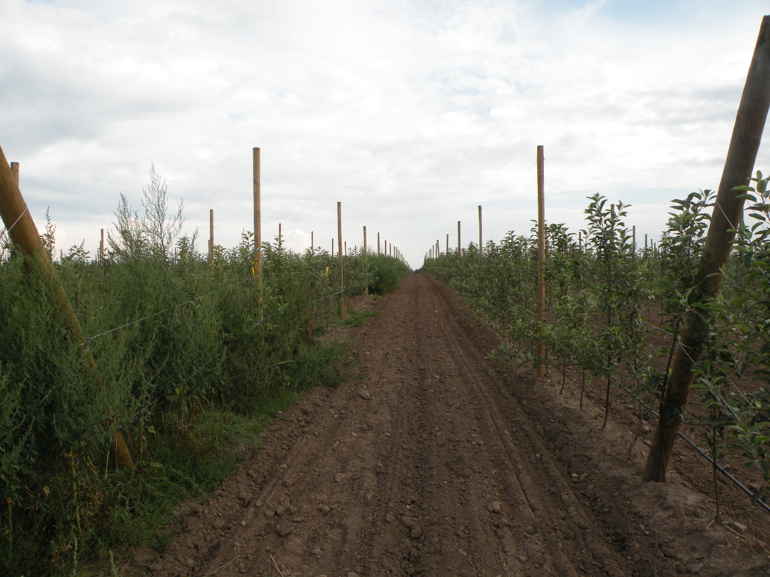
Lamont Fruit Farm
Gala on B9, Super Spindle, 1980 trees/acre
Untreated check
Notes:
This is the newly planted orchard (~May 15) at Lamont Fruit Farm and the bottom left corner is the untreated check. This is a Gala on Bud 9 super spindle system planted at 2X 11 ft spacing, 1980 trees per acre.

Slide 3
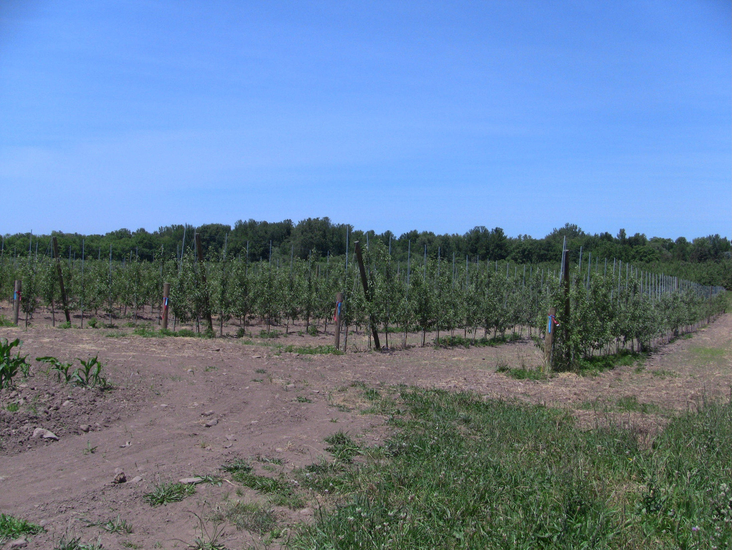
NESARE Partnership Grant – Mason Farms
Snappy Mac on M9, Tall Spindle, ~750 trees/acre
Notes:
This is Mason farms, the 1 year established orchard. Snappy Mac planted on Bud 9, tall spindle planting, at ~750 trees per acre.

Slide 4
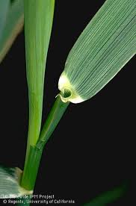
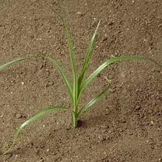
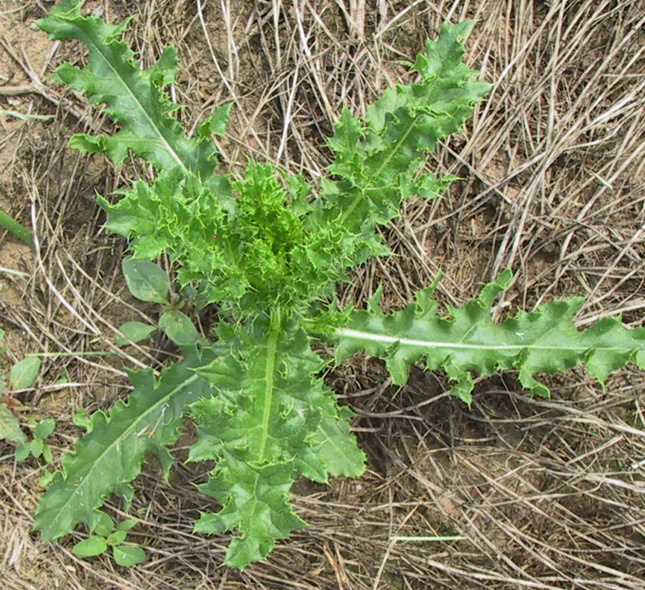
selecting herbicides Depends on Weed Problem:
Identify problem weeds before planting a new orchard
  Perennials, especially Canada thistle, milkweed, bindweed, curly and broadleaf dock, quackgrass, nutsedge, etc.

Slide 5
Depends on Weed Problem:
  Apply herbicide to actively growing perennials the year prior to planting
    use combination of 2,4-D + glyphosate or Stinger, depending on weed species and check the best growth stage of treatment for the specific weed.
    Or address these weeds using herbicides compatible with an annual glyphosate-resistant crop the year prior to planting. May still need to spot treat.

Slide 6
Herbicides Year of planting new orchard
Options include: Residual herbicides
pendamethalin (Prowl, Prowl H2O )
oryzalin (Surflan)
oxyfluorfen (Goal, GoalTender, Galigan H2O)
terbacil (Sinbar)
flumioxazin (Chateau SW)
Post-emergence: glyphosate, paraquat, Aim, Venue

Slide 7
 | MODE OF ACTION | STRENGTH | WEAKNESS | RAINFALL NEEDED?
Prowl | Root uptake, inhibits cell division at growing points | Annual grasses, lambsquarters, pigweed | ragweed | ½ - 1 in. before weeds germinate
Surflan | Root uptake, inhibits cell division at growing points | Annual grasses, annual broadleaves | ragweed and PA smart-weed | ½ - 1 in. before weeds germinate
Goal, GoalTender | Nontranslocated, cell membrane destruction, PPO | Annual broadleaves | annual grasses | Tank mix partner?
Chateau | Nontranslocated, cell membrane destruction, PPO | Annual broadleaves, and grasses | annual grasses | Tank mix partner?
Sinbar | Taken up by roots through xylem to older leaves, then younger leaves, inhibits photosynthesis | Annual grasses and broadleaves, suppresses nutsedge, quackgrass, horsenettle | pigweed | Within 3-4 days after application

Slide 8
Be CarefuL:
All of these herbicides can damage parts of new trees like they damage weeds physiologically if they come in contact.
Selectivity is through placement in the soil, limiting access to tree roots, and shoots.
Adjust graft unions, stamp in trees, water them in
Must wait until after soil settling rainfall after planting to prevent contact of these herbicides with tree roots.

Slide 9
Newly planted orchards
As soon as soil settling rainfall, apply pre-emergence residual herbicide –
  Prowl H20 or Surflan, or in combination with Goal/Goaltender by budswell or Chateau by pink.
  Sinbar at 8 oz./a
  Pre-emergence needs to be rained in by ½ - 1 inch of rain
Will need post-emergence control, paraquat or glyphosate (be careful to not spray green bark or drift!)
Paraquat is not as effective on ragweed
Notes:
Recommendations for newly planted orchards. Wait until a soil settling rainfall has occurred after tree planting to prevent the herbicides from washing down into the trees’ roots. Time it so you will get rainfall to incorporate the herbicide into the weed seed germination soon after application.

Slide 10
Evaluation of treatments
DAT - days after residual treatment when post-emergence needed
# P sprays – number of post-emergence treatments needed
% WC = % weed cover, goal is <20% avg for the season.
TCA (trunk cross-sectional area cm²) which I then use to predict potential crop load
Identified weeds that grew through treatments
Looked for trunk damage

Slide 11
2011 Lamont Fruit Farm - Newly planted trees (irrigated)
Treatment Residuals applied May 23 alone followed by P or G | DAT | # P sprays | Avg % WC* | TCA
Untreated |  |  | 74 a | 1.9 e
Surflan + paraquat (P) | 40 | 2 | 14 b | 2.7 bcd
Prowl + P | 40 | 2 | 4 b | 2.9 bc
Surflan + Chateau + P | 65 | 1 | 10 b | 2.9 abc
Prowl + Chateau + P | 40 | 2 | 7 b | 2.9 abc
Prowl + glyphosate (G) | 40 | 2 | 11 b | 3.5 a
Prowl + Chateau + G | 52 | 1 | 2 b | 3.1 ab
Surflan + GoalTender + P | 57 | 1 | 8 b | 2.9 abc
Prowl + Goaltender + P | 57 | 1 | 7 b | 3.0 abc
Sinbar + P | 40 | 3 | 12 b | 2.4 cde
Green Match - Post | 12 | 3 | 68 a | 2.2 de
* = values with the same letters are not statistically different, Tukey HSD All-Pairwise Comparison
Notes:
The weed control results for the untreated check and the Green Match (Omri certified organic burndown herbicide) were essentially the same. The % weed cover was date dependent, but the important factor was the number of days after the residual treatments were made that I needed to follow-up with a burndown Gramoxone or glyphosate. I the newly planted orchard, the Surflan, Prowl, and Sinbar treatments alone were the shortest residual. I added Chateau to Surflan or Prowl which should have extended the residual by another 2-3 weeks, but not sure why not in one of the Prowl Chateau treatments. I only added Chateau at 8 oz per acre but would have gotten a longer interval of control if I had used 12 oz./acre Adding Goaltender to Surflan or Prowl extended the control of Prowl or Surflan alone by 2-3 weeks and in these treatments, only 1 Gramoxone was needed for follow-up the remainder of the season. The last column shows the number of post-emergence treatments, Gramoxone (paraquat, P) or glyphosate (G) were necessary though August to maintain a low threshold of 20-30% weed cover. The Green Match was only effective on a 12 -14 day schedule and only worked on small seedlings. The ragweed grew around the burned parts of the plants sending up tougher, healthier stalks.

Slide 12
1st Leaf planting Data
No significant difference in %WC among trts before mid-Aug, all below 20% , 1-3 more sprays
All trts had significantly less % weed cover compared to Untreated and Post-emergent plots
Best trt =lowest % WC, Prowl + Chateau + 1 gly
Not different from Surflan/Prowl + GoalTender /Chateau + 1 paraquat
Prowl + gly had greatest tree trunk growth, better than Sinbar but not better than other combinations. Potential crop - 12 apples/tree
Least increase in tree growth in untreated checks and post-emergent plots. 7-8 apples/tree

Slide 13
2rd leaf options: established 1 year
All year-of-planting options
Simazine and diuron, lower rates
Matrix
Sandea, especially if nutsedge infestation
Casoron CS
Post-emergence: Rely, 2,4-D, TreeVix

Slide 14
2nd leaf Summary – Lamont 2012
Materials: | **DAT | # Post-Apps | Avg. % WC | TCA
Untreated check | - | - | 97 a | 3.8 g
Prowl 4 qt. + paraquat (P), Rely | 33 | 4 | 18 de | 6.2 bcdef
Surflan 4 qt. + P, Rely | 33 | 4 | 15 def | 5.4 cdef
Prowl 4 qt. + Chateau 12 oz. + P, Rely | 37 | 3 | 21 cd | 6.5 abcd
Surflan 3 qt. + Chateau 12 oz. + P, Rely | 37 | 3 | 17 def | 6.1 bcdef
Prowl 4 qt. + GoalTender 3 pt + P, Rely | 61 | 3 | 8 f | 6.3 bcde
Surflan 3 qt. + Goal Tender 3 pt. + P, Rely | 61 | 4 | 11 ef | 6.8 ab
Prowl 4 qt. + glyphosate (G)* | 71 | 2 | 14 def | 7.7 a
Prowl 4 qt. + Chateau 12 oz. + G | 37 | 3 | 14 def | 6.7 abc
Surflan 3 qt. + Matrix 4 oz. + P | 49 | 4 | 20 de | 5.2 def
Surflan 3 qt. + Matrix 4 oz. + Goaltender 3 pt. + P | 77 | 4 | 14 def | 5.2 ef
Sinbar 8 oz. + P, Rely | 33 | 4 | 17 def | 5.0 fg
paraquat, Rely - Post | 33 | 4 | 37 bc | 5.3 def

Slide 15
Mason Farms - established 1 year
Treatment Residuals applied April 22 alone followed by P or G | DAT | # P sprays | Average % WC* | TCA
Untreated |  |  | 82 A | 3.2 d
Surflan + P | 30 | 2 | 12 C | 4.8 abc
Prowl + P | 30 | 2 | 17 C | 5.9 a
Surflan + Chateau + P | 42 | 2 | 11 C | 5.1 abc
Prowl + Chateau + P | 42 | 2 | 7 C | 4.8 abc
Surflan + GoalTender + P | 82 | 2 | 12 C | 5.1 abc
Prowl + Goaltender + P | 76 | 2 | 16 C | 5.0 abc
Sinbar + P | 87 | 2 | 8 C | 4.6 abc
diuron + simazine + P | 73 | 2 | 19 C | 4.8 abc
Prowl + glyphosate | 30 | 2 | 15 C | 5.2 abc
Prowl + Chateau + glyphosate | 42 | 2 | 5 C | 4.1 cd
Green Match - Post | 17 | 4 | 43 B | 4.5 bc
* = values with the same letters are not statistically different, Tukey HSD All-Pairwise Comparison
Notes:
These are the standard, common treatments used in 1-year established orchards. Again, you can see the shortest residual was with Surflan or Prowl alone, but this time, the Sinbar was much more effective. The Chateau added another 12 days of residual, the Goaltender more than doubled the days of residual control. The older herbicide combination of diuron and simazine at low rates gave good control of 70s. All these treatments required 2 post-emergent applications after the initial pre-emergent applications on April 22. The Green Match required frequent treatment was only slightly better than the untreated check in control.

Slide 16
Mason Farms - established 1 year
Treatment Residuals applied April 22 alone followed by P or G | DAT | # P sprays | Avg % WC* | TCA
Untreated |  |  | 82 A | 3.2 d
Matrix + P | 90 | 1 | 3 C | 4.4 cd
Surflan + Matrix + P | 90 | 1 | 8 C | 5.1 abc
Surflan + Matrix + GoalTender + P | 90 | 1 | 3 C | 4.3 cd
Alion + P | 79 | 1 | 16 C | 5.7 ab
Sinbar + P | 87 | 2 | 8 C | 4.6 abc
diuron + simazine + P | 73 | 2 | 19 C | 4.8 abc
* = values with the same letters are not statistically different, Tukey HSD All-Pairwise Comparison
Notes:
These treatments are the new herbicides showing the extended control with Matrix by itself compared to the tank mix treatments. There was really no difference among the treatments which had Matrix and they only required 1 Gramoxone treatment which was applied in mid-August. The Alion treatments also showed long residual, and only 1 Gramoxone application in late Jul. These treatments were comparable to the Sinbar and diuron plus simazine treatments but have advantages if there are resistant weed types in the orchard.

Slide 17
2nd leaf Apple Data – Mason 2011
No irrigation
All plots were treated the same the year of planting in 2010.
Average % WC for 2011 season was:
  82% in untreated check
  43% in Post treatment
  19% in simazine + diuron
  3% in Surflan/GT/Matrix trt. but not significantly different from other treatments

Slide 18
2nd leaf options
The least tree growth in untreated checks, and the best tree growth – Prowl + P , but not different from other treatments.
Increase potential crop load from 50-85%
Irrigated orchards need more regular post-emergent herbicide than non-irrigated.

Slide 19
3rd leaf options
All options for new plantings
Options for trees established 1 year
Adjust rates for simazine + diuron
Alion on trees established for 3 years – 4th leaf?

Slide 20
3rd Leaf Summary – Mason 2012 Materials | DAT | # Post-Apps | Avg. % WC | TCA
Untreated check |  |  | 86 a | 5.4 c
Prowl 4 qt. + paraquat (P), Rely | 44 | 2 | 19 d | 8.6 ab
Surflan 4 qt. + P, Rely | 44 | 3 | 18 d | 7.4 bc
Prowl 4 qt. + Chateau 12 oz. + P, Rely | 62 | 2 | 10 fg | 7.0 bc
Surflan 3 qt. + Chateau 12 oz. + P, Rely | 46 | 2 | 7 ghi | 6.6 bc
Prowl 4 qt. + GoalTender 3 pt + P, Rely | 69 | 3 | 11 fg | 7.2 bc
Surflan 3 qt. + Goal Tender 3 pt. + P, Rely | 69 | 2 | 10 fgh | 7.9 abc
Prowl 4 qt. + glyphosate (G)* | 64 | 2 | 27 bc | 7.6 bc
Prowl 4 qt. + Chateau 12 oz. + G | 62 | 2 | 17 de | 6.4 bc
Matrix 4 oz. + P, Rely | 44 | 1 | 16 de | 6.5 bc
Surflan 3 qt. + Matrix 4 oz. + P | 44 | 2 | 17 de | 7.8 abc
Surflan 3 qt. + Matrix 4 oz. + Goaltender 3 pt. + P | 105 | 1 | 5 hi | 6.3 bc
Alion 5 oz. + P, Rely | 44 | 1 | 4 i | 10.2 a
Sinbar 8 oz. + P, Rely | 44 | 3 | 13 ef | 6.4 bc
diuron 4L + simazine 4L + P | 64 | 2 | 30 b | 7.8 abc
paraquat, Rely - Post | 44 | 2 | 31 b | 7.6 bc

Slide 21
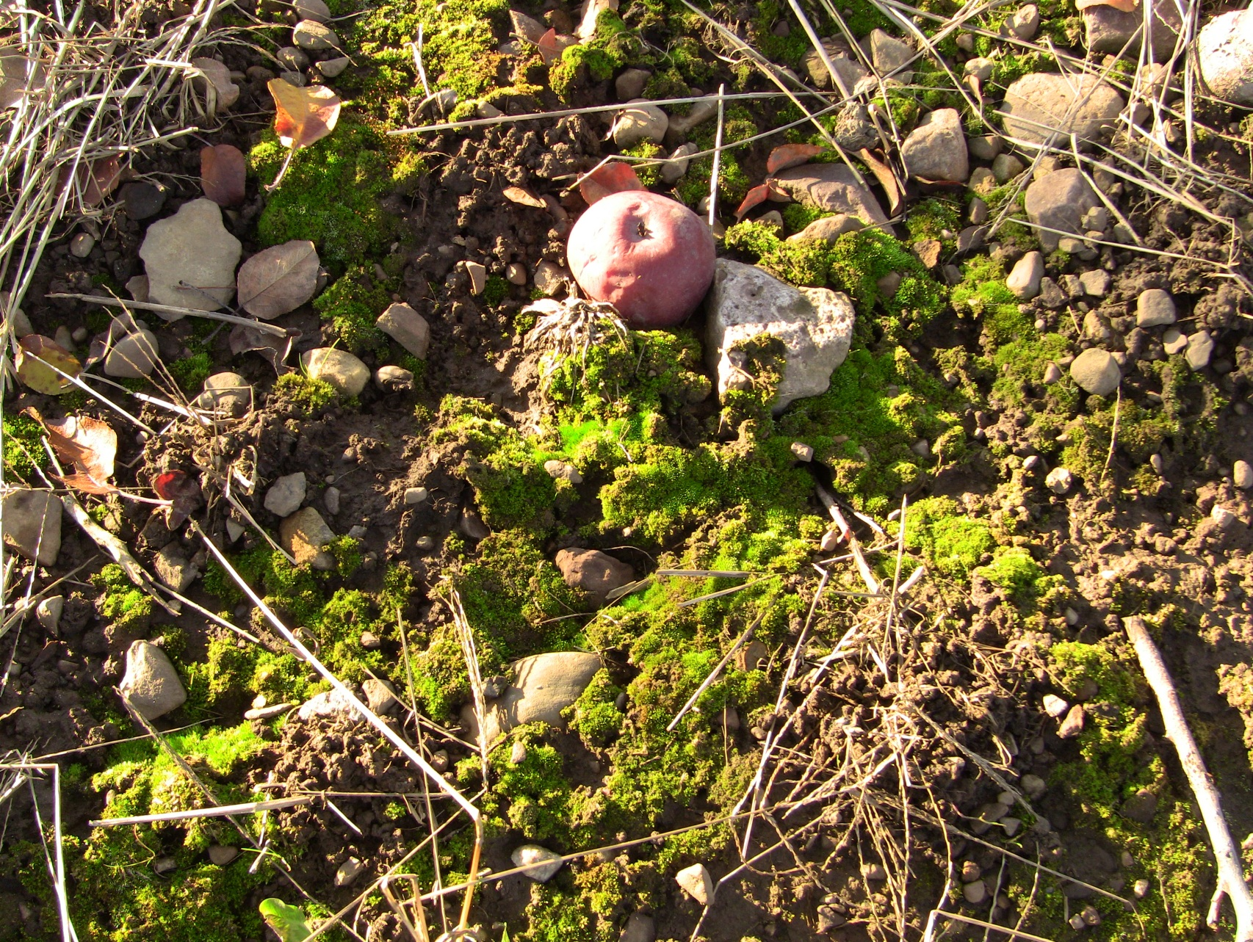
Alion – no winter annuals

Slide 22
3rd leaf
The best tree size and lowest average % weed cover was Alion. No winter annuals in herbicide strip in spring – moss… 40 fruit /tree
The smallest tree size was the untreated check 21 fruit/tree
Do we get more competition from weeds early in spring compared to later in the season?

Slide 23
Treatment costs
Treatment | $/treated acre
Untreated | lost production?
Surflan (4 qts/a) + 3P | $ 64
Prowl H2O (4 qts/a) +3P | $ 60
Surflan (3 qts/a) + Chateau (8 oz/a) + 2P | $ 91
Prowl H2O (4 qts/a) + Chateau (8 oz/a) + 2P | $ 97
Surflan (3 qts/a) + GoalTender (3 pt/a) + 2P | $106
Prowl H2O (4 qts/a) + Goaltender (3 pt/a) + 2P | $112
Matrix (4 oz/a) + 1P | $ 64
Surflan (3 qts/a) + Matrix (4 oz/a) + 1P | $ 94
Surflan (3 qts/a) + Matrix (4 oz/a) + GoalTender (3 pt/a) + 1P | $154
Sinbar (8 oz/a) + 2P | $ 36
Diuron 4L (1.6 pt/a) + simazine 4L (1 qt/a) + 2P | $ 26
Prowl H2O (4 qts/a) + 2 glyphosate | $ 55
Prowl H2O (4 qts/a) + Chateau (8 oz/a) + 2 glyphosate | $100
Alion + 1P | $60
$60/acre
Notes:
And it comes down to cost, compare the cost of the treatments highlighted in green (the best treatments for tree growth in the 1-yr trees. The least expensive are diuron plus simazine or Sinbar, the next range of $55-65 is Prowl or Surflan plus post-emergence, or Matrix. Then in $100 per acre range if add Chateau or Goaltender. Not much advantage in tank mixing other things with Matrix for now unless you reduce the rate, then you will reduce the residual control.

Slide 24
TRT | Mason |  | Lamont
 | Total % increase TCA | TCA | Total % increase TCA | TCA
Untreated | 252 b | 5.4 c | 157 c | 3.8 e
Prowl+P | 272 ab | 8.6 ab | 395 ab | 6.2 bcd
Prowl+G | 258 ab | 7.6 bc | 437 a | 7.7 a
Prowl+Chat+P | 248 b | 7.0 bc | 382 ab | 6.5 abc
Prowl+Chat+G | 225 b | 6.4 bc | 366 ab | 6.7 ab
Prowl+GoalT+P | 223 b | 7.2 bc | 351 ab | 6.3 abcd
Surflan+P | 293 ab | 7.4 bc | 293 b | 5.4 bcd
Surflan+Chat+P | 241 b | 6.6 bc | 380 ab | 6.1 bcd
Surflan+GoalT+P | 314 ab | 7.9 abc | 408 ab | 6.8 ab
Surflan+Matrix+P | 270 ab | 7.8 abc | 313 ab | 5.2 cd
Surflan+GoalT+Matrix+P | 240 b | 6.3 bc | 304 b | 5.2 cde
Sinbar+P | 223 b | 6.4 bc | 305 b | 5.0 de
P/Rely | 305 ab | 7.6 bc | 285 bc | 5.3 cd
Matrix | 274 ab | 6.5 bc | nd | nd
Alion | 390 a | 10.2 a | nd | nd
Simazine+diuron | 310 ab | 7.8 abc | nd | nd
$1206
$2358

Slide 25
What is the best herbicide?
Tree age ?
What is your management style ?
  3 week schedule to treat herbicides, or
  prepared to wait and react quickly
What is the bud stage of trees at time of application? Start with longest residual like GoalTender plus P or S, then switch to next longest residual like Chateau plus P or S.
Consider the weather conditions before and after application – be choosy, look for rainfall in near future if applying residuals, look for sunshine if applying post-emergence burndown herbicides.

