Slide 1
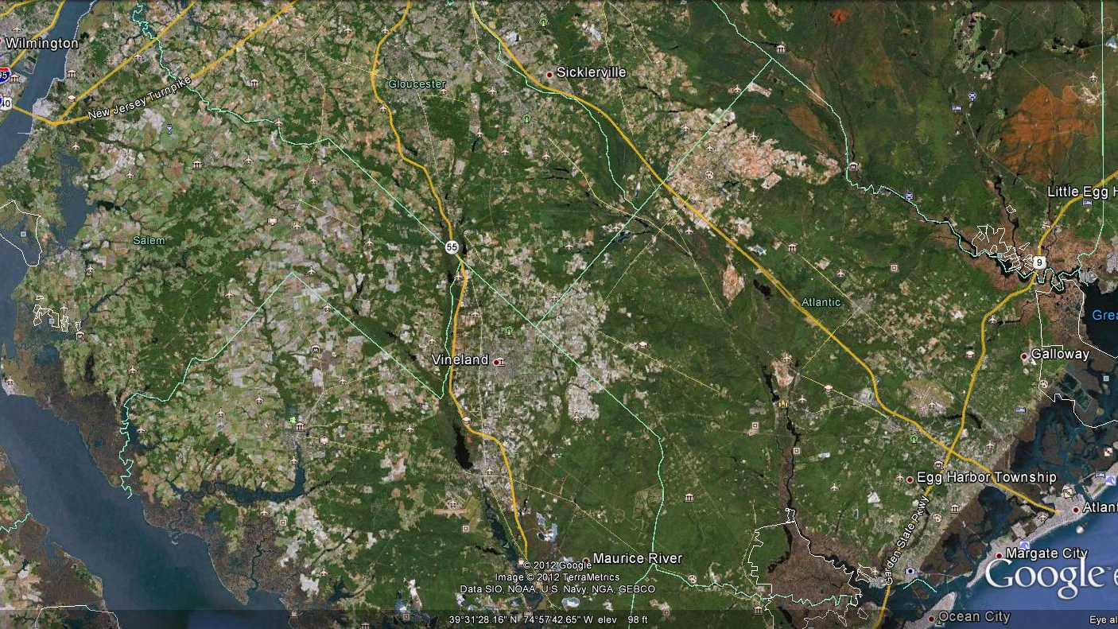
2012
Pepper weevil locations - = farm = non-farm
Figure 3 highlights the areas where pepper weevil was found during spring through fall 2012. The original area of evaluation is the cluster of 4 non-farm and farm areas at the right in Atlantic County plus the farm area shown near Sicklerville. More findings of the weevil ensued to expand the range of interest.

