Slide 1
Pepper weevil project 2012: results and follow-up
Joseph Ingerson-Mahar
Bernadette Eichinger

Slide 2
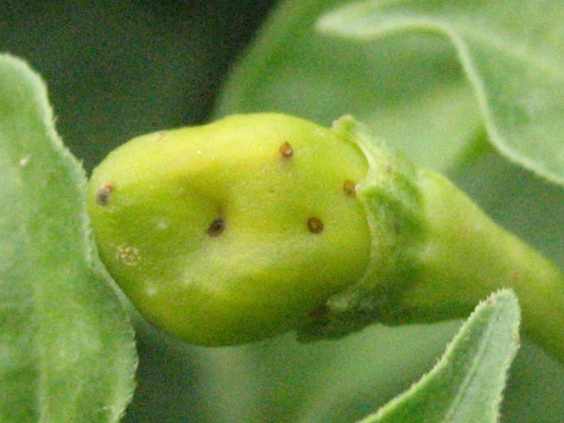
SARE partnership grant
Two questions:
How does pepper weevil get to NJ
How does pepper weevil spread in NJ
Notes:
Our initial goals and suspected means of transport.

Slide 3
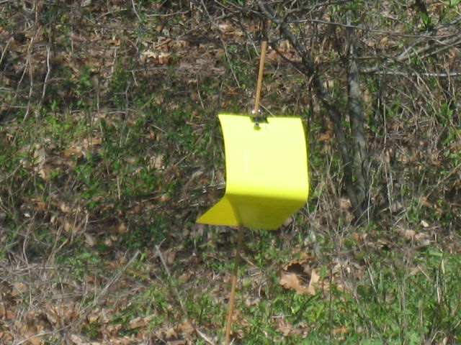
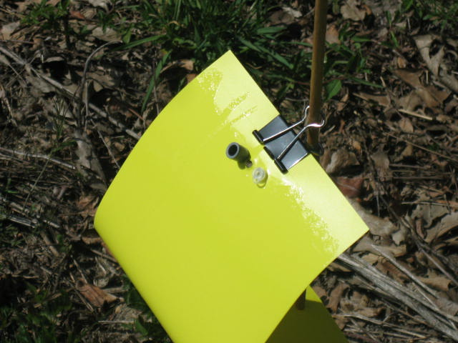
How we monitored
About 65 yellow sticky cards with sex and aggregation pheromone lures
Traps were placed in greenhouses, fields, packing sheds, vehicles, and next to dumpster

Slide 4
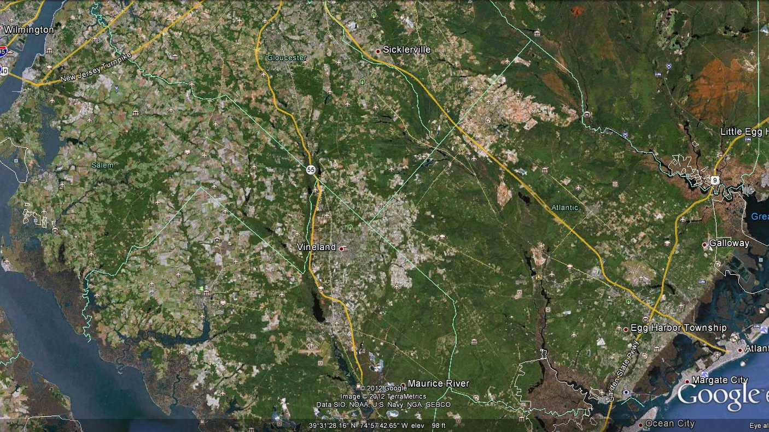
2012
Pepper weevil locations - = farm = non-farm
Notes:
10 farms/gardens raising peppers and infested. Found weevils at two non-farm locations.

Slide 5
What we have learned: How do they get here?
Does pw overwinter in NJ? No – no diapause, trapping in early spring in greenhouses yielded nothing
Can pw come in on southern transplants? Yes – but not a likely source since almost no one buys southern transplants
Can pw be transported in produce? Yes – either along with or inside pepper fruit – infested fruit are probably coming from a heavily infested field

Slide 6
What we have learned: How do they get here?
Can pw be transported by people? Yes – we have caught them on traps in vehicles – there is a potential that pw comes in with migrant workers
Are there multiple reintroductions? Yes, most likely - continual reintroductions via produce and migrants?
When should we begin looking for pw? March/April - Our earliest captures have been in mid-April at a repacking facility

Slide 7
What we have learned: How do they spread here?
How far can weevils fly? We don’t know – possibly ¼ to ½ mile?
Can weather fronts move them around? We don’t know
Can they be moved farm to farm? Yes - via shared equipment, produce bins, vehicles - Adults were commonly found in loading dock areas where peppers were being handled

Slide 8
What we have learned: About the weevil itself?
It has approximately a 21 day life cycle
It reproduces on peppers and nightshade laying 200 to 300 eggs, but does feed on other solanaceous crops
For a subtropical insect, it is remarkably cold tolerant - we have caught weevils as late as 1st week of December

Slide 9
What we have learned: About the weevil itself?
That we don’t know all the weevil biology:
Why do we collect weevils at non-crop sites?
Why do we get sudden bursts of adults?
Can we improve monitoring? Maybe – we need more specific pheromones that will trap just pw and especially gravid females

Slide 10
3
Dumpster repair
1
2
Over all of this:
Medical services County Agents
Legal services Field scouts
Social services Other agribusiness people
Meal vendors and vehicles
Prostitutes
All of which come either to the fields or migrant camp.
Terminal markets, auctions
Waste hauler
Repacker
Ethnic markets
5
Produce hauler
Produce distributors
4
Blueberry migrants
New Jersey
Day laborers
Florida, Texas, Mexico, Central America
Notes:
Starting with produce or people from the southern US or Mexico or Central America – 4 primary potential routes of entry into NJ. 1 – Produce distributor with links to produce hauler and repacker. Repacker connects with farms because of exchange of bins in the transport of produce, and may be close enough that weevils spread to farms naturally. Waste hauler takes waste material from repacker.

Slide 11
Early infestations are worse with a greater likelihood of yield loss
Severity of infestation here depends upon market price and how much longer to pick
Severity of infestation
June July August September October

Slide 12
What more do we need to know?
Confirm:
Sites of introduction
Origination of infested fruit
Primary means of spread
Connections between distant infestations
Develop:
Cost/benefit of monitoring and control

Slide 13
Ultimate pepper weevil goals
Develop mechanical or process change to inhibit or prevent weevil entry into state
Develop methods, or protocols, for limiting the spread of weevils once here
Provide detection, action level, and control protocol to assist farmers in managing the pepper weevil
Received $6,000 Charles Maier grant from Vegetable Growers Association
We have submitted a second SARE grant proposal

