Slide 1
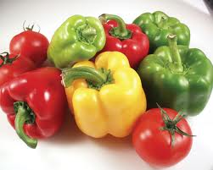
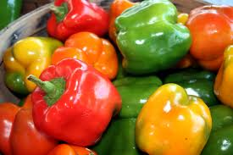
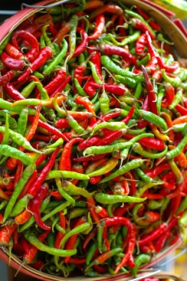
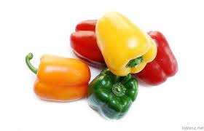
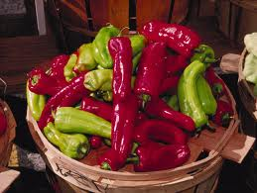
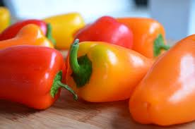
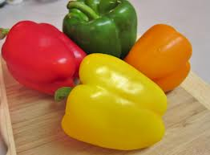
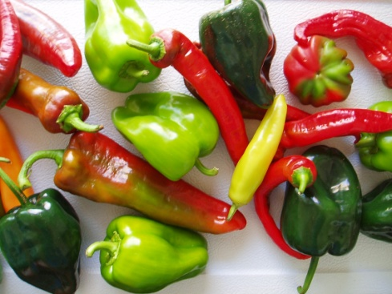
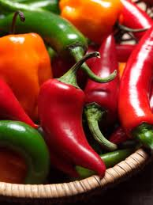
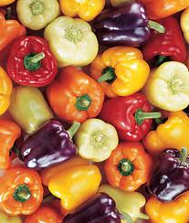
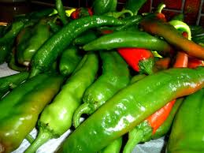
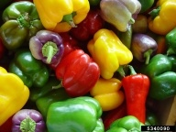
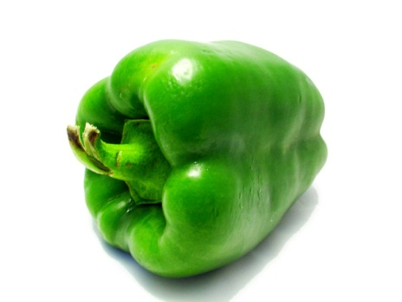
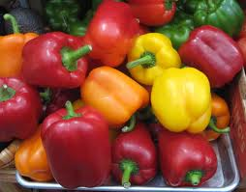
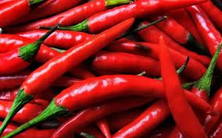
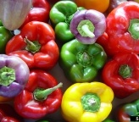
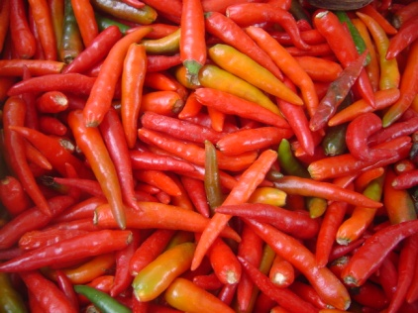
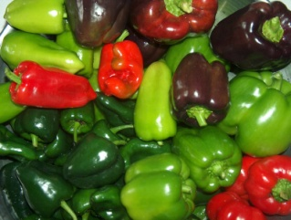

Slide 2
Tracking the Pepper Weevil
(Anthonomus eugenii Cano)
Joseph Ingerson-Mahar
Bernadette Eichinger
NJ-Acts
5 February 2013

Slide 3
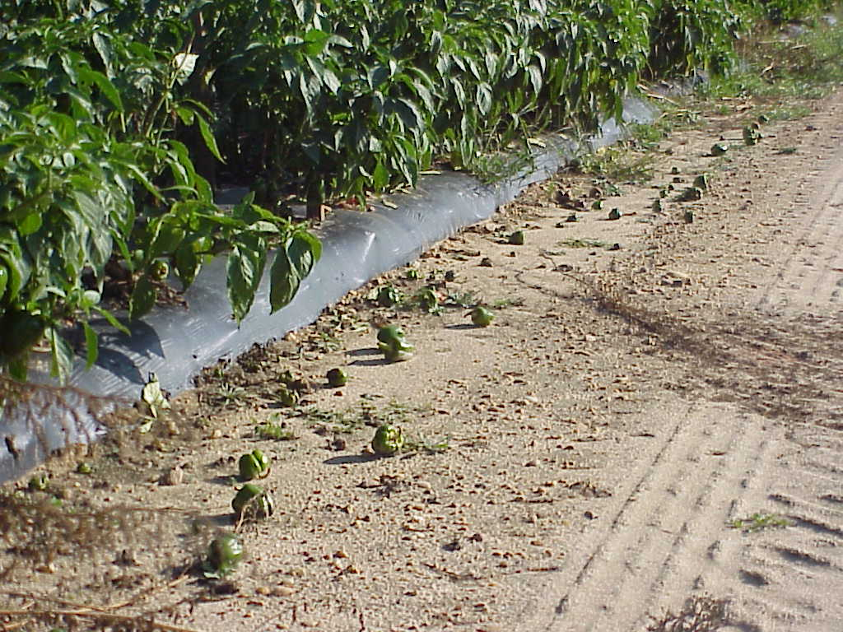
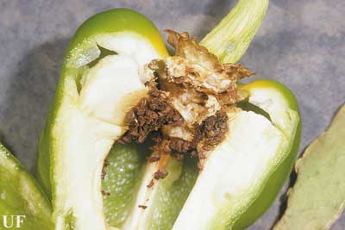
Why do we care about pepper weevil?
Most important pest of peppers in sub-tropical regions like California, Florida, Texas, Georgia, Arizona, and Mexico
Causes fruit drop and yield reduction
Spends its life inside the pepper damaging the core
Inaccessible therefore very difficult to control
Multiple lifecycles per season (~21day cycle)
Not native to New Jersey but we are finding it here
Appears to be spreading
Photograph by: Joseph Ingerson-Mahar, Rutgers University
Photograph by: John L. Capinera, University of Florida
Notes:
Also California and New Mexico
NJ 3rd largest US pepper producer

Slide 4
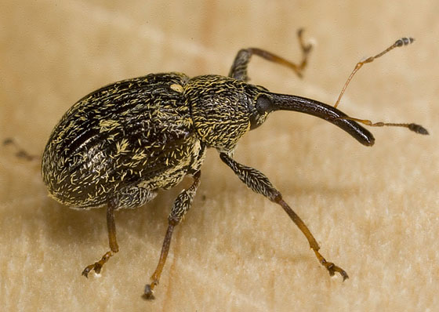
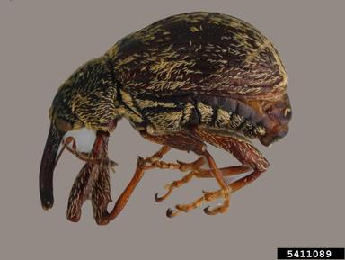
What does pepper weevil
look like?
Body Oval, arched
Size 2.0-3.5mm (1/8 in)
Color Reddish-brown to black
Tibia Bottom 2/3 orangey to red
Snout Stout, longer than head/prothorax
Antennae Long, thin, elbowed, clubbed
Hair-like scale Clumped, pattern uneven
Spur Underside of femora
Of note:
Plays dead
Not a regulated pest
bugguide.net/node/view/184395
Juliana Cardona-Duque, University of Puerto Rico
Notes:
Spur = profemoral tooth
Antennae about 2/3 forward on the snout
Same genus as boll weevil and cranberry weevil

Slide 5
Recent History
Pepper weevil (pw) found in 2004, 2006, 2007, 2008, 2009, 2010
2011 summer and winter
In July mounted traps and found pw at two Atlantic County farms and a Gloucester County farm.
Monitored fields at all three throughout the rest of 2011, including after fields plowed under. Then continued through the winter. Last pw found on 12/6/2011.
2012 spring
Added an unaffected fourth farm in Salem County. Monitored all the greenhouses and the fields being readied for 2012 at all four. Requested and received partnership grant from NE SARE (Northeast Sustainable Agriculture Research and Education).

Slide 6
PROGRAM GOALS
Determine pathways of pepper weevil (pw) arrival into southern New Jersey.
Determine scope of pest presence.
Provide protocol for management.
Part 1: Tracking and capturing the weevil.
Part 2: Results and follow-up.
Notes:
Also California and New Mexico

Slide 7
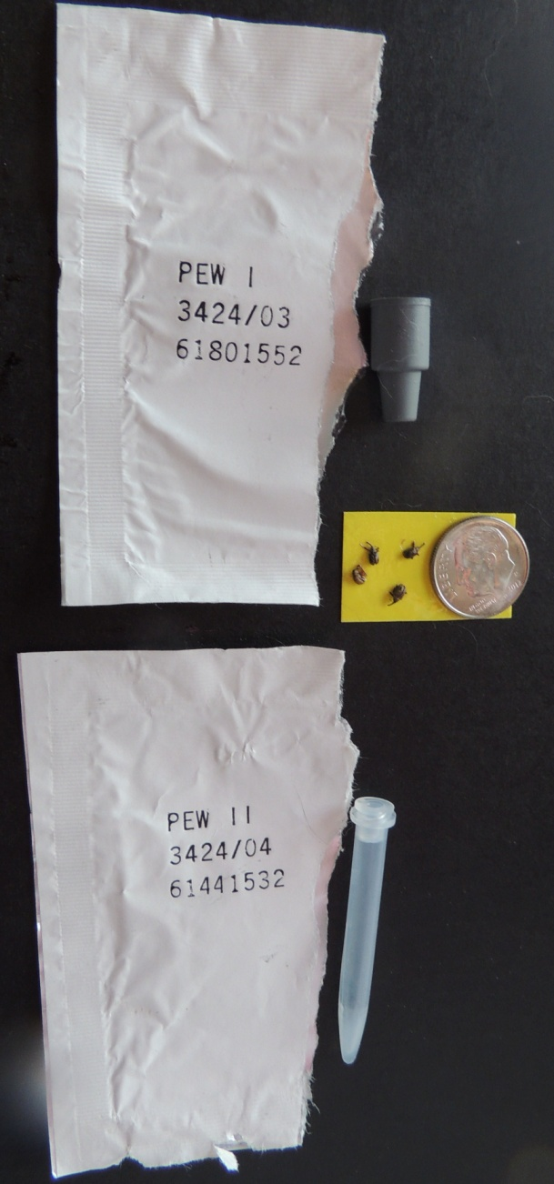
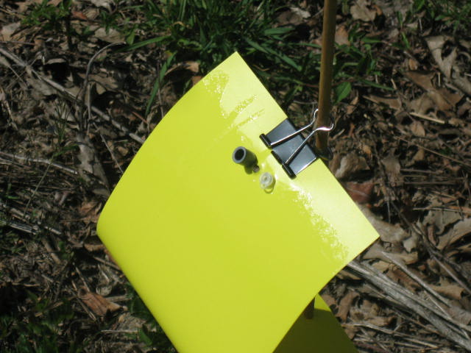
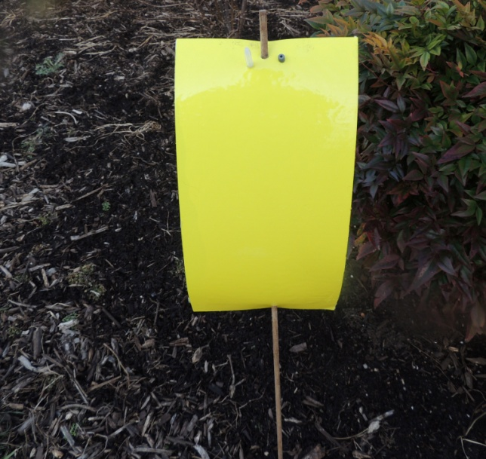
Catching the pepper weevil
We drilled holes into a 6”x12” yellow sticky card to accept a two-component pepper weevil lure system (Trécé), attached the card to a 3-4’x¼” dowel, then inserted the assembly into the soil.
Over the course of evaluations, traps were positioned in field and non-field areas (migrant housing, loading docks, roadways). We included two non-farm sites known to handle peppers in the processing and waste chains.

Slide 8
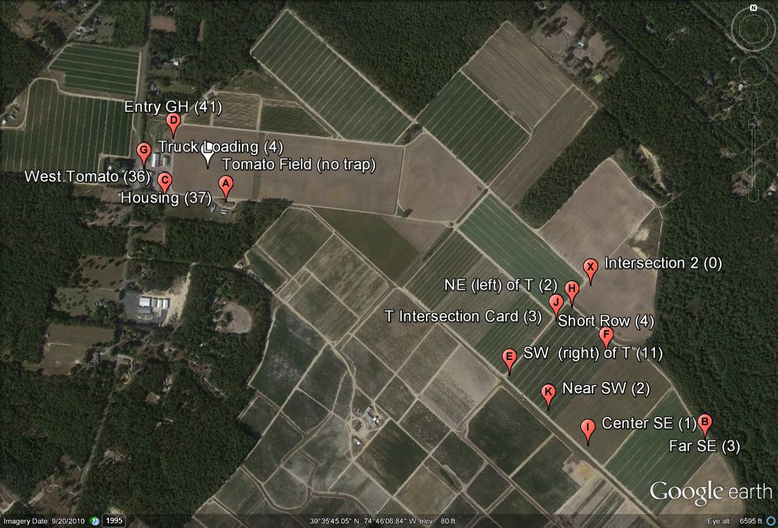
Farm 1 – Sticky trap placement - 2012

Slide 9
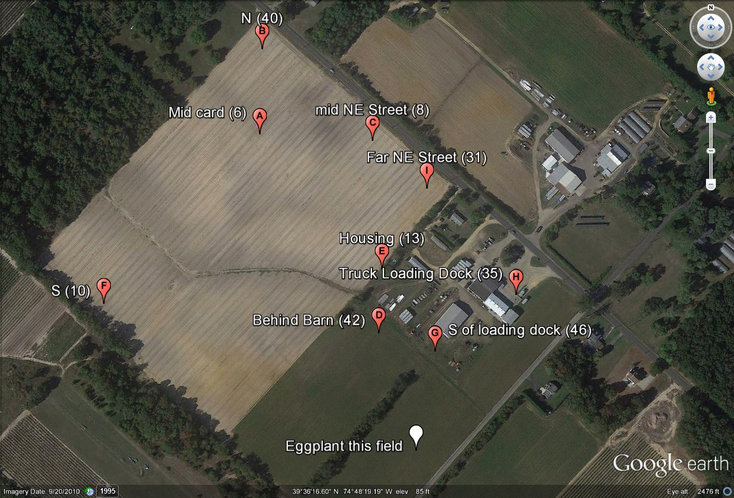
Farm 2 – Sticky trap placement - 2012

Slide 10
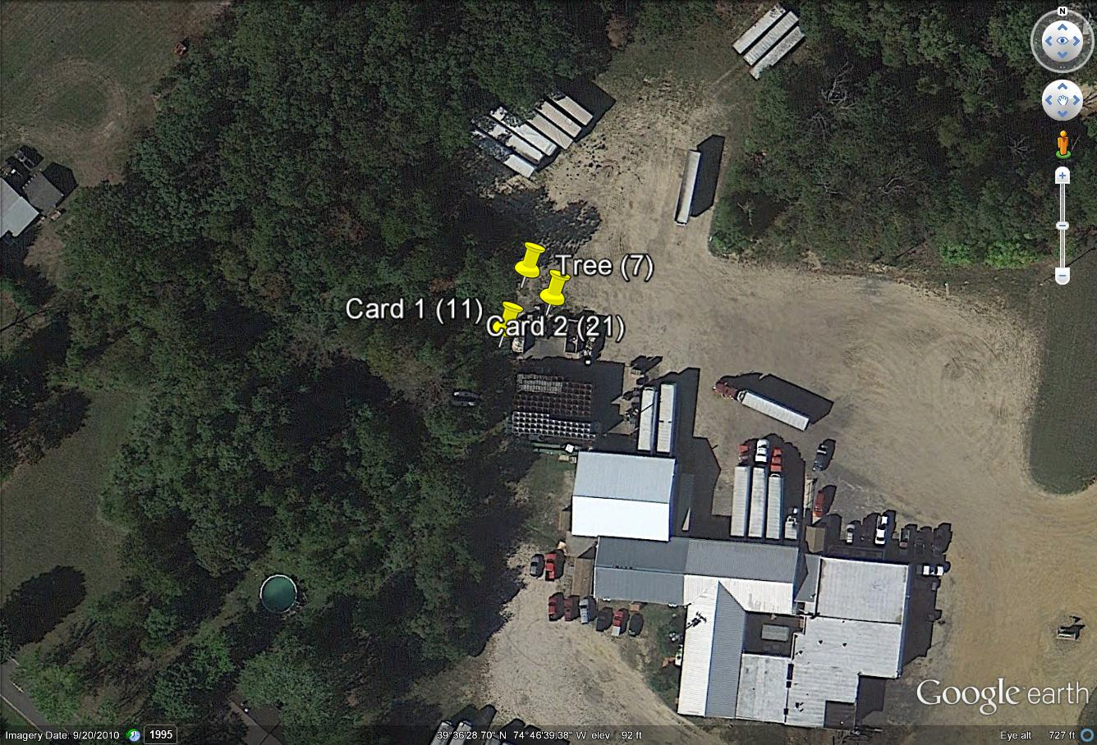
Commercial 1 – Sticky trap placement - 2012

Slide 11
Pepper Weevil Trap Placements and Catches
Spring and Summer 2012
Continuously monitored greenhouses and 2011 fields since prior year at four farms until transfer of transplants
Initial traps set in March at processing facility and waste user dump pile
Field traps for 2012 set at Atlantic, Salem, and Gloucester County farms in May as plants transferred to field
First 2 pw caught at an Atlantic County processing facility on 4/16/12
Next 2 at the same facility on 5/16/12
One at an Atlantic County field 5/28
No more until 8/16 and 8/20 in Atlantic County including 3 farms and the pepper-free waste dump area. Gloucester County arrival was 8/23

Slide 12
Pepper Weevil Trap Placements and Catches
Spring and Summer 2012 (cont’d)
From mid-August 2012
Alerted to damaged field in Cumberland
Alerted to equipment exchange among Cumberland and Atlantic farms
Added traps on 8/26 in Cumberland; first captures 8/28
One on card in investigator truck on 9/6
Added Salem County greenhouse and found weevils in fruit, but not on card.
Last 12/5 Gloucester County

Slide 13
By season’s end we had placed traps at two commercial facilities, ten farms, two greenhouse areas not previously surveyed, and in our own vehicles. Four counties are known affected for 2012.
In winter 2012-2013 we continue to monitor the two non-farm facilities.

Slide 14
2012 season’s number of traps placed and captures
Location | # Traps | # Weevils | ~ Acres of Peppers | County
CMRCL 1 | 3 | 39 | 0 | Atl
CMRCL 2 | 3 | 34 | 0 | Atl
EVAL 1 | 1 | 1 | 0 | roving
EVAL 2 | 1 | 0 | 0 | roving
FARM 0 | 4 | 1 | 4 | Sal
FARM 1 | 12 | 144 | 52 | Atl
FARM 2 | 10 | 231 | 36 | Atl
FARM 3 | 10 | 111 | 9 | Glou
FARM 4 | 7 | 92 | 10 | Atl
FARM 5 | 4 | 160 | 19 | Cum
FARM 6 | 3 | 19 | 28 | Cum
FARM 7 | 3 | 8 | 33 | Cum
FARM 8 | 2 | 31 | 10 | Cum
FARM 9 | 2 | 5 | <1 | Cum
FARM 10 | 1 | 5 | 30 | Glou
FARM 11 | 1 | 3 | <1 | Sal
Totals | 67 | 884 | 231
CMRCL = non-farm site
EVAL = truck of evaluator

Slide 15
Observations on 2012 season’s captures
There was an early arrival (April and May) of a few pests at a processing facility; and one on an Atlantic County farm in May.
Rapid arrival of the pests was detected in the late season, between 8/16 and 8/24, in Atlantic and Gloucester counties then quickly confirmed in Salem and Cumberland counties. Arrival continued through early December.
Most captures are associated with disturbed areas along roadways, near worker housing, and near equipment movement.79% of pw at a farm in Atlantic County were attached to cards ½ mile away from pepper fields. The same is true for 48% of those caught at a second Atlantic County farm.
Most cards erected (65 of 67) caught the weevil suggesting that the card system is effective.
The weevil spreads rapidly.

Slide 16
Observations on dual lures on sticky card system
No consensus was discovered in the literature relating the number of pests on a card to field damage. Most Southern state guidelines for spray application focus on percentage of field damage (5%) or number of insects found per number of buds (1 per 200 buds).
The card+lure system is useful as an indicator of presence of the pest.
The card is easily damaged by field traffic movement and weather systems.
Many other insects are trapped such as thrips, flies, moths, beetles, wasps. It takes a trained eye to locate pw.
Cards usually were changed twice a week, a messy process.
We changed lures monthly.
Many weevils other than pepper weevil are trapped. We found about 10 other species. Positive ID of pepper weevil requires training.
We found weevils inside fruit with no card indication.

Slide 17
Continuing goals for sticky card use and placement
Devise a protocol for minimum card placement that maximizes early detection of arrival/presence. This will involve fewer cards throughout farm fields and more at disturbed areas and areas of potential introduction and transport.
Determine the extent of pest presence in other counties.
Determine source of first arrival into an area. Involves the need for cooperation from many entities in the distribution and marketing chains to allow survey cards at their sites.
Notes:
Repeat test results but at lower quantity of test cards

Slide 18
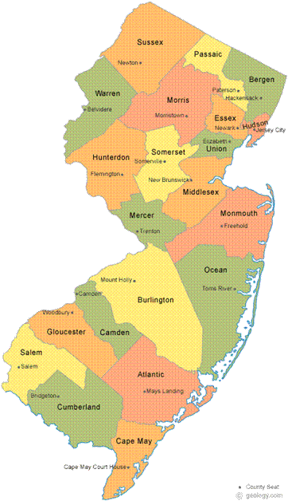
We would like to thank our partners in this cooperative investigation
Bob Muth of
Muth Family Farms
George Ruggero of
Homestead Farms
August Wuillermin of
Ed Wuillermin and Sons Farms

Slide 19
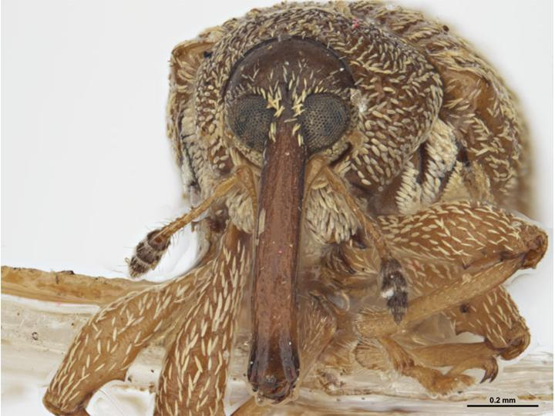
http://www.padil.gov.au/pests-and-diseases/Pest/Main/142382/44480

Slide 20
Back up slides
Serious infestations have occurred in New Jersey in the past
1957, 1967,1985, 1988 and 1989 (Ghidiu and Rabin – ‘The Grower’, 1991) Ghidiu, G. M., & Rabin, J. (1991). The Pepper Weevil in New Jersey. The New Jersey Grower, 14(1).
There was a light infestation at Centerton Research Farm and a local farm in unsprayed pepper plots in 1999

Slide 21
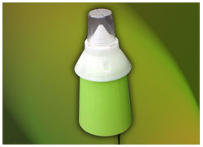
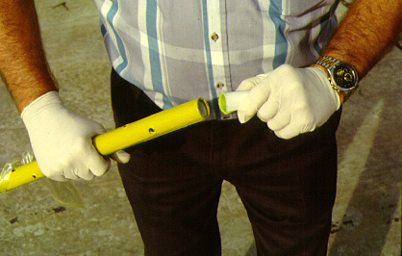
Below shown are two other trap methods that are used for boll weevil trapping. Experimentally, we added these, using pepper weevil lures, then discontinued the techniques, finding the sticky trap adequate.
http://www.solida.ca/ipm-supplies.html
Boll Weevil Bait Stick, J. Winfred, Flickr, 2/11/11

Slide 22
Table 2 lists the species of weevil found on cards in Atlantic County, between July 17 and July 31. This list excludes those important earlier arrivals, Ceutorhynus sp. (cabbage) and Anthonomus sp. (cranberry).
TABLE 2: Species and number of weevils caught on traps in Atlantic County between 7/17/12 and 7/31/12
Species of weevil | Number
Geraeus picumnus Herbst | 98
Geraeus picumnus | 54
Odontocorynus falsus LeConte | 40
Geraeus picumnus | 14
Geraeus penicillus Herbst | 1
Conotrachelus seniculus LeConte | 1
Acanthoscelidius acephalus Say | 1
Rhinoncus castor Fabricius | 1
No pepper weevil was found in this time frame.
Identification provided by USDA SEL-Jens Prena

Slide 23
University of Georgia College of Agricultural and Environmental Sciences http://www.ent.uga.edu/veg/solanaceous/pepperweevil.htm Prepared by Dr. Alton “Stormy” Sparks, Jr. and Dr. David G. Riley - University of Georgia
http://www.inspection.gc.ca/plants/plant-protection/directives/risk-management/rmd-10-28/eng/1304792116992/1304821683305E-mail Twitter Facebook Delicious Google
Digg StumbleUpon Reddit Newsvine Technorati
RMD-10-28: Anthonomus eugenii (pepper weevil) - Pest Risk Management Document
Canadian Food Inspection Agency 59 Camelot Drive Ottawa, Ontario, Canada, K1A 0Y9 (Tel.: 613-225-2342; Fax: 613-773-7204)
Date Issued: 2011-02-15

Slide 24
http://www.pestmanagement.rutgers.edu/ipm/Vegetable/ New: Pepper Weevil in New Jersey
Description, biology and damage (J. Ingerson-Mahar
http://onvegetables.com/2011/05/13/pepper-weevil-and-field-peppers/ Pepper weevil and field peppers
May 13, 2011 by Janice LeBoeuf « Carrot Weevil
How fast do weeds grow? »
Pepper weevil and field peppers
May 13, 2011 by Janice LeBoeuf
Janice LeBoeuf, OMAFRA Vegetable Crop Specialist, Ridgetow

Slide 25
