Slide 1



Yielding Returns for Greater Profitability for your Business in the
Lake Erie Wine Country
An Experience Economy Approach to Enhancing Chautauqua-Lake Erie Wine Tourism
NESARE Sustainable Community Grant: CN1109
Donna Quadri-Felitti, New York University
Ann Marie Fiore, Iowa State University
Notes:
Dr. Donna Quadri-Felitti, Clinical Associate Professor, New York University, Tisch Center for Hospitality, Tourism, and Sports Management.

Slide 2
Recommendations based on Research
Review of 20 years of previous research
USDA-Funded NESARE Sustainable Community Grant: CN1109
Data from 1,000 visitors/189 businesses
Summer 2011
Only study to focus on Lake Erie wine tourism
Based on proven business concept
Iowa State and New York Universities’ staff.

Slide 3
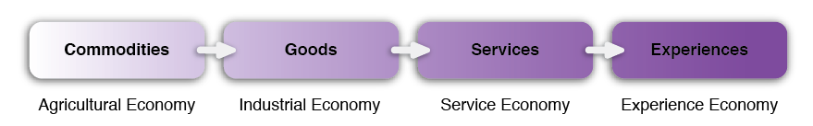
Experience Economy
Pine & Gilmore (1999, 2011)
Progression of Economic Value
Notes:
In their Experience Economy framework, Pine and Gilmore (1999) explain that sources of economic growth in the U.S. have shifted from extracting raw materials, called commodities, to processing the commodities to making goods, then to offering services, and now to staging positive, engaging memorable experiences.

Slide 4
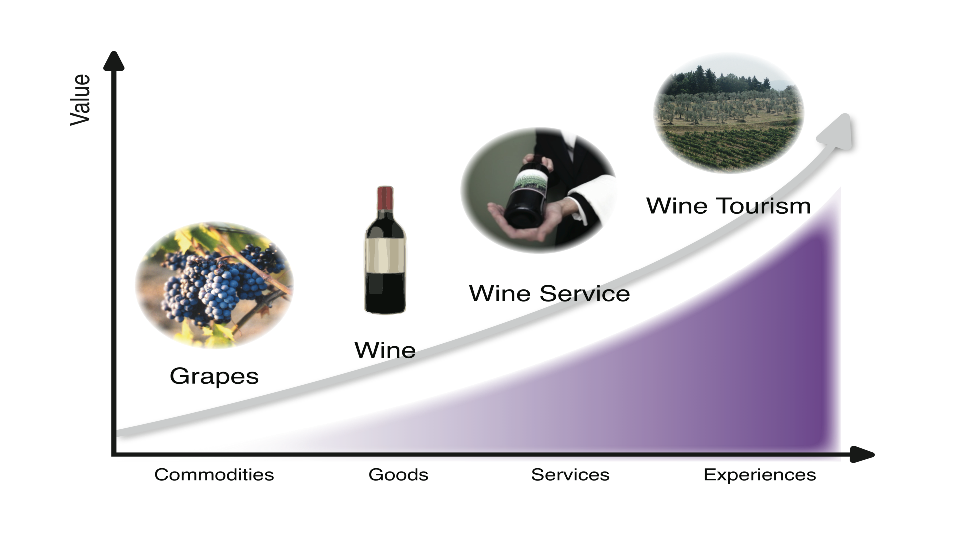
Wine Economic Value Ladder
Commodities Goods Services Experiences
Notes:
Using an adapted example wherein grapes replace corn, when they are vinified and sold as wine grapes move up the economic value ladder as goods in the form of wine. When the same bottle of wine is served in a restaurant table side by trained service staff, again value is added and the cost to purchase the same wine increases by the addition of service. When a customer stays overnight in the vineyard from which the grapes are harvested and participates in the rhythm of the harvest, or creates their own blend of wine from a vineyard selection, they customize the experience and are immersed in the consumption.

Slide 5
Staging the Experience
A memorable experience is “stage” craft
  Stage = service
  Props = goods
  Actors = staff
  Performance = delivery
  Purchases = souvenirs (memorabilia) of the experience
  Organizing theme is “theater”!
Notes:
The subtitle of Pine and Gilmore’s best selling 1999 book (and 2011 second edition) is: “Work is Theatre & Every Business a Stage”

Slide 6
Remember T.H.E.M.E.
T: Theme the experience
H: Harmonize with positive cues
E: Eliminate negative cues
M: Mix in Memorabilia
E: Engage the five senses
Notes:
Memories are bolstered by the memorabilia, “takeaways” from an event or experience. Personalizing purchases, arranging for photo opportunities, and digital uploads to company and personal social media sites, as memorabilia, underline the value of the experience. Engaging all five senses of the consumer during the experience further solidifies the positive memories of an experience.
More about how this may be leveraged in rural tourism is covered in Module 4.

Slide 7
Value in the Experience Economy
Absorption
Passive Participation
Active Participation
Immersion
Notes:
The Experience Economy offers four distinctive areas of experiential value to add to a business for customers. Pine and Gilmore (1999) termed these areas, the 4Es. The 4Es consist of adding Educational, Esthetic, Escapist, and Entertainment experiences to the business. The four experiences vary based on the customer’s active or passive participation and on absorption or immersion in the experience.

Slide 8
The 4Es
The 4Es create experiential value.
The 4Es are:
  Educational
  Esthetic
  Entertainment
  Escapist
All 4Es exist in
Lake Erie Wine Country.
Notes:
The experience economy model holds that when consumers experience these four dimensions, the consumption experience increases in value. Module 3 will present further results from the 2011 Lake Erie Wine Tourism Study demonstrating that the 4Es exist in the destination for visitors and are statistically significant in predicting tourists’ intentions to recommend and to return to the destination.

Slide 9
The Wine Tourist Experience
The wine tourist’s experience in dependent on the every supplier in value chain.
Value = positive, engaging, and memorable experiences.
Notes:
In the agri-tourism context of Chautauqua-Lake Erie wine region, farmers and other key stakeholders are dependent on one another to provide a total visitor experience. Research has shown that wine tourists desire a lot from their wine tourism experience; they want quality culinary offerings, cultural, recreational, and retail choices, and to enjoy the rural landscape that wine regions present (Brown, Havitz, & Getz, 2006; Bruwer & Alant, 2009; Getz & Brown, 2006; Getz, et al.; 2008).

Slide 10
Results of Experiential Value
  Fully satisfy visitors = loyal customers
  Increases customers’ willingness to return
  Encourages positive word-of-mouth
  Recruits new visitors
  Enhances the destination’s image
  Makes it difficult for competitors to copy
Notes:
All interrelated activities within the overall tourism experience make up the tourism supply chain and affect the customer experience. This describes the experiential view of consumption wherein tourists seek memorable, immersive experiences (Holbrook & Hirshman, 1982; Pine & Gilmore; 1999) in an ever increasingly competitive environment. Positive, engaging, and memorable experiences result in experiential value for rural wine tourists and in differentiation of the destination from competitors, large and small (Pine & Gilmore, 1999).

Slide 11
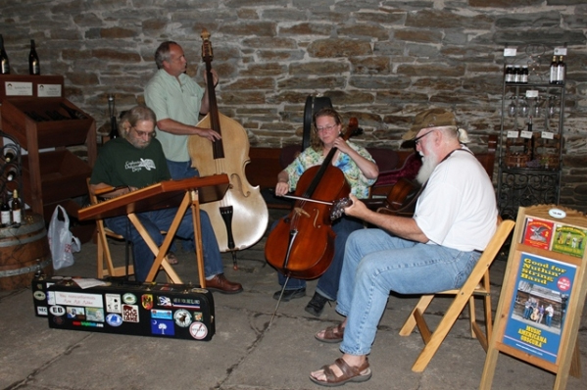
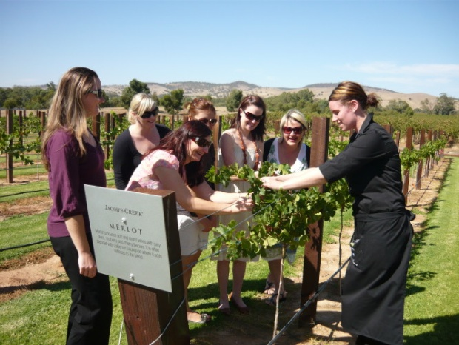
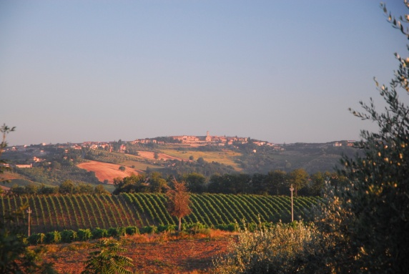
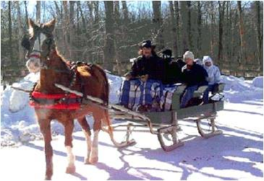
The 4Es in the Wine Tourism: Winery
Absorption
Entertainment
Education
“engaged by performers”
“enhanced knowledge or skills involving products”
Entertainment
Educational
Esthetics
Escapist
“enriched by unique environments”
“engrossed as a participant in a different place”
Esthetic
Escapist
Immersion
Notes:
Active – passive participation entails the level of customer involvement in creation of the experience. For instance, the customer can actively participate in a grape harvest or passively watch a bottling demonstration performed by a staff member. Passive participation of the customer in an experience characterizes the Entertainment and Esthetic dimensions of the visit, while active participation characterizes Educational and Escapist experiences. The customer who passively participates in an experiential activity or setting does not directly affect or influence these experiential offerings, whereas an active participant will personally affect these activities and settings.
Each of the above quadrants are explained further in the subsequent four slides.

Slide 12
4E Examples in Wine Tourism
Entertainment
Educational
Cellar concerts, music in vineyard
Wine blending demonstration
Farm & food demonstrations
Museum & heritage site visits
Wine tastings & seminars
Culinary-wine pairing events
Home wine making seminars
Cooking & craft making classes
Esthetics
Escapist
Consuming the ‘winescape’
Enjoying unique lodging
Visiting wine-art shows
Arts & crafts fairs
Sensory garden tours
Vineyard hiking, cycling tours
Hot air ballooning over vineyards
Vineyard tour by horse & carriage
Harvesting grapes, riding a grape picker
Notes:
Typical wine tourism activities that are categorized by the four categories of the experience economy. Another key element of the Experience Economy model is that when these experiences overlap, the experiential value of the consumption increases. When all four elements are present, the theory suggests that value and memory are enhanced.

Slide 13
Leveraging the 4Es
Incorporate all of the 4Es to maximize experiential value.
Specialize in one or more of the 4Es.
Use multiple strategies to highlight all the 4Es.
Underscore the 4Es in all communications.
4E Audit: Workshop activities - handout
Notes:
These examples cover wineries, lodging, attractions, retail, culinary, and overall destinations through events using one or multiple elements of the experience economy.

Slide 14
Your 4E Inventory
Take about 10 minutes to fill in the handout.
In each “E”, identify activities, displays, materials, customer interaction, that represent each of the 4Es.
Some of these may be listed in two or more.
  This is a “good” thing, center of sphere “sweet spot” in the experience economy.
Notes:
Use the Wine Tourism Experience Internal Audit Worksheet created by Donna Quadri-Felitti, Ph.D., CHE

Slide 15
What the Data Tells Us
The Experience Matters! Best predictor!
Demographics and Travel Characteristics ALONE do not predict future behavior well.
Opportunities exist to partner for the benefit of the entire destination.
Notes:
Three overarching summaries from research collected are these.

Slide 16
What the Data Tells Us
Businesses and visitors agree – esthetics are important!
They disagree about emphasis on entertainment, escapist, and education elements
Opportunities exist to strength the future intentions of your visitors.
Notes:
Visitors and business operators agree that the most valuable experiential aspect of the region are the esthetics, in this study, meaning the winescape, the natural and socio-cultural setting of the wine trail.

Slide 17
Research Summary
Experiential value (4Es) matters more than demographics or tripographics.
Esthetics matter the most.
Repeat visitors are Wine Country ambassadors.
Engaged visitors will more likely recommend and return.
Opportunities to design and leverage the 4Es.
Notes:
The experience matters more than who the customer is and practically more than if they are engaged (number of activities over 21) and if they had visited previously.
Esthetics: the winescape, natural, physical, and cultural environment is the most powerful aspect of the experience in driving future tourist intentions.
Engaged visitors: the more they are participating in the full range of activities in the destination the more powerful the memory and the intention to recommend and return.
Opportunities: Revise product offerings to include different escapist, education, and entertainment elements.

Slide 18
Typical LEWC Visitor
Relatively older
  (Average age – 41 years old)/ Majority over 55 years old (58.5%)
Relatively educated
  87% have some college training/Most frequently earned degree = Bachelors
Relatively affluent
  40% reported household income between $60K-$105K (mode)
  Nearly 18% reported HH income over $105K
These results are consistent with previous studies about wine tourists, irrespective of country or wine region.
Insights: Copy what the world renowned wine country and destinations do!
Notes:
Additional notes: no international visitor data collected

Slide 19
Typical LEWC Visitor
More than 72% of the sample is female*.
Most are NY or PA residents
  76% are in the drive market of 75 miles from home (USTA)
Life stage
  72% married or partnered
  20% with children under 18
Notes:
Additional notes: no international visitor data collected
*Part of how the study was conducted (electronically) demonstrates the previous research on women as purchasing deciders of household travel, and are more

Slide 20

More Visitor Demographics
Age
  14.4% Millennial, 18–29
  51.6% Gen X, 30–46
  23.0% Boomer, 47-65
  11.1% Silent, over 66
Education
  13.0% High school
  19.6% Some college
  14.1% Associate degree
  33.3% Bachelor degree
  16.2% Masters degree
  3.8% Doctoral degree (Ph.D., J.D., M.D.)
Notes:
Additional demographic sample summary data.

Slide 21

Visitor Demographics
Life Cycle
  19% Single
  82% Partnered
  27% No Children
  20% with
  Children under
  18 years old
Household Income
  19.1% : Under US$45K
  28.1%: $45K – Under 75K
  34.7%: $75K – Under $105K
  11.9%: $105K – Under 150K
  6.1%: : Over $150K
Notes:
Additional demographic sample summary data.

Slide 22
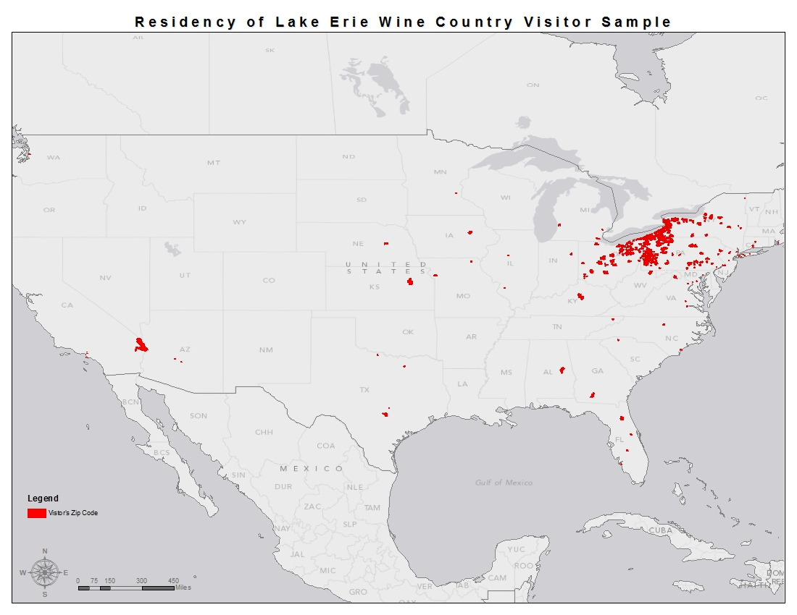
Visitors are primarily Locals
Notes:
Sample showed a primarily drive market, which is not surprising, due to the size of the nearest airports in Erie and Buffalo; however, the data also indicated it is not primarily populated by excursionists (day-trippers) with a majority staying overnight in an accommodation more than one night.

Slide 23
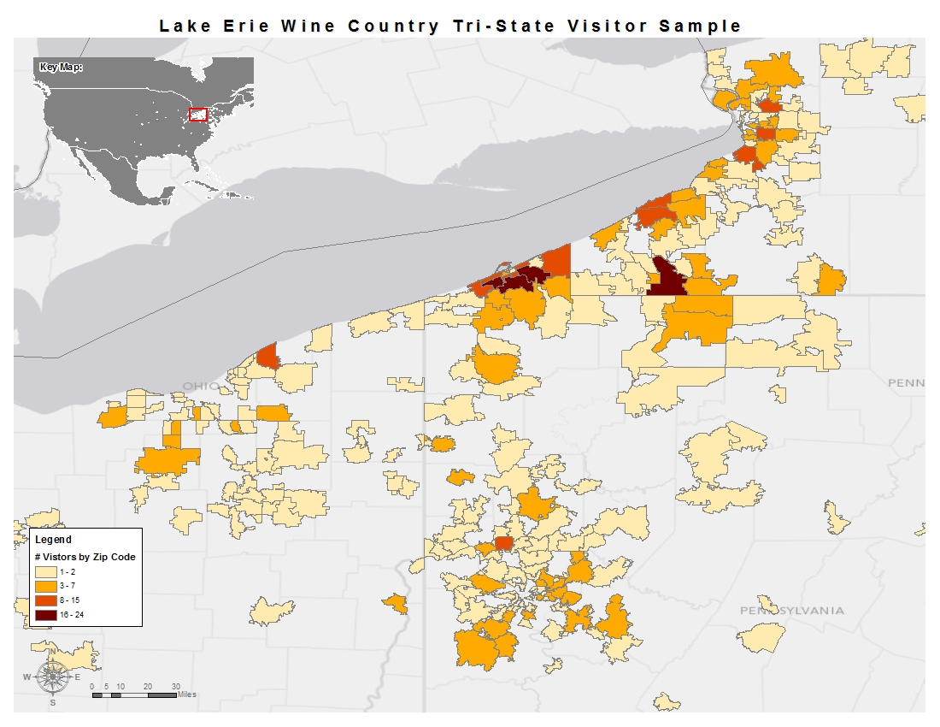
Mostly Tri-State (NY, PA, OH) Residents
Darker areas represent zip codes of more visitors.
Notes:
Yet, the results also suggest that the day tripper is a meaningful segment with overnight guests staying at major accommodation centers (highway or city centers) as traditional hotel and motels served as the single largest lodging selection at nearly half (48.4%). The next most popular accommodation choice was B&Bs at 18.3%.

Slide 24
Visitor Tripographics
Motivation
  40.2% Visit Wineries
  21.0% Special Event
  16.8% Annual Vacation
  15.2% VFR
  3.8% Other
85% visited within a year
  June-September, 2010
    to
  June-September, 2011
Size of travel party:
  45.8% Two persons - 21.7% Four persons
Notes:
Tripographics are the specific trip characteristics of the traveler. In this study, the tripographics used as predictors included purpose of trip; motivation, previous trip history; number of previous visits, and number of activities engaged in during the trip. Other trip characteristics are presented for context are recency of trip; size of travel party, average number of purchases; types of trip planning resources; different activities.

Slide 25
Visitor Tripographics
Length of Visit
  42.8% Daytrip
  57.3% Overnight
    15.4% One night stay – objective: move to 2
    18.6% Two night stay – objective: move to 3
    7.6% Three night stay
    15.7% Four or more
Move demand, lengthen stay
Traditional room inventory and opportunities
Notes:
Additional tripographic sample summary data.

Slide 26
Visitor Tripographics
No. of Previous Visits
  40.2% Six or more visits
  11.4% Three previous visits
  14.1% First visit – objective: create repeaters or recommenders
Lodging Choice
  48.4% Hotel/Motel
  18.3% Bed & Breakfast
  15.6% Friends & Family
  10.% Second Home or Chautauqua Institution
  6% Campgrounds (Cabin, RV or other)
Notes:
Additional tripographic sample summary data.

Slide 27
What Tourists Do
Visitor by activities | Frequency | Percent
Visit NY wineries | 890 | 91.8%
Dine in restaurant | 881 | 90.8%
Visit PA wineries | 853 | 87.9%
Visit farm stand | 779 | 80.3%
Visit retail shops | 777 | 80.1%
Insights: Opportunities to coop and create synergies.
Notes:
One of two slides about the frequency of activity by type of activity.

Slide 28
Average 21 Activities per Visit
Visitor activities by type | Frequency | Percent
Attend festival or event | 756 | 77.9%
Visit Lake Erie | 741 | 76.4%
Visit Chautauqua Institution | 724 | 74.6%
Visit public lands or parks | 728 | 75.1%
Visit art galleries, museums | 720 | 74.2%
Sports activities | 715 | 73.7%
Visit non-grape farm | 702 | 72.4%
Other activities | 300 | 30.9%
Insights: Opportunities to grow participation for longer length of stay.
Notes:
With an average of 21 activities per visit, regardless of length of stay visitors are relatively highly engaged. Culinary focus of visitors with top four activity choices, shopping as well as cultural and recreational activities also valued and enjoyed. Opportunities to improve culinary options.

Slide 29
Pre-Trip Planning Resources
Source | Frequency | Percent
Internet* | 569 | 28.0%
Friends & family | 333 | 16.4%
Direct promotional message* | 320 | 15.7%
Map or atlas | 212 | 10.4%
Insights: Referral programs, are you on all the maps you can be?
Notes:
It is no surprise that the internet is the number one resource for planning. Word of mouth remains essential to trip planning, suggesting, once again, that the satisfied customers are the best marketing opportunity for tourism suppliers.

Slide 30
More Pre-Planning Resources
Source | Frequency | Percent
Travel guide | 155 | 7.6%
Magazine or newspaper | 132 | 6.5%
Visitor center (highway or airport) | 92 | 4.5%
Other sources | 80 | 3.9%
Outdoor advertising | 69 | 3.4%
Social media | 57 | 2.8%
Travel professional | 15 | 0.7%
Opportunity to create special relationships and improve usage.
Notes:
Second slide related to resources consulted in the pre-planning stage of the visit to Lake Erie Wine Country.

Slide 31


Examples: Billboards
Value of billboards.
The Internet is the digital billboard.
  Note on social media
  Search engine optimization
  Attribution: the digital path
  Interaction
  Consistency
Notes:
Billboards must demonstrate the critical mass. A highway sign with a single business or winery is not apt to draw new visitors. Must think of the Internet as a digital billboard.

Slide 32
The Stats
Outcome Variables:
  Intention to recommend
  Intention to return
  Intention to repurchase LEWC wines
Predictors:
  Demographics (income, age, education)
  Tripographics (travel characteristics)
  4Es (Education, Esthetics, Entertainment, Escapist)
Notes:
Confirmatory Factor Analysis demonstrated these composite variables as valid and reliable. These three outcome variables have significance to marketing and business results as they come closest to predicting future transactions with consumers.

Slide 33
Few Demographics Predict Intentions
Females are slightly more likely to recommend.
Higher HH incomes are slightly less likely to repurchase.
Practical significance is slight.
Layer the 4Es on every demographic insight.
Notes:
Demographics don’t matter in predicting future intentions; however, demographics are often the first characteristics used to understand consumers. What few do prove statistically significant have little practical significance as evidenced by the r-squared or variance explained.

Slide 34
Tripographics predict a little more
Number of activities and previous visits predict:
  Intention to recommend
  Intention to repurchase
Previous visits predict:
  Intention to return.
Practical significance is greater but still slight.
Notes:
More practical significance as noted in the higher r-squared statistics but still slight. Pattern emerging of frequent visitors and number of activities – how engaged they are in the destination experience.

Slide 35
The 4Es Predict Future Intentions
In order of magnitude:
  Esthetics
  Escapist
  Education
  Entertainment
Predictive strength in order:
  Intent to recommend
  Intent to return
  Intent to repurchase
.
Notes:
Confirmatory factor analysis of the 4Es proved the model is a valid and reliable measure of the visitor experience. First of it’s kind to measure an entire destination using an adapted instrument. Previous research was B&B in rural mid-west and cruise experience in southeast Asia (Oh, et al., 2007; Hosany & Witham, 2010) See Module 1.

Slide 36
Discussion: Esthetics
“enriched by unique environments”
Visitors and businesses agree
Framing the view
Absorbing and being immersed
Clean, dramatic, volume
Emphasize in every communication
Notes:
It is clear, all activities that underscore, enhance, and preserve the esthetics of the region serves the greatest value to wine tourists.

Slide 37
Discussion: Escapist
“engrossed as a participant in a different place”
Challenging for this tourism inventory
Visitors want to be engrossed, want a relationship to the place
Businesses designed for transactions (in and out)
Remember those cardboard cutouts at the fair?
Notes:
The concept is not just about the escape from the routine (not about “running away”) but about becoming immersed in activities to the point of forgetting the routine.

Slide 38
Discussion: Education
“enhanced knowledge or skills involving products”
Lowest business design priority
Storytelling is education
“Edu-tainment”
Think relational not transactional (i.e. the rules)
Think multi-media
Notes:
Although tasting at wineries may be seen as an educational activity, it was the lowest priority of design by all the participants. Ways to educate visitors does not have to be obvious but part of telling the history and story of place or business. Video and other multi-media can serve both as promotional communication as well as educational enhancements on the premises of your business.

Slide 39
Discussion: Entertainment
“engaged by performers”
“Edu-tainment”
Events matter but every experience should be an event for the customer!
Staff training
Think multi-media: repurpose media
Inter-actvitiy (watching others)
Notes:
About watching others and can include performers or customers engaged in activities (i.e., karaoke, grape stomping); staff can be entertainers.

Slide 40
Visitor Comments
370 (about 38% of total) for a total of 397 related comments
Coded by two researchers
Overall positive
  86% positive
  16 negative
  Most commented on category: Total Experience
Notes:
Visitor comments help provide anecdotal and qualitative insights into the quantitative data.

Slide 41
Visitor Comments
Category Theme | % of Total Comments | Negative (% of Category ) | Positive (% of Category)
Tourism Experience | 53% | 4% | 96%
Esthetics | 10% | 8% | 92%
Wine Quality | 11% | 27% | 73%
Events | 7% | 33% | 77%
Service | 6% | 36% | 72%
Value | 5% | 47% | 53%
Transportation | 3% | 46% | 54%
Lodging | 2% | 22% | 78%
Dining | 2% | 67% | 44%
Positive outweigh the negative!
Notes:
Use the positive comments to assist you in online reviews.

Slide 42
Visitor Comments
Data vs. Anecdotal: both offer insights
Notes on negatives:
  Dining: lack of choices
  Value: tasting fees, overall value proposition
  Transportation: driving alternatives, signage
  Service: hours, staff friendliness
  Events: price-value, inconsistency of experience
  Wine quality: taste, comparisons!
  Lodging: conflict with graduation/cottage prices
Notes:
Understanding the opportunities to overcome the negative comments.

Slide 43
Visitor Comments Continued
Esthetics: individual business cleanliness
Overall Experience:
  lack of awareness about variety of things to do
  wine tours not “special” or available to non-groups
  comparisons to the Finger Lakes, California, Australia
Notes:
These are overall opportunities to improve the entire destination experience AS WELL AS individual business approaches.

Slide 44
The Tourism Supply Chain
The wine tourist’s experience consists of
  wineries, (tasting rooms, retail, grounds)
  restaurants, (cafes, table-cloth, diners, stands)
  lodging (B&Bs, hotels, cottages, campgrounds),
  retail (antiques, boutiques, souvenirs),
  cultural attractions (museums, heritage houses),
  recreation (parks, rails-to-trails, boating),
  transportation (roadways, signage),
  landscape (winescape, Main Streets, vistas).

Slide 45
Grape Opportunities Ahead
Holistic approach to the Tourist Experience
Lake Erie Wine Country has strong ambassadors!
Elements in place for great experiences.
Build relationships with visitors.
Partner and support local dining, attractions; hotels.
Shine a light on the entire region’s quality experience!
Notes:
Embracing a collaborative approach to understanding that it takes the entire tourism supply chain to deliver a positive experience will make these opportunities successful for the entire Lake Erie wine region community.

Slide 46
For More Information
These materials were partially supported by USDA-funded, NESARE Sustainable Community Grant can currently be found at:
Lake Erie Regional Grape Research Laboratory
  www.lergp.cce.cornell.edu
Email me at quadri@nyu.edu
Grant information at www.nesare.org
Notes:
For more information, please contact Donna Quadri at quadri@nyu.edu. In addition assistance was also provided by the Chautauqua County Visitors Bureau (www.tourchautauqua.com), Erie County Convention and Visitors Bureau (www.visiteriepa.com), the Lake Erie Wine Country (formerly the Chautauqua-Lake Erie Wine Trail, www.lakeeriewinecountry.org), North East Chamber of Commerce (www.nechamber.com), Cornell Lake Erie Grape Research Laboratory (http://lergp.cce.cornell.edu), Pennsylvania State University Lake Erie Grape Research and Extension Office (http://agsci.psu.edu/research/centers/erie), and the Lake Erie Concord Grape Heritage Belt Association (www.concordgrapebelt.org).

