Slide 1
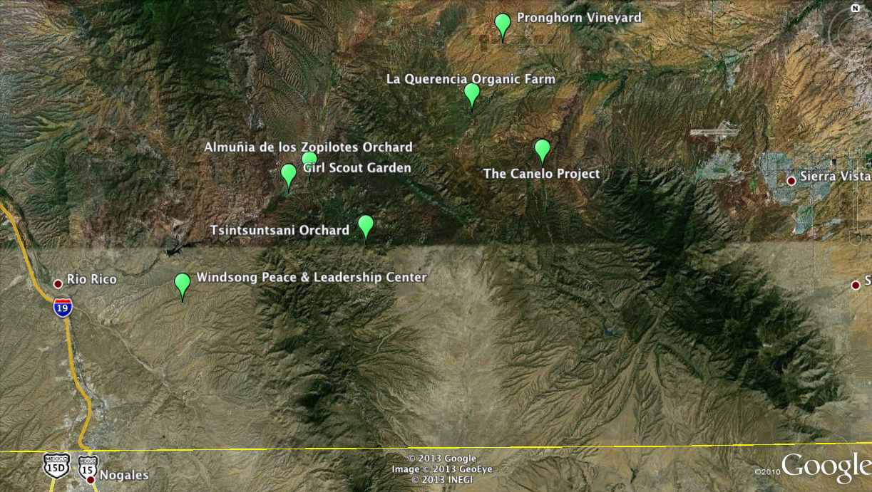
Pollinator Hedgerows in Santa Cruz County Arizona

