Slide 1
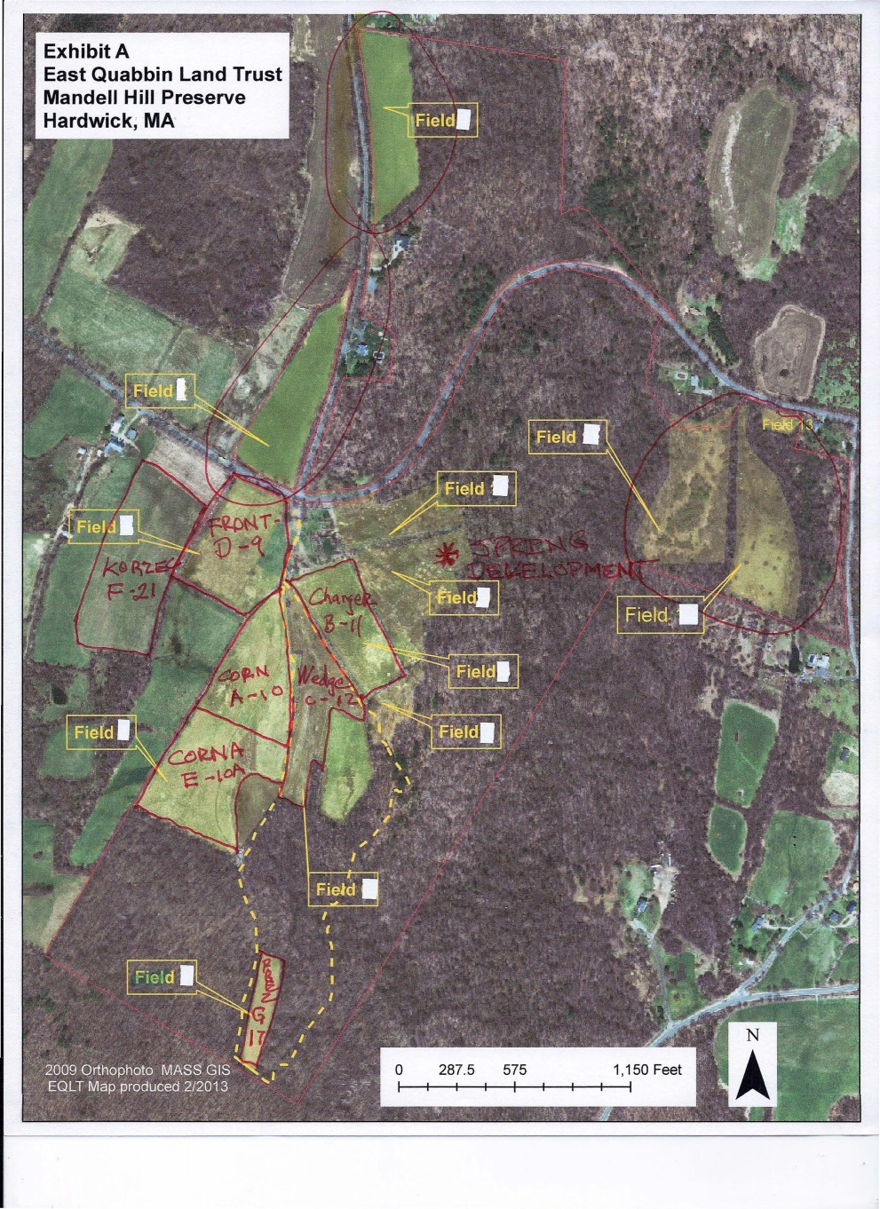
MAP OF PADDOCKS

Slide 2
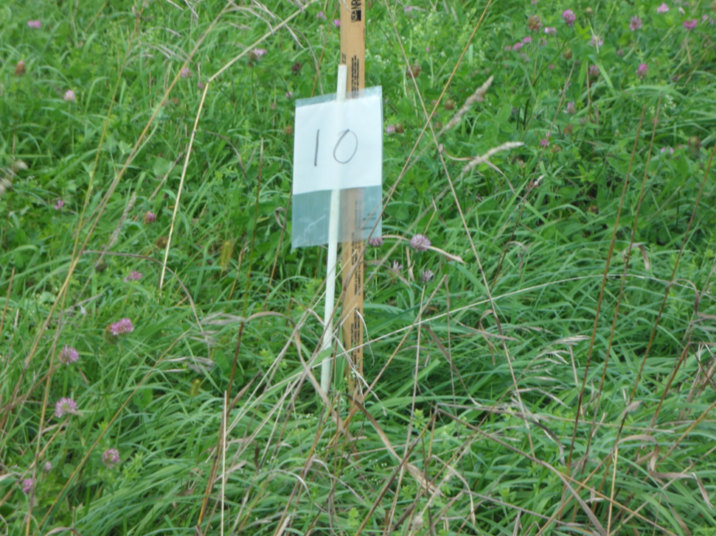
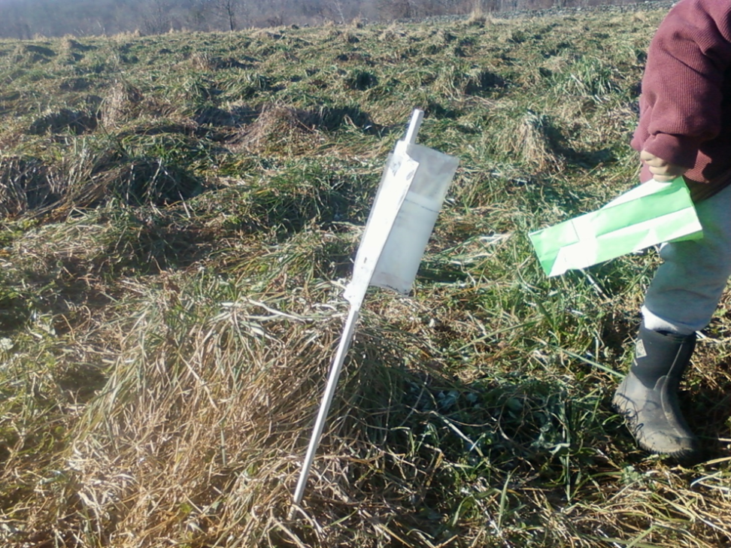
“Corn” Paddock –A -10
JULY 2011 sample
JANUARY 2012 sample

Slide 3
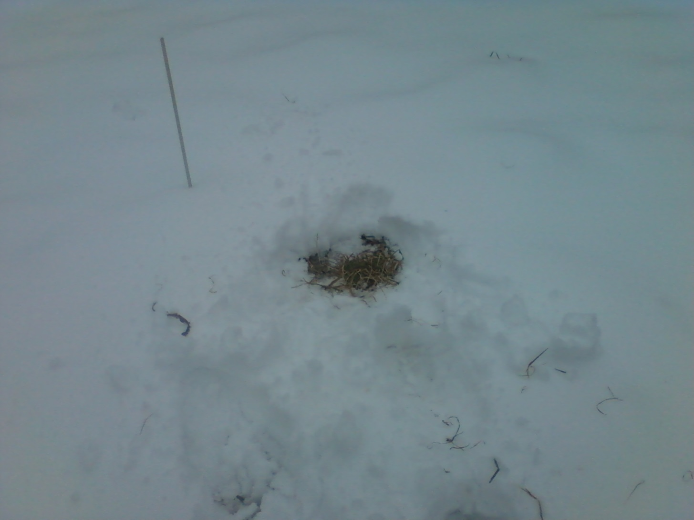
“Corn” Paddock-A-10
February 2012 sample

Slide 4
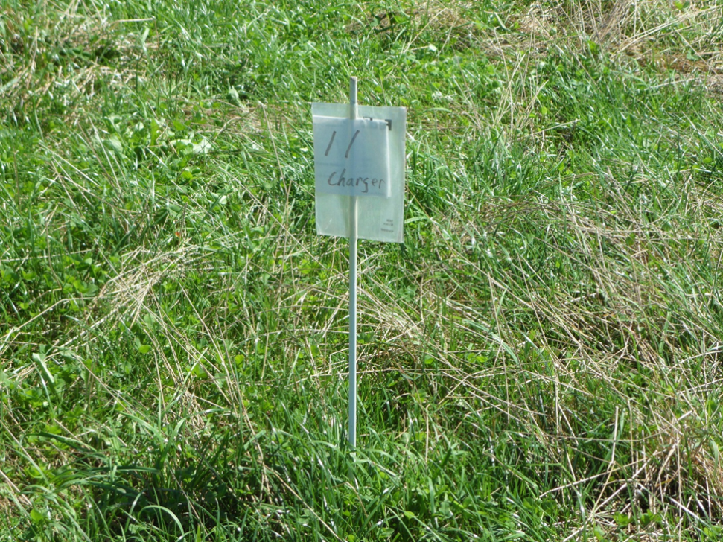
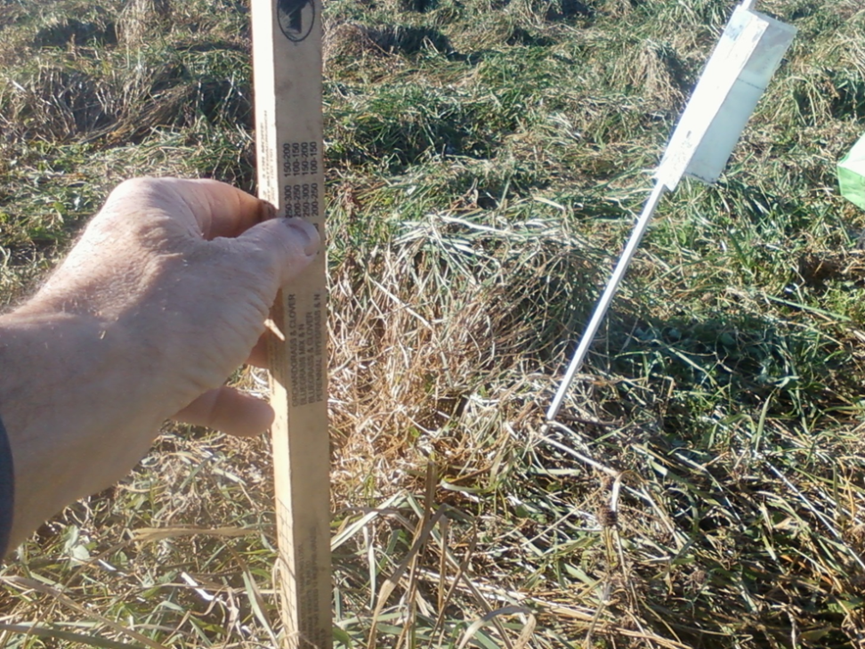
“Charger” Paddock-B-11
JULY 2011 sample
JANUARY 2012 sample

Slide 5
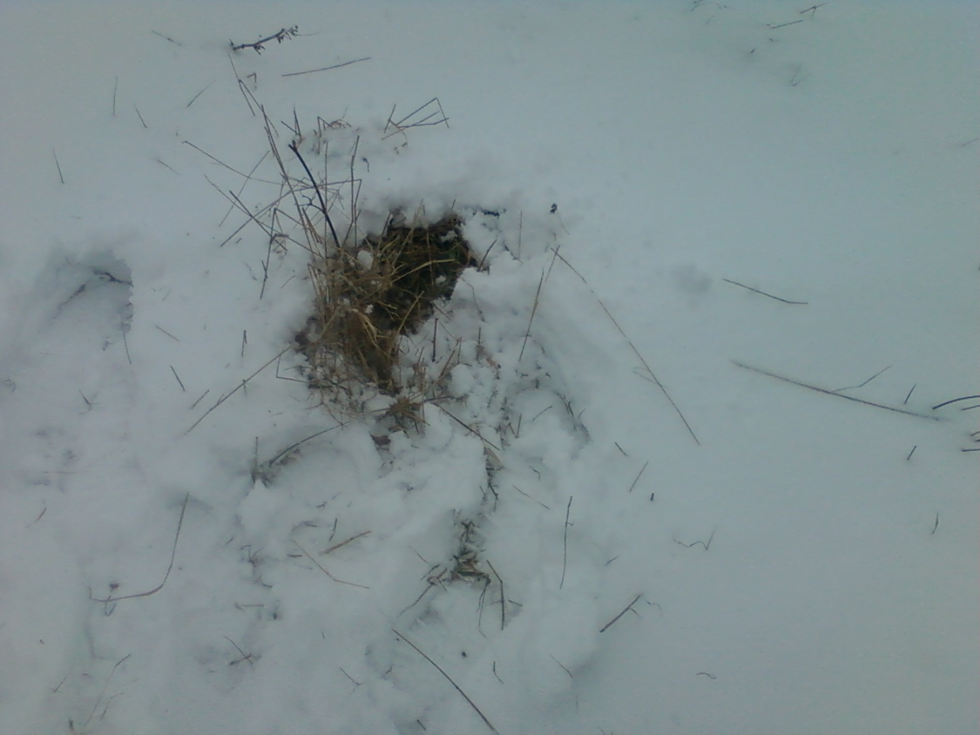
“Charger” paddock-B-11
February 2012 sample

Slide 6
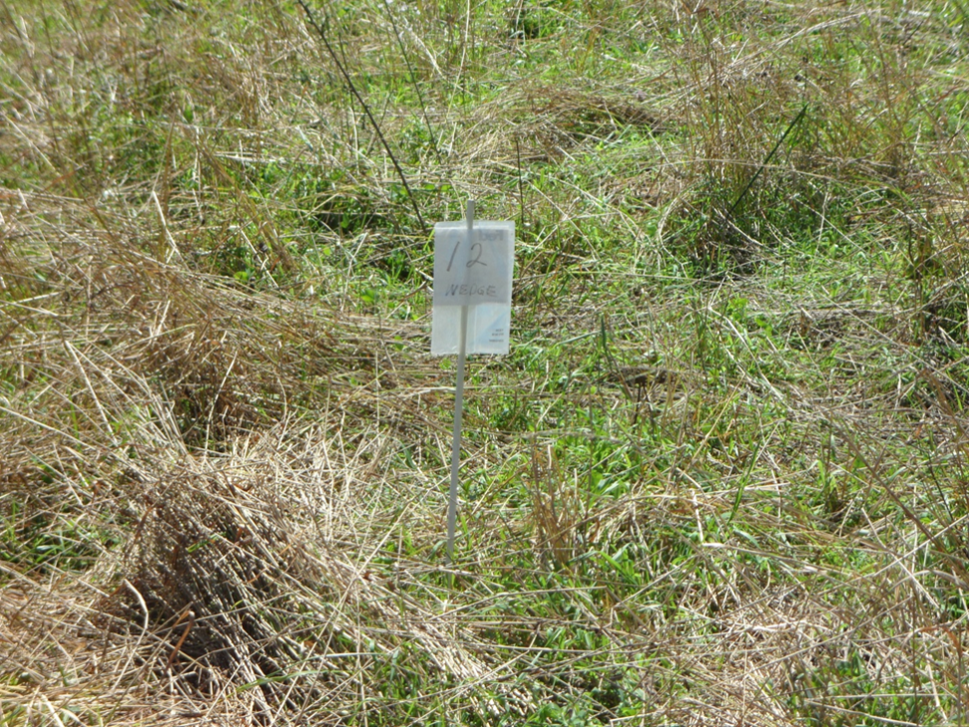
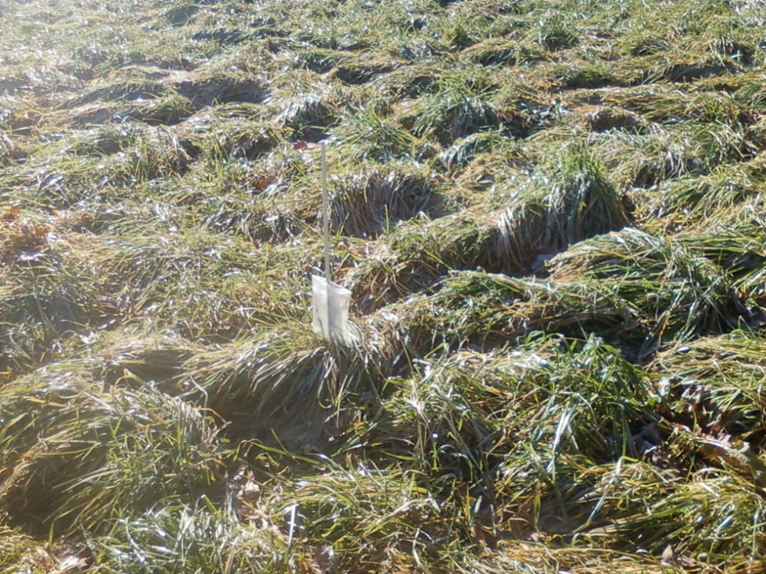
“Wedge” paddock-C-12
JULY 2011 sample
JANUARY 2012 sample

Slide 7
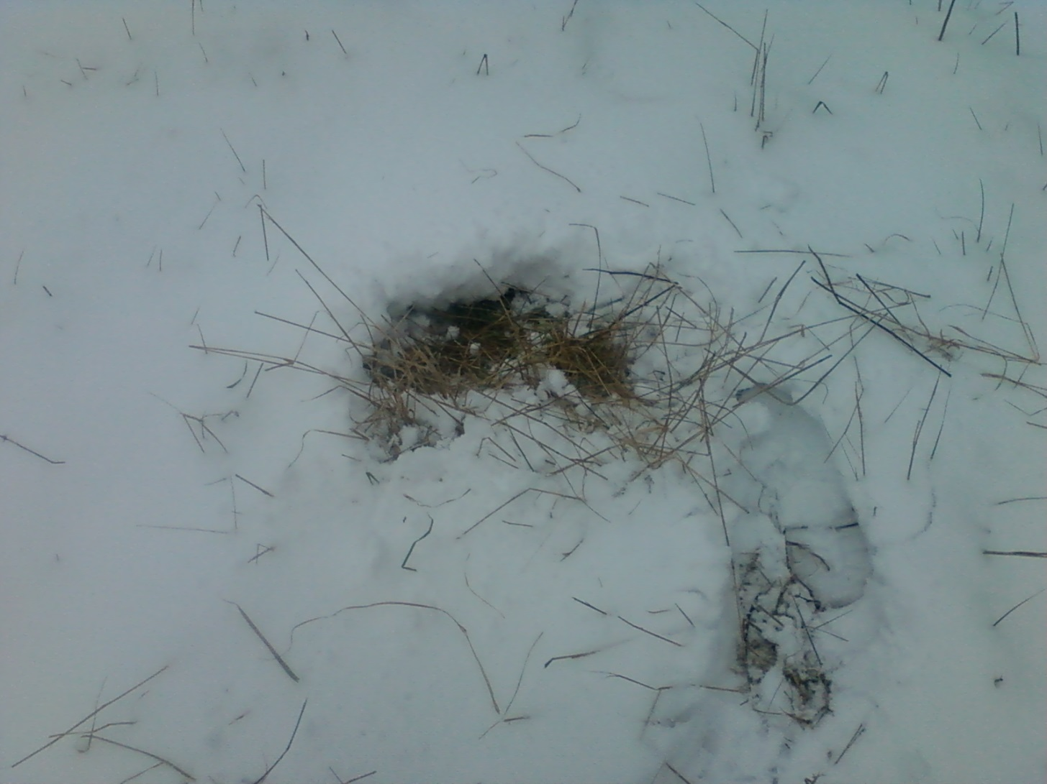
“Wedge” paddock-C-12
February 2012 sample

Slide 8
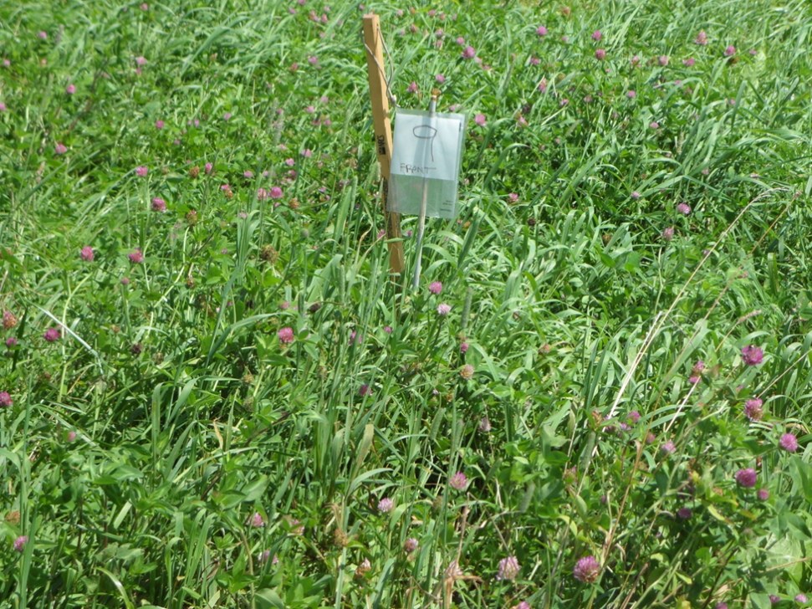
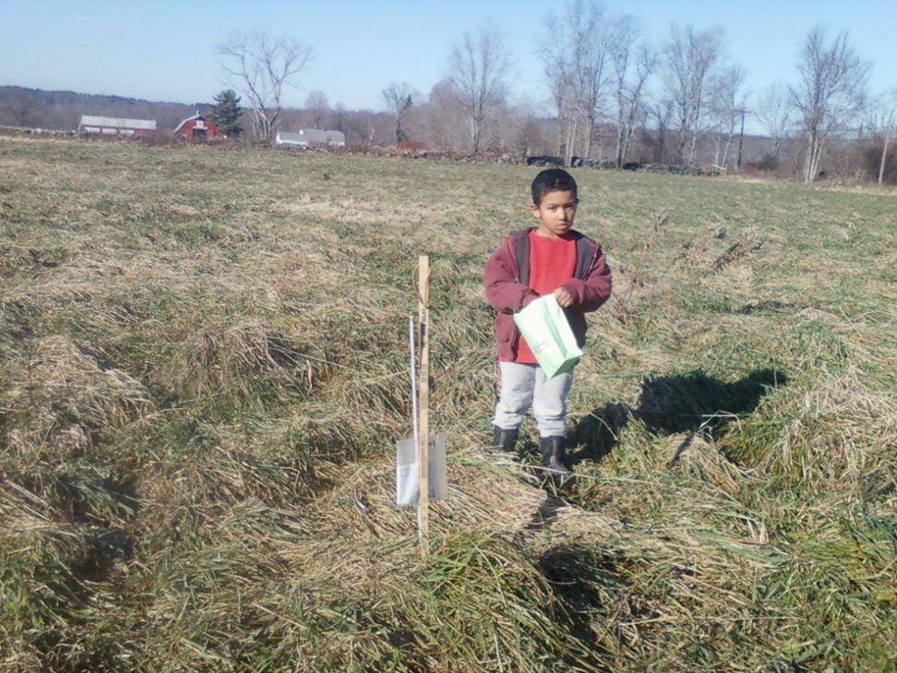
“Front” Paddock-D-9
JULY 2011 sample
JANUARY 2012 sample

Slide 9
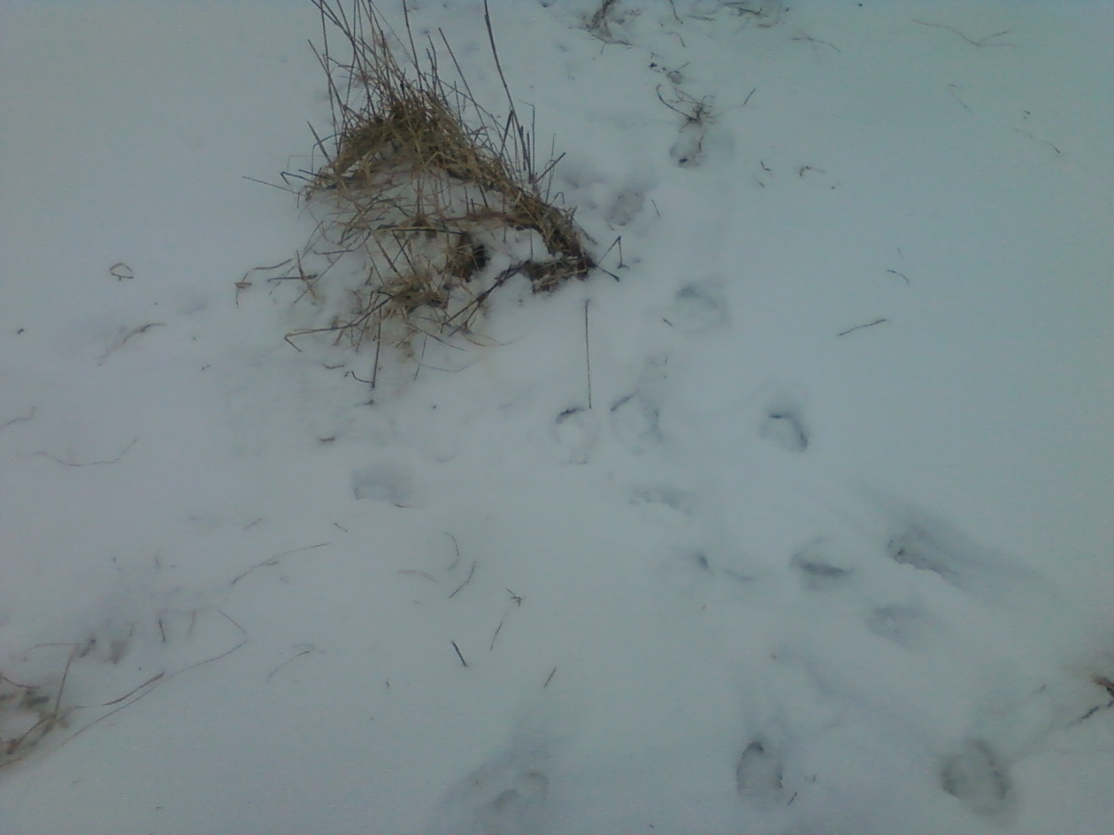
“Front” Paddock-D-9
February sample

Slide 10
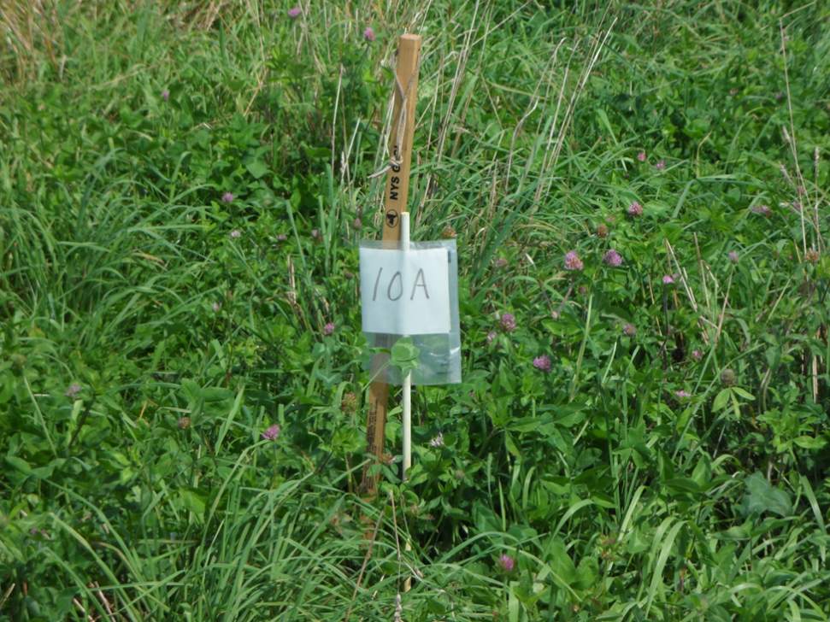

“Corn A” Paddock-E-10A
JULY sample
JANUARY sample

Slide 11
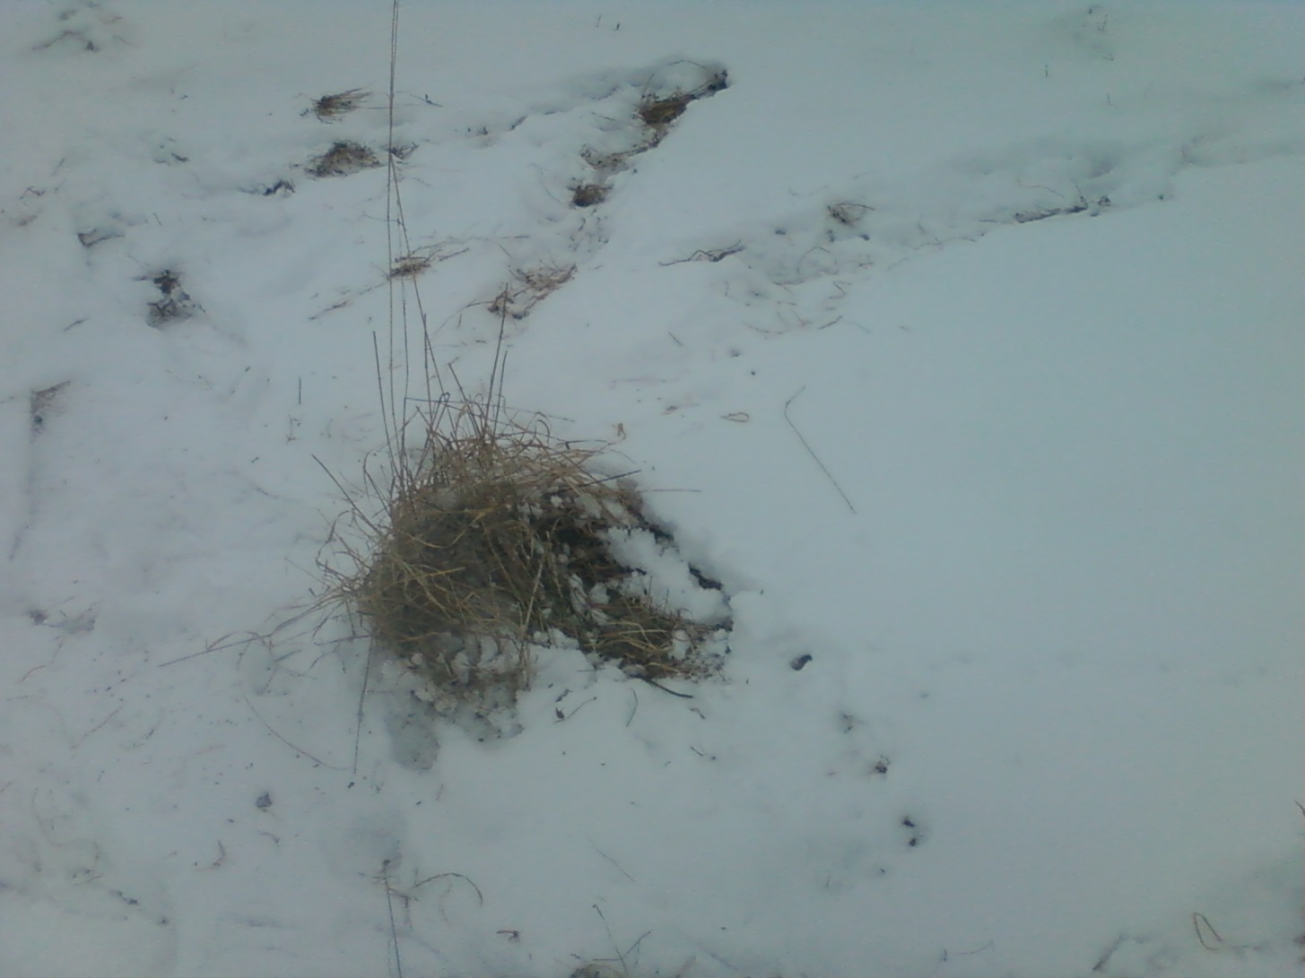
“Corn A” Paddock-E-10A
FEBRUARY 2012 sample

Slide 12
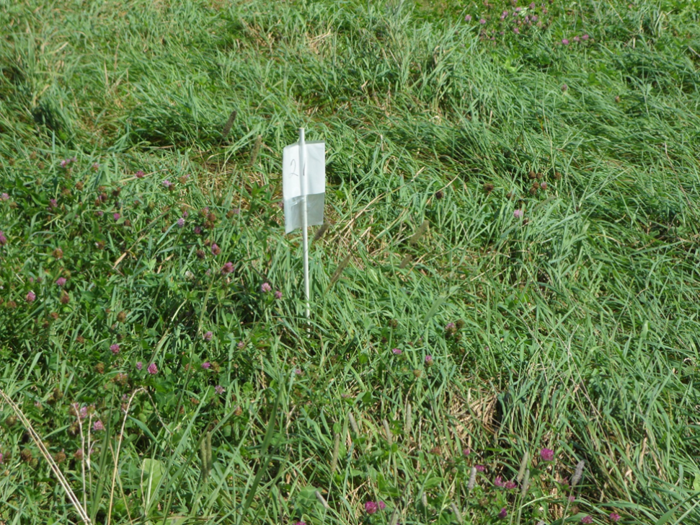
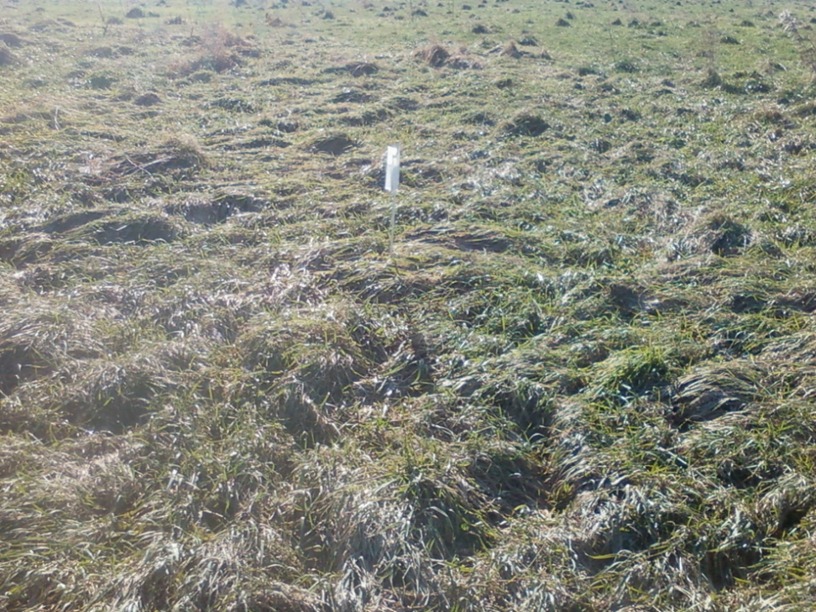
“Korzec” Paddock-F-21
JULY 2011 sample
JANUARY 2012 sample

Slide 13
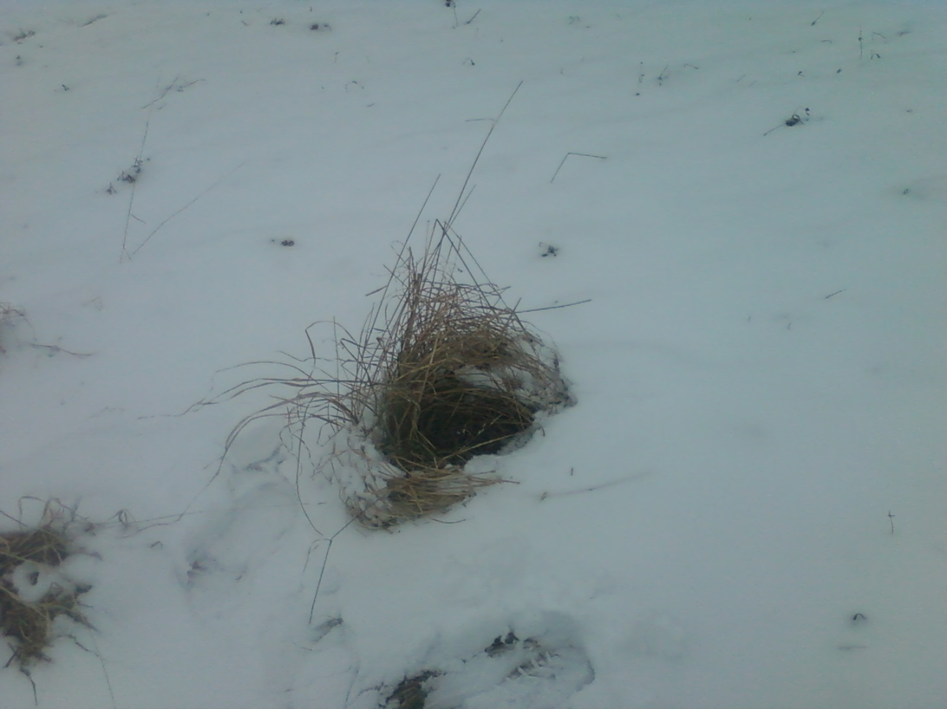
“Korzec” paddock-F-21
February 2012 sample

Slide 14
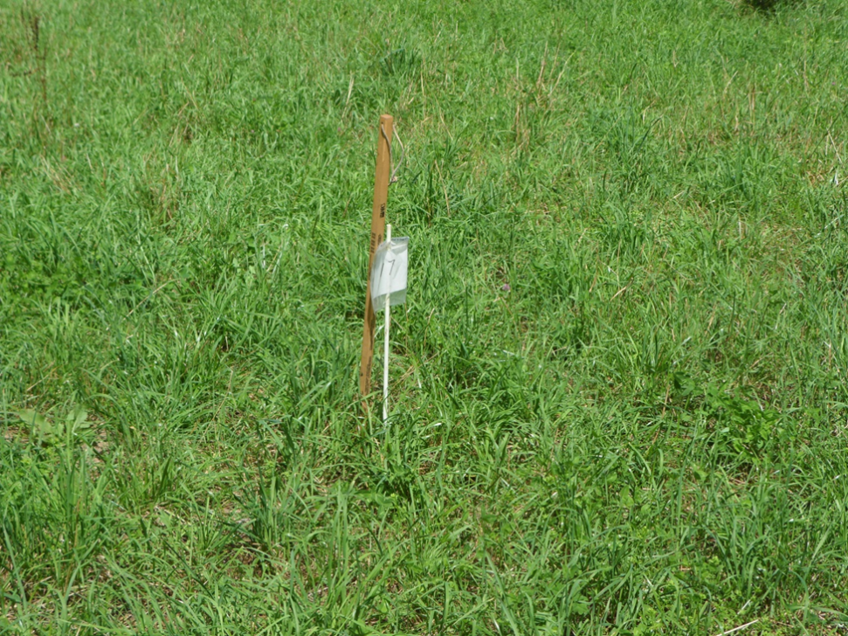
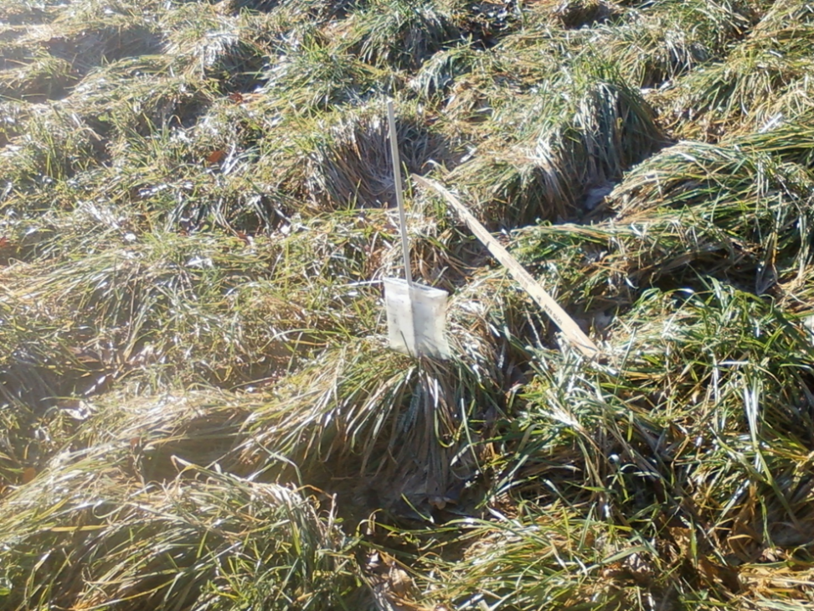
“Prez” Paddock-G-17
JULY 2011 sample
JANUARY 2012 sample

