Slide 1
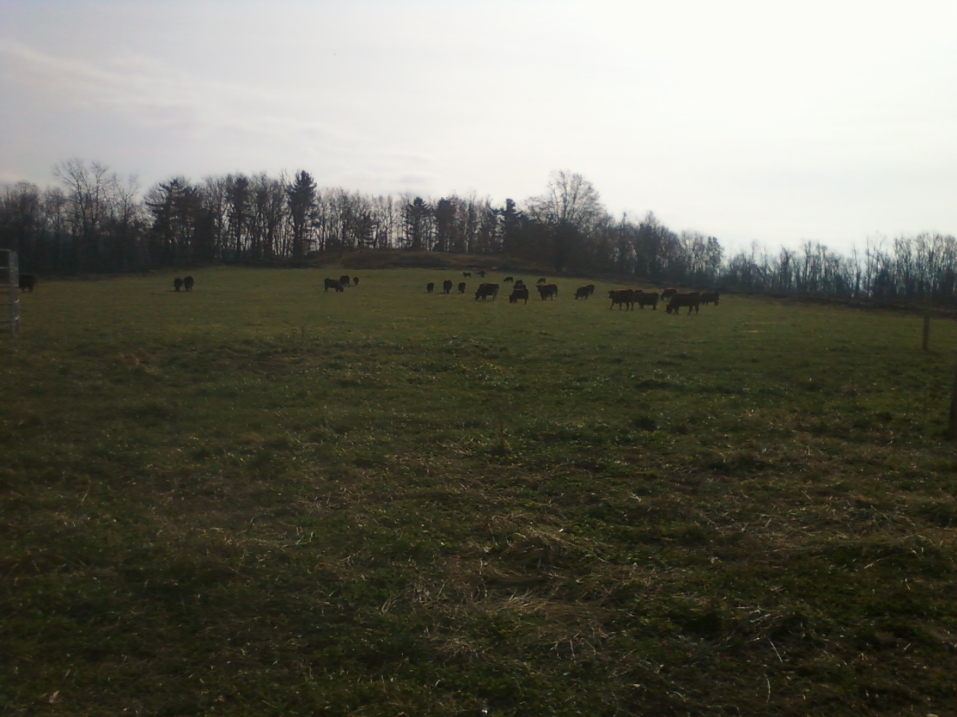
Cattle in “Charger” Paddock-B-11 OCTOBER 2011

Slide 2
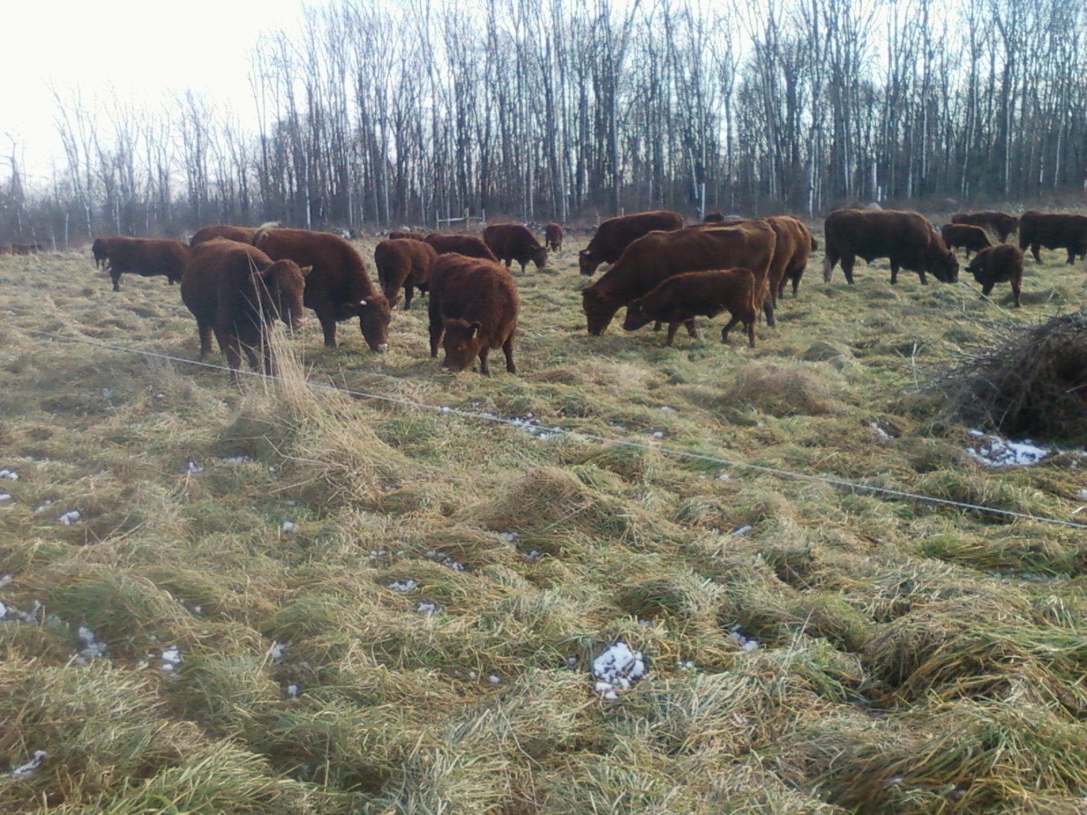
“WEDGE” Paddock-NOVEMBER 2011

Slide 3
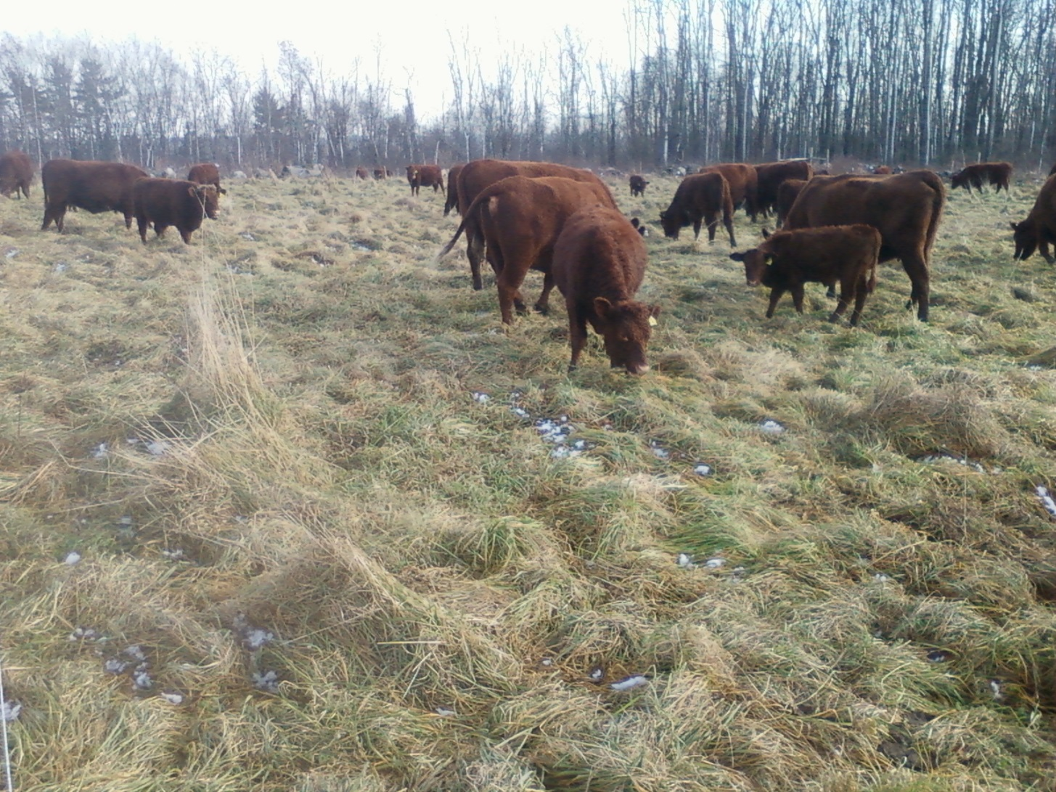
“PREZ” Paddock with Snow-NOVEMBER 2011

Slide 4
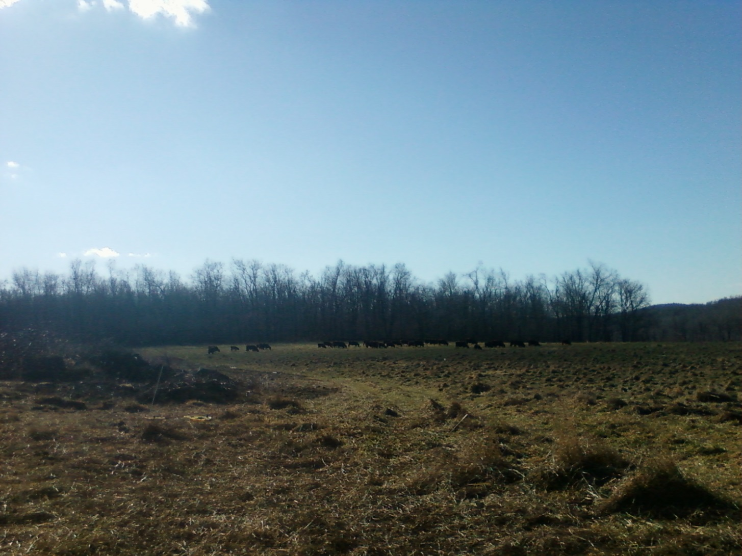
“CORN 10A” paddock
DECEMBER 2011

Slide 5
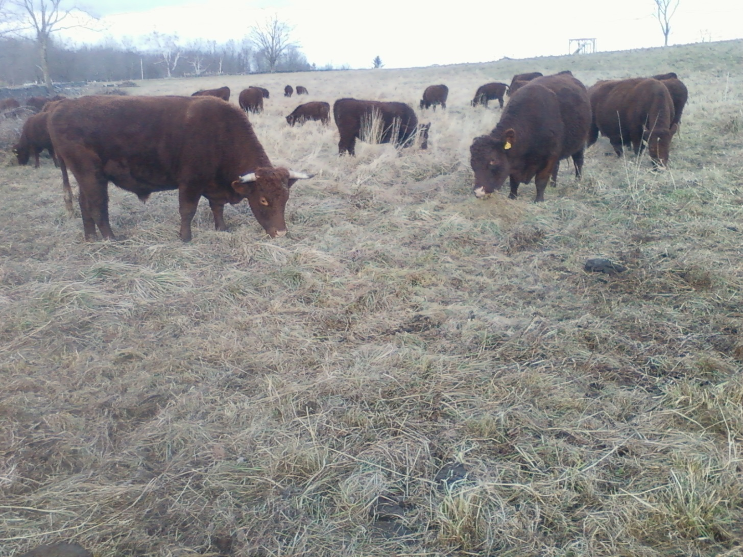
“CORN 10A” Paddock 2011
DECEMBER-Body Condition Score 7

Slide 6
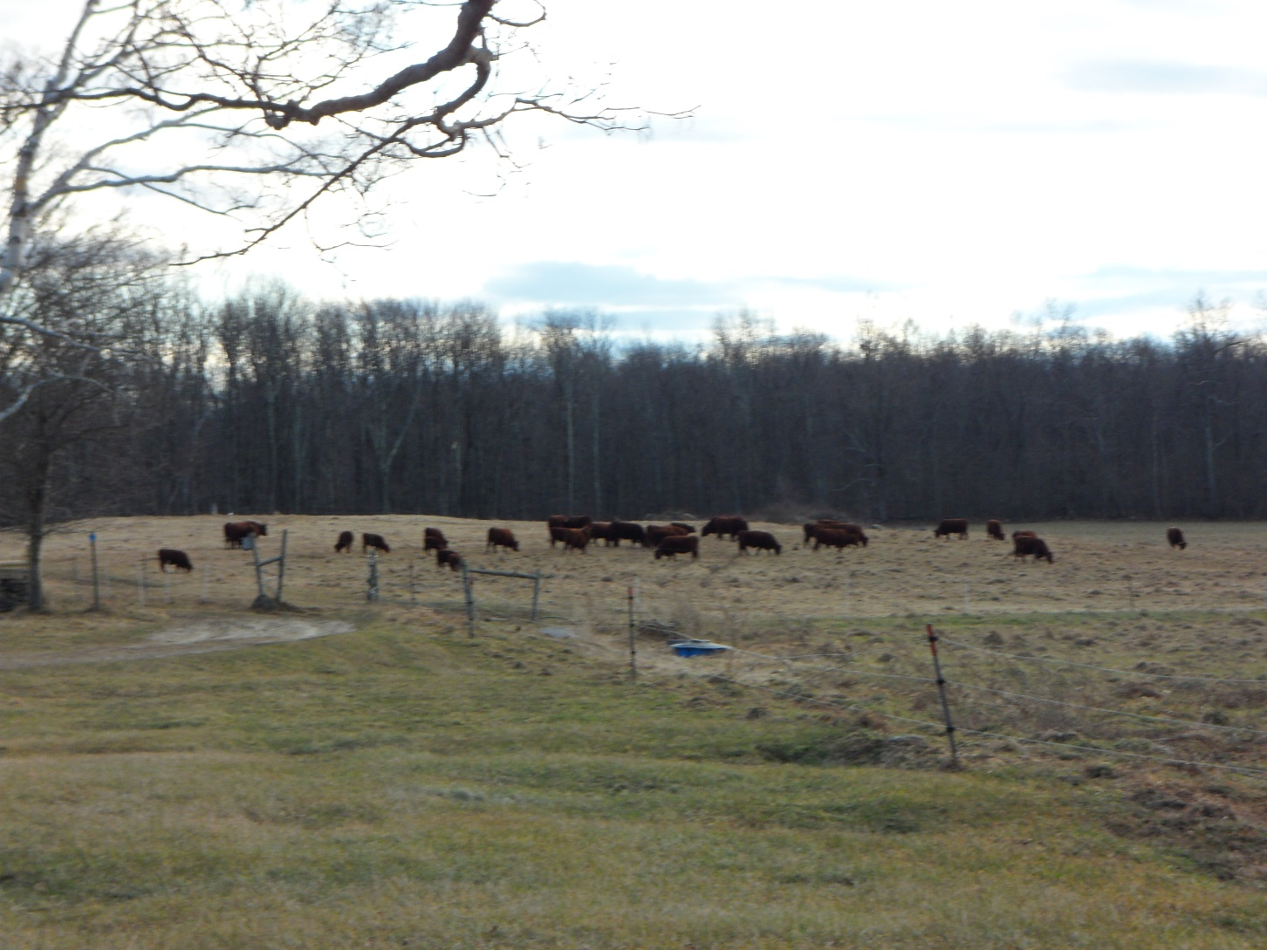
“CORN” Paddock
LATE DECEMBER 2011

Slide 7
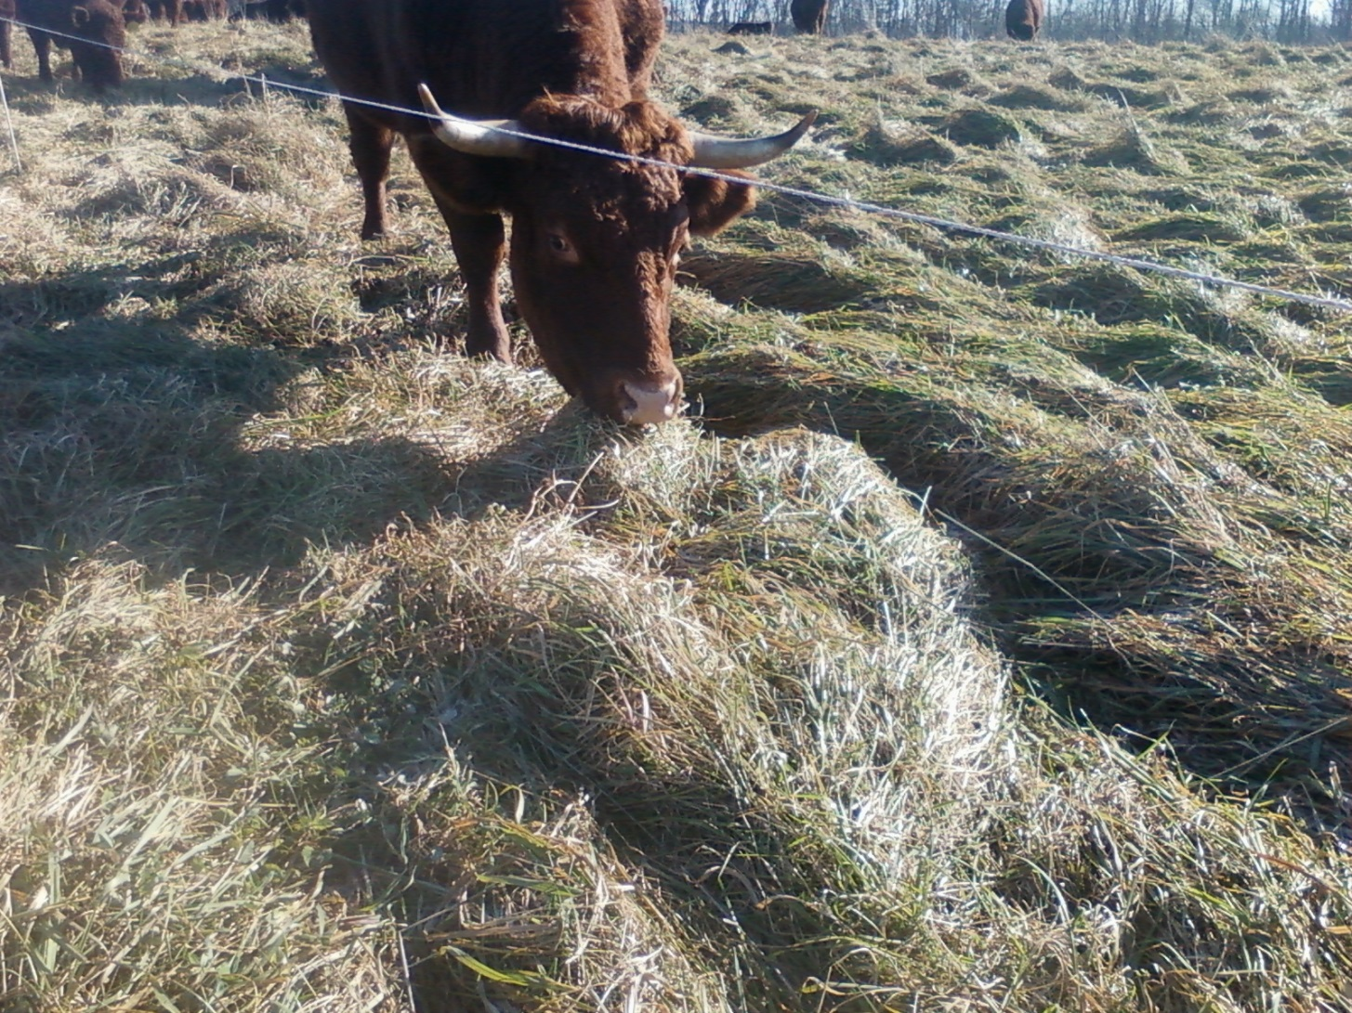
“CORN” Paddock
JANUARY 2012-new bite

Slide 8
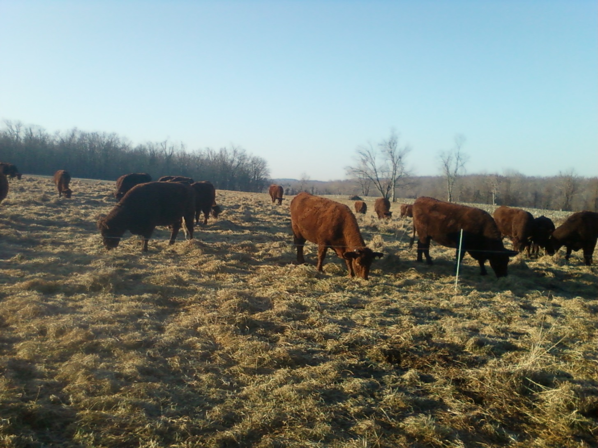
“CORN” Paddock 10
January 20th 2012--Body Condition Score 6.6

Slide 9
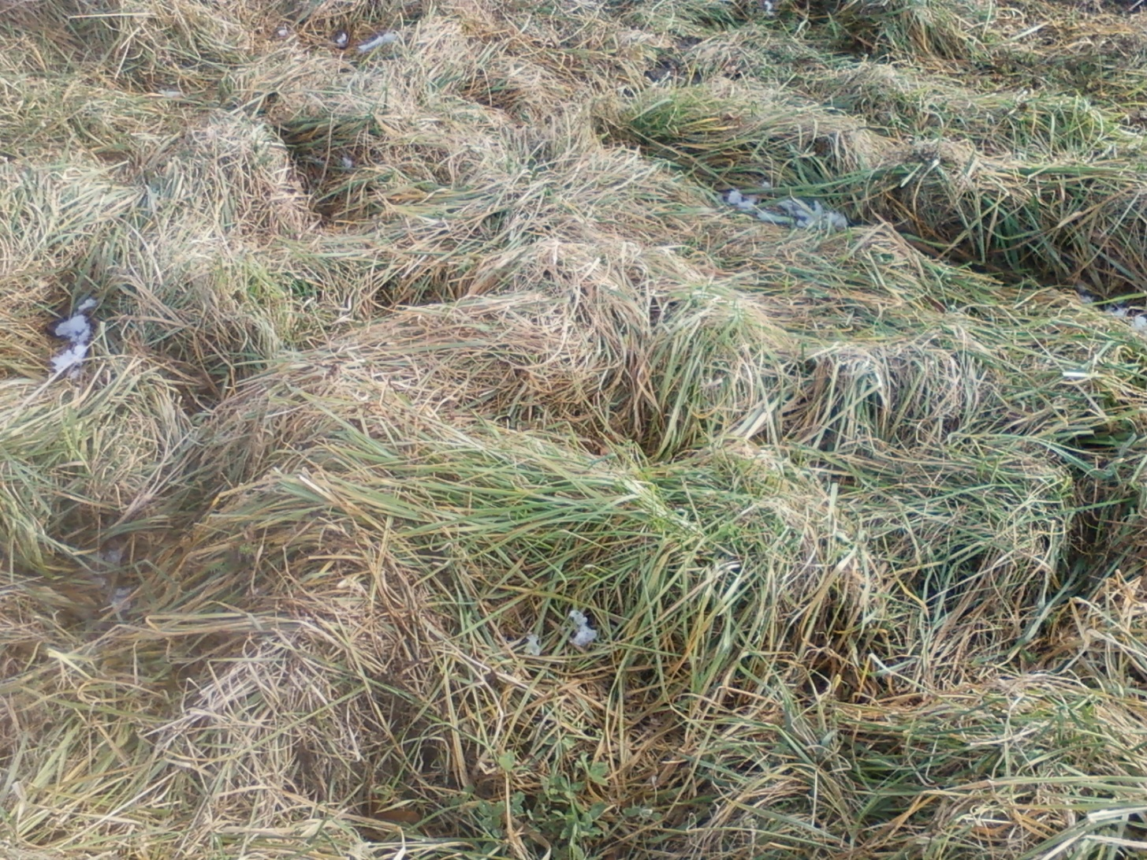
“KORZEC” Paddock 2012

Slide 10
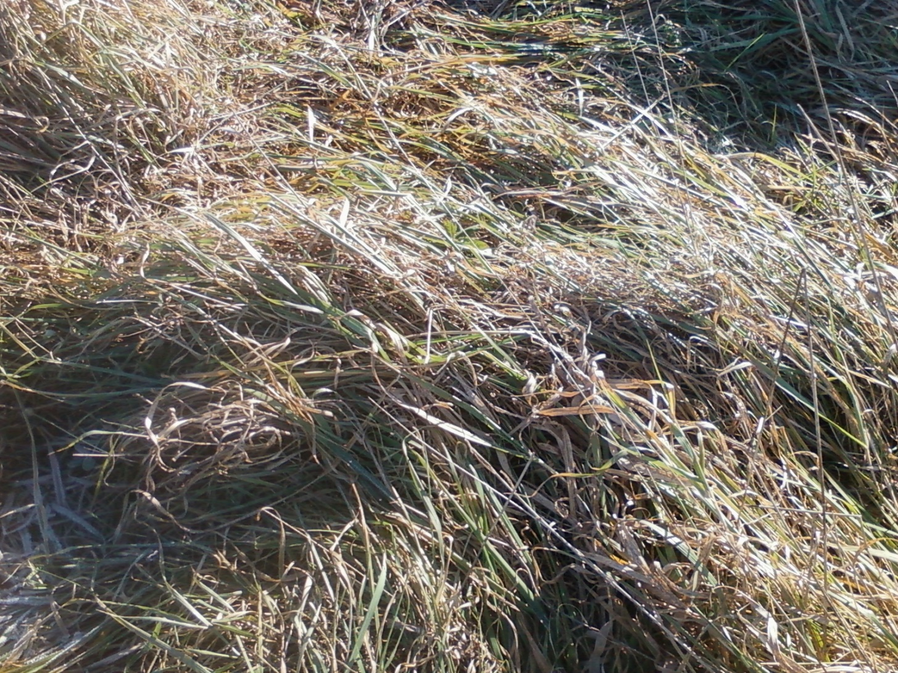
“FRONT” Paddock-9
BEFORE SNOW 2012

Slide 11
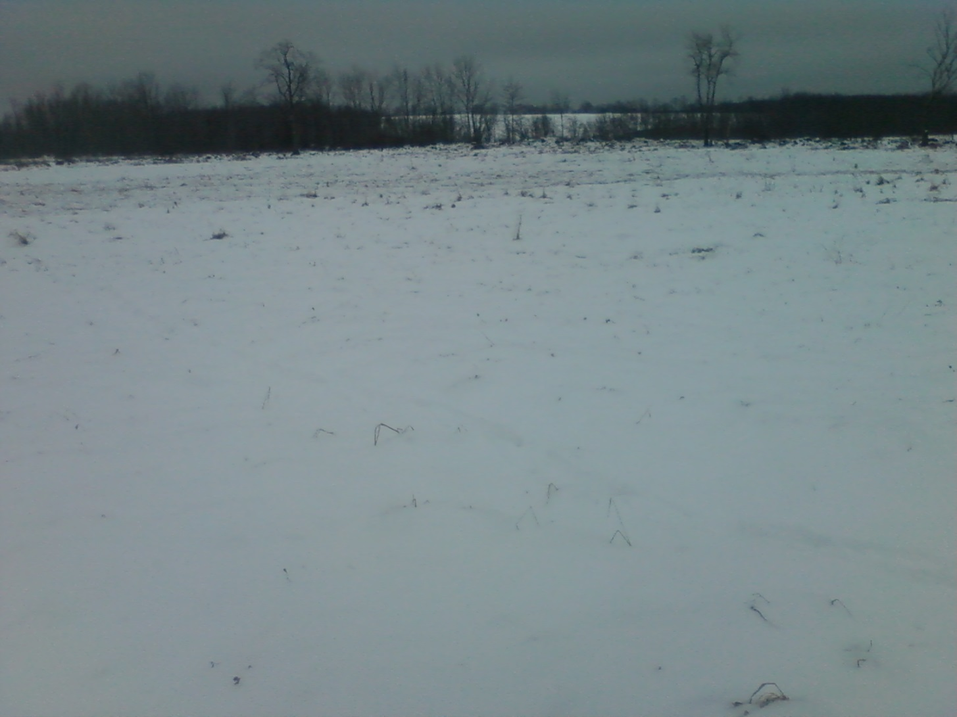
“Front” Paddock-9 one half grazed February 2012

Slide 12
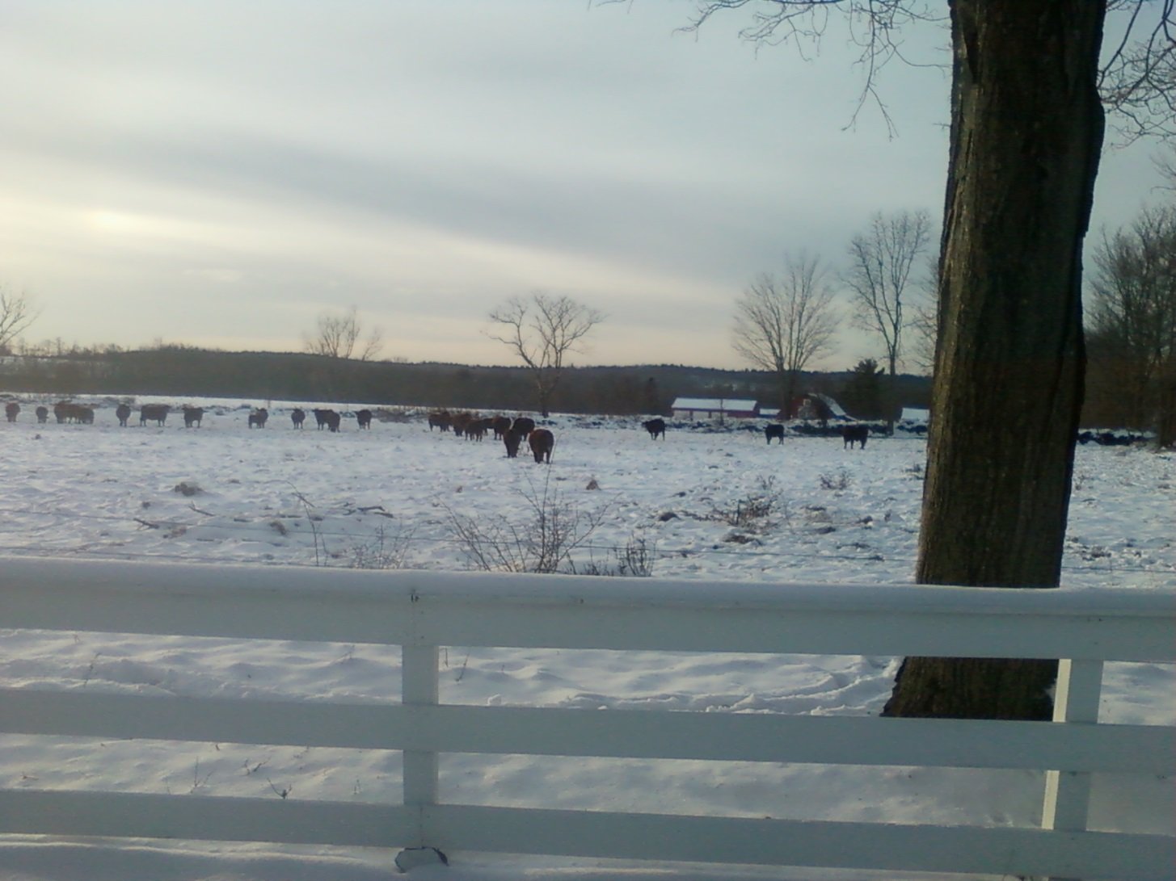
“FRONT” Paddock-9
FEBRUARY 15th 2012

