Slide 1
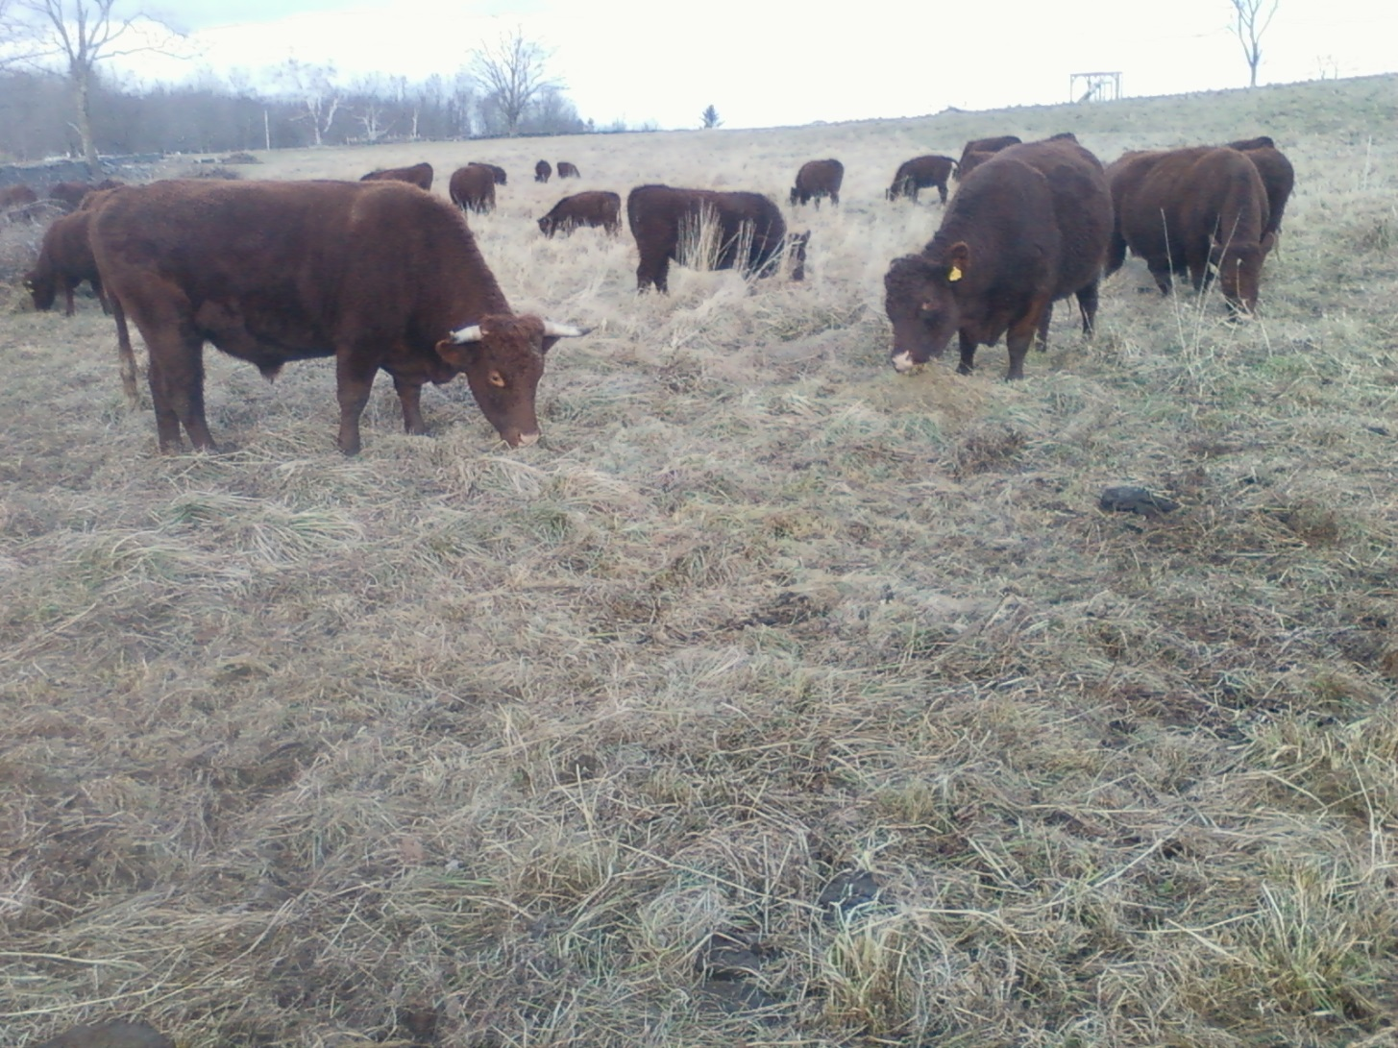
“CORN 10A” Paddock
DECEMBER-Body Condition Score 7

Slide 2
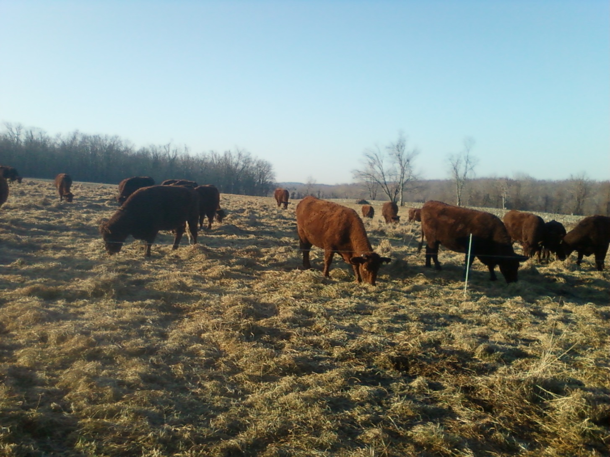
“CORN” Paddock 10
January 20th-Body Condition Score 7

