Slide 1
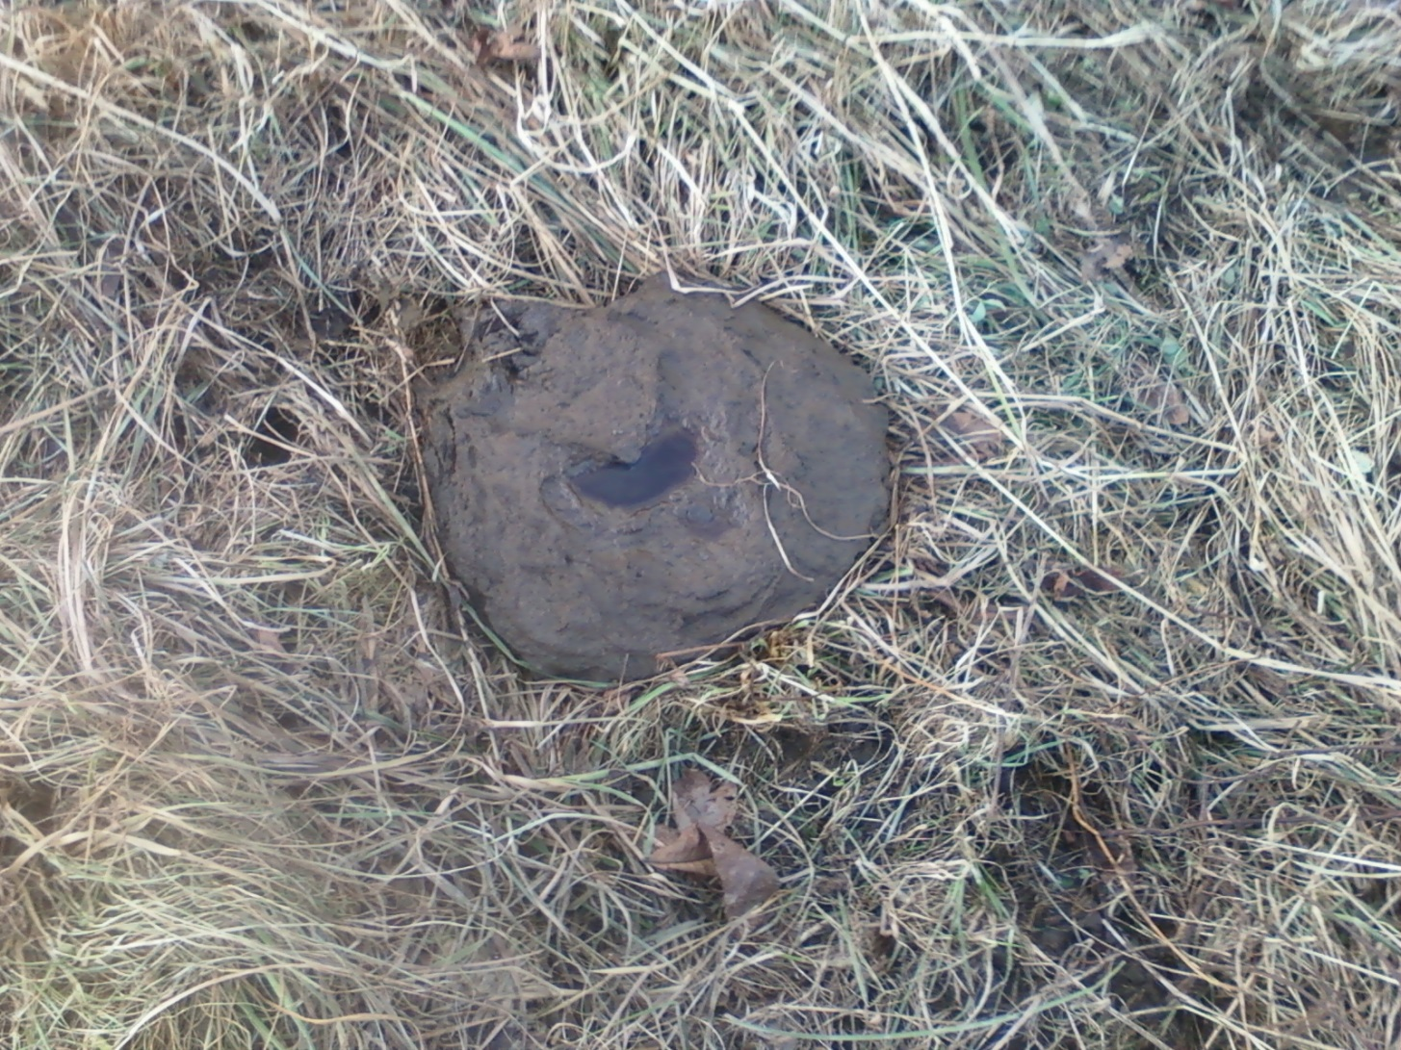
PERFECT MANURE-early February

Slide 2
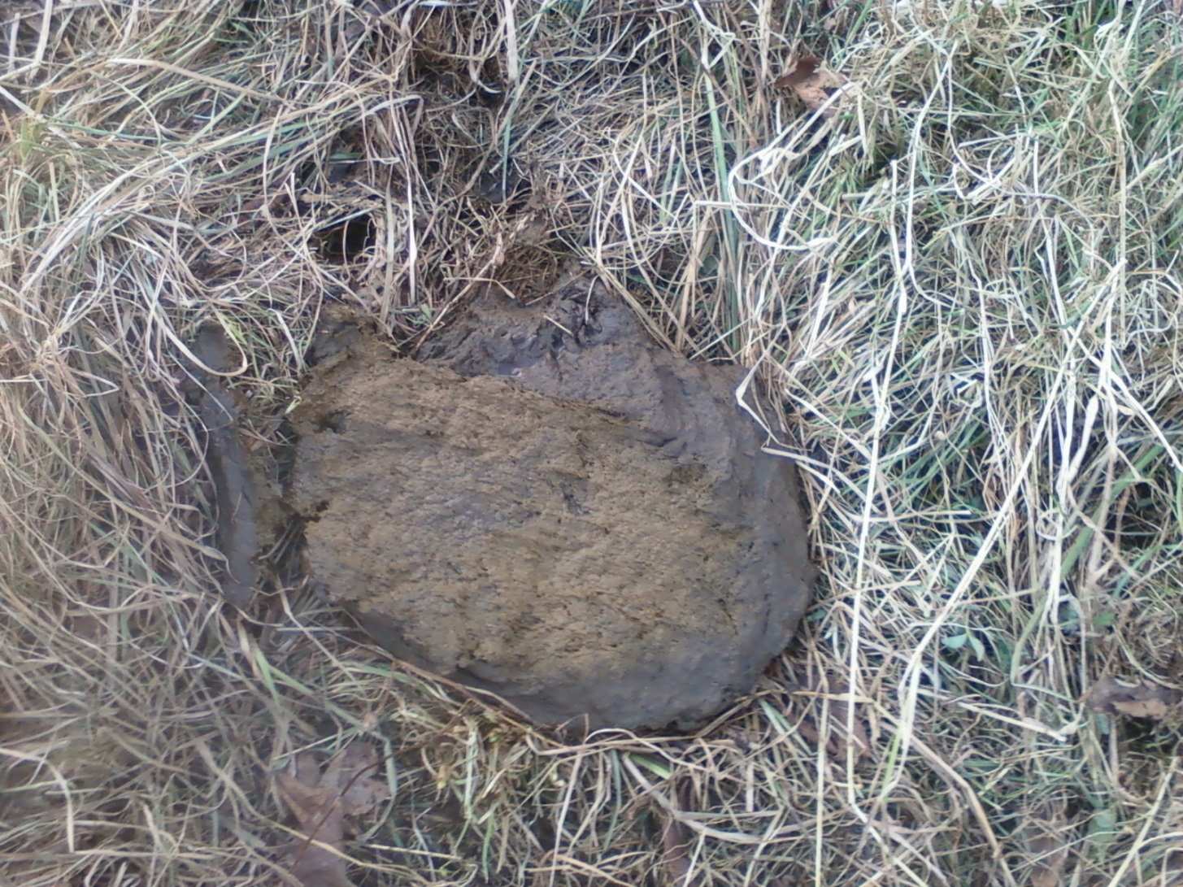
PERFECT MANURE-STOCKPILE GRASS

