Slide 1
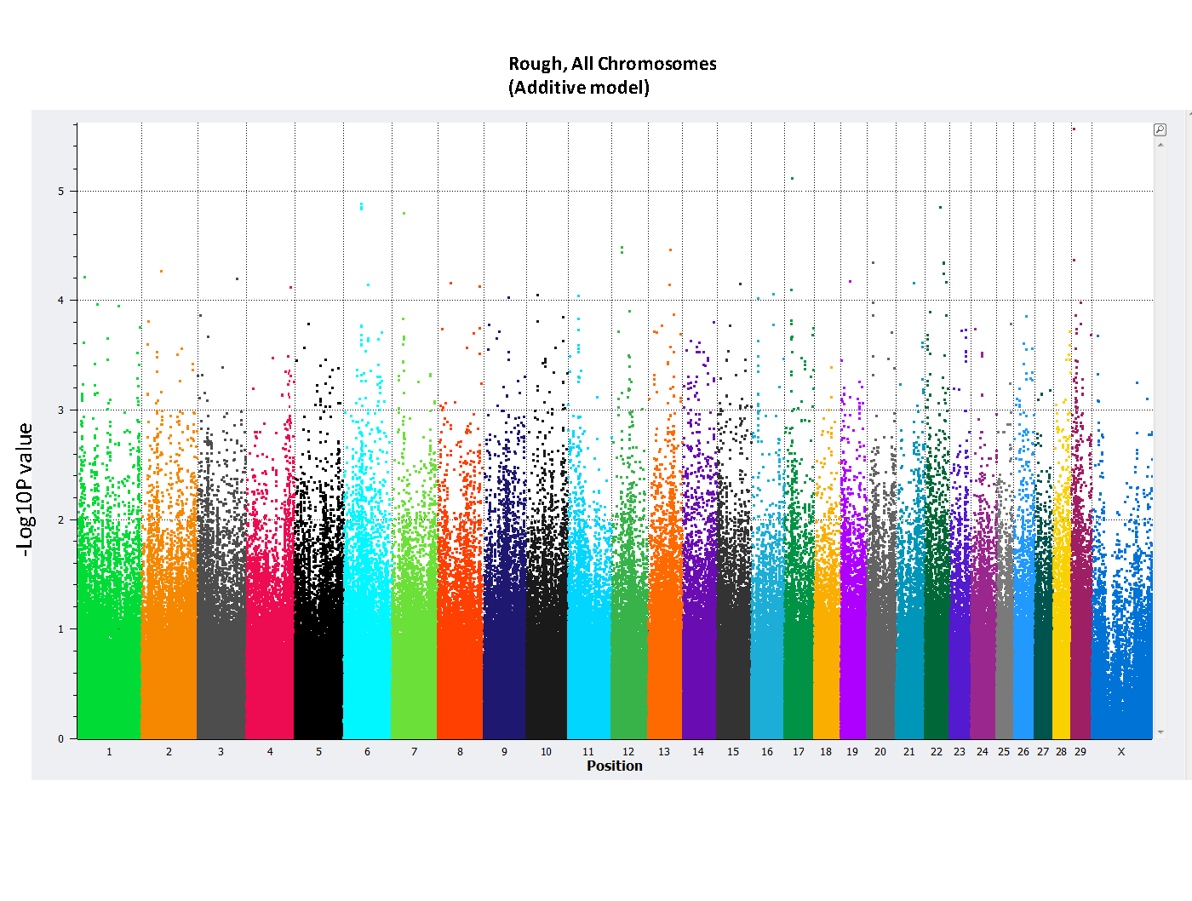
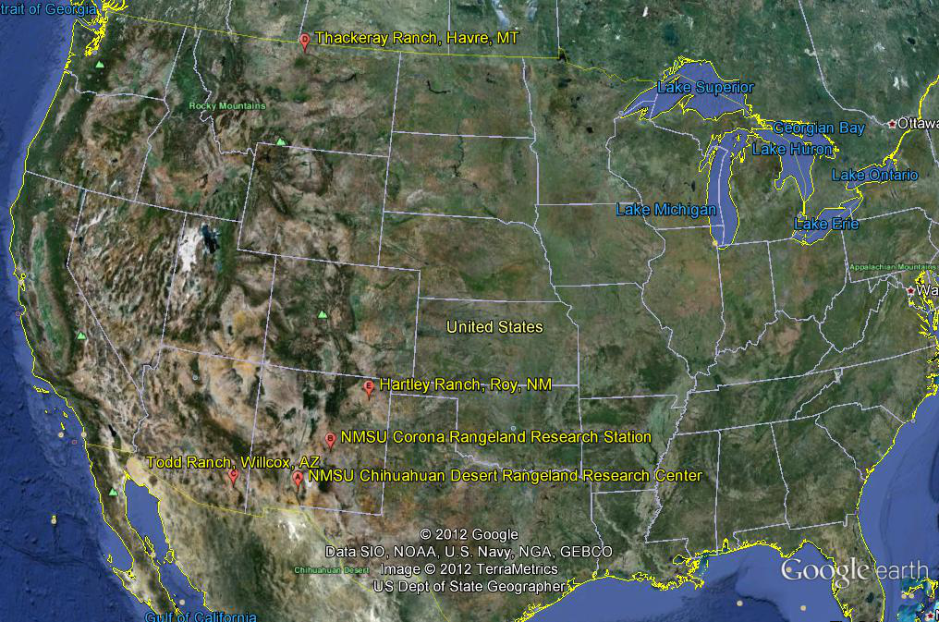
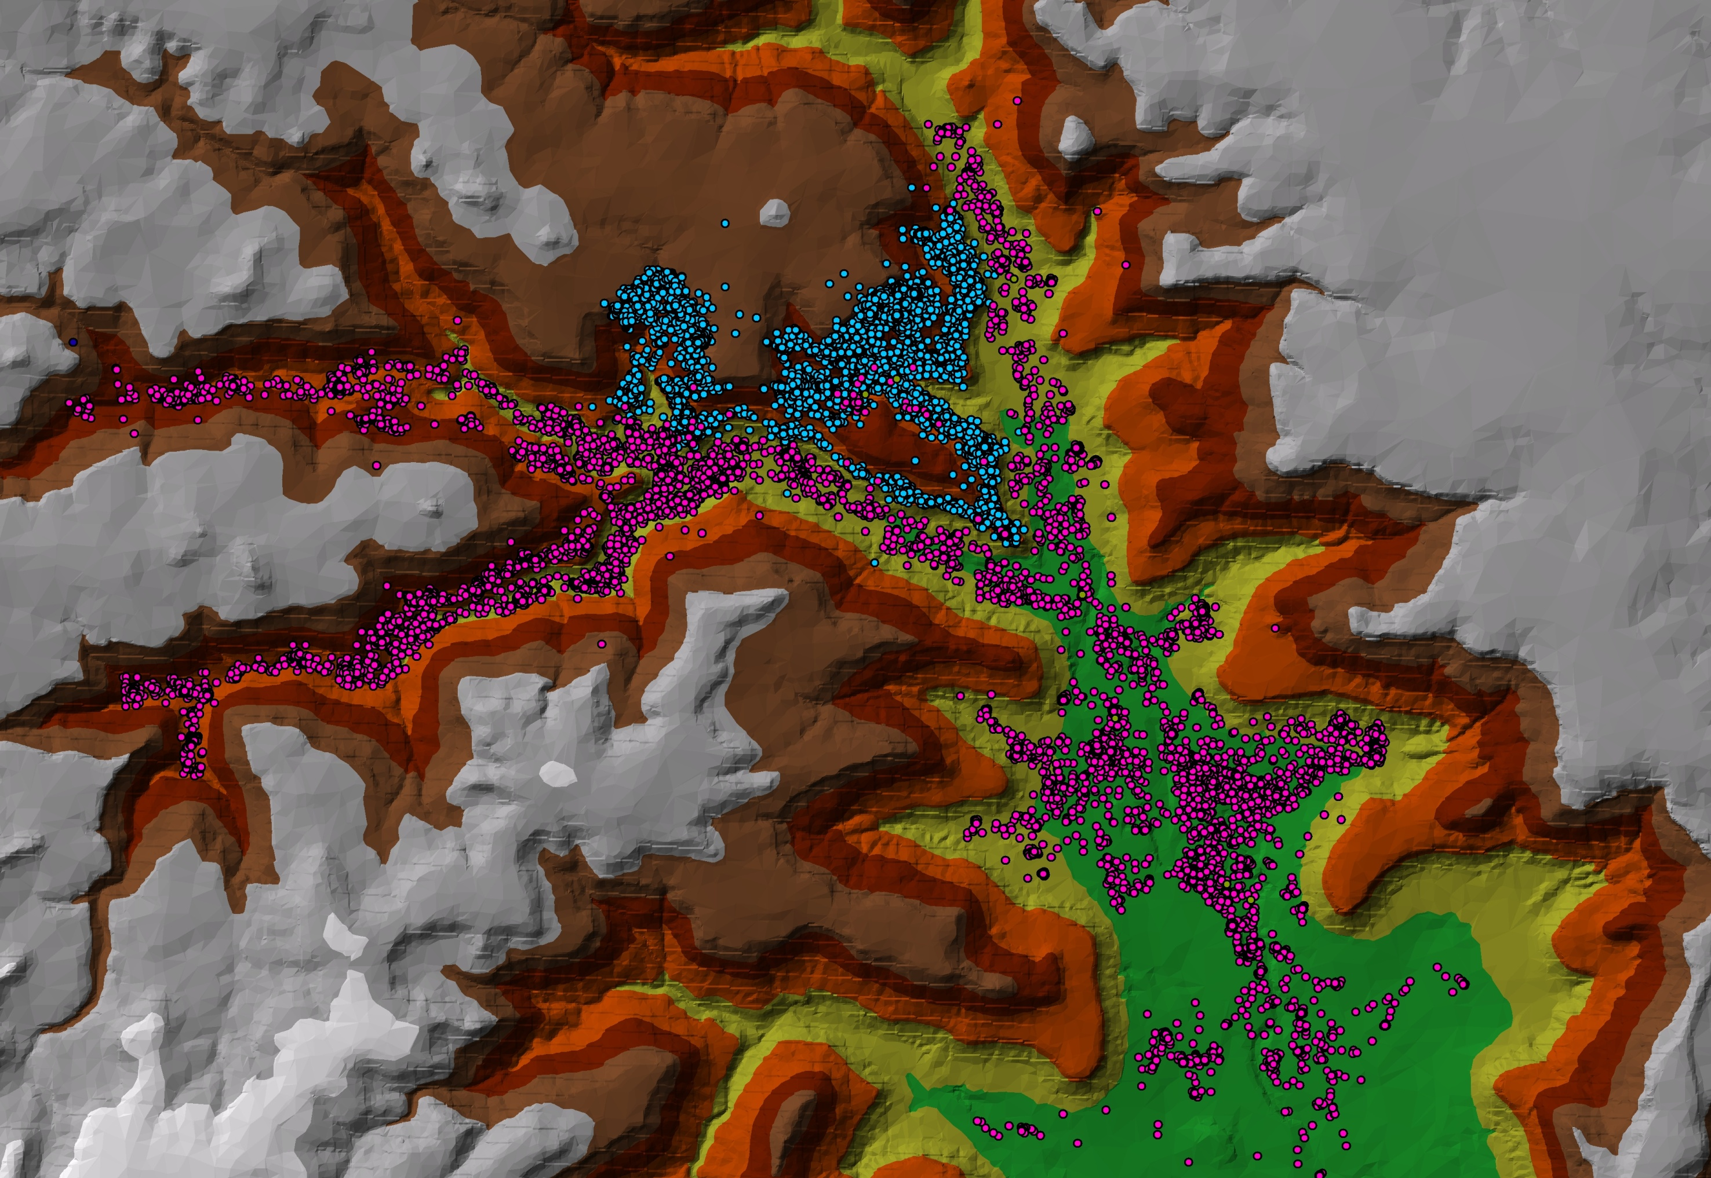
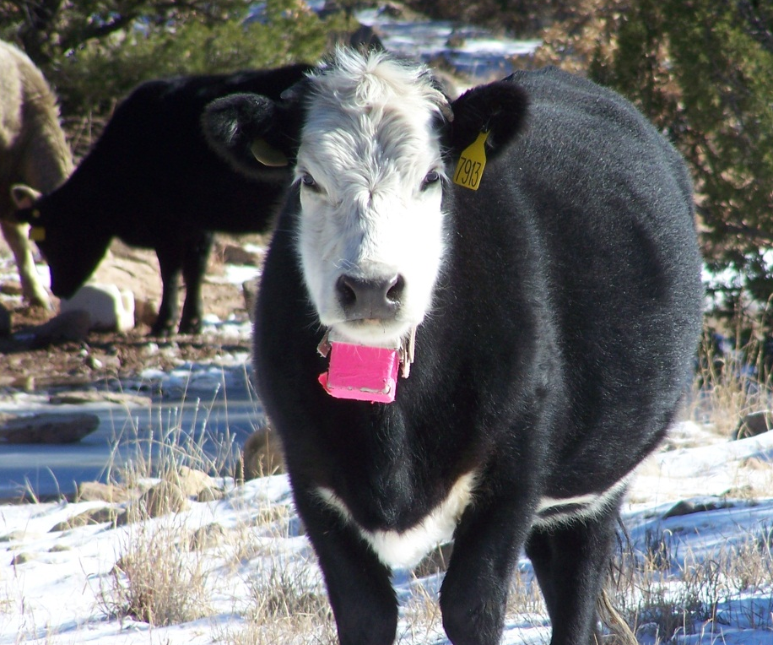
GENOME-WIDE ASSOCIATION STUDY OF GRAZING DISTRIBUTION TRAITS IN BEEF CATTLE K.L. DeAtley^{1,2}, M.G. Thomas², G. Rincon³, J.F. Medrano³, A.M. Lipka¹, S. Lunt¹, G.A. Silver¹, and D.W. Bailey¹ ¹New Mexico State University, Las Cruces, NM, ²Colorado State University, Fort Collins, CO³, University of California, Davis
Introduction
Results
A genome-wide association study (GWAS) was conducted using the BovineHD Bead Chip (Illumina, Inc., San Diego, CA) and grazing distribution phenotypes 1) Rough (i.e., combination of elevation and slope) and 2) Ratio (i.e., combination of elevation, slope, and distance to water) in beef cattle populations in Montana, New Mexico, and Arizona. Single nucleotide polymorphisms (SNP) on bovine chromosomes 17 and 29 were found to account for 17 and 25% of variation in the Rough trait, respectively. Additional quantitative trait loci (QTL) accounted for 5 to 10% variation in Ratio trait. Results suggest that heritability of slope and elevation use should be at least 25%.
Materials and Methods
A total of 87 multi-breed cows from five ranches in the Western U.S. were used in this study
Grazing traits
Rough = combination of elevation and slope
Ratio = combination of elevation, slope, and distance to water
Note: Traits are normalized averages, similar to weaning weight ratio (i.e., 100 is roughly average), above 100 is superior, below 100 is inferior
DNA collection, testing, and data analysis
Blood collected via caudal venipuncture
DNA genotyped by GeneSeek (Lincoln, NE) with BovineHD Bead Chip (~800,000 SNP genotypes; Illumina, Inc., San Diego, CA)
CLC Bio Genomics Workbench (www.clcbio.com/)
Manhattan plot for rough grazing distribution trait. The X axis is the position of SNP on each chromosome (University of Maryland genome assembly, v3) and the Y axis is the –logP.
A
B
C
Bottom dweller (A) and hill topper (B) cows and their grazing patterns (C; Bottom dweller = pink; Hill topper = blue) over __ d period at the Hartley Ranch (Roy, NM). Figure generated with _____ software (www…..).
Results
Single nucleotide polymorphism on chromosome 29 and 17 accounted for 25% and 21% of the variation in the Rough trait, respectively.
Additional QTL accounted for 5 to 10% variation in Ratio trait.
Most SNP accounted for only 1 to 2% of the variation in single trait.
Heritability of slope and elevation use should be at least 25%.
Conclusion
Identified two chromosomes associated with Rough trait
Identified QTL across the genome associated with Ratio trait
Results support further investigation of inheritance of grazing behavior
Acknowledgements:
Western Sustainable Agriculture Research and Education

