Slide 1
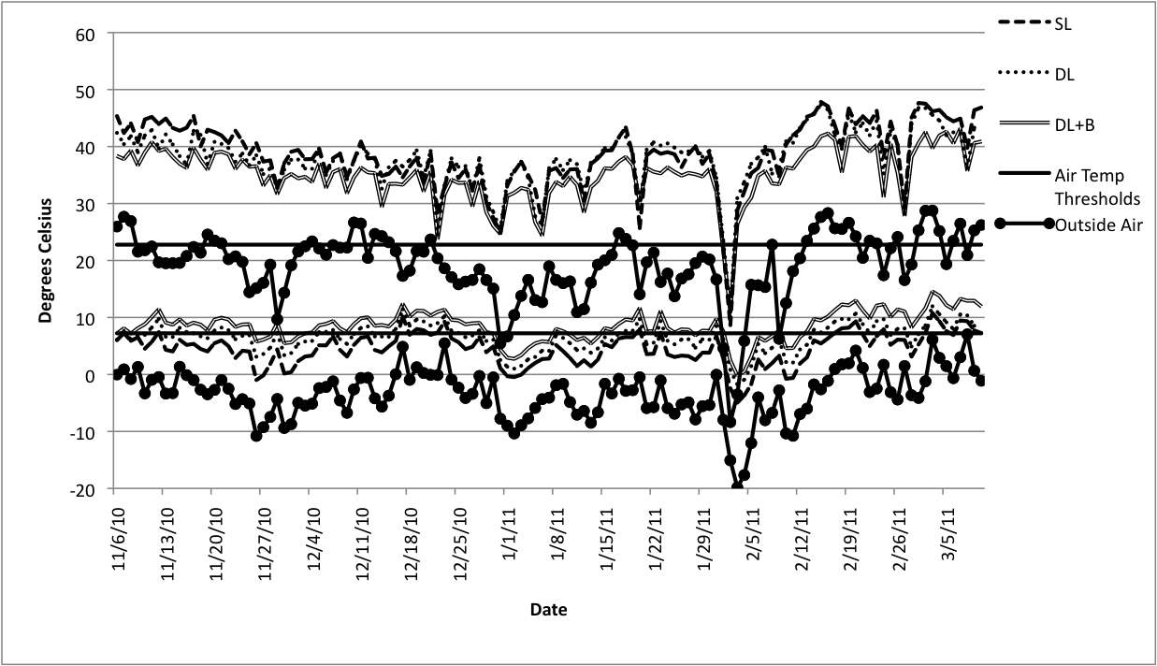
Figure 2. Air temperature comparison from the crop growing environment in three designs of high tunnels in Las Cruces during season 2 (2010-2011).

