Slide 1
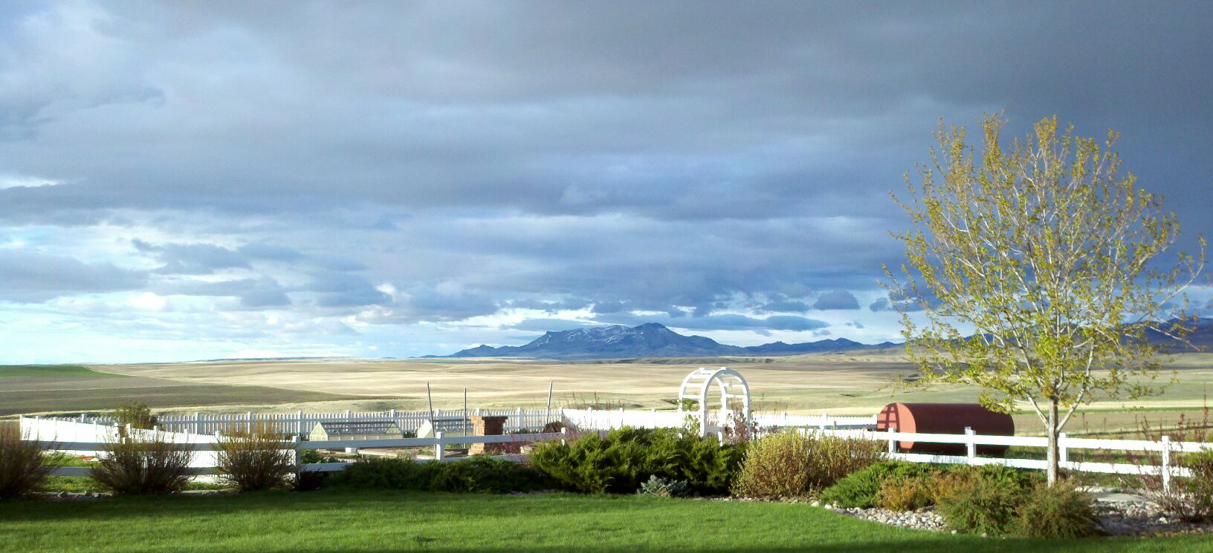
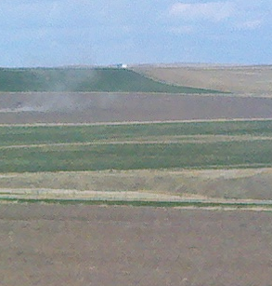
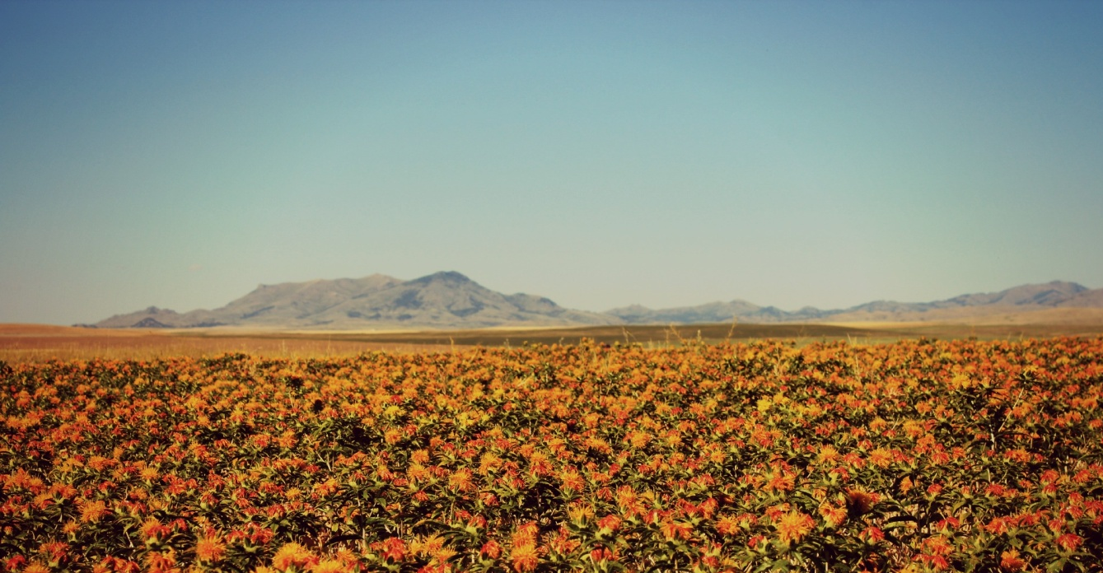
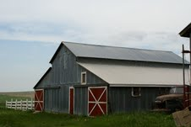
Quinn Farm & Ranch Big Sandy, MT est. 1920

Slide 2
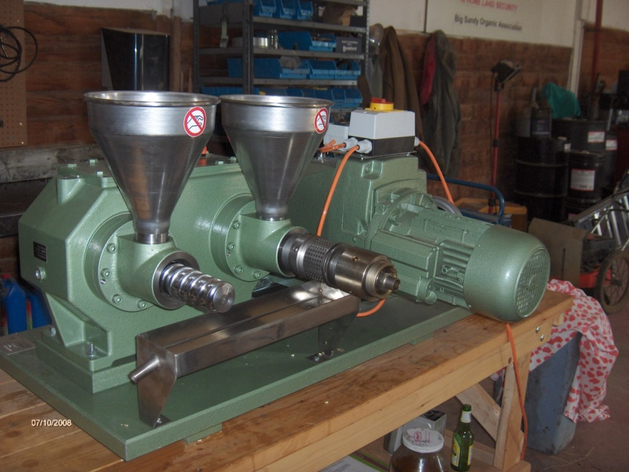
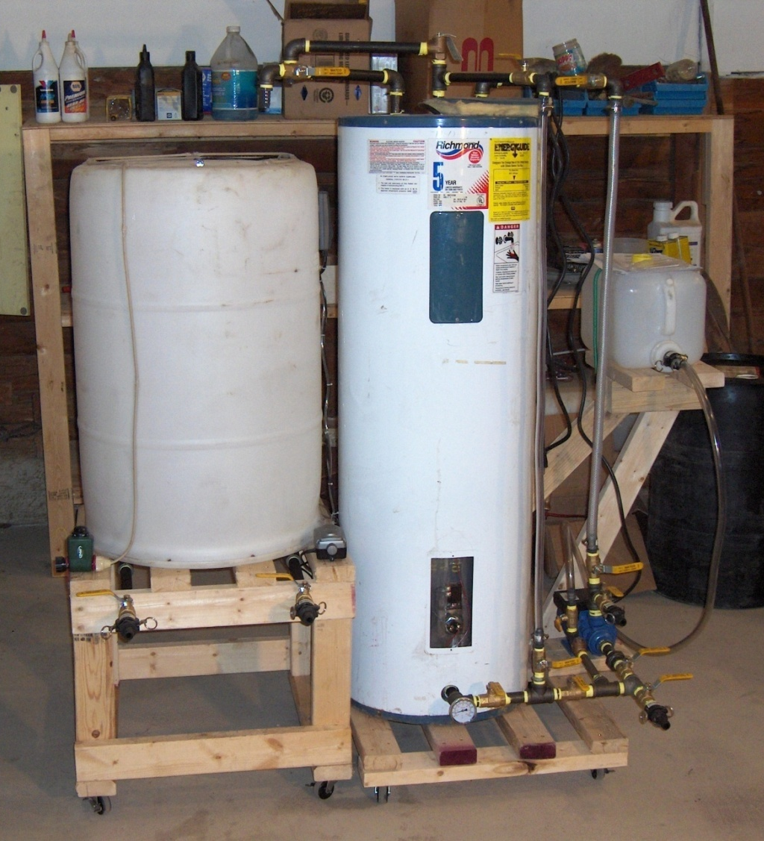
What is needed:
Oilseed crop
Press
Reactor
Downside of Biodiesel:
Cost of labor to operate
Cost of reagents
Disposal of waste water
Disposal of reagents (glycerin)
Inconsistent quality in small batches
Cost of testing (quality control)

Slide 3
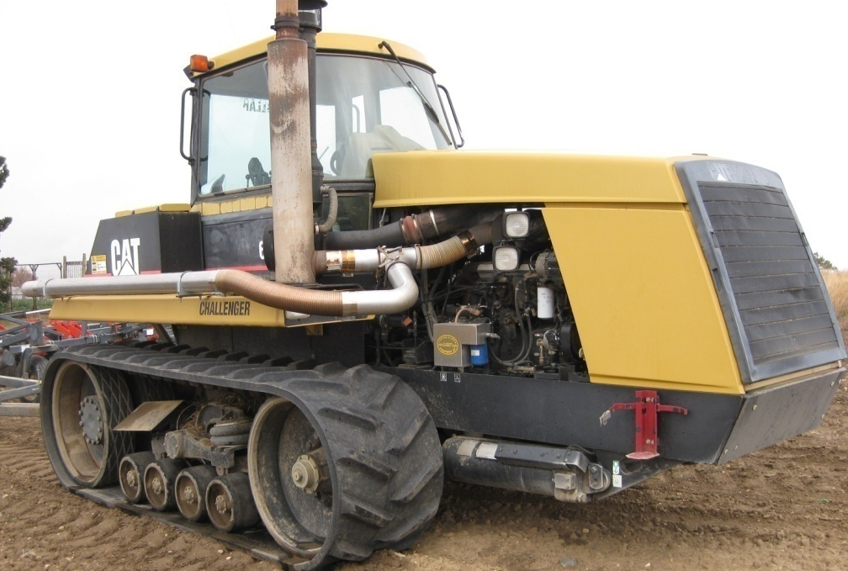
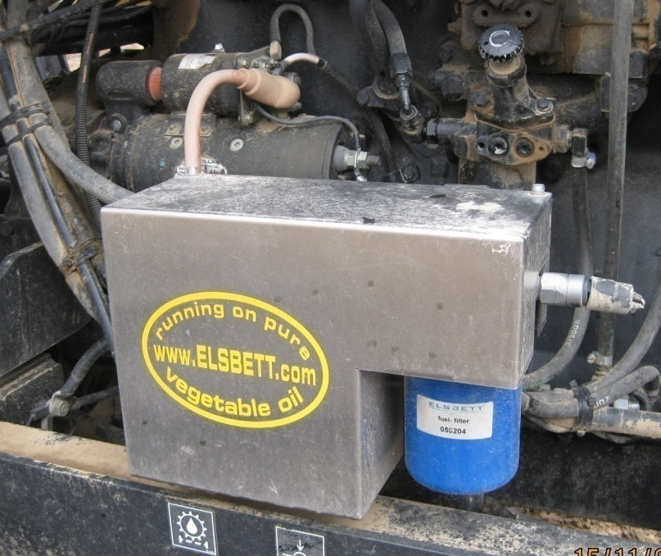
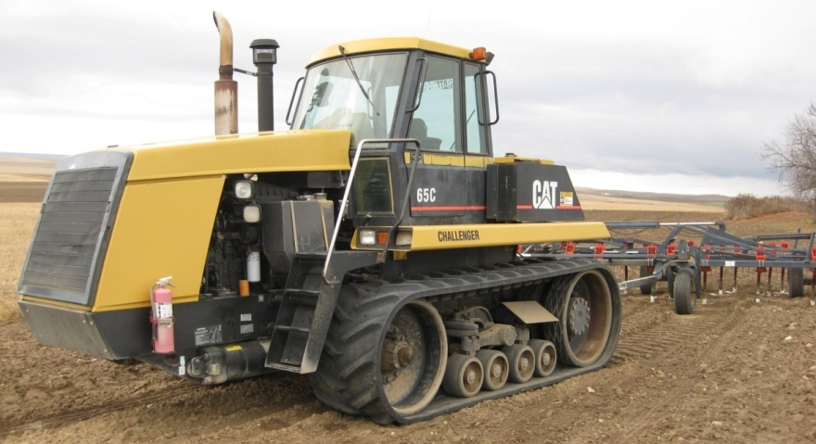
Biodiesel problems can be solved with SVO (straight vegetable oil):
Found Elsbett in Germany in 2007
Oil needs to be properly cleaned up
Engine adapter and filter can replace the biodiesel reactor

Slide 4
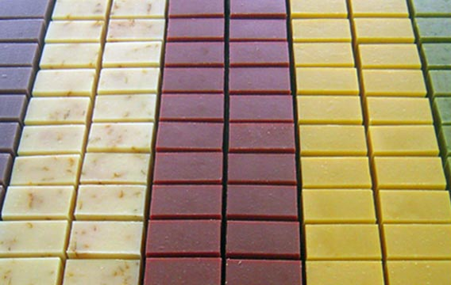
Unexpected opportunities:
Soap manufacturer
Skin care products
Grocery and health-food stores
Restaurants
Farm to school programs

Slide 5
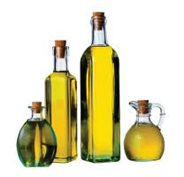
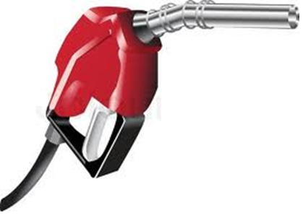
Food vs. Fuel
VS.

Slide 6
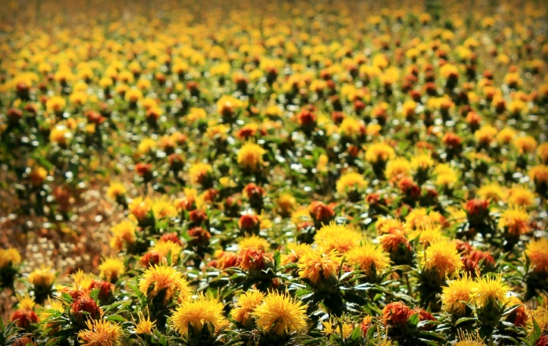
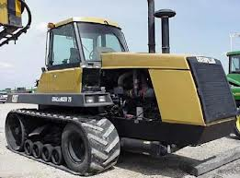


Slide 7
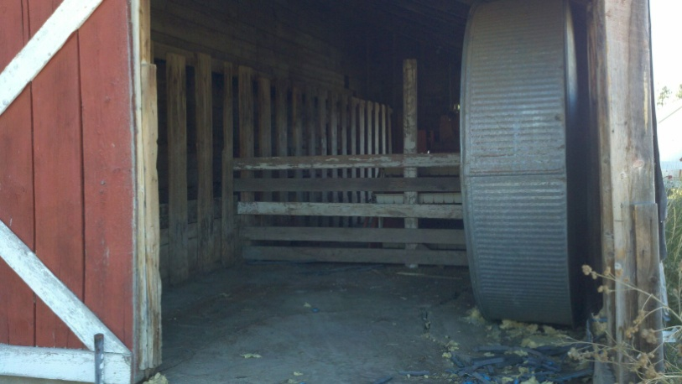
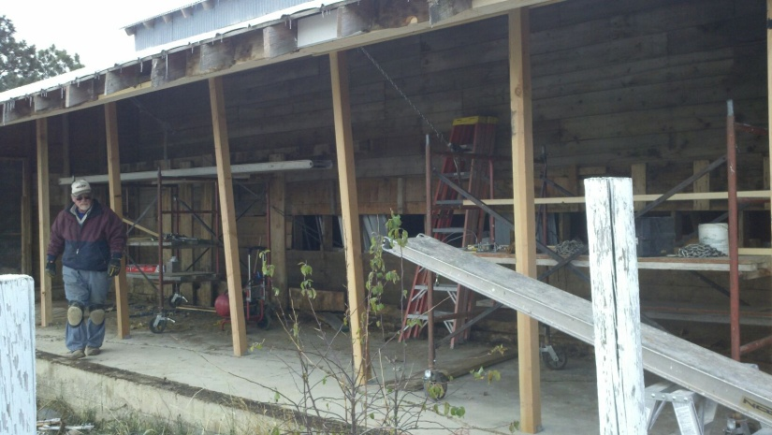
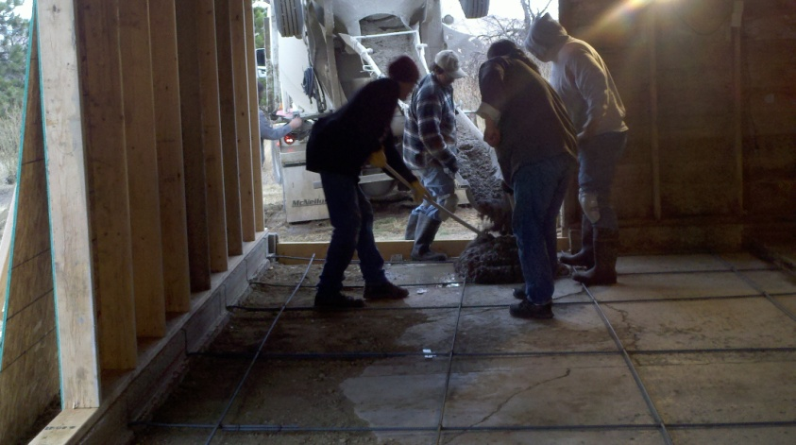
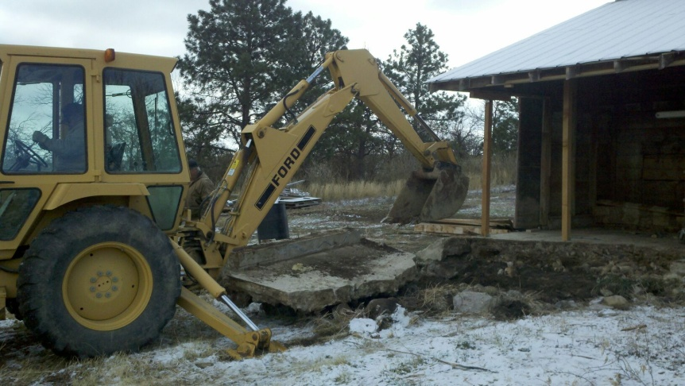

Slide 8

