Slide 1
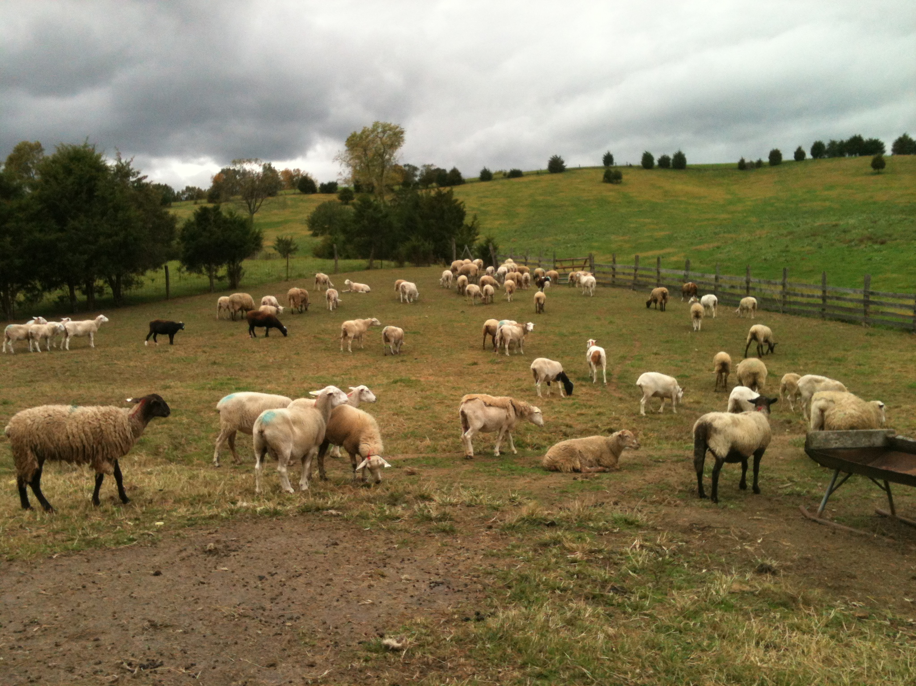

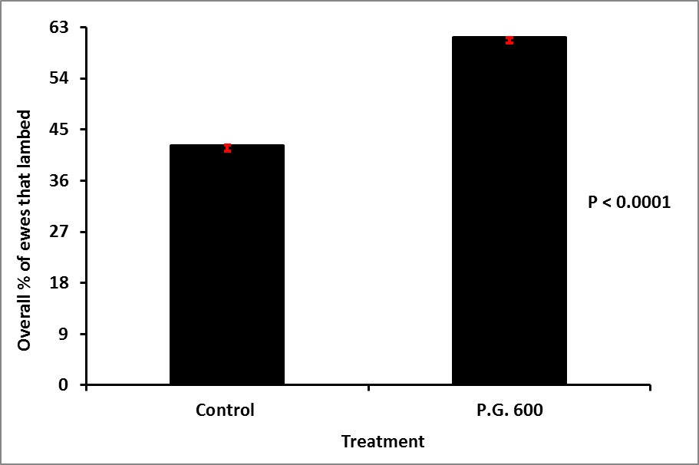
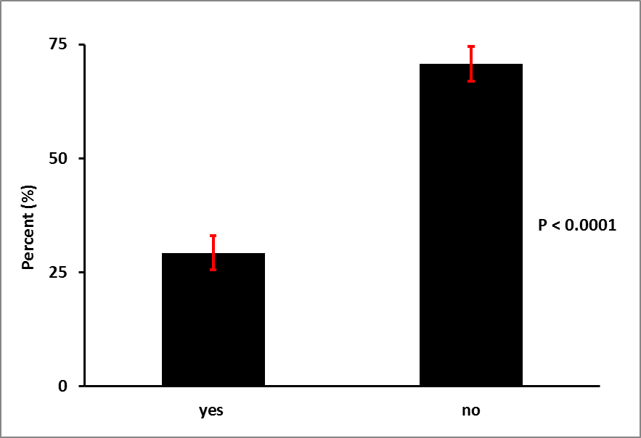
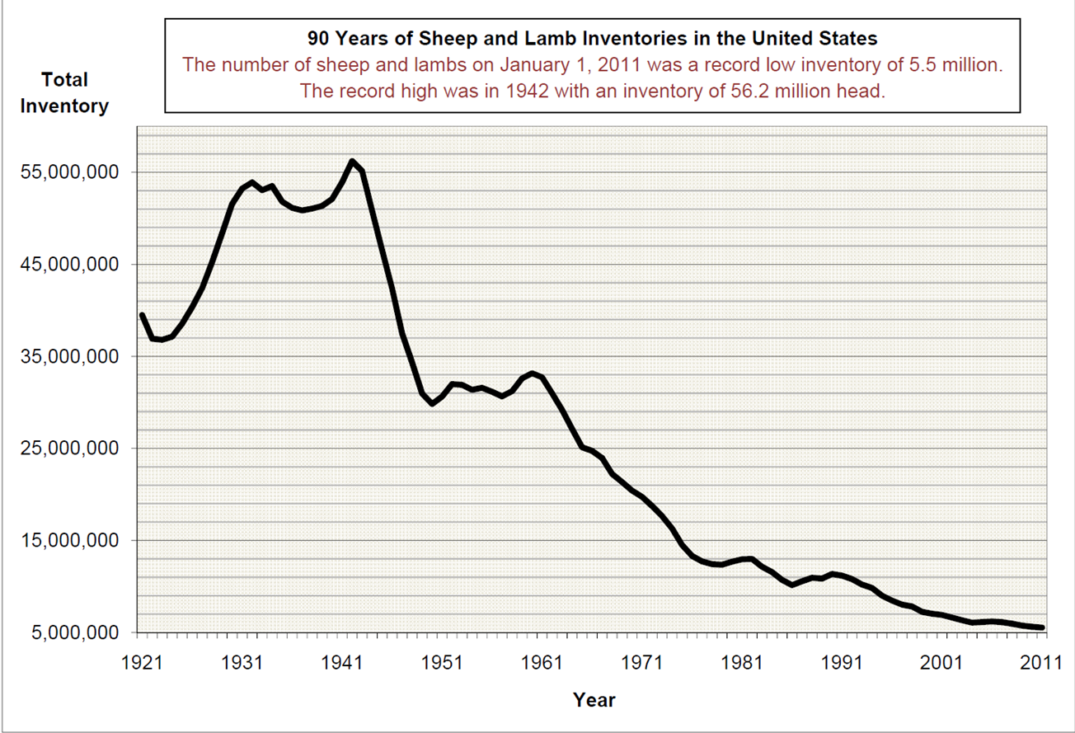
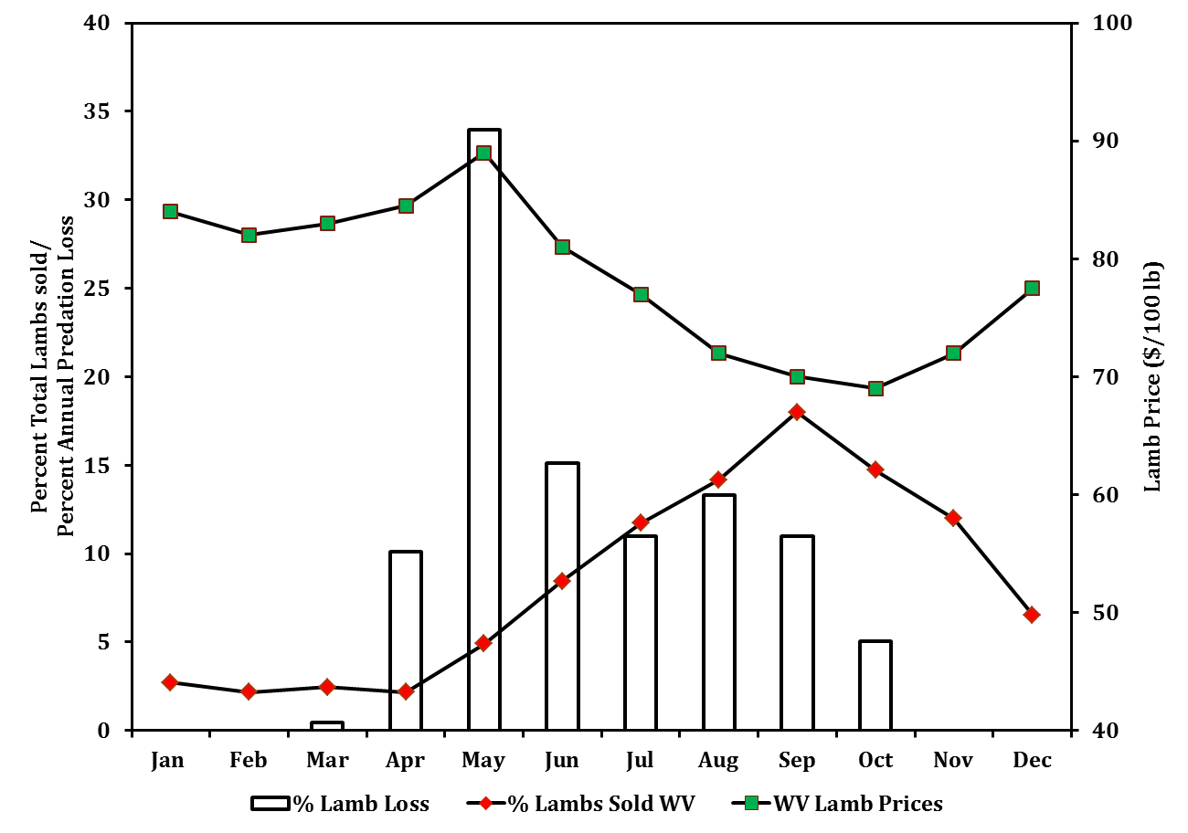
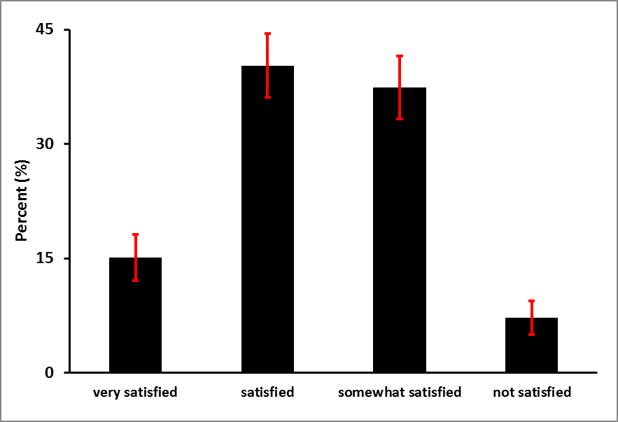
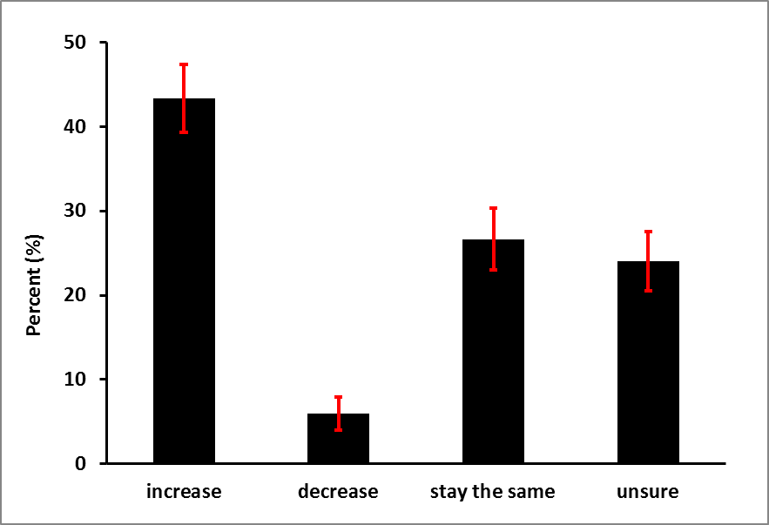
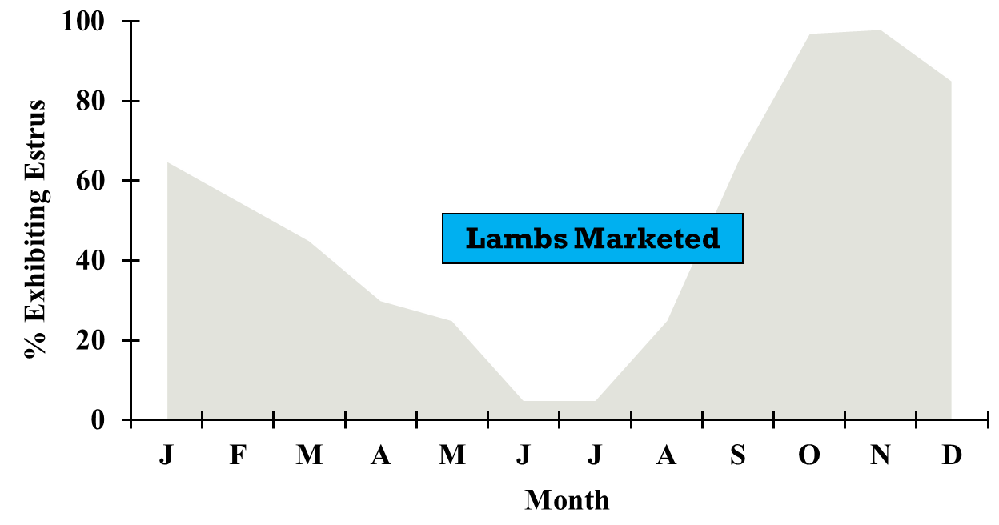
A Risk Management Strategy for Sheep Producers: The Benefits of Breeding Sheep Outside Their Normal Breeding Season
K.N. D’Souza¹, D. Singh-Knights² and M. Knights¹
Division of Animal and Nutritional Sciences¹, and Agriculture and Natural Resources- Extension Service²
West Virginia University, Morgantown, WV
ABSTRACT
RATIONALE
RESULTS
Seasonal reproduction of sheep limits the natural breeding season to the short-days of fall and early winter and has framed the conventional management system of breeding ewes in the fall with lambing occurring in the spring. The traditional fall-breeding, spring-lambing (FBSL) lamb production system exposes producers to increased financial and marketing risks associated with seasonally low prices. Producers practicing traditional FBSL systems also have higher production risks of increased lamb mortality and morbidity associated with lambs grazing pastures in spring and summer when predation and parasitism are highest. Further, the traditional lamb production system limits productivity to one lamb crop annually. We have successfully used assisted reproductive technologies to strategically shift the breeding and lambing season of 65-85% of ewes treated, allowing producers to capitalize on seasonally higher prices while reducing losses associated with parasitism and predation. Preliminary analyses indicate that the additional returns significantly exceed any additional feeding and management cost associated with “out-of-season” breeding (OSB). A survey conducted to assess the adoption potential of this risk management strategy indicated that 30% of WV producers currently practice OSB, with 90% indicating they were at least satisfied with the results. The number of producers reducing their inventory over the last 3 years was smaller and the number of producers planning to increase their inventory in the future was higher among producers practicing OSB compared to producers practicing FBSL only. OSB might be an effective risk management strategy to help sheep producers survive in an industry that is increasingly competitive.
Decreased production of lamb and lamb products due to decreasing inventory of sheep
Majority of lambs are sold within a narrow window when prices are lowest
Increasing demand for lamb and lamb products
b
b
a
a
Figure 1: Shows the sheep and lamb inventory in the U.S. over the past 90 years. The trend for the sheep inventory in WV is similar.
Figure 2: The monthly distribution of lamb sales, prices, and predator losses in WV. The majority of lambs are sold when prices are lowest.
Figure 4: The effects of P.G. 600 on the overall proportion of non-lactating ewes bred out-of-season that lambed. About 40% of control ewes lambed, while about 60% of the P.G. 600-treated ewes lambed.
Figure 5: The percent of sheep producers in WV that currently breed ewes out-of-season. About 30% do practice out-of-season breeding, while about 70% do not.
RISK FACTORS
Figure 6: The level of satisfaction of out-of-season breeding among WV sheep producers. About 90% of producers are at least satisfied with the results. (P < 0.0001)
Figure 7: The ability of out-of-season breeding to mitigate production risks can translate into a positive outlook on sheep production and resulted in producers willing to grow their flock rather than reduce inventory. (P < 0.0001)
Increased losses due to predation and parasitism
Lowest prices for spring-born lambs
Limited production of only one lamb crop/year
CONCLUSIONS
Figure 3: Shows risk factors associated with the traditional fall-breeding, spring-lambing production system employed by the majority of sheep producers in the U.S.
Although breeding sheep outside their normal breeding season has several benefits in terms of mitigating production risks, the majority of sheep producers in WV still use the traditional FBSL production system. The breeding and lambing seasons of the majority of ewes have successfully been shifted by using assisted reproductive technologies. However, a survey conducted in WV revealed that only about 30% of sheep producers are currently practicing OSB. Of those producers, about 90% are satisfied with the results. The ability of OSB to mitigate production risks can translate into a positive outlook on sheep production, while also resulting in the willingness of producers to grow their flocks rather than reduce inventory. In conclusion, OSB might be an effective risk management strategy to help sheep producers survive in an industry that is increasingly competitive.
MATERIALS & METHODS
ANIMALS AND TREATMENTS
Peak in Predation
Highest Worm
Burden
CIDR insertion
P.G. 600 injection
Observe for estrus
Ram removal
Lowest Prices
Lambs on Pasture
Ewes Bred
CIDR removal and
ram introduction
Ultrasonography for pregnancy diagnosis
~ The protocol used for this experiment is shown above. The experiment was conducted on 6 farms in
WV and PA over two summers. The animals (N = 907) used were primarily Katahdin, Suffolk, or Dorset.
Ewes Lamb
Production Limited to One Lamb Crop/Year
SHEEP PRODUCER SURVEY
~ A survey was developed to determine the level of adoption of out-of-season breeding in WV and
identify the socio-economic factors which influence the adoption of this practice among sheep
producers.
~ The survey was sent out via postal mail and email to 1,559 sheep producers in WV, and 151
responses were received and analyzed.

