Slide 1

Increasing Adoption of Out-of-Season Breeding to Enhance Profitability of Sheep Producers in West Virginia
Kellie D’Souza
West Virginia University
December 10th, 2011

Slide 2
Summary of Presentation
Downfalls of traditional breeding system
Benefits of out-of-season breeding (OSB)
Objectives of grant
Additional research on OSB
  P.G. 600

Slide 3

Northeast Sustainable Agriculture Research and Education
Part of the National Institute for Food and Agriculture
Funds grants that promote sustainable agriculture
Outreach is an important aspect

Slide 4
(Source: West Virginia Department of Agriculture, 2010)

Slide 5


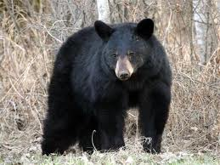
What caused the decline in the sheep industry in West Virginia?
$$$
Parasites
Predation
Low productivity of ewes

Slide 6
(Source: Compiled from Singh-Knights, 2003)

Slide 7
Benefits of out-of-season breeding
Take advantage of higher lamb prices
Lower parasite loads during winter months
Loss of lambs to predation is significantly decreased
Increase productivity of ewes

Slide 8
Why is adoption of OSB limited?
Determine what factors influence the adoption of this practice
Create a survey
  Farmer-specific attributes
  Farm attributes
  Perceived characteristics of OSB

Slide 9
Objectives of my grant
Evaluate the technical and economic feasibility of OSB programs in West Virginia
Identify socio-economic factors which influence the adoption of this practice
Increase awareness of the benefits of OSB

Slide 10

Use of P.G.600 to induce estrus
P.G.600
  Mixture of gonadotropins
  Recommended for inducing estrus in peripubertal gilts
1 injection of P.G.600 at CIDR removal

Slide 11
Effects of P.G.600 on dry ewes
Variable | P.G.600 | No P.G.600
N | 75 | 69
% ewes lambing | 65.1% | 71.0%
Prolificacy | 1.75 | 1.67

Slide 12
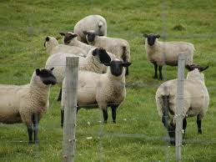
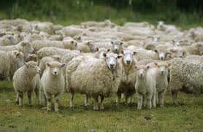
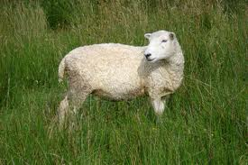
Thank you!
Kellie D’Souza
Email: kdsouza87@gmail.com
Phone: 304-376-1020

