Slide 1
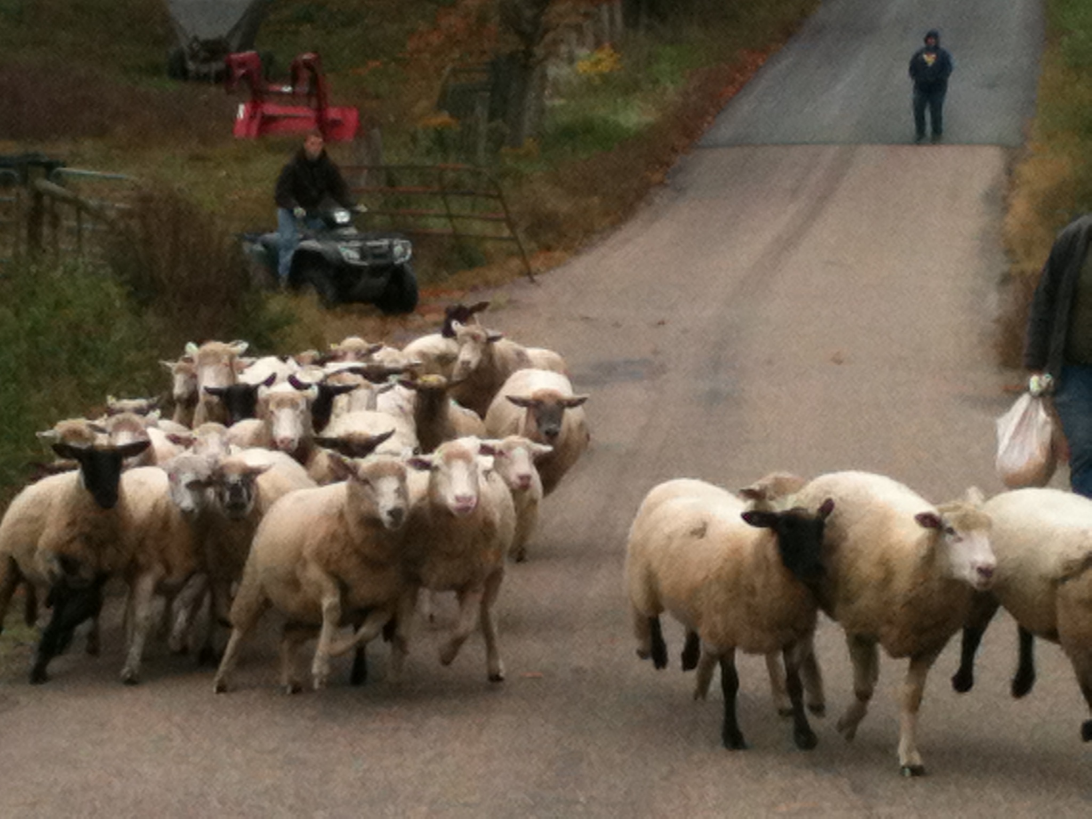

WV Sheep Producer Survey Results
Kellie D’Souza
West Virginia University
March 2nd, 2013

Slide 2

Purpose of survey
Determine the level of adoption of out-of-season breeding (OSB) in West Virginia and identify the socio-economic factors which influence the adoption of this practice among sheep producers
Distributed survey to 1,559 sheep producers in WV and received 151 responses (~10% response rate)

Slide 3
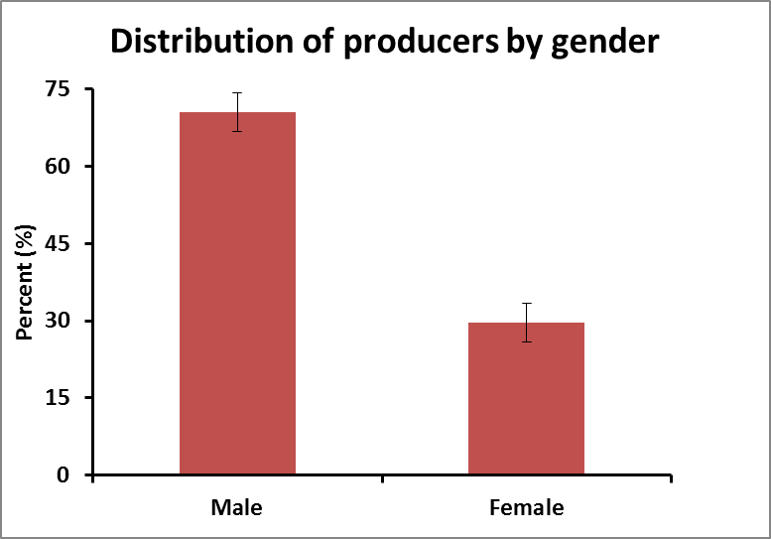
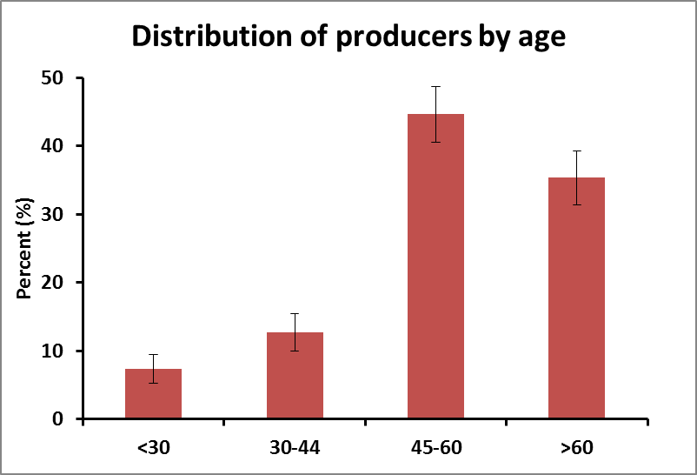
Demographics and Farm Characteristics
P < 0.0001

Slide 4
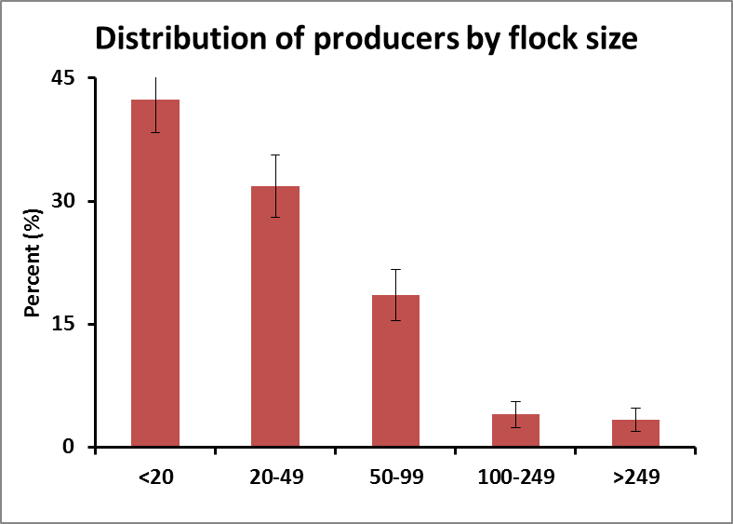
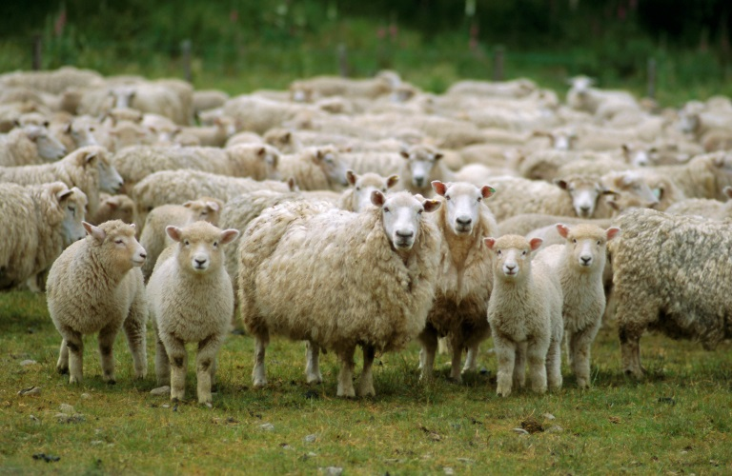
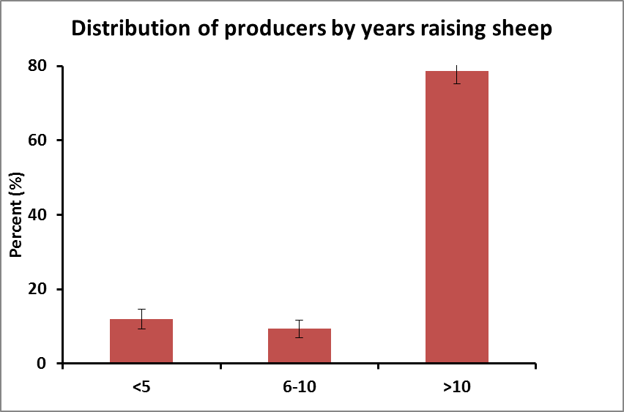
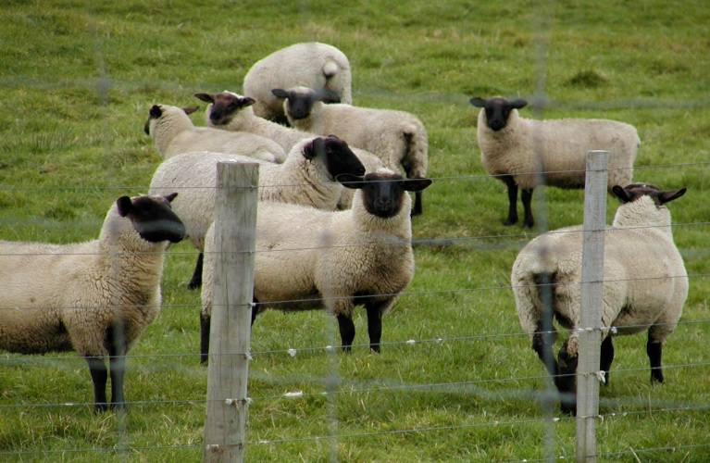

Slide 5

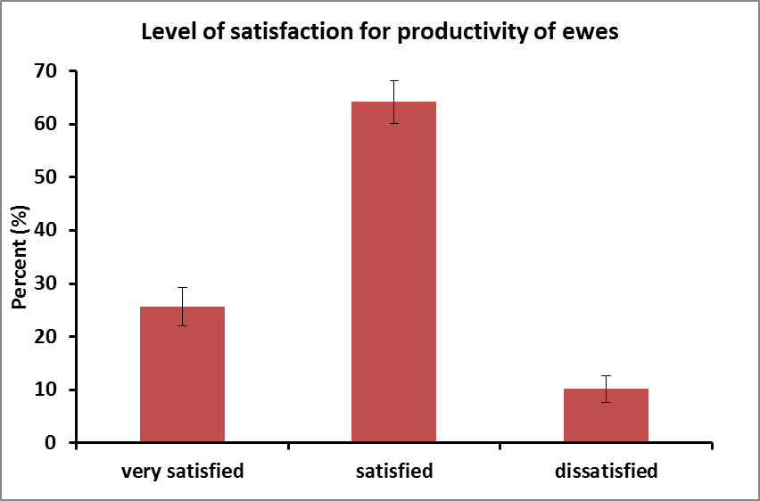
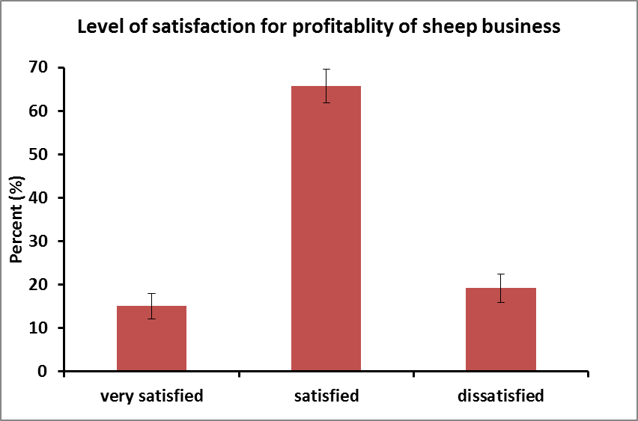

Slide 6
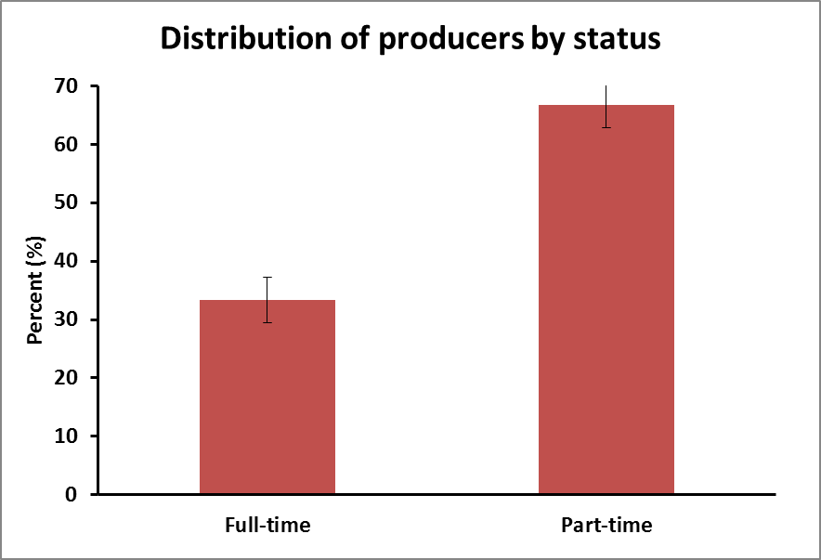

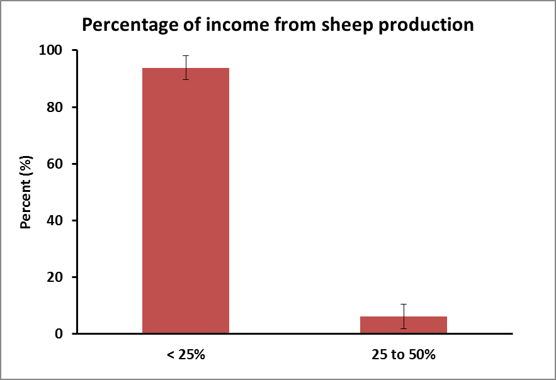
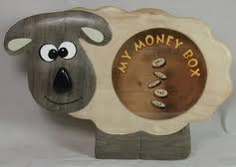
P < 0.0001
P < 0.0001

Slide 7
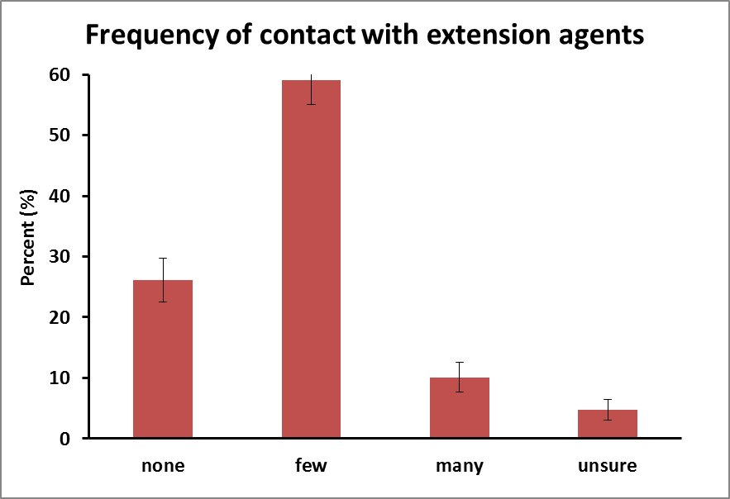

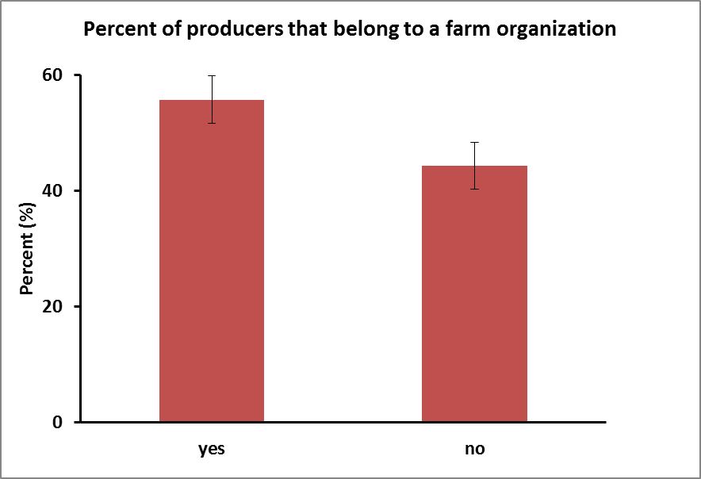


Slide 8
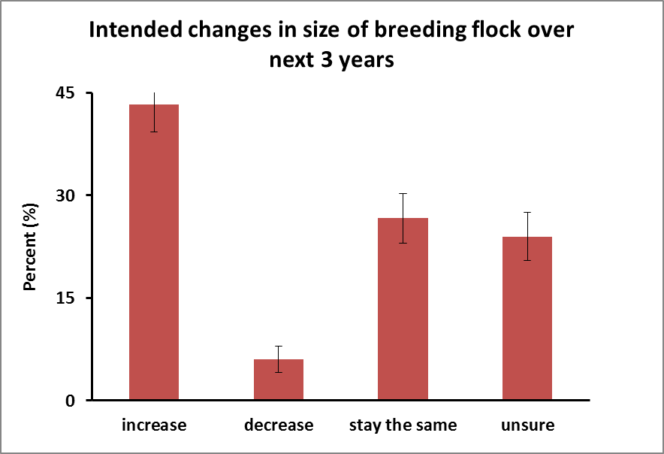
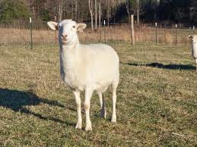
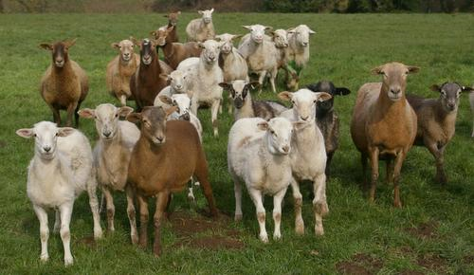

Slide 9
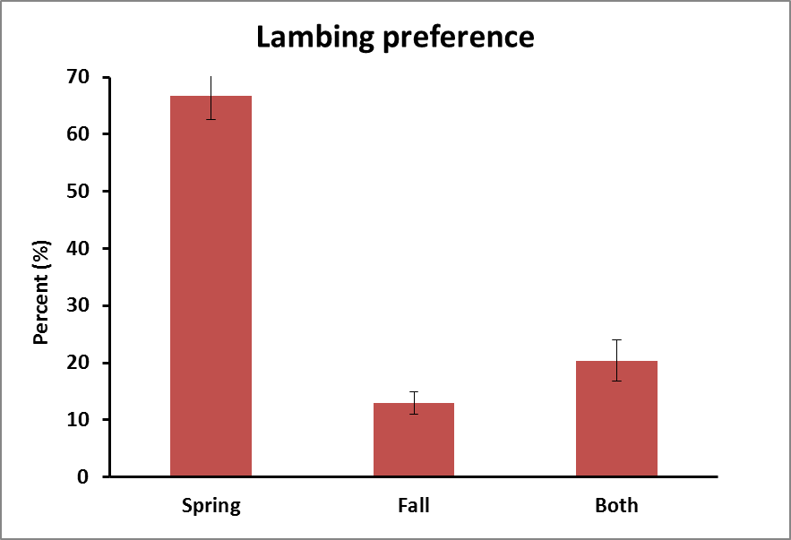
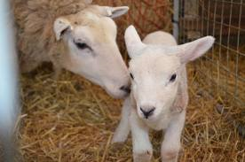
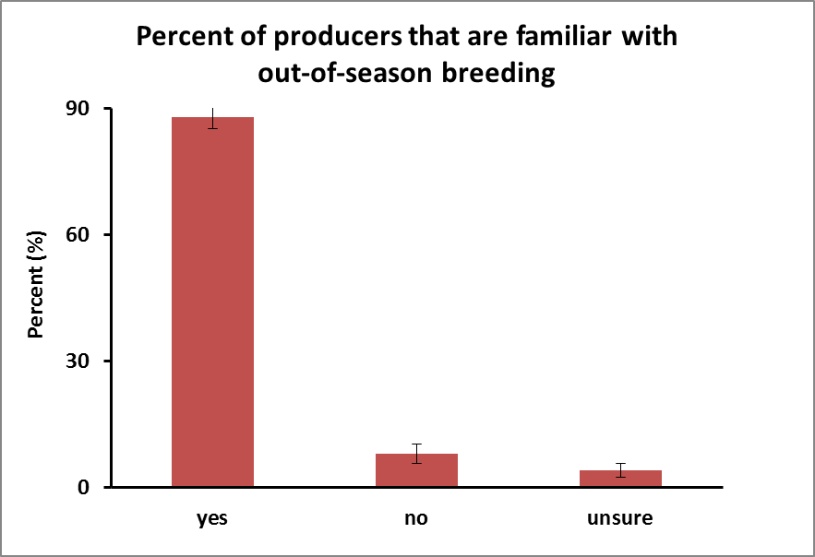
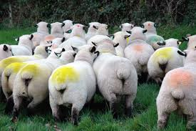

Slide 10
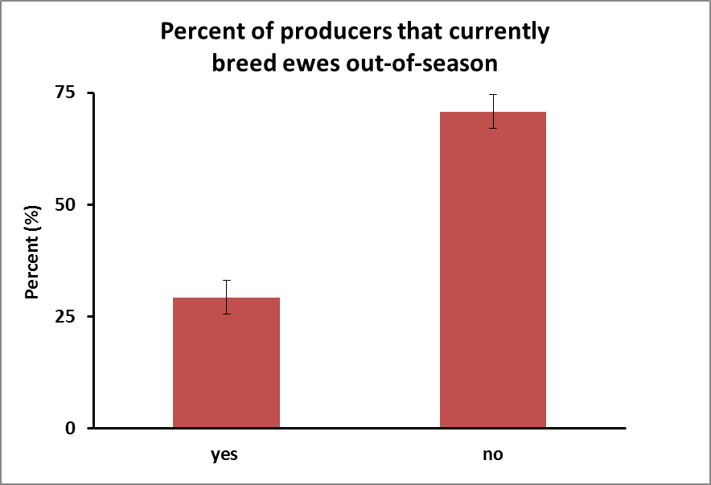
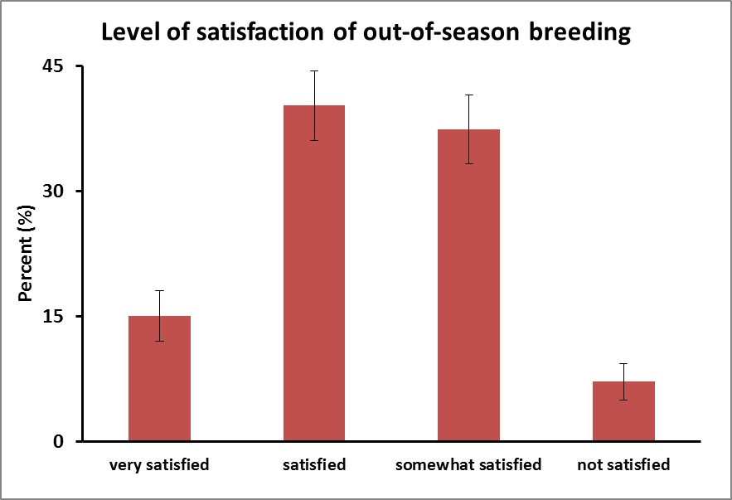
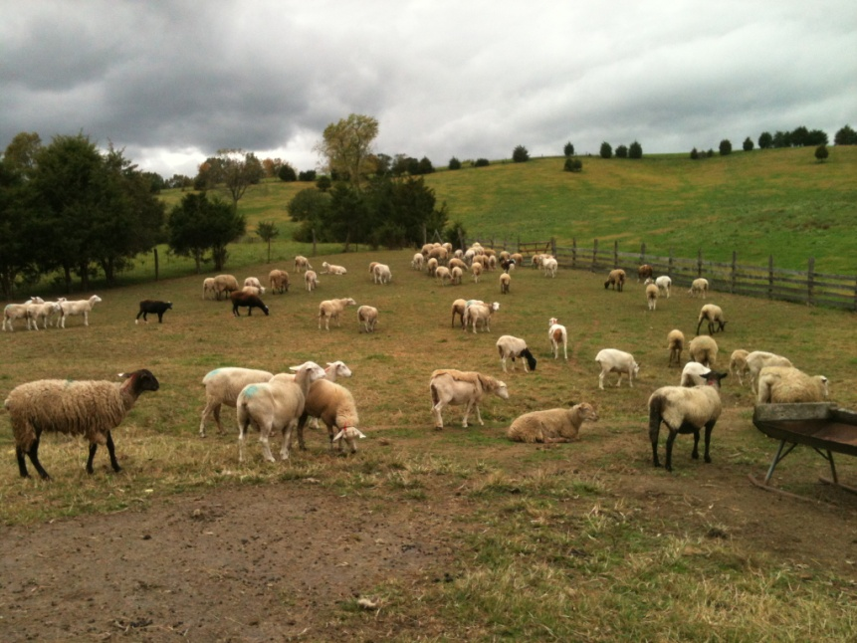
P < 0.0001

Slide 11
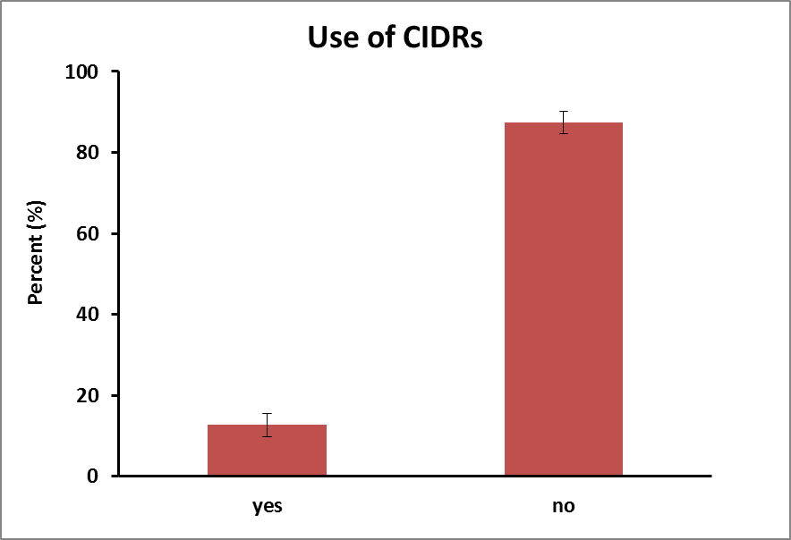
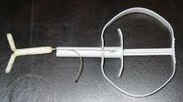
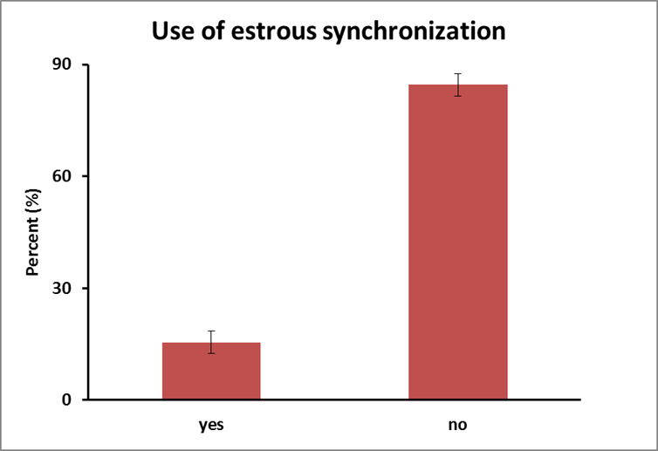
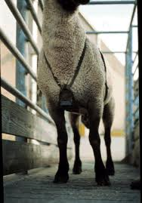
P < 0.0001
P < 0.0001

Slide 12
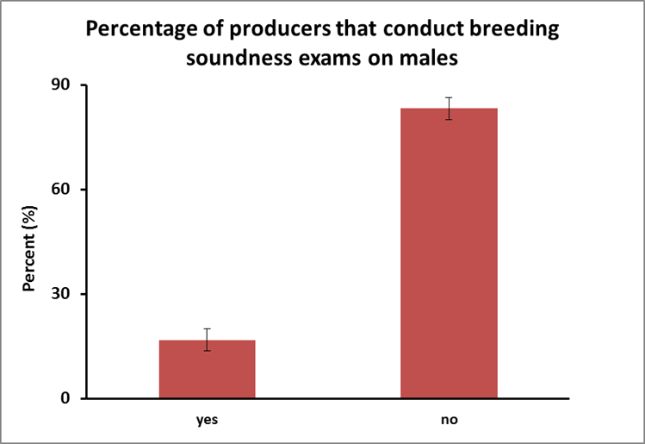
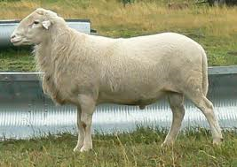
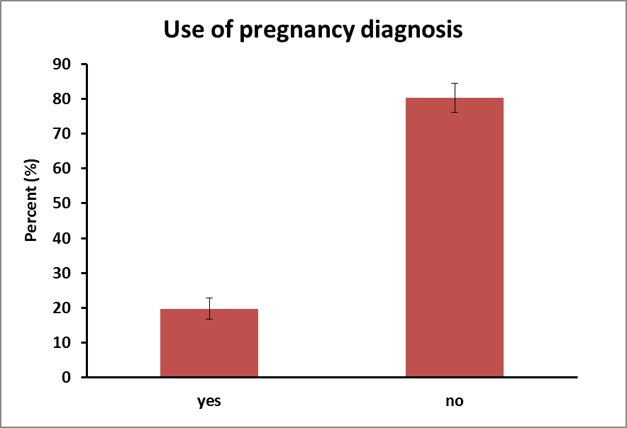
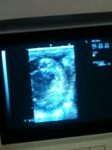
P < 0.0001
P < 0.0001

Slide 13
Conclusions from survey
Majority of producers were men, older than 45, that had greater than 10 yrs experience
Majority owned < 100 head, but intended to increase the size of their flock in the next 3 yrs
A majority of producers were only part-time and < 25% of their annual income was from sheep enterprise
About 30% of producers in WV currently practice OSB, and 90% of them indicated that they were satisfied with the results
A majority of producers are not practicing activities that have been shown to increase fertility in ewes, especially bred out-of-season

Slide 14
Notes on OSB
Successfully shifted the breeding and lambing seasons of 75% of ewes treated
Producers able capitalize on seasonally higher prices, while reducing losses associated with parasitism and predation
Preliminary analyses indicate that the additional returns significantly exceed any additional feeding and management costs associated with OSB

Slide 15
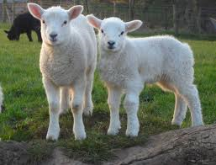
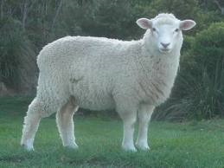
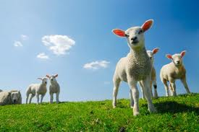
Looking for an easier way to market your lambs??

Slide 16
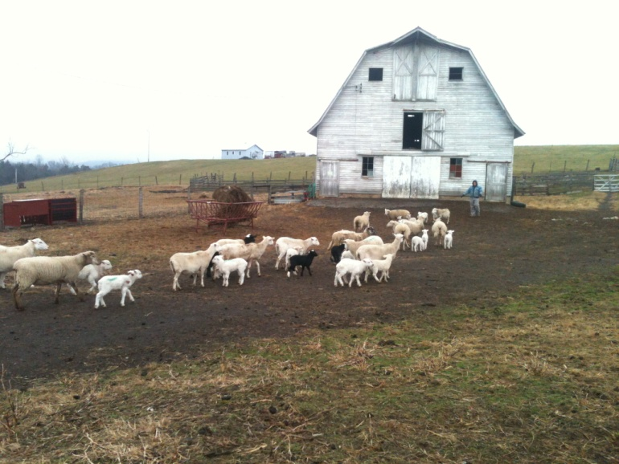
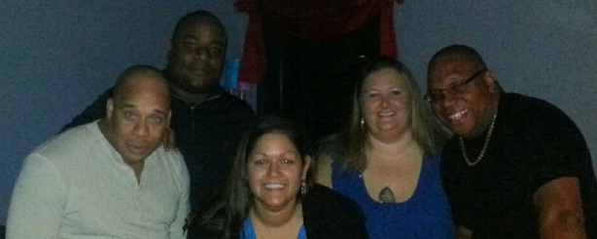
Thank you!
Name: Kellie D’Souza
Email: kdsouza87@gmail.com
Cell #: 304-376-1020

